Slide 1
High Credit Default Risk (HCDR)
SP25 Applied Machine Learning
Project Group 5
Junyeon Lee
Priyanka Prem Kumar
Simi Rajeev
Sumedh Ambapkar

Slide 2
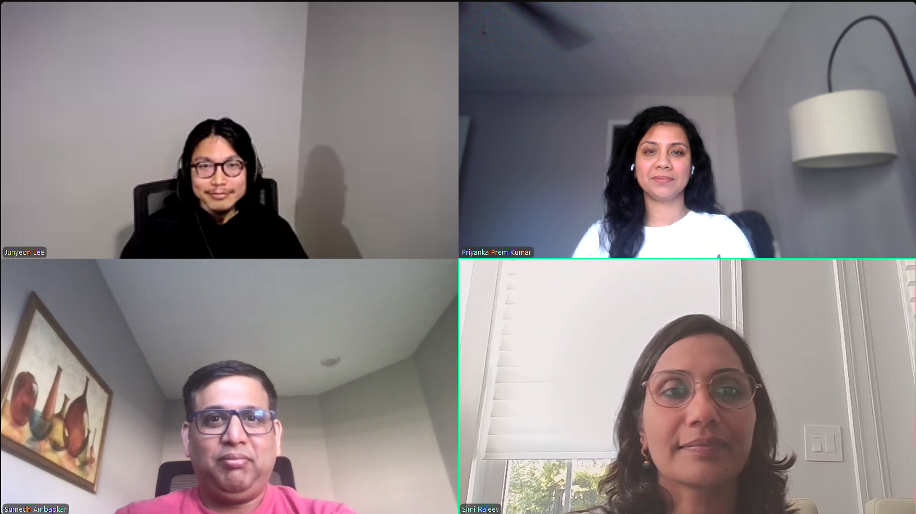
Team Credit Finders

Slide 3

Project Description
Home Credit strives to broaden financial inclusion for the unbanked population by providing a positive and safe borrowing experience. To ensure this underserved population has a positive loan experience, Home Credit utilizes a variety of alternative data—including telco and transactional information—to predict clients' repayment abilities using various statistical, machine learning and deep learning methods.
307,511 records on training data with Target Feature and 6 of second tier and third tier datasets having a primary key to join on the primary table.
Datasets: application_{train|test}, bureau, bureau_balance, POS_CASH_balance, credit_card_balance, previous_application, installments_payments, HomeCredit_columns_description

Slide 4
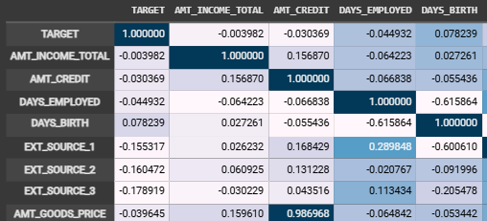
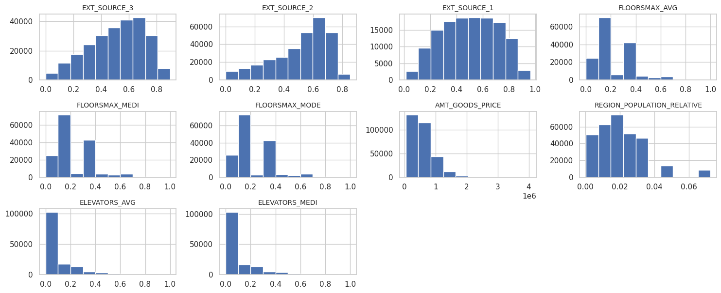
EDA
Detected skewed and imbalanced data, so we decided to apply a log scale to handle this situation
Detected highly inter-correlated features, indicating a potential need for dimensionality reduction or regularization.
Detected the target data is skewed and imbalanced, so we decided to balance it to improve model performance.

Slide 5
Feature Engineering, Transformation, Selection and Pre-processing
Feature Engineering
Identified numerical and categorical attributes (num_attribs, cat_attribs)
Combined selected features for downstream pipeline processing
Feature Transformation
Numerical Pipeline
  Selected numeric features using DataFrameSelector, Imputed missing values using SimpleImputer(strategy='mean'), Scaled values with StandardScaler for normalization
Categorical Pipeline
  Selected categorical features using DataFrameSelector, Imputed missing values using SimpleImputer(strategy='most_frequent'), Applied OneHotEncoder with handle_unknown="ignore" to handle unseen categories
Feature Selection
Combined pipelines using FeatureUnion
Final selected features:
  Total: {len(selected_features)}, ➤ Numeric: {len(num_attribs)}, ➤ Categorical: {len(cat_attribs)}
Feature Pre-processing
Modular and reusable pipelines using Scikit-learn's Pipeline and FeatureUnion
Ensures consistent data preparation for training, validation, and testing

Slide 6
Modeling Pipeline
Experimental Setup: Feature selection (RFE, PCA, Variance Threshold, SelectKBest) applied on 132 features to maximize ROC AUC.
Top Model: XGBoost + SelectKBest achieved highest Test ROC AUC of 74.7%.
Logistic Regression: Variance Threshold method; Test ROC AUC 75.22%; strong baseline, very close to XGBoost.
Deep Learning Models: Simple Network ROC AUC 74.6%, Multilayer Network ROC AUC 59.38%; simple model performed better.
Model Comparison:
XGBoost (SelectKBest): 74.7% ROC AUC (Best)
Logistic Regression (Variance Threshold): 75.22% ROC AUC (Strong baseline)
Random Forest (Variance Threshold): 72.43% ROC AUC (Decent but behind XGBoost)
LightGBM (RFE/Variance Threshold): 72.2% ROC AUC (Fast but slightly lower)
Gradient Boosting: 72.12% ROC AUC (Lower than baseline)
SVM: 67.21% ROC AUC (Lowest, dropped early)
Key Takeaways: XGBoost best overall; Simple Neural Network competitive but tree-based models superior; Logistic Regression remained a strong fallback.

Slide 7
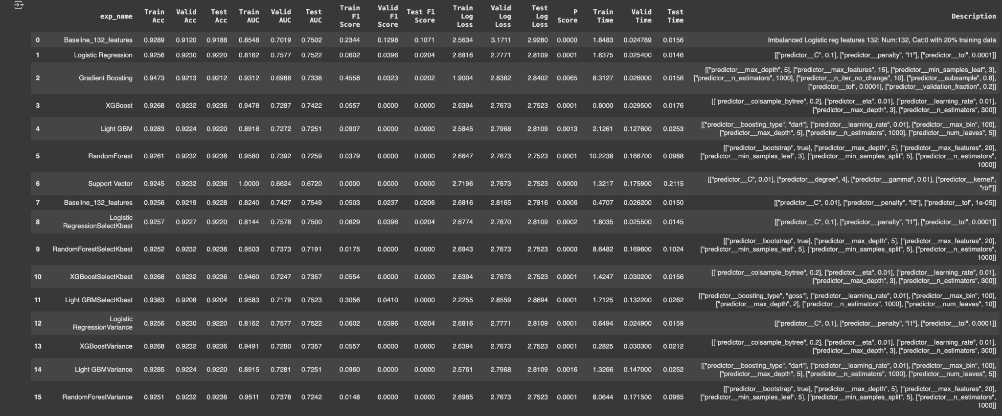
Experimental Results for ML -Ensemble of Models

Slide 8
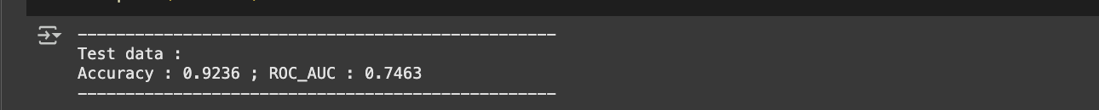

Experimental Results for Deep Learning
Simple Neural Networks
Deep Learning Models Simple Network Testing Accuracy: 93.08% ROC AUC Score: 74.61%
Outperformed multilayer deep learning, closely competing with XGBoost and Logistic Regression.
Multilayer Neural Networks
Multilayer Network Testing Accuracy: 91.20% ROC AUC Score: 59.38%
Significant drop in ROC, suggesting overfitting or network complexity issues.

Slide 9
Conclusion
XGBoost achieved the best overall balance between accuracy and ROC AUC, making it the top-performing model. It delivered a Training Accuracy of 94.91%, Testing Accuracy of 92.36%, and ROC AUC of 74.70%.
Logistic Regression slightly exceeded in ROC AUC (75.22%) but lacked the advanced learning capacity of XGBoost.
Deep Learning (Simple Model) closely followed with a ROC AUC of 74.61%, offering faster training but lower robustness.
XGBoost handled the high-dimensional, imbalanced dataset effectively.
XGBoost with feature selection is recommended for optimal performance.

Slide 10
Future Work
Model Enhancements:
Apply advanced deep learning architectures like TabNet or autoencoders for feature extraction.
Feature Engineering:
Explore SHAP or Boruta for automated feature selection; add time-based or interaction features to boost predictive power.
Dimensionality Reduction:
Implement PCA or t-SNE for reducing multicollinearity and visualizing high-dimensional data.
Hyperparameter Optimization:
Use Bayesian Optimization (e.g., Optuna or Hyperopt) for more efficient tuning.
Model Interpretability:
Leverage SHAP values to explain predictions and support business decisions.
Production Readiness:
Build an end-to-end pipeline for real-time prediction using tools like MLflow or FastAPI.
Deploy the model in a cloud environment for scalability (e.g., AWS SageMaker, GCP AI Platform).
Data Augmentation & Enrichment:
Explore external data sources (e.g., credit bureau data, macroeconomic indicators).
Use SMOTE or other oversampling methods to improve class balance.

Slide 11
Thank you

