Slide 1

Indicators & TOD
Public Policy Analytics
Week 3 – Spring 2024

Slide 2


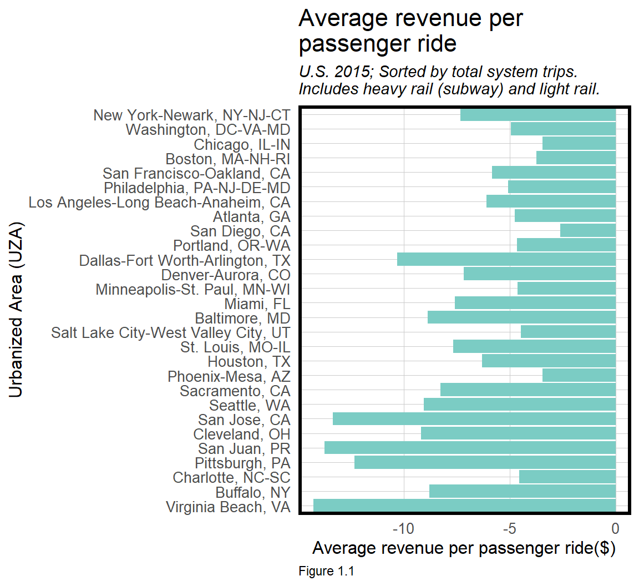
What are Indicators?
“a stylized fact that gives simple insight into a complicated phenomena”
Performance Measure (quantitative)
Relies on some form of data
Used to assess & evaluate various aspects of cities, development, sustainability, neighborhoods etc.
proxies for something not directly measurable.
https://urbanspatial.github.io/PublicPolicyAnalytics/TOD.html

Slide 3
Social Indicators
“Statistics and all other forms of evidence…that enable us to assess where we stand and where we are going with respect to our values and goals and to evaluate specific programs and determine their impact”
Bauer, 1966

Slide 4

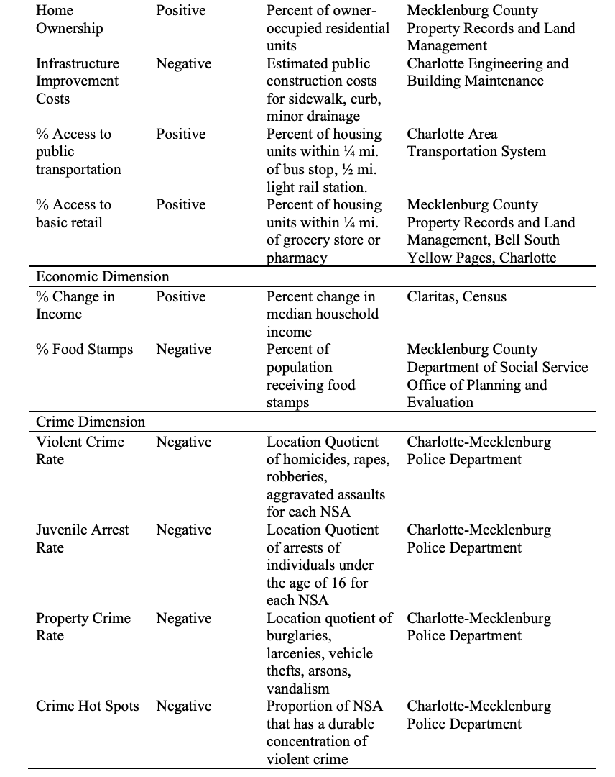
Neighborhood Indicators
National Neighborhood Indicators Project:
Measures of changing social, physical, and economic conditions of neighborhoods in cities throughout the US.
1990s, GIS became widespread an enabled cities to collect quantitative indicators.

Slide 5
Indicators reveal snapshots NOT causal relationships

Slide 6
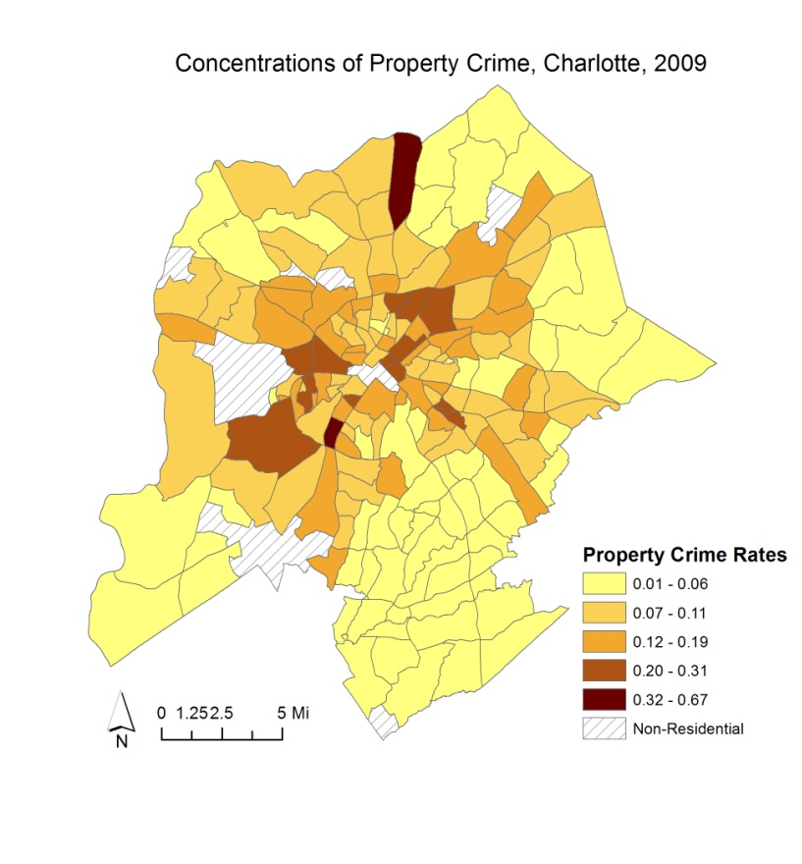
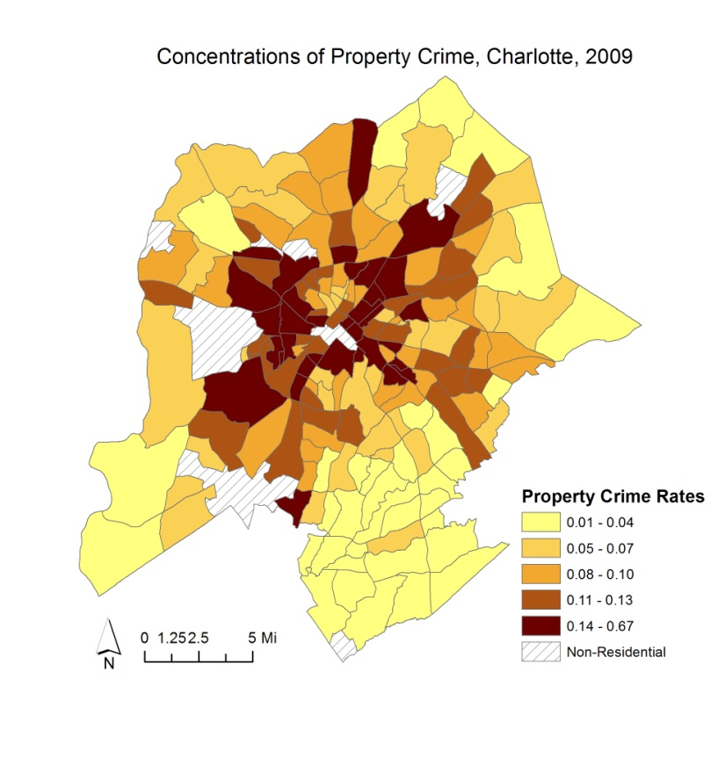
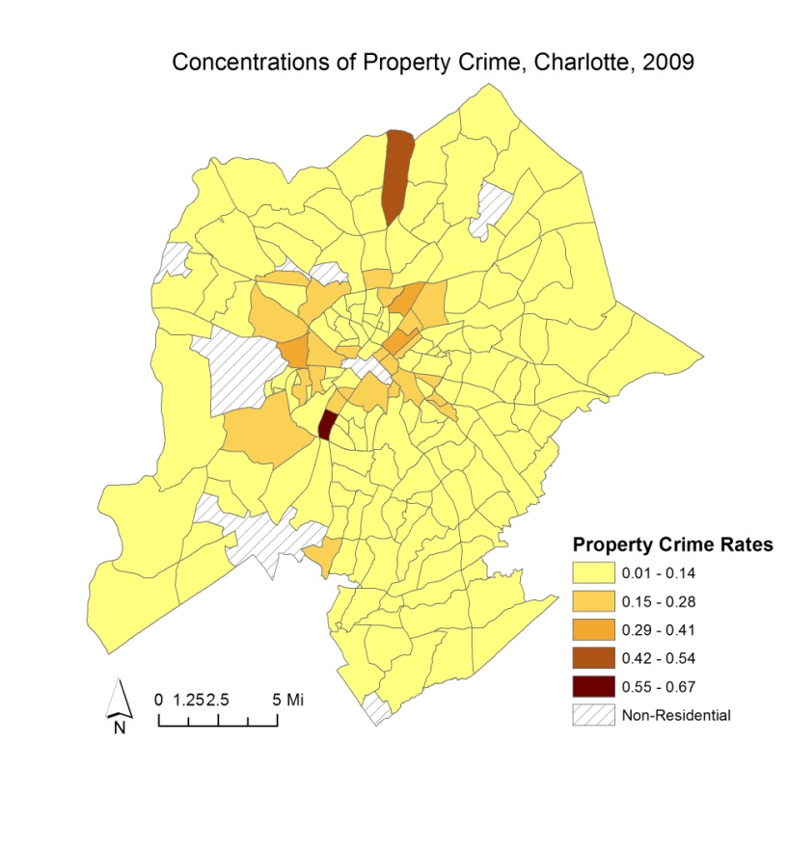
Problems with Areal, Aggregated Data
It’s a lie.
Ok, its subjective at least.
Which one is correct?

Slide 7

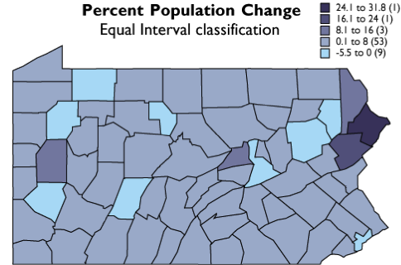
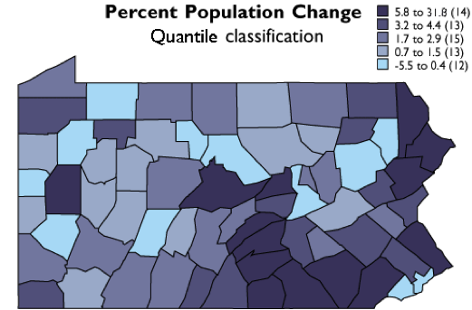
Problem 1: Classification

Slide 8
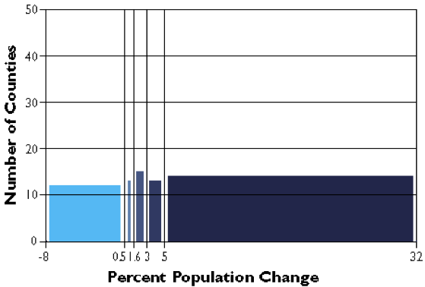
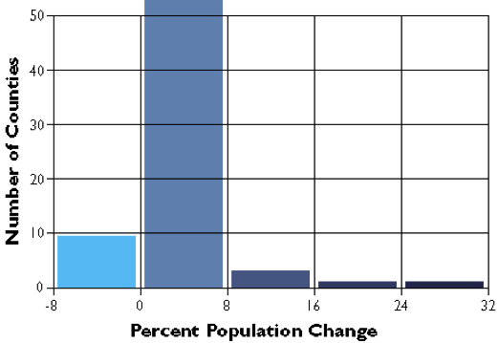
To drive home the point.
Quantiles
Equal Intervals

Slide 9
What to pick? (Tmap in R advice)
style = "pretty", the default setting, rounds breaks into whole numbers where possible and spaces them evenly;
style = "equal" divides input values into bins of equal range and is appropriate for variables with a uniform distribution (not recommended for variables with a skewed distribution as the resulting map may end-up having little color diversity);
style = "quantile" ensures the same number of observations fall into each category (with the potential downside that bin ranges can vary widely);
style = "jenks" identifies groups of similar values in the data and maximizes the differences between categories;
style = "cont" (and "order") present a large number of colors over continuous color fields and are particularly suited for continuous rasters ("order" can help visualize skewed distributions);
style = "cat" was designed to represent categorical values and assures that each category receives a unique color.
https://bookdown.org/robinlovelace/geocompr/adv-map.html

Slide 10
Problem 2: MAUP Modifiable Areal Unit Problem
Neighborhoods
100 Residents
10 Crimes
10 Crimes\
100 Residents
200 Residents
15 Crimes
7.5 Crimes\
100 Residents
Police District
300 Residents
25 Crimes
8.33 Crimes\100 Residents

Slide 11
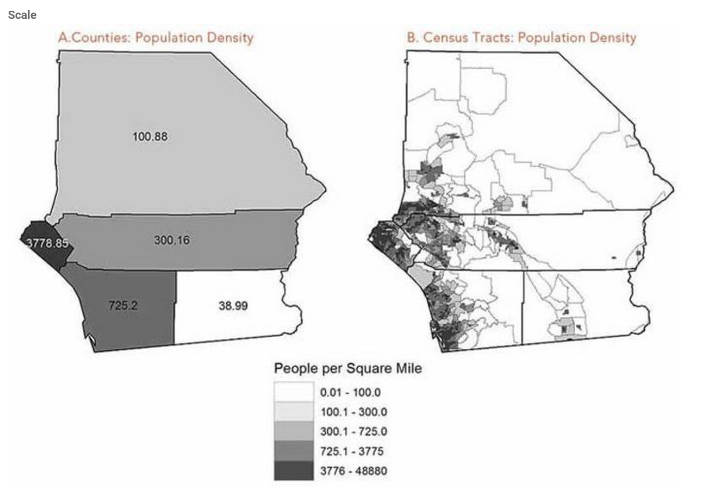

Slide 12

Problem 3: Ecological Fallacy
Neighborhoods
Ave. HH Income:
$50,000
% Residents with
College Degree 40%
Ave. HH Income:
$70,000
% Residents with
College Degree 20%
Conclusion: Individuals with higher Incomes
have lower levels of educational attainment.

Slide 13
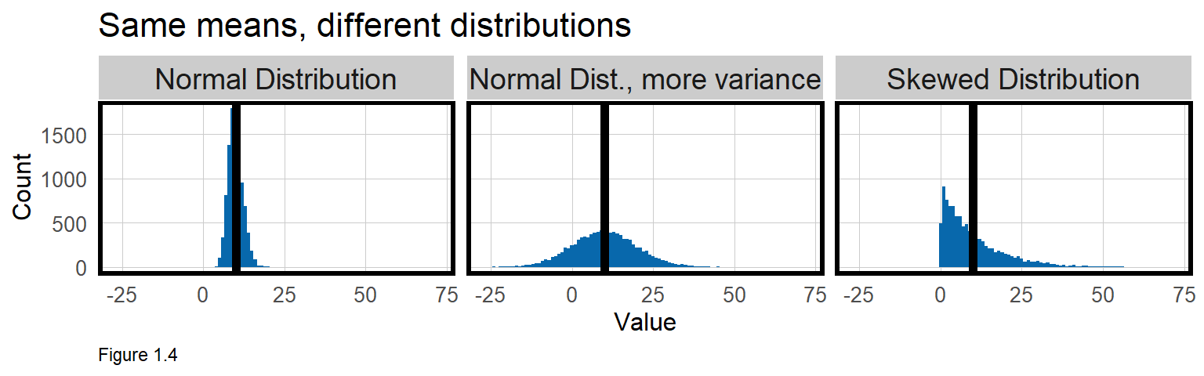
Means without SD = Peanut butter without Jelly
https://urbanspatial.github.io/PublicPolicyAnalytics/TOD.html

Slide 14
Case Study on TOD Indicators
Are Rents Higher in Areas Around Transit Stations?
Are people more willing to pay more to locate near transit amenities?
If so, consider modifying zoning code to allow more density around transit stations.
Higher land value = land developed more intensely.
More units = more property taxes!

Slide 15
Procedure – How we will study this
Get Open Transit Data (Wrangling)
Get Census Data
Define ‘Transit’ vs. ‘Non-Transit’ Neighborhoods

Slide 16
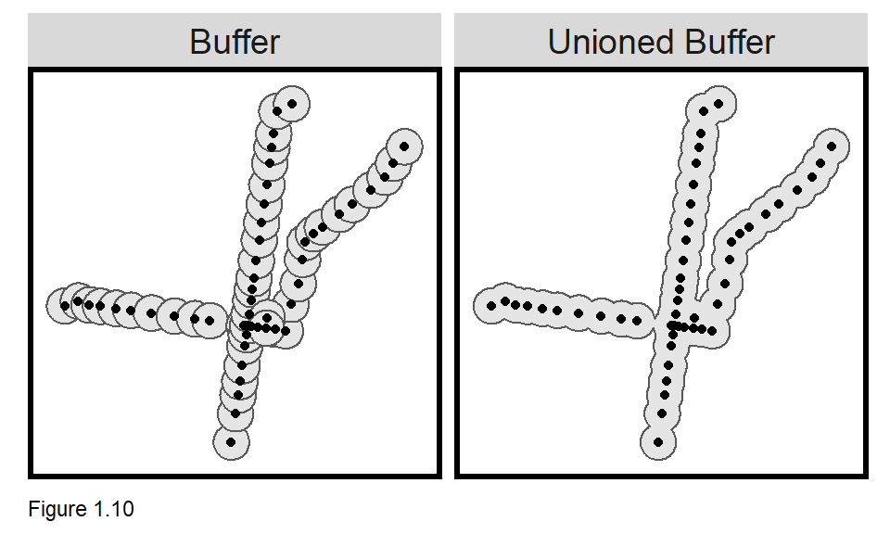
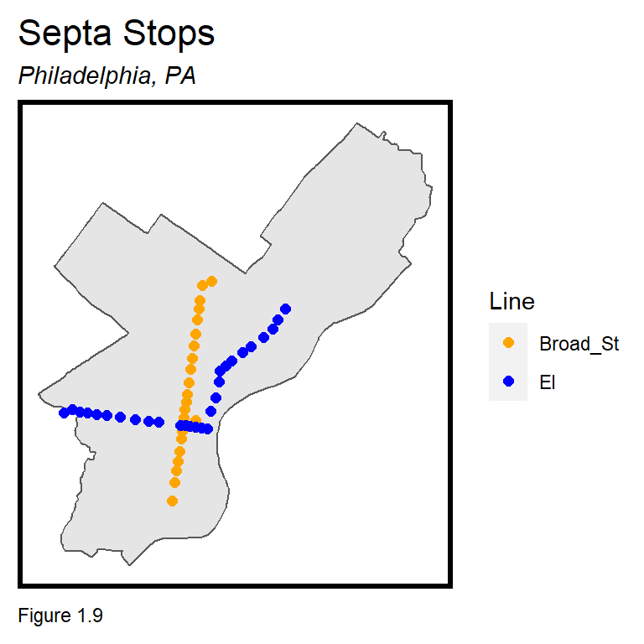
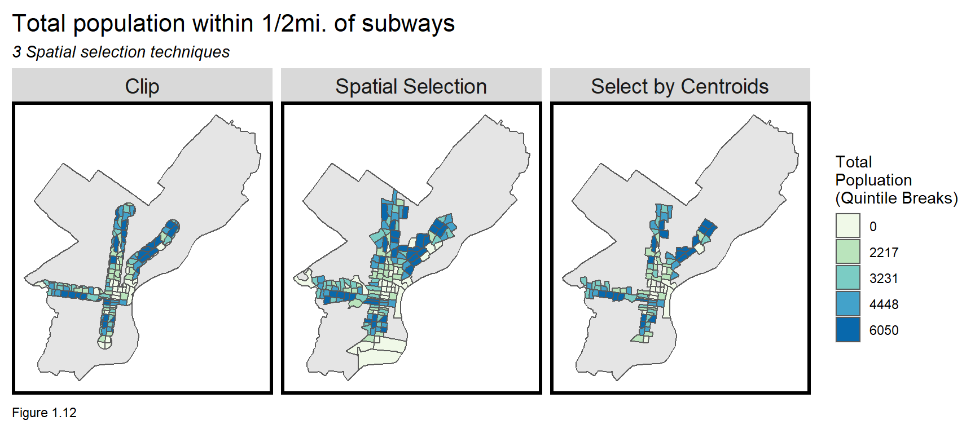

Slide 17
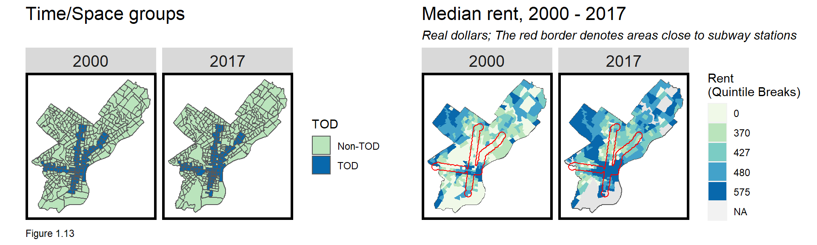
Compare Indicators between Transit & Non-Transit Tracts

Slide 18
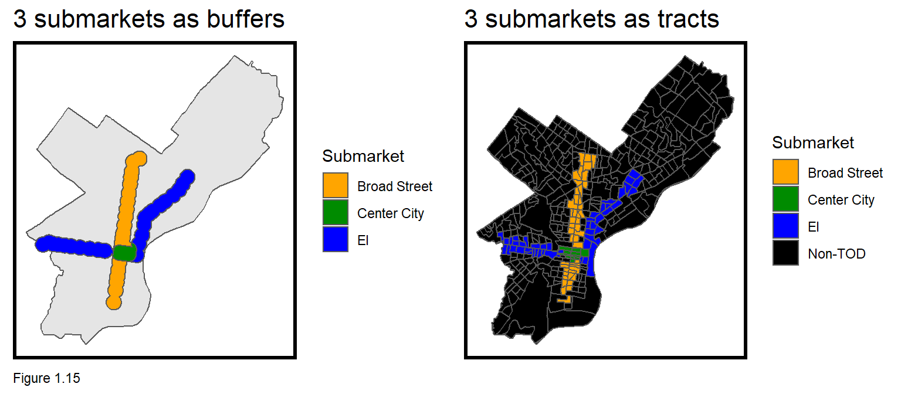
Capturing Submarket Heterogeneity
Intersect

Slide 19
Before We Dive Into the Lab
Review Group_By and Summarize
Long vs. Wide Data Format
St_Transform and other projection\coordinate system questions

Slide 20
Geographic coordinate system
All web map use geographic coordinate system
Ellipsoid
Datum: reference point on earth
NAD 27
Clarke1866, Meades Ranch, KS
NAD 83
GRS 80 ellipsoid, center of earth
WGS 84
Similar to NAD 83
Different ellipsoid by also use center of earth
GPS

Slide 21
Projected coordinate system
State plane
Flatten by state
UTM
Divide earth into zones
st_transform()
st_crs(tracts16)
?scale_colour_brewer

