Slide 1
Training A Convolutional Neural Network to Do Facial Recognition Using Big Data
Group Members
Cheah Jun Yitt WQD180107
Tan Yin Yen WQD180108
Choo Jian Wei WQD180124

Slide 2
Facial Recognition
A technology capable of identifying or verifying a person from a digital image or a video frame
Has been used in various system like security system, commercial identification, video surveillance etc.

Slide 3
Convolutional Neural Network (CNN)
Current state-of-the-art models for image recognition
Capable of learning and modelling non-linear and complex relationships
Apply a series of filters to the raw pixel data of an image to extract and learn higher-level features, which the model can then use for classification
Contains of three components:
- convolutional layers
- pooling layers
- fully connected layers

Slide 4

Process of Convolutional Neural Network
Each module consists of a convolutional layer followed by a pooling layer.
The last convolutional module is followed by layers that perform classification.
The final dense layer in a CNN contains a single node for each target class in the model, with a softmax activation
Softmax values for a given image is interpreted as relative measurements of how likely it is that the image falls into each target class.

Slide 5
MobileNetV2
Achieves very good Top-1 accuracy versus floating-point operations (FLOPs) required trade-off and has a relatively high Top-1 accuracy density.
Significantly reduces memory required and number of operations while maintaining the same accuracy

Slide 6
Data Acquisition
faces_data_new (FDN)
https://www.kaggle.com/gasgallo/faces-data-new
Labeled Faces in the Wild (LFW)
http://vis-www.cs.umass.edu/lfw/#deepfunnel-anchor
UTKFace
https://susanqq.github.io/UTKFace/

Slide 7
Scenario and Methodology - Identity Prediction
Train Set
Image Augmentation
Model Training
& Selection
E.g. Identity Tigerwood
Data Acquisition
FDN,LFW
Data Pre-processing
Test Set
Evaluation

Slide 8
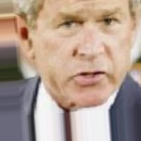
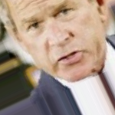
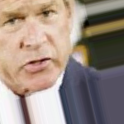


Identity Prediction – Image Augmentation

Slide 9
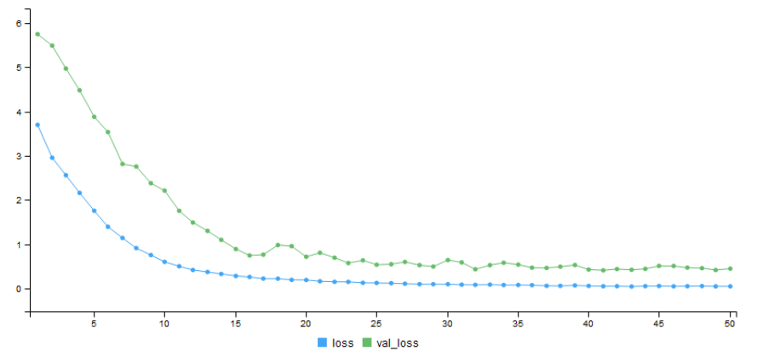
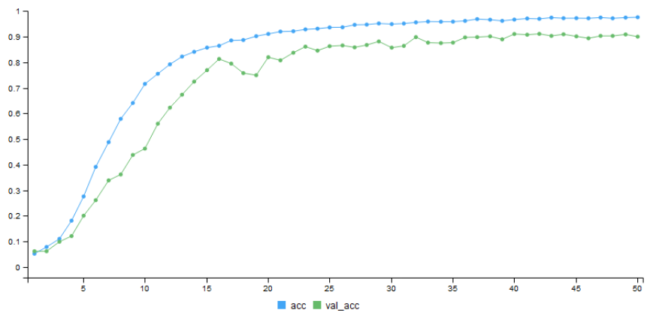
Identity Prediction – Model Training & Selection

Slide 10
Scenario and Methodology - Gender Prediction
Train Set
Image Augmentation
Model Training
& Selection
0 – Male
1- Female
Data Acquisition
UTKFace
Data Pre-processing
Test Set
Evaluation

Slide 11
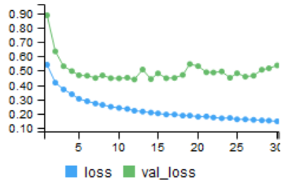
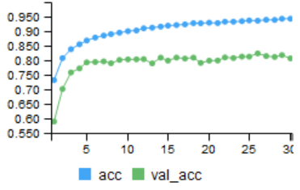
Gender Prediction - Model Training & Selection

Slide 12
Scenario and Methodology - Age Group Prediction
Train Set
Image Augmentation
Model Training
& Selection
E.g. Age Group 7-12
Data Acquisition
UTKFace
Data Pre-processing
Test Set
Evaluation

Slide 13
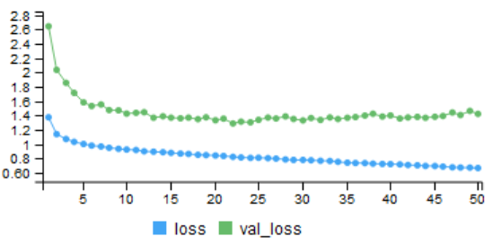
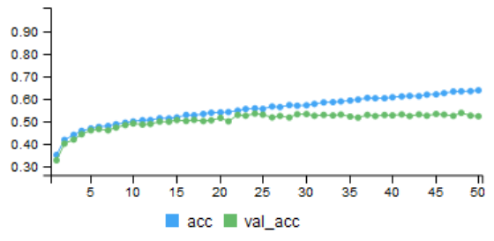
Age Group Prediction - Model Training & Selection

Slide 14
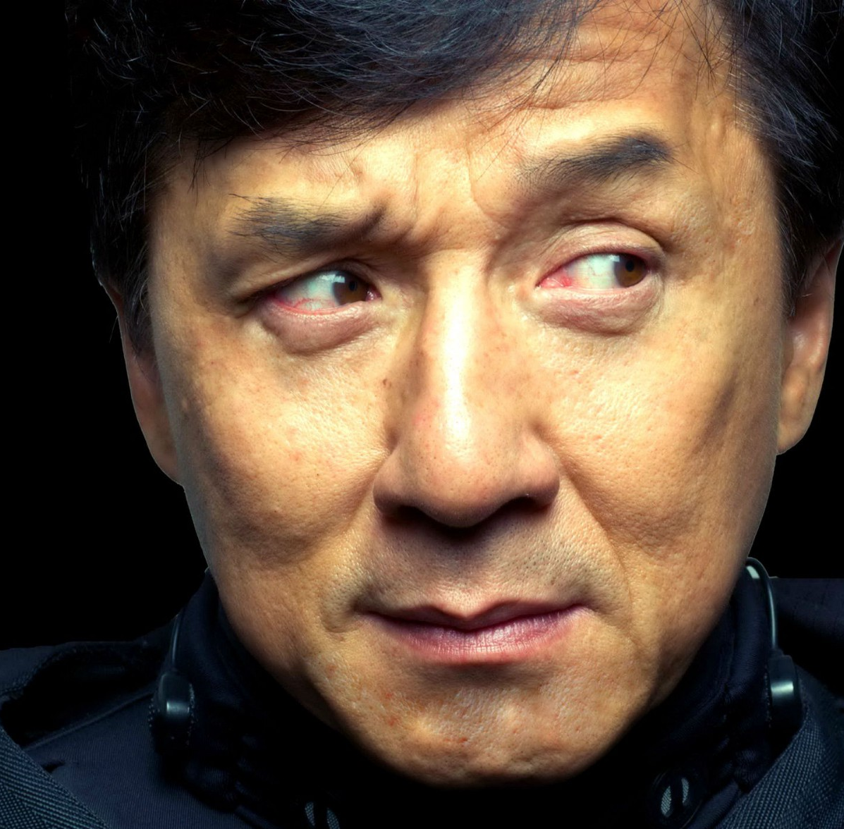

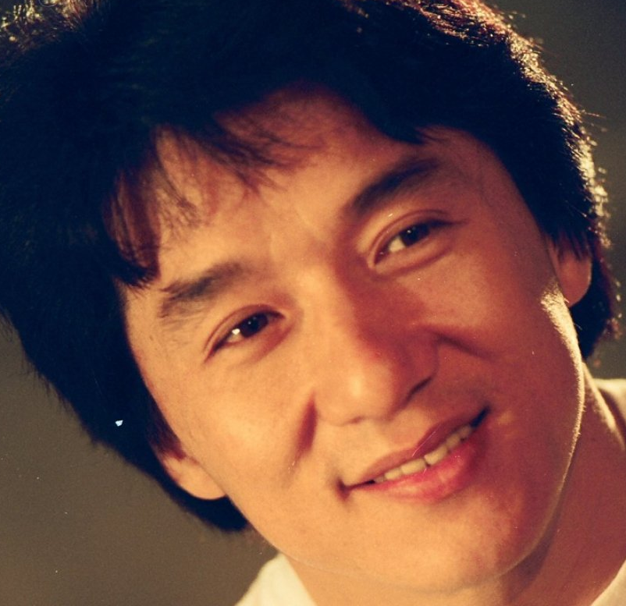
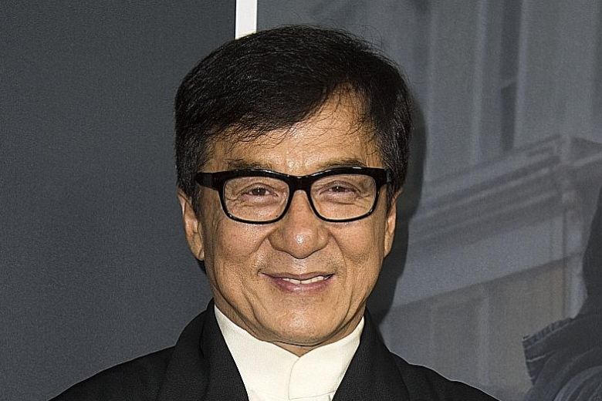
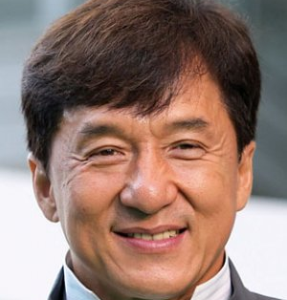
Person Re-Identification
Train Data
LFW + FDN
CNN
Feature Vector
Trained Identity Model
KNN Classification
Similar
Unseen Image
Feature
Vector
New Unseen Image

Slide 15
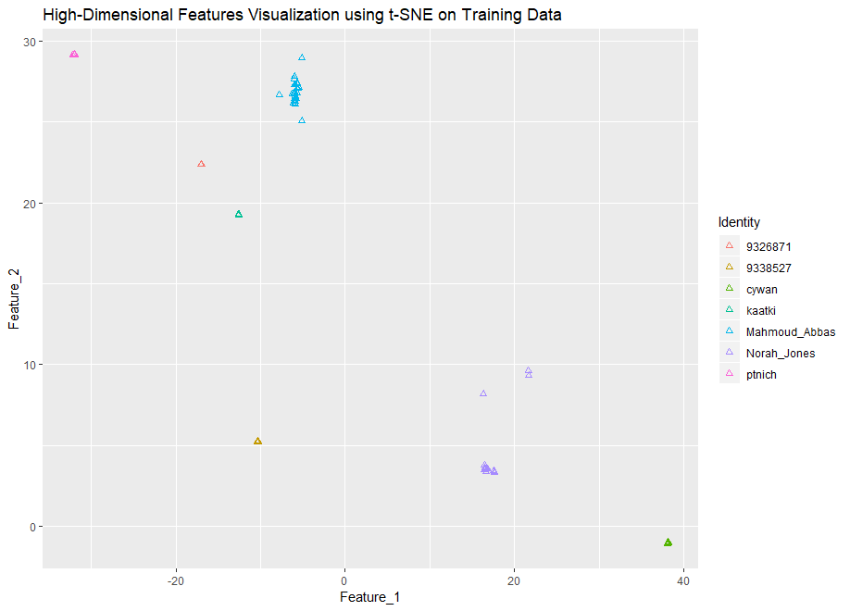
Feature Clustering

Slide 16
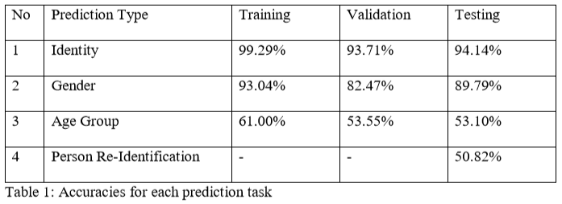
Conclusion
Facial recognition is widely used today
E.g. Amazon Go, Smartphones with Face Unlock
Achieved satisfactory accuracies on prediction

Slide 17
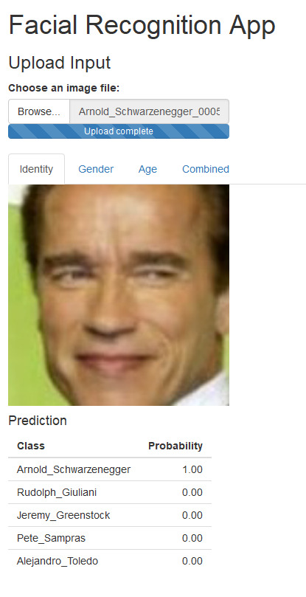
Facial Recognition App
Predicts:
identity
gender
age
based on images uploaded.

Slide 18
Thank You

