Slide 1
WiFi-OpenWRT
Team 3
Jun Yong Eom

Slide 2
Outline
Setting
Implementation
Certificate
Scanning
Beacon modification
Verification
Conclusion

Slide 3
Setting
Device
Access point (AP): Davolink DVW-604i
We can use any device which supports Wi-Fi
OpenWRT
My device: Laptop with Ubuntu 22.04
AP connection
Connect the AP and the laptop with console (or LAN) port
connection: telnet
telnet 192.168.1.1 6000
file transfer: tftp
tftp -r file_i_want -g targetIP
Notes:
ssid: smartair_2g_0 WiFi 비번: 123456789a
connection: root/snu20210818!

Slide 4
Setting
Build tool
Toolchain: toolchain-arm_cortex-a7_gcc-5.2.0_musl-1.1.24_eabi
This is used for compile source code and make executable files in the AP
toolchain-arm_cortex-a7_gcc-5.2.0_musl-1.1.24_eabi/bin/arm-openwrt-linux-gcc sample.c -o sample
OpenSSL
Client (Ubuntu 22.04)
libssl-dev version 3.0.2
Install: sudo apt install libssl-dev
AP
OpenSSL version 1.1.1g
Pre-installed in the AP
Notes:
ssid: smartair_2g_0 WiFi 비번: 123456789a
connection: root/snu20210818!

Slide 5
Implementation: Certificate
Goal
Sign the AP beacon using the AP’s private key
Envelope the signature to the beacon frame
Client verify the beacon using the AP’s public key
RSA key generation (AP side)
Private key
openssl genpkey -algorithm RSA -pkeyopt rsa_keygen_bits:512 -pkeyopt rsa_keygen_pubexp:3 -out privkey-A.pem
set the rsa key small size for envelope the key in the beacon frame body
Public key
openssl pkey -in privkey-A.pem -pubout -out pubkey-A.pem

Slide 6
Implementation: Certificate
Generating a self-signed certificate for the CA (AP side)
openssl req -x509 -new -nodes -key privkey-A.pem -sha256 -days 1024 -out root.crt
Country name: KR
Province: KR
Locality: Seoul
Organization name: snu
Organization unit name: cse
Common name: smartair_2G_0 (ssid)
Email: jyeom@snu.ac.kr
Output: root.crt

Slide 7
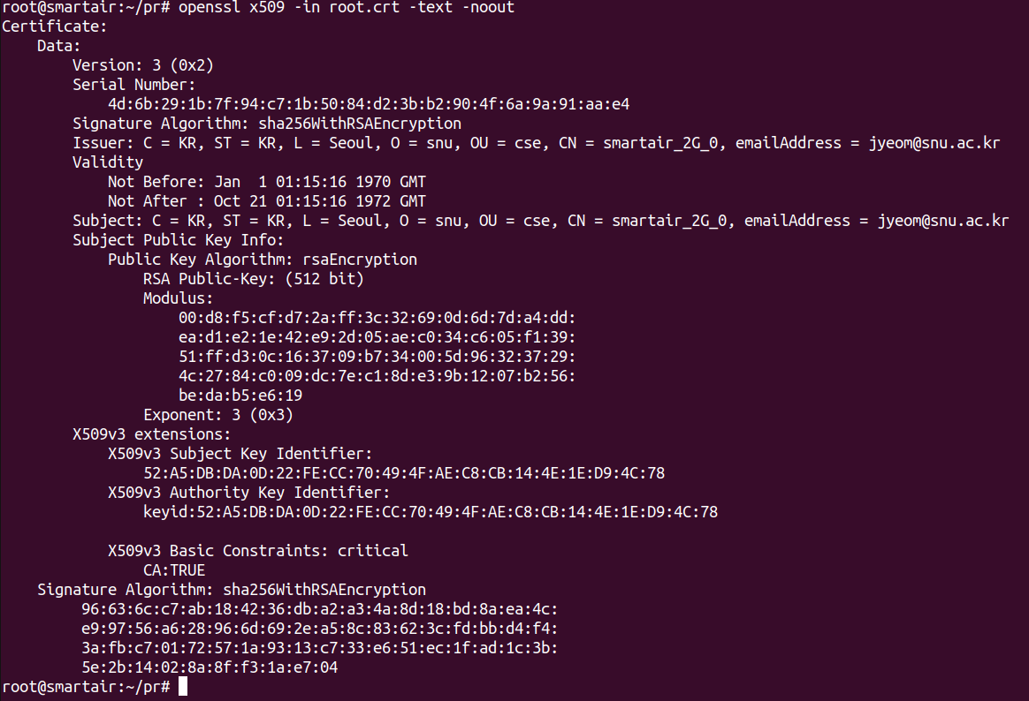
Implementation: Certificate
Viewing the certificate

Slide 8
Implementation: Certificate
Sending root.crt using tftp
tftp –p –l root.crt 192.168.1.117 (AP side)
For sending the file from the AP to the client, modify the tftp configure as follows:
sudo vi /etc/default/tftpd-hpa
TFTP_USERNAME=“root”
TFTP_DIRECTORY=“directory you want to get file”
TFTP_ADDRESS=“0:0:0:0:69”
TFTP_OPTIONS=“--secure –c –l –v –s”
Then restart: sudo service tftpd-hpa restart
Extract the public key from the root’s certificate
openssl x509 –pubkey –in root.crt –noout > pubkey-B.pem

Slide 9
Implementation: Scanning
This procedure is for analyze the modified beacon frame
Set network interface to monitor mode
sudo iw dev wlp4s0 interface add mon0 type monitor
sudo ip link set mon0 up
Wireshark setting
sudo apt install wireshark
sudo usermod –a –G wireshark $USER
sudo adduser $USER wireshark
sudo wireshark, then scan from mon0
beacon filter: wlan.fc.type_subtype == 0x08

Slide 10
Implementation: Beacon modification
Modify hostapd configuration (test)
vi hostapd-ath1.conf
add vendor_elements filed: <tagnumber><taglen><oui><data>
kill previous hostapd
ps | grep hostapd
kill –9 hostapd’s psid
restart hostapd
hostapd –B /var/run/hostapd-ath1.conf
run the hostapd background
I haven't found a way to apply configuration without restarting hostapd yet
I guess it might be a device dependent issue
Notes:
wifi restart: wifi –h
hostapd_cli –i ath1 –p /var/run/hostapd-wifi1/ update_beacon
vendor_elements field
configuration 바꾸고 ps kill하고 hostapd –B restart 해야되나보네
vendor_elements=DD<length><oui><subtype><elements> oui 부터 한바이트가 length 1
dda0

Slide 11
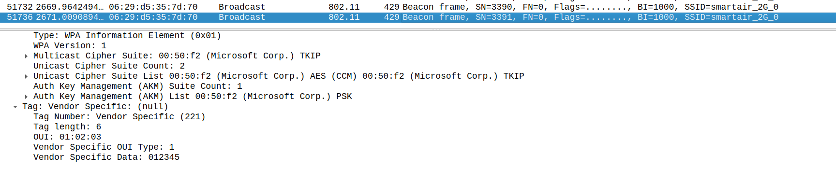
Implementation: Beacon modification
Modify hostapd configuration (test)
wireshark scan result

Slide 12
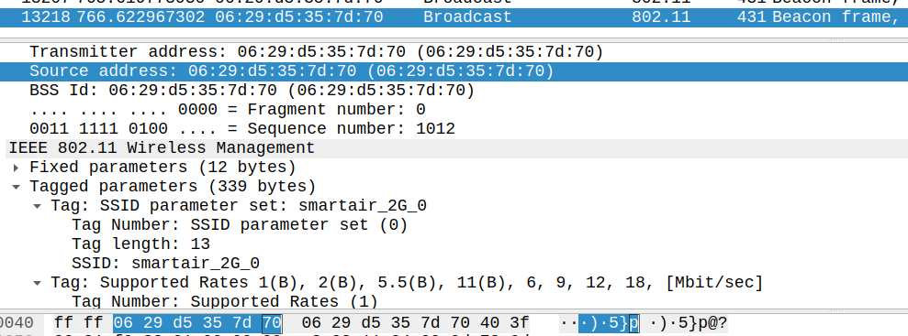
Implementation: Beacon modification
Sign the beacon header
As the hostapd restart constraint, lets make a signature only using the source address and the BSS ID field in the beacon MAC header
At least, we can guarantee that the source of the beacon is not forged
We can scan the value of source MAC and BSS ID using wireshark or just ifconfig, etc.

Slide 13
Implementation: Beacon modification
Sign the beacon header
Make a temporary file and enter the source address and the BSS ID
Sign the temporary file on the AP side
openssl dgst –sha256 -hex –sign privkey-A.pem –out sign.txt(output) sa_bssid(tmp)
awk {‘print toupper($0) }’ sign.txt > upsign.txt
Make the sign as hex format and make uppercase to paste it in the hostapd conf file
Envelope the sign in the beacon
Add vendor_elements field in the hostapd configure file and restart hostapd as before

Slide 14
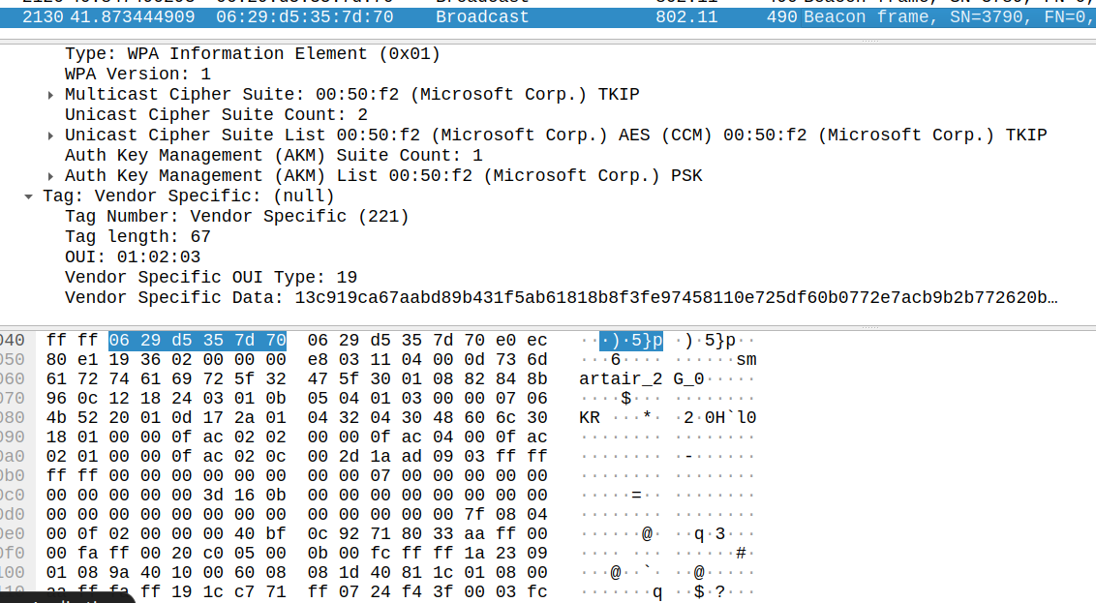
Implementation: Beacon modification
Viewing the modified beacon

Slide 15
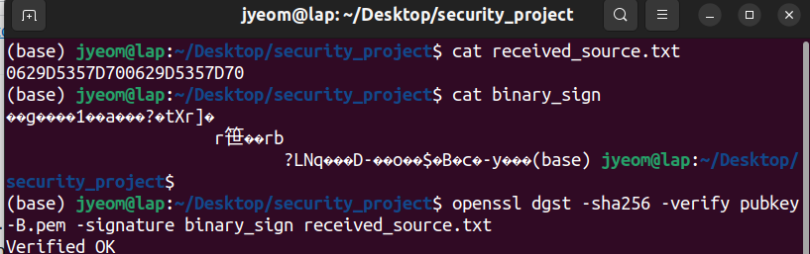
Implementation: Verification
Verify the received beacon on the client side
cat received_sign.txt | sed -e 's/.*= \([^ ]\+\)$/\1/' | xxd -r -p > binary_sign
Transform the hex format in the binary format for the verification
openssl dgst –sha256 –verify pubkey-B.pem –signature binary_sign received_sa_bssid.txt
Verification done

Slide 16
Conclusion
Succeeded to sign the beacon frame on the AP side and verify the beacon on the client side with some limitations
If the hostapd can be reconfigured without restart, beacon frame’s MAC header as well as mandatory fields can be signed for the better security

