Slide 1
Image Processing
Team Project

Slide 2
Text encryption & decryption
Team Project

Slide 3
Contents
Team name & Logo
Project Topic
Explanation of team name
Explanation of our Project Topic
Team Leader & Member
Algorithm
Introduction of Team
Algorithm of our Project
Photo of Team Member
Q&A
Our awesome Appearance
Question and Answer

Slide 4

1
Explanation of team name
We choose Supreme as out team name because we hope to be the best team
Team name & Logo

Slide 5

Team name & Logo
Explanation of team name
We choose Supreme as out team name because we hope to be the best team

Slide 6
2
Team Leader Hyungbae Lee(2011521)
Team Member Junyoung Park(20125753)
Team Member Yongseok Shim(20115278)
Team Member Vitor Lopez(50171074)
Team Leader & Member

Slide 7
Team Leader & Member
Our Team
Team Leader Hyeongbae Lee(20111521)
Team Member Junyoung Park(20125753)
Team Member Yongseok Shim(20115278)
Team Member Vitor Lopez(50171074)

Slide 8
3
Photo of Team members

Slide 9
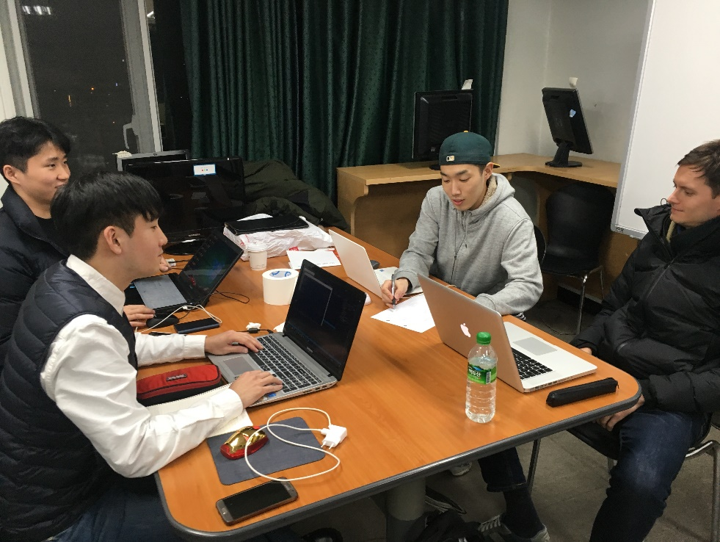
Photo of Team members
Our Team

Slide 10
4
Project Topic

Slide 11


Project Topic
Idea
Image Processing
+
Cryptography

Slide 12
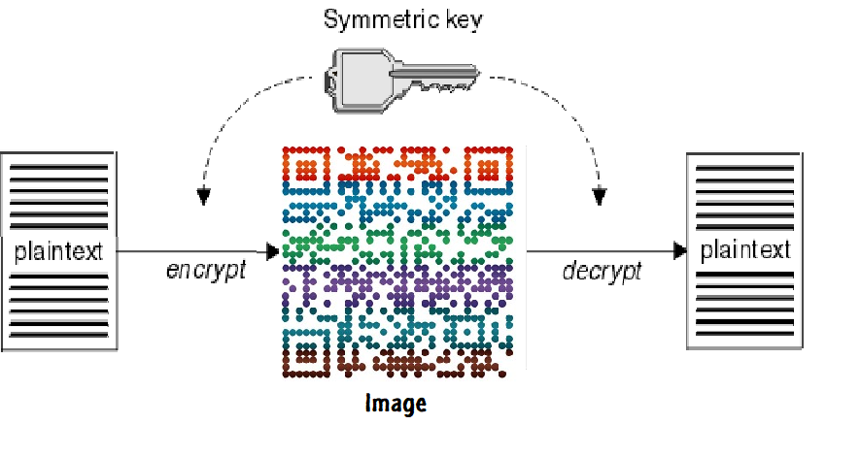
Team Leader & Member
Project Topic

Slide 13


Project Topic
Input
Result
Encryption
Convert Text to Image

Slide 14
Project Topic
Input
Result
decryption
Convert Image to text

Slide 15



Algorithm
Character mapping
Mapping the table
Create tree
Convert the table to tree
Make the new text by traversal
Read the text from tree

Slide 16

Algorithm
Convert Text to Image (Input: image , Key)
boy.jpg

Slide 17
Encryption

Slide 18





Algorithm
1) Map each character to a matrix
I
a

Slide 19
Algorithm
2) Use the Text to create a tree
I
I am a boy
a
m
a
b
o
y

Slide 20
Algorithm
3) Create the new text by traversing the tree in pre-order, in-order or post-order
Key=1 : pre-order
- new Text : Iaabmoy
Key=2 : in-order
- new Text : aabIomy
Key=3 : post-order
- new Text : abaoymI
I
a
m
a
b
o
y

Slide 21
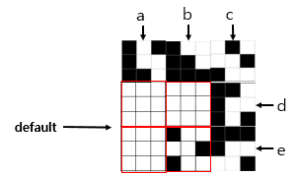
Text: abcde
4) Convert the new text to an image by using the mapping table
Resulting image

Slide 22
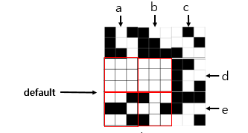
Text: abcde
4) Convert the new text to an image by using the mapping table
Resulting image

Slide 23
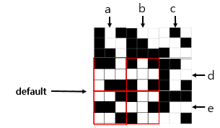
Text: abcde
4) Convert the new text to an image by using the mapping table
Resulting image

Slide 24
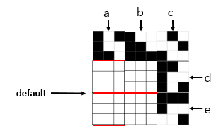
Text: abcde
4) Convert the new text to an image by using the mapping table
Resulting image

Slide 25
Decryption

Slide 26
Algorithm
5) Convert the mapping table to the tree in pre-order, in-order or post-order by using key
Pre-order

Slide 27
Algorithm
5) Convert the mapping table to the tree in pre-order, in-order or post-order by using key
I
Pre-order

Slide 28
Algorithm
5) Convert the mapping table to the tree in pre-order, in-order or post-order by using key
I
Pre-order
a

Slide 29
Algorithm
5) Convert the mapping table to the tree in pre-order, in-order or post-order by using key
I
Pre-order
a
a

Slide 30
Algorithm
5) Convert the mapping table to the tree in pre-order, in-order or post-order by using key
I
Pre-order
a
a
b

Slide 31
Algorithm
5) Convert the mapping table to the tree in pre-order, in-order or post-order by using key
I
Pre-order
a
m
a
b

Slide 32
Algorithm
5) Convert the mapping table to the tree in pre-order, in-order or post-order by using key
I
Pre-order
a
m
a
b
o

Slide 33
Algorithm
5) Convert the mapping table to the tree in pre-order, in-order or post-order by using key
I
Pre-order
a
m
a
b
o
y

Slide 34
Algorithm
6) Read the text from result tree.
I
Pre-order
a
m
a
b
o
y
Result : I am a boy

Slide 35
Thank you!
Any questions?

