Slide 1
Final Project
CSC 335
By Pengyu Yang
Feiran Yang
Junyu Liu
Zhexiang Jing

Slide 2
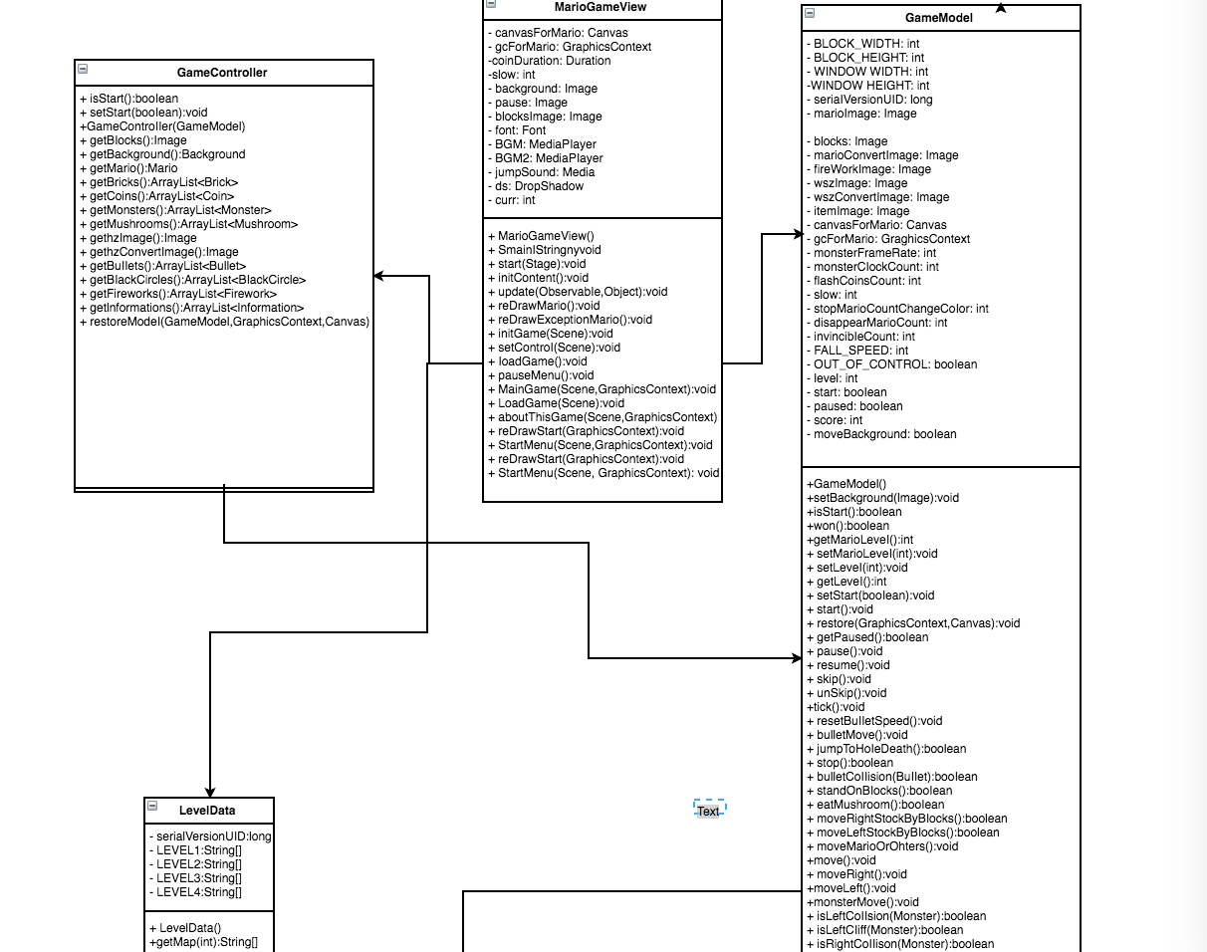
Design
JavaFx
Model-View-Controller Design
GameModel
MarioGameView
GameController
We draw everything on gc, call tick() to update model in GameModel
every frame. GameModel will notify MarioGameView, then
MarioGameView redraw everything on board.

Slide 3
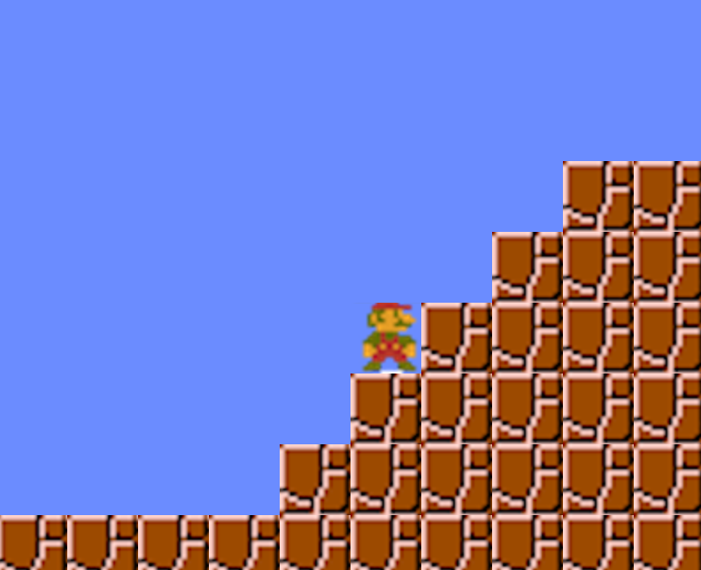
How to play
Use key on keyboard
Presss “W”- jump; “Enter”- confirm
“S”- down; “Esc” - menu
“A”- left;
“D” -right
“K” - shoot
(only appliable for character Lv3 )

Slide 4









Object in Game
Objects follow the rules in SuperMarioBro
Mario Monster Item Map Obj
Goomba Upgrade Unbreakble
Item Breakable Ko Koopa Coin Item hidden
PiranhaFlower
￼

Slide 5
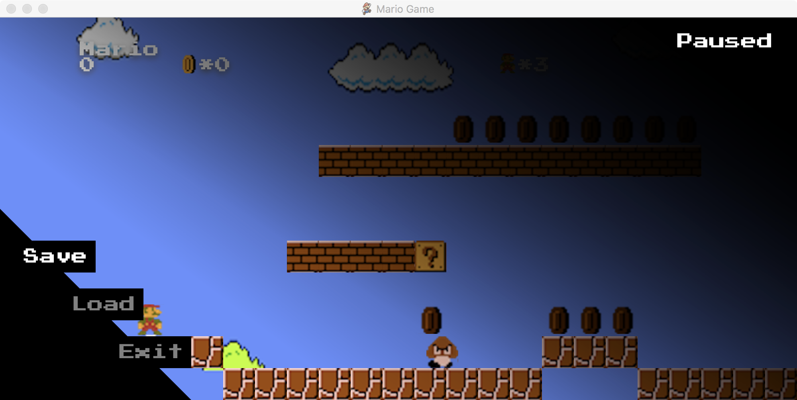
Play
Clear 3 stages!
Collect all coin!
You only have three lives.
Use save/load properly :)

Slide 6
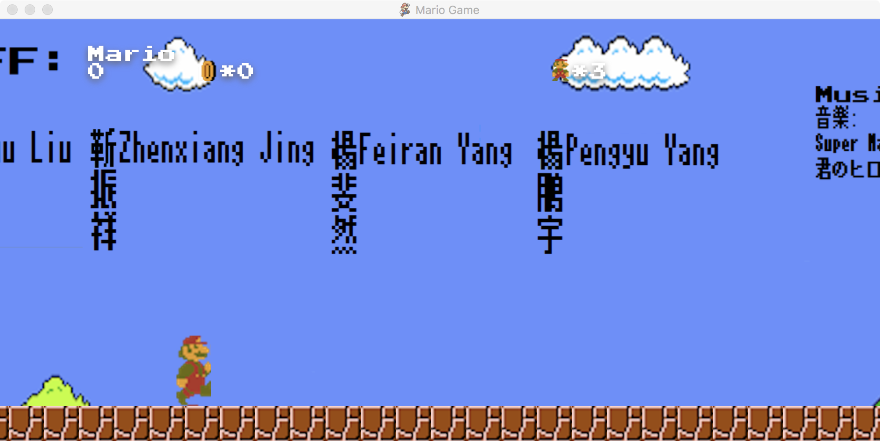
Wow factor
Extra Scene when mario goes jump beyond screen…

Slide 7

ENJOY

