Slide 1
Dark Springs Bottled Water
Ratnesh Shah
Yusuke Ouchi
Jun Zhang
Vinit Shah

Slide 2
Objectives
Develop a database for Dark Springs Bottled Water to store a collection of related data which includes but is not limited to customer, employee, bill, route, contract, delivery schedule, orders, location, item.
Users can place and return order, generate bill, check delivery schedule, refill inventory, etc., to support their business operations.

Slide 3
Business Rules
Only Accountants have access to bill table
Only Delivery Managers can create, update, or delete a route
One order generates one bill
When a customer places a return, the entire order will be returned
Customers must place a return before the bill due date passes
Customers must pay their last bills before they place a new order

Slide 4
E-R Diagram
Driver
(0, 1)
(1, N)
notes
(1, 1)
d
(1, 1)
(1, N)
Contract
(1, 1)
(1, 1)
Employee
handles
signs
Customer
(0, 1)
(1, 1)
(1, N)
(0, 1)
is assigned
Delivery
Schedule
(1, 1)
refers
returns
schedules
(1, 1)
(1, N)
(1, 1)
(1, 1)
is on
(1, N)
places
(1, N)
(1, 1)
(1, N)
has
Route
has
Order
is in
Bill
(1, 1)
(1, 1)
(1, 1)
(1, 1)
(1, 1)
(1, N)
(1, N)
(1, 1)
Item
is in
Order
Details
contains
Location
contains
(1, 1)
(1, N)

Slide 5
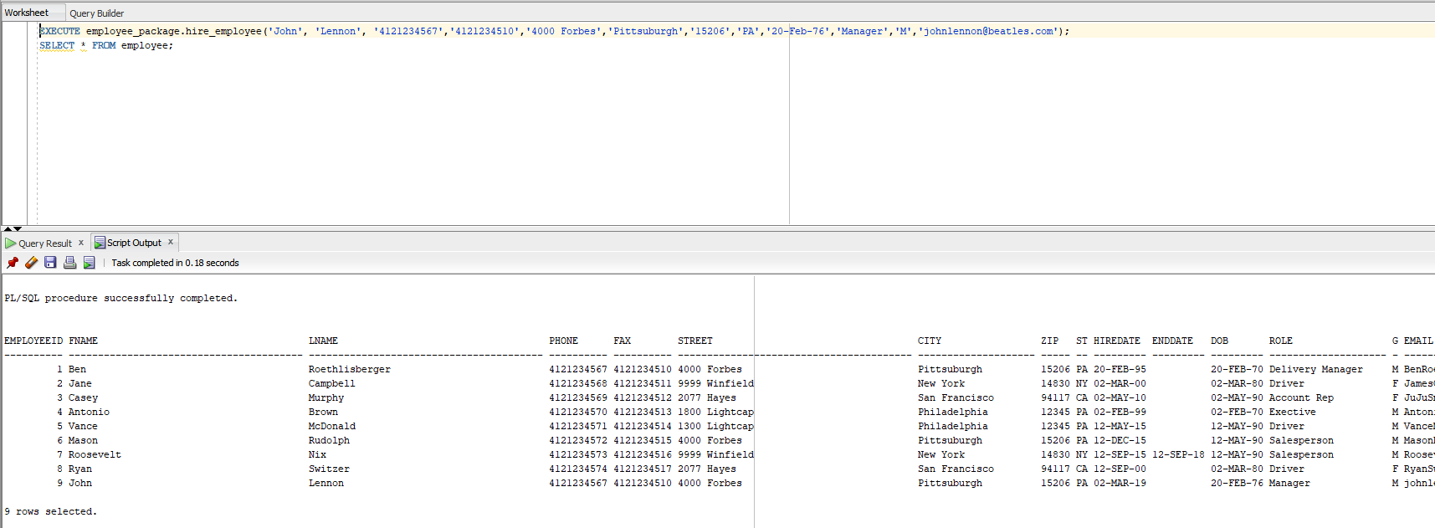
Database Objects
Package
Hire employee:

Slide 6
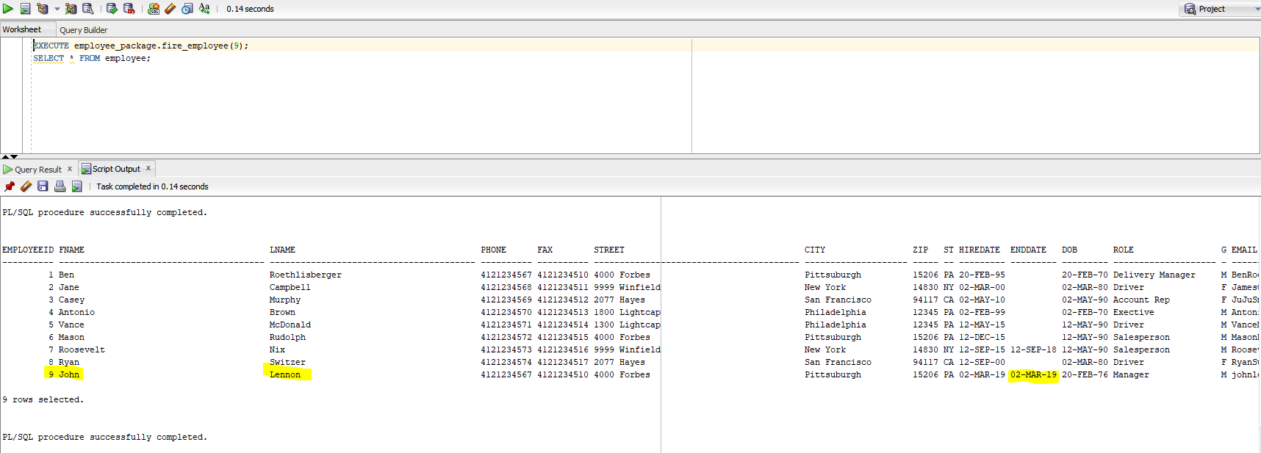
Database Objects
Package
Fire employee:

Slide 7
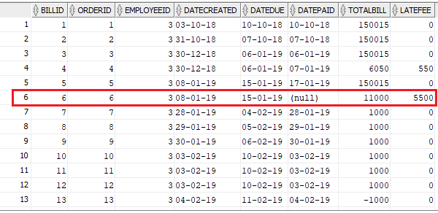

Database Objects
Function
Calculate late fee:
Bill table:
Output:

Slide 8
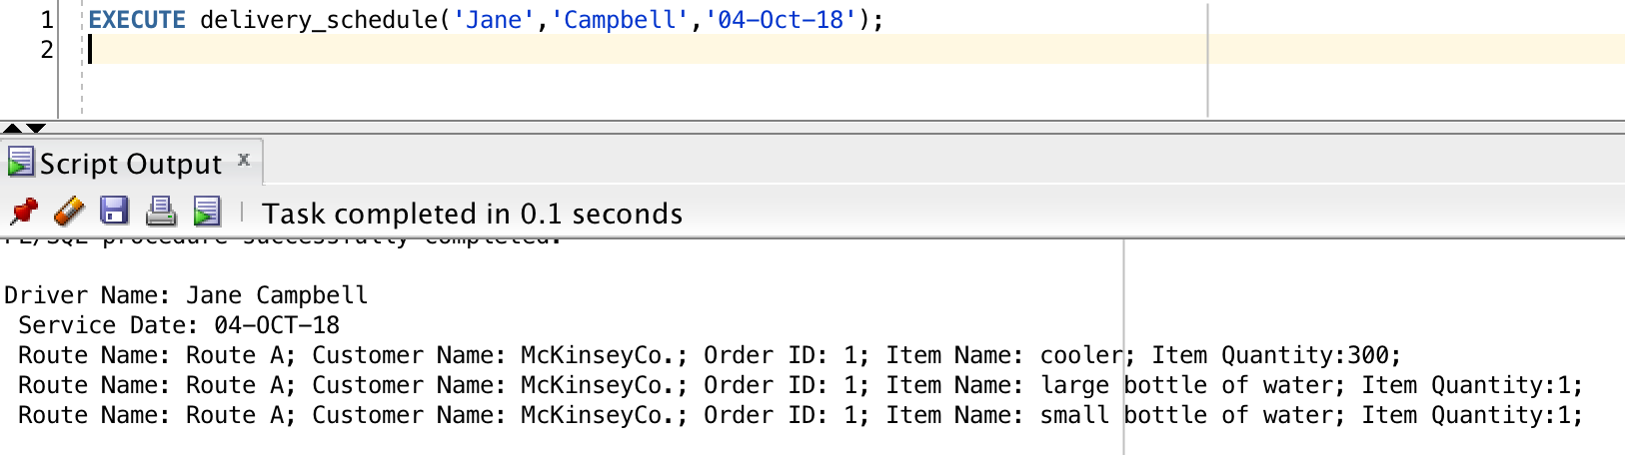
Database Objects
Procedure
Check delivery schedule:

Slide 9
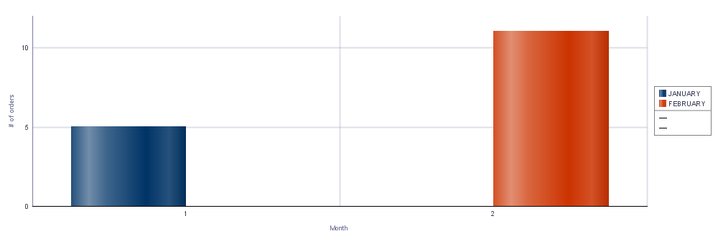
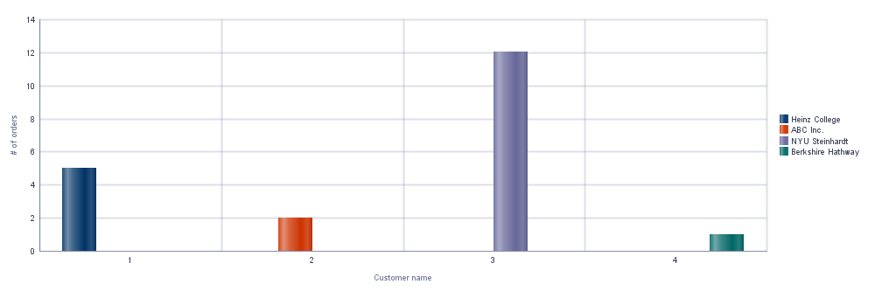
Report Outputs
Number of Orders Per Month
Number of Orders By Customer

Slide 10
Future Work
Inventory control
Payment control
Discount calculation
Route scheduling optimization

Slide 11
Thank you

