Slide 1

Nexus
From customer message
to accountable action.
Automation for small teams.
People stay in control.
TEAM NAILONG · SDC 2026 · DOMAIN 2

Slide 2
The work between the messages.
A customer asks. Someone must connect all the missing context.
01
02
03
Understand the request
Check what is possible
Keep the handoff moving
Read the message. Re-enter quantity, deadline and customer details.
Compare stock, staff capacity, skills and approved leave.
Find an approver, assign an owner and chase the next update.
Initial focus: 5–20-person Malaysian print and custom-gift teams.
Target-user hypothesis; field interviews and timing studies are planned.
02

Slide 3
A simple order. An avoidable promise.
Synthetic demonstration: Bunga Café requests 100 custom cups by 26 October.
100
80
20
cups requested
cups in stock
cups short
Restock first. Check availability. Confirm with a person.
Nexus shows the constraint before a delivery date or quotation is promised.
03

Slide 4
One request. A traceable handoff.
Automate the preparation. Make the decision explicit.
Customer message
Support prepares
Business checks
In-app conversation
Confirm requirements
Stock • skills • leave
Task & activity record
Recheck conditions
Human approval
Named employee + next step
Prevent stale decisions
Review, edit or reject
Support creates requests. Managers approve. Employees carry out the work.
04

Slide 5
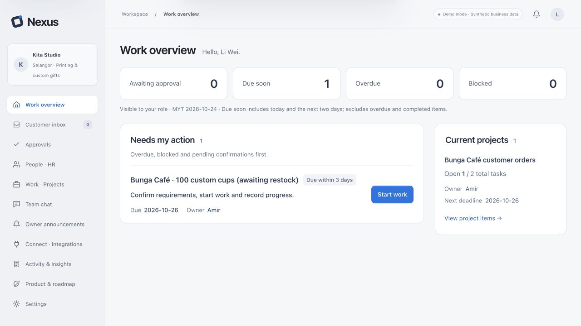
Open the workspace. Know the next action.
Actionable counts, a named owner and a concrete next step.
Scan
See what needs attention.
Act
Open the relevant task directly.
Actual English prototype · synthetic business data · browser-local state
05

Slide 6
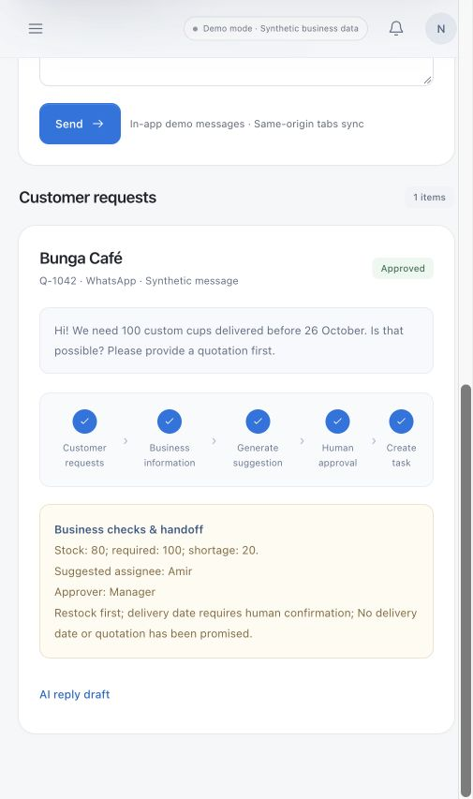
AI assists. Rules check. People decide.
Extract & draft
The OpenAI adapter is designed to structure
a message and suggest an editable reply.
Verify & approve
Business rules check resources. A person
confirms the decision and the outgoing reply.
API integrated; last live test was credit-blocked.
Successful model generation is not yet verified.
06

Slide 7
Built around the way small teams work.
Start with familiar inputs. Keep the learning burden low.
LANGUAGE
CONTEXT
INPUT
English. Chinese.
Bahasa Melayu.
Local business
information.
Bring a local
Excel or CSV file.
Interface language switches without changing the user’s original messages.
RM, Malaysia time and approved leave support practical scheduling checks.
Employee-resource tables are parsed in the browser; no Microsoft 365 account needed.
WhatsApp Business and cloud Excel sync are planned, not connected.
07

Slide 8
A small architecture. Clear boundaries.
Current deployed prototype · business storage and AI services are separate.
Browser workspace
Workflow rules
localStorage
HTML • CSS • JavaScript
Checks + human approval
Business records + activity
Sites / Worker
OpenAI Responses API
Cloudflare D1
Authenticated AI endpoint
gpt-4.1-mini adapter
AI usage counters only
Sites hosts UI + backend. API key stays server-side. AI drafts return to human review.
Credit-blocked AI verification • no shared business database or production tenant isolation yet
08

Slide 9
Reliability needs more than a good reply.
The prototype has workflow safeguards. Production controls are the next gate.
70
Recheck before committing
Stock, leave and capacity may have changed.
Prevent duplicate handoffs
automated tests passing
Repeated actions must not create extra tasks.
Keep human control
Review critical decisions; prevent self-approval.
Current test suite; not a security
certification or a customer trial.
State the remaining boundary
Demo role filtering is not server-side tenant security.
09

Slide 10
Save time. Keep people in control.
SDG 8.2: productivity through technology · SDG 8.3: MSME growth
Active handling time · minutes per request
30%
lower median handling time
100%
human approval coverage
for critical actions
Illustrative 10 → 7 minutes; reduction is a target, not a result.
Replace the estimate with observed manual timings.
10

Slide 11
From working prototype to a trusted pilot.
Phase 2: prove one end-to-end workflow before expanding the platform.
01 / UNDERSTAND
02 / HARDEN
03 / VALIDATE
Observe real
request handling.
Make shared
work safe.
Test the
complete handoff.
At least 5 target users. Measure the manual baseline and remove points of confusion.
Server-side identity, company permissions, a shared transactional database and recovery.
30 matched task pairs. Measure time, missing fields, completion and approval coverage.
Integration gate: connect one authorised business channel, then test failure and retry paths.
11

Slide 12
Less chasing.
Clearer decisions.
Nexus
Live prototype
nexus-nailong-2026.d7ystszcjf.chatgpt.site/
TEAM NAILONG · XIAMEN UNIVERSITY MALAYSIA
LING YUXUAN (Leader) · LI JUNZHANG
XIE WEIYE · HU ZHAOMING

Slide 13
Appendix · What is actually connected?
Current resource inventory, not a list of future integrations.
Component | Current use | Status
Sites / Cloudflare Worker | Hosts frontend and AI endpoint | Deployed
OpenAI · gpt-4.1-mini | Requirement extraction + reply draft adapter | Integrated; credit-blocked
Browser localStorage / D1 | Business demo data / AI counters respectively | Implemented; separate stores
Local XLSX / CSV · fflate 0.8.3 | Browser-side resource-table analysis | Implemented
Replit premium / VIP | SDC-provided development and testing access | Used; not the current live host
WhatsApp / Microsoft Graph / RunPod | No live connection; no RunPod usage | Not used / not connected
AI-assisted development: OpenAI ChatGPT / Codex. No claim of RunPod use or an organiser waiver.
13

Slide 14
Appendix · Evidence & recording guide
Competition requirements
Official Participant Handbook, §6.3.5.2 and §6.3.5.6:
problem, solution, technical approach, impact; 5–7-minute video.
Product & technical evidence
Repository branch feat/nexus-mvp; architecture, customer-flow,
AI-integration and Excel/WhatsApp notes. Screens show synthetic data.
Impact basis
UN SDG 8.2 / 8.3. Ten-minute baseline is a team estimate;
30% reduction and 100% approval coverage are Phase 2 targets.
Suggested recording
12 core slides, approximately 6½ minutes including the product demo.
Appendices are for reference. Use screenshots if the live demo fails.
14

