Slide 1


Huazhong University of Science and Technology
The Department of Electronics and Information Engineering
Electronic Circuit Analysis and Design
Dr. Tianping Deng
Email: dengtp@hust.edu.cn

Slide 2
Contents
PART 1 SEMICONDUCTOR DEVICES AND BASIC APPLICATIONS
Chapter 1 Semiconductor Materials and Diodes
Chapter 2 Diode Circuits
Chapter 3 The Field-Effect Transistor
Chapter 4 Basic FET Amplifiers
Chapter 5 The Bipolar Junction Transistor
Chapter 6 Basic BJT Amplifiers
Chapter 7 Frequency Response
Chapter 8 Output Stages and Power Amplifiers
PART 2 ANALOG ELECTRONICS
Chapter 9 Ideal Operational Amplifiers and Op-Amp Circuits
Chapter 10 Integrated Circuit Biasing and Active Loads
Chapter 11 Differential and Multistage Amplifiers
Chapter 12 Feedback and Stability
Chapter 13 Operational Amplifier Circuits
Chapter 14 Nonideal Effects in Operational Amplifier Circuits
Chapter 15 Applications and Design of Integrated Circuits
Chapter 10 Integrated Circuit Biasing and Active Loads

Slide 3

10.1 Bipolar Transistor Current Source
10.2 FET Current Source
10.3 Circuit with Active Loads
10.4 Small-Signal Analysis: Active Load Circuits

Slide 4
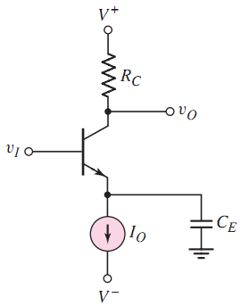
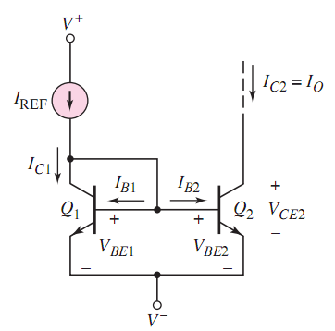
（P70）
CE
Which Region？
Forward active region

Slide 5
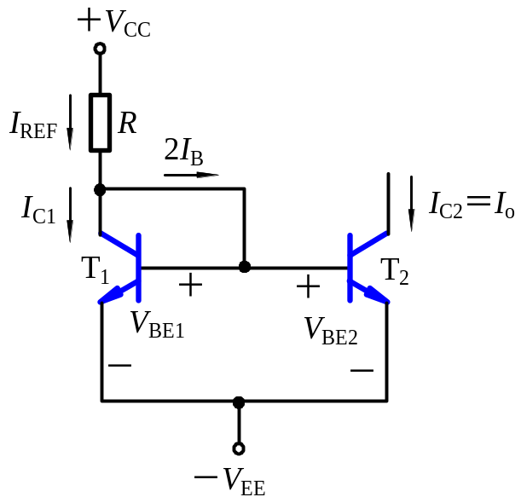



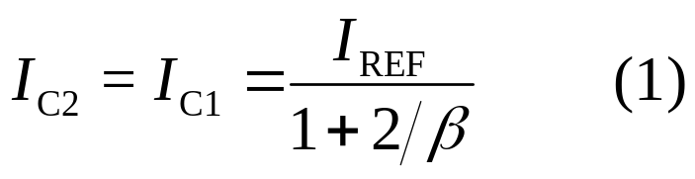



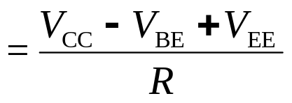
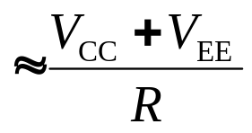
10.1 Bipolar Transistor Current Sources
10.1.1 Basic Current Source (Current Mirror) (P70)
T₁ ,T₂ are identical transistors.
I_{C2} is the mirror image of I_{C1}.
I_{C2} is almost constant, no matter the value of R_{C}.

Slide 6
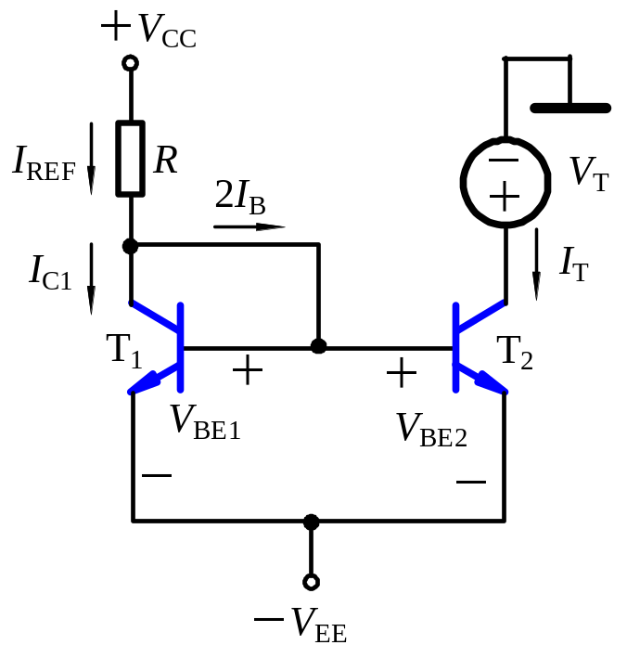


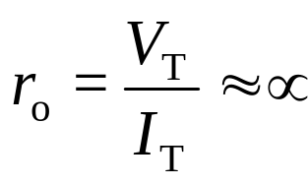
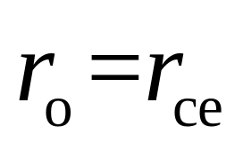
10.1.1 Basic Current Source (Current Mirror) (P70)
Because I_{C2} is almost constant, ac value of I_{C2} is
Output Resistance
In general, r_{o} is in order of 100 kΩ.

Slide 7
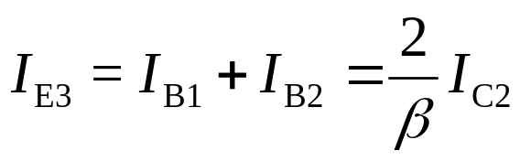
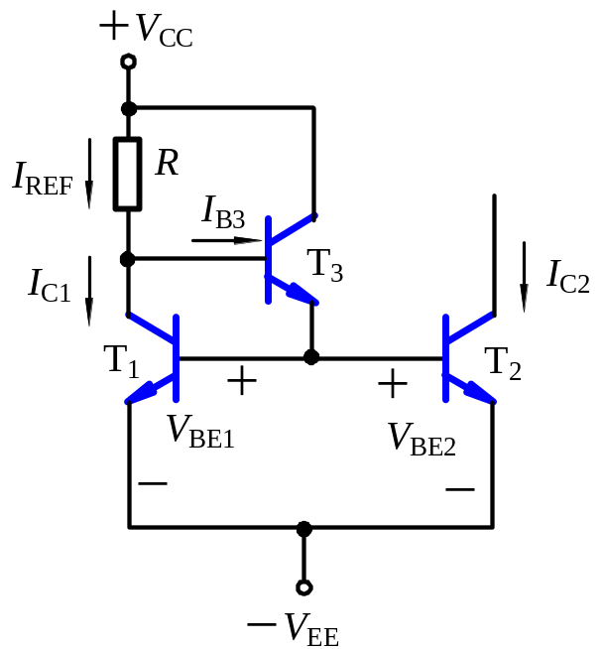
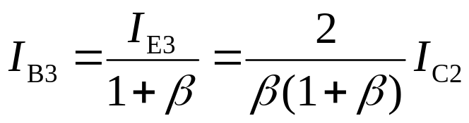
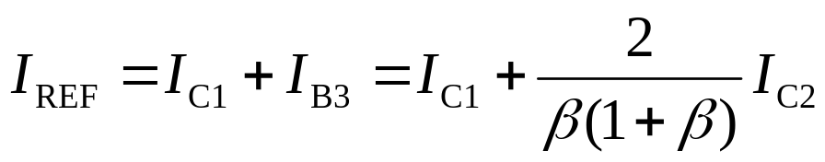
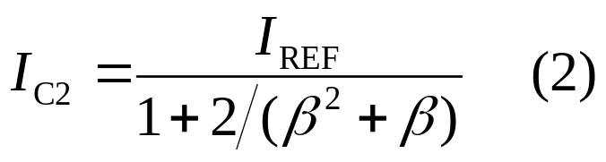
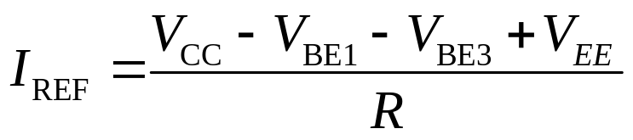
10.1.2 Improved Current Source (P75)
Comparing Expressions (1) and (2), when I_{C2}≈I_{REF}, the error of (2) can be reduced by adding transistor T₃.

Slide 8
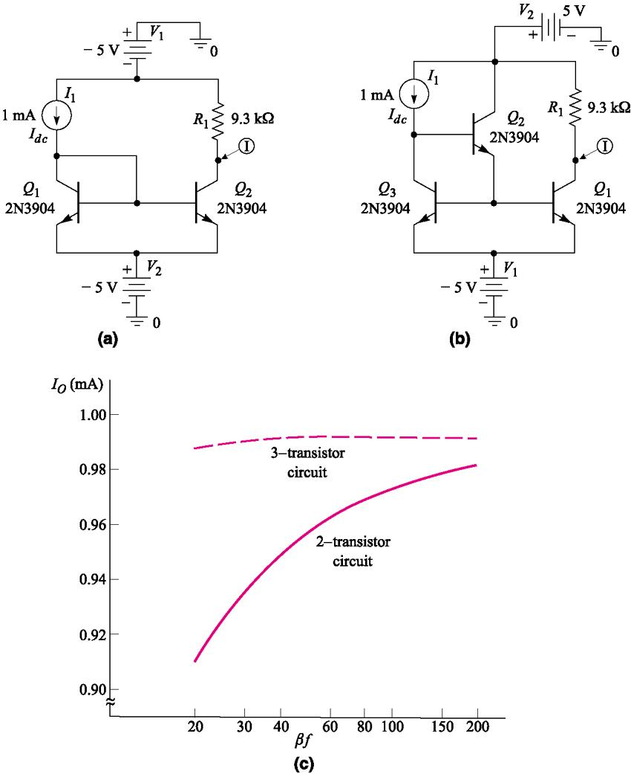
10.1.2 Improved Current Source（P77）

Slide 9
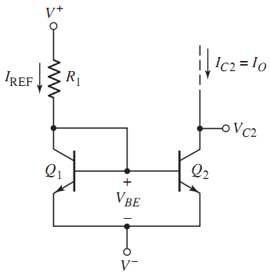




10.1.3 Widlar Current Source (P80)

Slide 10
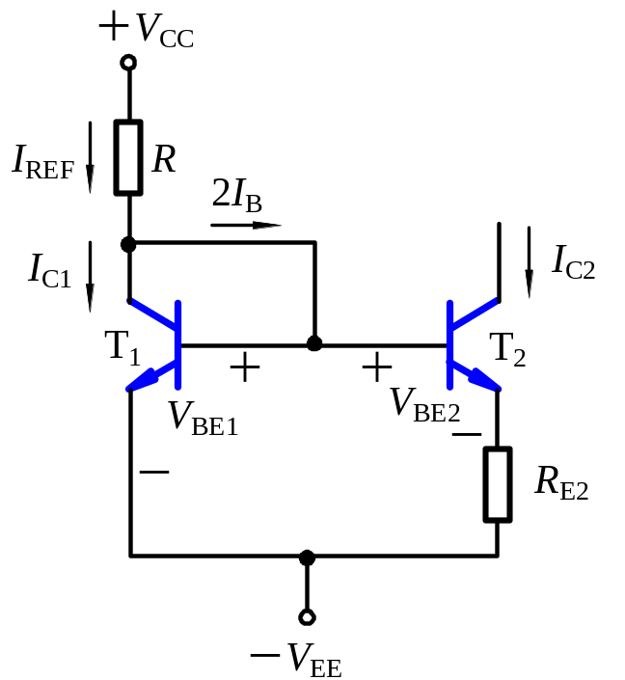
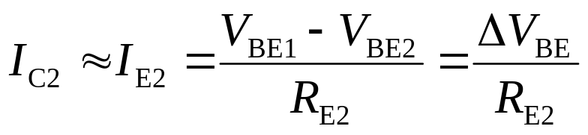
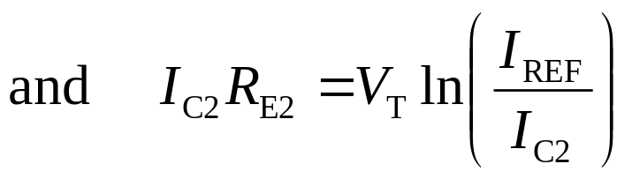
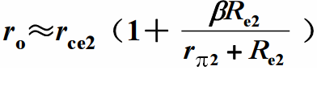
10.1.3 Widlar Current Source (P80)
Because ΔV_{BE} is very small, I_{C2} is very small.
(The process of derivation on page 81 ).

Slide 11
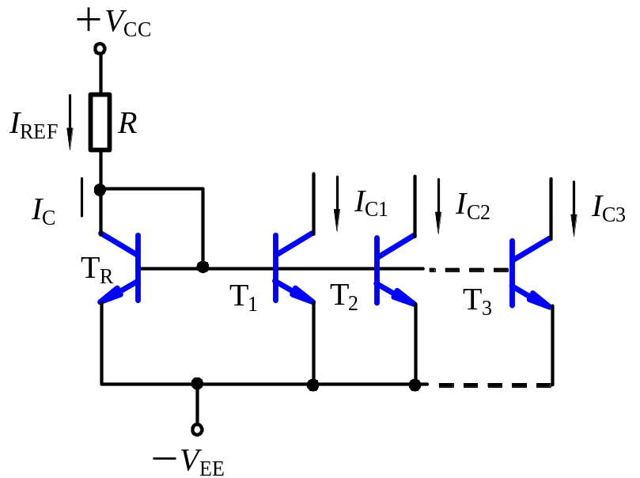
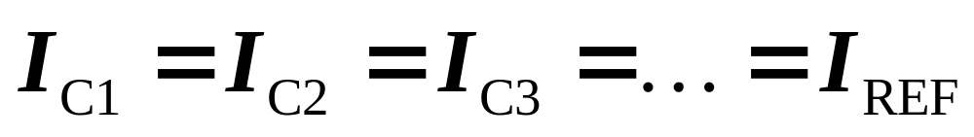
10.1.4 Multi-transistor Current Source（P87)
T and R serve as the reference for all output transistors.
T_{R} supplies the total base currents.
T_{R} makes I_{REF}≈ I_{C}.
There are N output transistors.

Slide 12
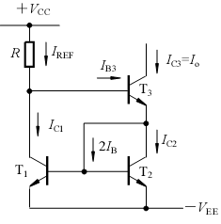

10.1 Bipolar Transistor Current Sources
I_{REF}=?

Slide 13
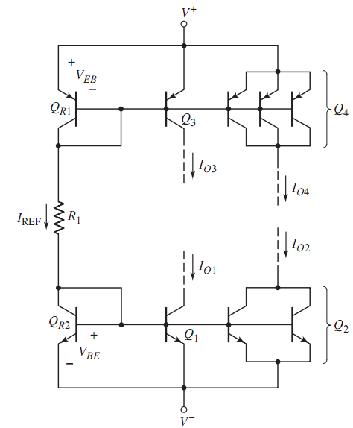
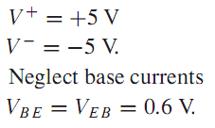





10.1.4 Multi-transistor Current Source（P89)

Slide 14
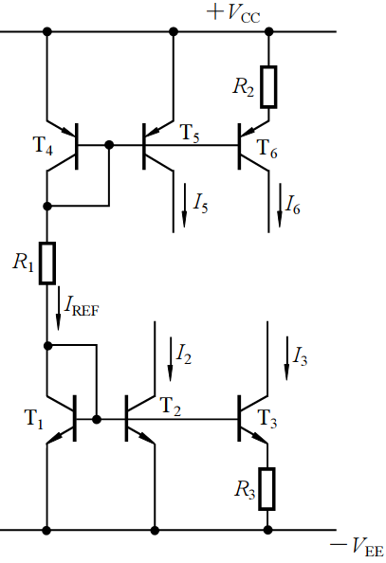
10.1 Bipolar Transistor Current Sources
reference current
Widlar current source
Widlar current source
Current Mirror

Slide 15
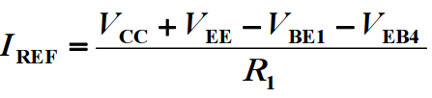
I_{REF}=?

Slide 16

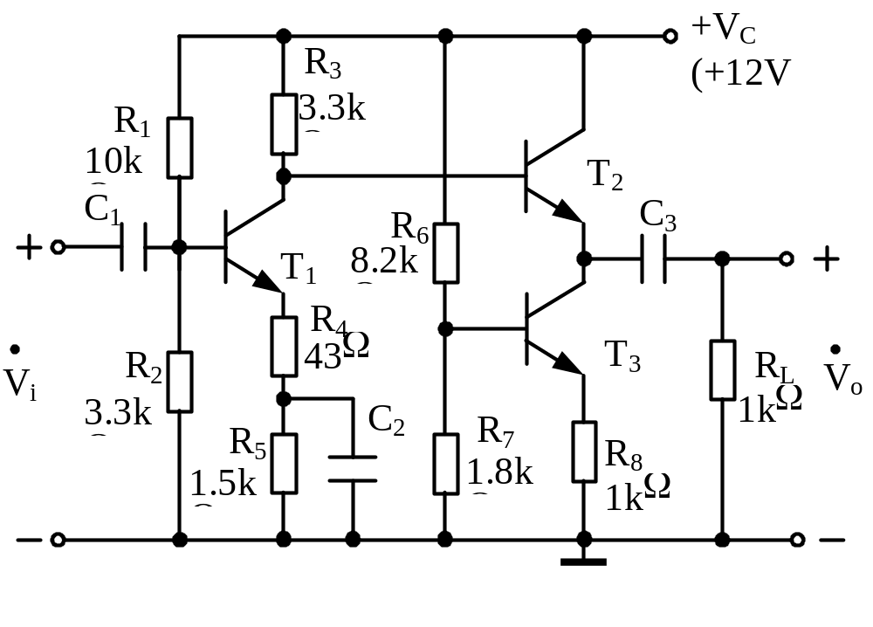
Example
CE
CC
c
b
e
b
current source

Slide 17
THE END
Questions
and
Answers

