Slide 1
Rethinking ImageNet Pretraining in Domain Adaptation
Junzhi Ning
University of Melbourne
Supervised by Dr Mingming Gong
February 24, 2022
Rethinking ImageNet Pretraining in Domain
Notes:
% Hello, welcome to the presentation of my summer project.
% The topic of my project is Rethinking ImageNet Pretraining in Domain Adaptation, and my project is by Dr Gong.

Slide 2




Overview
1
Introduction
2
Concepts
3
Experiments
4
Results and Discussions
Rethinking ImageNet Pretraining in Domain

Slide 3
Timeline of the Project
Familiar with the research topic and learn how to use HPC. (2 weeks)
Literature Reading, Design the experiment, Implement and Run the Models.(4 weeks)
Refine the experiments to obtain the final model results. (1 week) Report writing and preparation of presentation (1 week)
Rethinking ImageNet Pretraining in Domain
Notes:
% The first two weeks get familiar with the high computing platform at Spartan and understand the context of our research.
% Then read some Literature, design the experiment and make sure the model can be implemented successfully
% Figure out the ways to solve the problems found in the experiments and collect the data for report writing
% In the last week, we write the report and prepare for the presentation

Slide 4
Context of our exeriment
Pretrained Models weights help improve the performance of NN models.
Usually pre-trained Models trained on the larger dataset.
In computer vision, ImageNet is a good candidate for pretrained models to train on.
Rethinking ImageNet Pretraining in Domain
Notes:
In term of the context of our project
We know the pretrained models’ weight can be used as an initialization weight for training the NN models in various tasks .
For most of cases, it is more preferred to use the larger dataset to train pretrained models in order to obtain the better model generality.
In an area of computer vision, ImageNet is usually very good option for pretrained models to train on.
In our project, we are going to focus on the pretraining effect of ImageNet dataset in the special case of the transfer learning, domain adaptation.

Slide 5
Context of our exeriment
Domain Adaptation: Aim at learning from a source domain a model on another target domain.
Unsupervised Domain adaptation(UDA): Learned from source domains with labeled data to target domains with unlabeled data only.
Rethinking ImageNet Pretraining in Domain
Notes:
Domain adaptation refers to the learning from source domain a new model that can be used to perform the similar task on another target domain
We could have the unsupervised domain adaptation as well where we try to learn a model from the source domains with label data to target domain with unlabeled data.

Slide 6
Related Work
A recent study [2] shows that removing a portion of classes in the pretrained model from the ImageNet dataset, up to 20 %, can still achieve comparable or even better performance in transfer learning.
A research[3] in 2021 suggests that the Semi-supervised learning(SSL) methods outperform existing unsupervised domain adaptation (UDA) methods on the UDA benchmark and therefore should be promoted as baselines in the future.
Rethinking ImageNet Pretraining in Domain
Notes:
% One recent research paper suggests that removing a portion of classes in the pretrained model from the ImageNet dataset, up to 20 %, can still achieve comparable or even better performance in transfer learning.
However, the paper did not discuss the choice of removing or ignoring certain classes when using
the pretrained model weights in specific UDA classification tasks.
Another research manages to show that Semi-supervised learning methods outperform some existing UDA methods on UDA benchmark. But one thing to note here is that in this paper, the SSL methods and UDA methods employed the pretrained models trained on ImageNet dataset. We can not be 100 percent sure that the good performance of SSL methods on UDA benchmark datasets is or primarily due to the effect brought by methods itself and but not from the pretrained models. We think that it is
possible, in this scenories ,for the pre-trained networks to play a non-trivial role in reducing the domains gap, thereby overestimating the model of current SSL methods and UDA methods.

Slide 7
Intended goal of the project
Investigate how ImageNet pretraining affect the unsupervised domain adaptation methods.
Particularly, look into muting some chosen ImageNet class labels of same or similar types in the UDA benchmark datasets when obtaining the pre-trained model.
Rethinking ImageNet Pretraining in Domain
Notes:
Therefore,
The main goal of the project is to investigate how ImageNet Pretraining affect the domain adaptation methods.
Specifically, we are going to muting some chosen ImageNet class labels which we think are same or similar types in UDA benchmark datasets upon pretraining.

Slide 8
Concept: Alexnet
Alex-net is an architecture of Convolutional Neural Network Proposed by Alex Krizhevsky in the paper [4] of 2012.
Achieved top-5 error rate of 15.3 % in 2012.
Consist of 8 convolutional layers and 3 of full connected layers. In total, about 61M parameters.
Rethinking ImageNet Pretraining in Domain
Notes:
THe first concept we are going to introduce is Alexnet, which is an architecture of NN proposed in 2012.
It achieved top-5 classification error rate of 15 percent in 2012 ImageNet challenge.
This architecture consists of 8 convolutional layers and 3 of full connected layers with about 61 M parameters,which is considered as the relatively small NN compared to others.
We think it will be a good starting point of our experiment.
For our purpose of project, we will use this architecture for training pretrained models.

Slide 9
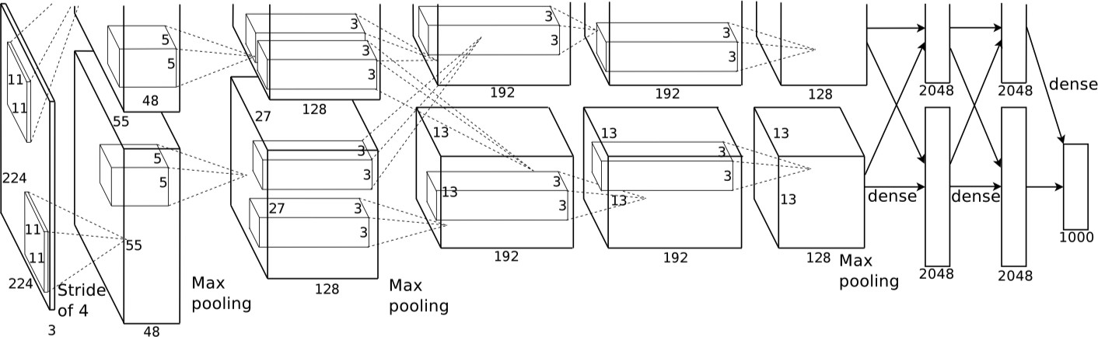
Concept: Alexnet
Figure: [4]Graphical illustration of Alexnet
Rethinking ImageNet Pretraining in Domain
Notes:
Here is a graphical illustration of alexnet

Slide 10
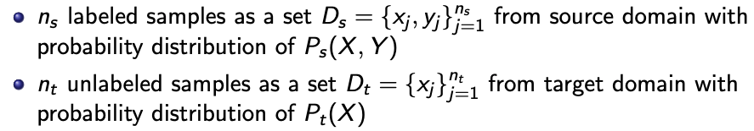
Concept: Unsupervised Domain Adaptation (UDA)
In a classification task of UDA, Given
Main goal of UDA: build a classifier C that minimizes the target risk
^{E}(x,y′)∼Pt (X,Y )^{|C (x ) − y ′|}
Rethinking ImageNet Pretraining in Domain
Notes:
Then we look at the concept of UDA problem.
Here we present one possible way to define general UDA problems.
We have ns number of labeled samples of set Ds which contains all pairs of x and y values from source domainn.
We also have nt number of unlabeled samples of set Dt which has nly x values and we assume that for every single x value in set Dt, there exists a corresponding unknown label of y'.
The main goal of UDA problem is we want to build a classifier C that minimizes the target risk, which is the expectation of the absolute value of the difference between C(x) and y’with the respect to P(x,y) of target domain.

Slide 11
Concept: Unsupervised Domain Adaptation (UDA)
Two main approaches of UDA:
Domain-invariant feature learning.
Domain mapping.
Rethinking ImageNet Pretraining in Domain
Notes:
Currently, there are two main approaches, or directions of general UDA tasks:
One direction is to use Domain-invariant feature learning which aims to align the source and target domain by generating a feature representation common to both domains.
Another direction is through domain mapping, which aims to find the best mapping directly from one domain to another so that the input values can be mapped into the domain(it could be target or source domains, it depends) that has known labels to train a classifier.
In our case, we will be examining one UDA architecture that uses the idea of domain-invariant feature learning.

Slide 12
Concept: Domain-adversarial Neural Network(DANN)
DANN was proposed in the paper[5] of 2016 by Yaroslav Ganin.
Consist of three components, feature extractor, domain classifier and label predictor.
The feature extractor that generates the feature representation can not be discriminated effectively by the domain classifier.
The label predictor maps the feature representation by the feature extractor to output the class label regardless of its input domains.
Rethinking ImageNet Pretraining in Domain
Notes:
That is DANN stands for Domain-adversarial Neural Network
It typically consists of three components;

Slide 13
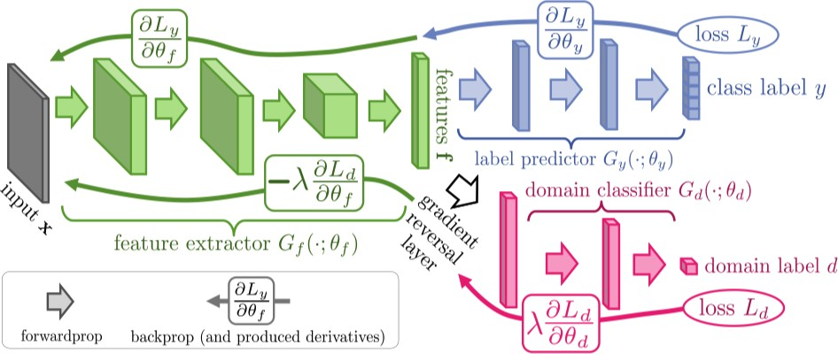
Concept: Domain-adversarial Neural Network(DANN)
Figure: Graphical illustration of [5]
Rethinking ImageNet Pretraining in Domain
Notes:
% This type of NN s based on the main ideas of Domain-invariant feature learning and adversial approach.
% The feature extractor and domain classifier will be trained in an adverisal approach, that means they compete against each other, the feature extractor tries to create the best feature representation that fool the classification of the domain classifier and the domain classifier will try their best to classify the output of feature extractor to see whether its input of the feature extractor comes from the source and target domains or not
Label predictor produces the predicted class label of input x.
The weight of three components of the DANN will be updated at the same time during the training.

Slide 14

Semi-supervised Learning
In a classification of SSL, Given
Main objective of SSL: find the mapping C such that it minimizes the risk
^{E}(X,Y )∼P(X,Y )^{|C (x ) − y|}
Rethinking ImageNet Pretraining in Domain
Notes:
The notion of the semi-supervised learning are very similar to formulation of general UDA, but we typically assume that the labeled samples and unlabeled samples come from the the same distribution.

Slide 15
Pseudo-label Method
The Pseudo-label method was introduced in the paper of the Simple and Efficient Semi-Supervised Learning Method for Deep Neural Networks [1] in 2013.
During the training iterations, the unlabeled data will being gradually labeled with the class that has the highest probability and confidence.
Rethinking ImageNet Pretraining in Domain
Notes:
In the SSL setting, we choose the Pseudo-label method as the study object for our experiments.
This methods trains the Neural Network with labeled and unlabeled data simultaneously.

Slide 16
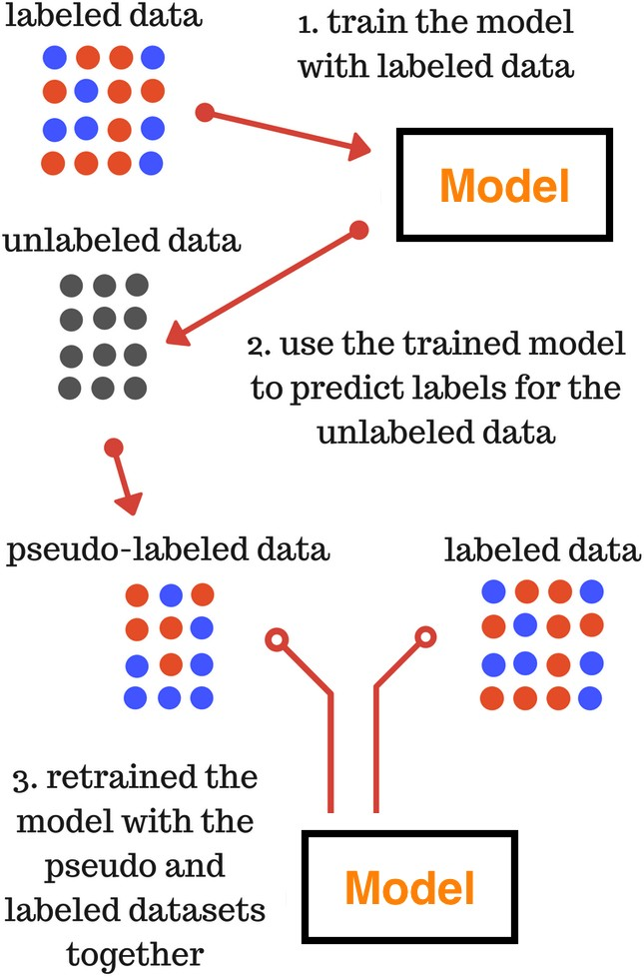
Figure: Graphical illustration of Pseudo-label Method[1]
Rethinking ImageNet Pretraining in Domain
Notes:
Firstly, we trained the network with our labeled data and use the trained model to predict labels for the unlabeled data.
Then, we label the unlabeled data with the class label that has the highest probability if the probability of the class label is above the threshold we set.
We treat the set of unlabeled data with our pseudo-labels as the ”true ”label data to retrained the model again we repeated the process until all unlabeled data are labeled with Pseudo-labels in this method.

Slide 17
Datasets
1
ImageNet (ILSVRC face-blurred)[6]
1.2 million training labeled images of 1000 categories, Roughly 50 thousand validation images.
Used for training our pretrained models.
Office31
Three domains: Amazon, Dslr and Webcam 6 Domain Adaptation Task:
A → W, A → D, W → D, W → A, D → A, D → W.
2
Rethinking ImageNet Pretraining in Domain
Notes:
In addition, the two datasets we use in our experiment are ImageNet and Office31
The imagenet dataset we used is the face-blurred version so as protect the privacy issue.
The imageNet dataset will mainly trained as the pretrained models.
And Office31 will be used as the evaluation dataset of our domain adaptation methods
Here we have three domains and 6 domain adaptation tasks in total.

Slide 18
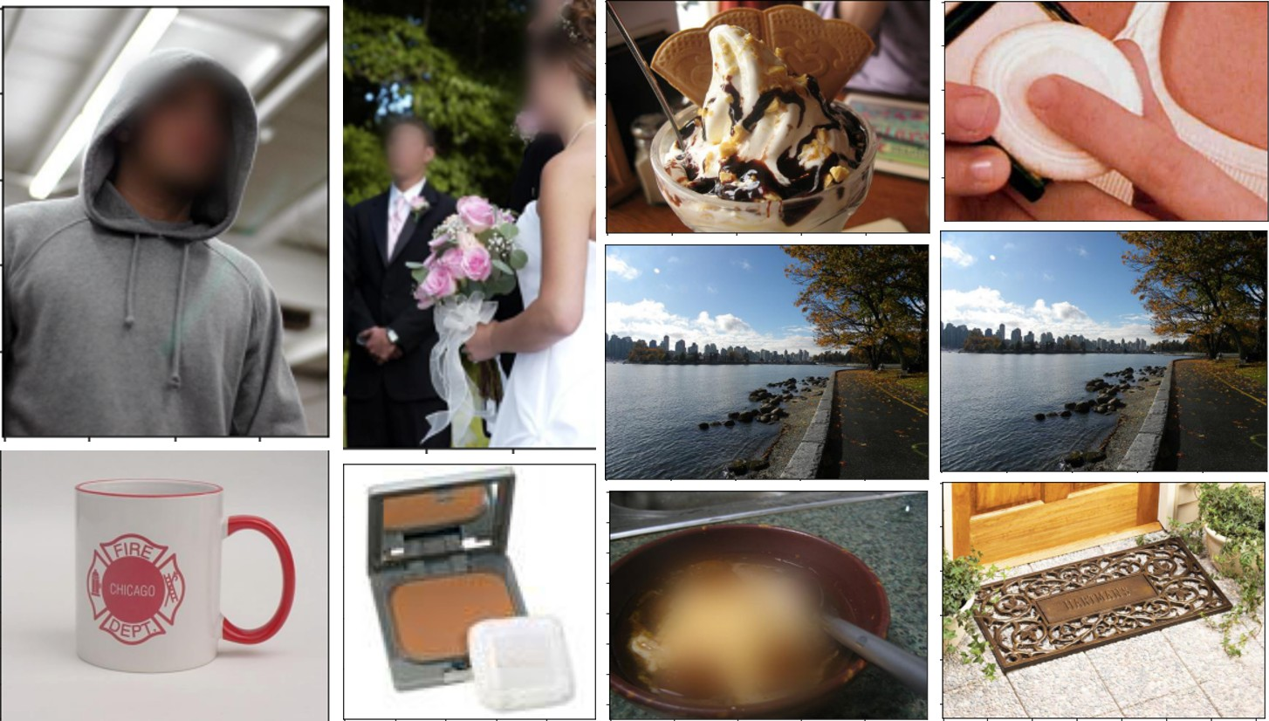
Datasets: ImageNet Face-blurred
Figure: Example of ImageNet
Rethinking ImageNet Pretraining in Domain

Slide 19
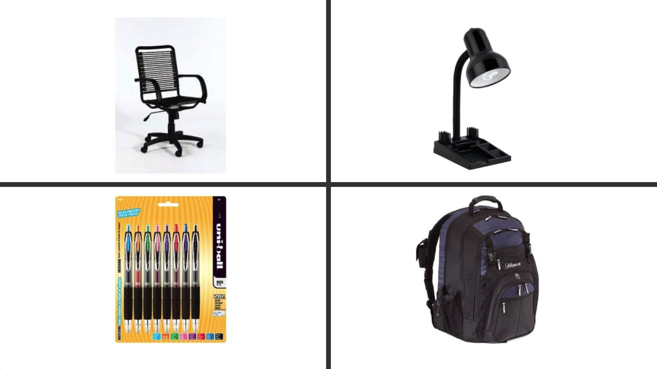
Datasets: Office31
Figure: Amazon domain
Rethinking ImageNet Pretraining in Domain

Slide 20
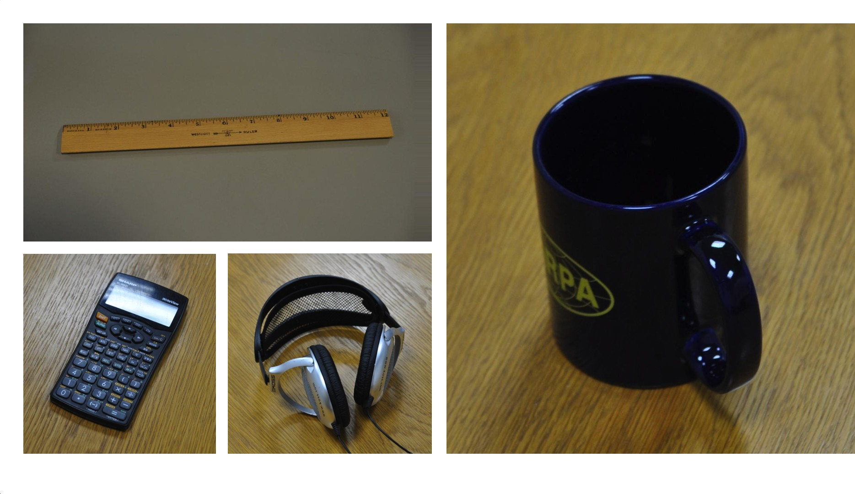
Datasets: Office31
Figure: Dslr domain
Rethinking ImageNet Pretraining in Domain

Slide 21
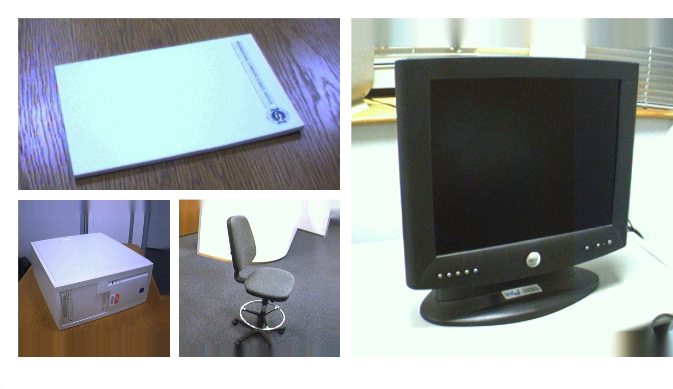
Datasets: Office31
Figure: Webcam domain
Rethinking ImageNet Pretraining in Domain

Slide 22
Setups: Outline
Create two modified datasets plus the original imageNet:
1
Dataset with selected masked classes labels. Dataset with randomly masked classes labels.
2
Trained the Alex-net models on the three datasets as pretrained models.
Use the pre-traiend models as feature extractors to fine-tune the source-only, DANN and Pseudo-label models on six domain adaptation tasks of Office31.
Rethinking ImageNet Pretraining in Domain
Notes:
In the steps of our experiments,
We have three datasets for pretarining,
We create two modified datasets from the ImageNet, Dataset with selected masked classes labels which we think are closely associated with the class label in the office31 dataset.
Another Dataset we simply randomly masked classes labels that has the same number of selected masked class labels above. Of course, the randomly masked classes labels will not include the masked classes labels from the above dataset.
In addition, We also use the original ImageNet as a comparsion group to see the results of the pretrained models.
Then, we trained the Alex-net models on these three datasets as the pre-trained models and the models will be utilized as the feature extractors to fine-tune the source-only, DANN and Pseudo-label methods on the 6 UDA tasks.

Slide 23
Setups: Pretraind models
Data-sets | No.classes | No.masked classes | No. Training images | No.validation images
Original | 1000 | 0 | 1281066 | 49997
Masked | 958 | 42 | 1226767 | 47897
Masked Random | 958 | 42 | 1227158 | 47897
Table: Three datasets used for training pretraining models
No.Epochs | learning rate | Optimizer | Batch size | Weight decay | LR scheduler
100 | 0.01 | SGD | 256 | 0.0005 | Every 30 epochs decay of 0.1
Table: Hyperparameters and setting of pre-trained models. Note that SGD stands for Stochastic Gradient Descent
Rethinking ImageNet Pretraining in Domain
Notes:
These two tables describe some details of training the pretrained models

Slide 24
Setups: Fine-tuning
Model types | Source-only | DANN | Pseudo-label
Number of Epochs Iterations per epoch | 50
 | 1000
FC layers Learning rate Backbone Learning rate | 0.0001 | 0.01
 | 0.00001 | 0.001
Optimizer | SGD with a momentum of 0.9
Batch Size | 32
γ (learning gamma) β (learning decay) Learning Rate Scheduler | 0.0003 | 0.001
 | 0.75
 | LR × (1 + γ × p)^{−β}
Weight Decay | 0.0005 | 0.001
Table: Hyper-parameters and setting of Fine-tuning Models Note that p is the training process from 0 to 1
Rethinking ImageNet Pretraining in Domain
Notes:
Here is the table to illustrate the parameters and training setting in fine-tuning methods.

Slide 25
Dicussions: Pretrained Models
Pre-trained models of Alex-net converges with top-1 accuracy of around 55 ± 0.5% and test loss of 1.94 ± 0.05 %.
Our results are still behind that of the original paper, which has the top-1 accuracy of 63.7 %.
No very substantial accuracy difference between the pretrained model with 1000 classes and the pretrained models (Random and Masked Datasets) with fewer classes.
Rethinking ImageNet Pretraining in Domain
Notes:
In terms of pretrained results.
Pre-trained models of Alex-net trained on three datasets converge at 100 epochs with overall top-1 accuracy of around 55 ± 0.5%.
Nonetheless, our results are still behind that of the original paper which achieved the top-1 of about 60 \%but considering of non-identical dataset and the coding platform used in implementing this architecture and training the model, we believe that there is still a room of improvement of classification accuracy after the hyperparameter optimization.
The validation accuracy on models with 1000 classes also does not exhibit inferior performance over the models (Random and Masked Datasets) with fewer classes, and it takes more training iterations to reach top-1 accuracy of 55 %.

Slide 26
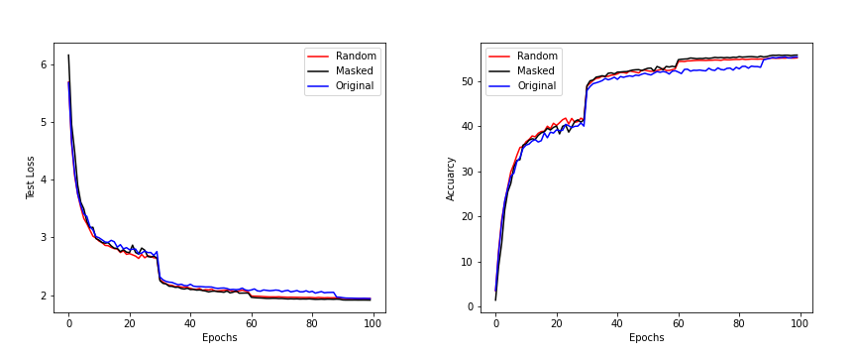
Figure: Validation Loss and Top-1 Accuracy of Pre-trained Models
Results: Pretraind Models
Rethinking ImageNet Pretraining in Domain
Notes:
Pre-trained models of Alex-net trained on three datasets converge at 100 epochs with overall top-1 accuracy of around 55 ± 0.5%.
Nonetheless, our results are still behind that of the original paper which achieved the top-1 classification accuarcy of about 60 \% but considering usage of non-identical dataset and the coding platform used in implementing this architecture and training the model, we believe that there is still a room of improvement of classification accuracy after the hyperparameter optimization.
The validation accuracy on models with 1000 classes also does not show inferior performance over the models (Random and Masked Datasets) with fewer classes, and it takes more training iterations to reach top-1 accuracy of 55 %.

Slide 27
Results:Pretraind Models
Table: Results of Pre-trained Models(Alex-net)
Data-set on which Model trained | Best Top 1 accuracy | Best Top 5 accuracy | Valid. Loss
Original | 55.18 | 78.27 | 1.949
Masked | 55.11 | 78.93 | 1.917
Random | 55.72 | 78.41 | 1.945
Rethinking ImageNet Pretraining in Domain
Notes:
The results of the pretrained models in table form .

Slide 28
Discussions: Domain Apdatation
The domain adaptation tasks perform better of the pretrained model trained on the random dataset.
The accuracy difference between domains for three methods does not give a consistent pattern.
These domain adaptation tasks experience a decrease in accuracy in at least one of three methods when the dataset of pre-trained models used changes from Masked to Random.
Masking some classes in the pretrained model’s dataset does not prevent the learning of relevant features in the pretrained dataset associated with Office31.
Rethinking ImageNet Pretraining in Domain
Notes:
In terms of domain apdataion methods
From the table above(Domain Adaptation methods), we observe in general that using DANN and source-only methods, the domain adaptation tasks perform better on the pretrained model trained on the random dataset. The average increase in domain transfer accuracy with the respect to the choice of dataset of pretrained models is more obvious to DANN methods, up to 1.36 \%. Similarly, the Pseudo-label models pretrained on "Random" Dataset have the higher accuracy than that of the models pretrained on "Masked" dataset.
% Examining more detailed level, the accuracy difference between domains for three methods does not give a consistent pattern, for example, W -> D , D -> A and D -> W, these domain adaptation tasks experience a decrease in accuracy in at least one of three methods when the dataset of pre-trained model changing from Masked to Random.
% We think the results obtained in first Table are affected by the certain level of randomness, and during the phase of fine-tuning, it is possible for some models to learn actual features quicker in the domain adaptation tasks, even though they are slightly different in initialization weights from pretrained model or even have a slight advantage of pretrained weights over others.
To avoid the weights being updated too much in our experiment when evaluating, we examine through the domain adaptation tasks result at the first epoch of fine-tuning training.

Slide 29
Results
Table: Summary of domain adaptation Results (% Accuracy) on Office31(Alex-net)
Dataset of pretrained model | Model Type | A → D | A → W | D → A | D → W | W → A | W → D | Avg.
Original | Source-only | 44.4 | 43 | 29.7 | 84.8 | 31.3 | 90.2 | 53.9
Masked | Source-only | 43.8 | 41.4 | 30.8 | 83.5 | 28.9 | 91.8 | 53.36
Random | Source-only | 46.2 | 44.8 | 30.2 | 81.3 | 29.7 | 90.4 | 53.77
Masked | DANN | 49.8 | 52.2 | 35.5 | 94.5 | 38.4 | 98.6 | 61.5
Random | DANN | 50.6 | 55.5 | 36.4 | 93.6 | 42.3 | 98.8 | 62.86
Masked | Pseudo-label | 41.96 | 44.65 | 28.8 | 90.18 | 31.55 | 97.38 | 55.75
Random | Pseudo-label | 43.77 | 43.52 | 32.44 | 91.07 | 32.62 | 95.78 | 56.53
Table: Summary of domain adaptation Results(% Accuracy) at Epoch 1
Dataset of pretrained model | Model Type | A → D | A → W | D → A | D → W | W → A | W → D | Avg.
Masked Random | Source-only Source-only | 35.7 34.1 | 34.1 35.5 | 27.4 27.2 | 74.6 73.7 | 22.1 25.8 | 84.3 79.5 | 46.53 45.96
Masked Random | DANN DANN | 47.2 46.8 | 47.3 48.1 | 30.4 30.9 | 89.1 89.6 | 31.4 35.2 | 97.0 98.4 | 57.06 58.17
Rethinking ImageNet Pretraining in Domain
Notes:
% From the table above(Domain Adaptation methods), we observe in general that using DANN and source-only methods, the domain adaptation tasks perform better on the pretrained model trained on the random dataset. The average increase in domain transfer accuracy with the respect to the choice of dataset of pretrained models is more obvious to DANN methods, up to 1.36 \%. Similarly, the Pseudo-label models pretrained on "Random" Dataset have the higher accuracy than that of the models pretrained on "Masked" dataset.
% But if we examine more detailed level, the accuracy difference between domains for three methods does not give a consistent pattern, for example, W -> D , D -> A and D -> W, these domain adaptation tasks experience a decrease in accuracy in at least one of three methods when the dataset of pre-trained model changing from Masked to Random.
% We think the results obtained in first Table are affected by the certain level of randomness, and during the phase of fine-tuning, it is possible for some models to learn actual features quicker in the domain adaptation tasks, even though they are slightly different in initialization weights from pretrained models.
To avoid the weights being updated too much in our experiment when evaluating, we examine through the domain adaptation tasks result at the first stage of fine-tuning training.
Despite our efforts, we still observe the alternating changing patterns of mean accuracy on some six domain adaptation tasks. It seems that masking some classes in the pretrained model’s dataset does not prevent the learning of relevant features in the pretrained dataset associated with Office31.

Slide 30
Dicussions: Domain Adpatation
Possible explanations
The quality of the pretrained models, DANN and Pseudo-label models underperforms.
Masking effect of pretrained models on DA tasks can only be reliably estimated through a considerably large number of repeated experiments.
Omit or fail to mask some or all relevant class labels in the pretrained dataset that are related to categories in Office31.
Rethinking ImageNet Pretraining in Domain
Notes:
So we proposed the following explanations for these observations in our experiments.
% 1. More actions were required to make sure the hyperparameters and training environment of the models are optimal in the current Office31 domain adaptation tasks.
% 2. Due to the limited times in these experiments, we did not manage to run the experiments multiple times. The estimates of the results obtained from the experiment might not be accurate.
% 3. For instance, should we mask the class label of bottle-cap if we intend to avoid the Neural Network to learn the feature of bottle as well? For some images of bottle-cap, the NN could use the information of the bottle to help classify the bottle-cap. Whether this type of situation will happen on the ImageNet, it still remain in doubt.

Slide 31
Limitation of Work and Future Work
Limited to explore one Neural Network architecture of Alexnet, one relatively small domain adaptation dataset of Office31 and DANN and SSL methods on pretraining effect.
Explore more architectures for pretrained models, evaluation of results on various domain adaptation benchmark datasets.
Rethinking ImageNet Pretraining in Domain
Notes:
Definitely we have lot of work to remain, and we were only able to …, one UDA benchmark dataset.
The future directions of our investigation of the pretraining effect could be on following three ways .
1. obtaining more reliable estimates of the experiment
2. working on improving our methods of choosing the masked classes in the experiment
3. employing more DA methods other than DANN on different domain adaptation datasets.

Slide 32
Acknowledgements
I would like to express my deep gratitude to Dr Mingming Gong, my supervisor, who kindly provided immerse help and timely guidance over the 8-weeks summer course of this project.
This project was undertaken using Spartan platform of High Performance Computing at the university of Melbourne, I am grateful of the University of Melbourne providing such resources to fellow researchers and students like me.
Also, I would like to thank Dongting for providing the help when I faced technical difficulties in using HPC.
Rethinking ImageNet Pretraining in Domain
Notes:
Lastly, I would like to thank Dr Gong, my supervisor who guide me through 8-weeks project.
That is the end of my presentation!

Slide 33
The End
Rethinking ImageNet Pretraining in Domain

Slide 34
References
Shubham, J., 2017. Pseudo Labeling — Semi Supervised Learning.
Analytics Vidhya. Available at: https://www.analyticsvidhya.com/blog/2017/09/
pseudo-labelling-semi-supervised-learning-technique/ [Accessed 23
February 2022].
Michal Kucer and Diane Oyen. “Transfer learning with fewer ImageNet classes”. In: (2021).
Yabin Zhang et al. “Semi-supervised models are strong unsupervised domain adaptation learners”. In: arXiv preprint arXiv:2106.00417 (2021).
Alex Krizhevsky, Ilya Sutskever, and Geoffrey E Hinton. “Imagenet classification with deep convolutional neural networks”. In: Advances in neural information processing systems 25 (2012).
Rethinking ImageNet Pretraining in Domain

Slide 35
References
Yaroslav Ganin et al. “Domain-adversarial training of neural networks”. In: The journal of machine learning research 17.1 (2016), pp. 2096–2030.
Jia Deng et al. “Imagenet: A large-scale hierarchical image database”. In: 2009 IEEE conference on computer vision and pattern recognition. Ieee. 2009, pp. 248–255.
Dong-Hyun Lee et al. “Pseudo-label: The simple and efficient semi-supervised learning method for deep neural networks”. In: Workshop on challenges in representation learning, ICML. Vol. 3. 2. 2013, p. 896.
Rethinking ImageNet Pretraining in Domain

