Slide 1
Rethinking ImageNet Pretraining in Domain Adaptation
Junzhi Ning
University of Melbourne
Supervised by Dr Mingming Gong
February 24, 2022
Rethinking ImageNet Pretraining in Domain

Slide 2



Overview
1
Introduction
2
Concepts
3
Experiments
4
Results and Discussions
Rethinking ImageNet Pretraining in Domain

Slide 3
Timeline of the Project
Familiar with the research topic and learn how to use HPC. (2 weeks)
Literature Reading, Design the experiment, Implement and Run the Models.(4 weeks)
Refine the experiments to obtain the final model results. (1 week) Report writing and preparation of presentation (1 week)
Rethinking ImageNet Pretraining in Domain

Slide 4
Context of our exeriment
Pretrained Models weights help improve the performance of NN models.
Usually pre-trained Models trained on the larger dataset.
In computer vision, ImageNet is a good candidate for pretrained models to train on.
Rethinking ImageNet Pretraining in Domain

Slide 5
Context of our exeriment
Domain Adaptation: Aaim at learning from a source domain a model on another target domain.
Unsupervised Domain adaptation: Learned from source domains with labeled data to target domains with unlabeled data only.
Rethinking ImageNet Pretraining in Domain

Slide 6
Related Work
A recent study [2] shows that removing a portion of classes in the pretrained model from the ImageNet dataset, up to 20 %, can still achieve comparable or even better performance in transfer learning.
A research[3] in 2021 suggests that the SSL methods outperform existing UDA methods on the UDA benchmark and therefore should be promoted as baselines in the future.
Rethinking ImageNet Pretraining in Domain

Slide 7
Intended goal of the project
Investigate how ImageNet pretraining affect the unsupervised domain adaptation methods.
Particularly, look into muting some chosen ImageNet class labels of same or similar types in the UDA benchmark datasets when obtaining the pre-trained model.
Rethinking ImageNet Pretraining in Domain

Slide 8
Concept: Alexnet
Alex-net is an architecture of Convolutional Neural Network Proposed by Alex Krizhevsky in the paper [4] of 2012.
Achieved top-5 error rate of 15.3 % in 2012.
Consist of 8 convolutional layers and 3 of full connected layers. In total, about 61M parameters.
Rethinking ImageNet Pretraining in Domain

Slide 9
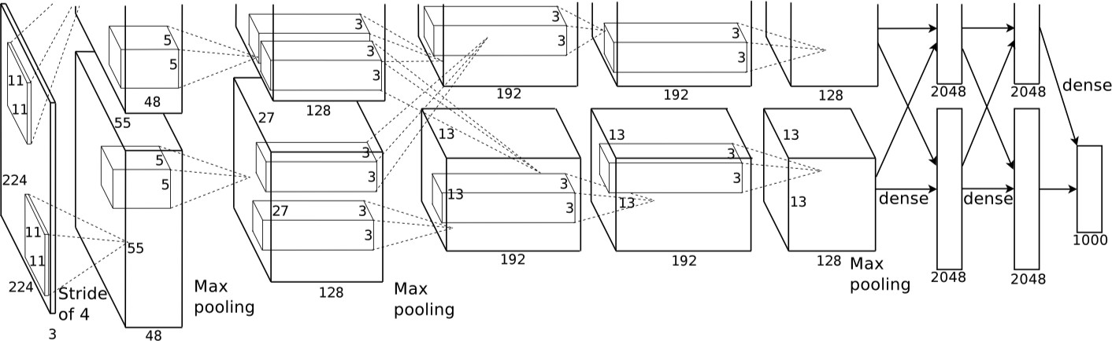
Concept: Alexnet
Figure: [4]Graphical illustration of Alexnet
Rethinking ImageNet Pretraining in Domain

Slide 10
Concept: Unsupervised Domain Adaptation (UDA)
In a classification task of UDA, Given
n labeled samples as a set D = {
n
x , y } from source domain with
s s
j j
s
j=1
probability distribution of P_{s} (X, Y )
n
n unlabeled samples as a set D = {x } from target domain with
t t j
t
j=1
probability distribution of P_{t} (X )
Main goal of UDA: build a classifier C that minimizes the target risk
^{E}(x,y′)∼Pt (X,Y )^{|C (x ) − y ′|}
Rethinking ImageNet Pretraining in Domain

Slide 11
Concept: Unsupervised Domain Adaptation (UDA)
Two main approaches of UDA:
Domain-invariant feature learning.
Domain mapping.
Rethinking ImageNet Pretraining in Domain

Slide 12
Concept: Domain-adversarial Neural Network(DANN)
DANN was proposed in the paper[5] of 2016 by Yaroslav Ganin.
Consist of three components, feature extractor, domain classifier and label predictor.
The feature extractor that generates the feature representation can not be discriminated effectively by the domain classifier.
The label predictor maps the feature representation by the feature extractor to output the class label regardless of its input domains.
Rethinking ImageNet Pretraining in Domain

Slide 13
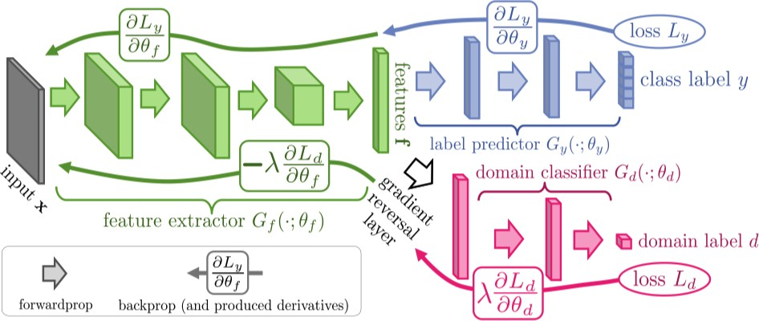
Concept: Domain-adversarial Neural Network(DANN)
Figure: [citation]Graphical illustration of [5]
Rethinking ImageNet Pretraining in Domain

Slide 14
Semi-supervised Learning
In a classification of SSL[citation], Given
n
n labeled samples as a set D = {x , y } from P(X, Y )
l l i i
l
i =1
n of unlabeled samples as a set D = {
n
x } from P(X )
u u i
u
i =1
Main objective of SSL: find the mapping C such that it minimizes the risk
^{E}(X,Y )∼P(X,Y )^{|C (x ) − y|}
Rethinking ImageNet Pretraining in Domain

Slide 15
Pseudo-label Method
The Pseudo-label method was introduced in the paper of the Simple and Efficient Semi-Supervised Learning Method for Deep Neural Networks [1] in 2013.
During the training iterations, the unlabeled data will being gradually labeled with the class that has the highest probability and confidence.
Rethinking ImageNet Pretraining in Domain

Slide 16
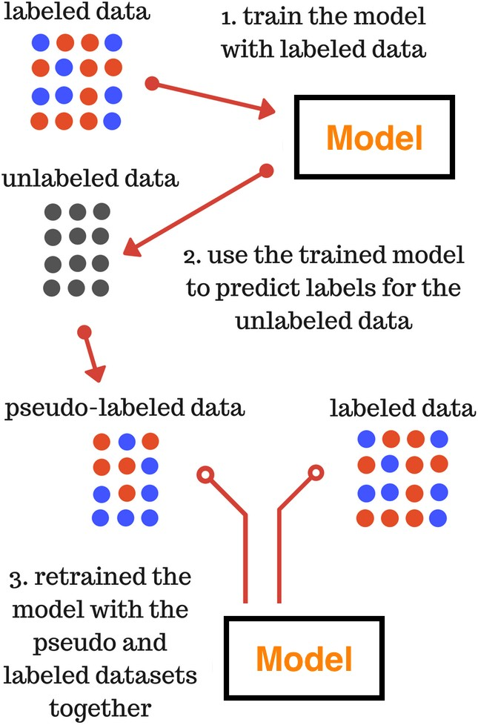
Figure: Graphical illustration of Pseudo-label Method[1]
Rethinking ImageNet Pretraining in Domain

Slide 17
Datasets
1
ImageNet (ILSVRC face-blurred)[6]
1.2 million training labeled images of 1000 categories, Roughly 50 thousand validation images.
Used for training our pretrained models.
Office31
Three domains: Amazon, Dslr and Webcam 6 Domain Adaptation Task:
A → W, A → D, W → D, W → A, D → A, D → W.
2
Rethinking ImageNet Pretraining in Domain

Slide 18
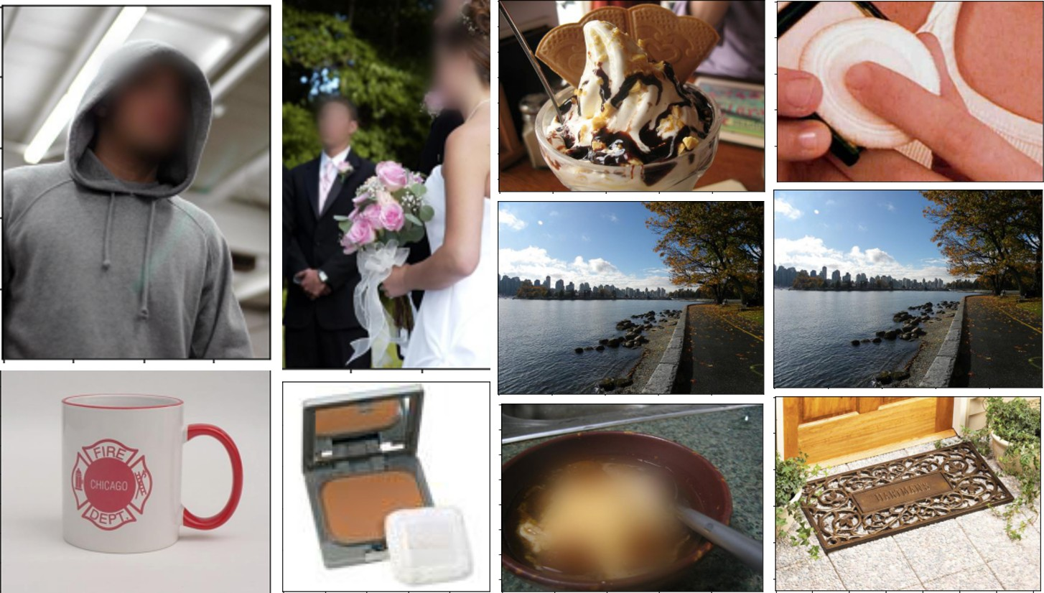
Datasets: ImageNet Face-blurred
Figure: Example of ImageNet
Rethinking ImageNet Pretraining in Domain

Slide 19
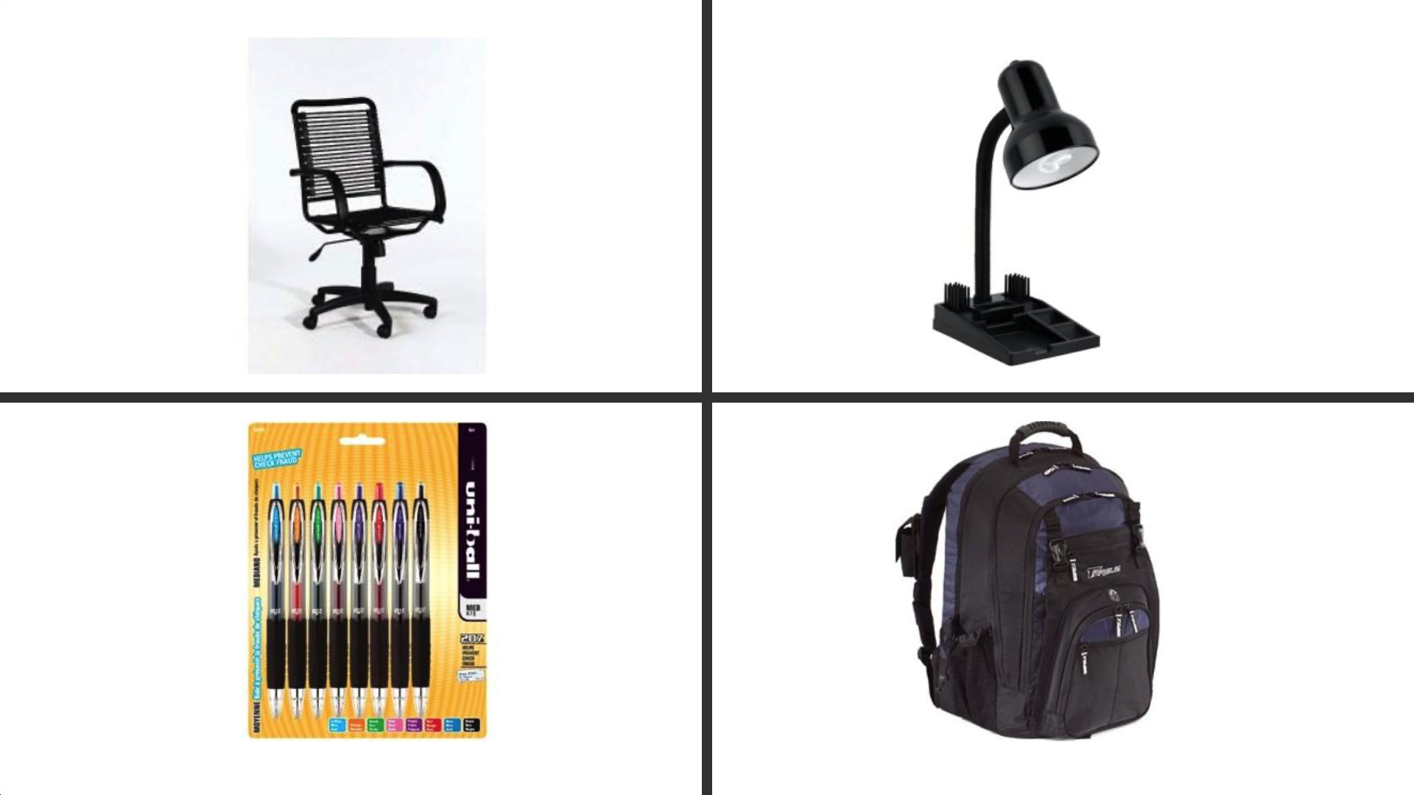
Datasets: Office31
Figure: Amazon domain
Rethinking ImageNet Pretraining in Domain

Slide 20
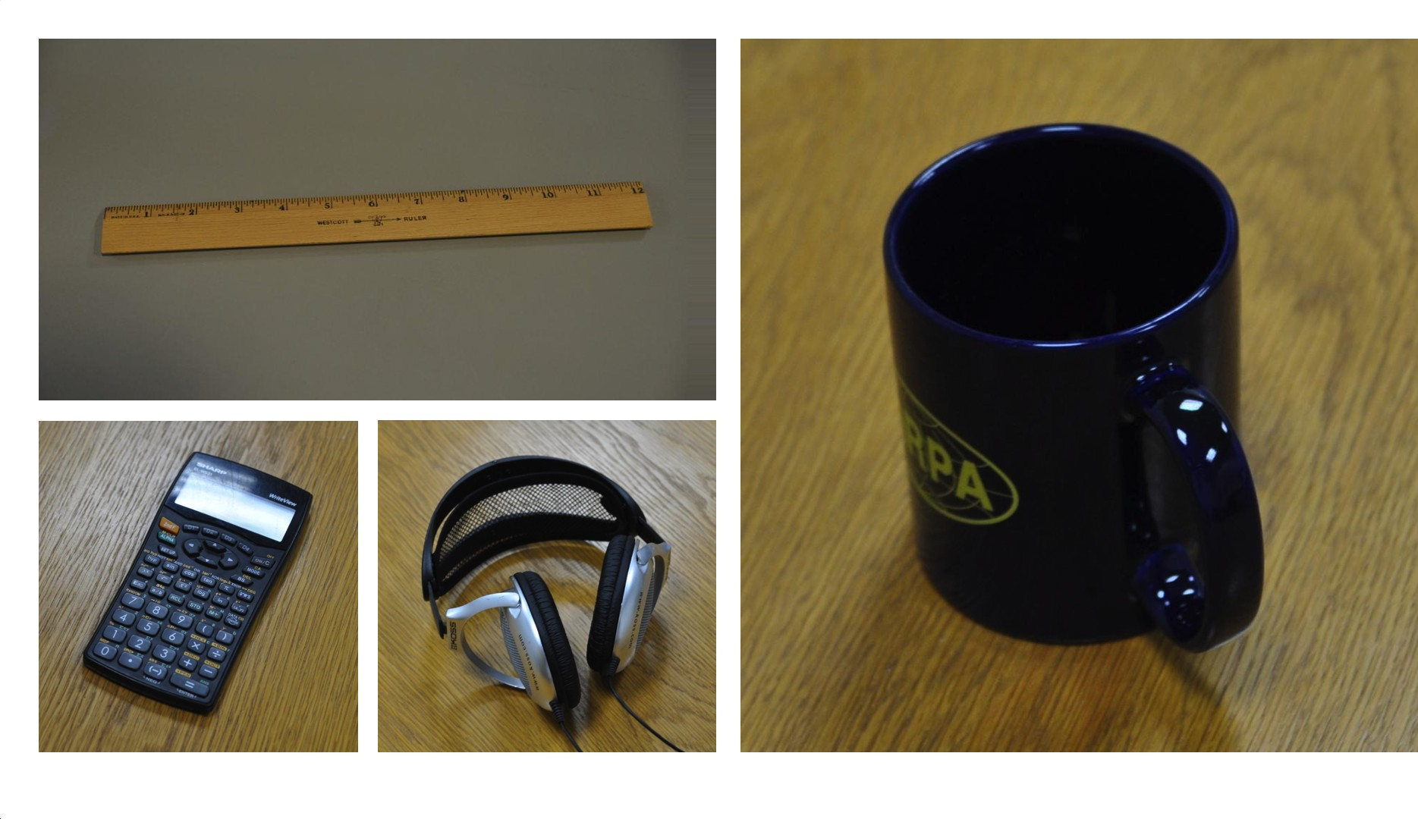
Datasets: Office31
Figure: Dslr domain
Rethinking ImageNet Pretraining in Domain

Slide 21
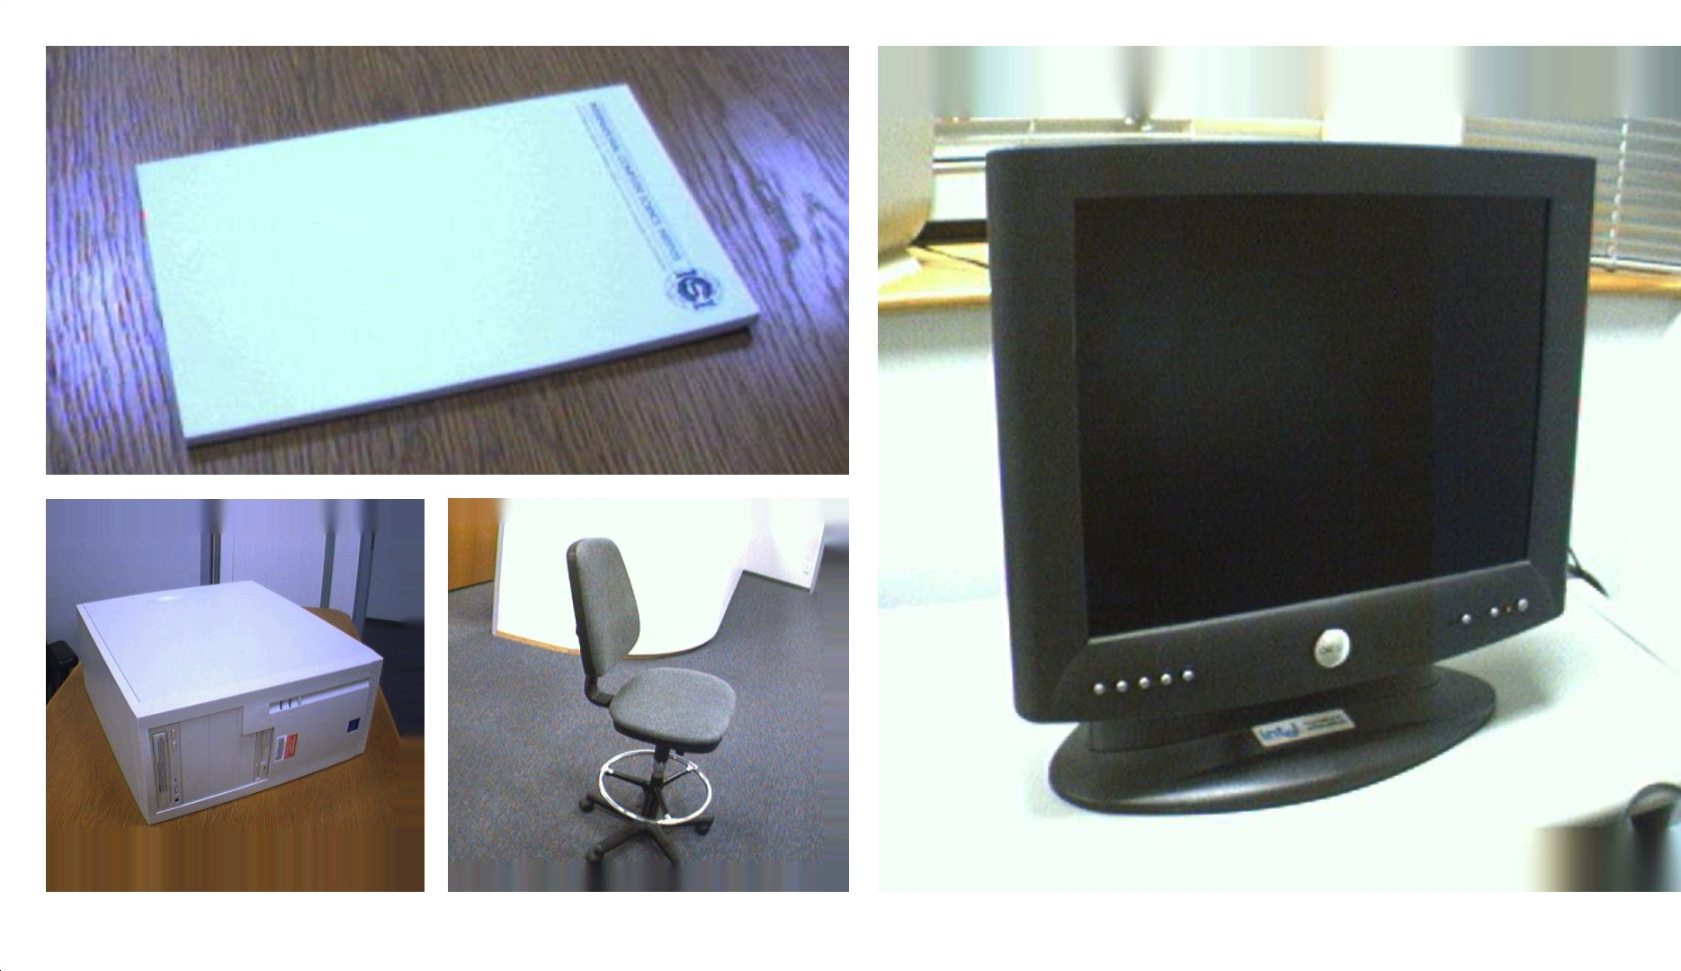
Datasets: Office31
Figure: Webcam domain
Rethinking ImageNet Pretraining in Domain

Slide 22
Setups: Outline
Create two modified datasets plus the original imageNet:
1
Dataset with selected masked classes labels. Dataset with randomly masked classes labels.
2
Trained the Alex-net models on the three datasets as pretrained models.
Use the pre-traiend models as feature extractors to fine-tune the source-only, DANN and Pseudo-label models on six domain adaptation tasks of Office31.
Rethinking ImageNet Pretraining in Domain

Slide 23
Setups: Pretraind models
Data-sets | No.classes | No.masked classes | No. Training images | No.validation images
Original | 1000 | 0 | 1281066 | 49997
Masked | 958 | 42 | 1226767 | 47897
Masked Random | 958 | 42 | 1227158 | 47897
Table: Three datasets used for training pretraining models
No.Epochs | learning rate | Optimizer | Batch size | Weight decay | LR scheduler
100 | 0.01 | SGD | 256 | 0.0005 | Every 30 epochs decay of 0.1
Table: Hyperparameters and setting of pre-trained models. Note that SGD stands for Stochastic Gradient Descent
Rethinking ImageNet Pretraining in Domain

Slide 24
Setups: Fine-tuning
Model types | Source-only | DANN | Pseudo-label
Number of Epochs Iterations per epoch | 50
 | 1000
FC layers Learning rate Backbone Learning rate | 0.0001 | 0.01
 | 0.00001 | 0.001
Optimizer | SGD with a momentum of 0.9
Batch Size | 32
γ (learning gamma) β (learning decay) Learning Rate Scheduler | 0.0003 | 0.001
 | 0.75
 | LR × (1 + γ × p)^{−β}
Weight Decay | 0.0005 | 0.001
Table: Hyper-parameters and setting of Fine-tuning Models Note that p is the training process from 0 to 1
Rethinking ImageNet Pretraining in Domain

Slide 25
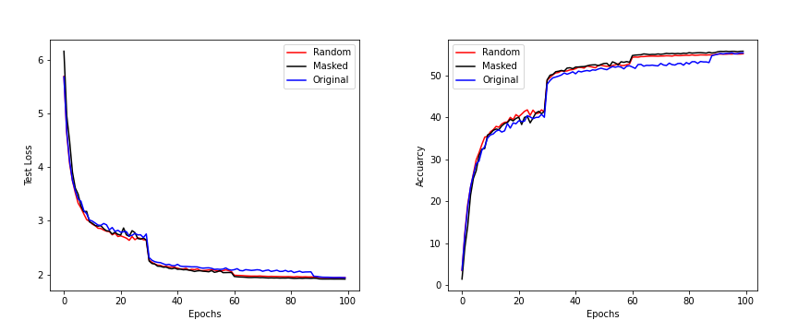
Figure: Validation Loss and Top-1 Accuracy of Pre-trained Models
Results: Pretraind Models
Rethinking ImageNet Pretraining in Domain

Slide 26
Results:Pretraind Models
Table: Results of Pre-trained Models(Alex-net)
Data-set on which Model trained | Best Top 1 accuracy | Best Top 5 accuracy | Test Loss
Original | 55.18 | 78.27 | 1.949
Masked | 55.11 | 78.93 | 1.917
Random | 55.72 | 78.41 | 1.945
Rethinking ImageNet Pretraining in Domain

Slide 27
Results
Table: Summary of domain adaptation Results (% Accuracy) on Office31(Alex-net)
Dataset of pretrained model | Model Type | A → D | A → W | D → A | D → W | W → A | W → D | Avg.
Original | Source-only | 44.4 | 43 | 29.7 | 84.8 | 31.3 | 90.2 | 53.9
Masked | Source-only | 43.8 | 41.4 | 30.8 | 83.5 | 28.9 | 91.8 | 53.36
Random | Source-only | 46.2 | 44.8 | 30.2 | 81.3 | 29.7 | 90.4 | 53.77
Masked | DANN | 49.8 | 52.2 | 35.5 | 94.5 | 38.4 | 98.6 | 61.5
Random | DANN | 50.6 | 55.5 | 36.4 | 93.6 | 42.3 | 98.8 | 62.86
Masked | Pseudo-label | 41.96 | 44.65 | 28.8 | 90.18 | 31.55 | 97.38 | 55.75
Random | Pseudo-label | 43.77 | 43.52 | 32.44 | 91.07 | 32.62 | 95.78 | 56.53
Table: Summary of domain adaptation Results(% Accuracy) at Epoch 1
Dataset of pretrained model | Model Type | A → D | A → W | D → A | D → W | W → A | W → D | Avg.
Masked Random | Source-only Source-only | 35.7 34.1 | 34.1 35.5 | 27.4 27.2 | 74.6 73.7 | 22.1 25.8 | 84.3 79.5 | 46.53 45.96
Masked Random | DANN DANN | 47.2 46.8 | 47.3 48.1 | 30.4 30.9 | 89.1 89.6 | 31.4 35.2 | 97.0 98.4 | 57.06 58.17
Rethinking ImageNet Pretraining in Domain

Slide 28
Dicussions: Pretrained Models
Pre-trained models of Alex-net converges at 100 epochs with top-1 accuracy of around 55 ± 0.5% and test loss of 1.94 ± 0.05 %.
Our results are still behind that of the original paper, which has the top-1 accuracy of 63.7 %.
No very substantial accuracy difference between the pretrained model with 1000 classes and the pretrained models (Random and Masked Datasets) with fewer classes.
Rethinking ImageNet Pretraining in Domain

Slide 29
Discussions: Domain Apdatation
The domain adaptation tasks perform better of the pretrained model trained on the random dataset.
The accuracy difference between domains for three methods does not give a consistent pattern.
These domain adaptation tasks experience a decrease in accuracy in at least one of three methods when the dataset of pre-trained models used changes from Masked to Random.
Masking some classes in the pretrained model’s dataset does not prevent the learning of relevant features in the pretrained dataset associated with Office31.
Rethinking ImageNet Pretraining in Domain

Slide 30
Dicussions: Domain Adpatation
Possible explanations
The quality of the pretrained models, DANN and Pseudo-label models underperforms.
Masking effect of pretrained models on DA tasks can only be reliably estimated through a considerably large number of repeated experiments.
Omit or fail to mask some or all relevant class labels in the pretrained dataset that are related to categories in Office31.
Rethinking ImageNet Pretraining in Domain

Slide 31
Limitation of Work and Future Work
Limited to explore one Neural Network architecture of Alexnet, one relatively small domain adaptation dataset of Office31 and two DANN and SSL methods on pretraining effect.
Explore more architectures for pretrained models, evaluation of results on various domain adaptation benchmark datasets.
Rethinking ImageNet Pretraining in Domain

Slide 32
Acknowledgements
I would like to express my deep gratitude to Dr Mingming Gong, my supervisor, who kindly provided immerse help and timely guidance over the 8-weeks summer course of this project.
This project was undertaken using Spartan platform of High Performance Computing at the university of Melbourne, I am grateful of the University of Melbourne providing such resources to fellow researchers and students like me.
Also, I would like to thank Dongting for providing the help when I faced technical difficulties in using HPC.
Rethinking ImageNet Pretraining in Domain

Slide 33
The End
Rethinking ImageNet Pretraining in Domain

Slide 34
References
Shubham, J., 2017. Pseudo Labeling — Semi Supervised Learning.
Analytics Vidhya. Available at: https://www.analyticsvidhya.com/blog/2017/09/
pseudo-labelling-semi-supervised-learning-technique/ [Accessed 23
February 2022].
Michal Kucer and Diane Oyen. “Transfer learning with fewer ImageNet classes”. In: (2021).
Yabin Zhang et al. “Semi-supervised models are strong unsupervised domain adaptation learners”. In: arXiv preprint arXiv:2106.00417 (2021).
Alex Krizhevsky, Ilya Sutskever, and Geoffrey E Hinton. “Imagenet classification with deep convolutional neural networks”. In: Advances in neural information processing systems 25 (2012).
Rethinking ImageNet Pretraining in Domain

Slide 35
References
Yaroslav Ganin et al. “Domain-adversarial training of neural networks”. In: The journal of machine learning research 17.1 (2016), pp. 2096–2030.
Jia Deng et al. “Imagenet: A large-scale hierarchical image database”. In: 2009 IEEE conference on computer vision and pattern recognition. Ieee. 2009, pp. 248–255.
Dong-Hyun Lee et al. “Pseudo-label: The simple and efficient semi-supervised learning method for deep neural networks”. In: Workshop on challenges in representation learning, ICML. Vol. 3. 2. 2013, p. 896.
Rethinking ImageNet Pretraining in Domain

