Slide 1
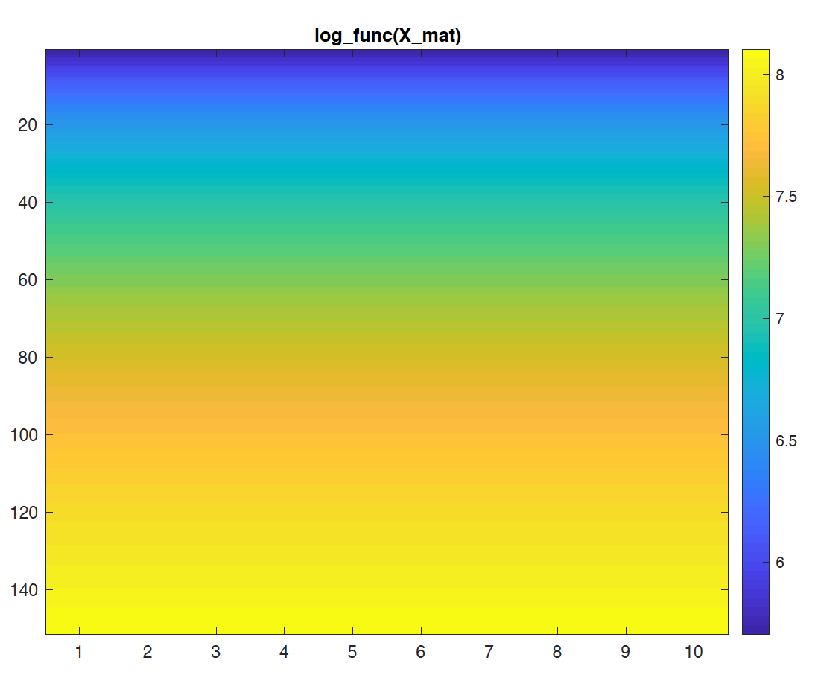
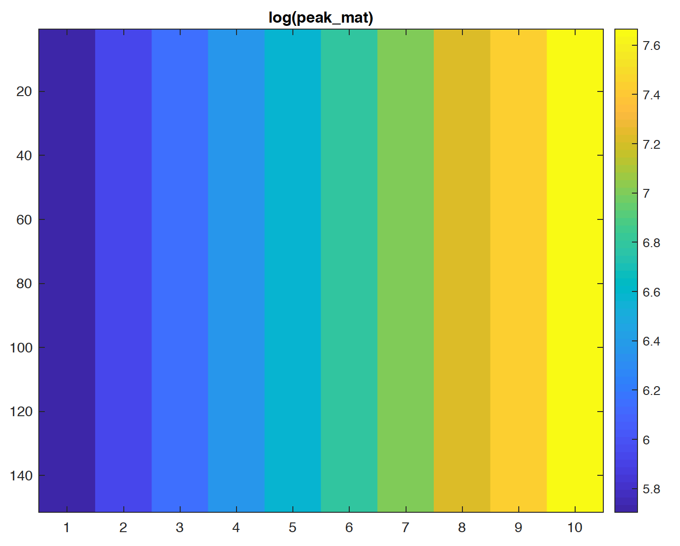
Left: This is logarithm of the time bin X repeated by 10 columns to generate 10 bumps.
x_mat = repmat(x, 1, n_peak);
log_func(x)
Logarithm is critical to make the later bumps more temporally diffuse, note the graded diffuseness across different bumps.
Right: This is logarithm of time bin X repeated vertically by the length of X, however a little trick (range_log(1):gap_log:range_log(2)-2*gap_log) helps to locate the peak of the last bump a bit upper (see, the final product).
peak_mat = repmat(peak, n_x, 1);
range_log = log_func(range);
gap_log = diff(range_log) / (n_bump + 1);
peak_log = range_log(1):gap_log:range_log(2)-2*gap_log;

Slide 2
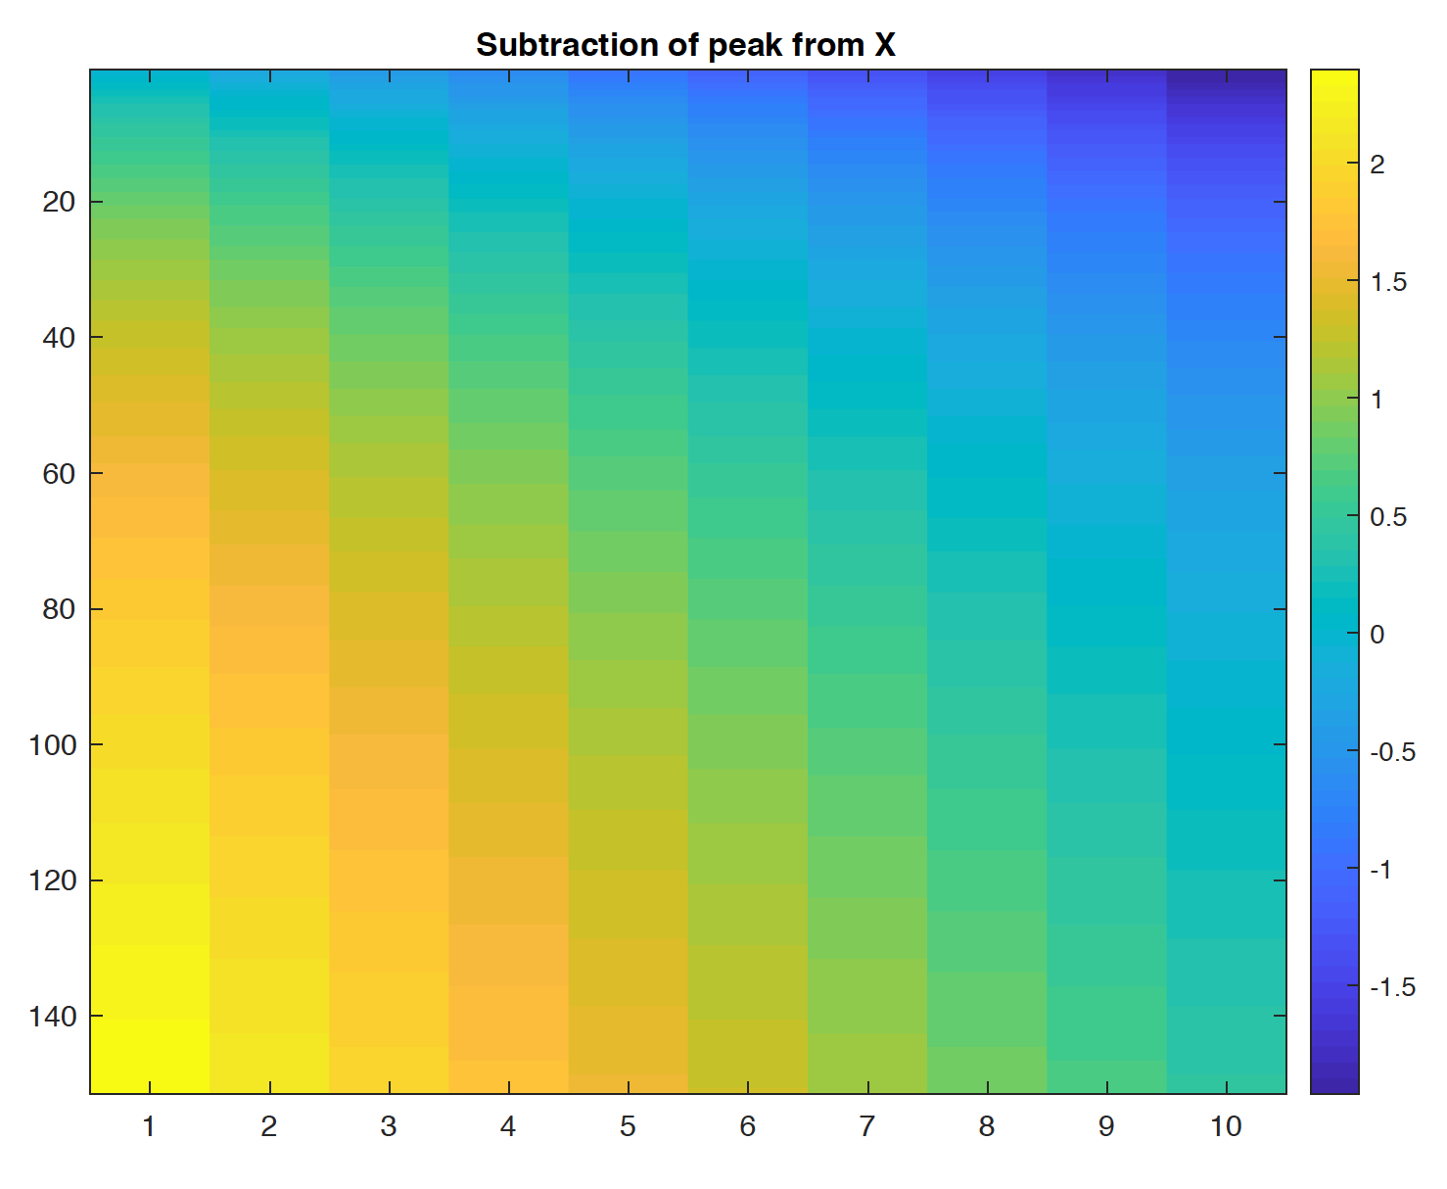
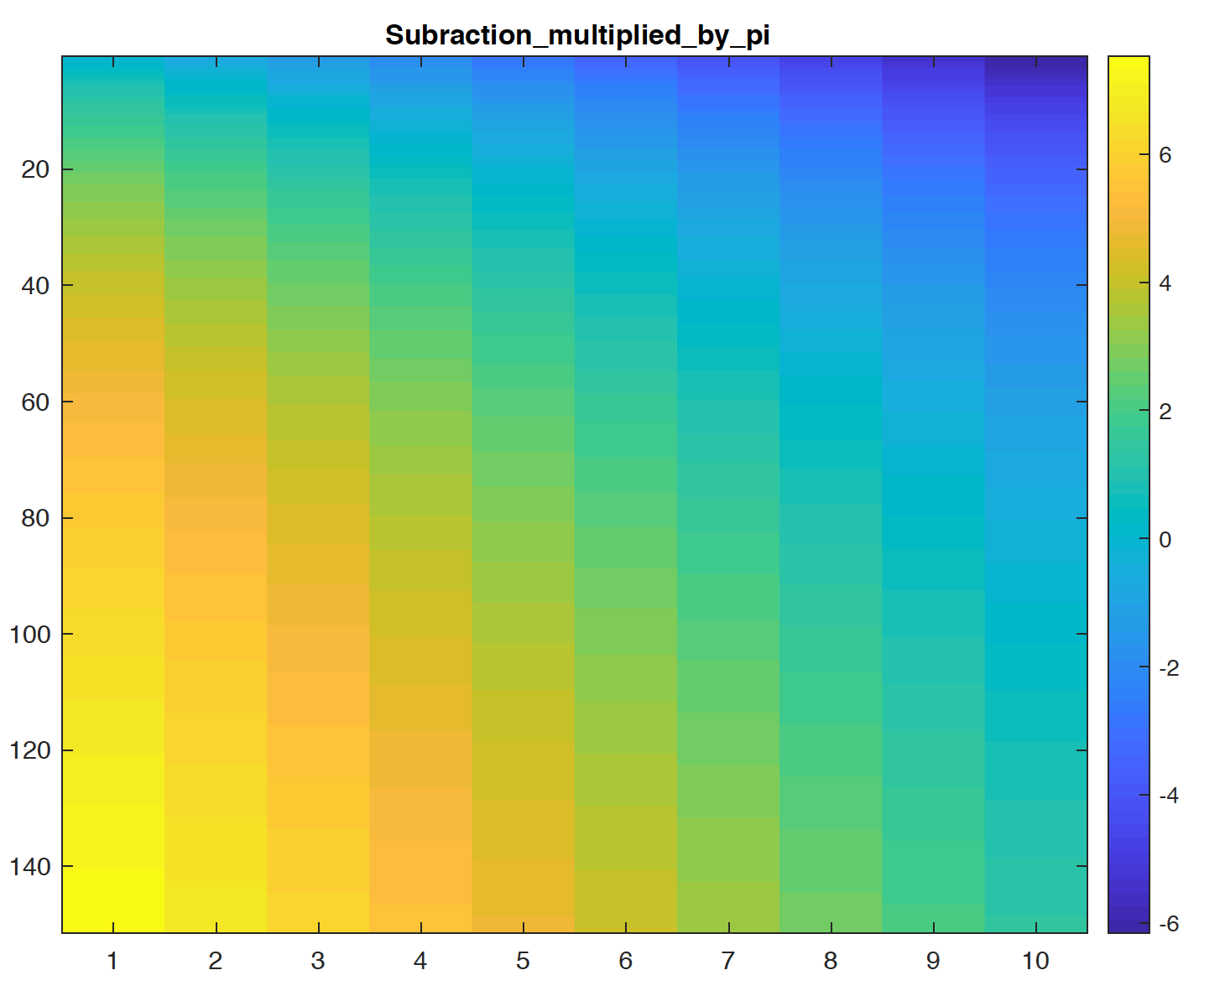
Left: This is just subtraction of the peak_mat from X_mat.
(log_func(x) – peak)
Right: Multiply subtracted values by pi.
(log_func(x) - peak)*pi

Slide 3
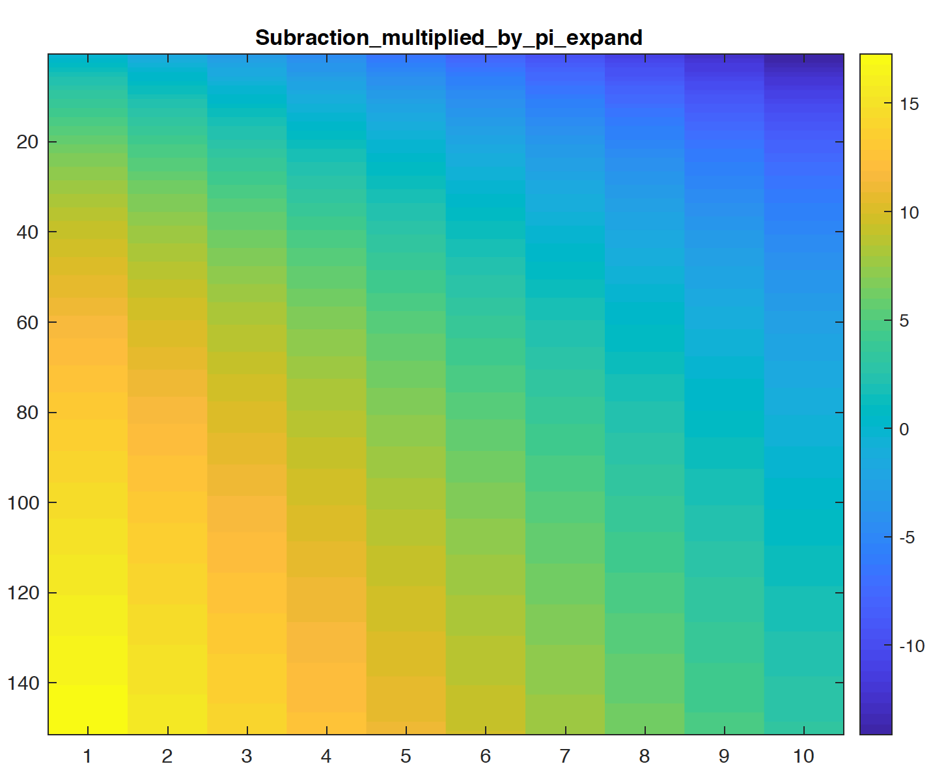
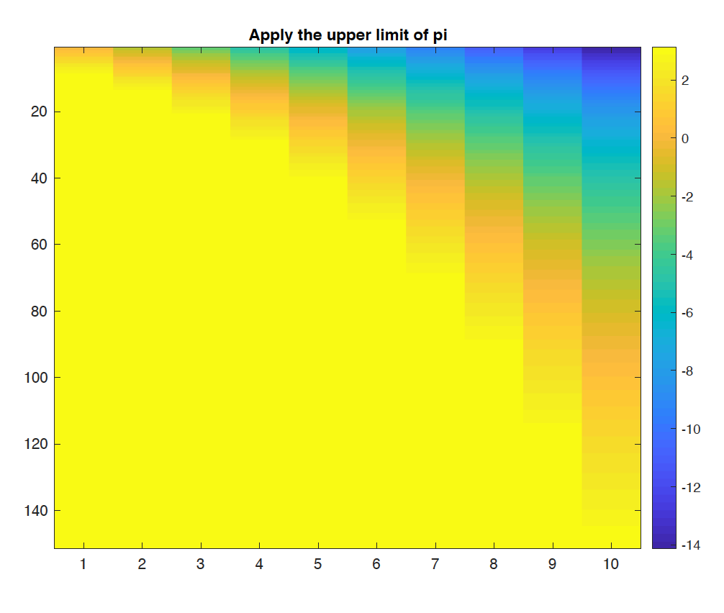
Left: dividing subtracted values by 2*gap_log, which is smaller than 1 (e.g. 0.4360) numerically has an effect of sharpening the cosine curves, i.e., the absolute values of cosine curve change faster from their max (1) and min (-1) values.
(log_func(x) - peak) * pi / (2 * gap_log)
Right: Apply the upper limit of pi.
min(pi, (log_func(x) - peak) * pi / (2 * gap_log))

Slide 4
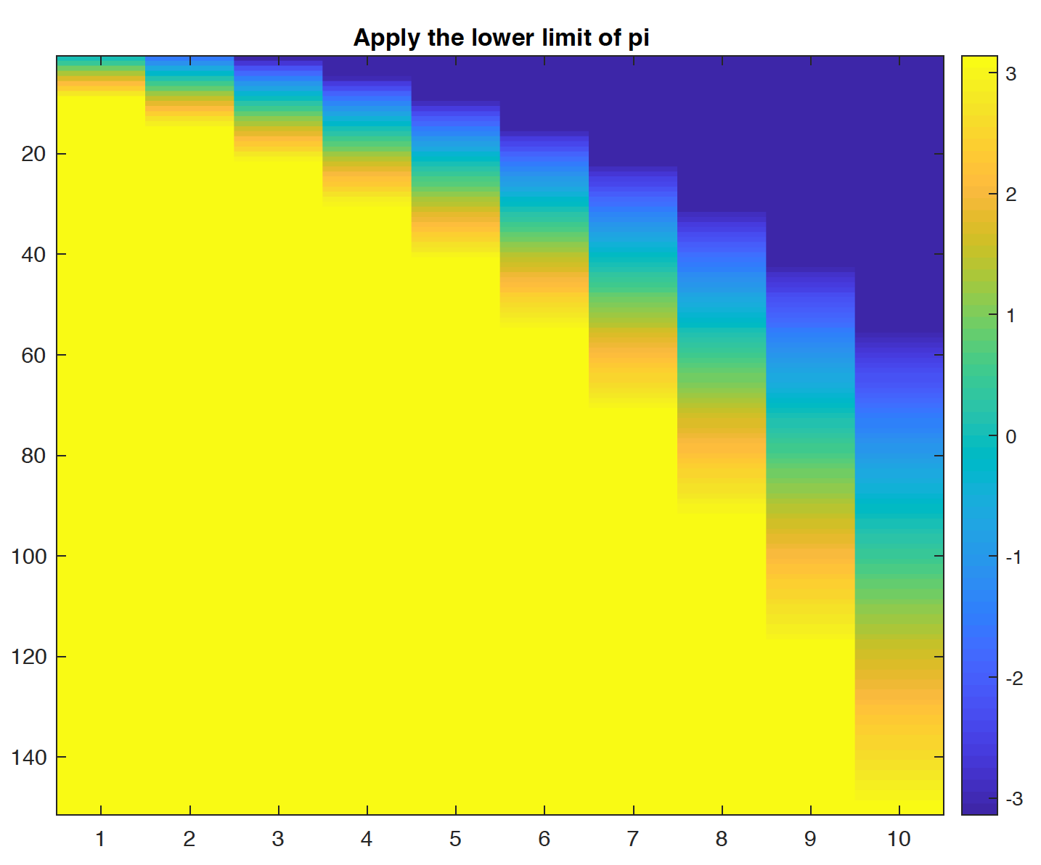
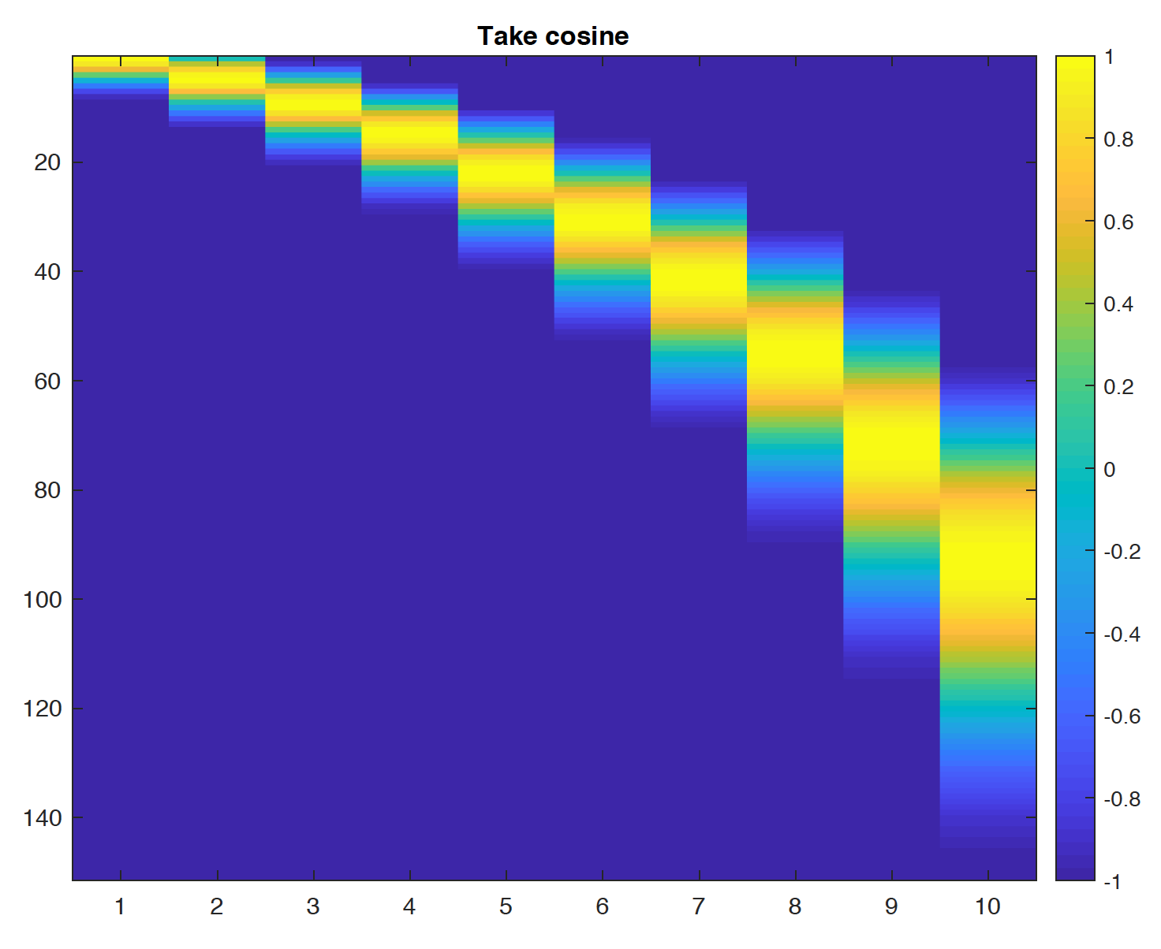
Left: Apply the lower limit of -pi.
max (-pi, min(pi, (log_func(x) - peak) * pi / (2 * gap_log)))
Now, they are within the range of –pi to pi, of which cosine values are within the range of -1 to 1.
Right: Finally, take cosine.
cosine(max (-pi, min(pi, (log_func(x) - peak) * pi / (2 * gap_log))))
Finally, take cosine so that the values are within the range of -1 to 1.
This is basically it. The last couple of operations (addition of 1 and division by 2) is just to convert the range to be 0 to 1, instead of -1 to 1.

