Slide 1

REFINITIV Labs - Data Science Challenge
Submitted by : Jitendra Upadhyay

Slide 2

Questions
Need to provide an efficient and sophisticated way to figure out what words are trending. Use the provided input which is a large collection of news texts with timestamps in the data file.
Method and interpretation of trending is up to you but please state your rationale and assumptions in clear flow. The submission will be considered with regards to
Methodology used
Analysis (Exploratory Data Analysis)
Programming,
Communication skills
Quality of results
Discussion of results

Slide 3

Model Methodology
A Data set has been provided by the Refinitiv which comprises of the large collection of news with different time stamp and the model should able to depict the top trending topics from the corpus
Questions to be answer:
How many Languages were news released?
What is the distribution of the news generated during certain interval.
Show the top trending topics in a dashboard

Slide 4
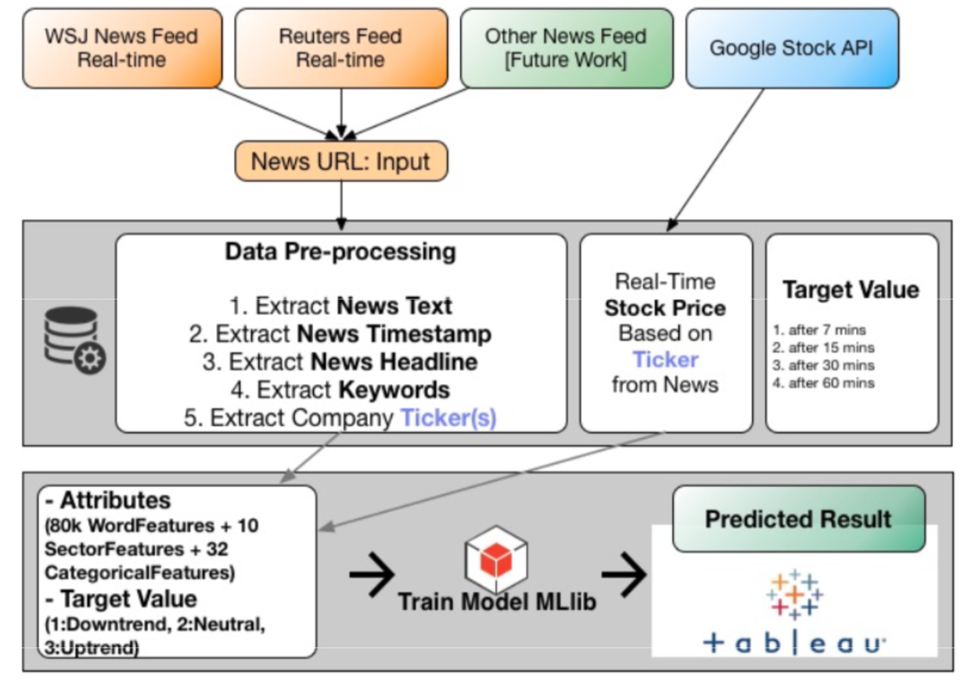

Slide 5
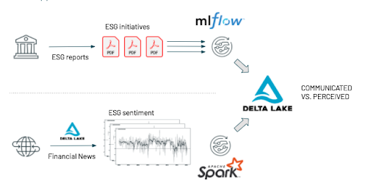

Slide 6
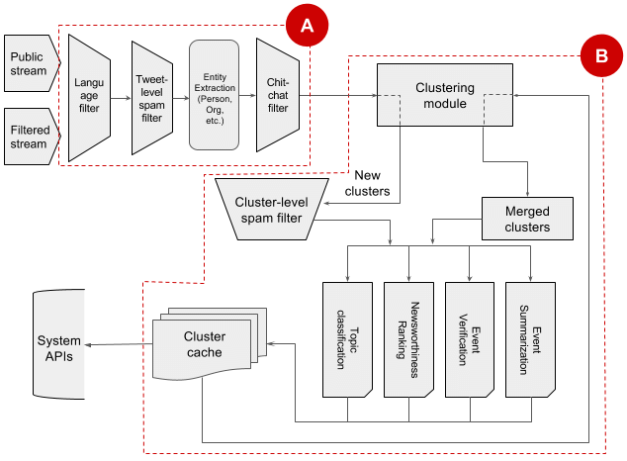

Slide 7
Step1: Data Cleaning
There is lot of rows with EVENT_TYPE AS ‘ DELETED’
some rows have the same 'UNIQUE_STORY_INDEX', in those cases we will keep the last duplicate as same.

Slide 8
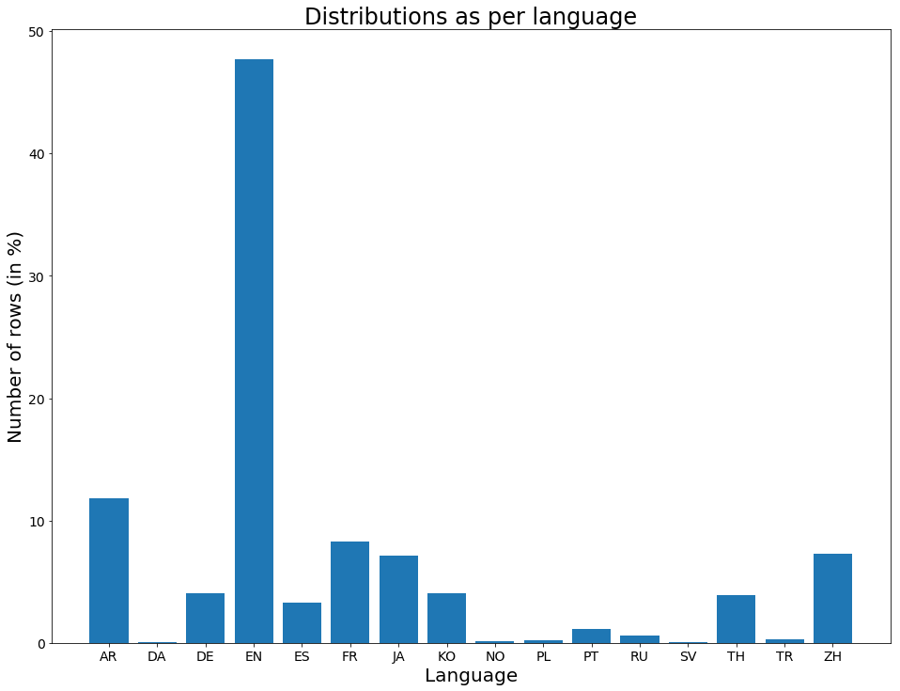
Distribution
Clearly English UTF-8 encoded is the majorly in the provided data points(so we will consider two languages to predict the top trending topics ‘EN’ & ‘AR’)

Slide 9
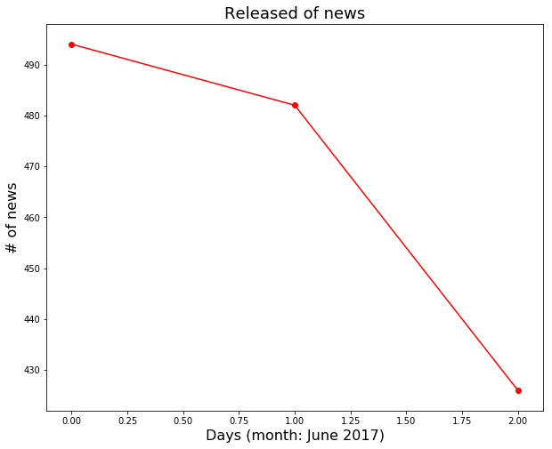
What are the date pattern in which news been generated?
There is a clear declination in the number of news populated during weekend as compare to week day

Slide 10
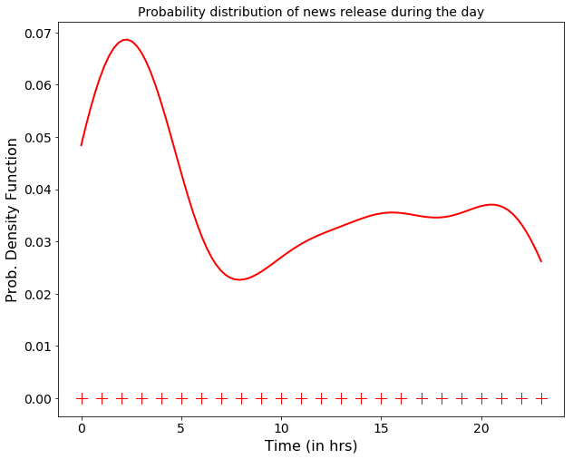
Probability Density Function during the day
Important times coincide with the early morning (6:00-7:00), the 'lunch time' (12:00-14:00), and a mayor release of news at 'dinner time'

Slide 11
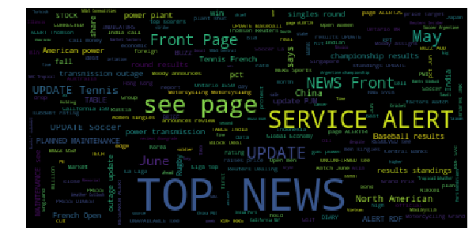
Top Trending words during three different intervals

Slide 12
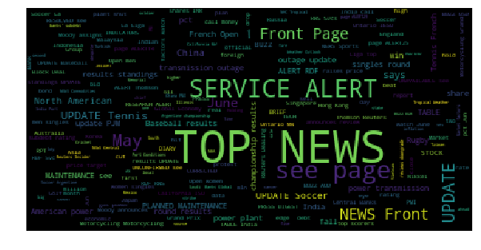
Group 2

Slide 13
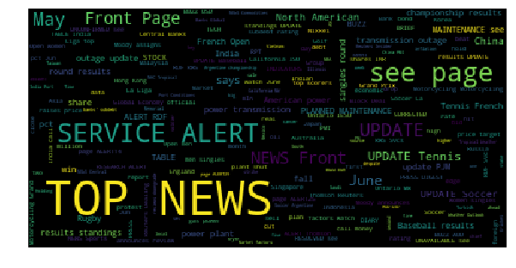
Group 3

Slide 14
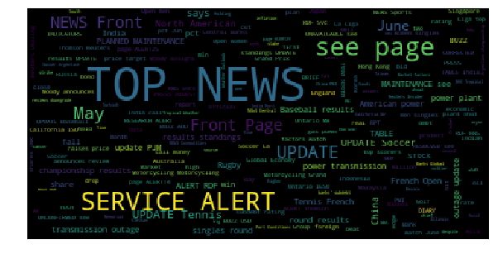
Group 4

Slide 15
Summary of top trends weekly
Trend for each day of the week [Mon-Sun]...
Out[1]:
 | Monday | Tuesday | Wednesday | Thusrday | Friday | Saturday | Sunday
0 | european | european | news | european | european | european | to
1 | euro | euro | top | euro | euro | euro | in
2 | eur | eur | in | eur | eur | eur | page
3 | eugene | eugene | update | eugene | eugene | eugene | soccer
4 | eu | eu | on | eu | eu | eu | results
5 | ethiopia | ethiopia | page | ethiopia | ethiopia | ethiopia | service
6 | ethanol | ethanol | for | ethanol | ethanol | ethanol | top
7 | estimated | estimated | of | estimated | estimated | estimated | power
8 | estates | estates | buzz | estates | estates | estates | of

Slide 16
LDA Method
Latent Dirichlet Allocation (LDA) is an example of topic model and is used to classify text in a document to a particular topic. It builds a topic per document model and words per topic model, modeled as Dirichlet distributions.
Data Pre-processing
We will perform the following steps:
Tokenization: Split the text into sentences and the sentences into words. Lowercase the words and remove punctuation.
Words that have fewer than 3 characters are removed.
All stopwords are removed.
Words are lemmatized — words in third person are changed to first person and verbs in past and future tenses are changed into present.
Words are stemmed — words are reduced to their root form.
Loading gensim and nltk libraries

Slide 17
TF-IDF
Create tf-idf model object using models.TfidfModel on ‘bow_corpus’ and save it to ‘tfidf’, then apply transformation to the entire corpus and call it ‘corpus_tfidf’. Finally we preview TF-IDF scores for our first document.

Slide 18
Performance evaluation by classifying sample document using LDA TF-IDF model.
Score: 0.5633556246757507 Topic: 0.073*"buzz" + 0.056*"test" + 0.052*"ignor" + 0.029*"protest" + 0.027*"apac" Score: 0.27660971879959106 Topic: 0.054*"tenni" + 0.047*"result" + 0.036*"market" + 0.035*"basebal" + 0.035*"updat" Score: 0.020007062703371048 Topic: 0.090*"june" + 0.030*"watch" + 0.024*"factor" + 0.023*"china" + 0.022*"reuter" Score: 0.020006509497761726 Topic: 0.121*"alert" + 0.095*"news" + 0.093*"page" + 0.066*"servic" + 0.027*"stock" Score: 0.02000598981976509 Topic: 0.084*"alert" + 0.063*"india" + 0.048*"servic" + 0.047*"page" + 0.042*"bank" Score: 0.020004799589514732 Topic: 0.150*"updat" + 0.063*"result" + 0.062*"soccer" + 0.034*"open" + 0.030*"tenni" Score: 0.020004523918032646 Topic: 0.044*"say" + 0.042*"rugbi" + 0.041*"soccer" + 0.039*"updat" + 0.037*"alert" Score: 0.02000240609049797 Topic: 0.232*"test" + 0.228*"ignor" + 0.078*"amer" + 0.077*"apac" + 0.062*"emea" Score: 0.02000175230205059 Topic: 0.061*"news" + 0.058*"test" + 0.052*"ignor" + 0.038*"amer" + 0.029*"global" Score: 0.020001590251922607 Topic: 0.049*"power" + 0.048*"updat" + 0.038*"test" + 0.037*"plant" + 0.036*"ignor"

Slide 19
Test on unseen data
unseen_document = 'S.KOREA MAY AVG EXPORTS PER WORKING DAY $2.10 BLN VS REVISED $1.93 BLN IN APRIL-REUTERS CALCULATIONS’
Perplexity: -21.280324231265787 Coherence Score: 0.41110174070639277

Slide 20
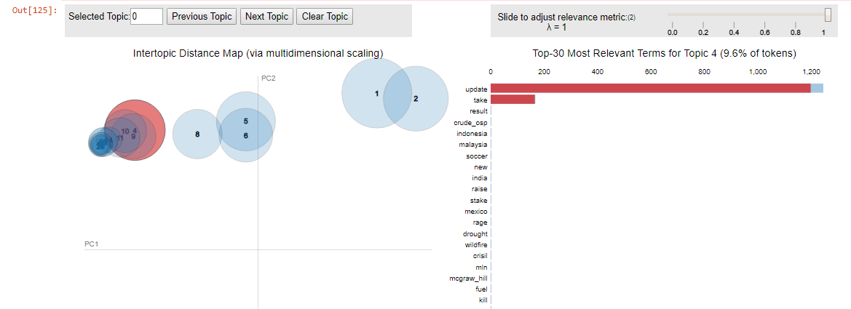
PyLdavis

Slide 21
Conclusions.
Have loaded the data provided using pandas dataframe after doing preprocessing followed by Exploratory data analytics we concentrate on the English news from that moment on.
Explore the time distribution of the released news
Performed a visualization of the trending words using wordclouds individually
Visualize the topics-keywords
Using LDA model is built, examine the produced topics and the associated keywords. pyLDAvis package’s interactive chart and is designed to work well with jupyter notebooks.

