Slide 1


Slide 2
Agenda
Introduction JS, jQuery
Overview AngularJS
First App
Setup environment
Directives
Expressions
MVC include router
Filters, Custom filters
Form Validation
Service
Custom Directives

Slide 3
Introduction : jQuery
jQuery is framework of JavaScript language for accessing HTML Dom and manipulate it.
How to access each HTML Dom on WebSite ?
We using jQuery selector reference Document => https://api.jquery.com/category/selectors/
Example
<html >
<body>
<div id=“a” class=“y”></div>
<div id=“b” class=“x”></div>
</body>
</html>
$(“div#a”) ➔ Green DIV
$(“div.x”) ➔ Blue DIV

Slide 4
Introduction : jQuery
How to Manipulate DOM with jQuery
Example
<html >
<body>
<div id=“a” class=“y”>Hello </div>
<div id=“b” class=“x”>World</div>
</body>
</html>
Get $(“div#a”).text(); ➔ Hello
Set $(“div.b”).text(‘Kitt’); ➔ <div id=“b” class=“x”>Kitt</div>

Slide 5
Overview : What is AngularJS?
AngularJS is an open source web application framework. It was originally developed in 2009 by Misko Hevery and Adam Abrons. It is now maintained by Google
AngularJS is a structural framework for dynamic web apps. It lets you use HTML as your template language and lets you extend HTML's syntax to express your application's components clearly and succinctly. Angular's data binding and dependency injection eliminate much of the code you currently have to write. And it all happens within the browser, making it an ideal partner with any server technology.

Slide 6
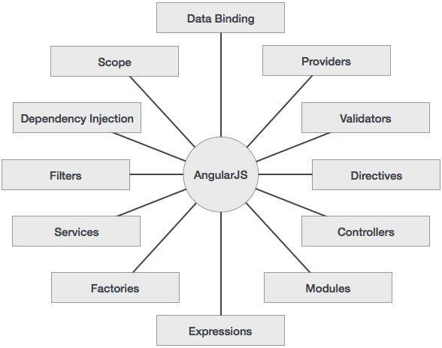
Overview : Concepts

Slide 7
Overview : Advantages
AngularJS provides capability to create Single Page Application in a very clean and maintainable way.
AngularJS provides data binding capability to HTML thus giving user a rich and responsive experience
AngularJS code is unit testable.
AngularJS uses dependency injection and make use of separation of concerns.
AngularJS provides reusable components.
With AngularJS, developer write less code and get more functionality.
In AngularJS, views are pure html pages, and controllers written in JavaScript do the business processing.

Slide 8
Overview : Disadvantages
Not Secure − Being JavaScript only framework, application written in AngularJS are not safe. Server side authentication and authorization is must to keep an application secure.
Not degradable − If your application user disables JavaScript then user will just see the basic page and nothing more.

Slide 9
First App
<html>
<head>
<script src="https://ajax.googleapis.com/ajax/libs/angularjs/1.5.6/angular.min.js"></script>
<title>AngularJS First Application</title>
</head>
<body ng-app = "myapp">
<h1>Sample Application</h1>
<div ng-controller = "HelloController" >
<p>Enter your Name: <input type = "text" ng-model = "helloTo.name"></p>
<p>Hello {{helloTo.name}} !</p>
</div>
<script>
angular.module("myapp", [])
.controller("HelloController", function($scope) {
$scope.helloTo = {};
$scope.helloTo.name = "AngularJS";
});
</script>
</body>
</html>

Slide 10
First App : Data binding
Data Binding in Classical Template Systems
Data Binding in Angular Templates

Slide 11





Setup environment

Slide 12
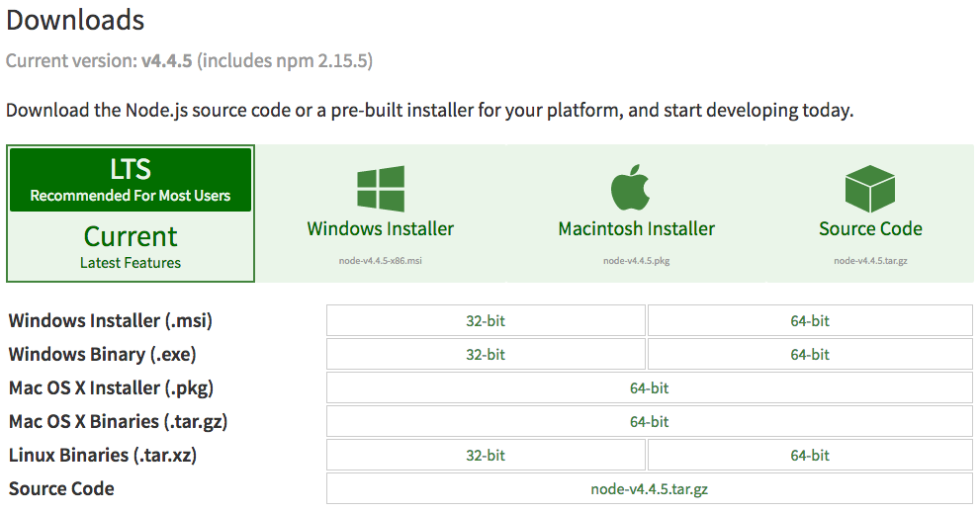
Setup environment : Node.js
https://nodejs.org/en/download/
npm install socket.io --msvs_version=2010
npm config set msvs_version 2010 –global
http://stackoverflow.com/questions/28621953/msbuild-error-msb3428-could-not-load-the-visual-c-component-vcbuild-exe

Slide 13
Setup environment : gulp
Install gulp using npm
npm install --g gulp-cli
More info : https://github.com/gulpjs/gulp/blob/master/docs/getting-started.md

Slide 14
Setup environment : bower
Install Bower using npm
npm install -g bower
Install packages
bower install <package>
bower install <package> --save
Save packages (bower.json)
bower init
Update or uninstall packages
bower update <package>
bower uninstall package
More info : http://bower.io/
Notes:
npm install -g yo gulp bower
npm install -g generator-gulp-angular

Slide 15
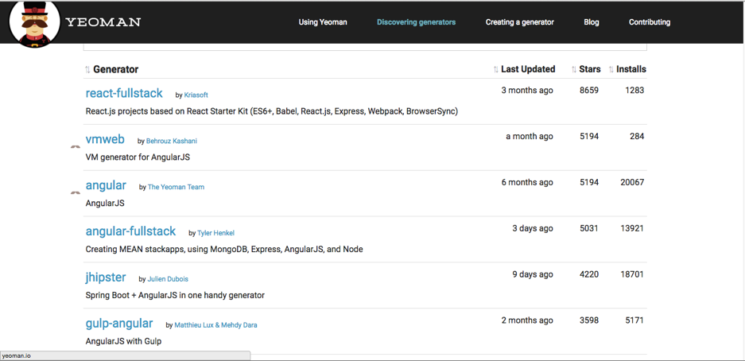
Setup environment : yeoman
Install yo using npm:
npm install -g yo
Install the needed generator(s): (http://yeoman.io/generators/)
npm install -g generator-gulp-angular
Notes:
npm install -g yo gulp bower
npm install -g generator-gulp-angular

Slide 16
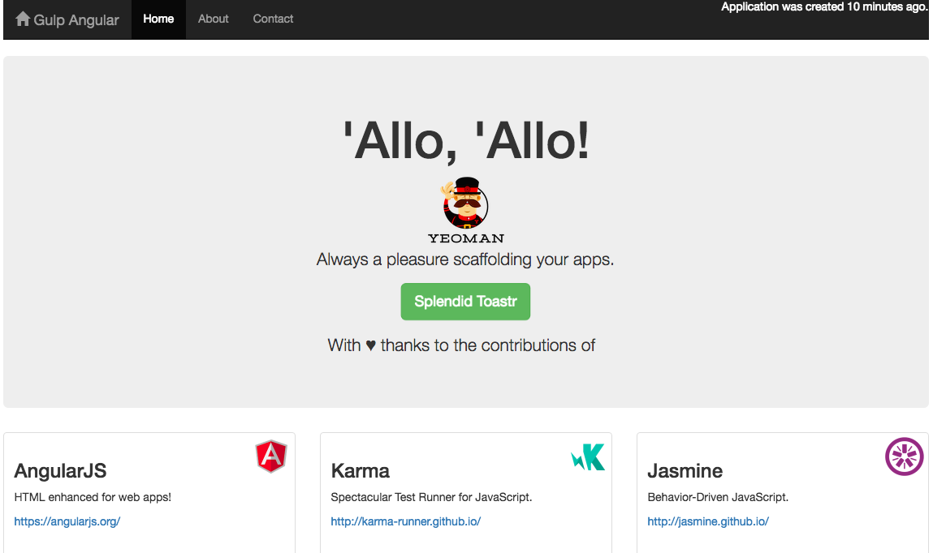
Setup environment : yeoman
Create gulp-angular project
yo gulp-angular
After create the new project
gulp serve
More info : http://yeoman.io/

Slide 17
Built-in Directives
name | description
ngApp | Use this directive to auto-bootstrap an AngularJS application. The ngApp directive designates the root element of the application and is typically placed near the root element of the page - e.g. on the <body> or <html> tags.
a | Modifies the default behavior of the html A tag so that the default action is prevented when the href attribute is empty.
ngHref | Using Angular markup like {{hash}} in an href attribute will make the link go to the wrong URL if the user clicks it before Angular has a chance to replace the {{hash}} markup with its value. Until Angular replaces the markup the link will be broken and will most likely return a 404 error. The ngHref directive solves this problem.
ngSrc | Using Angular markup like {{hash}} in a src attribute doesn't work right: The browser will fetch from the URL with the literal text {{hash}} until Angular replaces the expression inside {{hash}}. The ngSrc directive solves this problem.

Slide 18
Built-in Directives
name | description
ngForm | Nestable alias of form directive. HTML does not allow nesting of form elements. It is useful to nest forms, for example if the validity of a sub-group of controls needs to be determined.
form | Directive that instantiates FormController.
textarea | HTML textarea element control with angular data-binding. The data-binding and validation properties of this element are exactly the same as those of the input element.
input | HTML input element control. When used together with ngModel, it provides data-binding, input state control, and validation. Input control follows HTML5 input types and polyfills the HTML5 validation behavior for older browsers.
ngValue | Binds the given expression to the value of <option> or input[radio], so that when the element is selected, thengModel of that element is set to the bound value.

Slide 19
Built-in Directives
name | description
ngIf | The ngIf directive removes or recreates a portion of the DOM tree based on an {expression}. If the expression assigned to ngIf evaluates to a false value then the element is removed from the DOM, otherwise a clone of the element is reinserted into the DOM.
ngInit | The ngInit directive allows you to evaluate an expression in the current scope.
ngModel | The ngModel directive binds an input,select, textarea (or custom form control) to a property on the scope using NgModelController, which is created and exposed by this directive.
ngClick | The ngClick directive allows you to specify custom behavior when an element is clicked.
ngController | The ngController directive attaches a controller class to the view. This is a key aspect of how angular supports the principles behind the Model-View-Controller design pattern.
ngClass | The ngClass directive allows you to dynamically set CSS classes on an HTML element by databinding an expression that represents all classes to be added.

Slide 20
Built-in Directives
name | description
ngRepeat | The ngRepeat directive instantiates a template once per item from a collection. Each template instance gets its own scope, where the given loop variable is set to the current collection item, and $index is set to the item index or key.
ngShow | The ngShow directive shows or hides the given HTML element based on the expression provided to the ngShowattribute. The element is shown or hidden by removing or adding the .ng-hide CSS class onto the element. The.ng-hide CSS class is predefined in AngularJS and sets the display style to none (using an !important flag). For CSP mode please add angular-csp.css to your html file (see ngCsp).
ngHide | The ngHide directive shows or hides the given HTML element based on the expression provided to the ngHideattribute. The element is shown or hidden by removing or adding the ng-hide CSS class onto the element. The .ng-hide CSS class is predefined in AngularJS and sets the display style to none (using an !important flag). For CSP mode please add angular-csp.css to your html file (see ngCsp).
ngStyle | The ngStyle directive allows you to set CSS style on an HTML element conditionally.

Slide 21
More ..
https://docs.angularjs.org/api/ng/directive

Slide 22
Angular Expressions
Angular expressions are JavaScript-like code snippets that are mainly placed in interpolation bindings such as
<span title="{{ attrBinding }}">{{ textBinding }}</span>
, but also used directly in directive attributes such as
ng-click="functionExpression()".

Slide 23
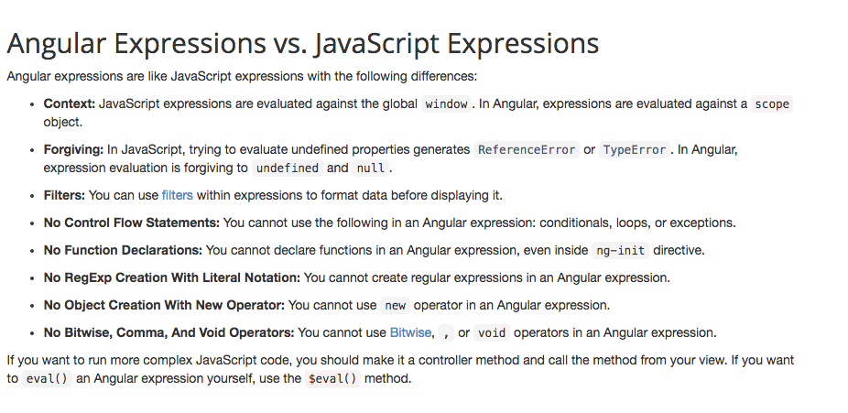
Angular Expressions

Slide 24
MVC
Model View Controller or MVC as it is popularly called, is a software design pattern for developing web applications. A Model View Controller pattern is made up of the following three parts
Model − It is the lowest level of the pattern responsible for maintaining data.
View − It is responsible for displaying all or a portion of the data to the user.
Controller − It is a software Code that controls the interactions between the Model and View.

Slide 25

MVC in AngularJS
View
$scope
Controller
$scope is the "glue" (ViewModel) between a controller and a view

Slide 26
MVC in AngularJS : SimpleController
<div class="container" data-ng-controller="SimpleController">
<h3>Adding a Simple Controller</h3>
<ul>
<li data-ng-repeat="cust in customers"> {{ cust.name }} - {{ cust.city }} </li>
</ul>
</div>
<script>
function SimpleController($scope) { $scope.customers = [
{ name: 'Dave Jones', city: 'Phoenix' },
{ name: 'Jamie Riley', city: 'Atlanta' },
{ name: 'Heedy Wahlin', city: 'Chandler' },
{ name: 'Thomas Winter', city: 'Seattle' }
];
}
</script>
Define the controller to use
Access $scope
$scope injected dynamically
Basic controller

Slide 27
MVC in AngularJS : Controller with router
var demoApp = angular.module('demoApp', []);
demoApp.controller('SimpleController', function ($scope) {
$scope.customers = [
{ name: 'Dave Jones', city: 'Phoenix' },
{ name: 'Jamie Riley', city: 'Atlanta' },
{ name: 'Heedy Wahlin', city: 'Chandler' },
{ name: 'Thomas Winter', city: 'Seattle' }
];
});
Define a Module
Define a Controller

Slide 28
MVC in AngularJS : Controller with router
The role of routes
SPA Demo
http://www.myspa.com
View1
/view2
View2
/view1
/view3
View4
/view4
View3

Slide 29
MVC in AngularJS : Controller with router
Defining routes
var demoApp = angular.module('demoApp', ['ngRoute']);
demoApp.config(function ($routeProvider) {
$routeProvider
.when('/',
{
controller: 'SimpleController',
templateUrl:'View1.html'
})
.when('/view2',
{
controller: 'SimpleController',
templateUrl:'View2.html'
})
.otherwise({ redirectTo: '/' });
});
Define Module Routes

Slide 30
MVC in AngularJS : Controller with router
How to pass Parameters in Route Urls
demoApp.config(function ($routeProvider) {
$routeProvider
.when('/paramRoute/:pageId',
{
controller: 'ParamRouteController',
templateUrl:'paramRoute.html'
})
});
Define param in route
demoApp.controller('ParamRouteController', function ($scope, $routeParams) {
$scope.pageId = $routeParams.pageId;
...
...
});
Use param in Controller

Slide 31
MVC in AngularJS : Controller with router
Where do Views Go in a Page?
Dynamically loaded views are injected into the shell page as a module loads:
SPA Demo
http://www.myspa.com
<div ng-view></div>
View1
OR
<ng-view></ng-view>

Slide 32
Filter
Filters are used to change modify the data. Following is the list of commonly used filters.
{{ 'testFilter' | uppercase }} // TESTFILTER
{{ 'testFilter' | lowercase }} // testfilter
{{ 50 | number }} // 50
{{ 50 | number:4 }} // 50.0000
{{ 50 | number:2 }} // 50.00
{{ 59.99 | currency }} // $59.99
{{ 59.99 | currency:'$COTCHES' }} // $COTCHES59.99
{{ 59.99 | currency:'£':0 }} // £60 - decimal point control
{{ '2014-10-19' | date }} // Oct 19, 2014
{{ '2014-10-19' | date:'yyyy' }} // 2014
{{ { name : 'name', surname : 'surname'} | json }}

Slide 33
Filter : Custom Filter
app.filter('ordinal', function() {
return function(number) {
if(isNaN(number) || number < 1) {
return number;
} else {
var lastDigit = number % 10;
if(lastDigit === 1) {
return number + 'st'
} else if(lastDigit === 2) {
return number + 'nd'
} else if (lastDigit === 3) {
return number + 'rd'
} else if (lastDigit > 3) {
return number + 'th'
}
}
}
});
{{ 1 | ordinal }} // 1st
{{ 2 | ordinal }} // 2nd
{{ 3 | ordinal }} // 3rd
{{ 4 | ordinal }} // 4th
{{ 21 | ordinal }} // 21st

Slide 34
Form Validation
AngularJS offers client-side form validation.
AngularJS monitors the state of the form and input fields (input, textarea, select), and lets you notify the user about the current state.
AngularJS also holds information about whether they have been touched, or modified, or not.
You can use standard HTML5 attributes to validate input, or you can make your own validation functions.

Slide 35
Form Validation
<form name="myForm"> <input name="myInput" ng-model="myInput" required> </form> <p>The input's valid state is:</p> <h1>{{myForm.myInput.$valid}}</h1>
<form name="myForm"> <input name="myInput" ng-model="myInput" type="email"> </form> <p>The input's valid state is:</p> <h1>{{myForm.myInput.$valid}}</h1>
Required (HTML5)
Email (HTML5)

Slide 36
Form Validation
$untouched – True if user has not touched the field yet
$touched – True if user has touched the field
$pristine - True if user has not interacted with the form yet
$dirty - True if user has already interacted with the form
$valid - True if all of the containing forms and controls are valid
$invalid - True if at least one containing control or form is invalid
$pending - True if at least one containing control or form is pending
$submitted - True if user has submitted the form even if its invalid

Slide 37
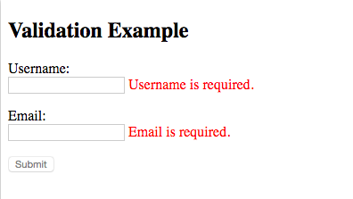
Form Validation
<html>
<script src="http://ajax.googleapis.com/ajax/libs/angularjs/1.4.8/angular.min.js"></script>
<body>
<h2>Validation Example</h2>
<form ng-app="myApp" ng-controller="validateCtrl"name="myForm" novalidate>
<p>Username:<br>
<input type="text" name="user" ng-model="user" required>
<span style="color:red" ng-show="myForm.user.$dirty && myForm.user.$invalid">
<span ng-show="myForm.user.$error.required">Username is required.</span>
</span>
</p>
<p>Email:<br>
<input type="email" name="email" ng-model="email" required>
<span style="color:red" ng-show="myForm.email.$dirty && myForm.email.$invalid">
<span ng-show="myForm.email.$error.required">Email is required.</span>
<span ng-show="myForm.email.$error.email">Invalid email address.</span>
</span>
</p>
<p>
<input type="submit”
ng-disabled="myForm.user.$dirty && myForm.user.$invalid ||
myForm.email.$dirty && myForm.email.$invalid">
</p>
</form>
<script>
var app = angular.module('myApp', []);
app.controller('validateCtrl', function($scope) {
$scope.user = 'John Doe';
$scope.email = 'john.doe@gmail.com';
});
</script>
</body>
</html>

Slide 38
Built-in Services
name | description
$anchorScroll | When called, it scrolls to the element related to the specified hash or (if omitted) to the current value of$location.hash(), according to the rules specified in the HTML5 spec.
$animate | The $animate service exposes a series of DOM utility methods that provide support for animation hooks. The default behavior is the application of DOM operations, however, when an animation is detected (and animations are enabled), $animate will do the heavy lifting to ensure that animation runs with the triggered DOM operation.
$animateCss | This is the core version of $animateCss. By default, only when the ngAnimate is included, then the$animateCss service will actually perform animations.
$templateCache | The first time a template is used, it is loaded in the template cache for quick retrieval. You can load templates directly into the cache in a script tag, or by consuming the $templateCache service directly.

Slide 39
Built-in Services
name | description
$templateCache | The first time a template is used, it is loaded in the template cache for quick retrieval. You can load templates directly into the cache in a script tag, or by consuming the $templateCache service directly.
$compile | Compiles an HTML string or DOM into a template and produces a template function, which can then be used to link scope and the template together.
$controller | $controller service is responsible for instantiating controllers.
$document | A jQuery or jqLite wrapper for the browser's window.document object.
$interval | Angular's wrapper for window.setInterval. The fn function is executed every delay milliseconds.

Slide 40
Built-in Services
name | description
$filter | Filters are used for formatting data displayed to the user.
$http | The $http service is a core Angular service that facilitates communication with the remote HTTP servers via the browser's XMLHttpRequest object or via JSONP.
$httpBackend | HTTP backend used by the service that delegates to XMLHttpRequest object or JSONP and deals with browser incompatibilities.
$interpolate | Compiles a string with markup into an interpolation function. This service is used by the HTML $compileservice for data binding. See $interpolateProvider for configuring the interpolation markup.

Slide 41
Built-in Services
name | description
$location | The $location service parses the URL in the browser address bar (based on the window.location) and makes the URL available to your application. Changes to the URL in the address bar are reflected into $location service and changes to $location are reflected into the browser address bar.
$rootElement | The root element of Angular application. This is either the element where ngApp was declared or the element passed into angular.bootstrap. The element represents the root element of application. It is also the location where the application's $injector service gets published, and can be retrieved using$rootElement.injector().
$rootScope | Every application has a single root scope. All other scopes are descendant scopes of the root scope. Scopes provide separation between the model and the view, via a mechanism for watching the model for changes. They also provide event emission/broadcast and subscription facility. See the developer guide on scopes.
$sce | $sce is a service that provides Strict Contextual Escaping services to AngularJS.

Slide 42
Built-in Services
name | description
$timeout | Angular's wrapper for window.setTimeout. The fn function is wrapped into a try/catch block and delegates any exceptions to $exceptionHandler service.
$window | A reference to the browser's window object. While window is globally available in JavaScript, it causes testability problems, because it is a global variable. In angular we always refer to it through the $windowservice, so it may be overridden, removed or mocked for testing.

Slide 43
Service
// Service definition
app.service('testService', function(){
this.sayHello= function(text){
return "Service says \"Hello " + text + "\"";
};
});
// AngularJS Controller that uses the service
function HelloCtrl($scope, testService){
$scope.fromService = testService.sayHello("World");
}
// Factory
app.factory('testFactory', function(){
return {
sayHello: function(text){
return "Factory says \"Hello " + text + "\"";
}
}
});
// AngularJS Controller that uses the factory
function HelloCtrl($scope, testFactory){
$scope.fromFactory = testFactory.sayHello("World");
}

Slide 44
Directive
Directive Types
Normalization
1. Strip x- and data- from the front of the element/attributes.
2. Convert the :, -, or _-delimited name to camelCase.
Element directives : <my-dir></my-dir>
Attribute directives : <span my-dir="exp"></span>
Comment directives : <!-- directive: my-dir exp -->
Css class directives : <span class="my-dir: exp;"></span>
For example, the following forms are all equivalent and match the ngBind directive:
<div ng-controller="Controller">
Hello <input ng-model='name'> <hr/>
<span ng-bind="name"></span> <br/>
<span ng:bind="name"></span> <br/>
<span ng_bind="name"></span> <br/>
<span data-ng-bind="name"></span> <br/>
<span x-ng-bind="name"></span> <br/>
</div>

Slide 45
Directive - Directive Properties
angular.module('moduleName') -> my-directive
.directive('myDirective', function () {
return {
restrict: 'EA', //E = element, A = attribute, C = class, M = comment scope: {
//@ reads the attribute value, = provides two-way binding, & works with functions
title: '@’,
test: ‘=‘,
funciton : ‘&’
},
template: '<div>{{ myVal }}</div>',
templateUrl: 'mytemplate.html',
controller: controllerFunction, //Embed a custom controller in the directive
link: function ($scope, element, attrs) { } //DOM manipulation
}
});
<my-directive title=“title” ></my-directive>

Slide 46
Directive - Creating a Directive that Manipulates the DOM
angular.module('docsTimeDirective', [])
.controller('Controller', ['$scope', function($scope) {
$scope.format = 'M/d/yy h:mm:ss a';
}])
.directive('myCurrentTime', ['$interval', 'dateFilter', function($interval, dateFilter) {
function link(scope, element, attrs) {
var format, timeoutId;
function updateTime() {
element.text(dateFilter(new Date(), format));
}
scope.$watch(attrs.myCurrentTime, function(value) {
format = value;
updateTime();
});
element.on('$destroy', function() {
$interval.cancel(timeoutId);
});
// start the UI update process; save the timeoutId for canceling
timeoutId = $interval(function() {
updateTime(); // update DOM
}, 1000);
}
return {
link: link
};
}]);

Slide 47
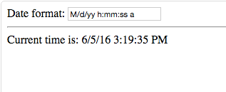
Directive - Creating a Directive that Manipulates the DOM(cont)
<div ng-controller="Controller">
Date format: <input ng-model="format"> <hr/>
Current time is: <span my-current-time="format"></span>
</div>

Slide 48

Directive - Creating a Directive that Wraps Other Elements
script.js
angular.module('docsTransclusionDirective', [])
.controller('Controller', ['$scope', function($scope) {
$scope.name = 'Tobias';
}])
.directive('myDialog', function() {
return {
restrict: 'E',
transclude: true,
scope: {},
templateUrl: 'my-dialog.html’
};
});
my-dialog.html
<div class="alert" ng-transclude></div>
index.html
<div ng-controller="Controller">
<my-dialog>Check out the contents, {{name}}!</my-dialog>
</div>

Slide 49
Directive - Creating a Directive that bind behavior from the other
script.js
angular.module('docsIsoFnBindExample', [])
.controller('Controller', ['$scope', '$timeout',
function($scope, $timeout) {
$scope.name = 'Tobias';
$scope.message = '';
$scope.hideDialog = function (message) {
$scope.message = message;
$scope.dialogIsHidden = true;
$timeout(function () {
$scope.message = '';
$scope.dialogIsHidden = false;
}, 2000);
};
}])
.directive('myDialog', function() {
return {
restrict: 'E',
transclude: true,
scope: {
'close': '&onClose’
},
templateUrl: 'my-dialog-close.html’
};
});

Slide 50
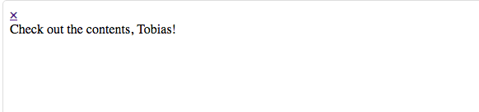
Directive - Creating a Directive that bind behavior from the other(cont.)
my-dialog-close.html
<div class="alert">
<a href class="close" ng-click="close({message: 'closing for now'})">&times;</a>
<div ng-transclude></div>
</div>
index.html
<div ng-controller="Controller">
{{message}}
<my-dialog ng-hide="dialogIsHidden" on-close="hideDialog(message)">
Check out the contents, {{name}}!
</my-dialog>
</div>

Slide 51
References
https://angularjs.org/
https://github.com/mgechev/angularjs-style-guide
https://github.com/getify/You-Dont-Know-JS
https://codestar.work/article/code-js

