Slide 1
.Net Bot Framework
What is this?
How can I use it?

Slide 2
A Bot
„Robot“
Traditionally a computer program without human interaction
Application

Slide 3
What we can handle
Text
Cards
Speech

Slide 4
Which Problem does the Framework solve
I/O-basics
Language skills
Dialog skills

Slide 5
Characteristics
REST-full Framework
Environment:
Visual Studio (2017)
Azure
Programming language:
C#
Node.js

Slide 6
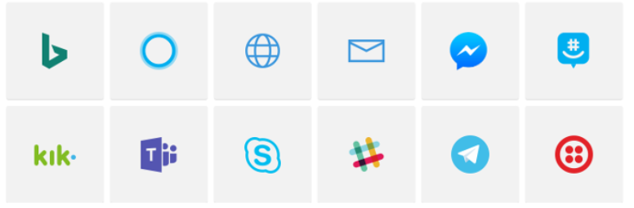
Connect to…
…Channels

Slide 7
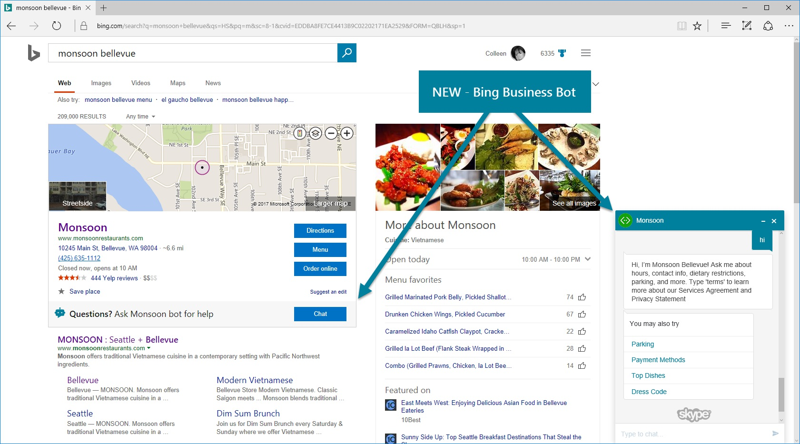
An example

Slide 8

Businesscases

Slide 9
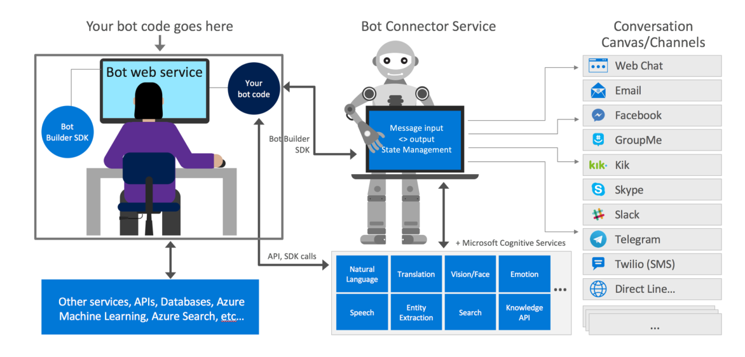
Architecture

Slide 10
Core Concepts
Channel
Bot Connector
Activity
Message
Dialog
Richcards

Slide 11
Add Intelligence
Language understanding
Knowledge extraction
Speech recognition and conversion
Web search
Image and video understanding
Notes:
Cognitive Services provides five APIs for language understanding:
The Language Understanding Intelligent Service (LUIS) is able to process natural language using pre-built
or custom-trained language models.
The Text Analytics API detects sentiment, key phrases, topics, and language from text.
The Bing Spell Check API provides powerful spell check capabilities, and is able to recognize the difference
between names, brand names, and slang.
The Linguistic Analysis API uses advanced linguistic analysis algorithms to process text, and perform
operations such as breaking down the structure of the text, or performing part-of-speech tagging and
parsing.
The Web Language Model (WebLM) API can be used to automate a variety of natural language processing
tasks, such as word frequency or next-word prediction, using advanced language modeling algorithms.
Learn more about language understanding with Microsoft Cognitive Services.

Slide 12
Bots success
Does the bot easily solve the user’s problem with the minimum number of steps?
Does the bot solve the user’s problem better/easier/faster than any of the alternative experiences?
Does the bot run on the devices and platforms the user cares about?
Is the bot discoverable? Do the users naturally know what to do when using it?

Slide 13
Try it

