Slide 1


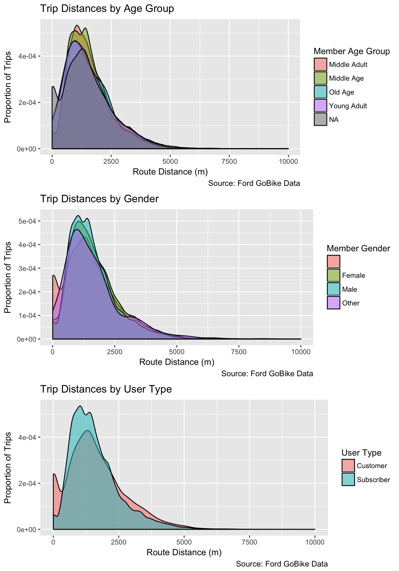
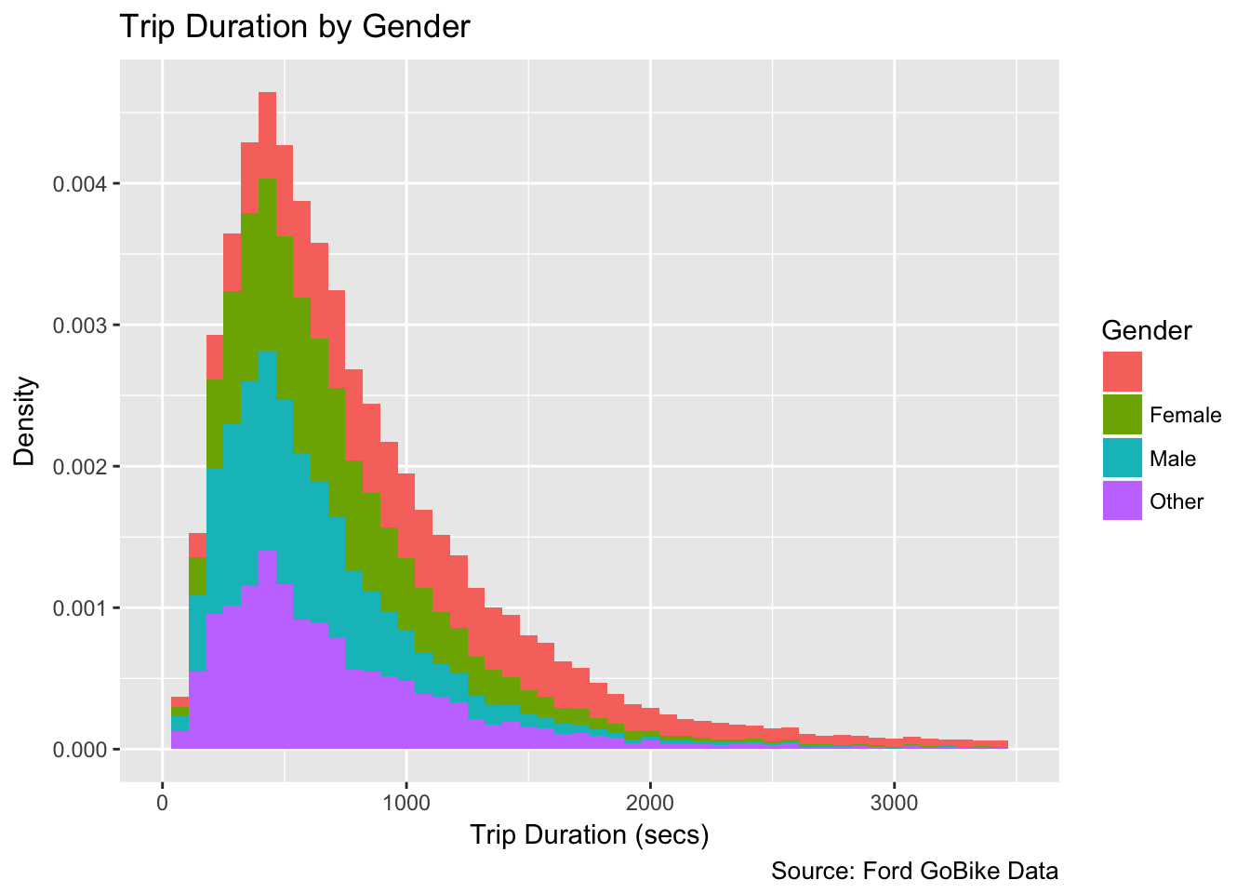
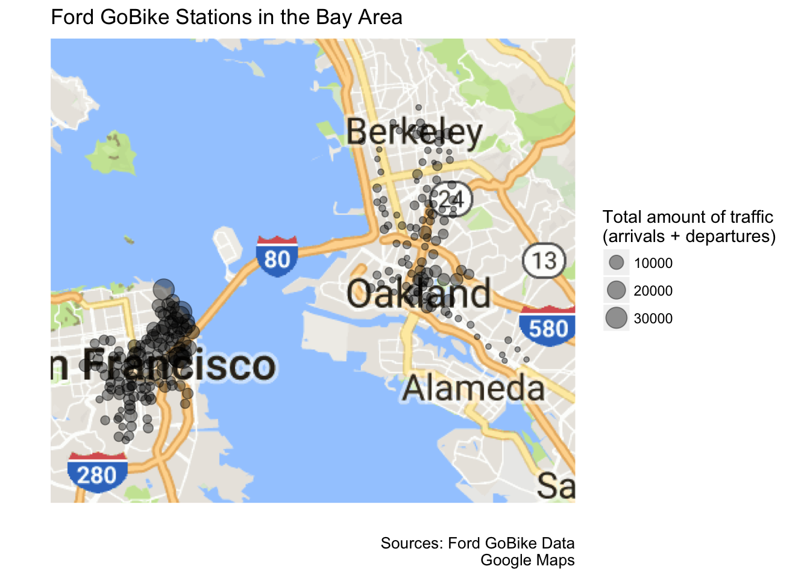
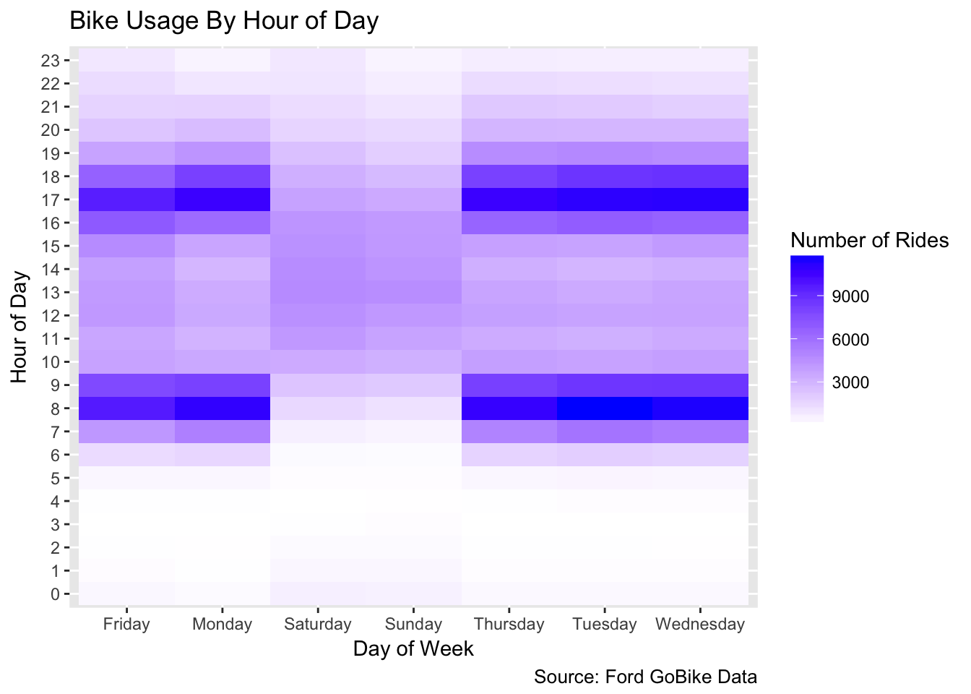
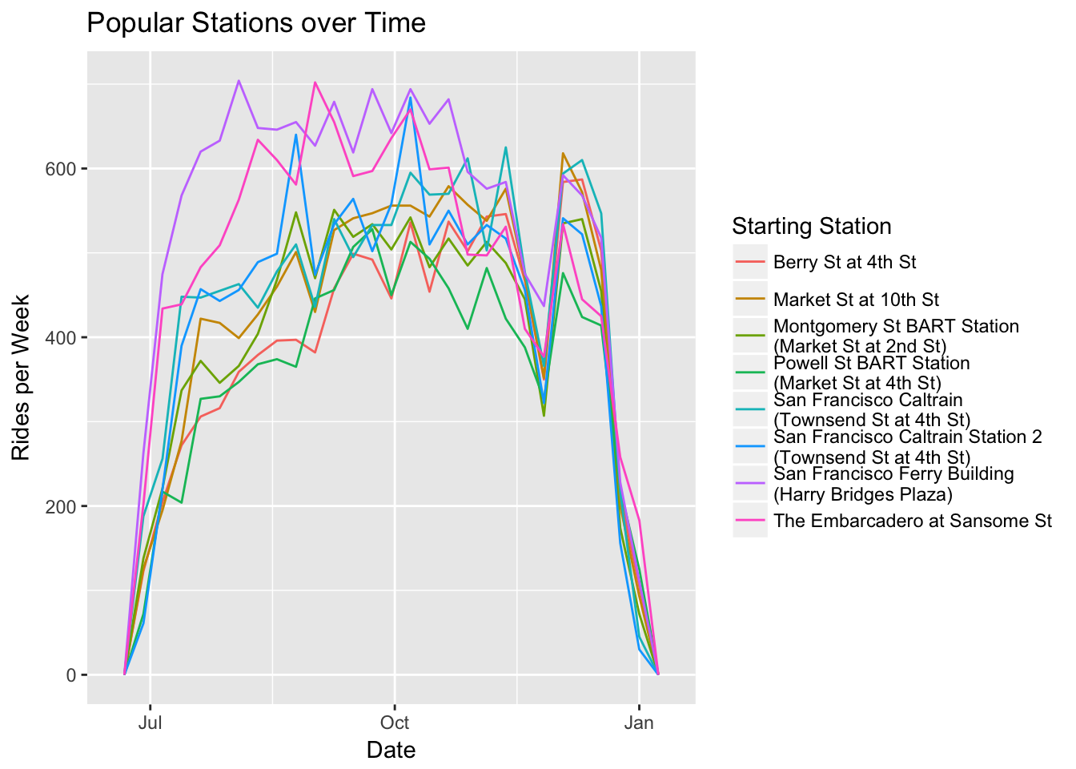
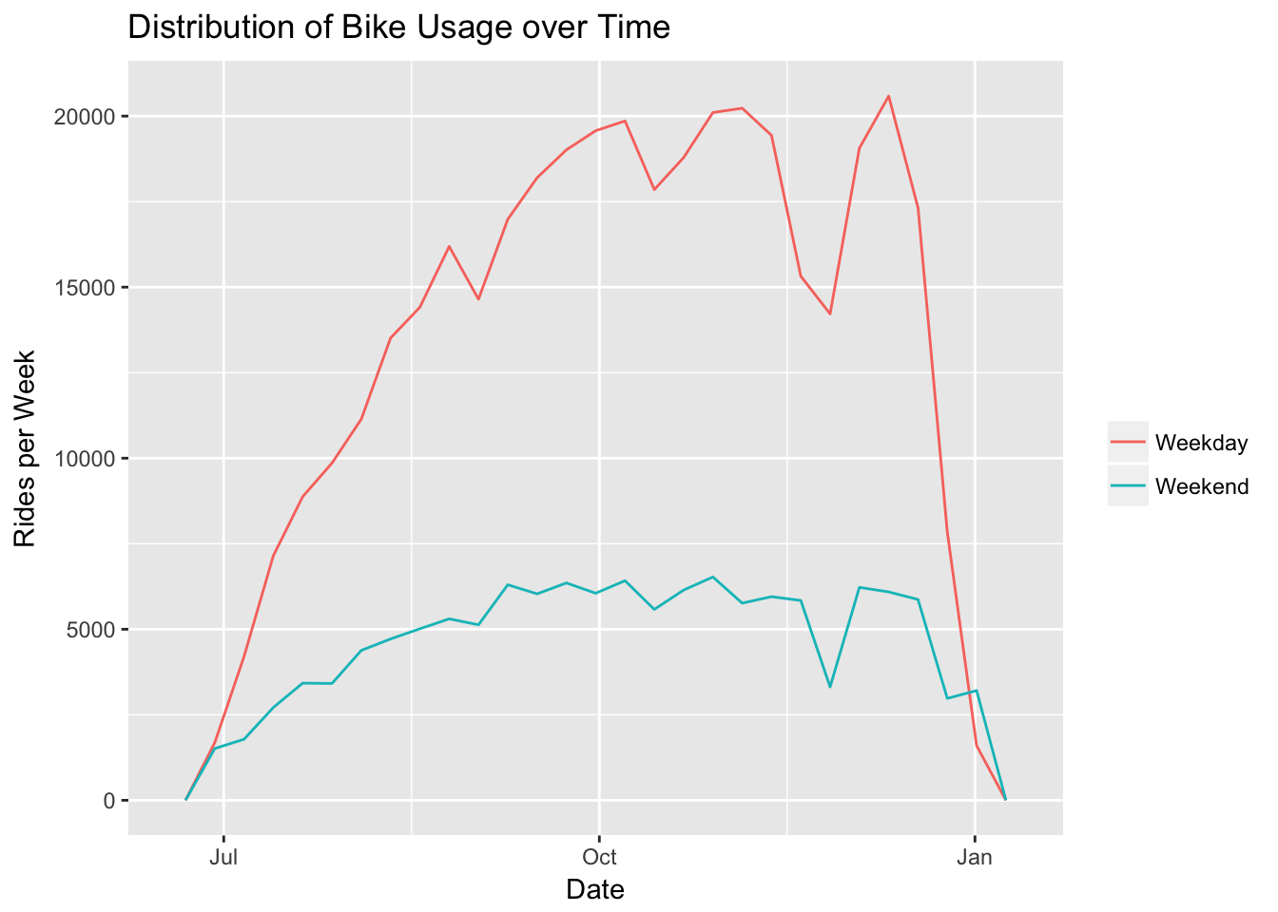
Analysis of Ford GoBike’s Open Data
Statistical Graphics and Visualization
Ross Hemmel, Joshua Huang, Julie Kim, Jinhee Lee
Background
Ford’s GoBike program provides an affordable bike-rental system in the San Francisco Bay Area. Users can either pay one-time or membership fees in order to take bikes from station A and ride them anywhere they please, returning them to station A or to any other GoBike station.
With the open-source data that Ford GoBike offers on their website, we are looking to gain insight on customer demographics and biking behaviors, through statistical graphics and visualizations.
Conclusion
TEXT

