Slide 1


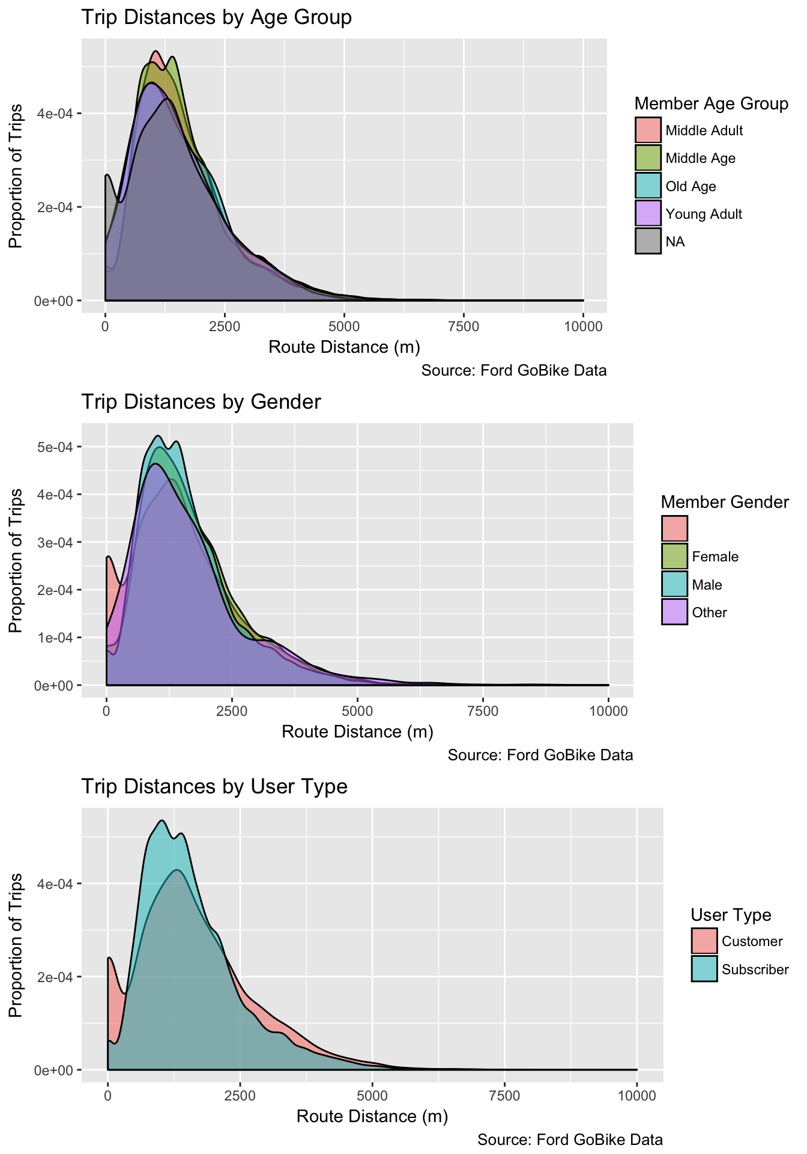
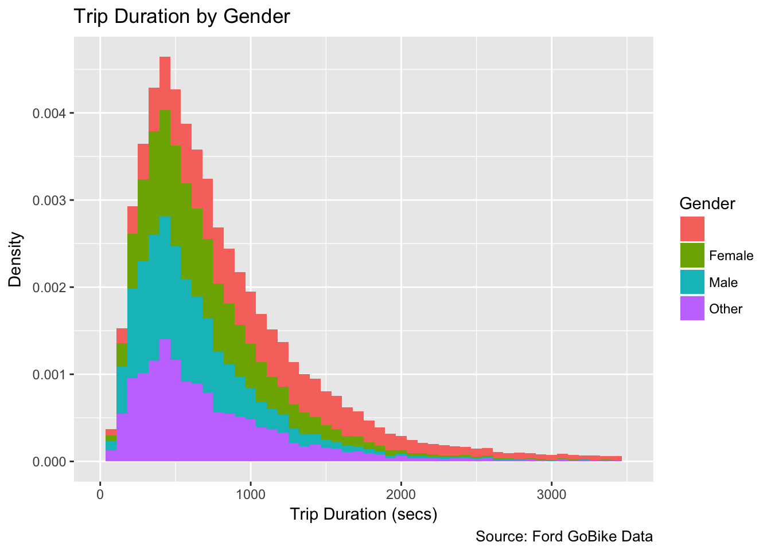
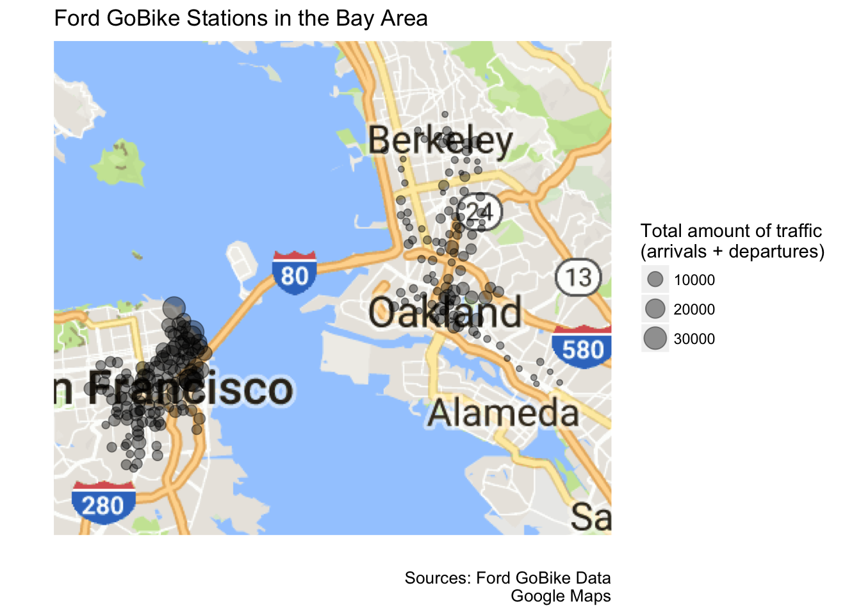
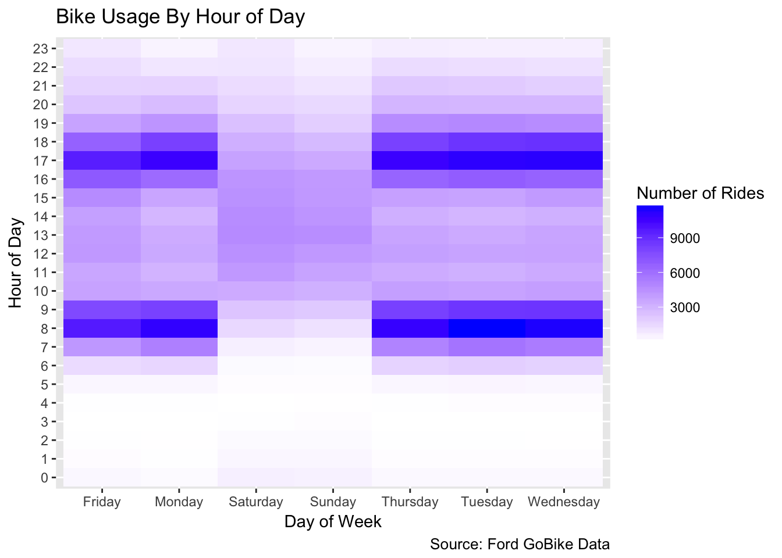
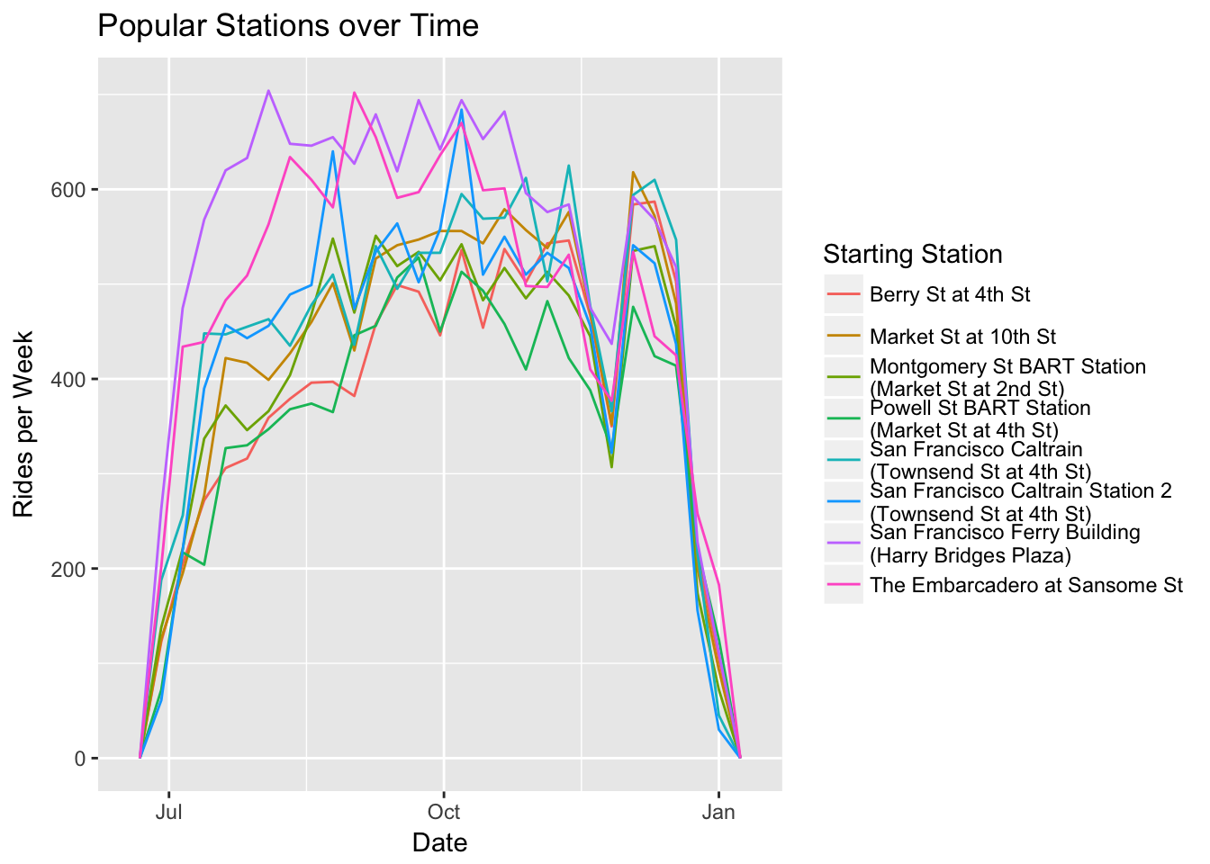
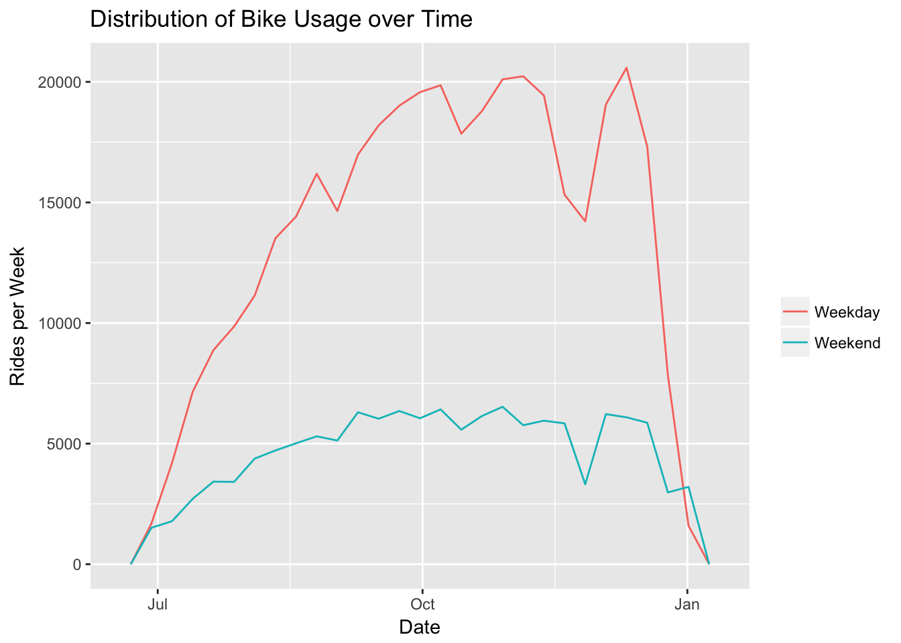
Analysis of Ford GoBike’s Open Data
Statistical Graphics and Visualization
Ross Hemmel, Joshua Huang, Julie Kim, Jinhee Lee
Background
Ford’s GoBike program provides an affordable bike-rental system in the San Francisco Bay Area. Users can either pay one-time or membership fees in order to take bikes from station A and ride them anywhere they please, returning them to station A or to any other GoBike station.
With the open-source data that Ford GoBike offers on their website, we are looking to gain insight on customer demographics and biking behaviors, through statistical graphics and visualizations.
Conclusion
By looking at bike usage data for each hour of each day, we found that users most frequently used the service during the rush hours of 8 a.m and 5 p.m during the weekdays.
Notes:
The distribution of age and gender for different user types showed that everyday customers were more centered at 30 years of age, probably utilizing bikes for work commute. On the other hand, subscribers had a wider range of customers from ages 25-40, probably utilizing bikes for leisure activities along with work commutes.

