Slide 1


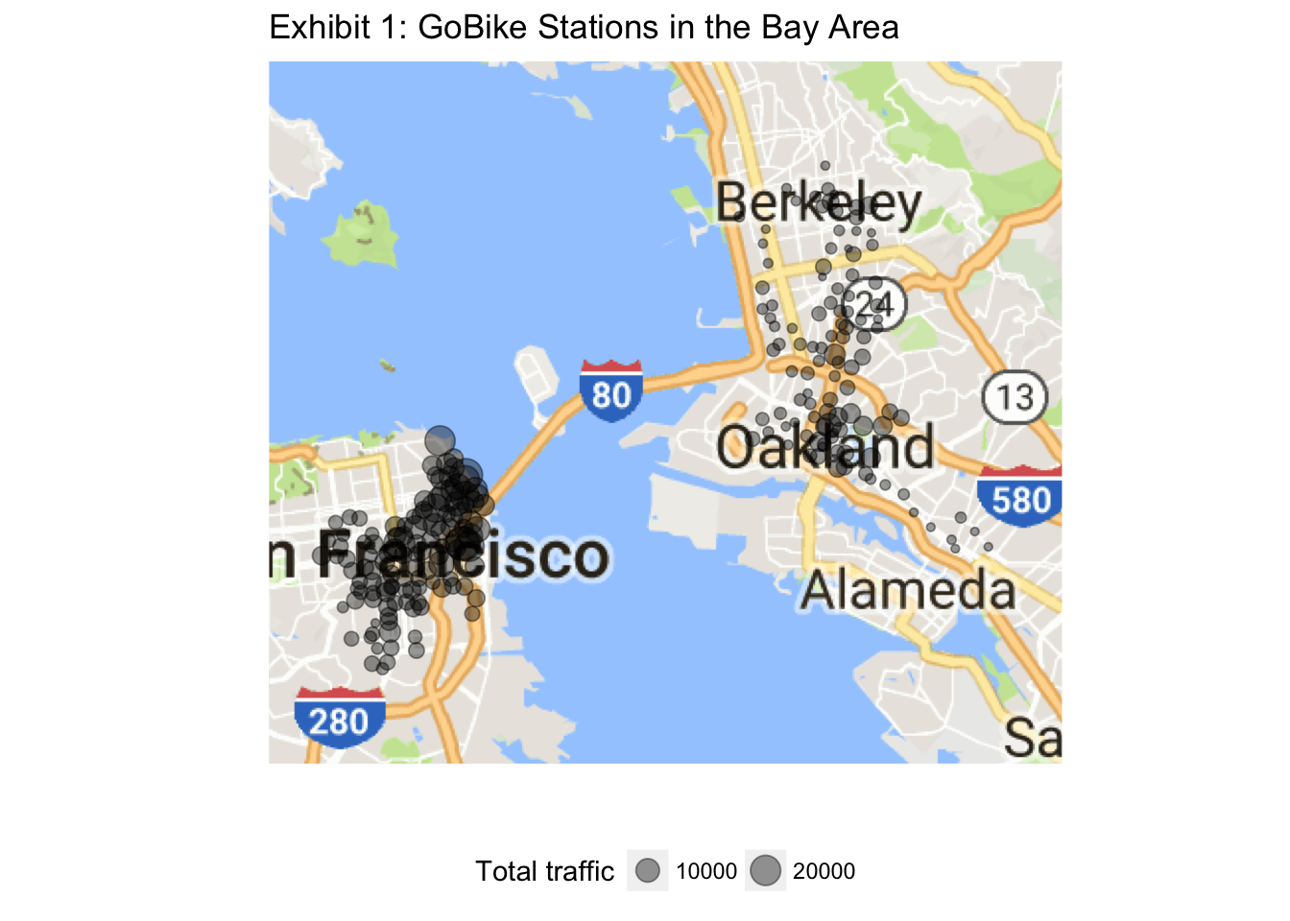
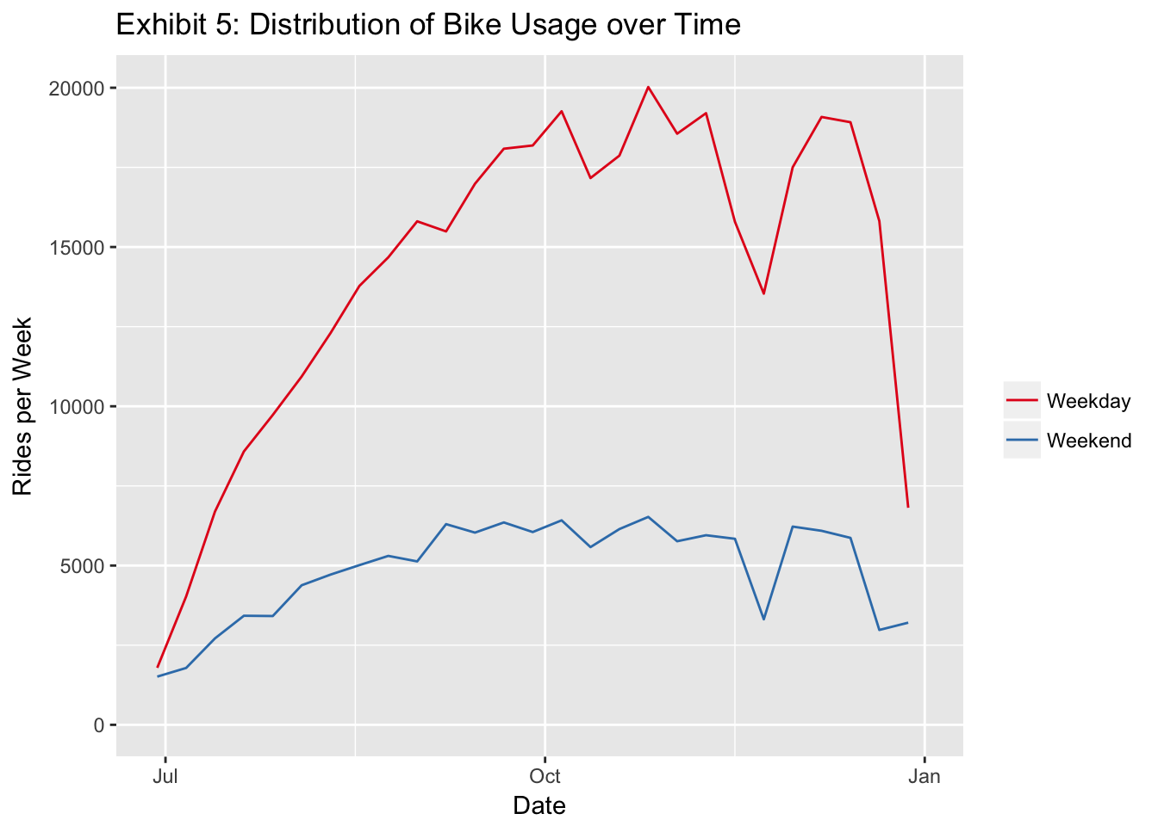
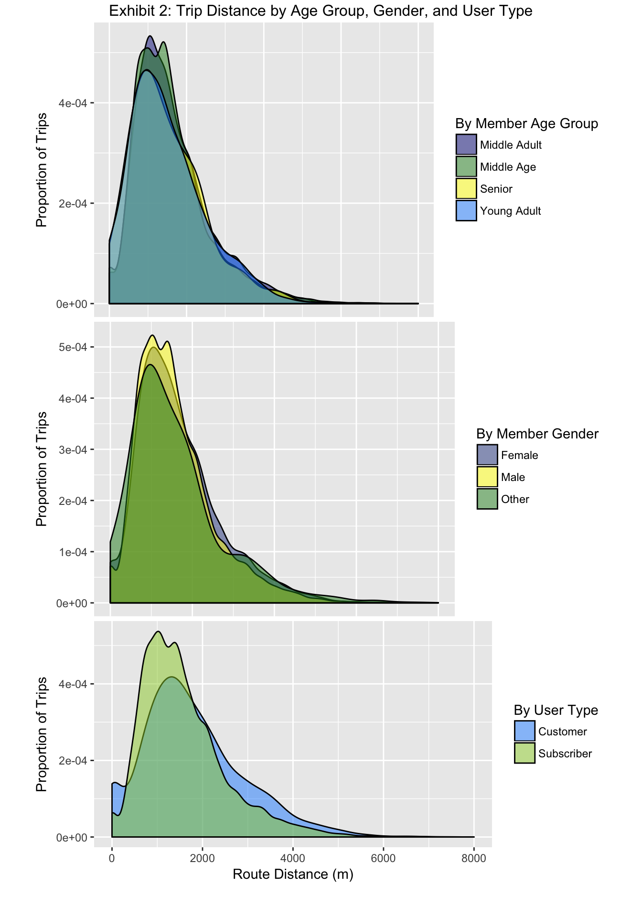
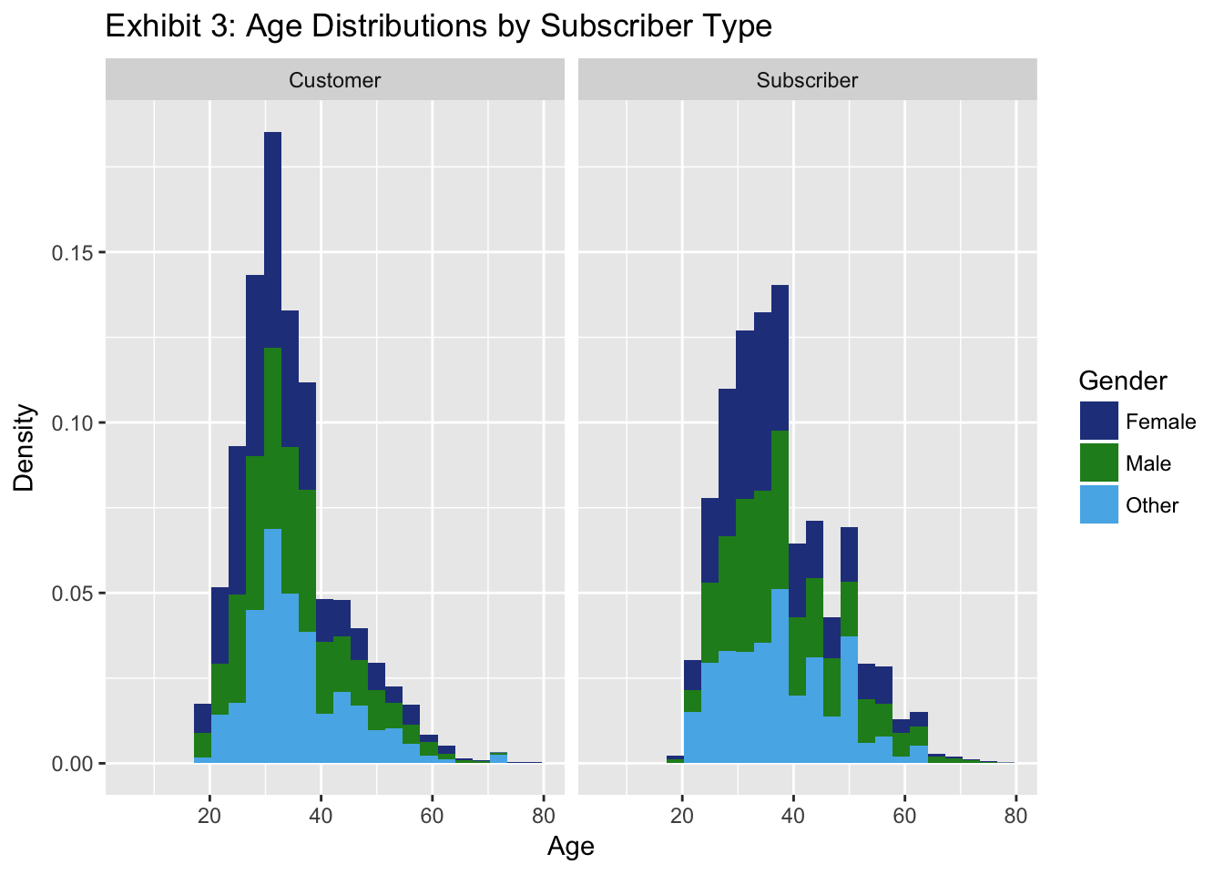
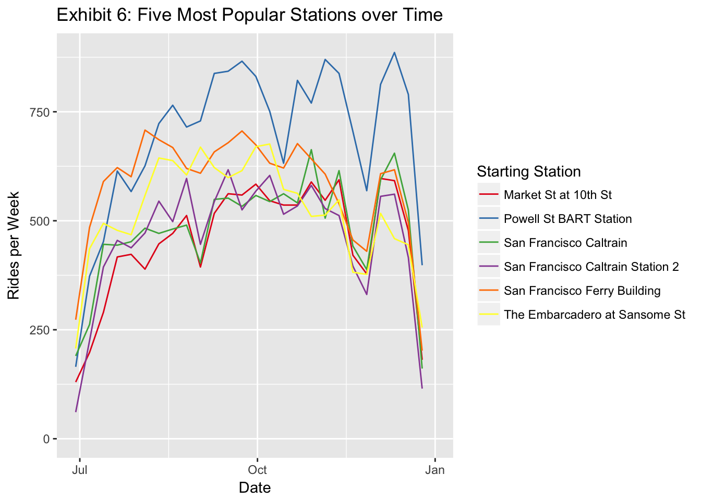
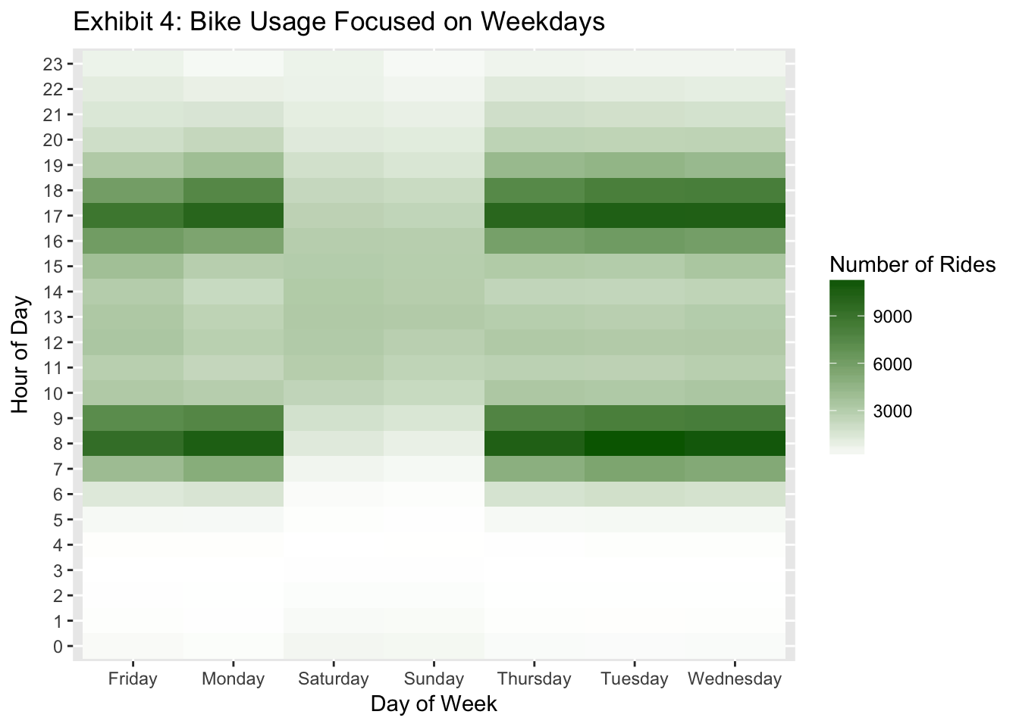
Analysis of Ford GoBike’s Open Data
36315: Statistical Graphics and Visualization
Carnegie Mellon University
Ross Hemmel, Joshua Huang, Julie Kim, Jinhee Lee
BACKGROUND
TIME SERIES
SOMETHING ELSE
Ford’s GoBike program provides an affordable bike-rental system in the San Francisco Bay Area. Users can either pay one-time or membership fees in order to borrow bikes from any station, and return them to any station.
With the open-source data that Ford GoBike offers on their website, we are looking to use statistical visualization in order to gain insight on customer demographics and biking behaviors. Our map base is pulled from Google.com.
The data involved was collected starting in June of 2017, and includes variables such as bike station geo-coordinates, trip start and end times, member types, and member characteristics.
FINDINGS
Exhibit 2: Distance travelled is not dependent on the age or gender of members. However, a higher volume of subscribing members ride shorter distances.
Exhibit 4: By examining bike usage data by each hour of each day, we found that users most frequently use the service during weekday rush hours of 8 a.m and 5 p.m.
Exhibit 5: Weekdays saw a large increase in users over the first few months while weekend riders remained steady.
Exhibit 6: A group of 3 stations appear to have very similar trends in user numbers while the other two follow different, sometimes opposite trends.
Exhibit 7:
Exhibit 8:

