Slide 1


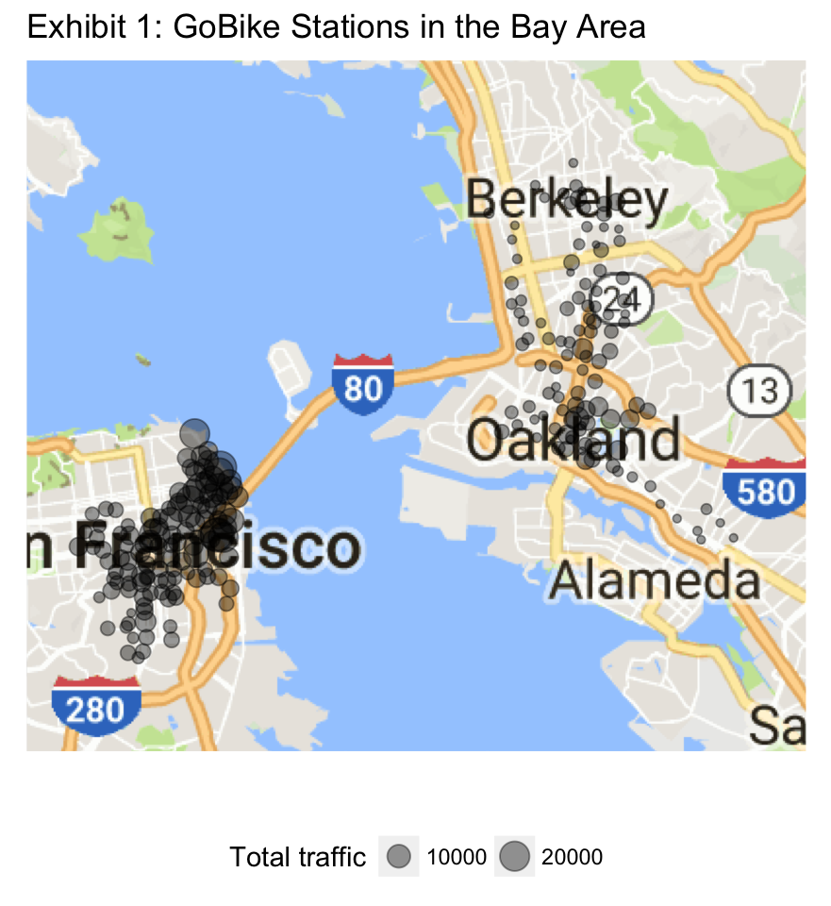
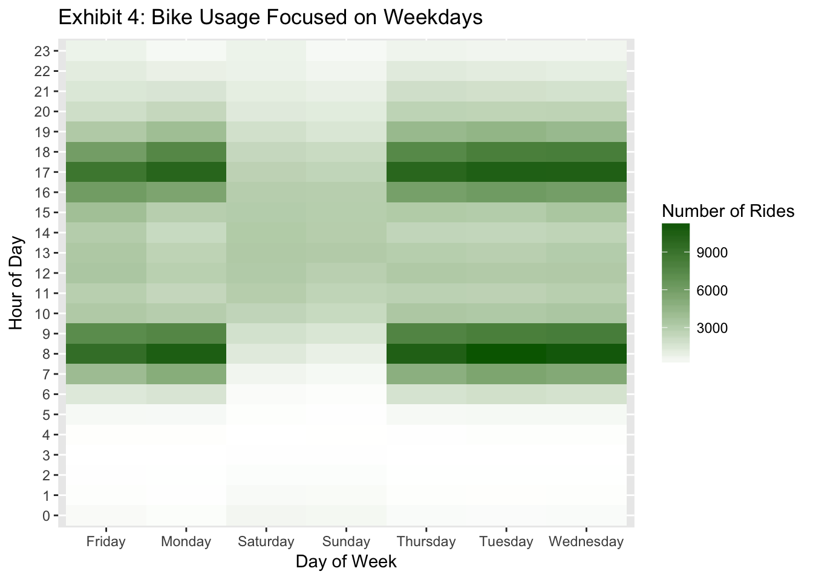
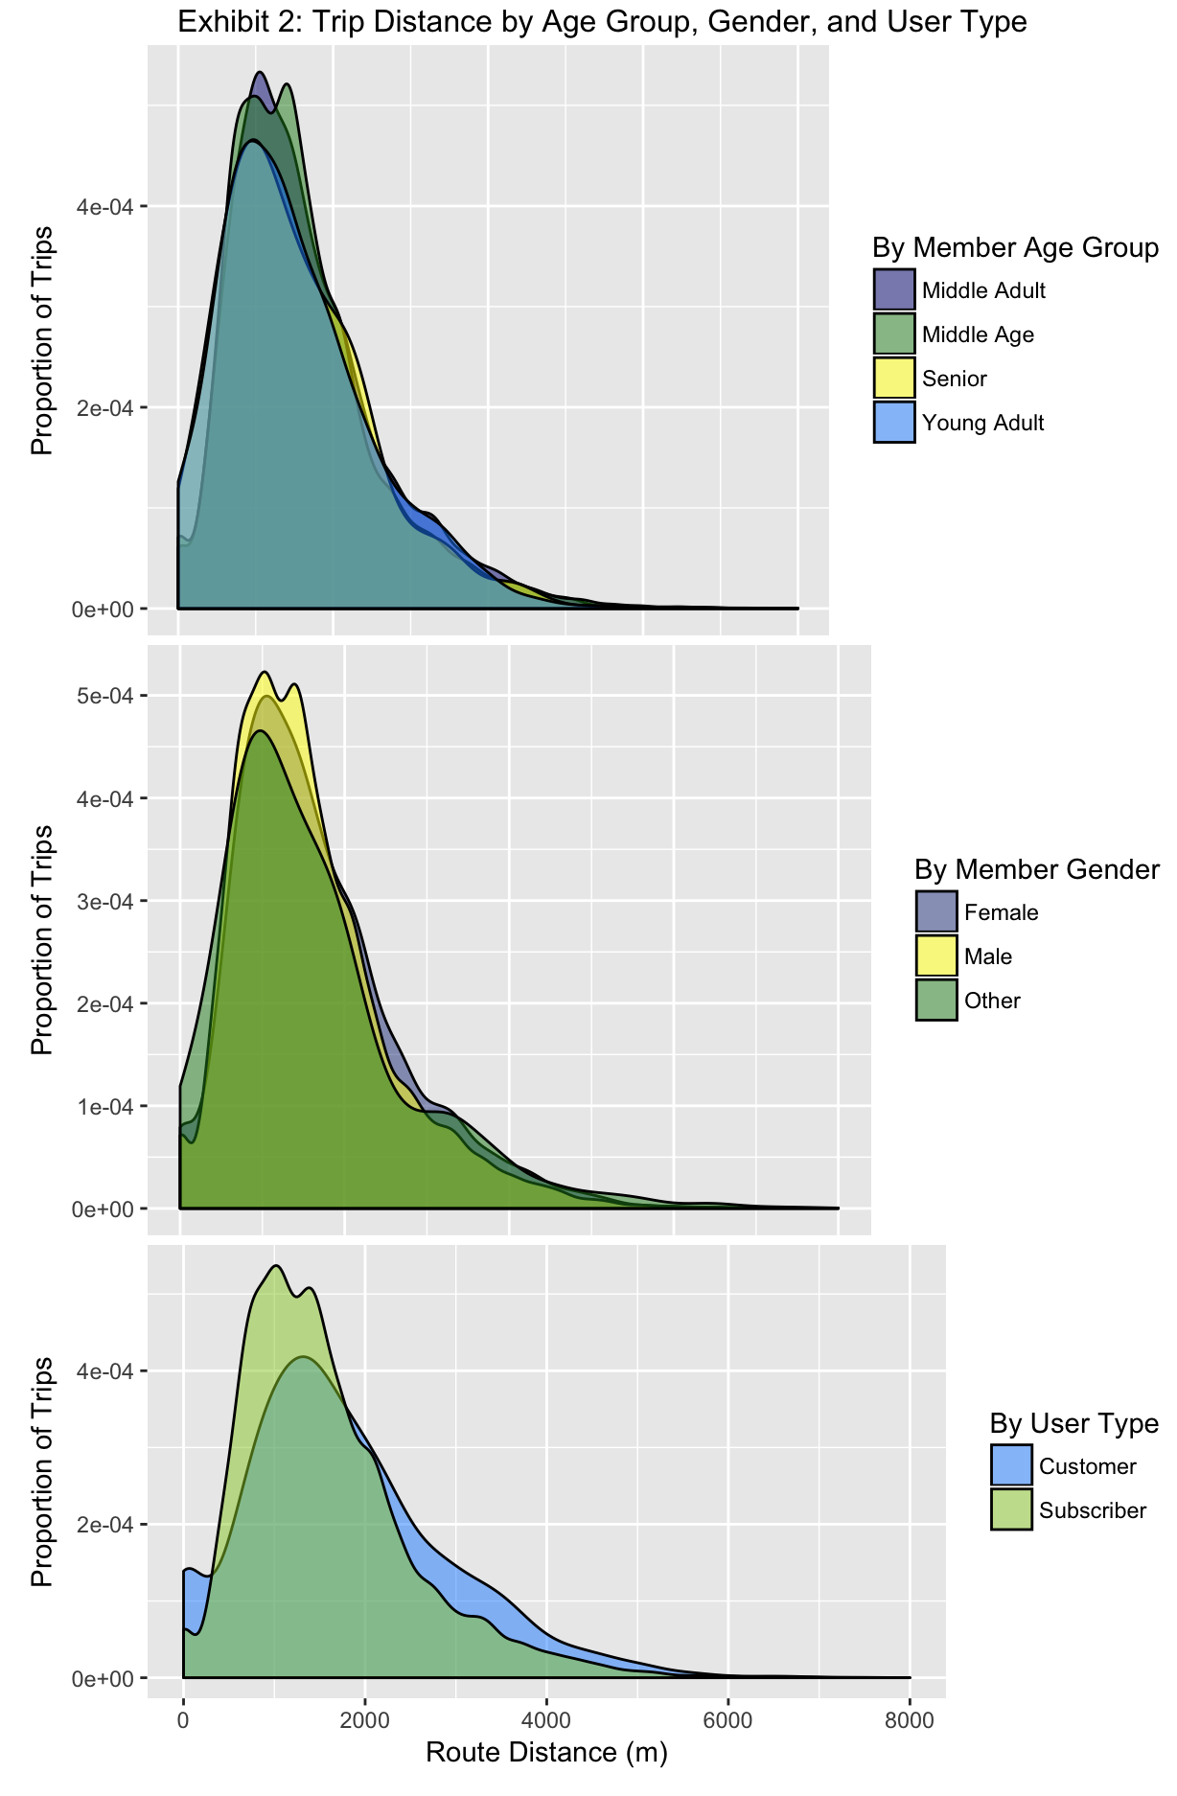
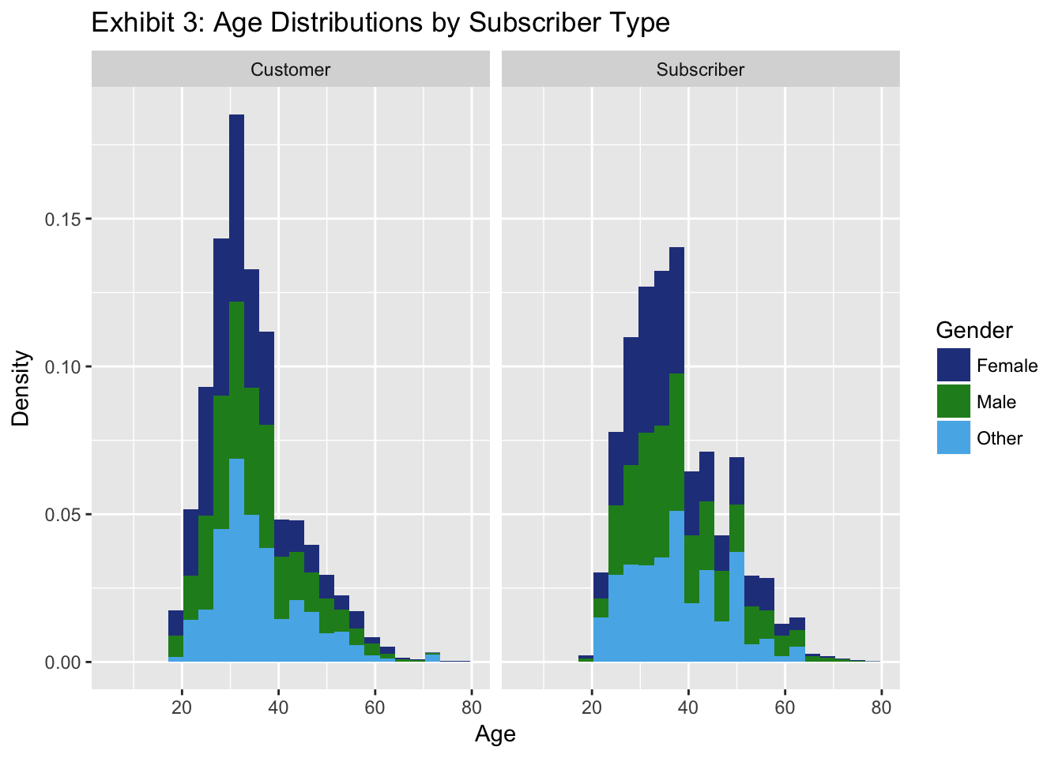
Analysis of Ford GoBike’s Open Data
36315: Statistical Graphics and Visualization
Carnegie Mellon University
Ross Hemmel, Joshua Huang, Julie Kim, Jinhee Lee
BACKGROUND
Ford’s GoBike program provides an affordable bike-rental system in the San Francisco Bay Area. Users can either pay one-time or membership fees in order to borrow bikes from any station, and return them to any station.
With the open-source data that Ford GoBike offers on their website, we are looking to use statistical visualization in order to gain insight on customer demographics and biking behaviors. Our map base is pulled from Google.com.
The data involved was collected starting in June of 2017, and includes variables such as bike station geo-coordinates, trip start and end times, member types, and member characteristics.
FINDINGS
Exhibit 2: The distribution of distance travelled does not appear to have a significant dependence on the age or gender of members. However, we found that a higher volume of members ride shorter distances. These are likely regular users who use the service to commute work or school.
Exhibit 4: By examining bike usage data by each hour of each day, we found that users most frequently use the service during weekday rush hours of 8 a.m and 5 p.m.
Exhibit 5:
Exhibit 6:
Exhibit 7:
Exhibit 8:

