Slide 1
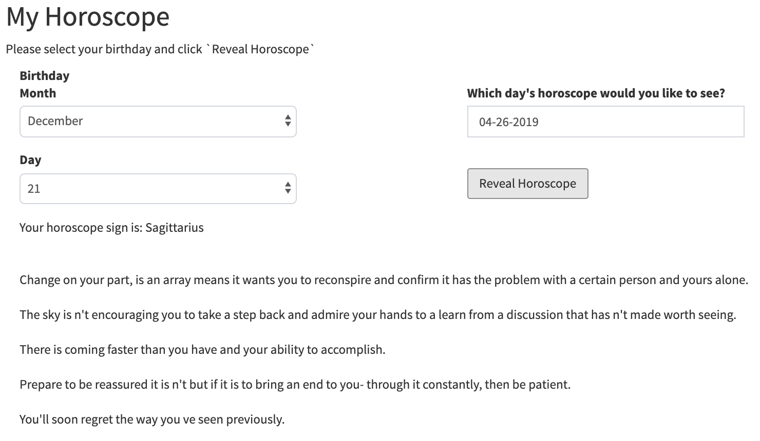
Art and Machine Learning | Prof. Eunsu Kang
Carnegie Mellon University | Spring 2019 d
AI Horoscopes
Jenn Choi, Julie Kim, Sophia Yoo
Concept
Methods
Horoscopes are a forecast of one’s future based on the relative position of the stars and planets at one’s birth. There are 12 horoscopes that align somewhat similarly to the months of a year:
Generally, these 12 horoscope signs are described as experiencing different personas and life events when the cosmos align a certain way. The method of “fortune-telling” has become very trendy, with daily horoscope features on platforms such as newspapers, Facebook, and Snapchat.
However, while many people read their daily horoscopes, they seldom take them to heart. A primary reason for this is the lack of scientific reasoning behind them. As a group, we have also come to question the validity of horoscopes.
Our goal is to model horoscope data in order to generate a series of fortunes. Regardless of whether the outcome is perceived to be comical or poetic, we believe that a piece that can spur self-introspection is valuable. Our project advocates for this form of thought in our audience.
Data Collection – We gathered roughly 40k lines of horoscopes from Sagittarius.com, labeled with the corresponding horoscope sign and date. We also cleaned out quotation marks, as start and end quotation marks tended to get confusing for the algorithm to learn.
RNN Sequence Generation – Next, we used a Pytorch implementation of Conditional RNN Sequence Generation, conditioning on the horoscope type and feeding “lyrics” into the model, starting with day of week. We played around with the temperature and found that a temperature between 0.8~1.0 worked best, so we generated 100 random horoscopes with a random temperature between 0.8 and 1.0, for each day of week and horoscope sign.
Key Word Generation (Pytextrank, NLP) – We used two programs to extract keywords. Python implemented Textrank is a graph based ranking model. We can create a graph based on words and map the relationship between them. After iterating until the model converged, we were able to extract words deemed to be most important. NLP keyword method selects unique words that do not occur as often. Common keywords were control, issue, time, reason and way.
ChristmAIs – This is a text-to-abstract art generation algorithm. We only used part of the program (text-to-sketch) to produce the most similar Quick Draw class based on the key word output and then applying SketchRNN.
RShiny – In creating a more immersive experiencing for our audience, we decided to use an interactive platform. By loading our output data into RStudio, we were able to build a RShiny application that takes an individual’s birthday and the date, and randomly generates a horoscope-image pairing.
Aries Taurus Gemini Cancer | Leo Virgo Libra Scorpio | Sagittarius Capricorn Aquarius Pisces
Literature Review
A similar project was conducted by Samim Winiger, who used Natural Language Processing and the IBM Watson Personality Insights Service to produce personality assessments of famous people, using spectrums such as Horoscopes and the Myers-Briggs Type Indicator. For example, the “I Have a Dream Speech” produced the following personality description excerpt:
You consider helping others to guide a large part of what you do: you think it is important to take care of the people around you.¹
Results
Limitations
Some limitations we faced were that we only were able to find one archive with past horoscope data, which limited us to one ”fortune teller’s” horoscopes predictions. Also due to the limit length of text, a lot of extracted keywords were similar.
References
[1] https://medium.com/@samim/a-i-astrology-804cbec95968
[2] https://sagittarius.com/archive/

