Slide 1
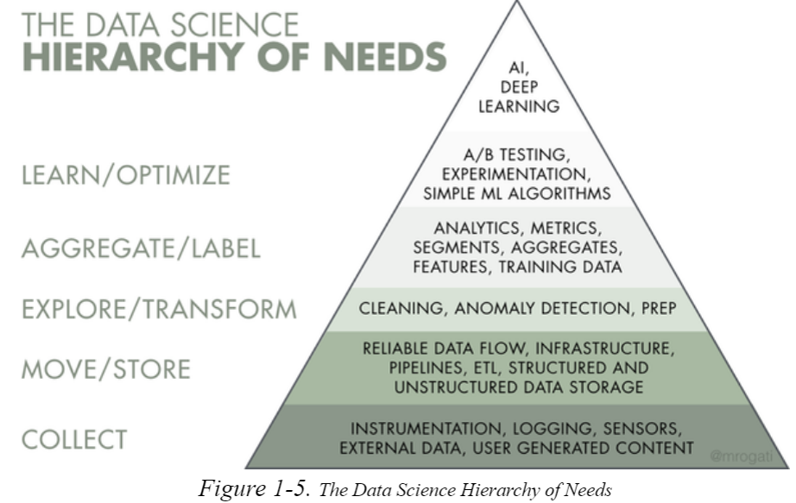
DS needs

Slide 2
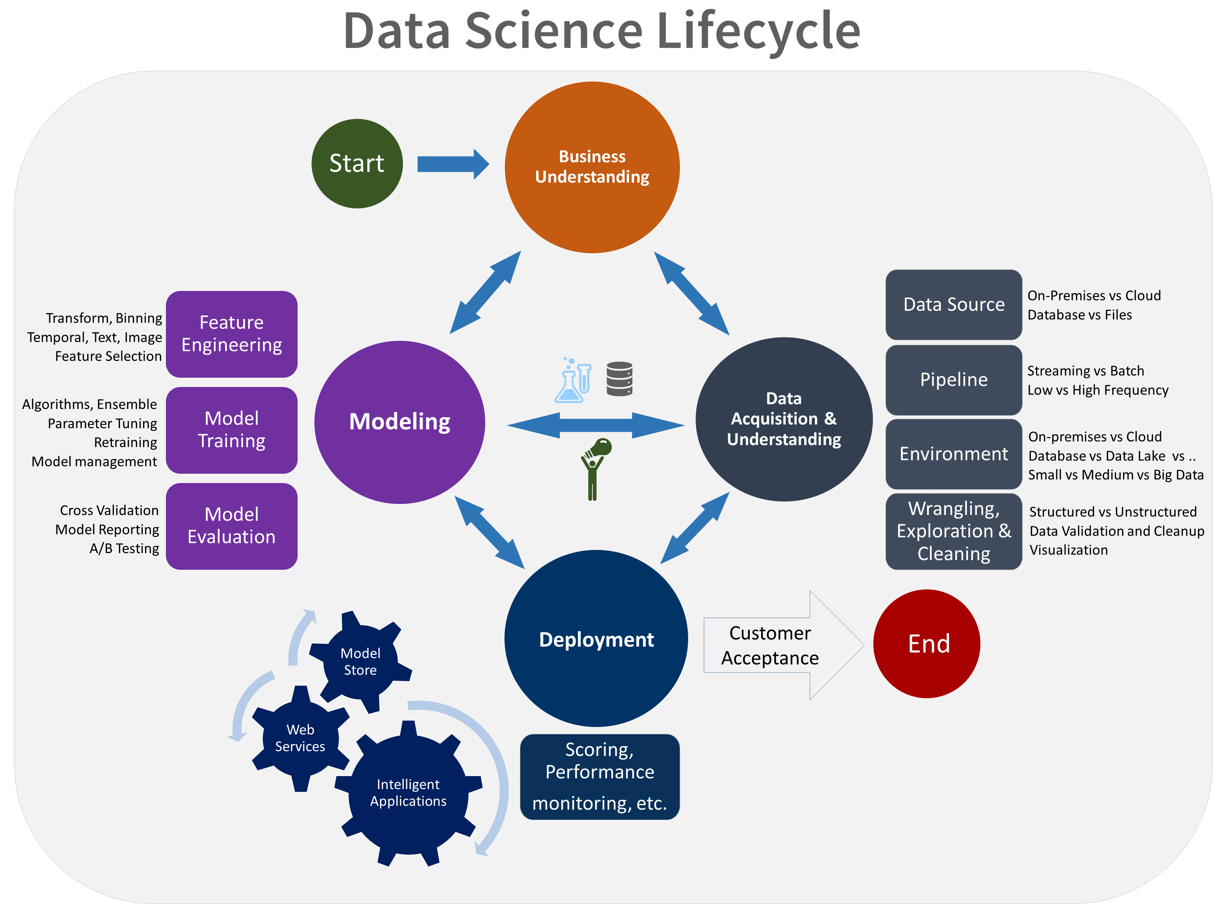
DS needs

Slide 3

Tech stack

Slide 4
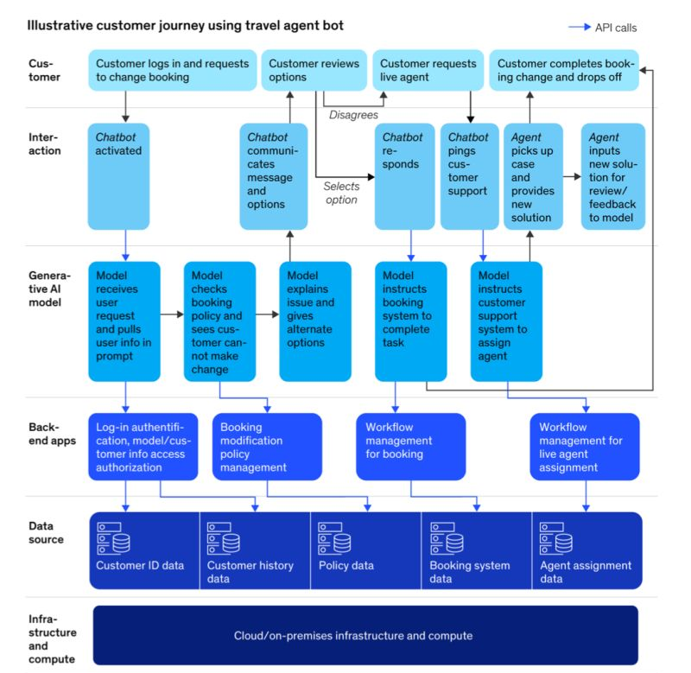
Layered view

Slide 5
