Slide 1

Content Marketing for Cryptocurrency Brokers
SixJupiter

Slide 2

The Problem: Content for Cryptocurrency Marketers
Content for cryptocurrency marketing can be challenging to develop
Lack of content makes it hard to build conversion funnels

Slide 3
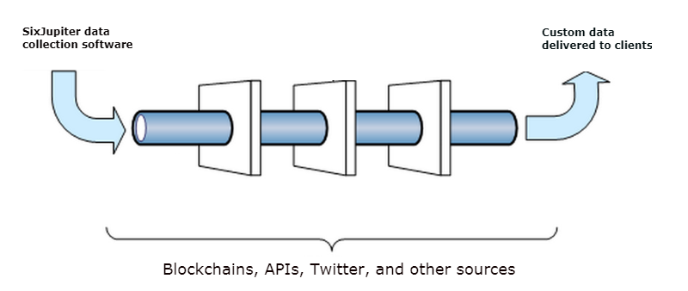
The Solution: A Custom Content Plan
Use our data to build web pages that helps you target the keywords you are focused on
Let us build custom metrics and reports that you can deliver to your subscribers regularly to stay in their minds and earn their trust

Slide 4

About Us: Data Science + Financial Marketing
Distributed team with 7 members in United States, Pakistan, and India
Founder: Simit Patel, data scientist/software developer with 12+ years experience in financial marketing
A small, technical team that moves fast

Slide 5

Run Content Marketing Campaigns That Work
Email: info@sixjupiter.com
SMS/phone/WhatsApp: +1 646 327 3895
Skype: simitp_1
URL: sixjupiter.com

