Slide 1
B.TECH • FIRST YEAR PROJECT
SMART HOME SECURITY
& INTRUDER DETECTION SYSTEM
SENSORS
LOGIC
A digital logic prototype that detects unexpected entry and triggers an alarm.
ALARM
DDCA • LOGIC GATES • LOGISIM SIMULATION
TEAM MEMBERS – GROUP 6
Section: 11
KL Deemed to be University • 2026–2027
S.No. | Name | Roll Number
1 | Sabeer | 2620030506
2 | Sushma | 2620030518
3 | Kaushik | 2620030525
4 | Lochan | 2620030526
5 | Bhavya | 2620030532
Project idea: detect a possible intrusion and alert the occupants.
01 / 06

Slide 2
PROJECT OVERVIEW
Introduction and Objective
A simple smart-home security concept modelled using digital logic.
THE PROBLEM
THE IDEA
THE RESPONSE
Unexpected entry may go unnoticed when a home is unattended.
Door and motion sensors provide binary signals to a controller.
When the system is armed and either sensor activates, raise an alarm.
OBJECTIVES
Represent sensor states as 0s and 1s.
INPUTS → DECISION → OUTPUT
Design an alarm rule using AND and OR gates.
Door sensor • PIR motion sensor • Armed switch
Output: Alarm LED / buzzer (conceptual)
Verify every input combination with a truth table.
Demonstrate the combinational circuit in Logisim Evolution.
SMART HOME SECURITY & INTRUDER DETECTION SYSTEM
02 / 06

Slide 3
DIGITAL LOGIC
Theory and Logic Circuit
The alarm is activated only when the system is armed and a sensor detects activity.
BOOLEAN EXPRESSION
HOW THE SIGNALS COMBINE
ALARM = (D AND A) OR (M AND A)
D
AND
D = Door open M = Motion detected
A = System armed 1 = active, 0 = inactive
A
OR
!
GATES USED
M
AND
Both inputs must be 1.
AND
OR
At least one input must be 1.
A
D and M are gated by A before the final OR.
SMART HOME SECURITY & INTRUDER DETECTION SYSTEM
03 / 06

Slide 4
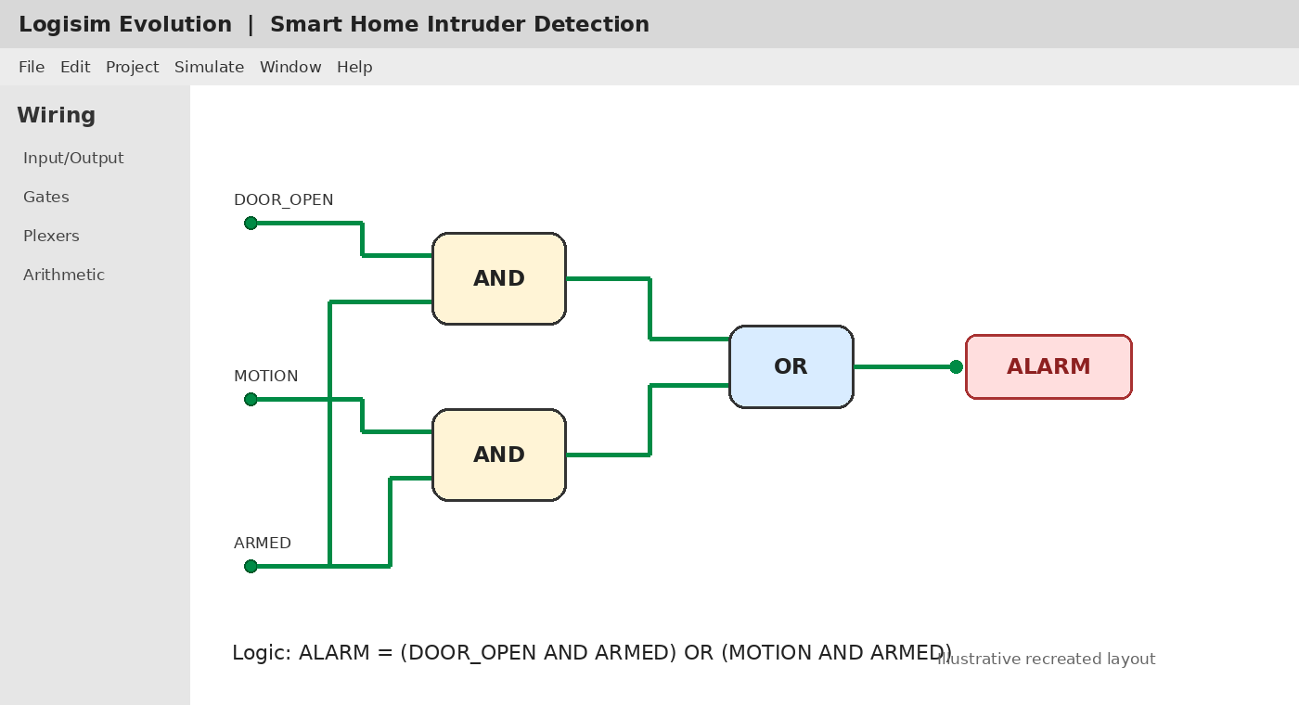
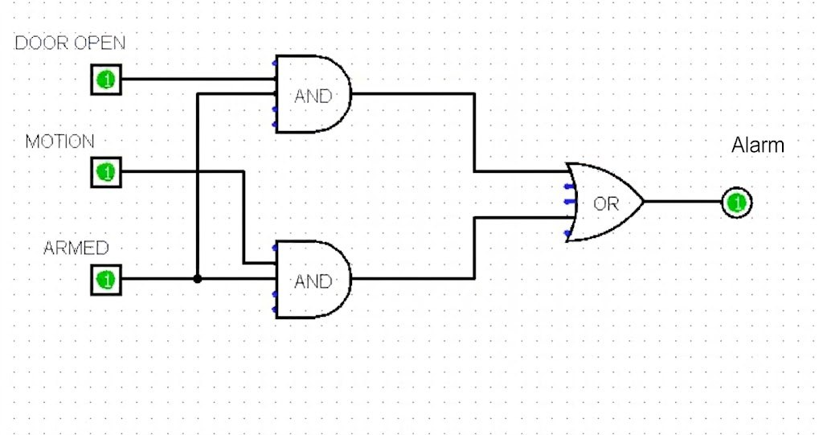
IMPLEMENTATION
Circuit Design in Logisim
Circuit layout for the Boolean rule: ALARM = (D AND A) OR (M AND A).
INPUT PINS
DOOR_OPEN, MOTION, ARMED
PROCESSING
Two AND gates feed one OR gate.
OUTPUT
ALARM output becomes 1 when triggered.
Note: the supplied PPT did not contain an actual Logisim screenshot; this is a recreated circuit-layout visual to guide the implementation.
SMART HOME SECURITY & INTRUDER DETECTION SYSTEM
04 / 06

Slide 5
TESTING AND VERIFICATION
Simulation Results
Truth table for all combinations of Door (D), Motion (M), and Armed (A).
D | M | A | ALARM
0 | 0 | 0 | 0
0 | 0 | 1 | 0
0 | 1 | 0 | 0
0 | 1 | 1 | 1
1 | 0 | 0 | 0
1 | 0 | 1 | 1
1 | 1 | 0 | 0
1 | 1 | 1 | 1
EXPECTED BEHAVIOUR
DISARMED (A=0)
Alarm stays 0, even if a sensor is active.
ARMED + NO SENSOR
D=0 and M=0, so alarm stays 0.
ARMED + ACTIVITY
If D=1 or M=1, alarm becomes 1.
Test each row by toggling the input pins in Logisim.
SMART HOME SECURITY & INTRUDER DETECTION SYSTEM
05 / 06

Slide 6
OUTCOME
Conclusion and Applications
The project demonstrates how simple digital logic can represent a practical security rule.
CONCLUSION
APPLICATIONS
The AND–OR circuit combines sensor signals with the armed state to generate a clear alarm output.
Home entry alerts, motion-triggered lights, lab/office access monitoring, and basic intrusion alarms.
POSSIBLE IMPROVEMENTS
Add a latch or flip-flop to remember alarm state.
FINAL RESULT
Add a reset / disarm control and status LEDs.
A verifiable truth table and a combinational circuit design suitable for Logisim simulation.
Connect a buzzer or real sensor hardware.
Extend with a phone notification module (future work).
Thank you
SMART HOME SECURITY & INTRUDER DETECTION SYSTEM
06 / 06

