Slide 1
ELECTRONICS AND COMMUNICATION ENGINEERING
AI-Based Signal
Interference Visualizer
Interactive Signal Quality Analysis Using Digital Signal Processing
Mini-project presentation · Electronics and Communication Engineering
Presented by: [Student Name] · Roll Number: [Roll Number]
Institution: [College Name] · Guided by: [Faculty Name]
Notes:
Introduce the project as a proposed educational simulation that makes changing signal quality visible, measurable, and easier to discuss.

Slide 2



THE SIGNAL PATH
Communication signals are shaped by noise and interference
Communication systems transmit information using electrical or electromagnetic signals. Noise and interference can enter during transmission and reduce received-signal quality.
Transmitter
Noisy channel
Receiver
Creates the desired communication signal.
Random noise and unwanted interference enter the path.
Receives a changed signal that must be analyzed.
Digital Signal Processing helps analyze signal behavior mathematically.
PROJECT PROPOSITION
This project proposes an interactive visual tool for understanding signal degradation.
Notes:
Frame the problem as a signal path: the receiver sees the result of both the intended signal and the disturbances introduced along the channel.

Slide 3
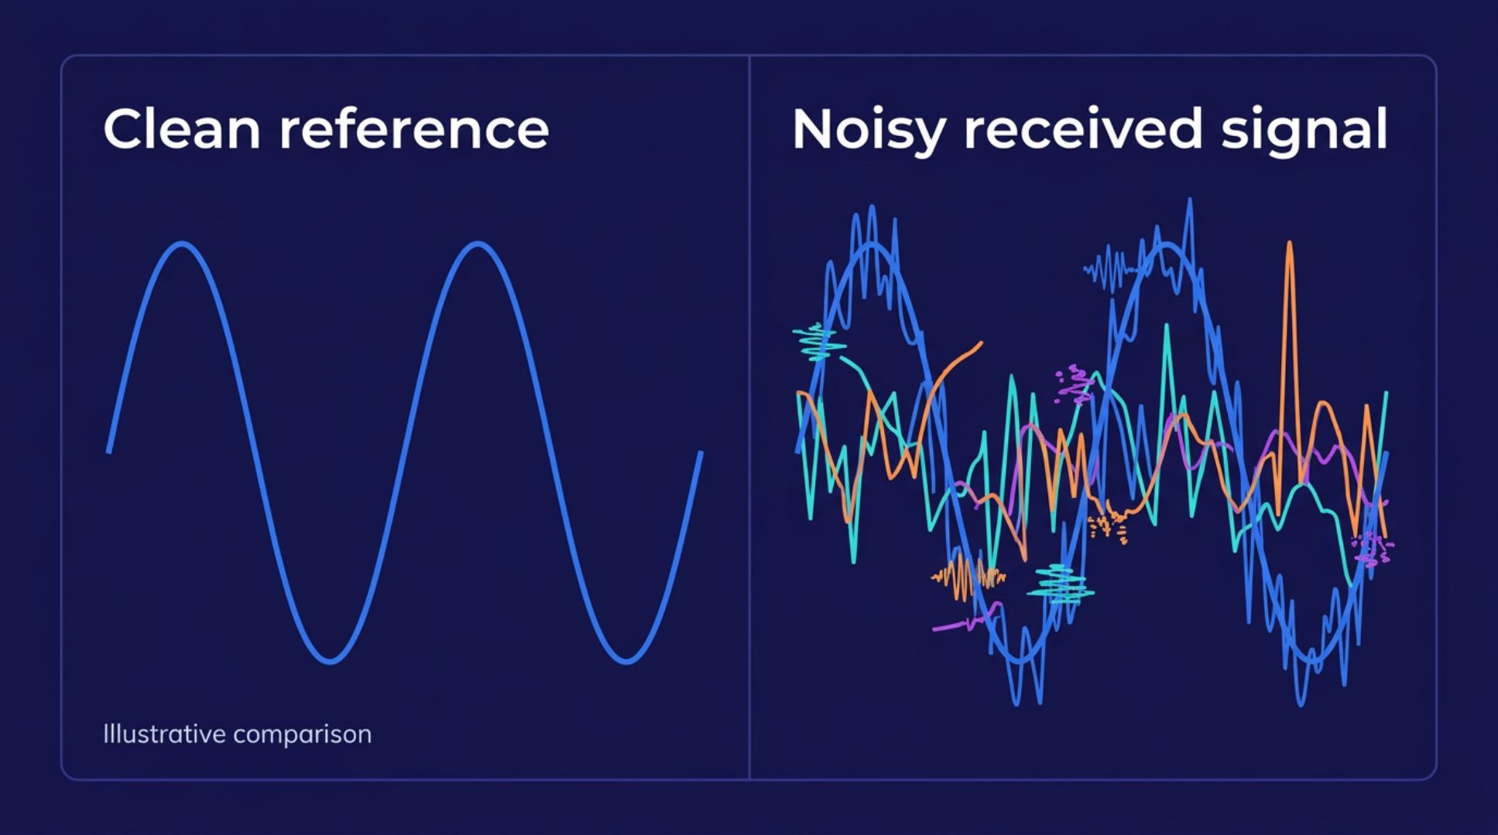
THE LEARNING GAP
ILLUSTRATIVE COMPARISON · TO BE VERIFIED IN IMPLEMENTATION
Static theory makes changing signal quality hard to see
Noise and interference distort a desired signal, but a static graph cannot show the immediate effect of changing the disturbance level.
The proposed dashboard generates a clean signal, adds adjustable simulated disturbances, displays both waveforms, calculates metrics, and classifies simulated conditions.
Students may find degradation difficult to visualize from theory alone.
Manual signal-quality calculations can be time-consuming.
Changing a parameter should produce an immediate visual response.
Notes:
Emphasize the gap between knowing the formula and seeing the effect. The visual comparison is illustrative, not an experimental result.

Slide 4
PROJECT PURPOSE
An integrated educational simulation connects controls, metrics, and visuals
Objectives
Generate a clean reference signal.
Simulate adjustable random noise and sinusoidal interference.
Visualize original and received signals interactively.
Calculate signal power, noise power, and SNR.
Display quality classifications from transparent calculated thresholds.
Demonstrate Fourier analysis where implemented.
Proposed innovation
Interactive parameter adjustment and immediate waveform comparison.
Automatic signal-quality metrics in a beginner-friendly dashboard.
Positioning: an integrated educational simulation—not a claim that the underlying DSP algorithms are new.
Notes:
Clarify the scope. The contribution is the integrated learning experience and visualization, while the underlying signal-processing methods remain established concepts.

Slide 5
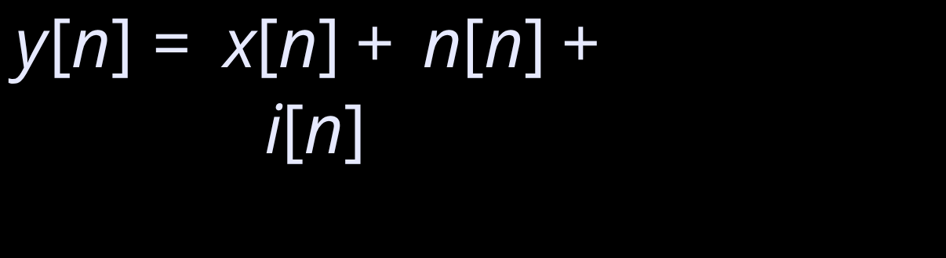



CORE CONCEPTS
Core ECE concepts turn waveform changes into measurable quantities
Signal: Information represented as a quantity varying with time.
Noise: Unwanted random disturbance added to the desired signal.
Interference: Unwanted signal or disturbance affecting the desired signal.
SNR: Desired signal power relative to noise power.
Fourier analysis: Examines frequency components present in a signal.
MEASUREMENT MODEL
x[n] = desired signal · n[n] = noise · i[n] = interference · N = number of samples
Notes:
Walk from the received-signal model to the two power calculations and then to SNR. Fourier analysis adds a frequency-domain view when implemented correctly.

Slide 6
SYSTEM DESIGN
Proposed architecture flows from user controls to dashboard results
01
02
03
04
User controls
Signal generation
Disturbance model
Received signal
Frequency, amplitude, noise, interference.
Create digital samples.
Add noise and optional interference.
Combine the sample streams.
05
06
07
08
Measurements
Classification
Visualization
Dashboard
Calculate power and SNR.
Apply transparent rules.
Waveform and optional spectrum.
Refresh results and indicators.
Suggested implementation: Base44 frontend · JavaScript simulation and calculations · compatible interactive charting library · optional FFT-based spectrum.
Notes:
Describe the architecture as a connected pipeline. Each control change should flow through simulation, measurement, classification, and visual refresh.

Slide 7
METHODOLOGY
Methodology converts discrete samples into interpretable signal quality
Generate · Disturb
Combine · Measure
Generate x[n] = A sin(2πfn/Fs), then add simulated random noise and optional sinusoidal interference.
Form y[n] = x[n] + n[n] + i[n]; calculate signal and noise power from generated samples.
Quantify · Optional SINR
Classify · Update
Calculate SNR using the power ratio. Optional SINR: desired power divided by total unwanted disturbance power, with assumptions stated.
Apply transparent rule-based thresholds to simulated conditions; refresh waveform graphs and measurements.
FFT analysis can reveal dominant and additional frequency components when a correct FFT implementation is included.
Notes:
Stress that every classification is derived from generated samples and stated rules. SINR is optional and assumption-dependent; it should not be presented as a universal measurement without defining the unwanted components.

Slide 8
PROPOSED DASHBOARD MOCKUP
Interactive dashboard makes each disturbance visible
CONTROLS
VIEWS
INDICATORS
Signal setup
Signal windows
SNR · dB
Amplitude
ORIGINAL WAVEFORM
RECEIVED WAVEFORM
Calculated from simulated samples.
Frequency
Optional frequency spectrum when FFT is implemented.
Noise level
Interference: ON / OFF
Signal-quality status
Rule-based classification · TO BE VERIFIED
Demonstration sequence: start clean, increase noise, observe SNR decrease at constant signal power, then enable interference and compare the measurements.
Notes:
This is a proposed dashboard mockup. The implementation and demonstration results remain to be verified.

Slide 9
WHAT THIS ENABLES
Expected outcomes support teaching today and deeper analysis later
Proposed outcomes
Applications
Future scope
Clear clean-versus-noisy waveform visualization.
Automatic SNR calculation from simulated samples.
Visible quality changes as noise increases.
Comparison with and without interference.
Optional spectrum view if FFT is implemented.
DSP laboratory demonstrations.
Communication-systems education.
Introductory signal analysis.
Digital filtering · advanced modulation · real recorded signals · SDR integration.
Genuine machine-learning classification using a trained model and labeled data.
All outcomes are proposed until experimentally verified. Without a trained model, classification remains rule-based rather than AI-based.
Notes:
Separate what the project can support immediately from future extensions. The AI label is conditional: genuine AI classification requires a trained model and labeled data.

Slide 10
Conclusion
Noise and interference affect communication signals in visible ways.
Interactive simulation connects core ECE concepts with web-based learning.
SNR calculations quantify the effect of noise on signal quality.
Fourier analysis can add insight into frequency components.
The dashboard can support DSP and communication-systems learning.
CONCLUSION
Make signal quality visible.
Measure the change. Explain the cause.
PROPOSED EDUCATIONAL SIMULATION
CLEAN WAVEFORM · NOISY WAVEFORM · SNR INDICATOR
Thank You
Questions and Answers
Notes:
Close by returning to the central promise: the visualizer links signal behavior, measurable quality, and engineering interpretation in one learning environment.

