Slide 1



DEBUGGING JUPYTERLAB EXTENSIONS
Max Klein
Software Developer
JP Morgan
telamonian@hotmail.com
github.com/telamonian

Slide 2
When to debug
When stuff goes wrong
When you want to inspect the internals of your extension
When to debug
How to debug (using vscode)
Notes:
Run notebook command: jupyter notebook

Slide 3
How to know stuff has gone wrong
UI elements don’t show up
Errors appear in Python console
Errors appear in browser console
When to debug
How to debug (using vscode)
Notes:
Run notebook command: jupyter notebook

Slide 4
Enter into a terminal
$ pip install cookiecutter
$ cookiecutter gh:jupyterlab/debug-config-cookiecutter –f
Answer any prompts that come up
Configure stuff in .vscode dir as necessary
For the “mybutton” example project, change “webroot” to: "webRoot": "${workspaceFolder}/demo/completed-demo”,
Needs the “Debugger for Chrome” extension for vscode
When to debug
How to debug (using vscode)
Notes:
Run notebook command: jupyter notebook

Slide 5
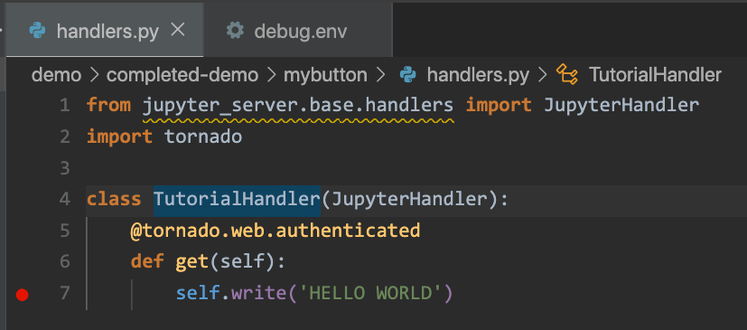
Set breakpoints in vscode
When to debug
How to debug (using vscode)
Notes:
Run notebook command: jupyter notebook

Slide 6
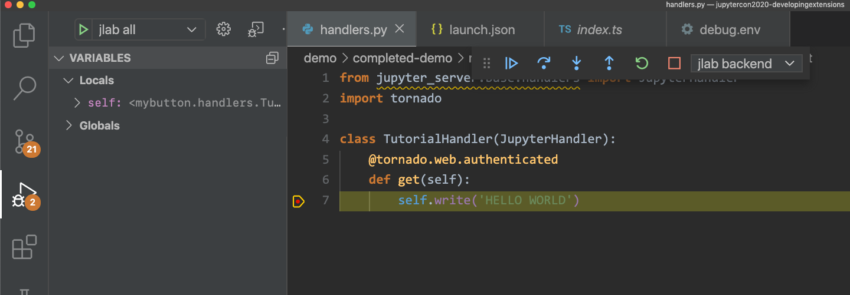
Run debug tasks in “run” sidebar
Run “jlab all”
When to debug
How to debug (using vscode)
Notes:
Run notebook command: jupyter notebook

Slide 7
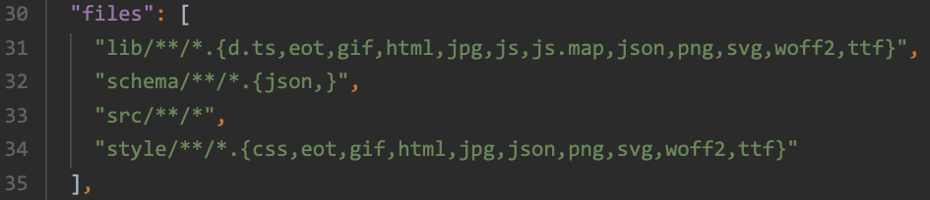
Project config (for your own extensions)
Add “sourceMap” to tsconfig.json
"sourceMap": true,
Make sure that “files” in package.json includes src
Example:
When to debug
How to debug (using vscode)
Notes:
Run notebook command: jupyter notebook

Slide 8
If you run into any problems…
Please make an issue on the jupyterlab/debug-config-cookiecutter repo: https://github.com/jupyterlab/debug-config-cookiecutter/issues
Example video: https://youtu.be/VB-0o6JZVE4
When to debug
How to debug (using vscode)
Notes:
Run notebook command: jupyter notebook

