Slide 1
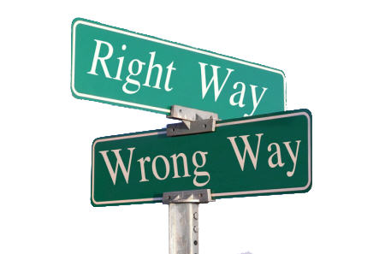
Theory of Knowledge Presentation
Mariana Phuong Juraj Masár

Slide 2
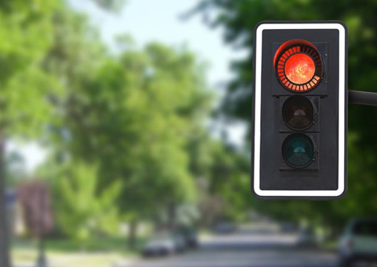
To cross or not to cross?

Slide 3


To skip or not to skip?
X
…when you have to
write a dossier

Slide 4
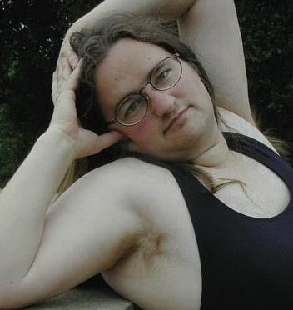
“How do I look, honey?”

Slide 5
Anything in common?
…a moral conflict

Slide 6
Knowledge issue
How do we know we are acting morally?

Slide 7
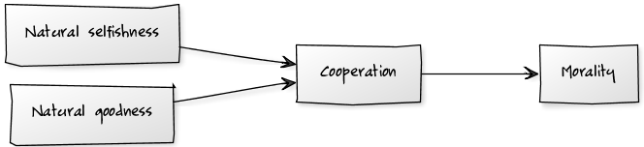
Why does morality exist?
…because of the human nature
Morality deals not only with action but also with intention.
Our perception of morality is strongly influenced by the actual situation we find ourselves in.

Slide 8
Real-life situation
Your are driving a car and about to cross traffic lights when red is on because...
…the road looks empty
…you don’t want to miss the finals of The Champions League
…your friend needs urgent medical help

Slide 9

…but how do we know?
Sources of morality:
Intuition
Authority
Observation and reasoning
Social consensus

Slide 10
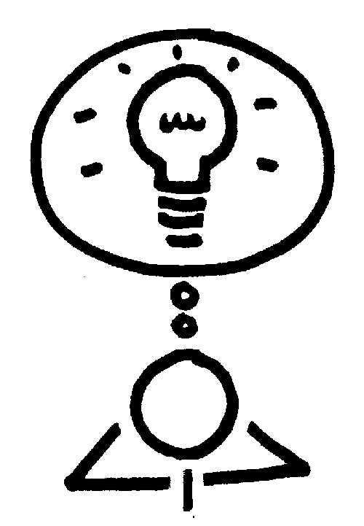
Sources of morality: Intuition
Primary source of morality
Conscience
Subjective

Slide 11

Sources of morality: Authority
Parents
Kindergarten teachers
Culture
Kamikaze
Hara-kiri
Religion and other beliefs
Polygamy in Christianity and Islam
Universe people (.com)

Slide 12
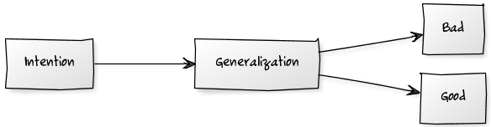
Sources of morality: Observation and reasoning
Immanuel Kant
Utilitarianism
Maximize aggregate happiness

Slide 13

Sources of morality: Social and political agreement within a smaller society
Laws
Ethical standards
Objective

Slide 14
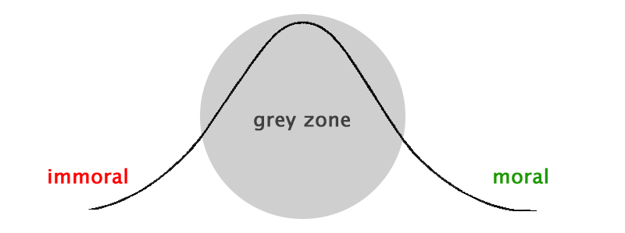
Is there anything like objective morality?
Disagreement among people

Slide 15
Objective morality: The grey zone problem
How to determine the “right” opinion?
Mean (?)
Manipulation of masses
Factors against:
Education
Encourages critical thinking ⬄ having own opinion
Weighted mean (?)
Level of education as weight

Slide 16

So… how do we know we are acting morally?
…we don’t.
“Treat others as you would like to be treated.”

Slide 17
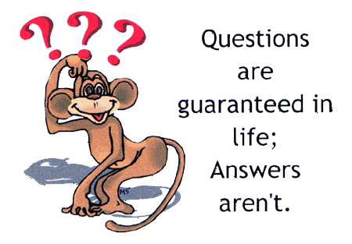
Thank you for your attention!
Questions or comments?

