Slide 1
ZNA Junior Data Scientist – Case Study
Commercial Auto Insurance
Claim Risk Scoring
Predicting which policies are likely to file a claim, from EDA to a production-minded scoring pipeline
Juraj Riedel
September 2026
Notes:
Intro. Thanks for the opportunity - quick overview: I'll walk through what I found in the data, what I changed and why, how I validated it, what's still left before production, what I learned, and how I used AI tools along the way. About 15-20 minutes, happy to take questions as we go.

Slide 2
AGENDA
What I'll cover
01
Findings
02
Improvements
What the data looks like, and what surprised me
Modeling methodology + production readiness changes
03
Validation & results
04
Roadmap
How I tested it, and how well it performs
What's still needed before this goes to production
05
What I learned
06
AI tools
New concepts this case study pushed me to use properly
What I used, and how I checked it before trusting it
2

Slide 3
BACKGROUND
Scoring policies for claim risk
Commercial auto insurance covers business vehicle policies - Auto Physical Damage (APD) and Auto Liability (AL); an insured can carry either or both.
Goal: given a policy's underwriting information, estimate the probability it will have at least one claim during the period.
Started from a prototype notebook with a significant data leakage issue - reviewed it, then rebuilt the pipeline.
THE DATA
15,075
policies 2020-2022 (train, with outcomes)
3,000
policies 2023-2024 (score, no outcomes)
12.3%
of training policies had a claim
3
Notes:
Set the scene: APD vs AL, why risk scoring matters for underwriting profitability. Train has outcomes, score doesn't - that's what I'm predicting for. Note the prototype notebook I started from had a real leakage bug, which is where the EDA findings on the next few slides come in.

Slide 4
FINDING 1 OF 5
The target is imbalanced, and severity is skewed
WHAT THIS MEANS FOR MODELING
Only ~12% positive rate - predicting "no claim" for everyone already scores 88% accuracy, so accuracy is the wrong metric.
Among policies that did claim, total loss amount is strongly right-skewed - a few large losses dominate the mean.
Defined this as a binary classification problem (probability of >=1 claim), focusing on whether a claim occurs rather than predicting the claim amount — there are not enough claims to model dollar amounts reliably.
4
Notes:
First EDA finding. 12.3% positive rate - imbalanced enough that accuracy is misleading. Severity is heavily skewed. This is why I framed the problem as classification with AUC/PR-AUC/Brier, not accuracy, and why I didn't try to predict the dollar loss directly.

Slide 5
FINDING 2 OF 5
Four columns look useful at first, but would cause data leakage
Data dictionary flags 4 columns as only known after a claim is reported/resolved: first_claim_reported_date, claim_paid_amount_current_period, claim_status_current_period, days_to_first_claim_report.
In train.csv, these fields are filled in when a claim occurs, so using them as model inputs would cause target leakage.
In score.csv, 300 out of 3,000 rows have these fields filled in, even though they should not contain any outcome information.
300 / 3,000
score.csv rows with
"post-outcome" fields
filled in anyway
5
Notes:
This was the most important finding. The prototype used two of these leaky columns directly as features - that's the single biggest bug I fixed. And critically, checking 'is this column non-null in score.csv' isn't a safe test for whether it's OK to use - 10% of score rows have it populated anyway. Hard-coded ban list plus a schema assertion, not a heuristic.

Slide 6
FINDING 3 OF 5
Three issues with business_type
INCONSISTENT CASING
A RARE, UNDOCUMENTED CATEGORY
AN UNSEEN CATEGORY
"Trucking" / "trucking" / "TRUCKING" all mean the same thing, but encoder treats them as different categories.
"Agriculture"
"Rideshare"
isn't even in the data dictionary and shows up in only 8 of 15,075 train.csv rows - too few to learn anything reliable from.
appears in 60 score.csv rows (2%) but zero train.csv rows - the model never learned anything about this segment.
Fix: normalize case and whitespace before encoding.
Fix: group into "Other" rather than risk overfitting to 8 rows.
Fix: detect unseen categories explicitly, log a warning, route to "Other" on purpose.
6
Notes:
Three separate category issues in business_type. Casing is a straightforward cleanup. Agriculture is rare and undocumented - only 8 rows, not enough to learn from, so it gets folded into Other. Rideshare is the more interesting production risk: it's completely unseen in training, so I catch it explicitly and log a warning rather than letting the encoder silently zero it out.

Slide 7
FINDING 4 OF 5
The same company shows up more than once
insured_id is not unique per row - a company can have an APD row and an AL row and can appear across multiple annual snapshots.
Most insureds in score.csv were already seen in train.csv - this is mostly a renewal book, not brand-new business.
Distributing records from the same company across both training and validation splits introduces subtle data leakage, as the model can pick up feature patterns specific to that entity during training.
~96%
of holdout insureds
were already seen
in training data
7
Notes:
This finding directly shaped the validation strategy - grouping by insured_id in cross-validation, and later splitting holdout results by 'seen vs new' insured so I'm not overstating how well the model would do on genuinely new customers.

Slide 8
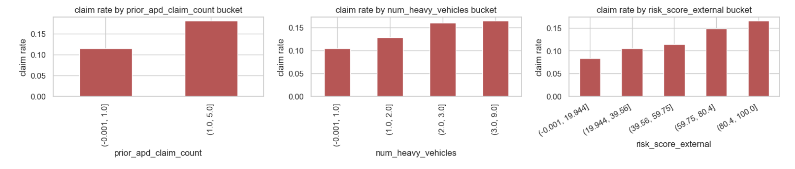
FINDING 5 OF 5
Do the numeric features actually predict claims?
Claim rate (%) rises consistently from the lowest to the highest bucket for all three - a real, if modest, signal worth keeping as model features (not just noise).
8
Notes:
Before trusting a feature, I checked whether claim rate actually moves across buckets of it, not just what the raw distribution looks like. All three show a fairly monotonic increase from low to high bucket - reassuring that these aren't noise, and a sanity check the permutation importance results later confirm.

Slide 9
IMPROVEMENTS - PART 1
Modeling methodology
1
Removed data leakage
2
Time-based holdout
3
Grouped + stratified CV
Excluded the 4 post-outcome columns and added a schema check that raises an error if they are used.
Train on older policies and test on newer ones to better reflect how the model would work in practice.
StratifiedGroupKFold on insured_id - no company split across folds
4
Calibrated probabilities
5
Model comparison
6
Feature engineering
CalibratedClassifierCV, auto-comparing isotonic vs sigmoid + AUC/PR-AUC/Brier
LogisticRegression vs HistGradientBoosting, selected on CV metrics
driver_per_vehicle, heavy_vehicle_ratio, loss_to_limit_ratio
9
Notes:
Six changes, but the leakage removal is by far the most important - the prototype used two post-outcome columns directly as features. Everything else here is about making the validation numbers trustworthy: if I don't fix the split and the grouping, a good-looking AUC doesn't mean much.

Slide 10
IMPROVEMENTS - PART 2
Production readiness
1
Schema safety check
2
Shared preprocessing
3
Structured logging
validate_schema() fails if a banned or missing feature is used
One function prepares train and score identically - no train/serve skew
Timestamped, leveled logs instead of print() - readable, filterable
4
Model persistence
5
Modular, testable code
6
Portable data paths
joblib.dump() - reload the exact fitted model without retraining
Functions + main() guard, not a linear notebook cell sequence
Optional DATA_DIR env var - same script runs locally and on Databricks
10
Notes:
These are about what breaks in production that doesn't show up in a notebook: a feature quietly missing from new data, train and score being prepared slightly differently, no way to reload a model without retraining. The schema check specifically would have caught has_safety_program being absent from score.csv.

Slide 11
VALIDATION
Two validation angles, used together
TEMPORAL HOLDOUT
GROUPED, STRATIFIED CV
dev (older)
holdout
StratifiedGroupKFold(5), grouped by insured_id, within the development set.
Sorted by snapshot_date - most recent ~20% held out. Mirrors how the model is actually used: trained on the past, scored on the future.
Grouped: a company's rows never split across train/validation in the same fold
Stratified: ~12% positive rate stays consistent across folds
Same grouped folds reused for calibration - not just model selection
11
Notes:
Two angles, not one, because they answer different questions: can the model generalize to the future, and can it generalize to companies it hasn't priced before. I also reused the exact same grouped folds inside the calibration step - otherwise calibration could leak a company's info between its own folds.

Slide 12
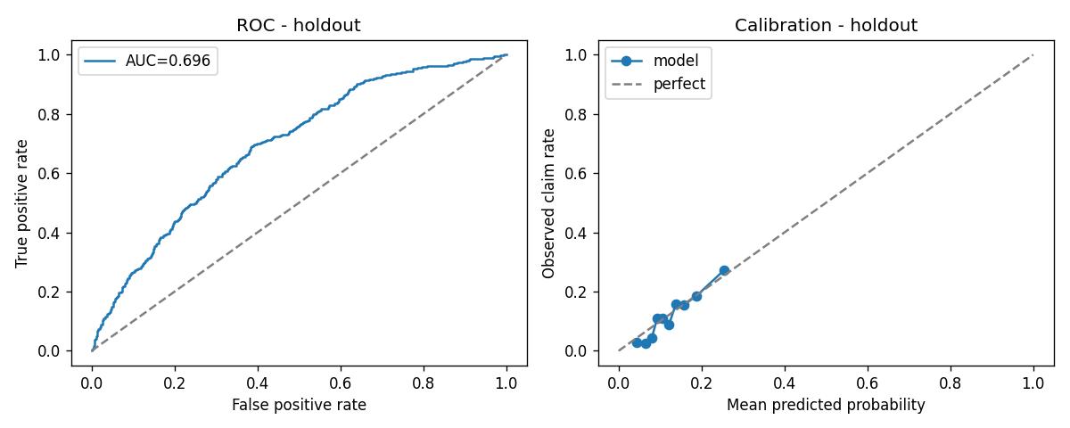
RESULTS
Model evaluation
CROSS-VALIDATION (dev, 5-fold)
Model | AUC | PR-AUC | Brier
LogisticRegression (selected) | 0.660 | 0.219 | 0.229
HistGradientBoosting | 0.643 | 0.215 | 0.106
CALIBRATION METHOD COMPARISON (holdout)
isotonic: AUC 0.694 / PR-AUC 0.221 / Brier 0.099 sigmoid: AUC 0.696 / PR-AUC 0.223 / Brier 0.099 - sigmoid selected
HOLDOUT (after calibration method selection)
ROC and calibration curves on the holdout set.
Slice | n | AUC | PR-AUC | Brier
Overall | 3,008 | 0.696 | 0.223 | 0.099
Insured seen in dev | 2,889 | 0.695 | 0.223 | 0.100
Insured new to holdout | 119 | 0.722 | 0.284 | 0.085
Accuracy wasn't used - predicting "no claim" for everyone already scores 88% on this data.
12
Notes:
LogisticRegression was selected on CV AUC and PR-AUC. After calibration, holdout AUC is 0.694 overall. I report seen-vs-new insured separately - the new-insured slice looks slightly better here but n=119 is small, so I read that as noise, not evidence the model generalizes better to new business.

Slide 13
EXPLAINABILITY
Which factors drive the risk score
TOP FINDING
coverage_type
(APD vs AL) was the most important feature in the final model. This also supports the EDA finding that the two coverage types may behave differently. I kept them in one model to keep the solution simpler and have more data for training, but separate models could be tested in the future.
13
Notes:
Computed via permutation importance on the holdout set - shuffle one feature, measure how much AUC drops. coverage_type dominates, which is a good reason to revisit the APD/AL pooling decision on the roadmap.

Slide 14
BOTTOM LINE
What the Model Produces
Leakage-proofed
banned columns + a schema check that fails loudly
3,000
Validated realistically
temporal holdout + grouped CV, not a random split
Calibrated honestly
isotonic vs sigmoid chosen by evidence, not convention
policies scored,
one calibrated
probability each
Explainable
permutation importance shows what actually drives the score
Production-minded
predictions.csv
logging, model persistence, portable across environments
This isn't a finished pricing model - it's a demonstration that the process behind it was built the way a production risk-scoring system should be.
14
Notes:
This is the 'so what' slide before I move into the roadmap. The output is one number per policy, but what actually matters is the methodology behind it - each of these five things is something the prototype notebook didn't have, and each is something a reviewer could ask me to defend in detail.

Slide 15
ROADMAP
Before this goes to production
Modeling & validation
Explainability & fairness
Compare XGBoost/LightGBM/CatBoost
Re-test isotonic vs sigmoid calibration at scale
Evaluate splitting APD / AL into separate models
Per-prediction explanations (SHAP), not just aggregate importance
Check model performance across state and business_type
Monitoring & operations
Engineering & governance
Monitor feature and prediction drift and set up for unexpected changes
Define a regular retraining process and compare the model against the existing risk_score_external benchmark
Move the current script into a versioned production pipeline with automated data and schema checks
Add model documentation, access controls, audit logging, and the necessary actuarial and compliance review before deployment
14
Notes:
None of this is implemented - it's meant to show I understand the full ML lifecycle, not just the modeling part. The monitoring piece specifically would have caught the Rideshare and leakage-trap findings automatically instead of via manual EDA.

Slide 16
REFLECTION
What I learned working on this
1
A "fair" comparison isn't automatic
2
Raw Brier can mislead across models
LogisticRegression had class_weight="balanced"; HistGradientBoosting didn't. Easy to miss, changes the outcome.
HGB looked better pre-calibration just because tree ensembles output more extreme probabilities - not more accurate ones.
3
Leakage isn't only about the target
4
The selection metric is a choice
has_safety_program isn't a target leak - it's simply missing from score.csv. Different problem, same fix.
Switching the calibration tie-breaker from AUC to Brier changed which method won.
16
Notes:
Four concrete technical things this case study surfaced, not generic lessons. The class_weight asymmetry and the Brier-before-calibration point are the two I'd lead with if asked to pick one - they're the kind of subtle issue that's easy to miss even when the overall pipeline looks correct.

Slide 17
AI-ASSISTED DEVELOPMENT
How I used AI tools
Claude (Anthropic) was used as an AI assistant throughout this project - to review the original prototype and help identify the data leakage and validation issues discussed above, and to support the development of the Python script and EDA notebook.
It was also used to improve parts of the documentation and to discuss some of the technical decisions made during the project, though every suggestion was checked against the actual dataset and code before being incorporated. All final code, analysis, and conclusions in this submission were reviewed and are understood by me.
16
Notes:
Straightforward disclosure. Used it heavily and I'm saying so directly - what matters for this conversation is that I can walk through and defend every part of it, which I'm happy to do in questions.

Slide 18
Thank you
Questions & discussion
Juraj Riedel
Repository: https://github.com/jurajriedel/Riedel-Commercial-Auto-Risk-Scoring-Case-Study
Notes:
Closing. Happy to go deeper on any slide - validation setup, the leakage trap, or the roadmap items.

