Slide 1




From SQL to Azure Cosmos DB
Jimmy Bogard
@jbogard
github.com/jbogard
jimmybogard.com

Slide 2
What is Azure Cosmos DB?

Slide 3
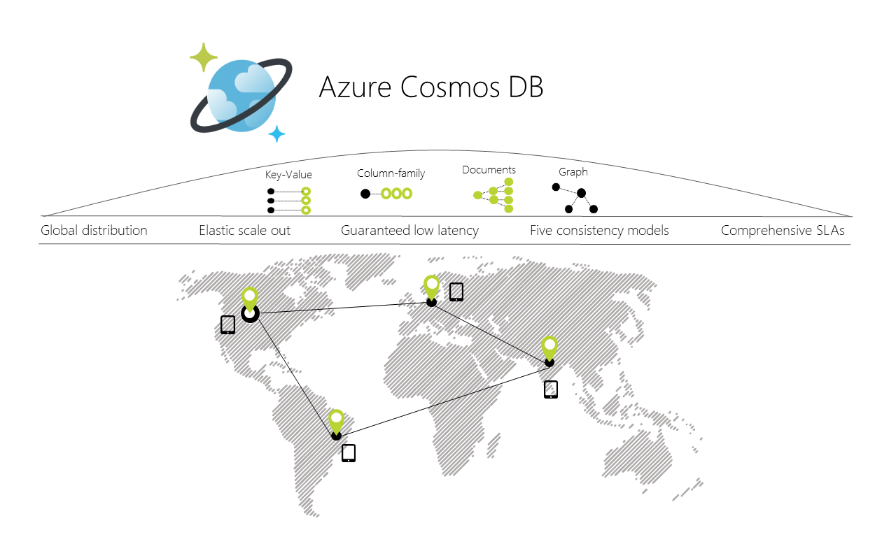
Notes:
globally distributed, multi-model database service

Slide 4
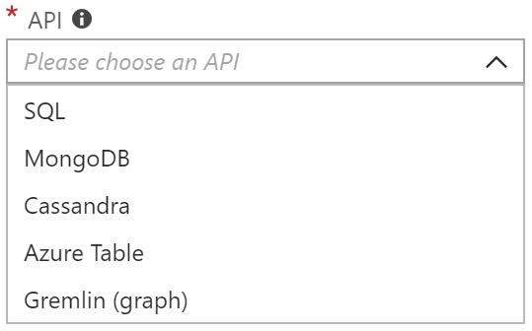
Multi-Model
SQL-over-JSON
Document
Column
Table (Azure Table Storage)
Graph
More to come

Slide 5
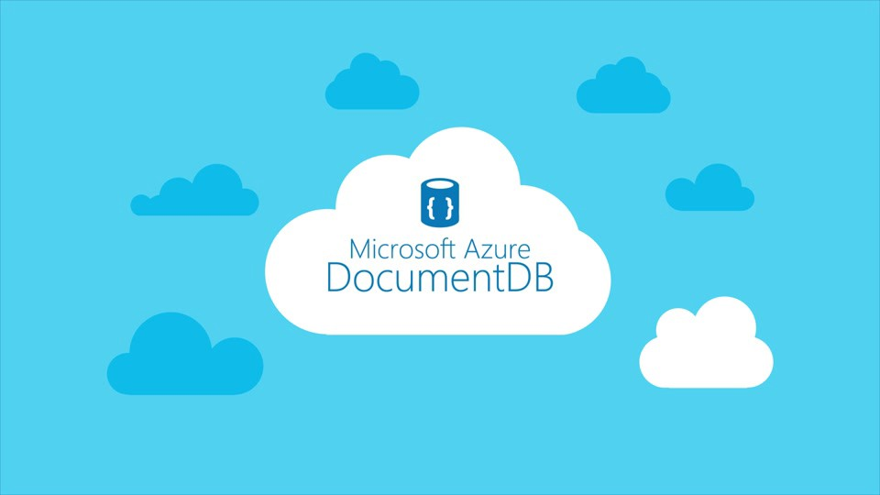

Slide 6
Why should I use it?

Slide 8
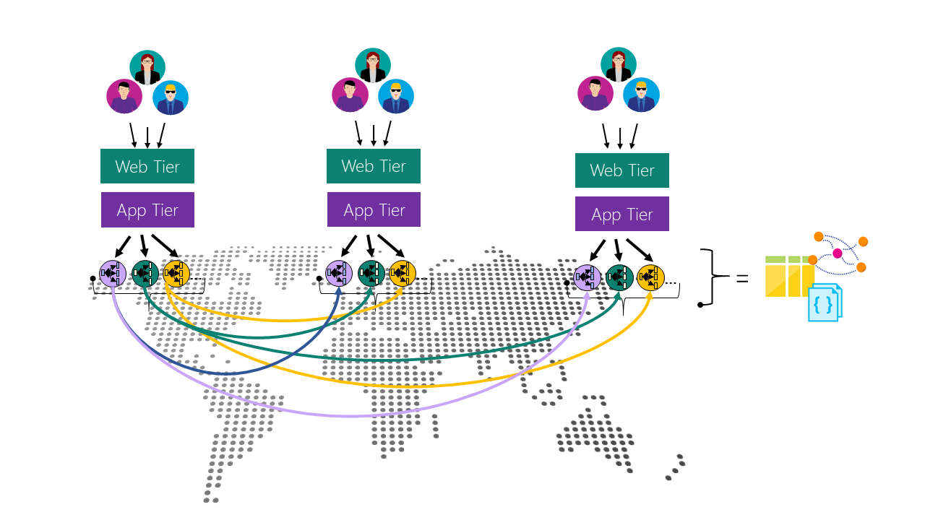

Slide 9





Slide 10
Schema-less in SQL

Slide 11
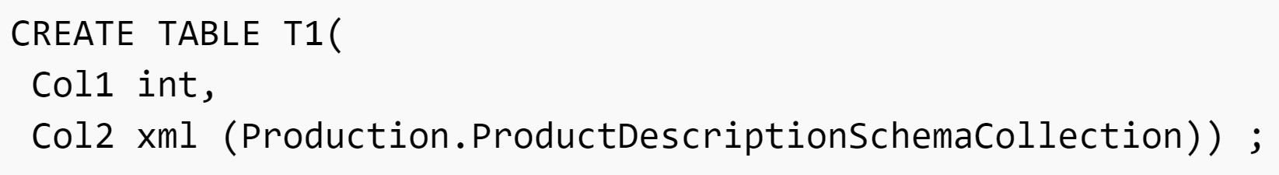

Slide 12
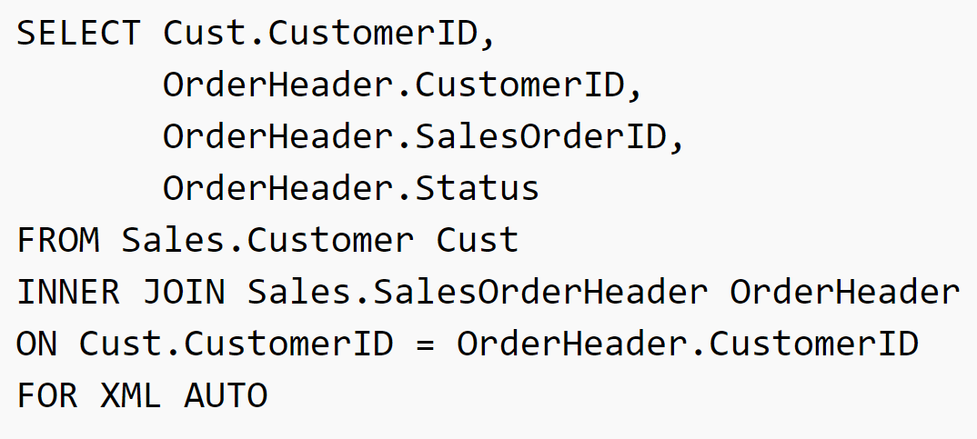

Slide 13
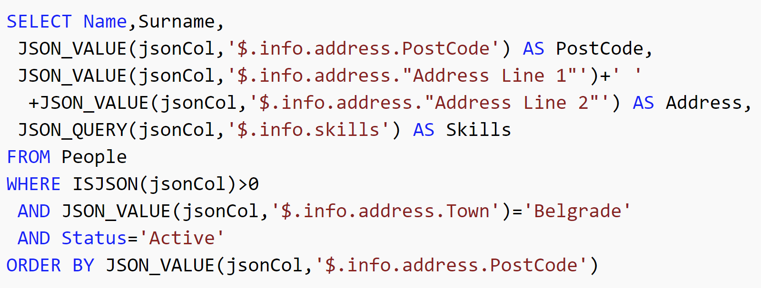

Slide 14
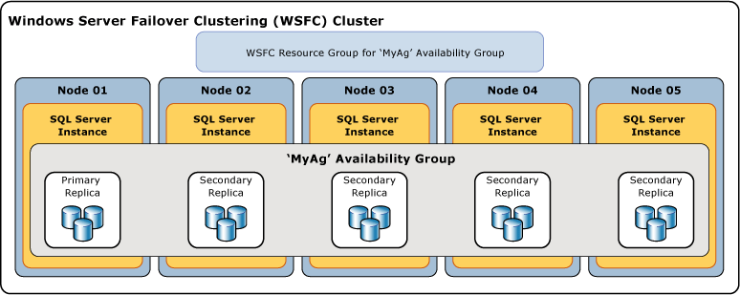

Slide 15
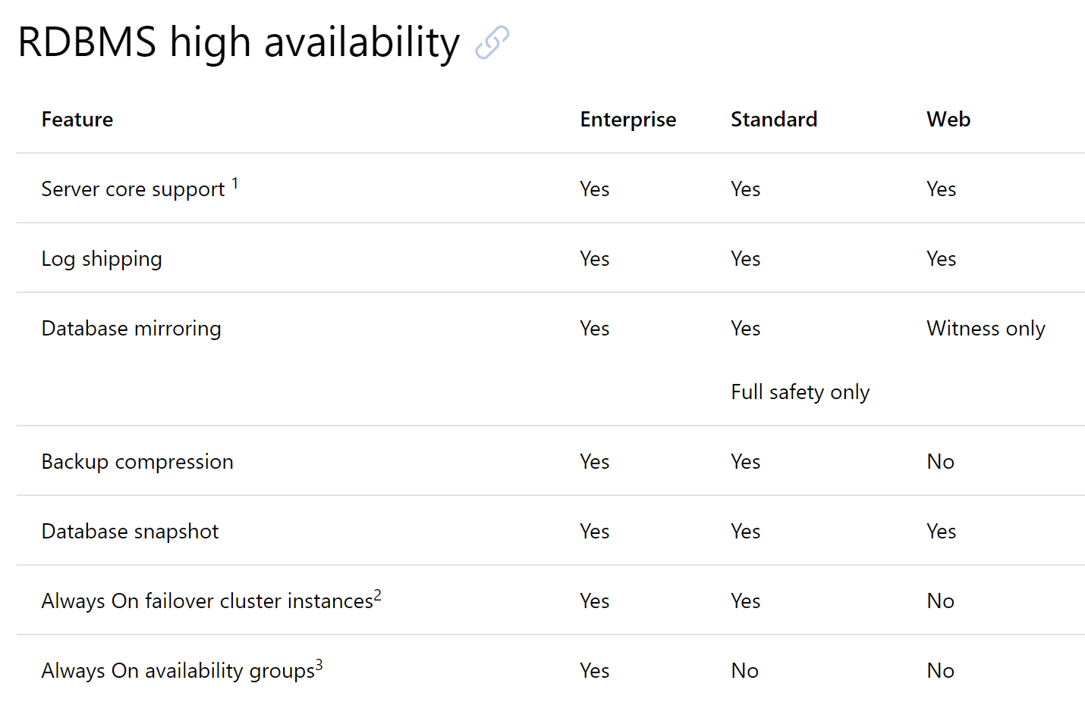

Slide 16
Transitioning from SQL

Slide 18
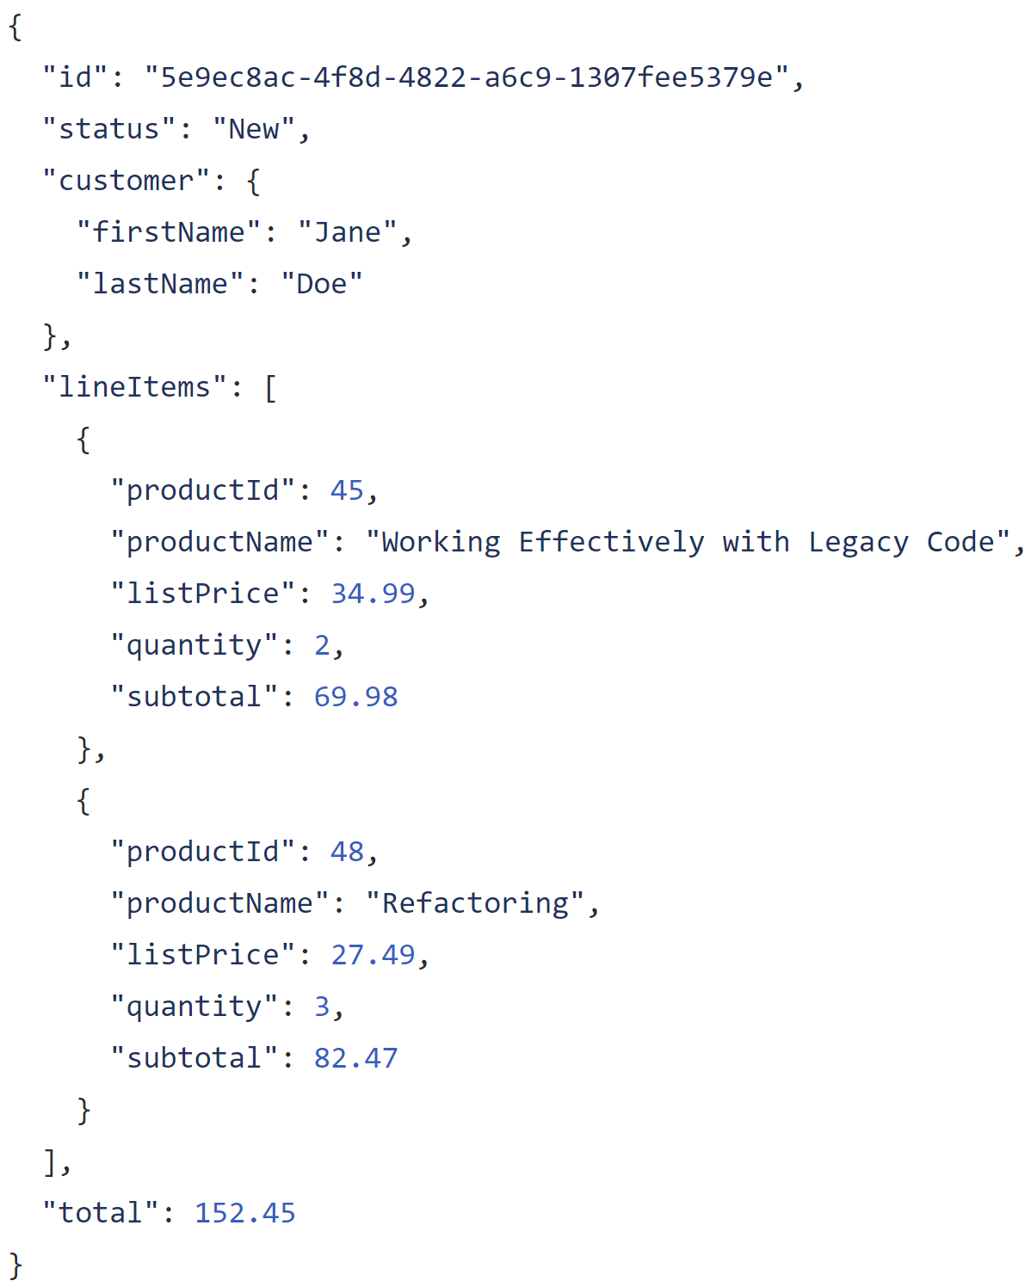

Slide 19
Entire model in one record

Slide 20
Complex structures

Slide 21
Arrays for one-to-many

Slide 22
Store keys for other/external entities

Slide 23
Duplicate data as needed

Slide 24
Not all duplicate data is evil!

Slide 25
Catalog
Cart
Order
Fulfillment
Customer Journey and Value Stream

Slide 26
$24.99
Catalog
Cart
Order
Fulfillment
Customer Journey and Value Stream

Slide 27
$24.99
$24.99
Catalog
Cart
Order
Fulfillment
Customer Journey and Value Stream

Slide 28
$24.99
$24.99
$24.99
Catalog
Cart
Order
Fulfillment
Customer Journey and Value Stream

Slide 29
$24.99
$24.99
$24.99
$24.99
Catalog
Cart
Order
Fulfillment
Customer Journey and Value Stream

Slide 30
$24.99
$25.49
$24.99
$24.99
$24.99
Catalog
Cart
Order
Fulfillment
Customer Journey and Value Stream

Slide 31
?
?
?
$24.99
$25.49
$24.99
$24.99
$24.99
Catalog
Cart
Order
Fulfillment
Customer Journey and Value Stream

Slide 32
$24.99
$25.49
$24.99
$24.99
$24.99
Catalog
Cart
Order
Fulfillment
Customer Journey and Value Stream
Data may move around and when it crosses service boundaries, its meaning can change

Slide 35
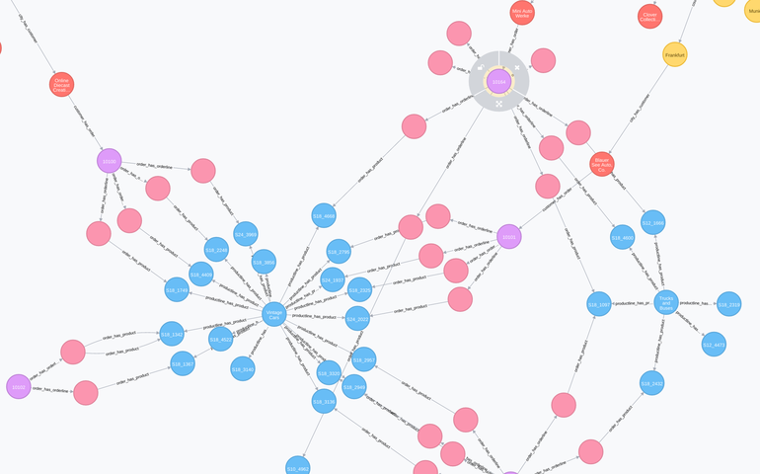

Slide 36
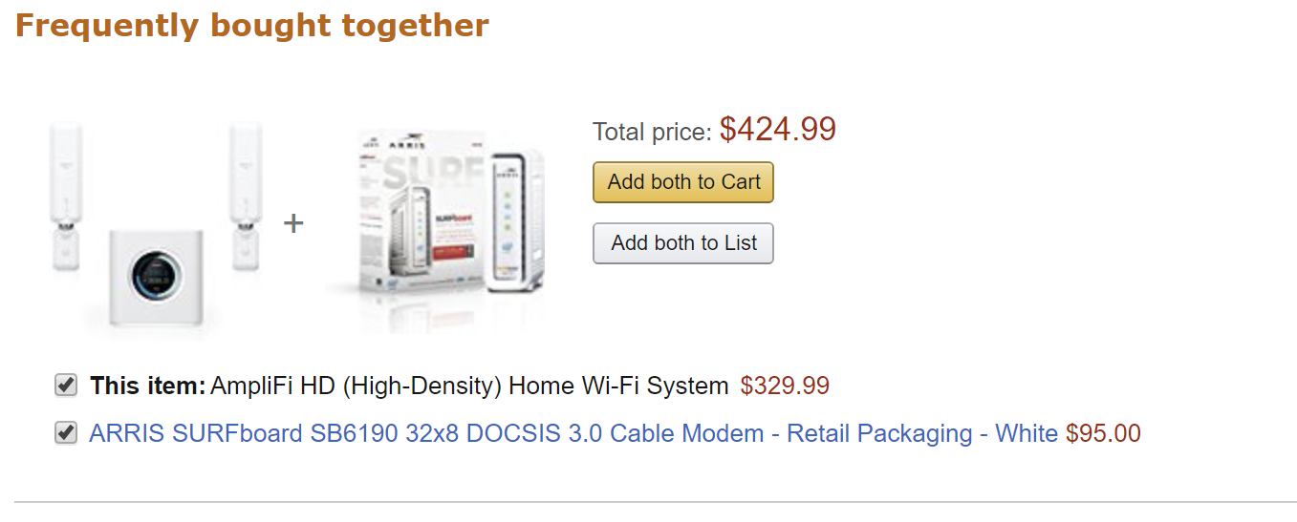

Slide 37
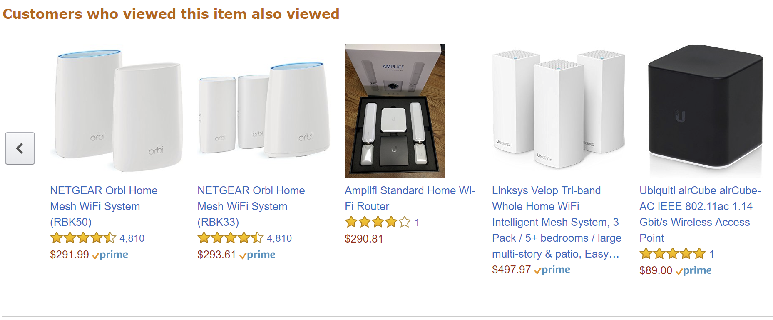

Slide 38
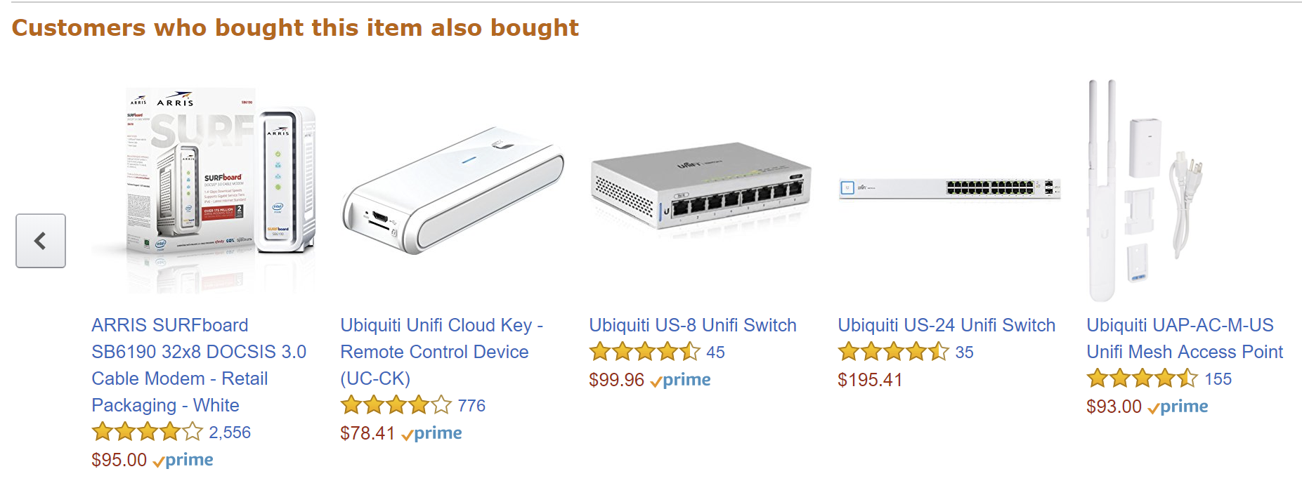

Slide 40
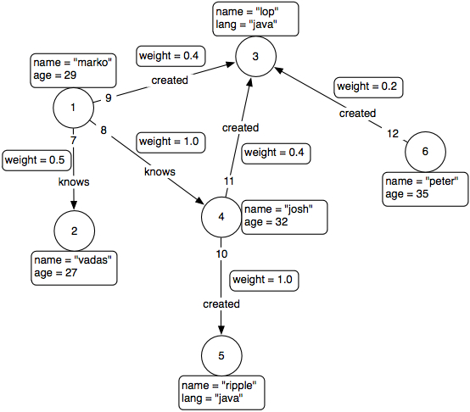
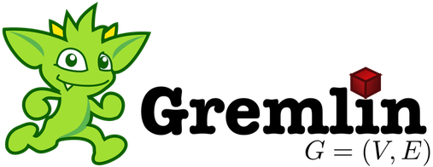

Slide 41
Demo

Slide 42
Transitioning from Transactioning in SQL

Slide 43


Slide 44
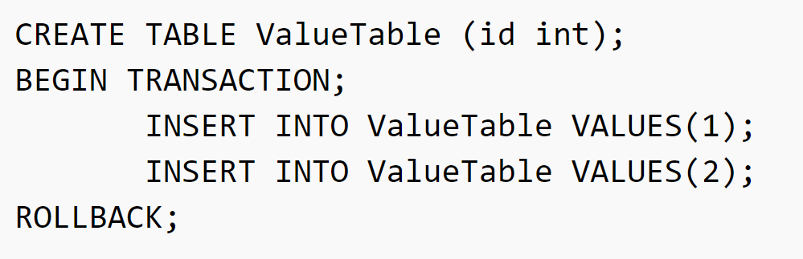

Slide 45
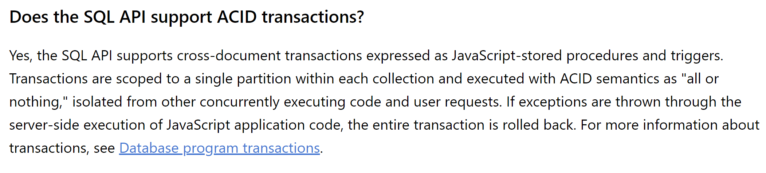

Slide 47
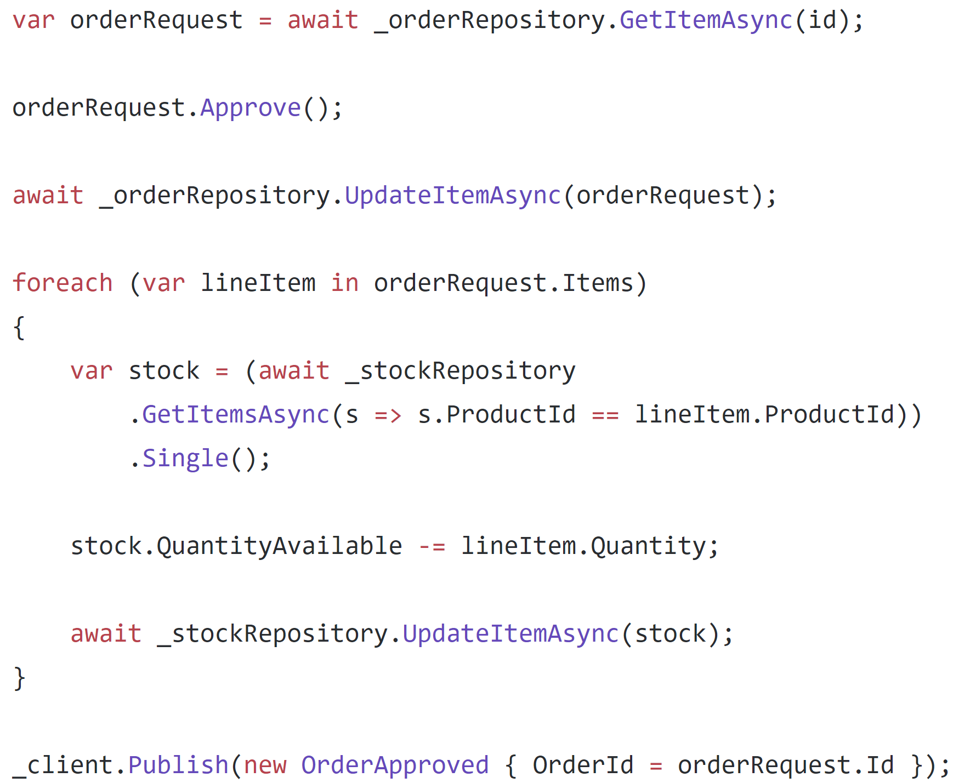

Slide 48
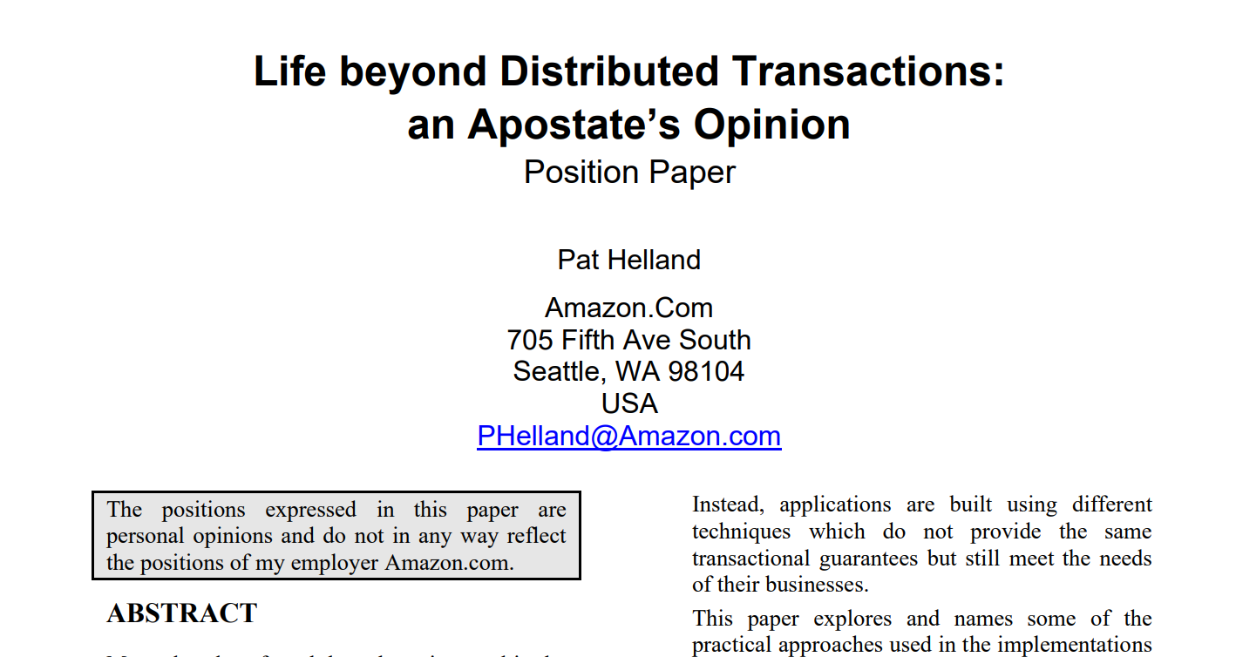

Slide 49
Epiphany: Assume a transactional boundary of a single item

Slide 50
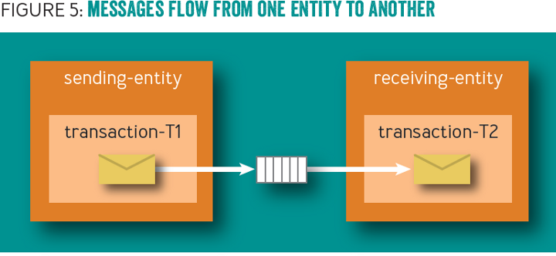

Slide 51
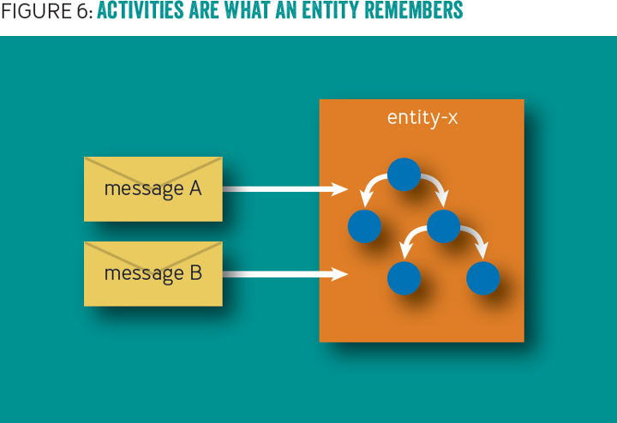

Slide 52
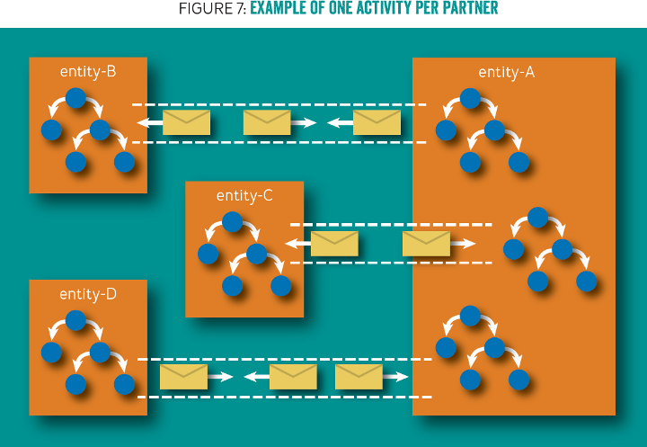

Slide 53
Problem: No code, only pictures

Slide 54
Document
Document
Business Data
Business Data
Outbox
Outbox
Inbox
Inbox

Slide 55
Aggregate
Aggregate
Business Data
Business Data
Outbox
Outbox
Inbox
Inbox

Slide 56
Example
Notes:
IDocumentMessage
DocumentBase
OrderRequest.ctor
OrderRequest.Approve
OrderRequest.Reject

Slide 57
Facilitating communication with a dispatcher

Slide 58
Document
Document
Data
Data
In
In
Out
Out
Document
Data
In
Out
Notes:
3 documents participating in a single request, but no way to coordinate a transaction between the 3

Slide 59
Document
Document
Data
Data
…
…
In
In
Out
Out
Document
Data
In
Out
Notes:
Initial request initiates changes in the first document. It needs to communicate to the others so it creates a couple of domain events.

Slide 60
✓
Document
Document
Data
Data
…
…
In
In
Out
Out
Document
Data
In
Out
Notes:
The transaction for the first document document commits, including the domain events

Slide 61
✓
Document
Document
Data
Data
…
…
In
In
Out
Out
Document
Data
Dispatcher
In
Out
Notes:
The domain event dispatcher is responsible for taking domain events and dispatching them to event handlers (and eventually other documents)

Slide 62
✓
Document
Document
Data
Data
…
…
In
In
Out
Out
Document
Data
Dispatcher
In
Out
Notes:
The dispatcher reads the first event from the document

Slide 63
✓
Document
Document
Data
Data
…
…
In
In
Out
Out
Document
Data
Dispatcher
In
Out
Notes:
And will dispatch it to handlers, who know how to match domain events to documents

Slide 64
✓
Document
Document
Data
Data
…
…
…
…
In
In
Out
Out
Document
Data
Dispatcher
In
Out
Notes:
The first domain event is matched to an document, and the document handles it by mutating its data and storing this handled domain event in its inbox

Slide 65
✓
✓
Document
Document
Data
Data
…
…
…
…
In
In
Out
Out
Document
Data
Dispatcher
In
Out
Notes:
This document document transaction succeeds

Slide 66
Example
Notes:
Dispatcher
IDocumentMessageHandler
OrderCreatedHandler

Slide 67
When things go wrong

Slide 68
✓
✓
Document
Document
Data
Data
…
…
…
…
In
In
Out
Out
Document
Data
Dispatcher
In
Out
Notes:
This document document transaction succeeds

Slide 69
✓
✓
Document
Document
Data
Data
…
…
…
…
In
In
Out
Out
Document
Data
Dispatcher
In
Out
Notes:
Upon dispatch to the second document however, this one fails, so no data is written and no event stored in the outbox

Slide 70
✓
✓
Document
Document
Data
Data
…
…
…
…
In
In
Out
Out
Document
Data
Dispatcher
In
Out
Retry
Notes:
Detecting a failure, the dispatcher sends a durable message to an document retry queue, noting the document type and ID to retry domain events.

Slide 71
Retries

Slide 72
Document
Document
Data
Data
…
…
…
…
In
In
Out
Out
Document
Data
Dispatcher
In
Out
Retry
Notes:
For retries, the dispatcher reads messages from the document retry queue.

Slide 73
Document
Document
Data
Data
…
…
…
…
In
In
Out
Out
Document
Data
Dispatcher
In
Out
Retry
Notes:
The dispatcher then pulls the document and attempts to re-dispatch its domain events to the relevant handlers

Slide 74
Document
Document
Data
Data
…
…
…
…
In
In
Out
Out
Document
Data
Dispatcher
In
Out
Retry
Notes:
For the first document, it sends the domain event to the handler

Slide 75
Document
Document
Data
Data
…
…
…
…
In
In
Out
Out
Document
Data
Dispatcher
In
Out
Retry
Notes:
The document checks its inbox and compares the ID of the incoming domain event to its inbox of processed events

Slide 76
¯\_(ツ)_/¯
Document
Document
Data
Data
…
…
…
…
In
In
Out
Out
Document
Data
Dispatcher
In
Out
Retry
Notes:
It sees that the message has already been processed, so ignores the event. Handling the domain event maintains idempotency, so that receiving a domain event at-least-once results in the actual processing of the event to only happen once

Slide 77
¯\_(ツ)_/¯
Document
Document
Data
Data
…
…
…
…
In
In
Out
Out
Document
Data
…
…
Dispatcher
In
Out
Retry
Notes:
The dispatcher notifies the next handler of a domain event

Slide 78
¯\_(ツ)_/¯
Document
Document
Data
Data
…
…
…
…
In
In
Out
Out
✓
Document
Data
…
…
Dispatcher
In
Out
Retry
Notes:
However, this document has not processed this domain event before, so it processes the domain event and stores it in its inbox.

Slide 79
¯\_(ツ)_/¯
Document
Document
Data
Data
…
…
…
…
In
In
Out
Out
✓
Document
Data
…
…
Dispatcher
In
Out
Retry
Notes:
Now that all handlers have successfully processed the domain event, the dispatcher tells the originating document that the domain event can safely be deleted (or marked as processed)

Slide 80
✓
¯\_(ツ)_/¯
Document
Document
Data
Data
…
…
…
…
In
In
Out
Out
✓
Document
Data
…
…
Dispatcher
In
Out
Retry
Notes:
The originating document is now saved, and we repeat for all domain events.

Slide 81
Example
Notes:
OrderCreatedHandler
OrderFulfillment.Handle
DocumentBase.Process

Slide 82
How do we dispatch?

Slide 83
Document
Document
Document
Document
Document
Document
Document
Document
Notes:
A single activity results in a cascade of interactions with other Documents

Slide 84
Document
Document
Document
Document
Document
Document
Unit of Work
Document
Document
…
…
…
…
Notes:
As Documents are loaded, they get registered in the unit of work

Slide 85
Document
Document
Document
✓
Document
Document
Document
Unit of Work
Document
Document
…
…
…
…
Notes:
The first Document completes with domain events, and registers with the unit of work

Slide 86
✓
Document
Document
Document
✓
Document
Document
✓
Document
Unit of Work
Document
Document
…
…
…
…
Notes:
The unit of work, through the dispatcher, dispatches domain events to other Documents, which also register in the unit of work

Slide 87
✓
✓
Document
Document
Document
✓
Document
✓
Document
✓
Document
Unit of Work
✓
Document
Document
…
…
…
…
Notes:
And continues to the next level, each Document committing independently

Slide 88
✓
✓
✓
Document
Document
Document
✓
Document
✓
Document
✓
Document
Unit of Work
✓
Document
Document
…
…
…
…
Notes:
But at some point we encounter a failure

Slide 89
✓
✓
✓
Document
Document
Document
✓
Document
✓
Document
✓
Document
Unit of Work
✓
Document
Document
…
…
…
…
Retry
Notes:
We can retry the Document directly above the failure. This will put the failed Documents out of the unit of work processing

Slide 90
✓
✓
✓
Document
Document
Document
✓
Document
✓
Document
✓
Document
Unit of Work
✓
Document
Document
…
…
…
…
Retry
Notes:
Or we can retry at the root of the failure. Most of the operations will be no-op, but we would only have marked the domain events as deleted if the entire operation below it succeeds.

Slide 91
Example
Notes:
UnitOfWork
Repository

Slide 92
What if something goes REALLY wrong?

Slide 93
Document
Document
Document
Document
Document
Document
Document
Document
Notes:
A single activity results in a cascade of interactions with other Documents

Slide 94
✓
✓
Document
Document
Document
✓
Document
✓
Document
✓
Document
Unit of Work
✓
Document
Document
…
…
…
…
Notes:
And continues to the next level, each Document committing independently

Slide 95
✓
✓
✓
Document
Document
Document
✓
Document
✓
Document
✓
Document
Unit of Work
✓
Document
Document
…
…
…
…
Notes:
But at some point we encounter a failure

Slide 96
✓
✓
✓
Document
Document
Document
✓
Document
✓
Document
✓
Document
Unit of Work
✓
Document
Document
…
…
…
…
Notes:
But at some point we encounter a failure

Slide 97
✓
✓
✓
Document
Document
Document
✓
Document
✓
Trigger
Document
…
…
…
…
✓
Document
Unit of Work
✓
Document
Document
…
…
…
…
Notes:
But at some point we encounter a failure

Slide 98
✓
✓
✓
Document
Document
Document
✓
Document
✓
Trigger
Document
…
…
…
…
✓
Document
Unit of Work
✓
Document
Document
…
…
…
…
Notes:
But at some point we encounter a failure

Slide 99
✓
✓
✓
Document
Document
Document
✓
Document
✓
Trigger
Document
…
…
…
…
✓
Document
Unit of Work
✓
Document
Document
…
…
…
…
Retry
Notes:
But at some point we encounter a failure

Slide 100
Example
Notes:
DocumentFeedObserver

Slide 101
Complex Coordination with Sagas

Slide 102
An order can be fulfilled when: The request is approved The stock is confirmed

Slide 103
Order Request
Order Fulfillment
Stock

Slide 104
Order Request
Order Fulfillment
OrderCreated
Stock

Slide 105
Order Request
Order Fulfillment
OrderCreated
Stock

Slide 106
Order Request
Order Fulfillment
StockRequest [123]
Stock

Slide 107
Order Request
Order Fulfillment
StockRequest [123]
StockRequest [456]
Stock

Slide 108
Order Request
Order Fulfillment
StockRequest [123]
StockRequest [456]
StockRequest [789]
Stock

Slide 109
Order Request
Order Fulfillment
Stock
StockRequest [123]
StockRequest [456]
StockRequest [789]

Slide 110
Order Request
Order Fulfillment
Stock
StockRequestConfirmed [123]
StockRequest [456]
StockRequest [789]

Slide 111
Order Request
Order Fulfillment
Stock
StockRequestConfirmed [123]
StockRequestConfirmed [456]
StockRequest [789]

Slide 112
Order Request
Order Fulfillment
Stock
StockRequestConfirmed [123]
StockRequestConfirmed [456]
StockRequestConfirmed [789]

Slide 113
Order Request
Order Fulfillment
StockRequestConfirmed [123]
StockRequestConfirmed [456]
StockRequestConfirmed [789]
Stock

Slide 114
Order Request
Order Fulfillment
OrderApproved
Stock

Slide 115
Order Request
Order Fulfillment
OrderApproved
Stock

Slide 116
Order Request
Order Fulfillment
OrderFulfillmentSuccessful
Stock

Slide 117
Order Request
Order Fulfillment
OrderFulfillmentSuccessful
Stock

Slide 118
Order Request
✓
Order Fulfillment
Stock

Slide 119
Demo

Slide 120
An order can be canceled when: The stock is denied OR The request is rejected

Slide 121
An order can be canceled when: The stock is denied OR The request is rejected

Slide 122
Order Request
Order Fulfillment
StockRequest [123]
StockRequest [456]
StockRequest [789]
Stock

Slide 123
Order Request
Order Fulfillment
Stock
StockRequest [123]
StockRequest [456]
StockRequest [789]

Slide 124
Order Request
Order Fulfillment
Stock
StockRequestConfirmed [123]
StockRequest [456]
StockRequest [789]

Slide 125
Order Request
Order Fulfillment
Stock
StockRequestConfirmed [123]
StockRequestConfirmed [456]
StockRequest [789]

Slide 126
Order Request
Order Fulfillment
Stock
StockRequestConfirmed [123]
StockRequestConfirmed [456]
StockRequestDenied [789]

Slide 127
Order Request
Order Fulfillment
StockRequestConfirmed [123]
StockRequestConfirmed [456]
StockRequestDenied [789]
Stock

Slide 128
Order Request
Order Fulfillment
CancelOrderRequest
StockReturnRequested [123]
StockReturnRequested [456]
Stock

Slide 129
Order Request
Order Fulfillment
CancelOrderRequest
Stock
StockReturnRequested [123]
StockReturnRequested [456]

Slide 130
Order Request
✓
Order Fulfillment
Stock

Slide 131
Demo
Notes:
DocumentFeedObserver

Slide 132
An order can be canceled when: The stock is denied OR The request is rejected

Slide 133
Order Request
Order Fulfillment
OrderRejected
Stock

Slide 134
Order Request
Order Fulfillment
OrderRejected
Stock

Slide 135
Order Request
Order Fulfillment
StockReturnRequested [123]
StockReturnRequested [456]
StockReturnRequested [789]
Stock

Slide 136
Order Request
Order Fulfillment
Stock
StockReturnRequested [123]
StockReturnRequested [456]
StockReturnRequested [789]

Slide 137
Order Request
✓
Order Fulfillment
Stock

Slide 138
Demo
Notes:
DocumentFeedObserver

Slide 139
Broker
Microservice A
Microservice B
Dispatcher
Translator
Receiver
Dispatcher
SQL
SQL
Outbox
Inbox

Slide 140
Our lessons
Modeling in SQL is “familiar”
Modeling in documents is not
Transactions are tricky/impossible
Outbox to coordinate communication across transactional boundaries

Slide 141
From SQL to Azure Cosmos DB
Jimmy Bogard
@jbogard
github.com/jbogard
jimmybogard.com

