Slide 1




Life Beyond Distributed Transactions: An Apostate's Implementation
Jimmy Bogard
@jbogard
github.com/jbogard
jimmybogard.com

Slide 2
A Simpler Time…

Slide 3
The Database
The App

Slide 4
The Database
The App
UPDATE Orders
SET Status = 3
WHERE Id = 123

Slide 5
The Database
The App

Slide 6
The Database
The App
SELECT Status
FROM Orders
WHERE Id = 123

Slide 7
The Database
The App
SELECT Status
FROM Orders
WHERE Id = 123
And all was good.jpg

Slide 8
The Database
The App

Slide 9
The Database
The App
UPDATE Orders
SET Status = 4
WHERE Id = 123
UPDATE Inventory
SET Quantity = Quantity – 3
WHERE ProductId = 456

Slide 10
The Database
The App

Slide 11
The Database
The App
SELECT Status
FROM Orders
WHERE Id = 123
SELECT Quantity
FROM Inventory
WHERE ProductId = 456

Slide 12
The Database
The App

Slide 13
The Database
The App
UPDATE Orders
SET Status = 4
WHERE Id = 123
UPDATE Inventory
SET Quantity = Quantity – 3
WHERE ProductId = 456

Slide 14
The Database
The App
UPDATE Orders
SET Status = 4
WHERE Id = 123
UPDATE Inventory
SET Quantity = Quantity – 3
WHERE ProductId = 456

Slide 15
The Database
The App
UPDATE Orders
SET Status = 4
WHERE Id = 123
UPDATE Inventory
SET Quantity = Quantity – 3
WHERE ProductId = 456

Slide 16
The Database
The App
UPDATE Orders
SET Status = 4
WHERE Id = 123
UPDATE Inventory
SET Quantity = Quantity – 3
WHERE ProductId = 456

Slide 17
✓
The Database
The App
UPDATE Orders
SET Status = 4
WHERE Id = 123
UPDATE Inventory
SET Quantity = Quantity – 3
WHERE ProductId = 456

Slide 18
A Slight Wrinkle…

Slide 19
The Database
The App

Slide 20
Sales Database
UPDATE Orders
SET Status = 4
WHERE Id = 123
The App
Stock Database

Slide 21
Sales Database
UPDATE Orders
SET Status = 4
WHERE Id = 123
The App
Stock Database
UPDATE Inventory
SET Quantity = Quantity – 3
WHERE ProductId = 456

Slide 22
✓
Sales Database
UPDATE Orders
SET Status = 4
WHERE Id = 123
The App
Stock Database
UPDATE Inventory
SET Quantity = Quantity – 3
WHERE ProductId = 456

Slide 23
Sales Database
UPDATE Orders
SET Status = 4
WHERE Id = 123
The App
Stock Database
UPDATE Inventory
SET Quantity = Quantity – 3
WHERE ProductId = 456

Slide 24
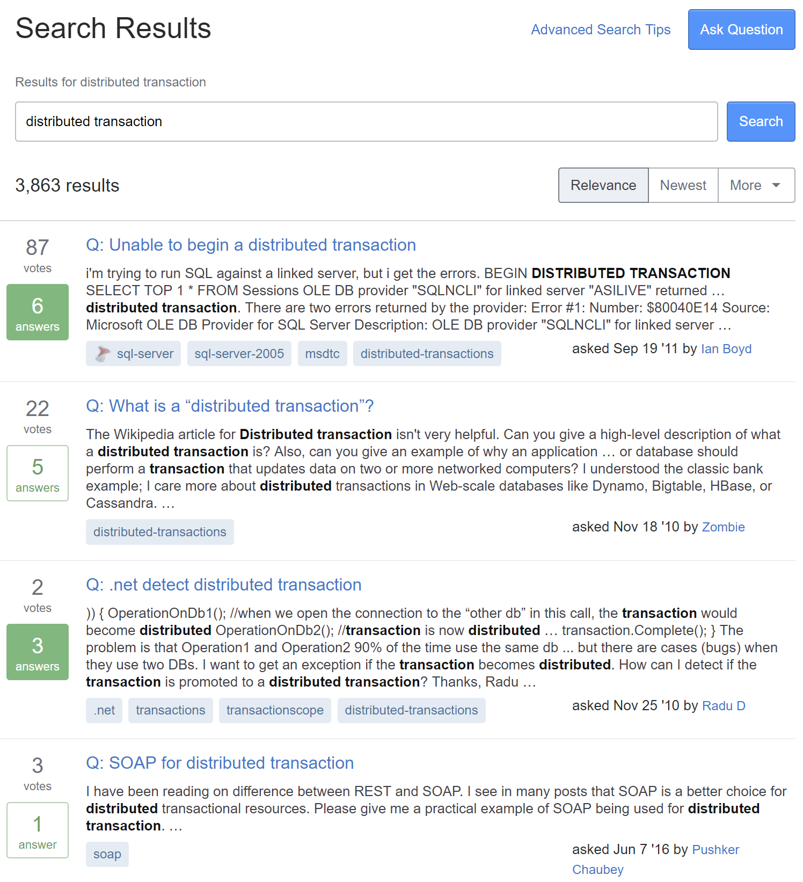

Slide 25
Distributed Transaction?

Slide 26
A database transaction in which two or more network hosts are involved

Slide 27
Most common protocol: Two-Phase Commit (aka 2PC)

Slide 28
Prepare
Resource A
Coordinator
Feedback
Resource B
Commit

Slide 29
Prepare
Resource A
Coordinator
Feedback
Resource B
Commit

Slide 30
✓
SQL Server
MS DTC
SQL Server

Slide 31
Always On
SQL Server
SQL Server
MS DTC
SQL Server

Slide 32
Azure
SQL Server
MS DTC
SQL Server

Slide 33
✓
SQL Server
MS DTC
MSMQ

Slide 34
SQL Server
MS DTC
RabbitMQ

Slide 35
NoSQL DB
MS DTC

Slide 36
2PC Summary
Transactions in a single resource – yes
Transactions across identical resources – no
Transactions across disparate resources – no
Transactions across multiple items – YesSQL and NoSQL

Slide 37
CosmosDB
MS DTC
RabbitMQ

Slide 38
Order Fulfillment Example
Consuming messages from RabbitMQ
Multiple writes to Azure CosmosDB
Producing messages to RabbitMQ
All in a single "transactional" activity

Slide 39
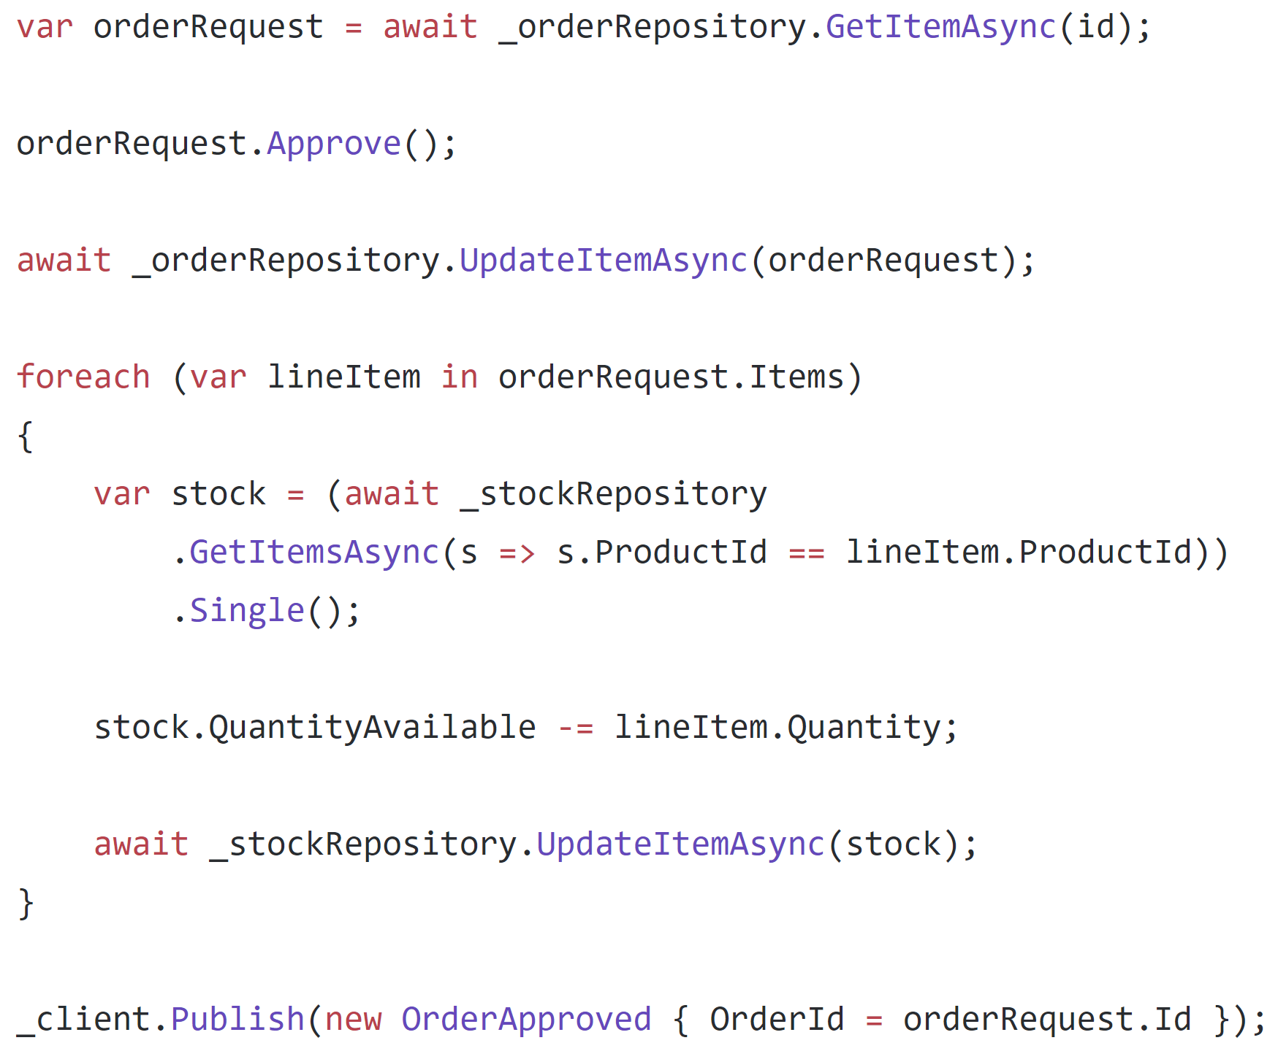

Slide 40
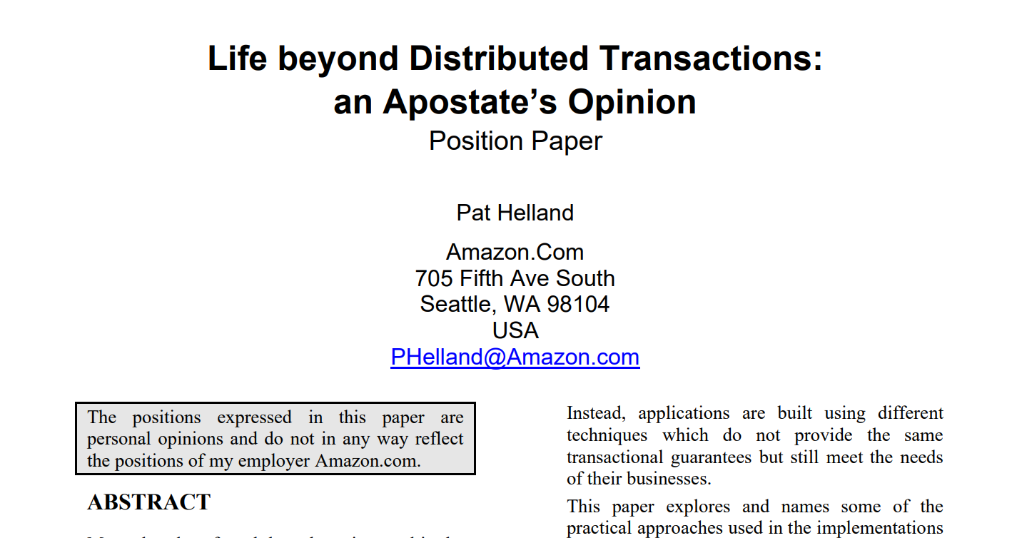

Slide 41
Epiphany: Assume a transactional boundary of a single item

Slide 42
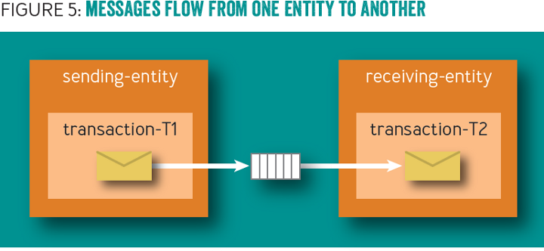

Slide 43
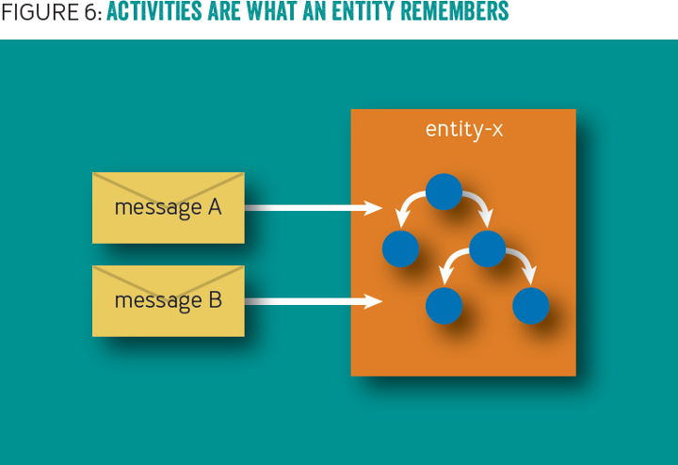

Slide 44
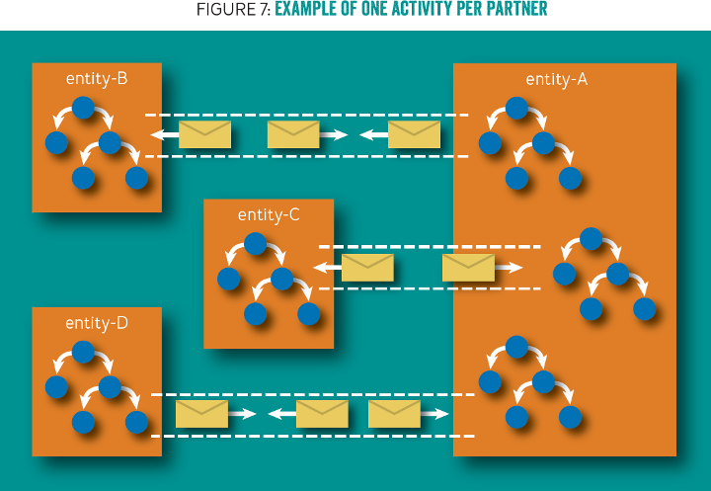

Slide 45
Problem: No code, only pictures

Slide 46
Document
Document
Business Data
Business Data
Outbox
Outbox
Inbox
Inbox

Slide 47
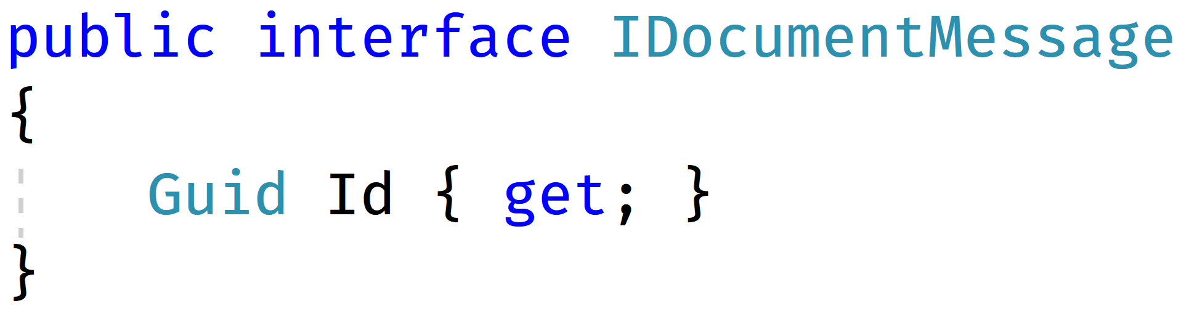

Slide 48
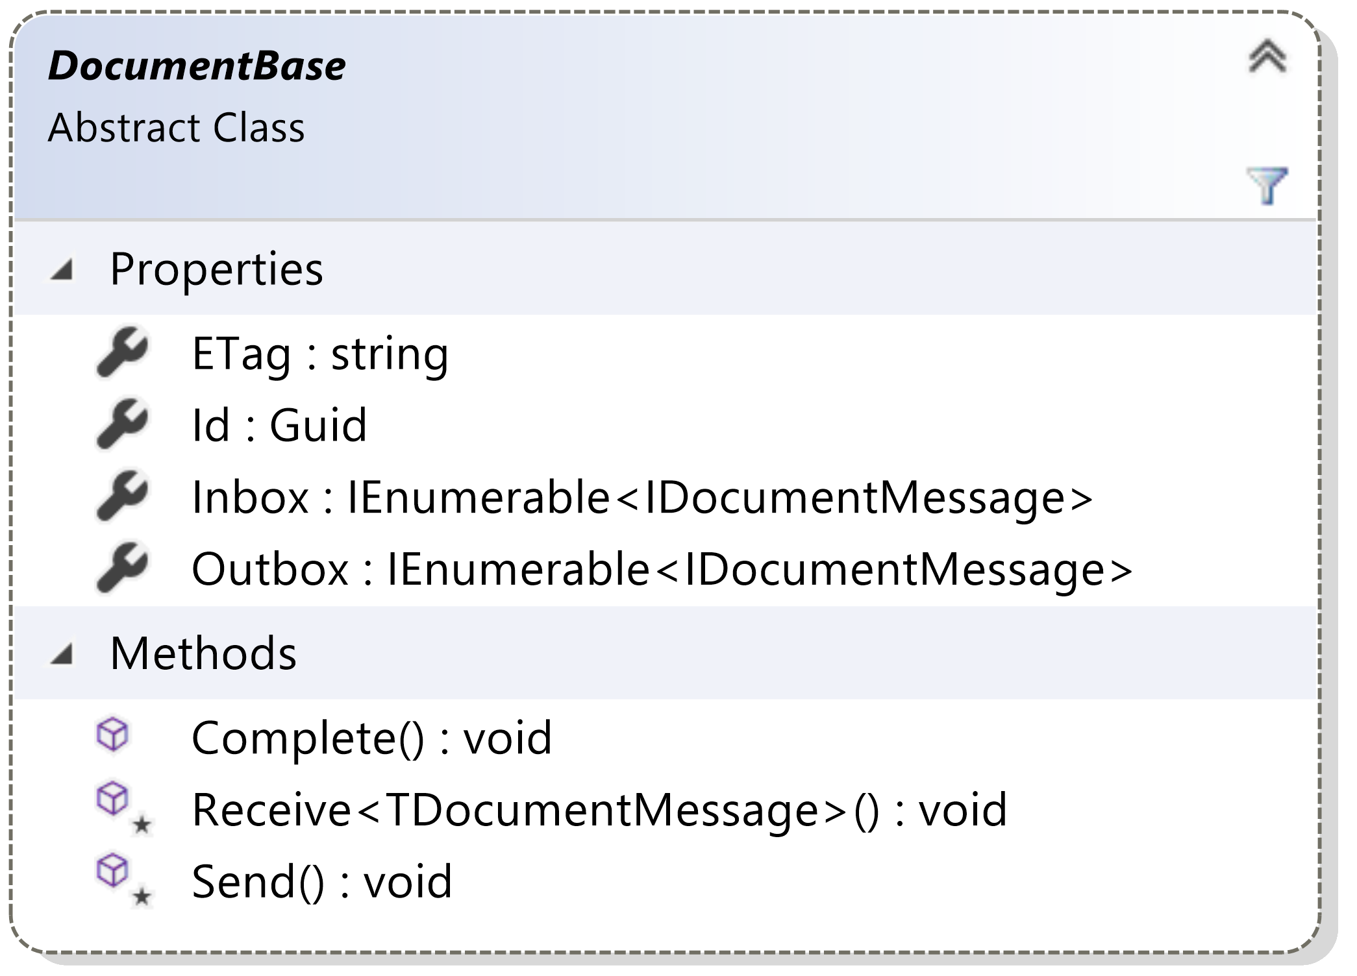

Slide 49
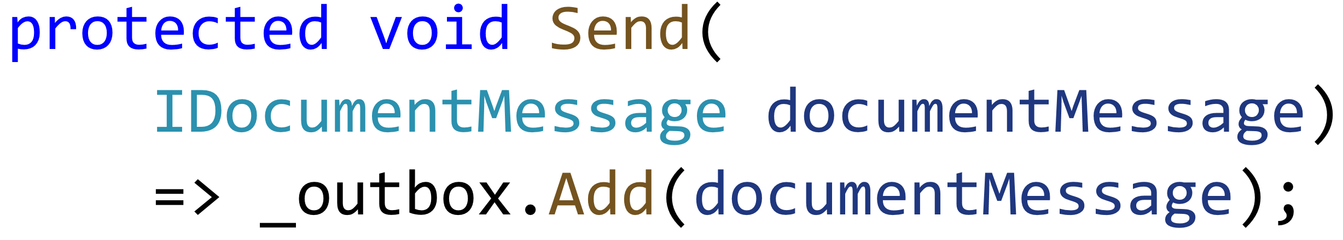

Slide 50
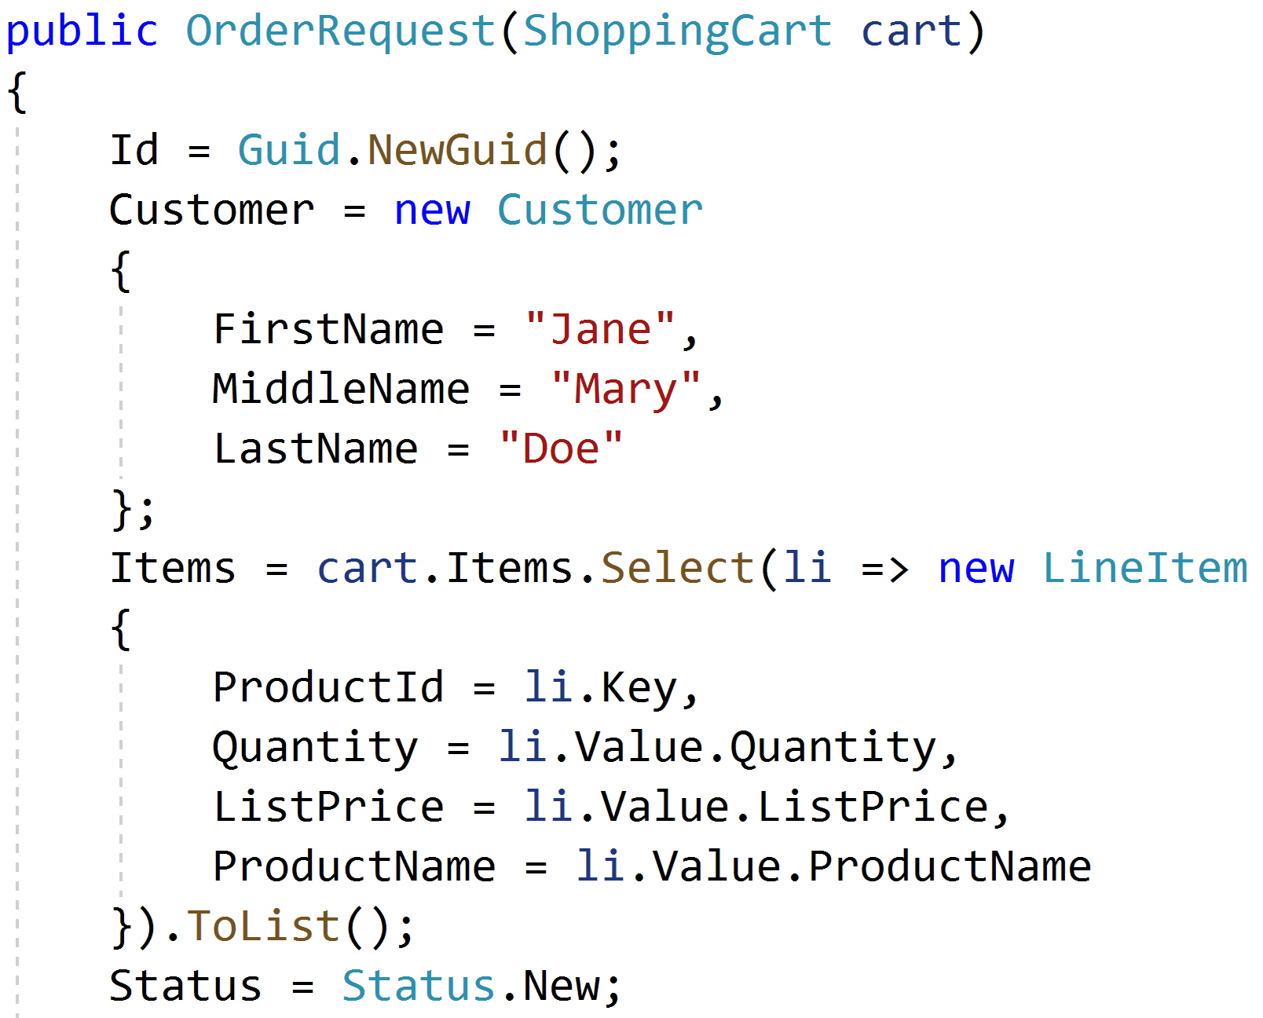

Slide 51
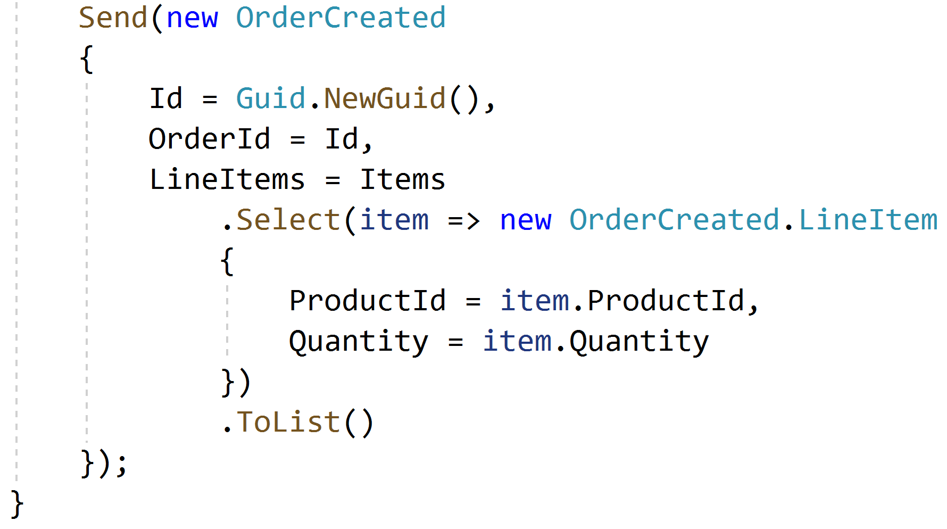

Slide 52
Facilitating communication with a dispatcher

Slide 53
Document
Document
Data
Data
In
In
Out
Out
Document
Data
In
Out
Notes:
3 documents participating in a single request, but no way to coordinate a transaction between the 3

Slide 54
Document
Document
Data
Data
…
…
In
In
Out
Out
Document
Data
In
Out
Notes:
Initial request initiates changes in the first document. It needs to communicate to the others so it creates a couple of domain events.

Slide 55
✓
Document
Document
Data
Data
…
…
In
In
Out
Out
Document
Data
In
Out
Notes:
The transaction for the first document document commits, including the domain events

Slide 56
✓
Document
Document
Data
Data
…
…
In
In
Out
Out
Document
Data
Dispatcher
In
Out
Notes:
The domain event dispatcher is responsible for taking domain events and dispatching them to event handlers (and eventually other documents)

Slide 57
✓
Document
Document
Data
Data
…
…
In
In
Out
Out
Document
Data
Dispatcher
In
Out
Notes:
The dispatcher reads the first event from the document

Slide 58
✓
Document
Document
Data
Data
…
…
In
In
Out
Out
Document
Data
Dispatcher
In
Out
Notes:
And will dispatch it to handlers, who know how to match domain events to documents

Slide 59
✓
Document
Document
Data
Data
…
…
…
…
In
In
Out
Out
Document
Data
Dispatcher
In
Out
Notes:
The first domain event is matched to an document, and the document handles it by mutating its data and storing this handled domain event in its inbox

Slide 60
✓
✓
Document
Document
Data
Data
…
…
…
…
In
In
Out
Out
Document
Data
Dispatcher
In
Out
Notes:
This document document transaction succeeds

Slide 61
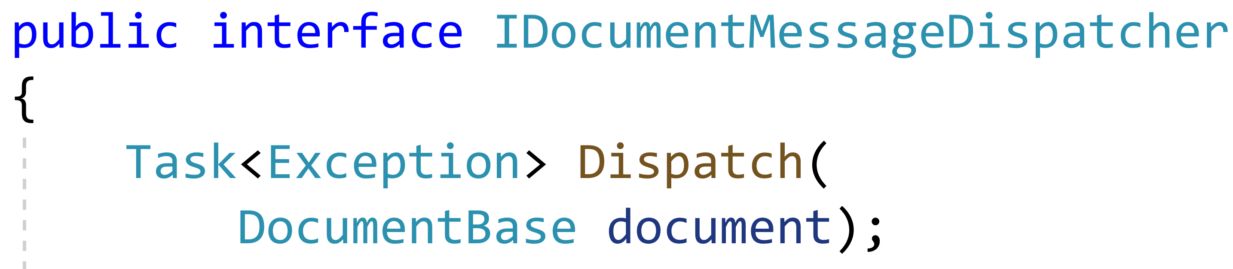

Slide 62
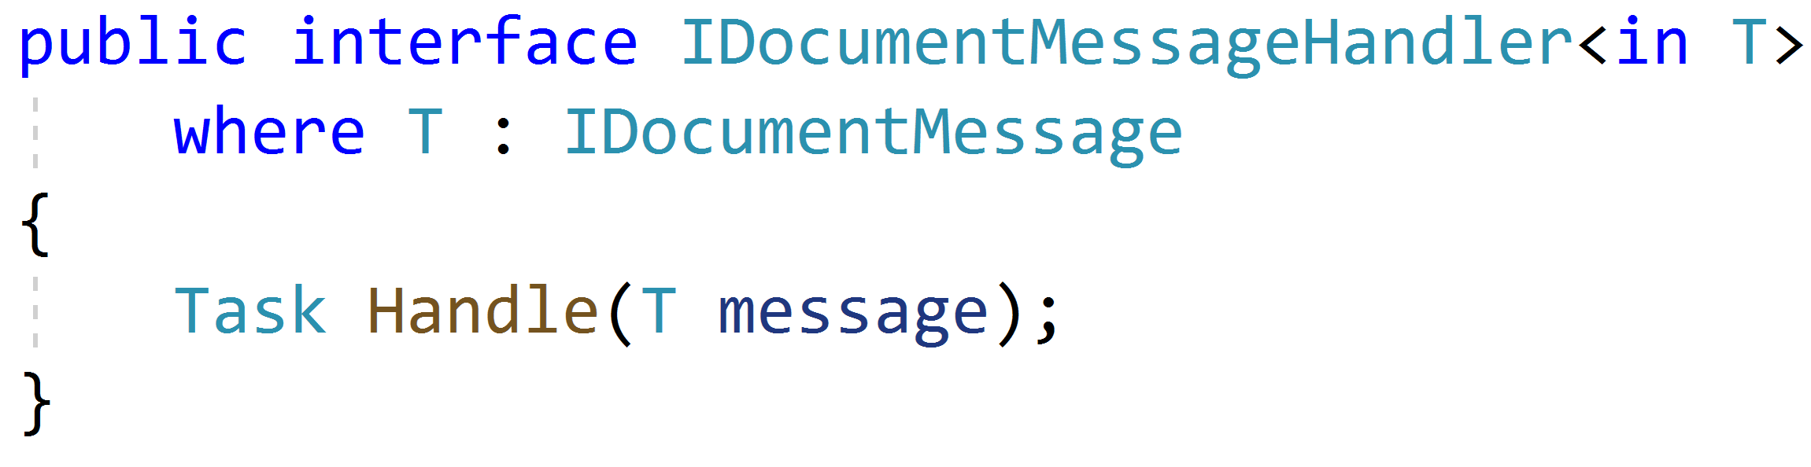

Slide 63
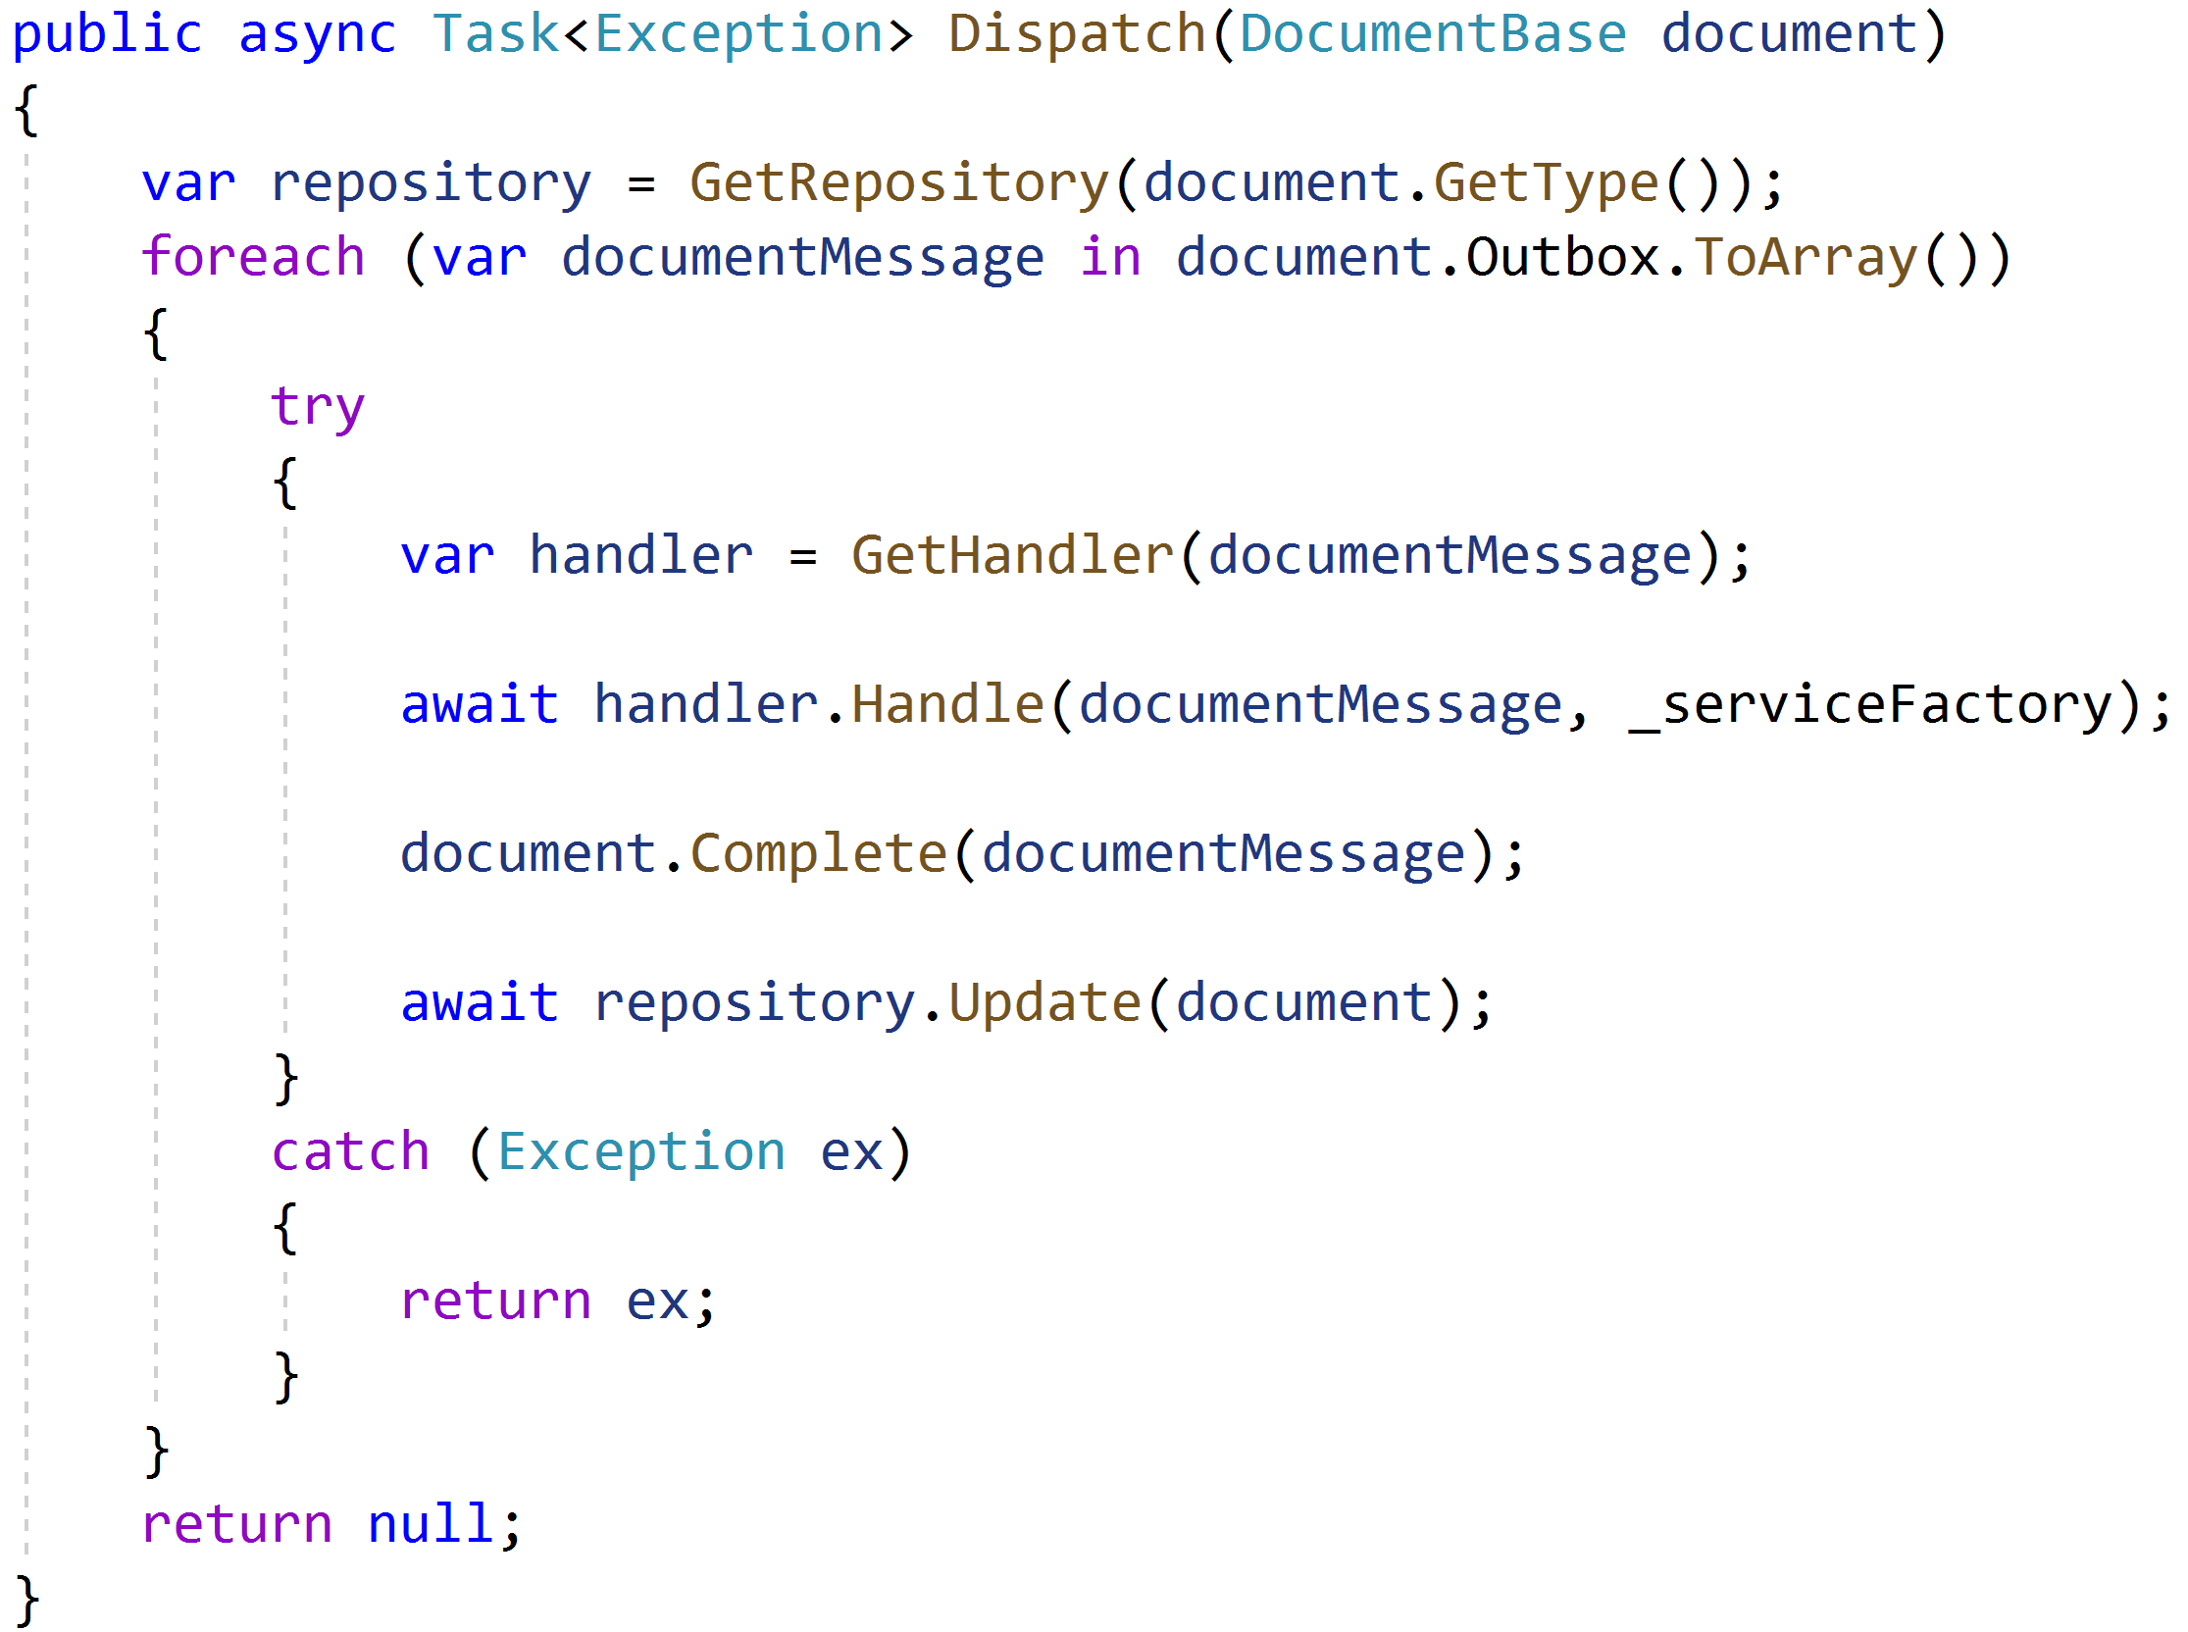

Slide 64
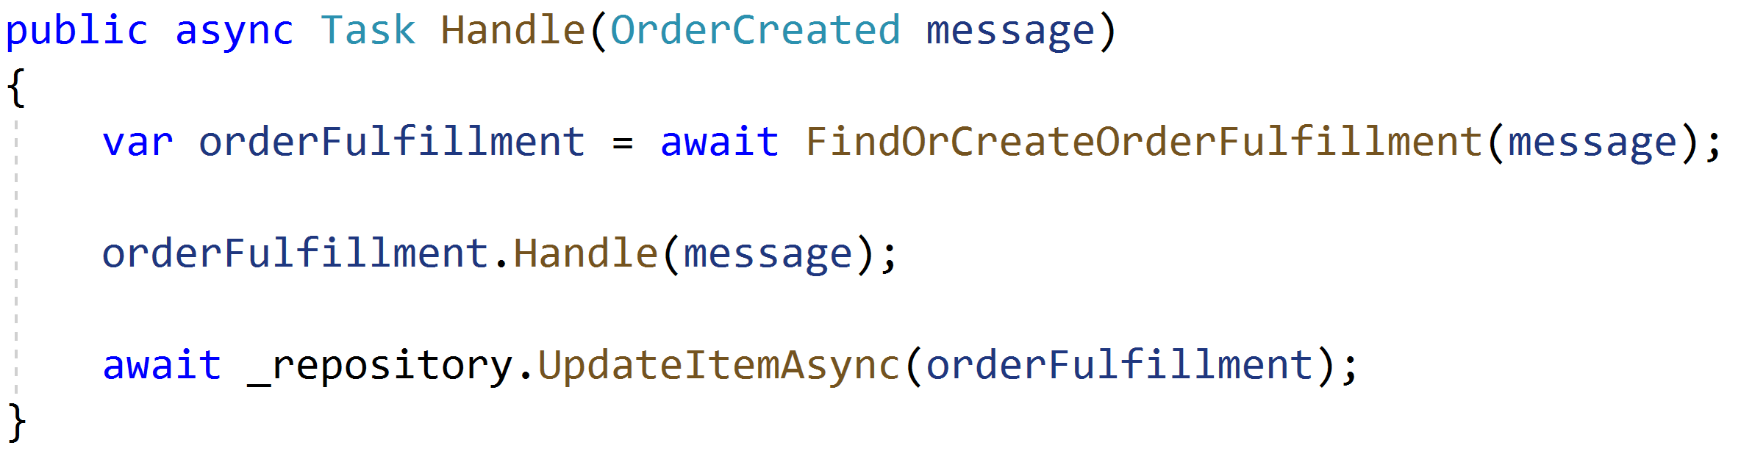

Slide 65
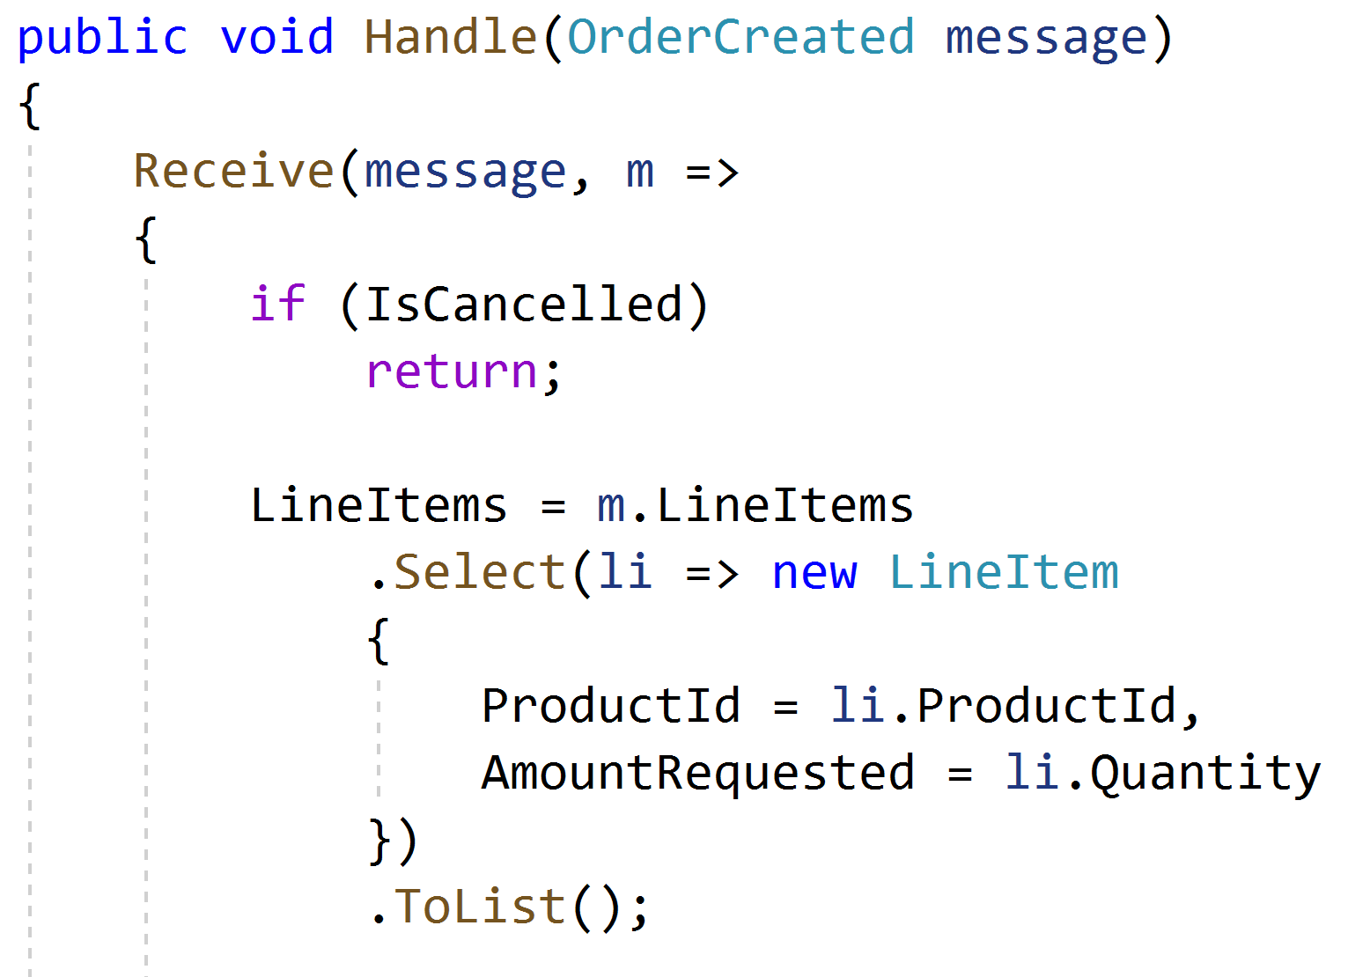

Slide 66
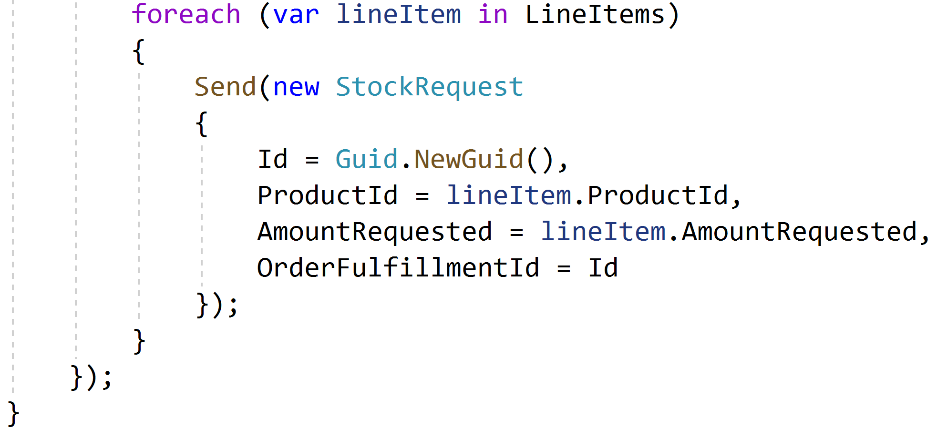

Slide 67
When things go wrong

Slide 68
✓
✓
Document
Document
Data
Data
…
…
…
…
In
In
Out
Out
Document
Data
Dispatcher
In
Out
Notes:
This document document transaction succeeds

Slide 69
✓
✓
Document
Document
Data
Data
…
…
…
…
In
In
Out
Out
Document
Data
Dispatcher
In
Out
Notes:
Upon dispatch to the second document however, this one fails, so no data is written and no event stored in the outbox

Slide 70
✓
✓
Document
Document
Data
Data
…
…
…
…
In
In
Out
Out
Document
Data
Dispatcher
In
Out
Retry
Notes:
Detecting a failure, the dispatcher sends a durable message to an document retry queue, noting the document type and ID to retry domain events.

Slide 71
Retries

Slide 72
Document
Document
Data
Data
…
…
…
…
In
In
Out
Out
Document
Data
Dispatcher
In
Out
Retry
Notes:
For retries, the dispatcher reads messages from the document retry queue.

Slide 73
Document
Document
Data
Data
…
…
…
…
In
In
Out
Out
Document
Data
Dispatcher
In
Out
Retry
Notes:
The dispatcher then pulls the document and attempts to re-dispatch its domain events to the relevant handlers

Slide 74
Document
Document
Data
Data
…
…
…
…
In
In
Out
Out
Document
Data
Dispatcher
In
Out
Retry
Notes:
For the first document, it sends the domain event to the handler

Slide 75
Document
Document
Data
Data
…
…
…
…
In
In
Out
Out
Document
Data
Dispatcher
In
Out
Retry
Notes:
The document checks its inbox and compares the ID of the incoming domain event to its inbox of processed events

Slide 76
¯\_(ツ)_/¯
Document
Document
Data
Data
…
…
…
…
In
In
Out
Out
Document
Data
Dispatcher
In
Out
Retry
Notes:
It sees that the message has already been processed, so ignores the event. Handling the domain event maintains idempotency, so that receiving a domain event at-least-once results in the actual processing of the event to only happen once

Slide 77
¯\_(ツ)_/¯
Document
Document
Data
Data
…
…
…
…
In
In
Out
Out
Document
Data
…
…
Dispatcher
In
Out
Retry
Notes:
The dispatcher notifies the next handler of a domain event

Slide 78
¯\_(ツ)_/¯
Document
Document
Data
Data
…
…
…
…
In
In
Out
Out
✓
Document
Data
…
…
Dispatcher
In
Out
Retry
Notes:
However, this document has not processed this domain event before, so it processes the domain event and stores it in its inbox.

Slide 79
¯\_(ツ)_/¯
Document
Document
Data
Data
…
…
…
…
In
In
Out
Out
✓
Document
Data
…
…
Dispatcher
In
Out
Retry
Notes:
Now that all handlers have successfully processed the domain event, the dispatcher tells the originating document that the domain event can safely be deleted (or marked as processed)

Slide 80
✓
¯\_(ツ)_/¯
Document
Document
Data
Data
…
…
…
…
In
In
Out
Out
✓
Document
Data
…
…
Dispatcher
In
Out
Retry
Notes:
The originating document is now saved, and we repeat for all domain events.

Slide 81
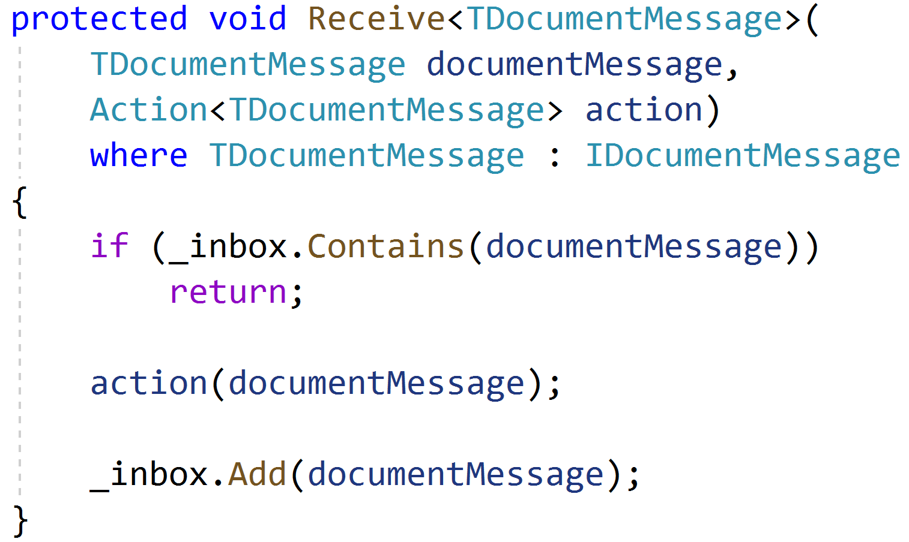

Slide 83
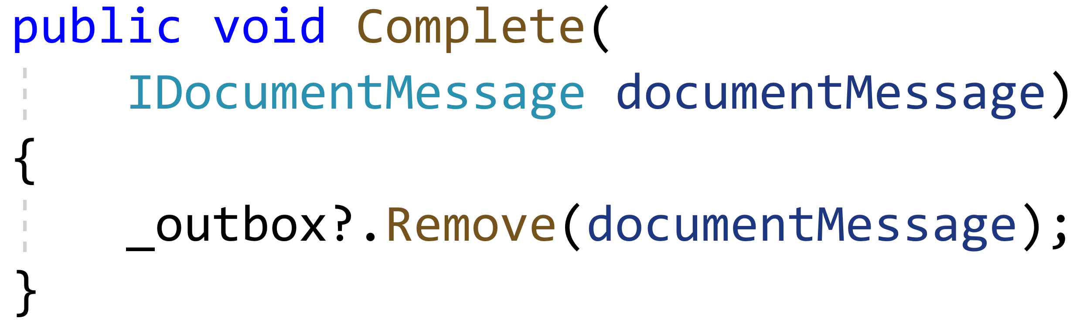

Slide 84
How do we dispatch?

Slide 85
Document
Document
Document
Document
Document
Document
Document
Document
Notes:
A single activity results in a cascade of interactions with other Documents

Slide 86
Document
Document
Document
Document
Document
Document
Unit of Work
Document
Document
…
…
…
…
Notes:
As Documents are loaded, they get registered in the unit of work

Slide 87
Document
Document
Document
✓
Document
Document
Document
Unit of Work
Document
Document
…
…
…
…
Notes:
The first Document completes with domain events, and registers with the unit of work

Slide 88
✓
Document
Document
Document
✓
Document
Document
✓
Document
Unit of Work
Document
Document
…
…
…
…
Notes:
The unit of work, through the dispatcher, dispatches domain events to other Documents, which also register in the unit of work

Slide 89
✓
✓
Document
Document
Document
✓
Document
✓
Document
✓
Document
Unit of Work
✓
Document
Document
…
…
…
…
Notes:
And continues to the next level, each Document committing independently

Slide 90
✓
✓
✓
Document
Document
Document
✓
Document
✓
Document
✓
Document
Unit of Work
✓
Document
Document
…
…
…
…
Notes:
But at some point we encounter a failure

Slide 91
✓
✓
✓
Document
Document
Document
✓
Document
✓
Document
✓
Document
Unit of Work
✓
Document
Document
…
…
…
…
Retry
Notes:
We can retry the Document directly above the failure. This will put the failed Documents out of the unit of work processing

Slide 92
✓
✓
✓
Document
Document
Document
✓
Document
✓
Document
✓
Document
Unit of Work
✓
Document
Document
…
…
…
…
Retry
Notes:
Or we can retry at the root of the failure. Most of the operations will be no-op, but we would only have marked the domain events as deleted if the entire operation below it succeeds.

Slide 93
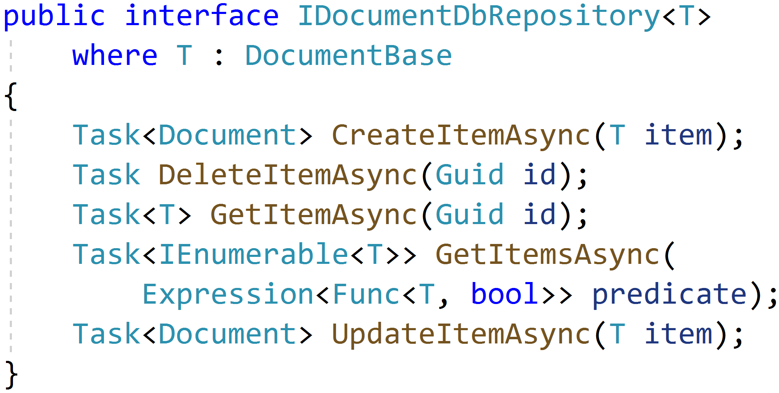

Slide 94
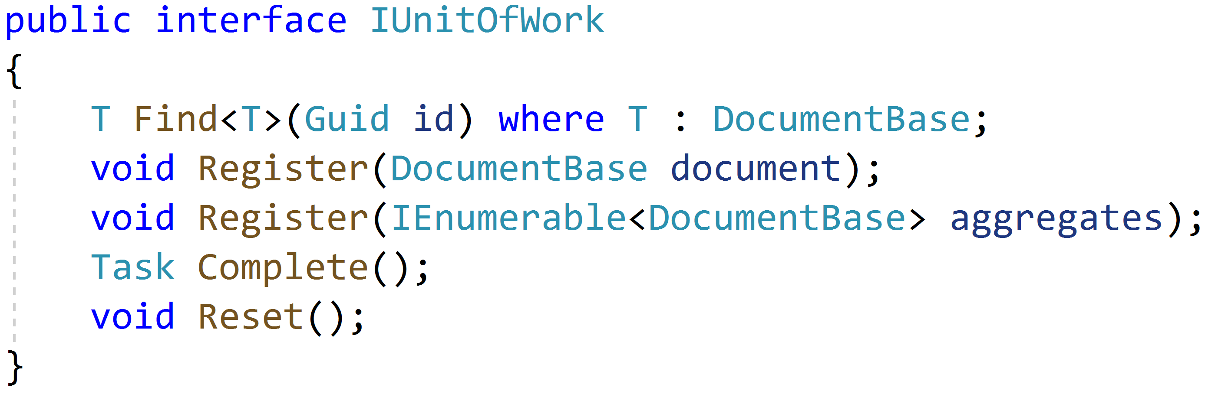

Slide 95
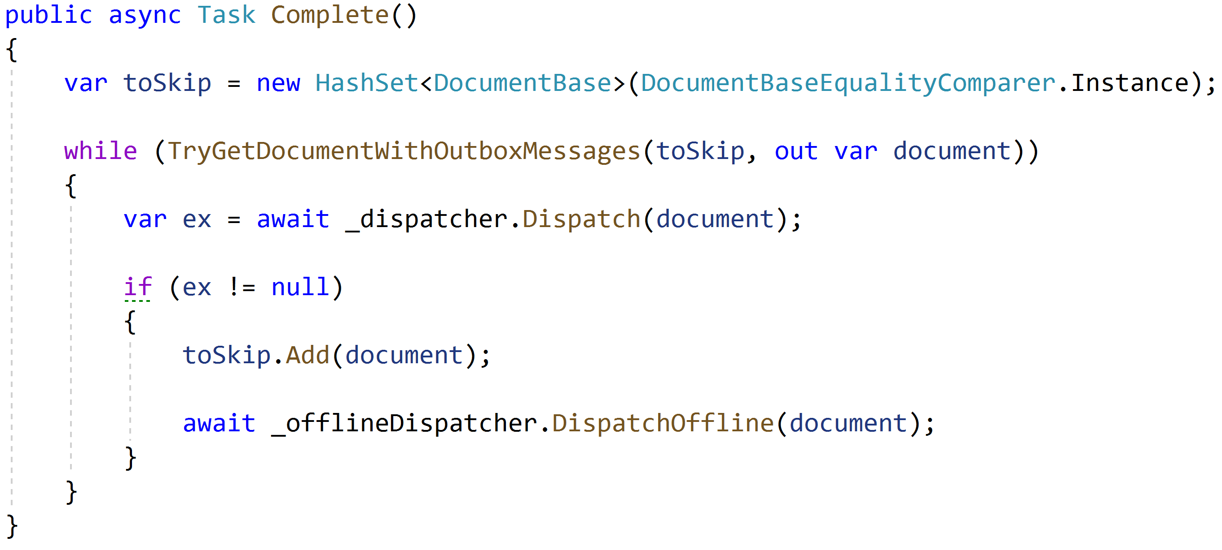

Slide 96
What if something goes REALLY wrong?

Slide 97
Document
Document
Document
Document
Document
Document
Document
Document
Notes:
A single activity results in a cascade of interactions with other Documents

Slide 98
✓
✓
Document
Document
Document
✓
Document
✓
Document
✓
Document
Unit of Work
✓
Document
Document
…
…
…
…
Notes:
And continues to the next level, each Document committing independently

Slide 99
✓
✓
✓
Document
Document
Document
✓
Document
✓
Document
✓
Document
Unit of Work
✓
Document
Document
…
…
…
…
Notes:
But at some point we encounter a failure

Slide 100
✓
✓
✓
Document
Document
Document
✓
Document
✓
Document
✓
Document
Unit of Work
✓
Document
Document
…
…
…
…
Notes:
But at some point we encounter a failure

Slide 101
✓
✓
✓
Document
Document
Document
✓
Document
✓
Trigger
Document
…
…
…
…
✓
Document
Unit of Work
✓
Document
Document
…
…
…
…
Notes:
But at some point we encounter a failure

Slide 102
✓
✓
✓
Document
Document
Document
✓
Document
✓
Trigger
Document
…
…
…
…
✓
Document
Unit of Work
✓
Document
Document
…
…
…
…
Notes:
But at some point we encounter a failure

Slide 103
✓
✓
✓
Document
Document
Document
✓
Document
✓
Trigger
Document
…
…
…
…
✓
Document
Unit of Work
✓
Document
Document
…
…
…
…
Retry
Notes:
But at some point we encounter a failure

Slide 104
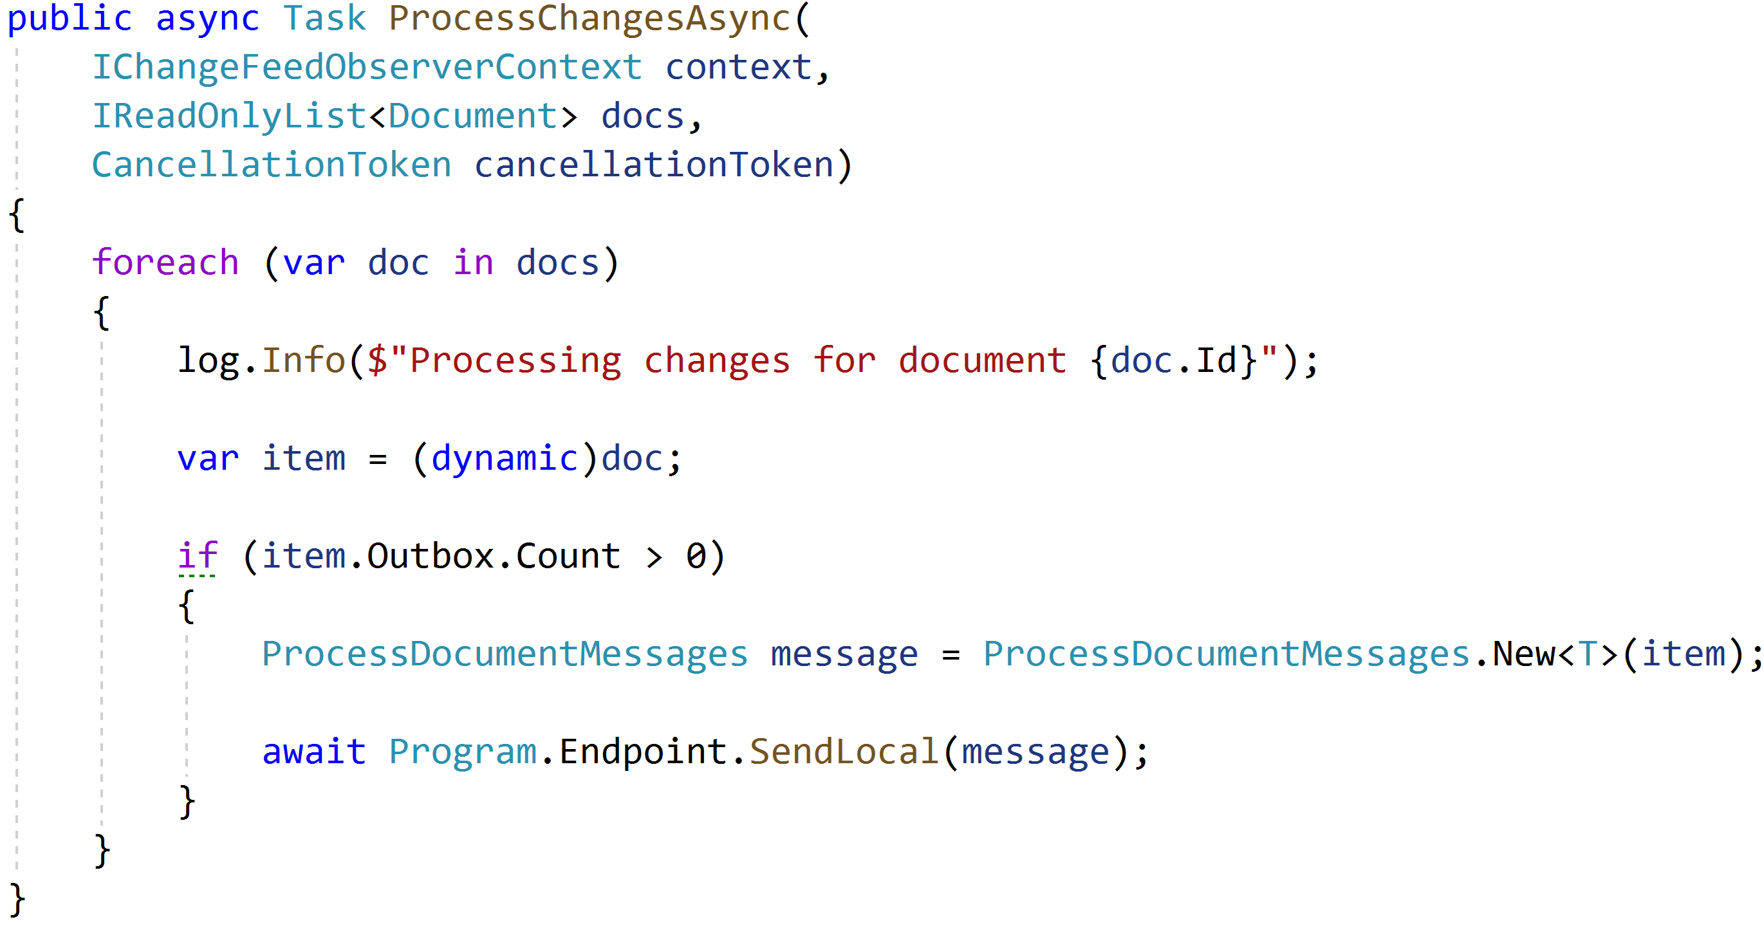

Slide 105
Complex Coordination with Sagas

Slide 106
An order can be fulfilled when: The request is approved The stock is confirmed

Slide 107
Order Request
Order Fulfillment
Stock

Slide 108
Order Request
Order Fulfillment
OrderCreated
Stock

Slide 109
Order Request
Order Fulfillment
OrderCreated
Stock

Slide 110
Order Request
Order Fulfillment
StockRequest [123]
Stock

Slide 111
Order Request
Order Fulfillment
StockRequest [123]
StockRequest [456]
Stock

Slide 112
Order Request
Order Fulfillment
StockRequest [123]
StockRequest [456]
StockRequest [789]
Stock

Slide 113
Order Request
Order Fulfillment
Stock
StockRequest [123]
StockRequest [456]
StockRequest [789]

Slide 114
Order Request
Order Fulfillment
Stock
StockRequestConfirmed [123]
StockRequest [456]
StockRequest [789]

Slide 115
Order Request
Order Fulfillment
Stock
StockRequestConfirmed [123]
StockRequestConfirmed [456]
StockRequest [789]

Slide 116
Order Request
Order Fulfillment
Stock
StockRequestConfirmed [123]
StockRequestConfirmed [456]
StockRequestConfirmed [789]

Slide 117
Order Request
Order Fulfillment
StockRequestConfirmed [123]
StockRequestConfirmed [456]
StockRequestConfirmed [789]
Stock

Slide 118
Order Request
Order Fulfillment
OrderApproved
Stock

Slide 119
Order Request
Order Fulfillment
OrderApproved
Stock

Slide 120
Order Request
Order Fulfillment
OrderFulfillmentSuccessful
Stock

Slide 121
Order Request
Order Fulfillment
OrderFulfillmentSuccessful
Stock

Slide 122
Order Request
✓
Order Fulfillment
Stock

Slide 123
Demo

Slide 124
An order can be canceled when: The stock is denied OR The request is rejected

Slide 125
An order can be canceled when: The stock is denied OR The request is rejected

Slide 126
Order Request
Order Fulfillment
StockRequest [123]
StockRequest [456]
StockRequest [789]
Stock

Slide 127
Order Request
Order Fulfillment
Stock
StockRequest [123]
StockRequest [456]
StockRequest [789]

Slide 128
Order Request
Order Fulfillment
Stock
StockRequestConfirmed [123]
StockRequest [456]
StockRequest [789]

Slide 129
Order Request
Order Fulfillment
Stock
StockRequestConfirmed [123]
StockRequestConfirmed [456]
StockRequest [789]

Slide 130
Order Request
Order Fulfillment
Stock
StockRequestConfirmed [123]
StockRequestConfirmed [456]
StockRequestDenied [789]

Slide 131
Order Request
Order Fulfillment
StockRequestConfirmed [123]
StockRequestConfirmed [456]
StockRequestDenied [789]
Stock

Slide 132
Order Request
Order Fulfillment
CancelOrderRequest
StockReturnRequested [123]
StockReturnRequested [456]
Stock

Slide 133
Order Request
Order Fulfillment
CancelOrderRequest
Stock
StockReturnRequested [123]
StockReturnRequested [456]

Slide 134
Order Request
✓
Order Fulfillment
Stock

Slide 135
Demo
Notes:
DocumentFeedObserver

Slide 136
An order can be canceled when: The stock is denied OR The request is rejected

Slide 137
Order Request
Order Fulfillment
OrderRejected
Stock

Slide 138
Order Request
Order Fulfillment
OrderRejected
Stock

Slide 139
Order Request
Order Fulfillment
StockReturnRequested [123]
StockReturnRequested [456]
StockReturnRequested [789]
Stock

Slide 140
Order Request
Order Fulfillment
Stock
StockReturnRequested [123]
StockReturnRequested [456]
StockReturnRequested [789]

Slide 141
Order Request
✓
Order Fulfillment
Stock

Slide 142
Demo
Notes:
DocumentFeedObserver

Slide 143
Other situations

Slide 144
SQL Server
MS DTC
RabbitMQ

Slide 145
Find the transactional boundaries

Slide 146
NoSQL DB
doc1
doc2
doc3
MS DTC
RabbitMQ

Slide 147
NoSQL
DB
doc1
Tx
doc2
Tx
doc3
Tx
MS DTC
RabbitMQ

Slide 148
SQL Server
row1
row2
row3
Tx
MS DTC
RabbitMQ

Slide 149
SQL Server
row1
row2
row3
Outbox
Id
Type
Body
Dispatcher
Tx
RabbitMQ

Slide 150
Broker
Microservice A
Microservice B
Dispatcher
Translator
Receiver
Dispatcher
SQL
SQL
Outbox
Inbox

Slide 151
This Is Hard

Slide 152
Demo w/ NServiceBus

Slide 153
Our lessons
Distributed transactions are "Easy" locally
Distributed transactions are hard/impossible when…distributed
Find the transactional boundary
Outbox to coordinate communication

Slide 154
Life Beyond Distributed Transactions: An Apostate's Implementation
Jimmy Bogard
@jbogard
github.com/jbogard
jimmybogard.com
github.com/jbogard/AdventureWorksCosmos

