Slide 1
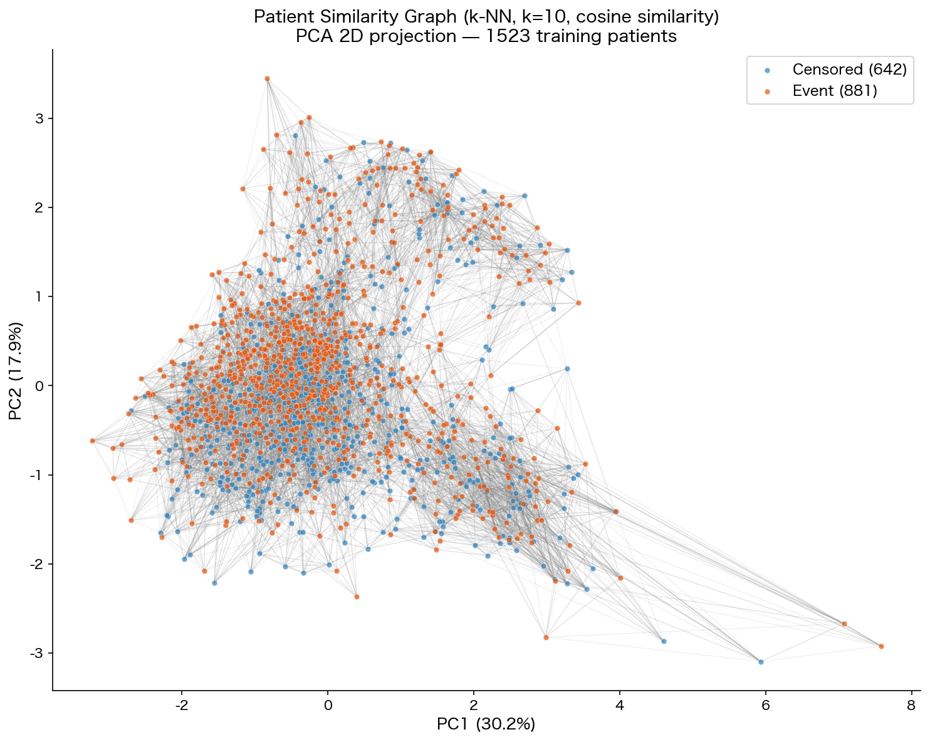
Modernization and Integration
of a New Graph-Based
Deep Learning Method
for Survival Analysis
Yosuke Kimoto Sena Fukabe
ECN — Ecole Centrale de Nantes
June 2026
01 / 20
ECN | Ecole Centrale de Nantes

Slide 2
Agenda
EPN Integration
1
Background: Survival Analysis
2
Objective
3
Models Overview
MLP / EPN / SurvivalDGM
4
Implementation
Repository Structure • Two-Stage Pipeline • Engineering Challenges
5
Experimental Results
6
Discussion & Future Work
Kimoto & Fukabe — ECN 2026
02 / 20
ECN | Ecole Centrale de Nantes

Slide 3
Background: Survival Analysis
EPN Integration
What is Survival Analysis?
Survival Curve Concept
Goal: predict S(t|x) — the probability that a patient
survives beyond time t given clinical features x.
Challenge: censored observations — patients who
left the study before experiencing the event.
Standard ML cannot handle censoring directly.
S(t)↑
1.0 │╲ Low risk
│ ╲
0.5 │ ╲─── High risk
0.0 └──────────► t
Dataset: METABRIC
Patients:
1,904
Evaluation Metrics
Features:
9 clinical variables (x0–x8)
C-index (Concordance Index)
Ranking accuracy of predicted risk
0.5 = random / 1.0 = perfect
Event rate:
~58% (death = 1)
IBS (Integrated Brier Score)
Evaluation:
5-fold cross-validation
Mean squared prediction error vs. outcomes
Lower is better
Kimoto & Fukabe — ECN 2026
03 / 20
ECN | Ecole Centrale de Nantes

Slide 4
Objective
EPN Integration
Integrate the Error Propagation Network (EPN) into existing PyTorch Lightning pipeline
1
Verify existing SurvivalDGM pipeline (5-fold CV)
2
Wrap Oriane's MLP as a Lightning module
3
Build patient similarity graph (PyTorch Geometric)
4
Reimplement EPN as a tensor-only Lightning module
5
Integrate Hydra configuration management
Kimoto & Fukabe — ECN 2026
04 / 20
ECN | Ecole Centrale de Nantes

Slide 5
Three Models at a Glance
EPN Integration
SurvivalDGM
MLP
EPN
Probabilistic Graph Model
Feedforward Neural Network
Graph Attention Network
baseline
★ BEST
★ BEST
(this project)
Existing baseline
Stage 1 of our pipeline
Stage 2 of our pipeline
Stochastic latent graph
Architecture: 9 → 64 → 64 → 1
Corrects MLP predictions
Requires 100 forward passes
Loss: CoxPH
using k-NN neighbour errors
per split for stable C-index
Loss: CoxCC
Mean C-index
Mean C-index
Mean C-index
0.6043
0.6495
0.6157
Kimoto & Fukabe — ECN 2026
05 / 20
ECN | Ecole Centrale de Nantes

Slide 6
Stage 1: MLP Architecture
EPN Integration
Input (dim = 9)
9 clinical features
Training Configuration
Loss function
CoxPH
Linear(9 → 64) + ReLU
Epochs
110
Optimizer
Adam
Linear(64 → 64) + ReLU
Learning rate
0.001
Linear(64 → 1)
→ risk score
Weight decay
0.0005
Evaluation
5-fold CV
PyCox CoxPH wrapper
Output S(t|x): survival probability at ~1,391 discrete
time points per patient → used as EPN input
S(t|x) [N × T]
survival curves
Kimoto & Fukabe — ECN 2026
06 / 20
ECN | Ecole Centrale de Nantes

Slide 7
Stage 2: Error Propagation Network (EPN)
EPN Integration
Core Idea:
If the MLP consistently misestimates survival for patients similar to patient A,
we can correct A's prediction using those neighbour errors.
①
Find k=10 nearest neighbours in the k-NN graph
②
Compute MLP prediction error for each neighbour j:
error_j(t) = true_survival_j(t) − MLP_pred_j(t)
③
Compute attention weights (learned Key/Query projections):
att_j = softmax( (W_q · feat_A) · (W_k · feat_j) / √F )
④
Compute correction term:
correction(t) = Σ_j att_j × error_j(t)
⑤
Corrected prediction:
S_corrected_A(t) = MLP_pred_A(t) + correction(t)
Training loss: CoxCC (Case-Control Cox approximation)
Kimoto & Fukabe — ECN 2026
07 / 20
ECN | Ecole Centrale de Nantes

Slide 8
Repository Structure
EPN Integration
Survival_Analysis/
├── configs/ [Configuration]
│ └── experiment/
│ └── ★ run_epn.yaml Hydra main config
│ └── model/ { mlp.yaml, epn.yaml }
└── src/survival_analysis/
├── data/ [Data Layer]
│ ├── metabric_datamodule.py
│ ├── ★ graph_builder.py k-NN similarity graph
│ └── ★ epn_datamodule.py MLP curves + graph
├── models/ [Model Layer]
│ ├── ★ mlp_module.py MLP LightningModule
│ ├── ★ epn_module.py EPN graph attention
│ └── dgm_model.py SurvivalDGM (existing)
└── experiments/ [Experiment Scripts]
├── ★ run_mlp.py Train MLP (5 splits)
├── ★ run_epn_v2.py Full MLP+EPN pipeline
└── ★ visualize.py Graph & survival plots
■ Gray = Already existing
★ Blue = Added by this project
Kimoto & Fukabe — ECN 2026
08 / 20
ECN | Ecole Centrale de Nantes

Slide 9
Two-Stage Pipeline Architecture
EPN Integration
Stage 1: MLP Training
5-fold CV
DataModule: MetabricGraphSurvivalDataModule
↓
MLPModule: 110 epochs | CoxPH loss | Adam lr=0.001
↓
Evaluate: CoxPH wrapper → C-index, IBS
Train: ~1,523
Val: ~381
↓ mlp.freeze() — weights permanently locked
Stage 2: EPN Training
EPNDataModule.setup():
• Pre-compute MLP curves for all patients [N_all, T]
• Build training k-NN graph → train_nn_idx [1523, 10]
• Build val k-NN graph → val_nn_idx [1904, 10]
↓
EPNModule: 50 epochs | CoxCC loss | Adam lr=0.001
↓
Evaluate: EvalSurv → C-index, IBS
Kimoto & Fukabe — ECN 2026
09 / 20
ECN | Ecole Centrale de Nantes

Slide 10
Patient Similarity Graph Construction
EPN Integration
Concept
Parameters
● feat_B
/
●────Patient A────● feat_D
\ (k=10 neighbours)
● feat_C
Metric: cosine similarity
(scale-invariant across features)
Library
PyTorch Geometric (PyG)
Metric
Cosine similarity
Neighbours k
10 per patient
Self-loop
Excluded
Output
edge_index [2, N×10]
Two Separate Graphs
Training: 1,523 train patients → train patients only
Validation: All 1,904 patients
Val patients attend to TRAIN errors only
★ Prevents data leakage
Kimoto & Fukabe — ECN 2026
10 / 20
ECN | Ecole Centrale de Nantes

Slide 11
Engineering Challenge ①: Removing the DataFrame Dependency
EPN Integration
✗ Before (Bad Practice)
✓ After (Refactored)
forward(self,
df: pd.DataFrame, ← !
nn_idx
)
# Parses column names
→ incompatible with Lightning pipeline
forward(self,
features, # [N, 9]
surv_preds, # [N, T]
labels, # [N, 2]
nn_idx, # [N, 10]
test_idx, val_idx
)
# Pure tensor interface ✓
DataLoader yields: { "features":[N,9] "surv_preds":[N,T] "labels":[N,2] "nn_idx":[N,10] }
Kimoto & Fukabe — ECN 2026
11 / 20
ECN | Ecole Centrale de Nantes

Slide 12
Engineering Challenge ②: Out-of-Memory Problem
EPN Integration
Naive approach: compute attention over ALL patients simultaneously
Tensor: [1,523 × 1,523 × 1,391] → ~12.9 GB ✗ OOM CRASH
Optimization ①: Mini-batching
+
Optimization ②: Graph-constrained
Process 256 randomly selected
training patients per step
[256, 256, 1391] ≈ 363 MB
Attend only to k=10 pre-selected
neighbours (not all N patients)
[256, 10, 1391] ≈ 14 MB ✓
Method
Tensor Shape
Memory
All patients, full attention
[1523, 1523, 1391]
~12.9 GB
Mini-batch (256), full att.
[ 256, 256, 1391]
~363 MB
Mini-batch (256) + graph ★
[ 256, 10, 1391]
~14 MB ✓
Result: 26× memory reduction vs. mini-batch alone
Kimoto & Fukabe — ECN 2026
12 / 20
ECN | Ecole Centrale de Nantes

Slide 13
Hydra Configuration Management
EPN Integration
# configs/experiment/run_epn.yaml
CLI Overrides — no source code changes
mlp:
hidden_dim: 64
epochs: 110
optimizer:
lr: 0.001
weight_decay: 0.0005
epn:
epochs: 50
learning_rate: 0.001
alpha: 0.0 # L1 regularization
beta: 0.0 # L2 regularization
graph:
k: 10
metric: cosine
# Change neighbourhood size
python -m ...run_epn_v2 \
graph.k=20
# Extend EPN training
python -m ...run_epn_v2 \
epn.epochs=100
Benefits
✓ No source code changes for experiments
✓ Reproducible experiment configurations
✓ Consistent with the pipeline
✓ Grid search via multirun
Kimoto & Fukabe — ECN 2026
13 / 20
ECN | Ecole Centrale de Nantes

Slide 14
Results: Patient Similarity Graph Visualization
EPN Integration
Figure 1: Patient Similarity Graph (k-NN, k=10, cosine similarity) | PCA 2D projection — PC1: 30.2%, PC2: 17.9% ● Censored (blue) ● Event/death (orange)
• Event and censored groups are interleaved → No clear separation in feature space → Consistent with modest C-index values
• Dense cluster (centre): patients with average clinical profiles • Peripheral points: extreme feature values
Kimoto & Fukabe — ECN 2026
14 / 20
ECN | Ecole Centrale de Nantes

Slide 15
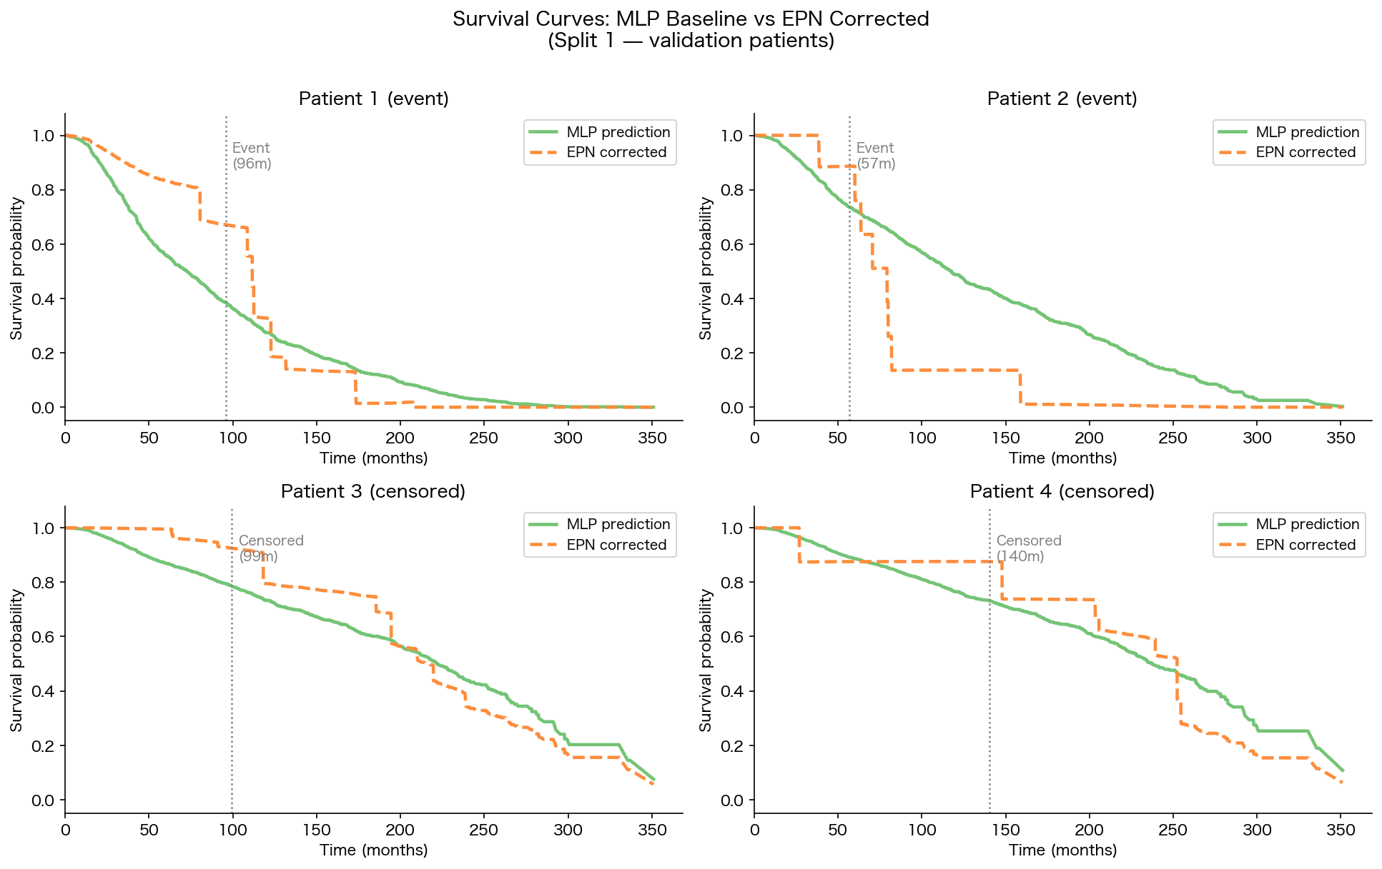
Results: Survival Curve Comparison
EPN Integration
── MLP baseline (green) - - EPN corrected (orange) ┊ Observed event/censoring time
Event patients (top): EPN shifts survival curve downward after event time → error signal from similar neighbours
Censored patients (bottom): correction is more moderate → weaker error signal for censored observations
Kimoto & Fukabe — ECN 2026
15 / 20
ECN | Ecole Centrale de Nantes

Slide 16
Results: Quantitative Performance
EPN Integration
MLP vs EPN — Per Fold
Split
MLP C-index
MLP IBS
EPN C-index
EPN IBS
1
0.6546
0.1718
0.5879
0.1818
2
0.6486
0.1558
0.6345
0.1606
3
0.6332
0.1777
0.6055
0.1822
4
0.6578
0.1685
0.6347
0.1822
5
0.6491
0.1605
0.6171
0.1778
Mean
0.6487±0.009
0.1669
0.6159±0.018
0.1769
Three-Model Comparison
Model
Mean C-index
Mean IBS
Note
SurvivalDGM
0.6043±0.024
0.1754
existing baseline
MLP (Stage 1) ★
0.6495±0.010
0.1664
★ BEST
EPN (this work)
0.6157±0.016
0.1769
> SurvivalDGM ✓
Kimoto & Fukabe — ECN 2026
16 / 20
ECN | Ecole Centrale de Nantes

Slide 17
Discussion: Why EPN Does Not Yet Surpass the MLP
EPN Integration
The MLP is a strong baseline for METABRIC (n≈1,900, 9 features).
Small dataset + appropriate survival loss (CoxPH) = already competitive.
Graph-based population methods tend to excel on larger datasets (e.g., SUPPORT: n≈9,000).
①
Hyperparameters are untuned
k=10, 50 epochs, default lr — no systematic search performed
②
Feature similarity ≠ error similarity
Clinically similar patients may differ in prediction errors due to complex biological interactions
③
Limited training data
~1,523 training patients may not provide diverse enough error signals for graph correction
④
Loss function mismatch
MLP uses CoxPH; EPN uses CoxCC → Difficult to isolate the graph correction's contribution
Kimoto & Fukabe — ECN 2026
17 / 20
ECN | Ecole Centrale de Nantes

Slide 18
Future Improvements
EPN Integration
Area
Proposed Improvement
Graph size (k)
Grid search: k ∈ {5, 10, 20, 50} — Larger k may provide richer error signals
Training epochs
EPN convergence test with 100+ epochs
Loss alignment
Use CoxPH for EPN to enable direct comparison with MLP baseline
Graph construction
Feature-importance-weighted similarity or end-to-end learned graph edges
Dataset scale
Test on SUPPORT (n≈9,000) where population-based corrections are more effective
Kimoto & Fukabe — ECN 2026
18 / 20
ECN | Ecole Centrale de Nantes

Slide 19
Conclusion
EPN Integration
Engineering Achievements
Results
✓
EPN fully reimplemented as tensor-only
LightningModule (DataFrame-free)
MLP (Stage 1)
C-index = 0.6495 ★ Best
EPN (this work)
✓
Memory: ~12.9 GB → ~14 MB (26× reduction)
via graph-constrained attention + mini-batching
C-index = 0.6157
SurvivalDGM
C-index = 0.6043
✓
Hydra configuration management integrated
→ reproducible, CLI-configurable experiments
EPN surpasses SurvivalDGM baseline.
For small datasets like METABRIC,
hyperparameter tuning is essential.
Most promising next step:
tuning graph size k and EPN epochs.
✓
Modular codebase consistent with
Valentin's existing pipeline conventions
Kimoto & Fukabe — ECN 2026
19 / 20
ECN | Ecole Centrale de Nantes

Slide 20
References
EPN Integration
[1] Blondel, O. (2022). surv_epn: Error Propagation Network for survival analysis. INSA Lyon.
[2] Curtis, C. et al. (2012). The genomic and transcriptomic architecture of 2,000 breast tumours. Nature, 486, 346–352.
[3] Kvamme, H., Borgan, O., & Scheel, I. (2019). Time-to-event prediction with neural networks and Cox regression. JMLR, 20(129), 1–30.
[4] Falcon, W. et al. (2019). PyTorch Lightning. GitHub.
[5] Fey, M. & Lenssen, J. E. (2019). Fast Graph Representation Learning with PyTorch Geometric. ICLR Workshop.
[6] Yao, D. et al. (2023). Hydra: A framework for elegant experiment management. Meta AI.
[7] Katzman, J. L. et al. (2018). DeepSurv: personalized treatment recommender system using Cox deep neural network. BMC Medical Research Methodology, 18(1), 24.
Kimoto & Fukabe — ECN 2026
20 / 20
ECN | Ecole Centrale de Nantes

Slide 21
Backup: CoxPH vs CoxCC Details
EPN Integration
CoxPH — used by MLP
CoxCC — used by EPN
Partial likelihood:
L(β) = Π_i exp(f(x_i)) /
Σ_{j: t_j≥t_i} exp(f(x_j))
Risk set = all patients not yet
failed at time t_i
→ Handles censored data naturally
→ Expensive for large N
Case-Control approximation:
• Replace full risk set with
random sample of controls
• Reduces computation while
approximating CoxPH gradient
• Standard approach for large-scale
survival deep learning
Kimoto & Fukabe — ECN 2026
B1 / B4
ECN | Ecole Centrale de Nantes

Slide 22
Backup: Data Leakage Prevention
EPN Integration
Problem: Data Leakage Risk
If validation patients attend to each other's errors → information from val set leaks into the model
Solution: Separate Graphs
Training Graph
Validation Graph
Train patients → Train patients only
(intra-training neighbourhood)
No val patients involved
Val patients → Train patients only
★ Val patients CANNOT attend
to other val patients
EPNDataModule.setup(): val_nn_idx indices always point to training patients
→ no information leakage across the train/val boundary
Kimoto & Fukabe — ECN 2026
B2 / B4
ECN | Ecole Centrale de Nantes

Slide 23
Backup: SurvivalDGM Evaluation Details
EPN Integration
Why SurvivalDGM requires 100 forward passes per split
SurvivalDGM: Stochastic Graph
SurvivalDGM learns a latent graph — each edge is sampled stochastically (Bernoulli)
→ Every forward pass produces a different graph structure
→ Single-pass C-index is unstable
Solution: average C-index over 100 forward passes per split
EPN: Deterministic Fixed Graph
EPN uses a fixed k-NN graph:
→ Deterministic: same graph every pass
→ Single forward pass = stable C-index
→ No repeated sampling required
Kimoto & Fukabe — ECN 2026
B3 / B4
ECN | Ecole Centrale de Nantes

Slide 24
Backup: Full Hydra Config Tree
EPN Integration
configs/
├── experiment/
│ └── run_epn.yaml # Main experiment config (Hydra entry)
├── model/
│ ├── mlp.yaml # MLP-specific hyperparameters
│ └── epn.yaml # EPN-specific hyperparameters
├── data/
│ └── metabric.yaml # Dataset & cross-validation settings
├── trainer/
│ ├── default.yaml # Lightning Trainer defaults
│ └── gpu.yaml # GPU-specific override
└── callbacks/
├── model_checkpoint.yaml # Checkpoint saving config
└── early_stopping.yaml # Early stopping config
Composability:
python -m ...run_epn_v2 trainer=gpu data=metabric graph.k=20
Kimoto & Fukabe — ECN 2026
B4 / B4
ECN | Ecole Centrale de Nantes

