Slide 1
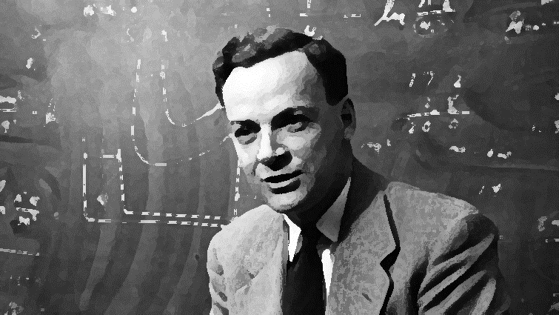

Slide 2
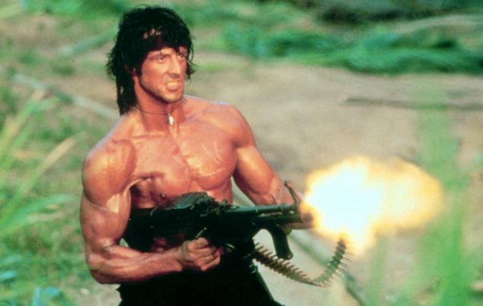
They drew first ambiguous antecedents, not me!
them
her
he
him
she
they
it

Slide 3


