Slide 1

Transport Data Analysis
Presented By: Jurgen Tan

Slide 2
URLs
COE Results : https://data.gov.sg/dataset/coe-bidding-results
Driving Licence: https://data.gov.sg/dataset/driving-licence-information-qualified-driving-licence-holders
HDB Carpark https://data.gov.sg/dataset/hdb-carpark-information

Slide 3
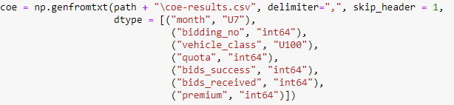
COE Results Dataset
Bidding Number : 1 (Week 1) & 2 (Week 3)
Category A: Car up to 1600CC & 97KW
Category B: Car above 1600CC or 97KW
Category C: Goods Vehicle & Bus
Category D: Motorcycle
Category E: Open

Slide 4
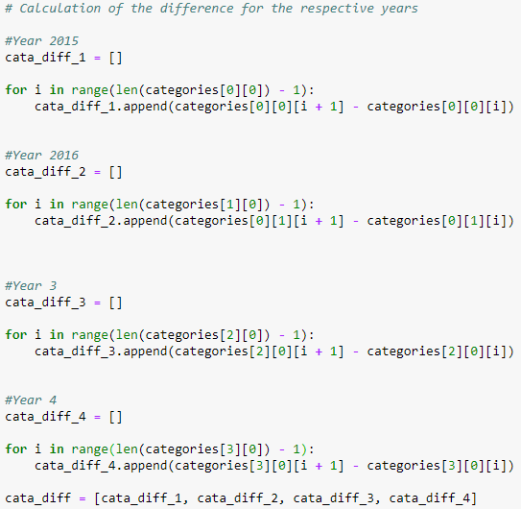
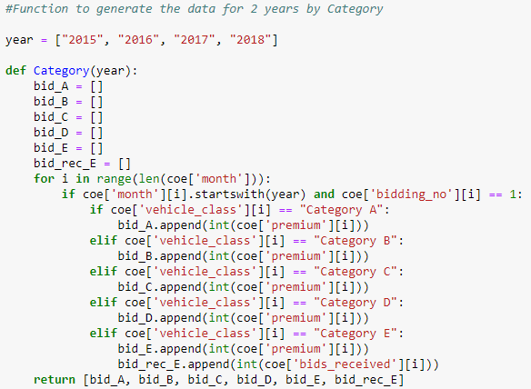
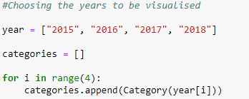
COE Results Dataset Preparation
Function to seperate the different categories
List of the different years
Calculate the difference for the month as compare to the month before

Slide 5
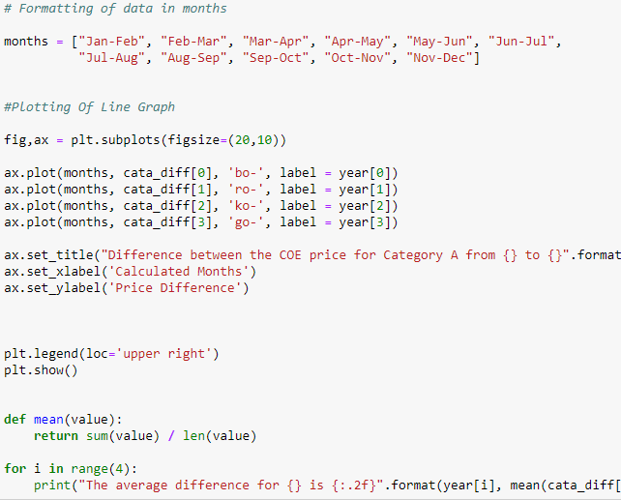
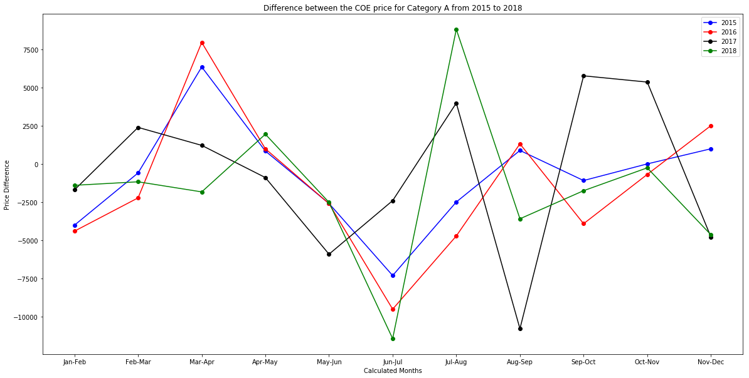

Price Difference Between The Months From 2015 to 2018 For Category A
Negative : Cheaper & Positive: More Expensive
High Volatility
May – Jul: 2015, 2016 & 2018 Plunge
Jun – Aug: 2015, 2016 & 2018 Peak
2017 was very unlike the past data

Slide 6
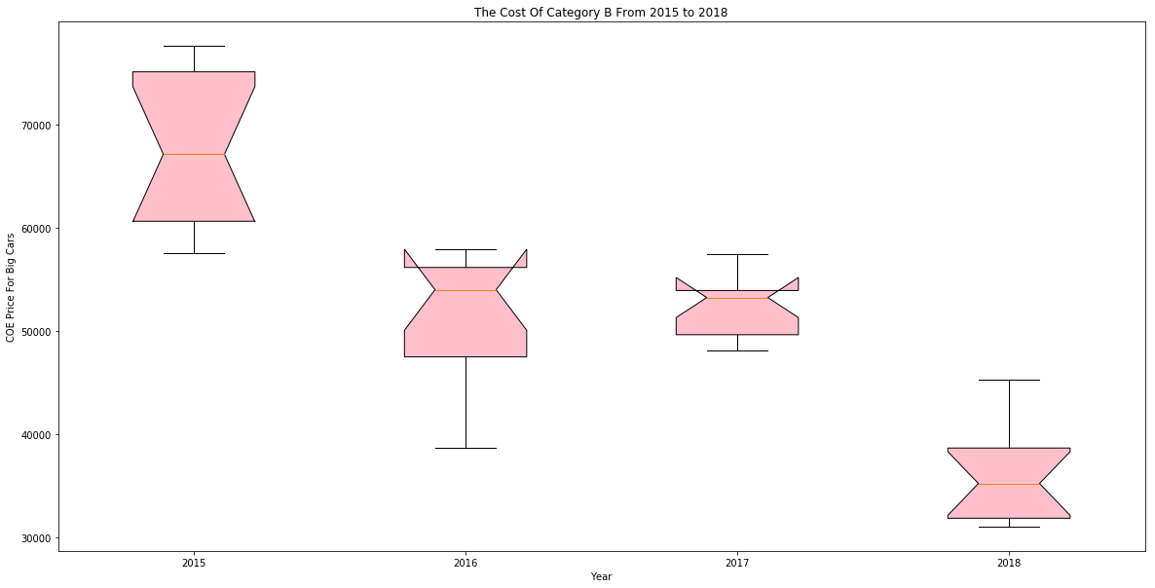
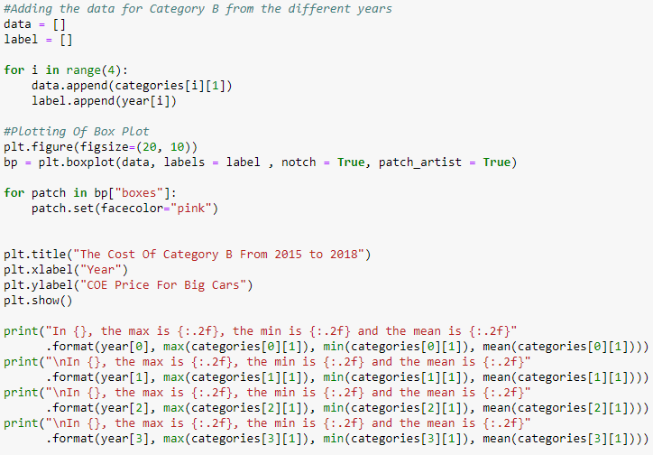
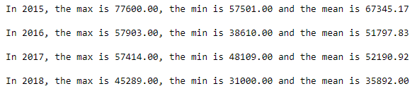
The Cost Of Category B From 2015 to 2018
2015 Min & 2016 Max is almost the same
2017 Min & 2018 Max is almost the same
CI > UQ : 95% for 2016 & 2017

Slide 7
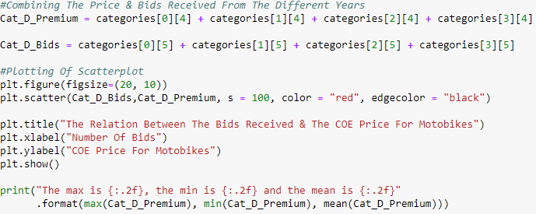
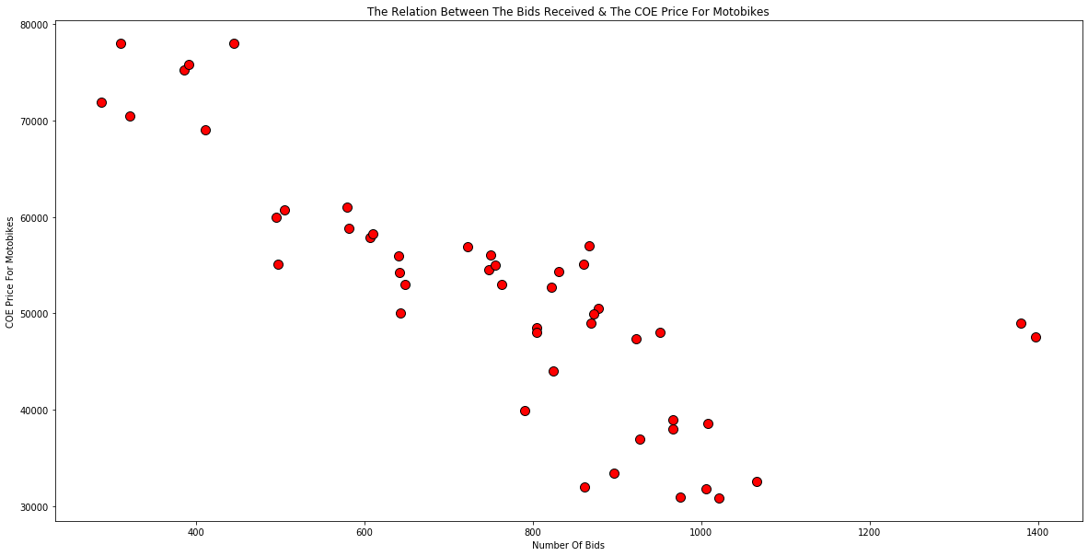
The Relation Between The Bids Received & Category D
Negative Gradient, Harsh Decline
2 Outliers
Lower Bids = Higher COE Price

Slide 8
Driving Licence Dataset
End Of The Year
Total Number
Overlapping Of Licenses

Slide 9
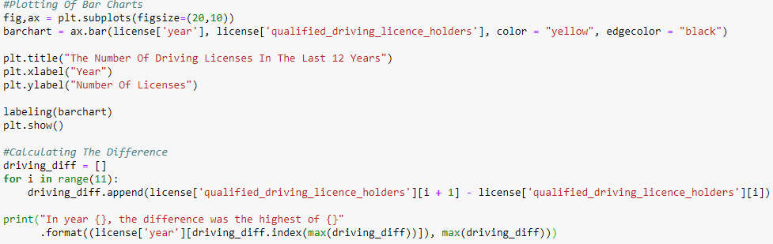
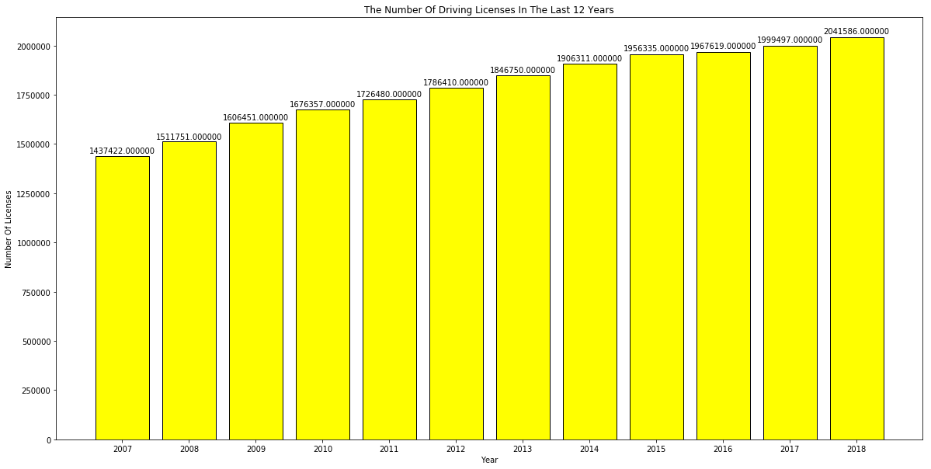
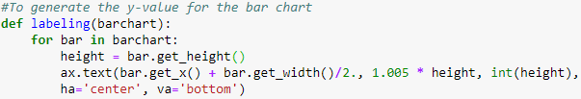
The Number Of Driving Licenses In The Last Decade
Gradual Increase Over The Years

Slide 10
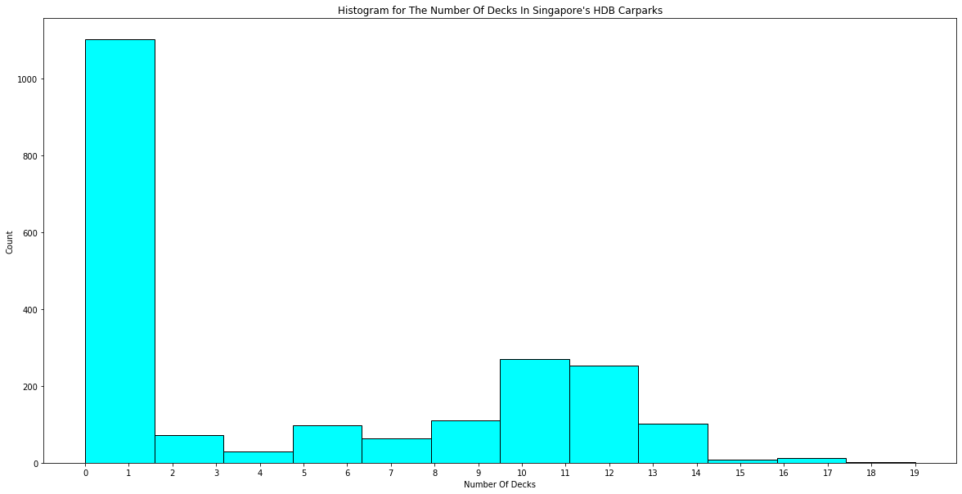
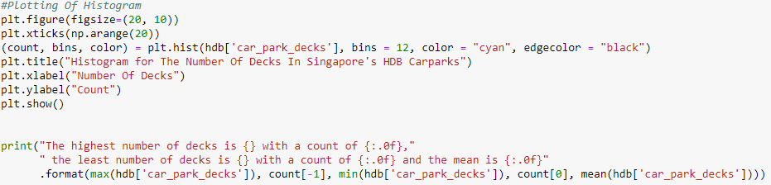
The Number Of Decks In Singapore's HDB Carparks
Most HDB Car Parks are 1 leveled
The average car park level is 5
There are only 2 HDB carparks that are 19 leveled

