Slide 1
Programming Data Science
Presented By: Jurgen Tan

Slide 2
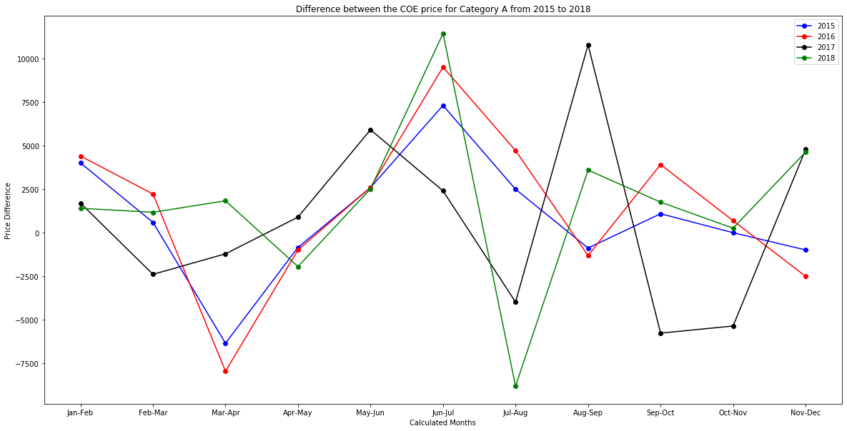
Price Difference Between The Months From 2015 to 2018 For Category A
Asdasdadsa
Asdasd
das

Slide 3
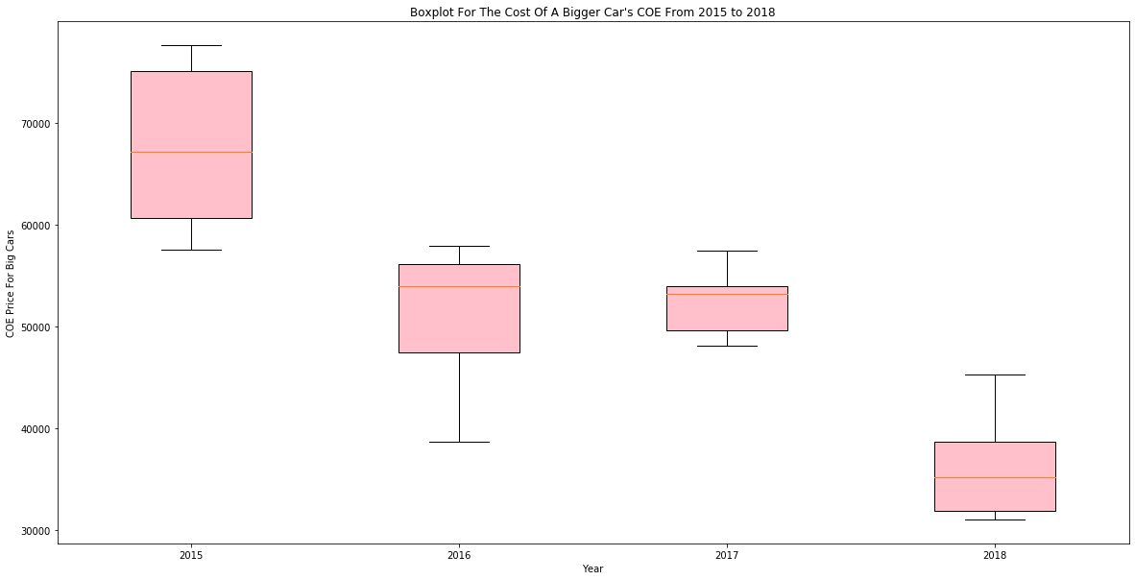
The Cost Of Category B From 2015 to 2018
Asdasdadsa
Asdasd
das

Slide 4
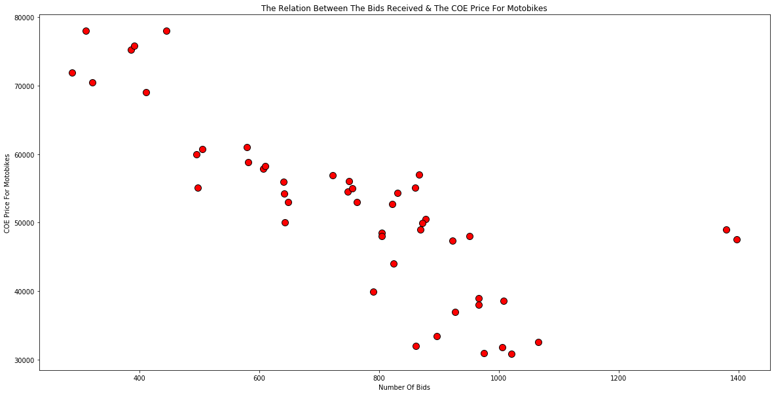
The Relation Between The Bids Received & Category D
Asdasdadsa
Asdasd
das

Slide 5
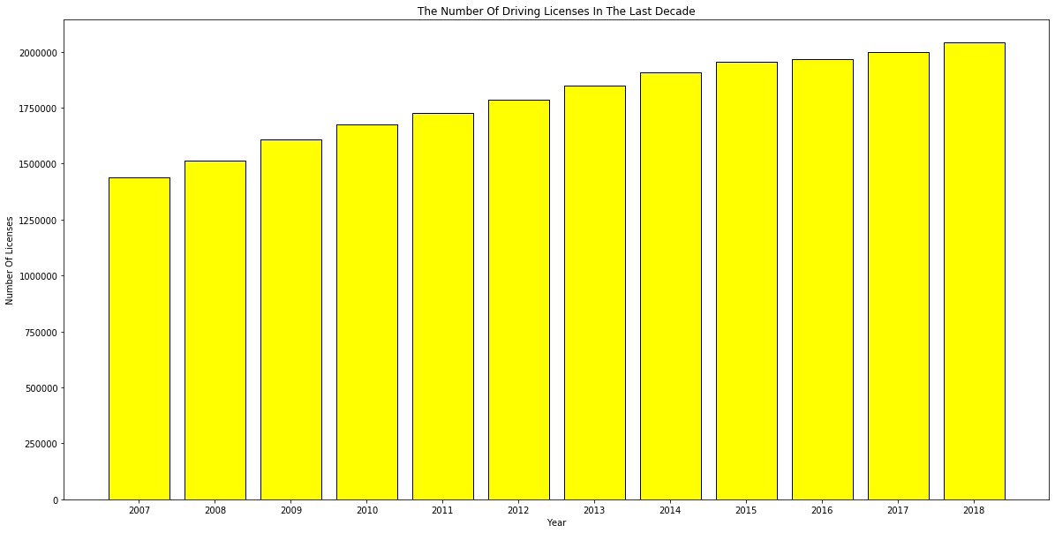
The Number Of Driving Licenses In The Last Decade
Asdasdadsa
Asdasd
das

Slide 6
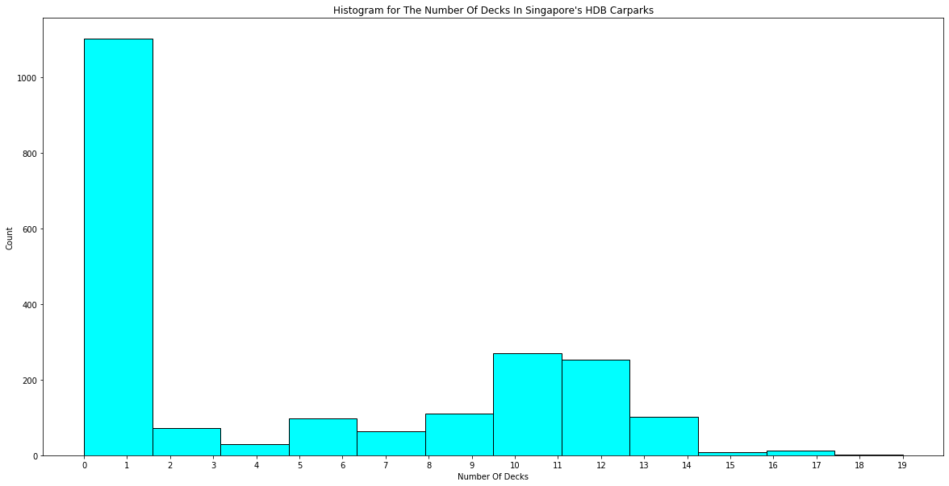
The Number Of Decks In Singapore's HDB Carparks
Asdasdadsa
Asdasd
das

