Slide 1

[Insert dolphin photograph here]
Domain-Robust Common/Bottlenose Dolphin Species Classification from Whistles Using Unsupervised Feature Projection and Contextual-Bandit Learning
Jurica Jerinić
Mentors: dr. sc. Roee Diamant, dr. sc. Nikola Mišković
Faculty of Electrical Engineering and Computing, University of Zagreb

Slide 2
Motivation
• Problem: automatically classify dolphin species from underwater whistle recordings
• Why it matters: Passive Acoustic Monitoring enables non-invasive biodiversity assessment
• Species-level classification supports long-term population monitoring at scale
• Key challenges:
• Whistles vary with behavior, individual identity, and geography
• Closely related species show highly overlapping acoustic structure
• Classifiers can learn recording-domain cues instead of species cues

Slide 3
State of the Art
Category | Representative Work | Key Idea
Contour extraction | Roch 2011; Gruden 2016/2020; Li 2023 | Track whistle time-frequency contour from spectral peaks
Feature-based | Azzolin 2014; Machado 2024; Amorim 2022 | Handcrafted acoustic parameters + classifier
Deep learning | Jiang 2019; Frainer 2023; Makropoulos 2025 | CNN / ViT learns patterns from spectrograms
RL feature selection | Janisch 2019; Rasoul 2021; Liu 2021 | Sequential decision process selects features

Slide 4
State of the Art — Main Approaches
• Feature-statistics & ML: handcrafted whistle parameters + Random Forest / SVM
• Deep learning: CNNs and Vision Transformers on spectrogram images
• RL-based feature selection: sequential decisions on which features to keep
• Evaluation so far: same geographical region, same recording setup
Knowledge gap: no existing method explicitly addresses geographical domain shift

Slide 5
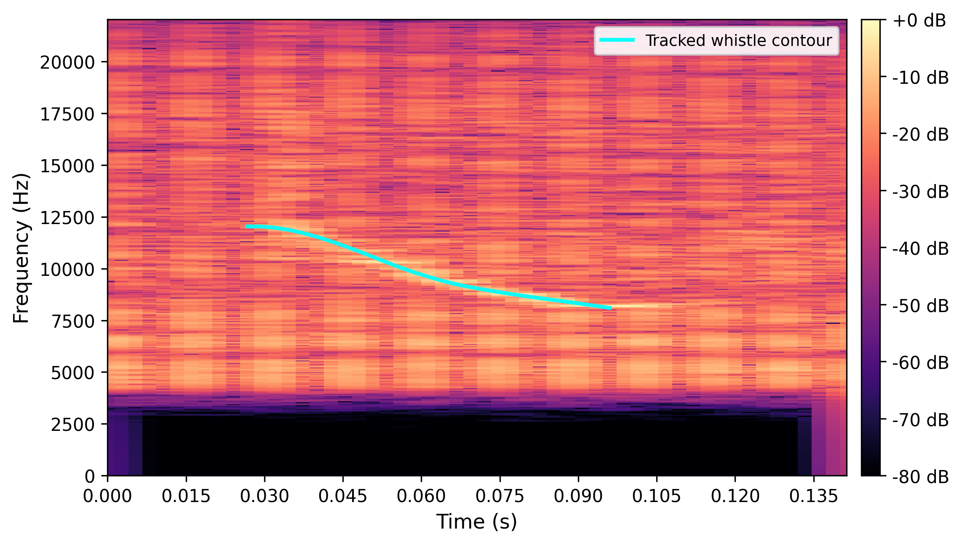
System Model — Setup and Assumptions
• Single hydrophone, offline (not real-time) processing
• Recordings split into ~1.8 s segments, each capturing one whistle
• Binary classification target: Common dolphin vs. Bottlenose dolphin
• Assumes a whistle presence detector and time-synchronization step upstream

Slide 6
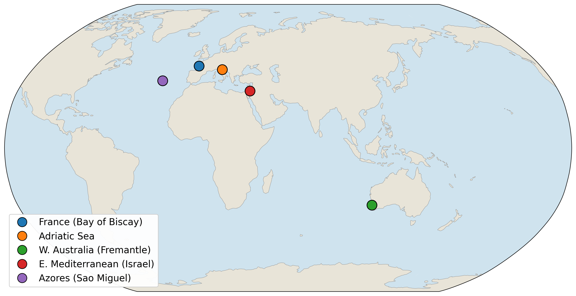
Datasets — Recording Locations

Slide 7
Datasets — Summary
 | France | Adriatic Sea | W. Australia | E. Mediterranean | Azores
Species | Common | Bottlenose | Bottlenose | Common + Bottlenose | Bottlenose + Risso's
Whistles | 3,825 | 199 | 314 | 925 + 384 | 163 + 44
Role | Training | Training | Training | Cross-/in-domain test | Open-set case study

Slide 8
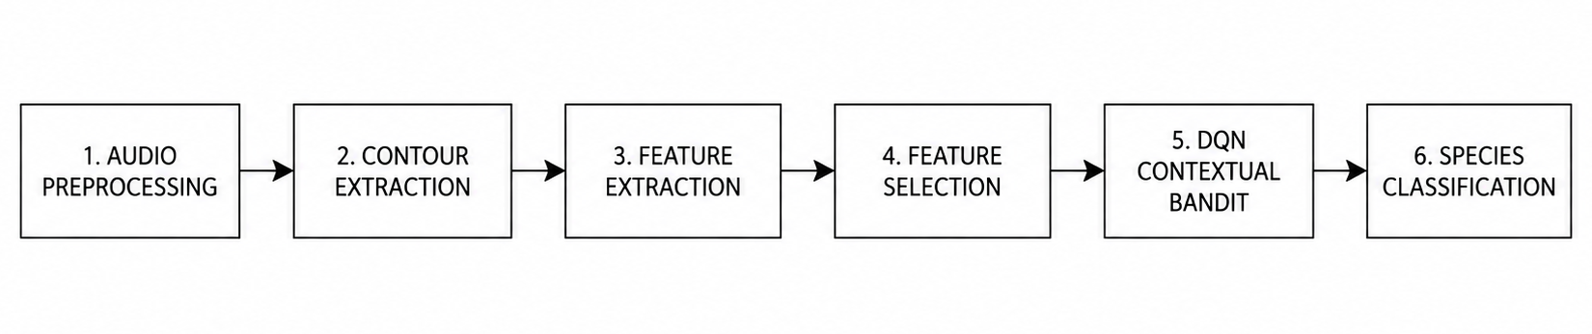
Method — Classification Pipeline
• Raw audio → whistle detection & time synchronization → contour tracking (Viterbi)
• 46 structural features extracted per whistle → PCA projection → DQN classification

Slide 9
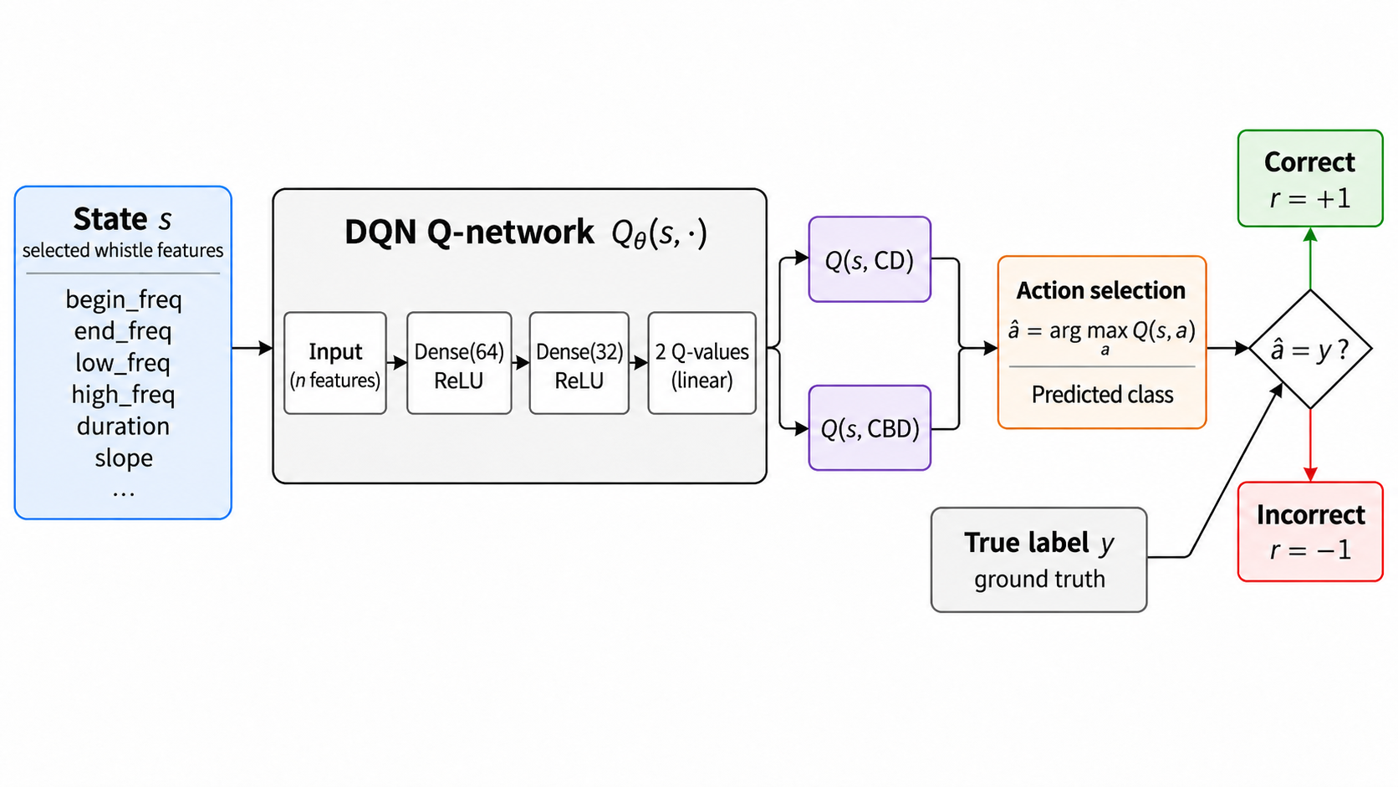
Method — DQN Contextual-Bandit Architecture
• State = projected feature vector; Action = predicted species; Reward = +1 / -1
• Network: 2 fully-connected layers (64, 32 units, ReLU) → 2 Q-values
• Trained with experience replay, ε-greedy exploration, class-balanced sampling

Slide 10
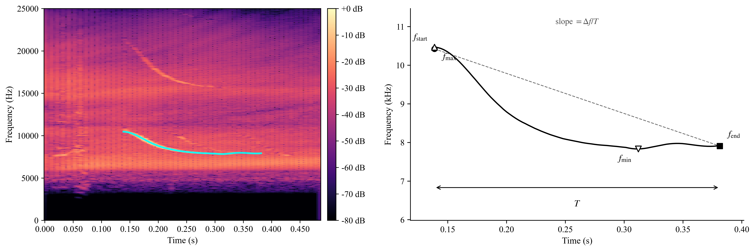
Feature Extraction
• 46 features per whistle, grouped into three families:
• Contour shape: start/end/min/max frequency, duration, slope, inflections
• Spectral descriptors: centroid, entropy
• Cepstral: 13 MFCCs (mean + std)

Slide 11
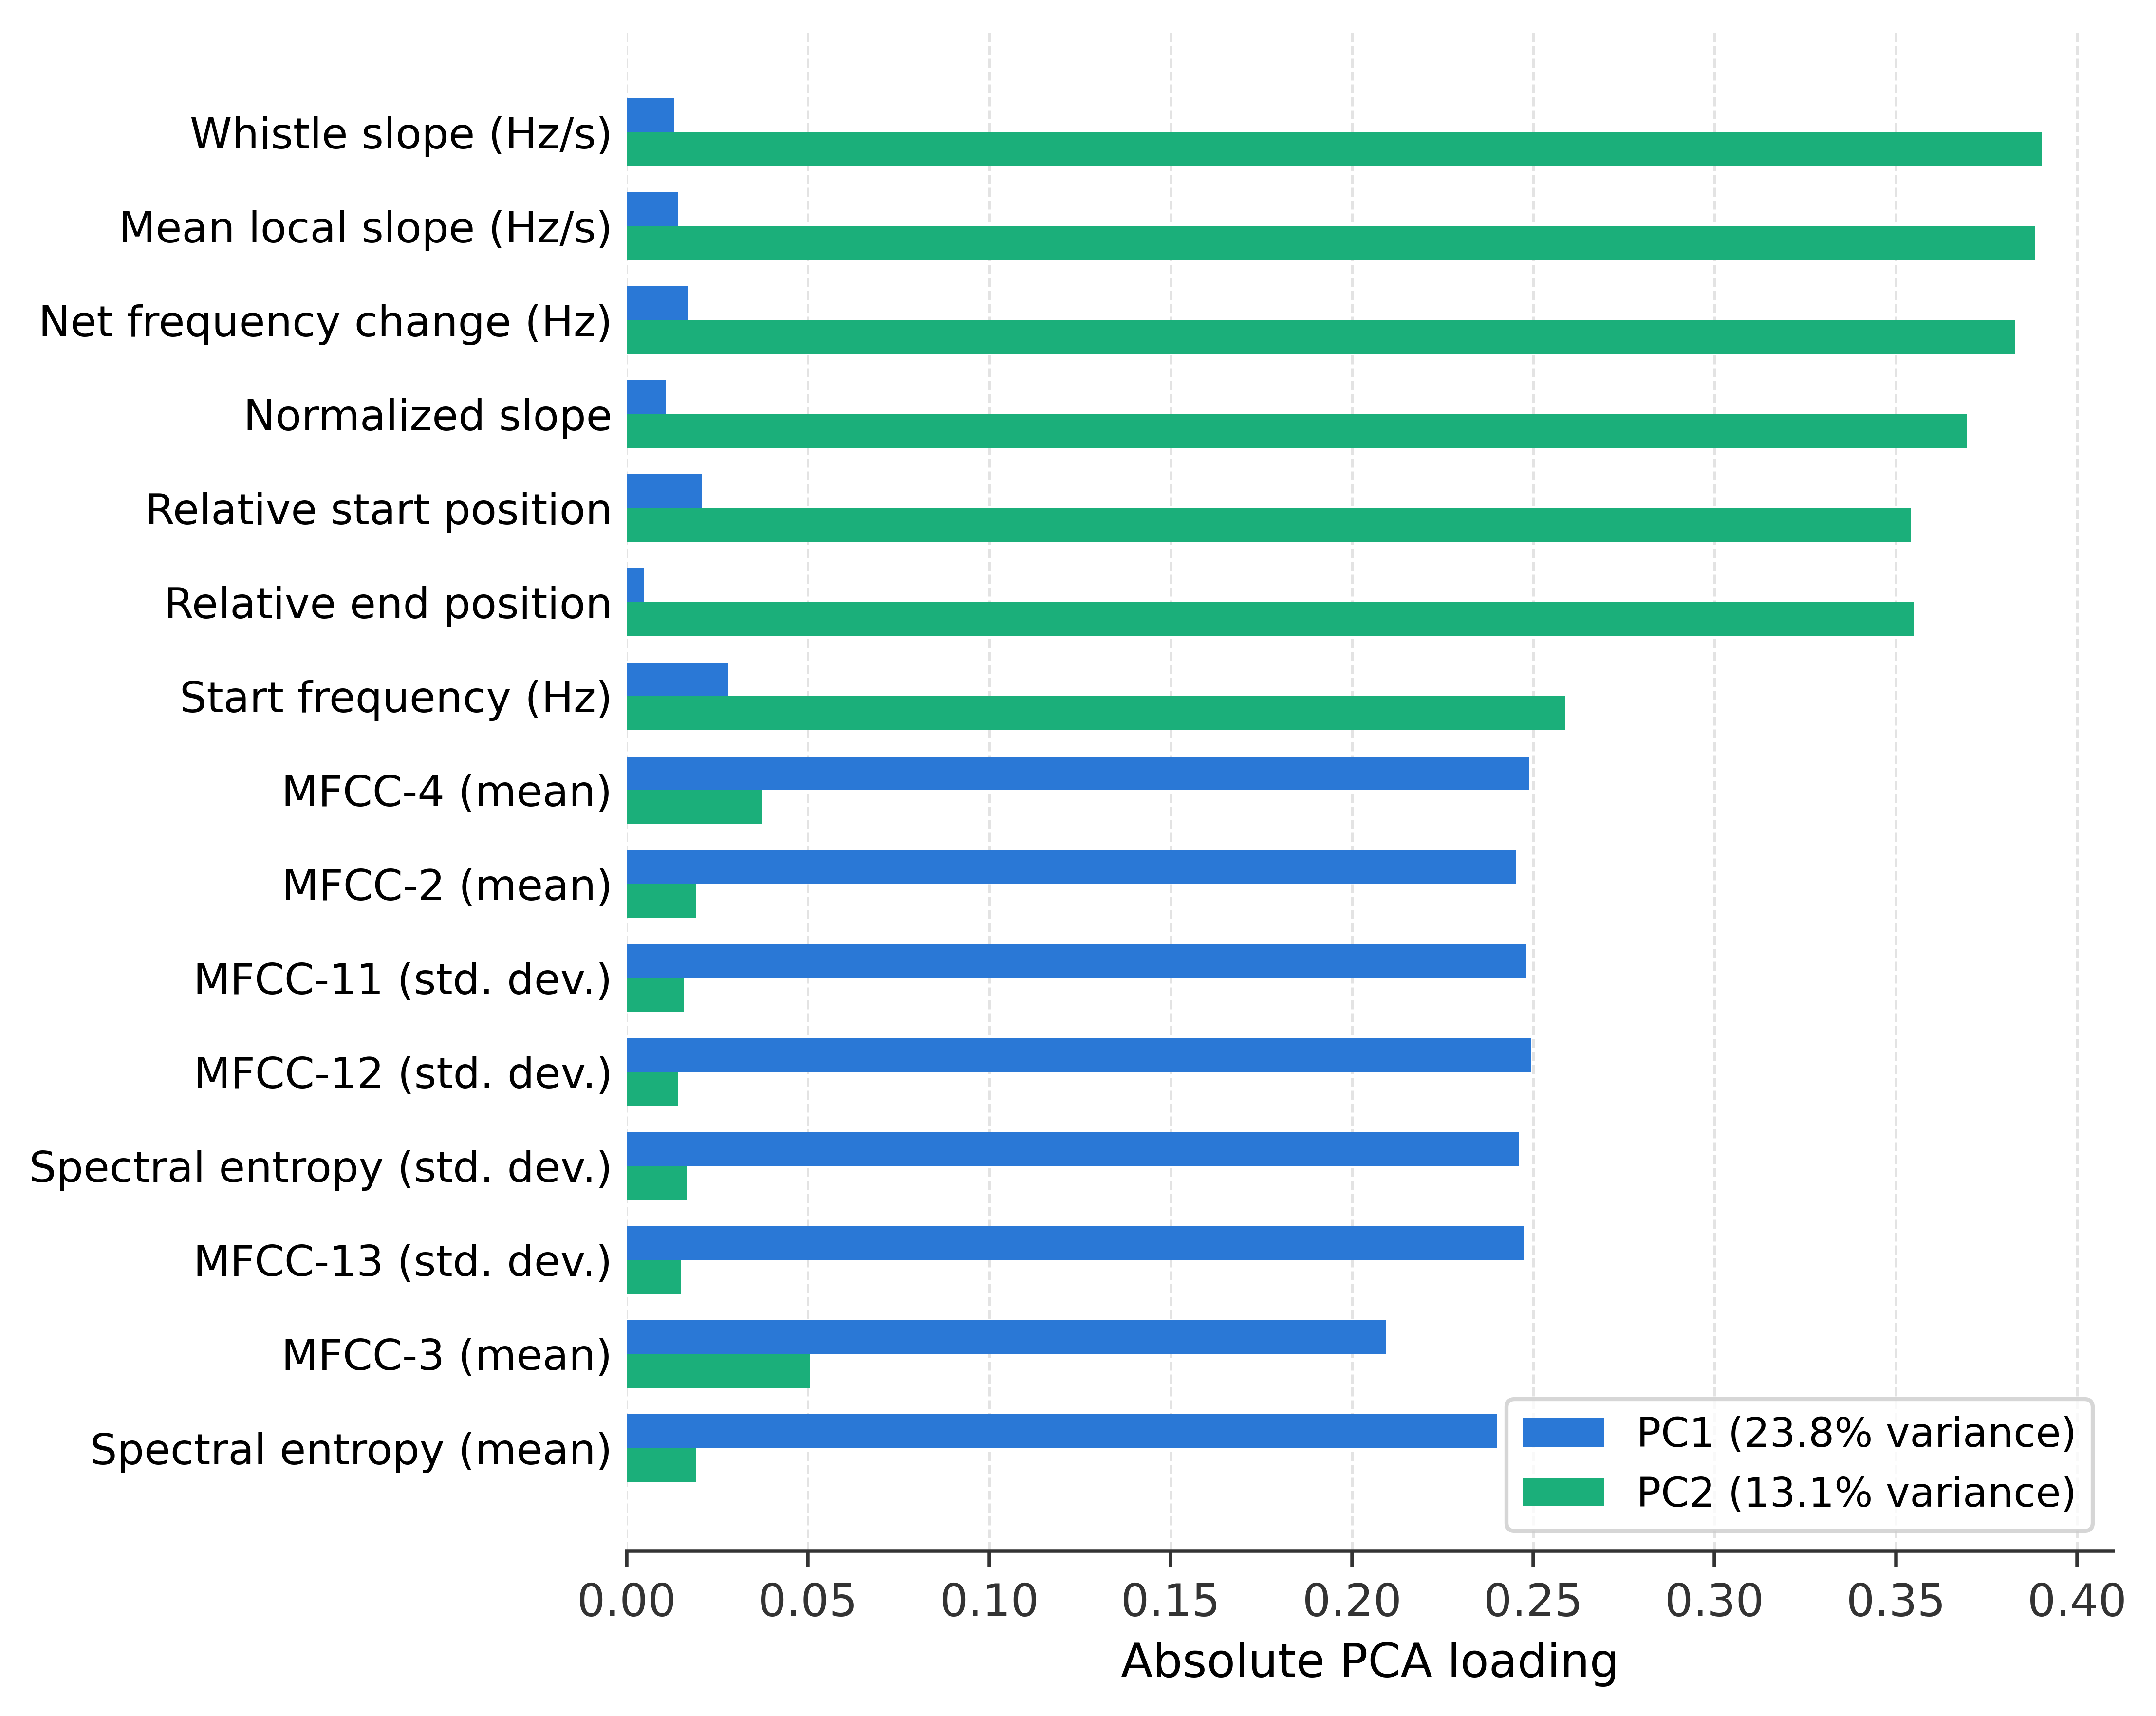
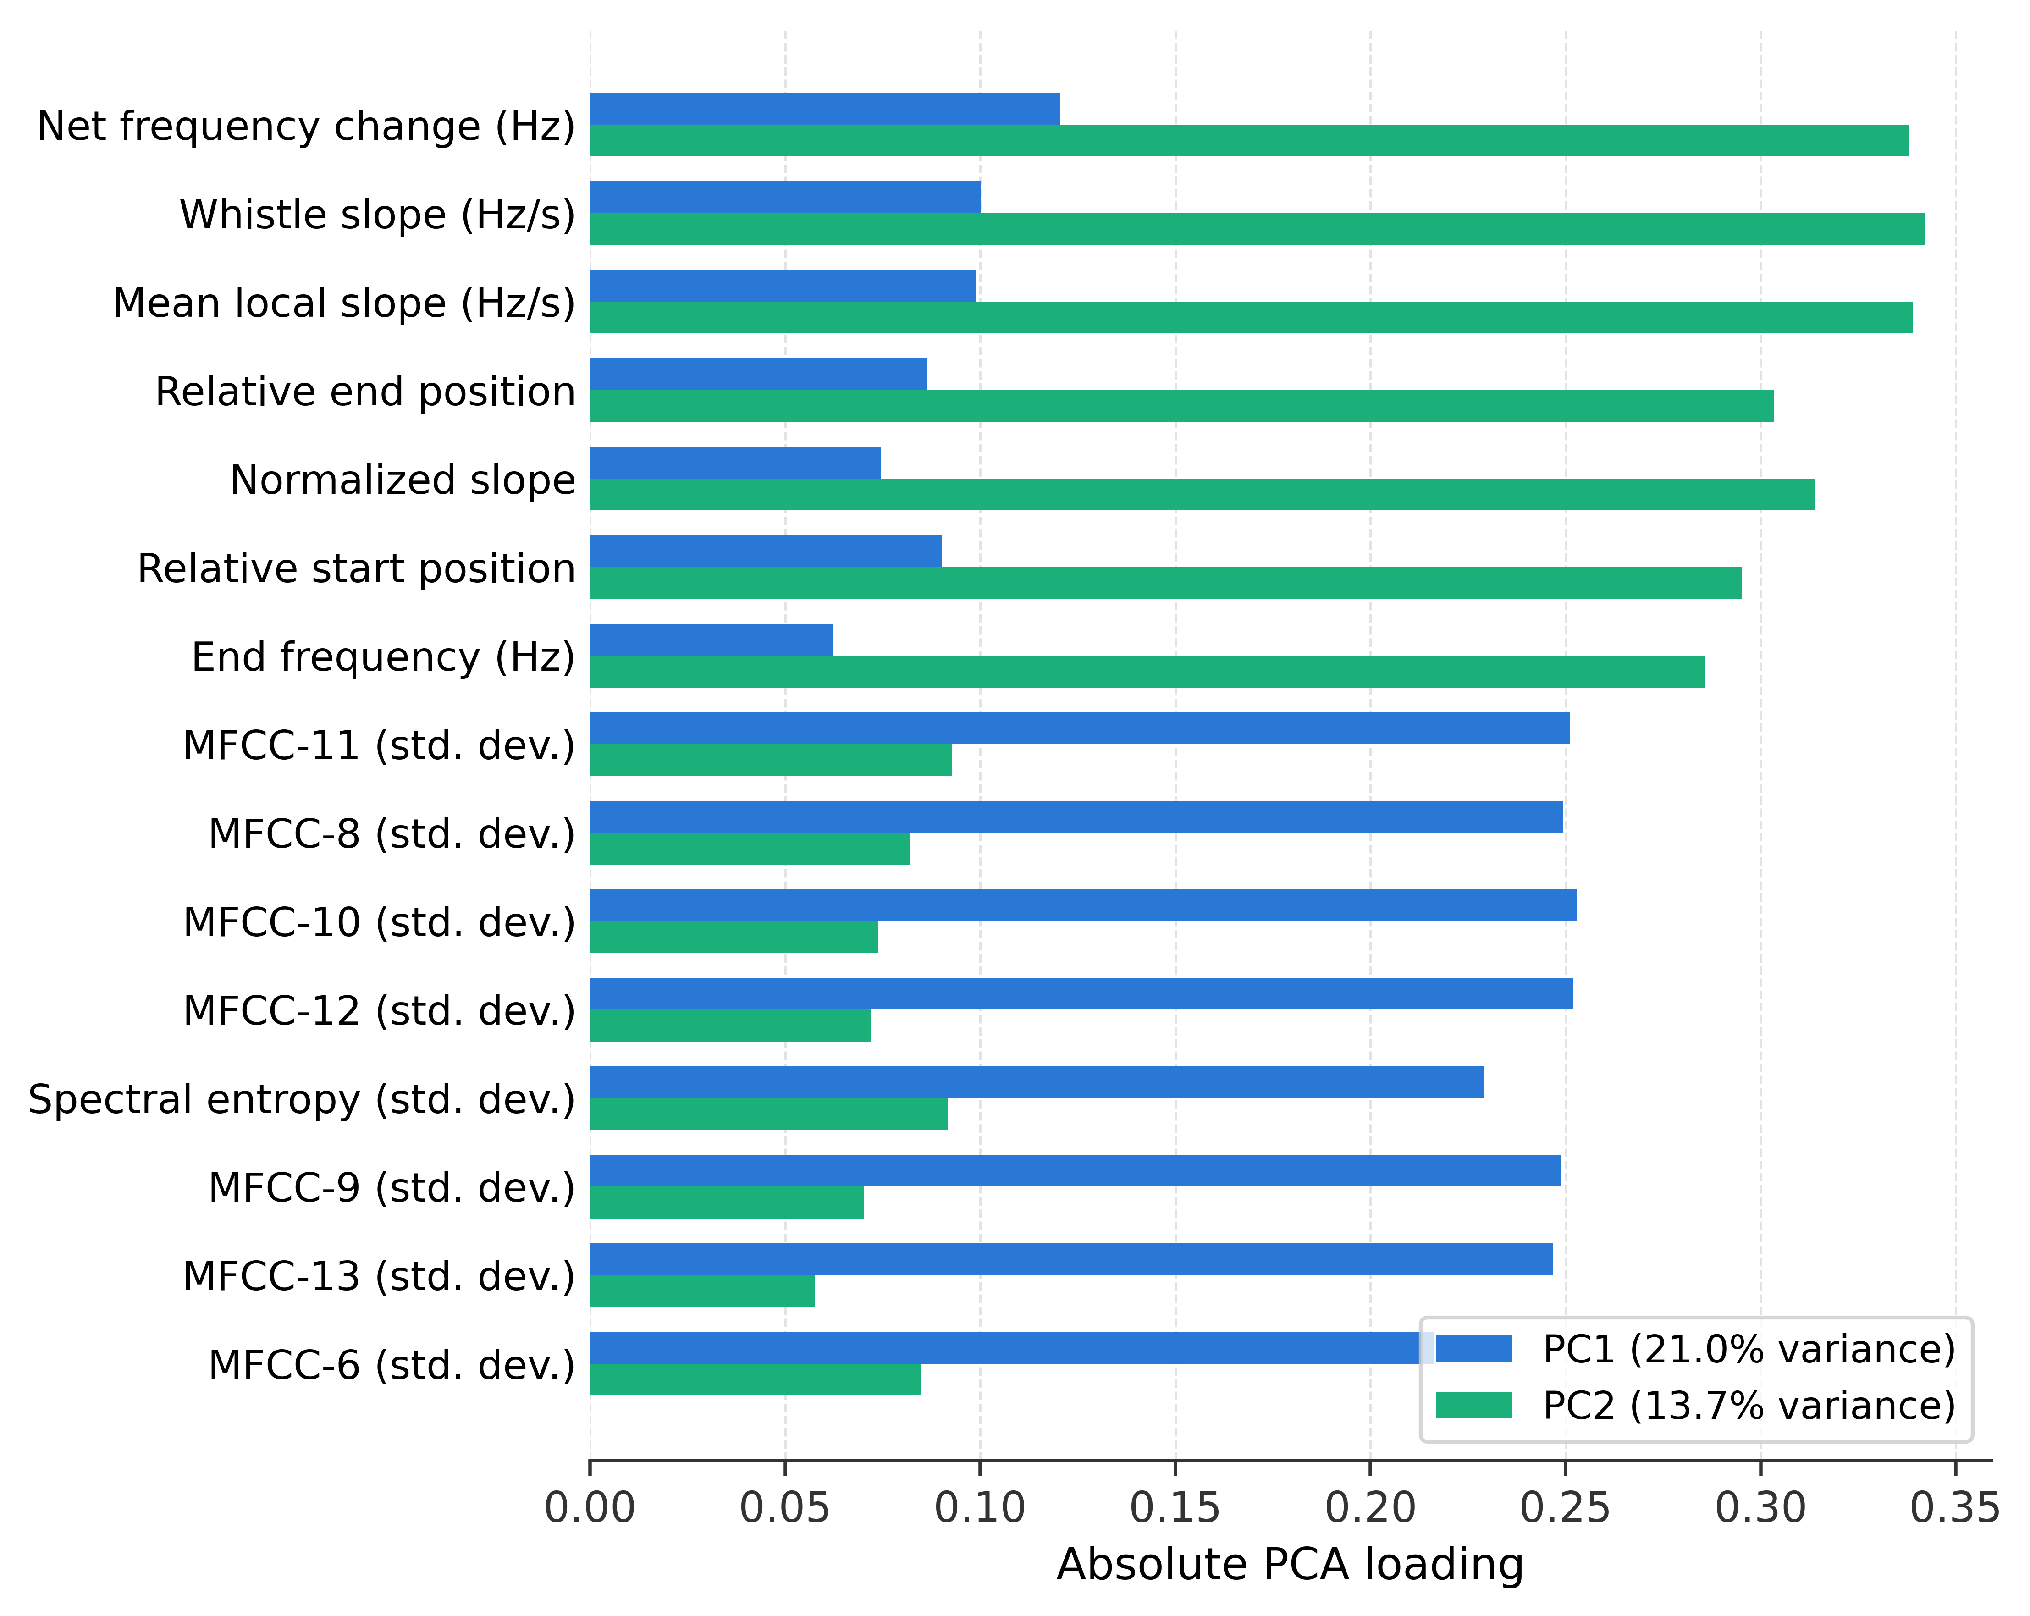
Feature Extraction — PCA Projection
• Features standardized and PCA fit on training domains only
• Test data projected using the same fitted transform (no refitting)
• Unsupervised: no species labels or domain information used
• k ∈ {2, 5, 10} evaluated — low k gives the most robust cross-domain result

Slide 12
Results — Cross-Domain (Trained Elsewhere, Tested on Israel)
Method | Bal. Acc. | Precision | Recall | F1 | PR-AUC
Machado et al. | 0.531 | 0.478 | 0.112 | 0.181 | 0.389
Frainer et al. | 0.510 | 0.511 | 0.455 | 0.482 | 0.597
Rasoul et al. | 0.469 | 0.095 | 0.021 | 0.034 | 0.239
Proposed method | 0.657 | 0.413 | 0.766 | 0.536 | 0.523
• Proposed method: highest balanced accuracy (0.657) and F1-score (0.536), driven by higher recall on the minority Bottlenose class

Slide 13
Results — In-Domain (Trained & Tested on Israel)
Method | Bal. Acc. | Precision | Recall | F1 | PR-AUC
Machado et al. | 0.686 | 0.739 | 0.436 | 0.548 | 0.658
Frainer et al. | 0.752 | 0.759 | 0.564 | 0.647 | 0.752
Rasoul et al. | 0.797 | 0.847 | 0.641 | 0.730 | 0.863
Proposed method | 0.937 | 0.945 | 0.896 | 0.920 | 0.967
• Removing domain shift sharply raises every method — proposed method nearly saturates the task (0.937 bal. acc., 0.967 PR-AUC)

Slide 14
Test With Azores — Open-Set Third Species
True species | N (usable) | Classified as Bottlenose | Mean margin
Bottlenose dolphin | 163 | 135/163 (82.8%) | 1.204
Risso's dolphin | 44 | 44/44 (100%) | 2.062
• Cross-domain model applied to Azores data with no re-training
• Classifier has no “unknown species” mechanism — it must pick one of the two trained classes
• Risso's dolphin whistles are assigned Bottlenose with higher confidence than true Bottlenose whistles
• Case study illustrating a failure mode of forced binary classification under an open-set species

Slide 15
Conclusion & Future Work
Conclusion
• PCA feature projection improves cross-domain classification robustness
• Contextual-bandit DQN gives the best cross-domain F1-score and recall
• In-domain accuracy does not predict cross-domain performance
Future Work
• Collect training domains containing both species per campaign
• Average results over multiple independently trained seeds
• Extend classification to more species and more recording regions

Slide 16
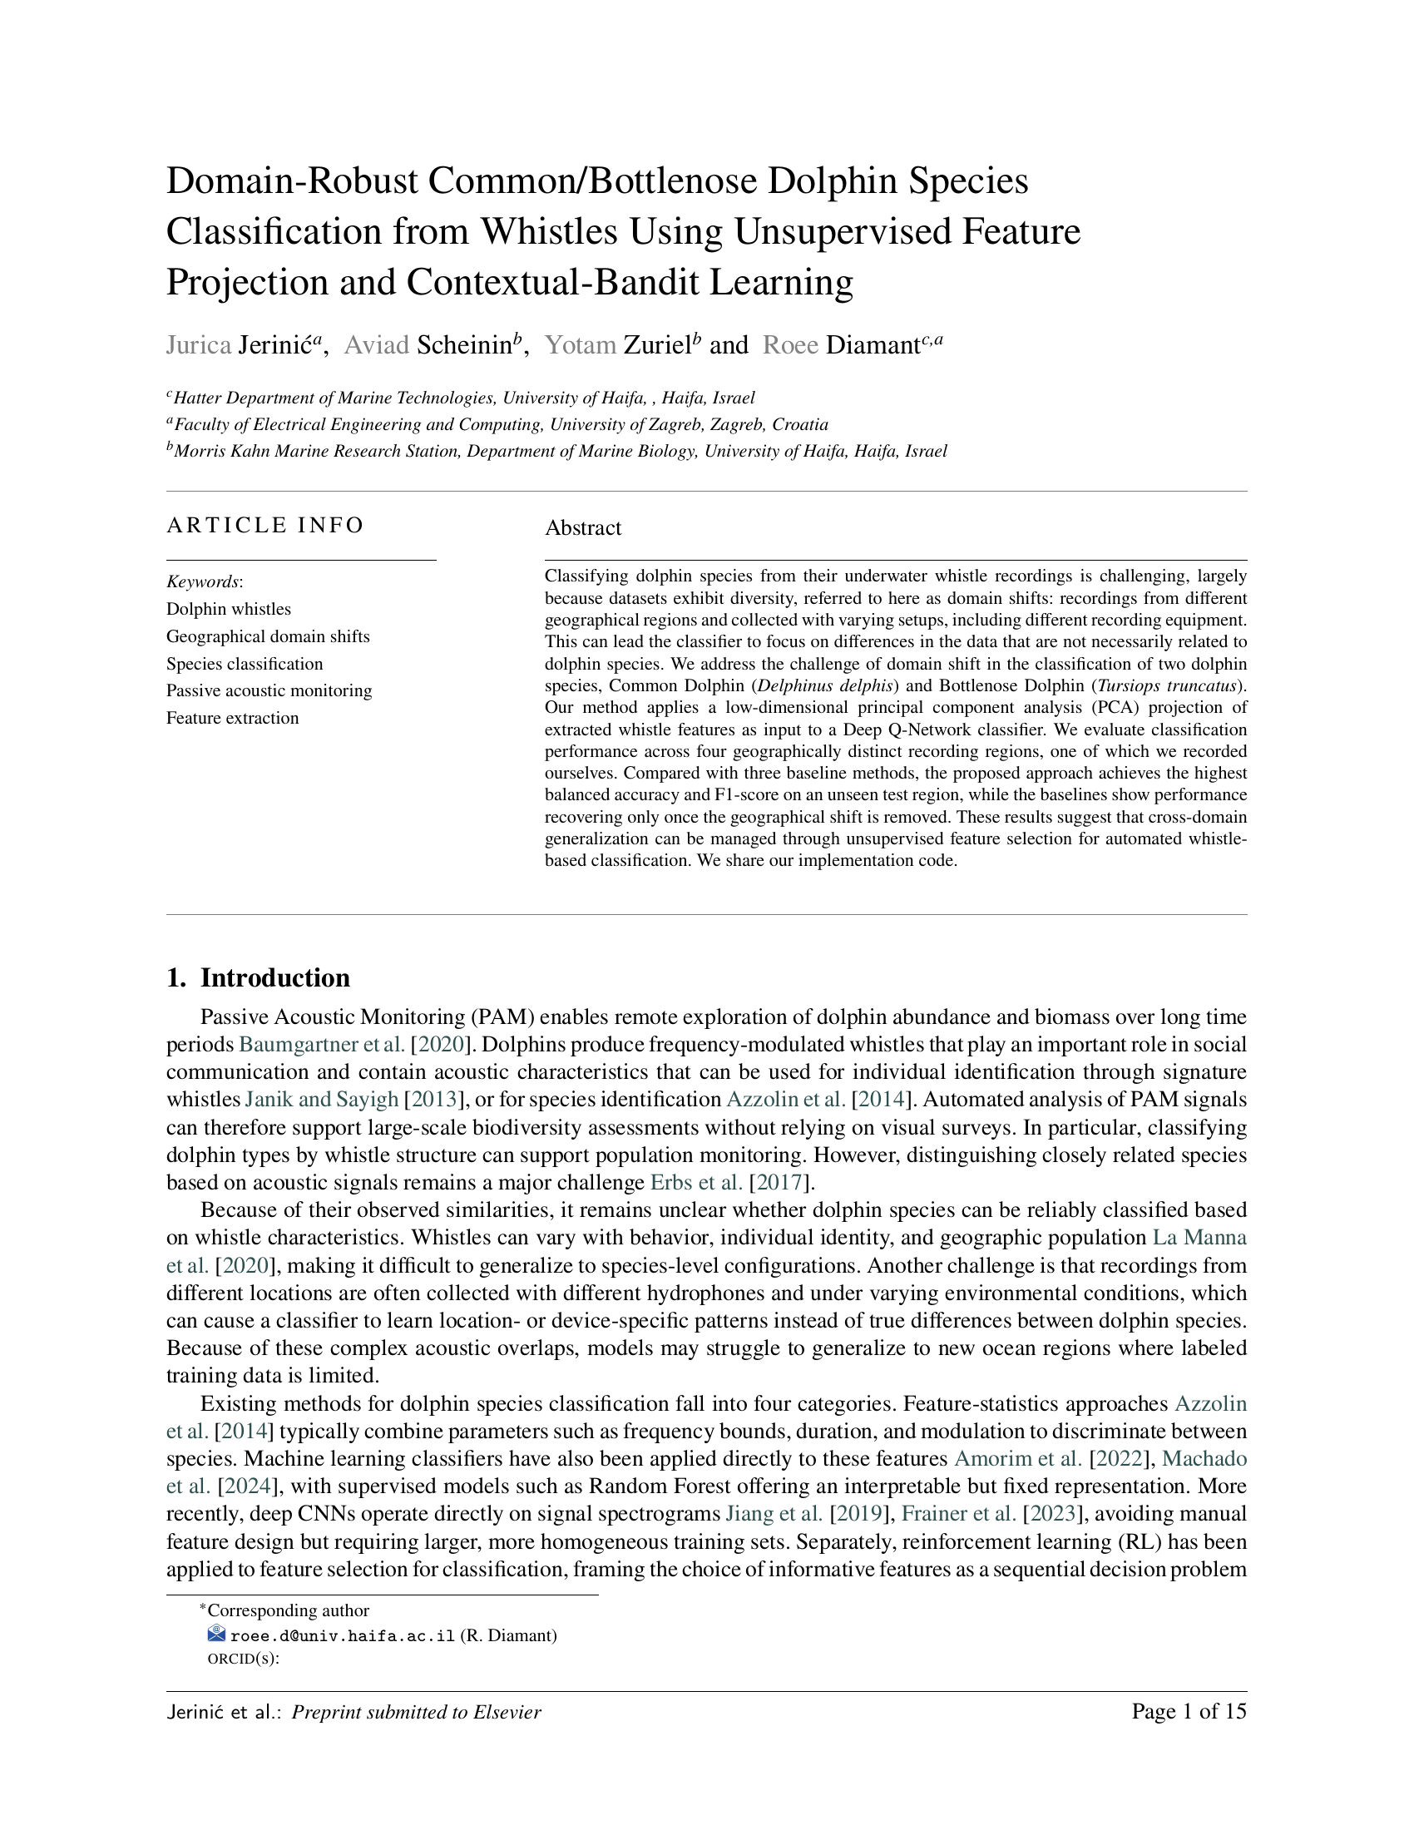
Paper Submitted to Ecological Informatics

