Slide 1
Hamiltonian Cycle Problem
Jurij Cerar
TU Wien, Austria

Slide 2
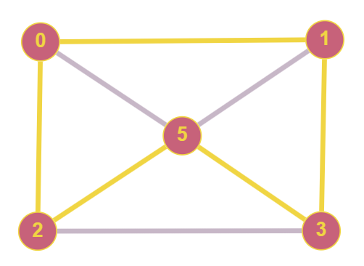
Problem Description
Visit each vertex exactly once, ending on the same vertex as we began.
Encode problem and feed to SAT solver
Output if graph is Hamiltonian and if so write out the cycle

Slide 3
Tools Used
Python v3.11.9
PySAT
Efficient SAT Techniques for Relative Encoding of Permutations with Constraints by Miroslav N. Velev and Ping Gao
FHCP Challenge Set

Slide 4
Implementation
HCP format files (dimension & edges)
S_{ij} - vertex i is the direct predecesor of j (successor/edges)
O_{ij} - vertex i is the predecesor of j (variable order)
Each has 4 properties that need to be encoded
Relationship constraint S_{ij} => O_{ij}

Slide 5
Problems
pySAT dependencies didn‘t work (later fixed)
Mutual exclusion constraint for successor variables added
First vertex should not have relationship constraint in order to complete the cycle
Hard to debug on large graphs

Slide 6

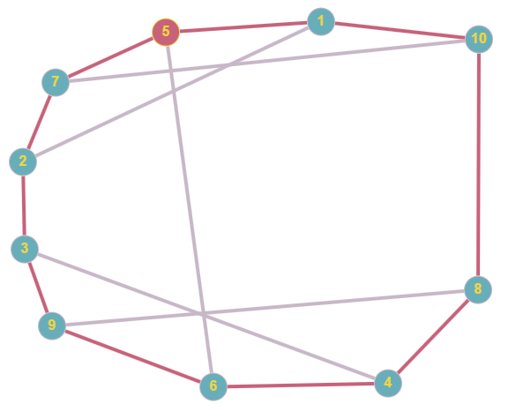
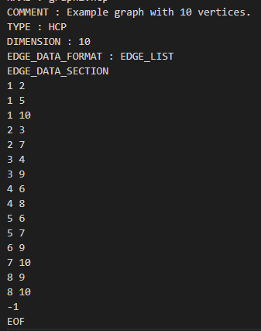
Example
210 vertice graph took 17s

Slide 7
END
THANK YOU!

