Slide 1
Lattice.io

Slide 2





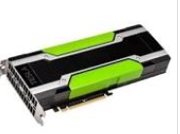

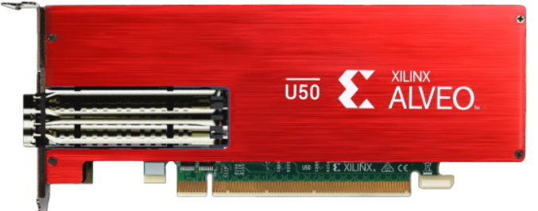
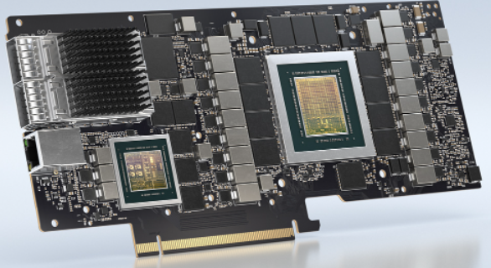

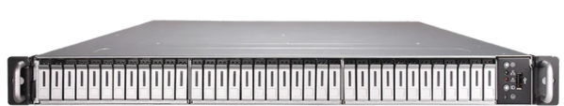
Computing infrastructure landscape evolving
GPU
GPU/Accelerator centric
FPGA
DPU
GPU/FPGA/DPU become mainstream
Storage shifting to high performance SSD
Need better infrastructure for resource pooling, sharing, utilization
High performance SSD

Slide 3

Lattice.io provides the Solution
GPU
FPGA
Tb/s IO & Networking
DPU
Based on ground breaking PCIE Lattice Fabric technology
Enabling flexible deployment and scheduling of VM/Container across servers
Global resource sharing/pooling
Direct data streaming across servers/accelerators/SSD

Slide 4
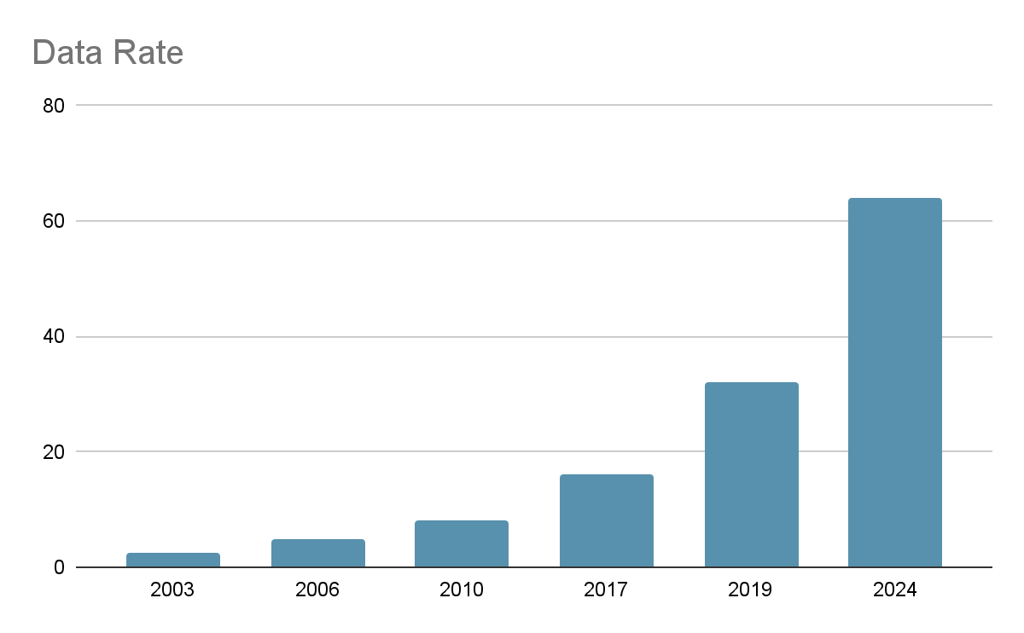
PCI Express Evolution
64G
X16 1Tbps
32G
X16 512G
16G
5G
8G
2.5G

Slide 5
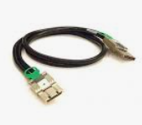
Lattice.io extends PCI Express for server interconnect
GPU pooling
DIstributed AI training
HPC computing
SSD pooling
High performance storage
Memory pooling
Big Data
VR/AR/Rendering
Lattice Fabric: Flexible composition, High performance, High utilization

Slide 6
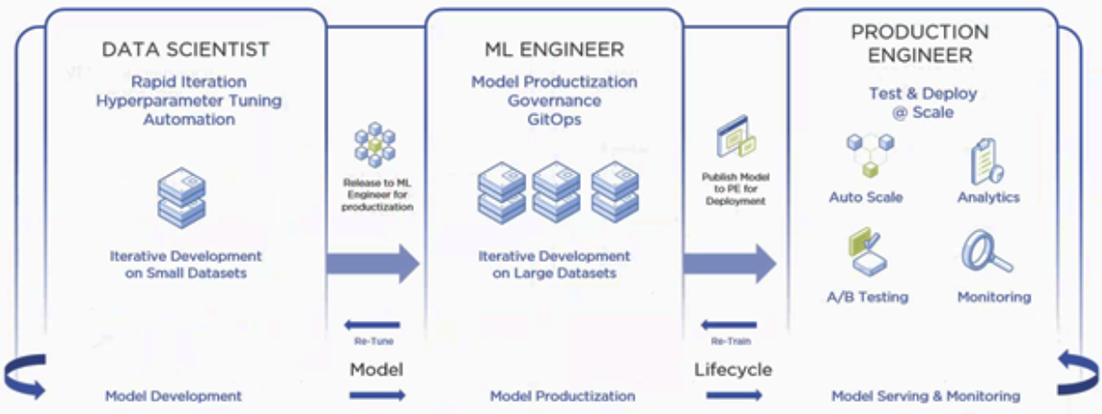




Lattice Fabric for AI
Lattice Fabric provide more scalable and common solution than NVlink
Feature | Nvlink | Lattic.io
Fabric | Proprietary | Standardard
Bandwidth | Tb/s | Tb/s
SSD Streaming | No | Yes
Memory pooling | No | Yes
AI workload optimization | Yes | Yes
End to end ML Pipeline and data serving

Slide 7



Memory Pooling Over Lattice Fabric
Lattice fabric pooling memory inside each server
Unified memory address space, transparent to applications
3D rendering/VR, Big data, Bioinformatics
More scalable solution compared to CXL
VR Rendering
Big Data
Bioinformatics
Giant Memory Server

Slide 8





Lattice.io – High performance Kubernetes
Kubesphere
OpenShift
Metal As Service
Lattice SSD File system
Tb/s IO & Networking

Slide 9
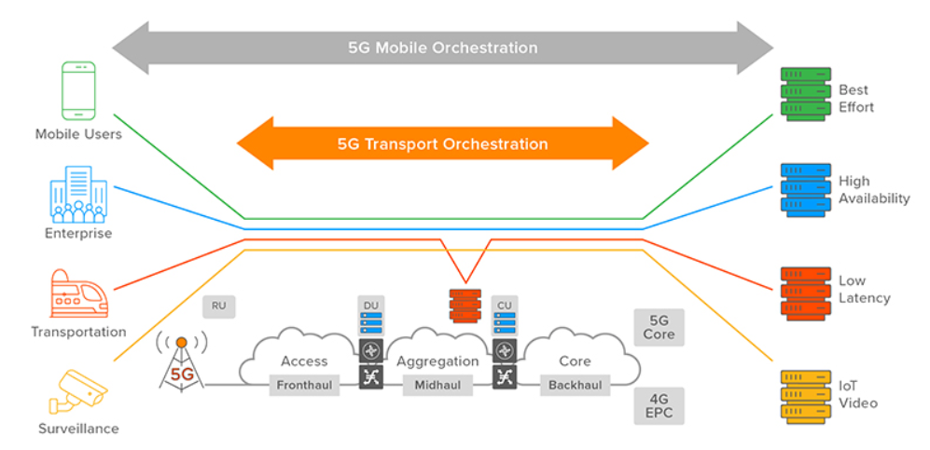
HA servers for 5G Open RAN
Resource pooling enable flexible 5G slicing
High availability through lattice fabric ensure continuous operation
Fast storage for large capacity caching
Lattice Fabric turning any servers into high available, high performance clusters

Slide 10
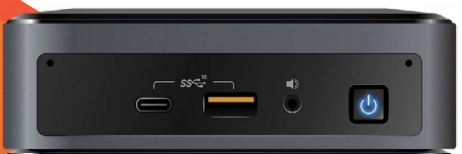

Edge Computing HA cluster
Edge computing is constrained in power/space, Lattice fabric naturally scale out edge computer device to achieve high performance and high availability
High availability through lattice fabric
Scale out computing node
GPU sharing
Pooling and sharing fast SSD storage
High speed networking through lattice fabric
Intel NUC

Slide 11


Other PCIE infrastructure vendor comparison
Lattice.io
Heavy hardware investment, proprietary server box
GPU/FPGA inside one big box
No SSD file system
No memory pooling
Minimal hardware, agile deployment
Flexible GPU/FPGA placement
High performance flash file system
Global memory pooling/sharing

Slide 12
Development Phases
Building Team
Hire ~25 people team HW/SW development System integration Performance tuning
Product sampling
AI training library complete, Memory pooling library complete
6 Month
18 Month
0
12 Month
First generation product complete
Flash file system development done,
PCIE Gen6 development in progress
HW development done
Library for AI training Roll out
Provide AI training library support Nvidia, AMD GPU
3千万 ¥ Seed Funding

Slide 13
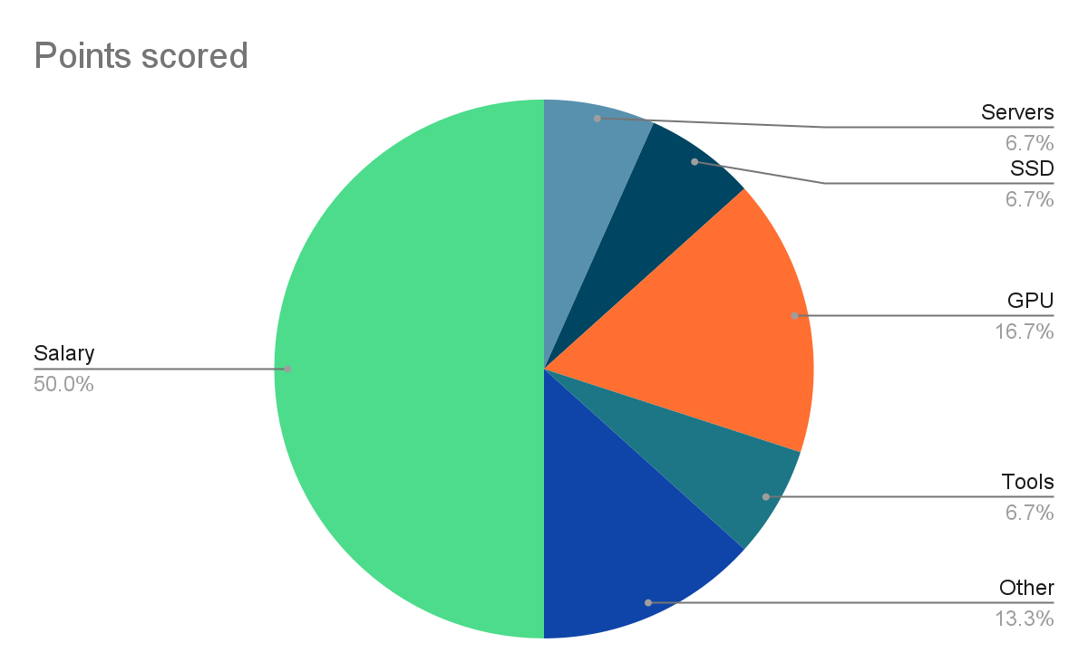
Budget breakdown
Hiring Cost
Junior Engineer: 16 x 25万 x 1.5 = 600 万
Senior Engineer: 5 x 40万 x 1.5 = 300 万
Architect: 3 x 100万 x 1.5 = 450 万
HR/GA 3 x 30万 x 1.5 = 135 万
Total ~1500 万
Equipment/Server/SSD
Server: 200 万
SSD: 200 万
GPU 500 万
Equipment/Tools 200 万
Other Operation Cost 400 万
Total ~1500 万

Slide 14
Go to Market
Work together with first tier public company to provide high performance computing solution for large computing/storage deployment
中软。。。
Work with cloud computing company for enterprise private cloud deployment with high performance storage
青云 。。
University, Institution, R&D center with high demand for high performance computing and storage
Work with US technology partner targeting school district, entertainment sector, CDN provider etc

Slide 15
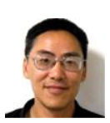
创始团队
周为，中科大，斯坦福应用物理系硕士。二十多年存储研发经验。有在 Altera，Marvell， SK Hynix 等知名公司任研发和管理工作，带百人研发团队。拥有存储架构，互联多项专利。现任 SK Hynix 资深研发总监
K. Wong，软件架构总负责，二十多年软件，固件，系统研发经验。Marvell， SK Hynix 主任工程师。
X. Chen，技术总负责，二十多年软件，固件，系统研发经验，资深 Linux 内核开发者，在多家存储系统公司任高级技术职位

