Slide 1
KubeFlash
Revolutionary All Flash Technology For HCI and Kubernetes

Slide 2
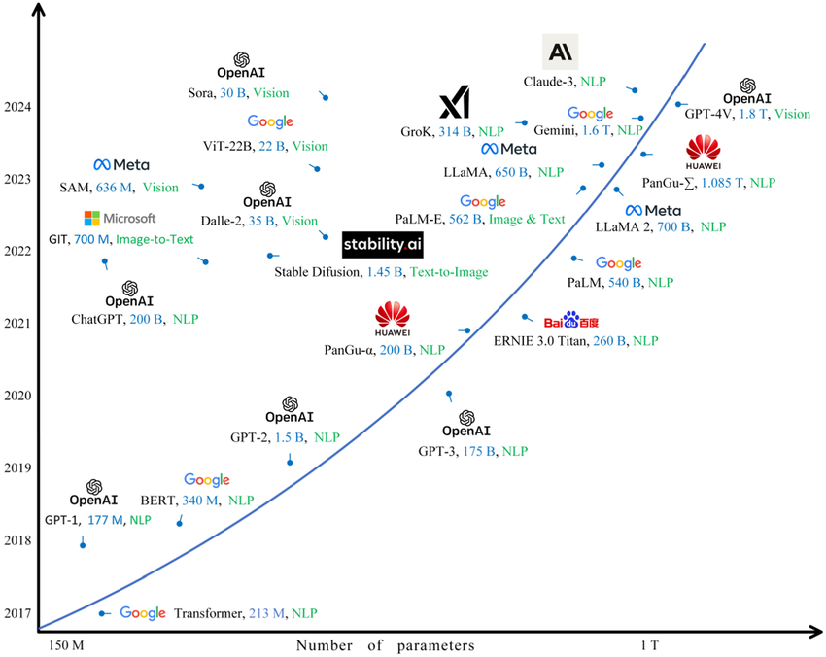
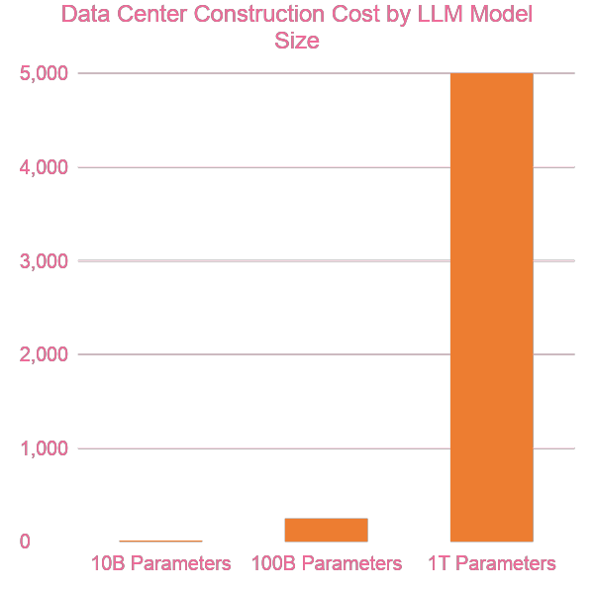
Cost of AI data centers grows even faster than LLM models
$5B
(50,000+ GPUs)
Estimated Capital Expenditure ($ millions)
$15M
(~256 GPUs)
$250M
(~4,000 GPUs)
Model Complexity
Source: https://www.researchgate.net/

Slide 3
The Need to Democratize AI Data Centers
 | Public AI | Private AI
Data Privacy | Shared environment; risk of data leakage. | Air-gapped security; zero external exposure.
IP Protection | IP may inadvertently "train" a competitor's model. | 100% ownership of model weights and logic.
Cost Profile | Variable OpEx; high scaling "tax" at volume. | Fixed CapEx; lower TCO for high-utilization.
Customization | General-purpose; limited hardware tuning. | Bespoke architecture for specific domain tasks.
Governance | Subject to vendor Terms of Service (ToS). | Full control over compliance and ethics.
Despite the necessity of private AI, >99.9% of companies cannot afford owning proprietary AI data centers, limiting AI's proliferation in enterprise applications.

Slide 4
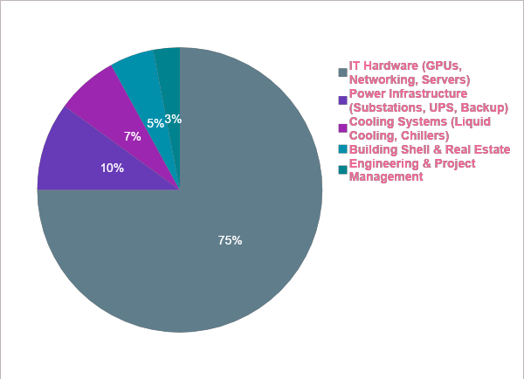
AI Data Center Cost Breakdown
All cost factors are based on the number of GPUs provisioned.

Slide 5

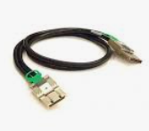
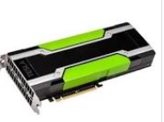
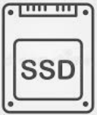
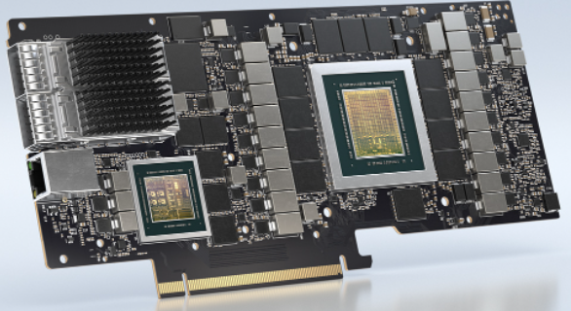
KubeFlash extends PCI Express for server interconnect
GPU pooling
DIstributed AI training
HPC computing
NVME SSD pooling
High performance storage
Memory pooling
Big Data
VR/AR/Rendering
Lattice Fabric: Flexible composition, High performance, High utilization

Slide 6
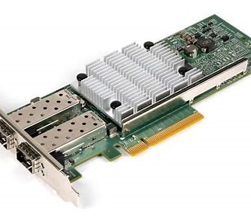
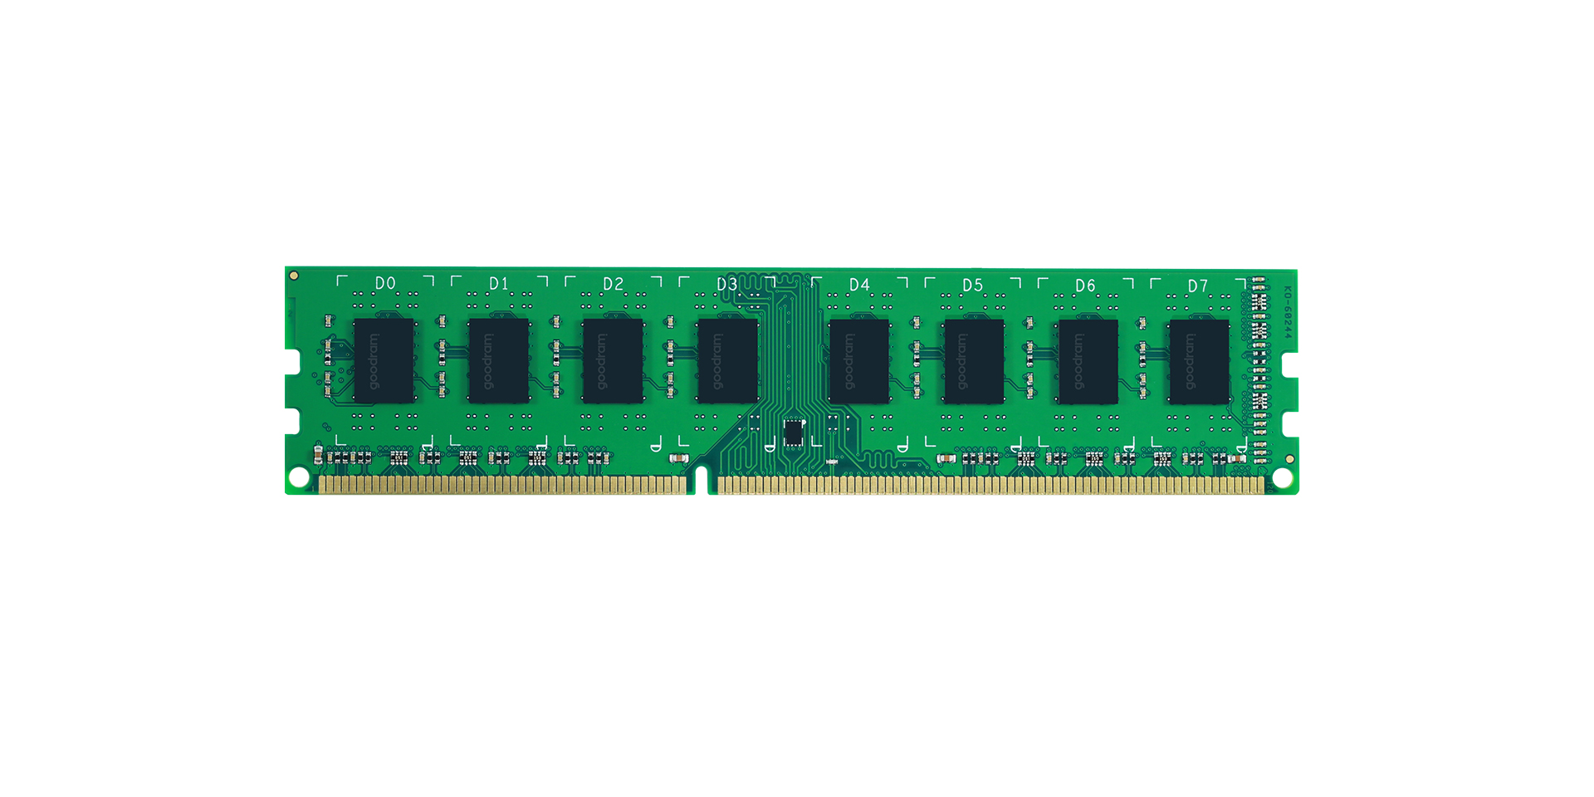
GPU/SSD Data Exchange
PCIE
PCIE
Network
PCIE
PCIE
SSD
NIC
NIC
Memory
GPU
Memory
milli second latency
KubeFlash Enable
KubeFlash Extended PCIE
SSD
GPU
Micro second latency

Slide 7
KubeFlash: Tightly coupled GPU/SSD KV Cache for LLM
GPU
Paged KV Cache
GPU
Paged KV Cache
GPU
Paged KV Cache
GPU
Paged KV Cache
Extended PCIE Fabric
Extended PCIE fabric provide pooling for memory and SSD
Data movement all in hardware, minimal driver/FW involvement
Big improvement in bandwidth and latency compared with traditional RDMA

Slide 8
KubeFlash's Revolutionary KFNative™ Technology
Each GPU paired with SSD
GPUs have dedicated computing scratch pad
SSD hold all model parameters, gradients, optimizer states
GPU exchange data through neighboring SSD
PCIE Switch
PCIE Switch

Slide 9
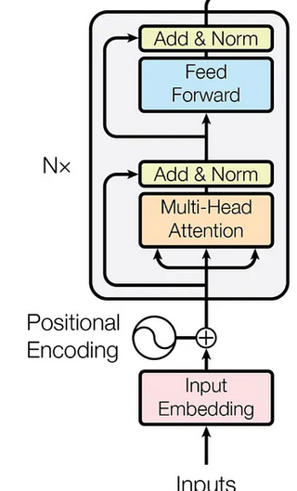
Case Study of Streaming Computing during LLM Inference
Comparable Performance with Far Fewer GPUs
GPT-3 175B, 96 layer
Each layer ~1.8B, 3.6G Bytes
Gen6x16 SSD bandwidth ~ 100GB/s
Model loading time for one layer: 3.6/100 ~ 35ms
Computing: 100K x 1.8B / 1000 T ~ 180ms

Slide 10
GPU Server Ring Extension
Commodity GPU, less HBM dependency
No NVlink dependency
Better parallelism All/All Ring reduce
Train largest LLM with 64X fewer GPUs
PCIE Switch
PCIE Switch

Slide 11
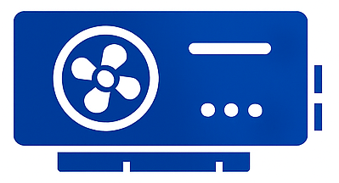
KubeFlash enable large scale training with low cost GPU or Alternative
Nvidia 5090 ~ $2K
256 5090 ~$500K
Aggregated ~ 50 Pflops
Train any of the largest LLM
Multi-Agent Reinforcement Learning
Data center cost is reduced >100 times.

Slide 12
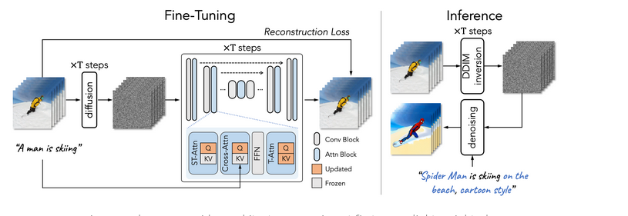
Diffusion Transformer (DiT) - Video Generation
Inverse and Denoise process both have long computing to overlap with IO loading
High definition video gen requires large HBM in current approach
Kubeflash provide high quality video Gen solution with single GPU

Slide 13





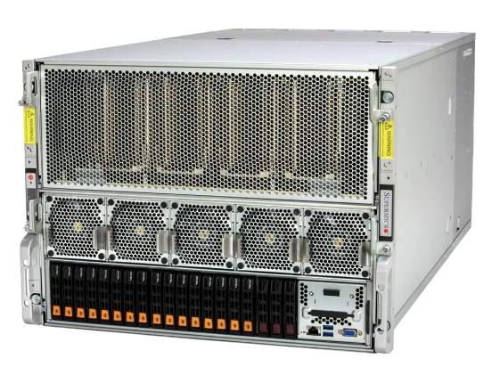
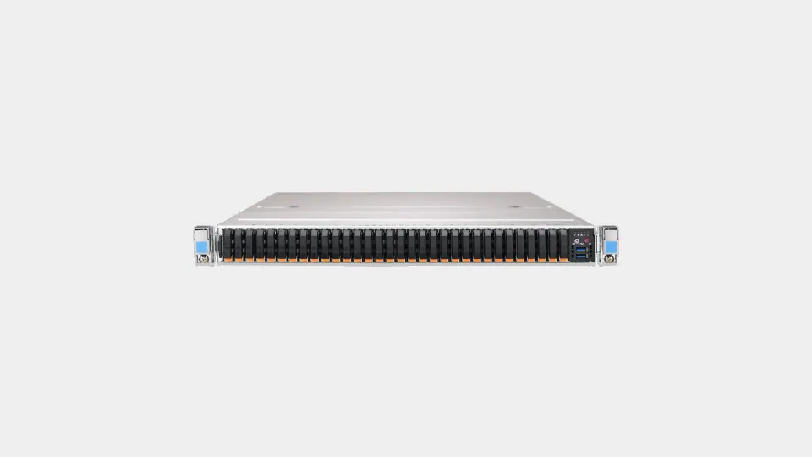
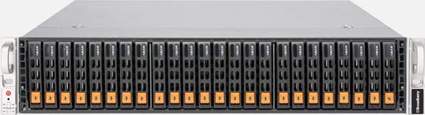
KubeFlash integrating with any platform with ease
Extended PCIE fabric could turn any server platform into high performance cluster
All Flash Array built from standard off shelf components
Converged and native SSD performance across cluster

Slide 14




KubeFlash Computing infrastructure evolving
KV Cache, KFnative
Vector DB
Tightly coupled GPU/SSD
Traditional Server
HCI
HCI 2.0
1
Tier0 NFS
Native NVME VM/Kubernetes
2
Lattice PCIE Fabric
All Flash Array
Traditional AFA
KubeFlash
3
AFA NVMEoF
AFA Native NVME

Slide 15

Market Segments for KubeFlash
All Flash Array
HCI
AI & Data Analytics
Market Size
~ 25B
~ 15B
Billions
Major Player
Many Players
- Converged SSD/Memory Caching
- Native NVME throughput for KV cach
- Boosting data analytics with native flash storage
KubeFlash
Advantage
- Off-the-Shelf components
- Utilizing server from any vendor
- High performance and low CPU utilization
- Native local NVME performance
- Power efficient
- Revolutionary all flash solution for Kubernetes
-

Slide 16
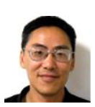
Founding Team
Wei Zhou, worked in Storage industry for over 20 years, have held senior management position at Marvell and SK hynix, leading teams in storage HW/FW/system engineering. Master degree of Applied Physics from Stanford.
David Chen,
K. Wong，have worked in various fields in storage, have broad experience in SSD FW engineering and linux kernel engineering, have held principle engineer positions at Marvell and Sk Hynix
X. Chen，20 years plus experience in storage industry, strong kernel and OS engineering expertise, have held various engineering and management positions at Marvell and Startups

