Slide 1



Sanjeev Aneja
simple ways of living
a healthy,
prosperous,
and satisfied life

Slide 2
Seeking WEALTH?
HAPPINESS?
PEACE?

Slide 3

Just one lesson a day...
action + items + affirmations = successful life
story of your own creation

Slide 4
Lesson 1: Start With Gratitude
Wake up with a sense of gratitude
Thank God for all you have been blessed with,
and thank God for
the possibilities that lie ahead

Slide 5
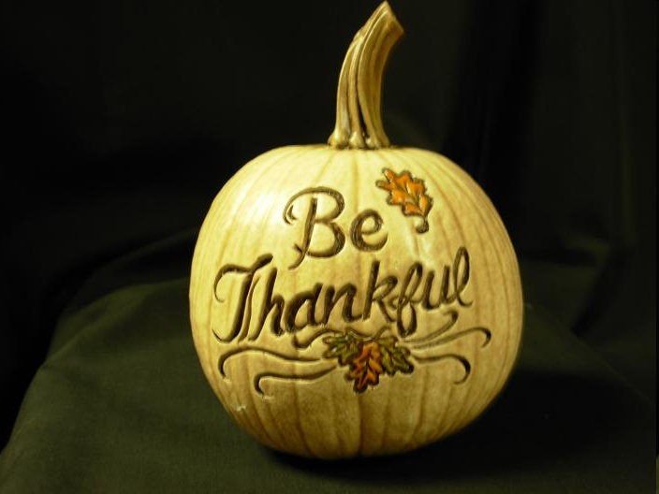

Slide 6
Key Concepts
All important things in life are given to us free by God
Human life is the most blessed life of all entities
Change from “Why me?” to “Thank God it’s not me!”

Slide 7
Gratitude is about being thankful for what we have and enjoying all we have
Helps us recognize and enjoy what we have now instead of being unhappy about what we don’t have yet, or what we may lose tomorrow
Simply recognize what you have and say a few words of appreciation everyday

