Slide 1
Lesson 10: Have Patience
all actions are wasted when the proper amount
of patience is not applied

Slide 2
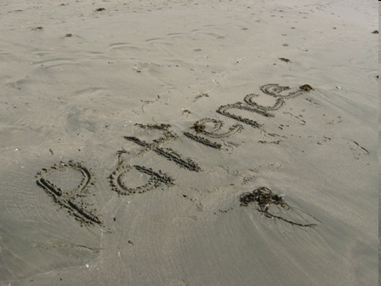

Slide 3
Key Concepts
We must take action but be patient with the results
Follow the laws of nature
Need to give necessary time to achieve the result
Have faith in your actions
Don’t miss any steps while working on your goals

