Slide 1
Jurre Hageman
Hanze University of Applied Sciences
Groningen
Bioinformatics data processing and –analysis using the scripting language Python
Introduction to programming with Python Input and Output

Slide 2
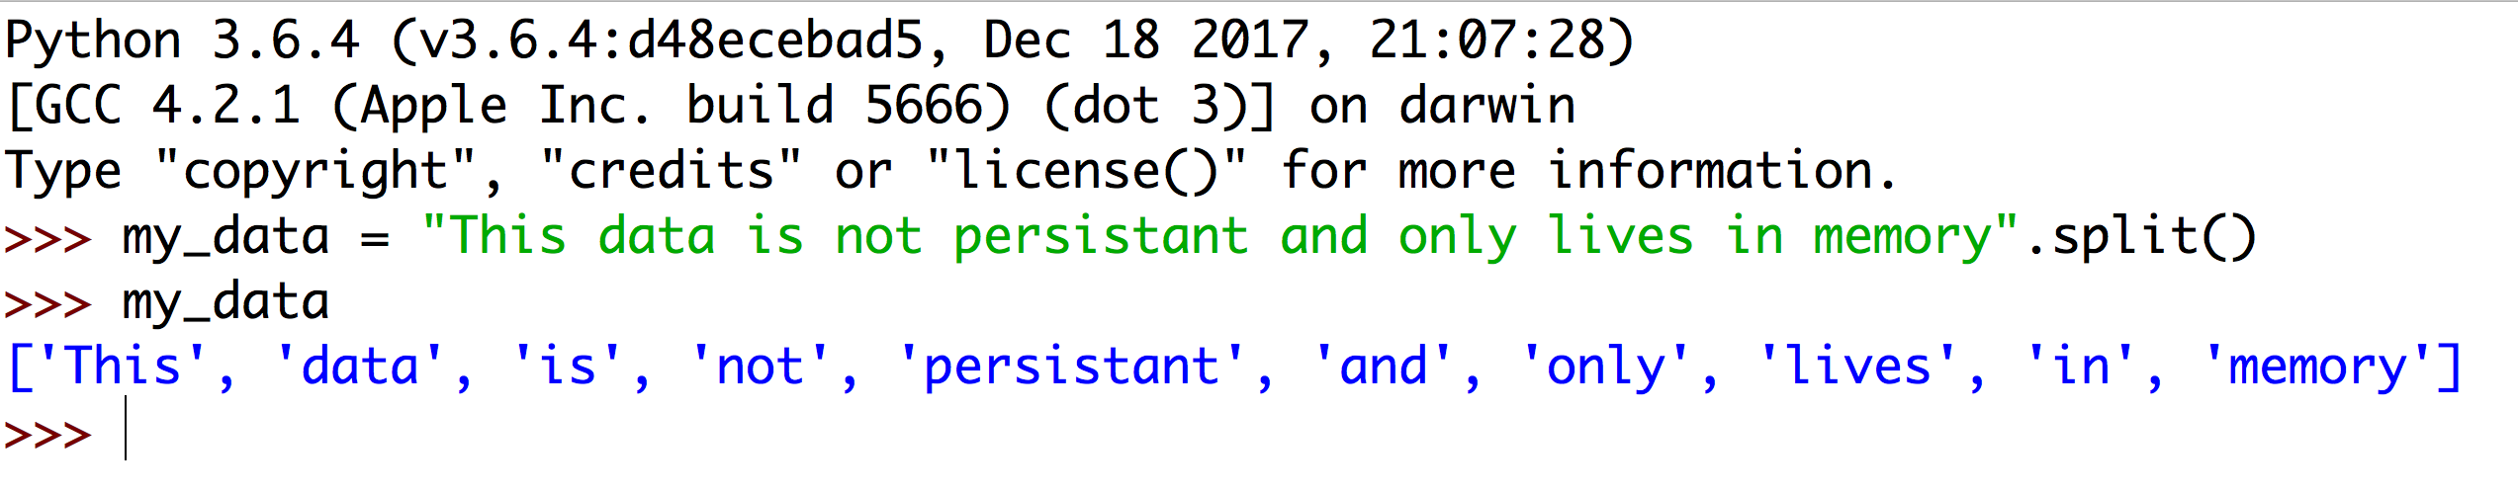
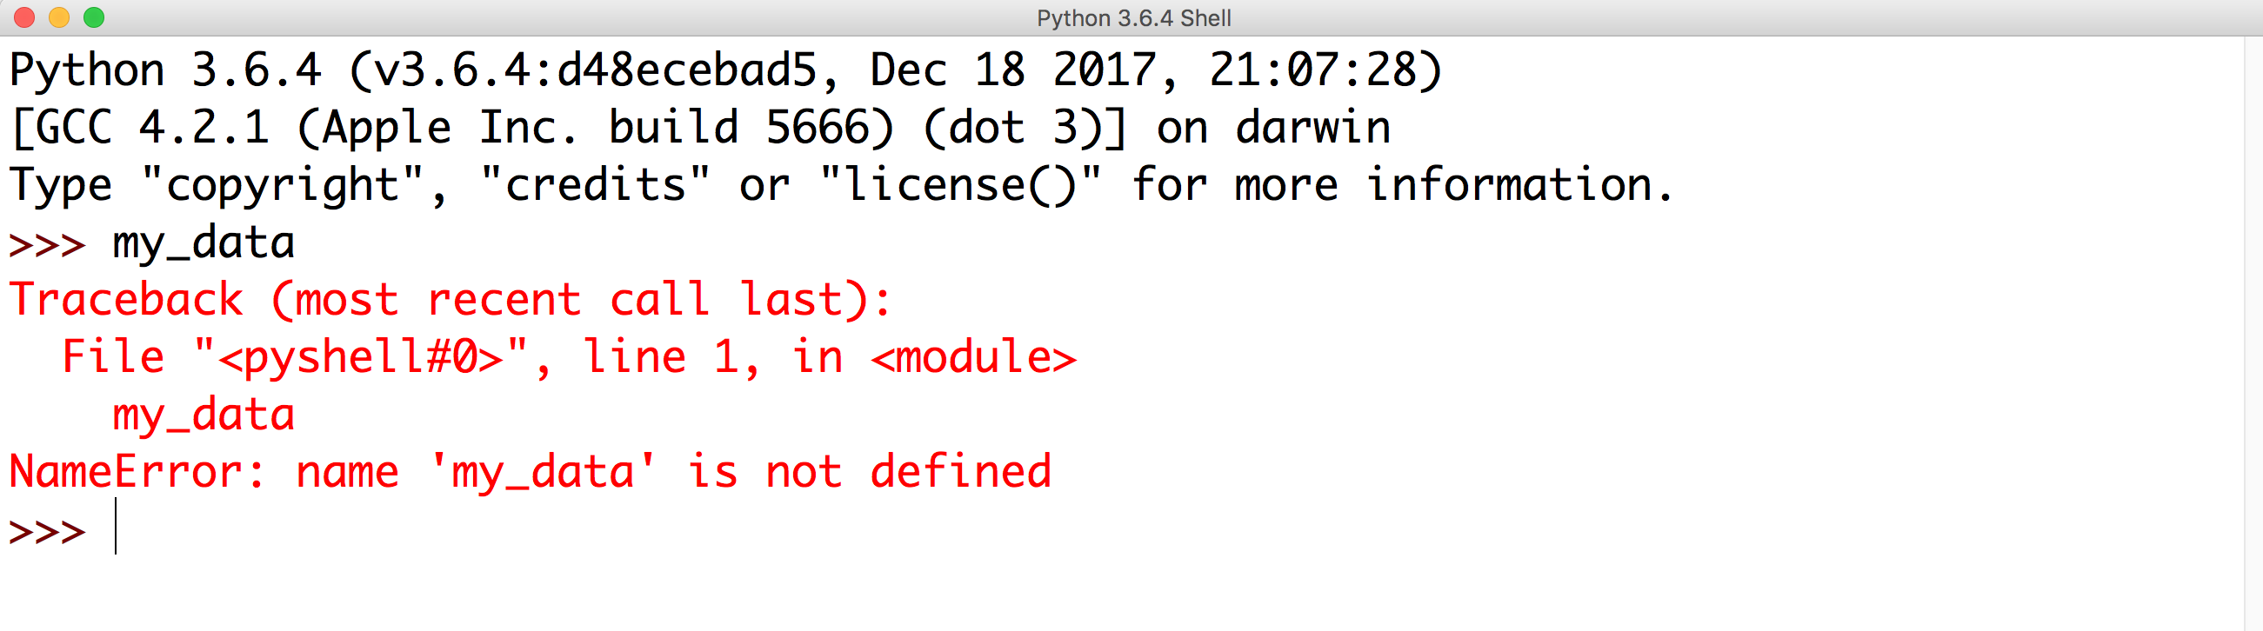
Data
Often, you want to read data in your program.
Your data will not be present in lists, tuples and dictionaries. These data structures only live in memory. Not in a persistent state.
Closed the IDLE session.
After opening again, the data is lost.

Slide 3
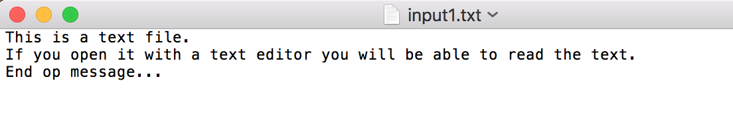
Text Files
Python can read many file types.
The most basic file type is the text file or ASCII file.
This is a file that you can open with a text-editor and yields readable text:

Slide 4
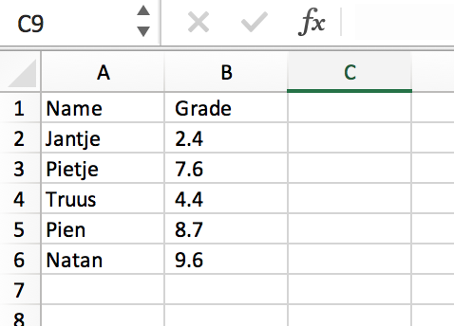
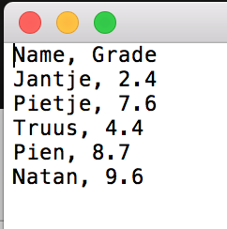
CSV Files
Often, researchers use text files to store data and store it in a table. If comma’s are used, such a file is a comma-separated text file or csv file. Instead of comma’s, other column separators can be used.
Note that the comma acts as column separator. You can also open the file in Excel.

Slide 5
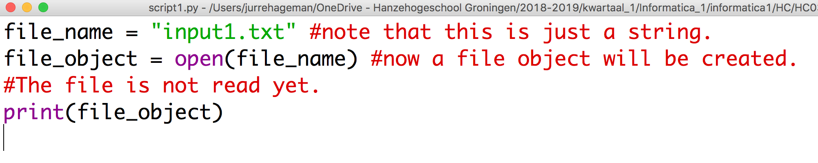
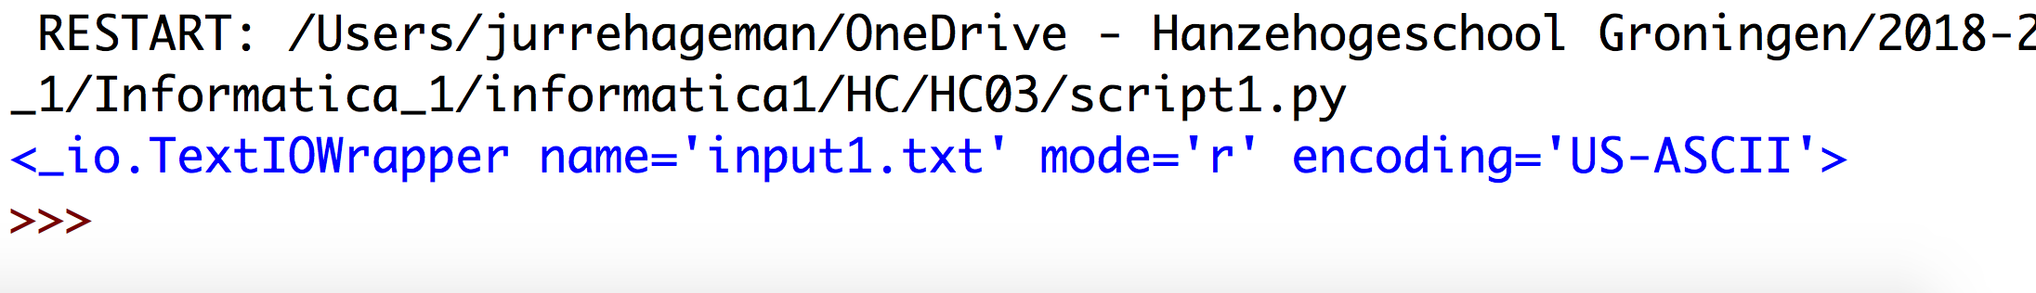
Open a file in Python
Python can generate a file object with the "open” function.
You can use the file name as an argument. Put your file in the same folder as your Python script.
Note that the file content is not yet opened. Only a file object is constructed

Slide 6
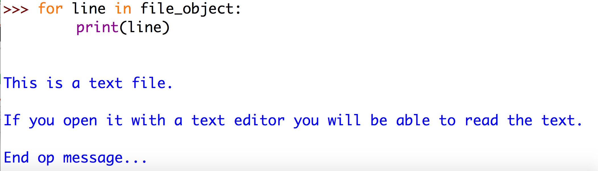
Open a file in Python
The file object is an itterable. This means that you can loop through it:
line is the placeholder in the for loop. You can name it whatever you want.
Note that there is a newline after each line of text. This because the text file has newlines after each line

Slide 7
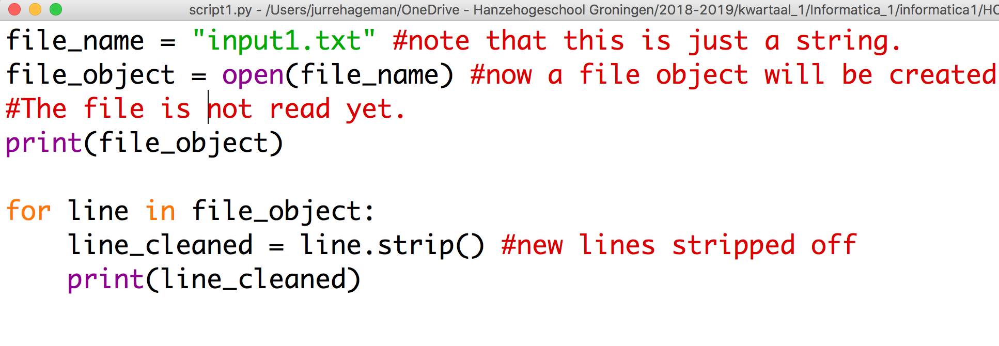
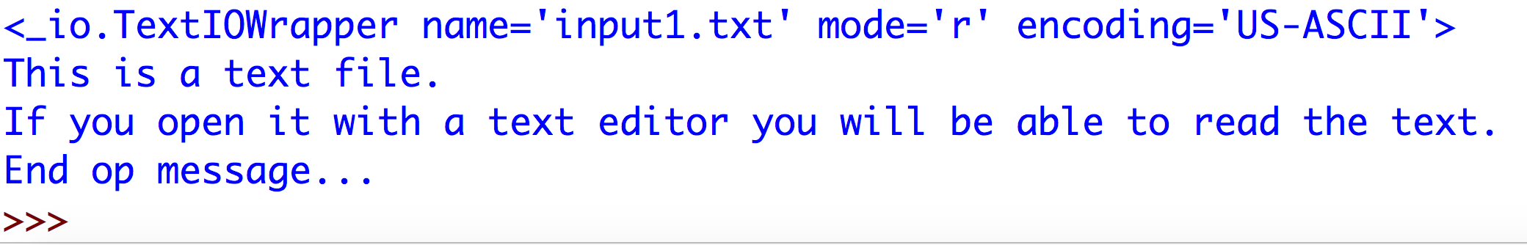
Open a file in Python
Now the new lines are stripped off.

Slide 8
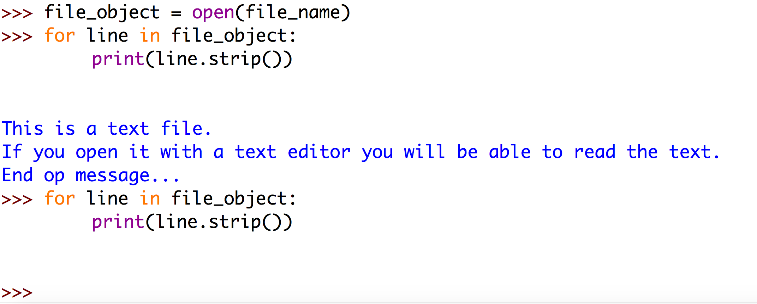
Open a file in Python
A file object is itterable, but it is itterable only once. You can not go back. You need to create a new object to iterate through the lines again:
Note that the file object is empty now. You need to create a new file object to iterate through it again.

Slide 9
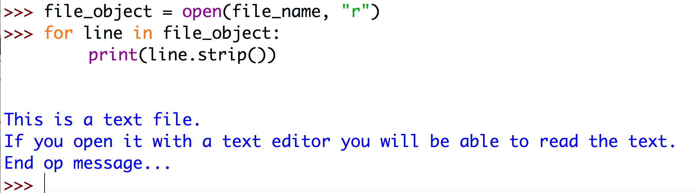
File modi in Python
There are 3 modi a file object can be in:
Read “r”
Write “w”
Append “a”
Read is default so you do not have to explicitly define it:
File object in read modus.
You can omit this argument for reading files.

Slide 10
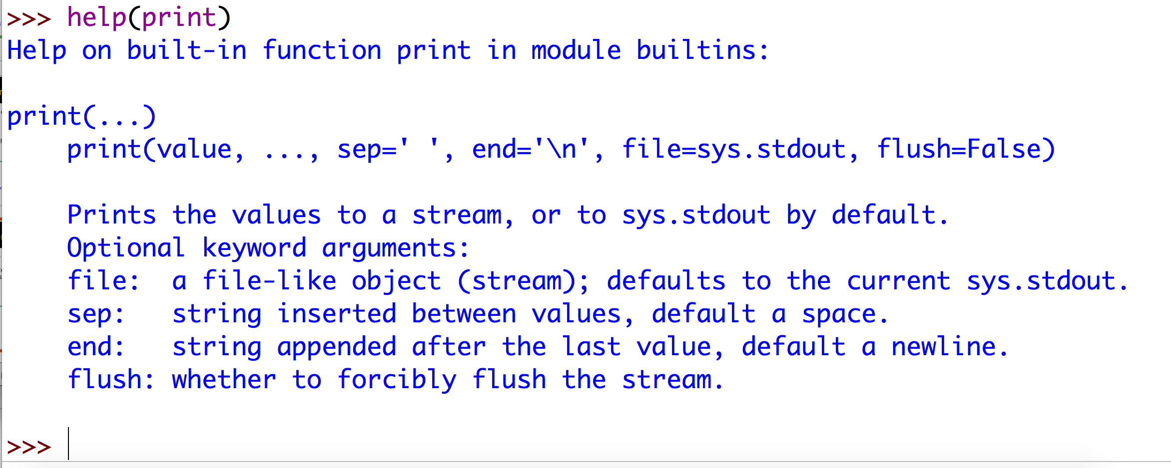
Write File in Python
You can write data to a file by generating a file object in write modus.
The print function can write data using
Close the file object. This is especially important when writing data!
Print can write data to a file.

Slide 11
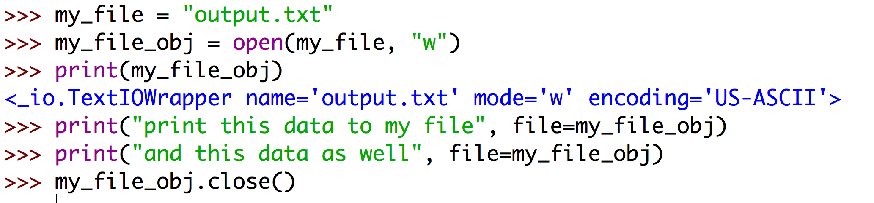
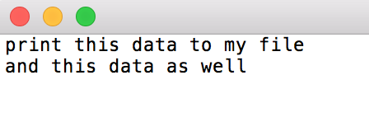
Write File in Python
You can write data to a file by generating a file object in write modus.
The print function can write data using
Close the file object. This is especially important when writing data!
Yes, it worked!

Slide 12
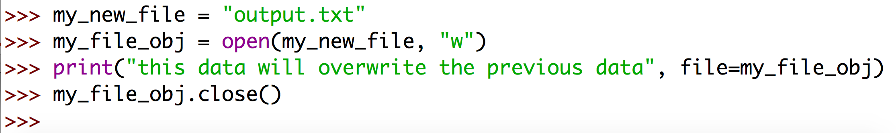
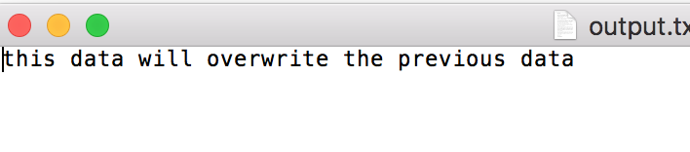
Append File in Python
Write mode will create a new file and overwrite your data:
The data is overwritten!

Slide 13
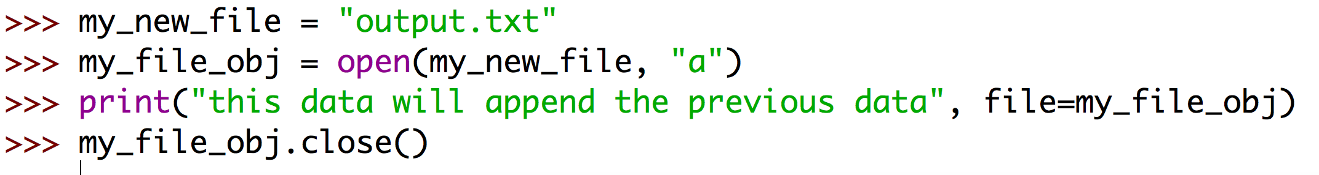
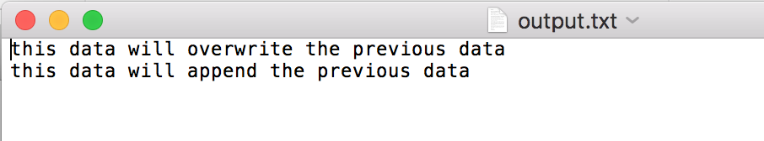
Append File in Python
Use the “a” argument to append to the file:
The data is appended to the previous data!

Slide 14
A script to calculate GC content
A script that calculates the GC content
Reports the highest GC percentage
Reports the sequence with the highest GC percentage
Writes data to file

Slide 15
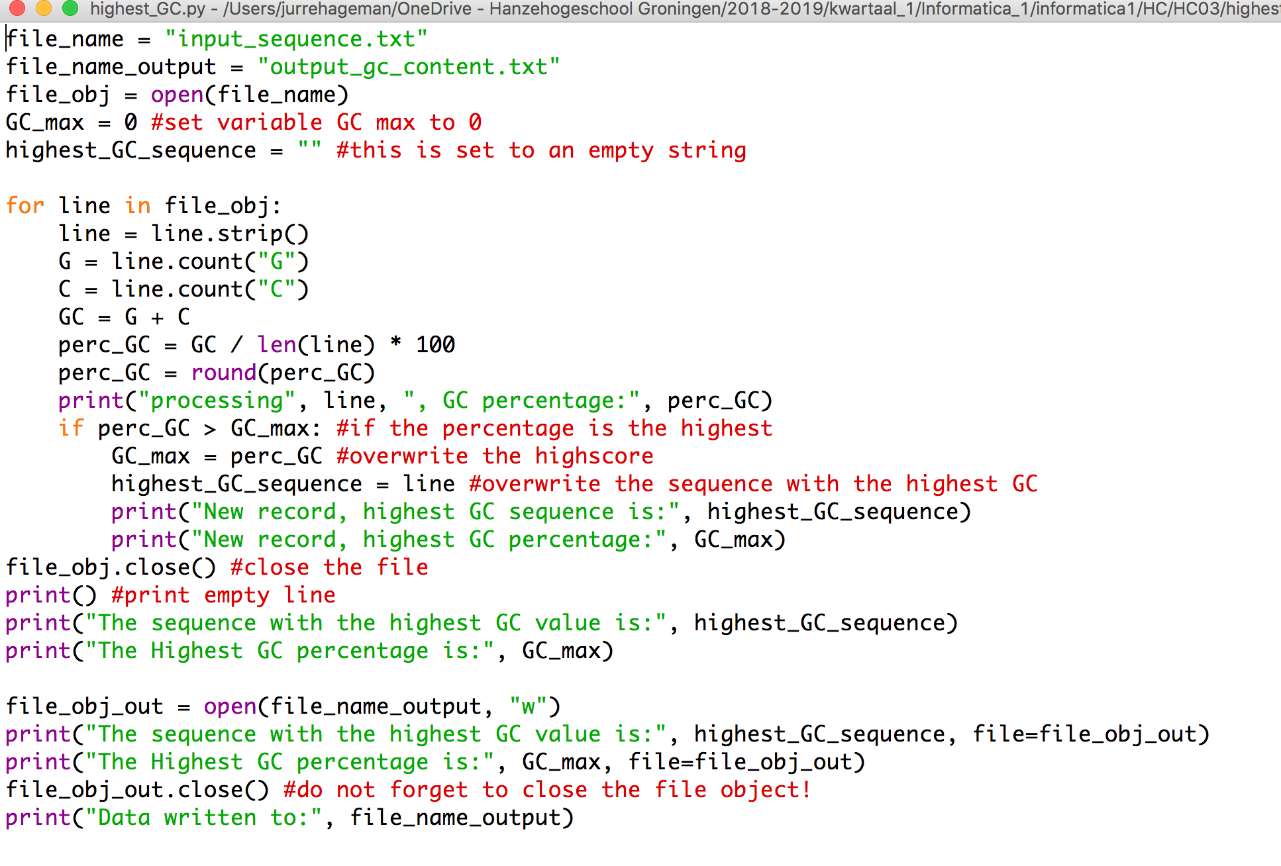
A script to calculate GC content

