Slide 1
Introduction to programming with Python Data types and collections
J. Hageman
Hanze University of Applied Sciences
Groningen
Bioinformatics data processing and –analysis using the scripting language Python

Slide 2
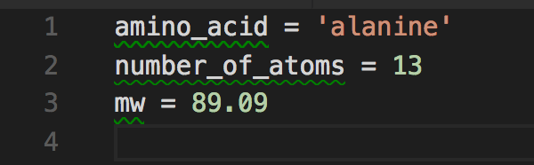
Programs and data
All programs need data to work on
To store data, you need a placeholder for it: these are called variables. Here are a few examples:

Slide 3
Creating variables
Here you can find a movie that explains variables.
Information (data) comes in many forms, such as numbers, characters, words, pictures, sound. In programming languages like python information is stored in variables. You can think of a box that has a label on it and stuff is stored into that. You can find or use the information later by searching for the box with the label you stored the information in.

Slide 4

Creating variables
What happens when I type amino_acid = 'alanine' ?
'alanine' is a literal, the value to be assigned to the variable amino_acid
amino_acid is the name of the variable you have just created
The assignment operator = was used to assign the string alanine to the variable amino_acid

Slide 5
Introduction
Python has several data types. We will cover several types.
None
Booleans: True/False
Strings: “Hello”
Integers: 7
Floats: 2.5

Slide 6
Introduction
Python has several collections. We will cover several collections.
List: mutable, ordered collection
Tuple: immutable, ordered collection
Set: unordered collection of unique items
Dictionary: unordered library of key-value pairs

Slide 7
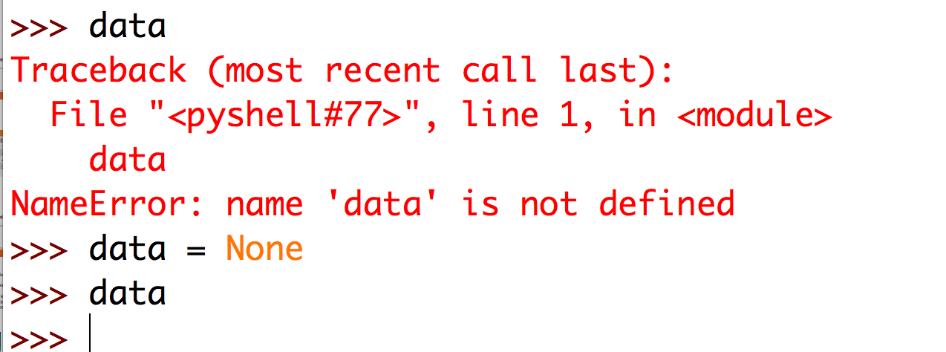
None
None is just a value that commonly is used to signify 'empty', or 'no value here'. It is a signal object.
This way, you can declare a variable with empty data, preventing a NameError.

Slide 8
Booleans
There are only two possible booleans:
True
False
In Python you can convert many datatypes to boolean with the bool() function

Slide 9
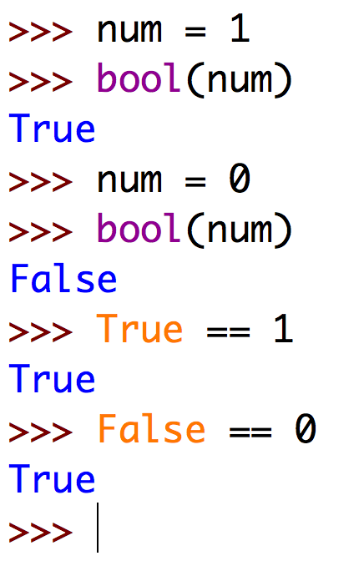
Booleans
The == means a equality test. Python evaluates if the two are equal.
Not only is 1 converted to True. 1 equals True directly!
0 equals False. 1 and True are the same thing in Python!

Slide 10
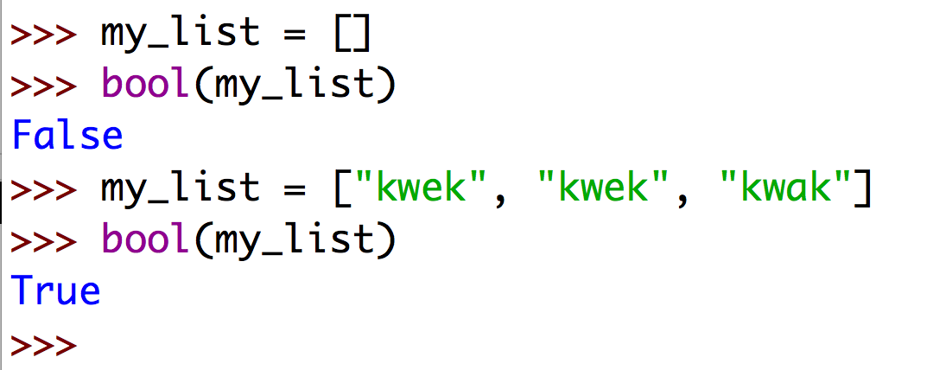
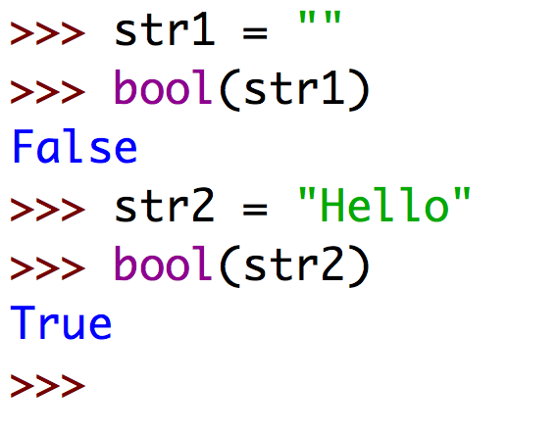
Booleans
Empty collections evaluate as False when converted to bool. Non-empy as True.
Later more about this.
This holds for strings as well!

Slide 11
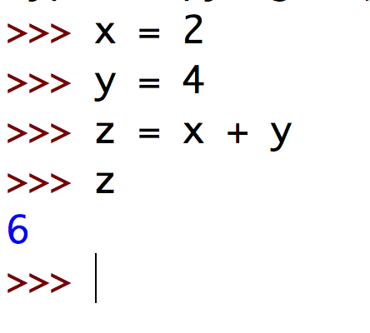
Integers
Working with integers is easy in Python. Just type the number and your done. You can also store integers as variables and do simple math.

Slide 12
Floats
Floats represent real numbers and are written with a decimal point dividing the integer and fractional parts. Floats may also be in scientific notation, with E or e indicating the power of 10

Slide 13
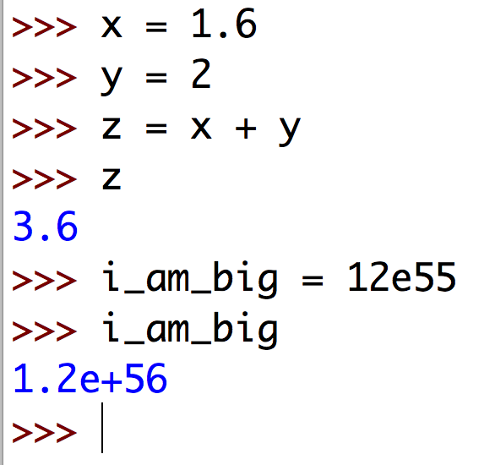
Floats

Slide 14
Strings
Strings are ordered sequences of Unicode characters.
Strings can be created using single quotes or double quotes.
Strings are iterables which means that it can take sequential indexes starting from zero.
Strings have a zero-based index in Python

Slide 15
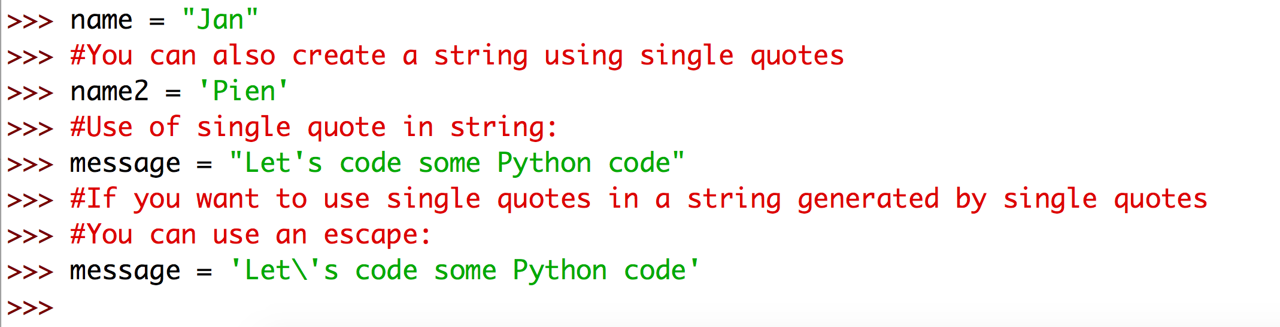
Strings
The \ character serves as an escape character!

Slide 16
String indexing
String positions can be specified using an index.
When working form the start, indexes start at 0
When working from the end, indexes start at -1
character at index [2] is 'A'
0 1 2 3 4 5 6 7
G A A T C T G G
-8 -7 -6 -5 -4 -3 -2 -1
character at index [-3] is 'T'

Slide 17
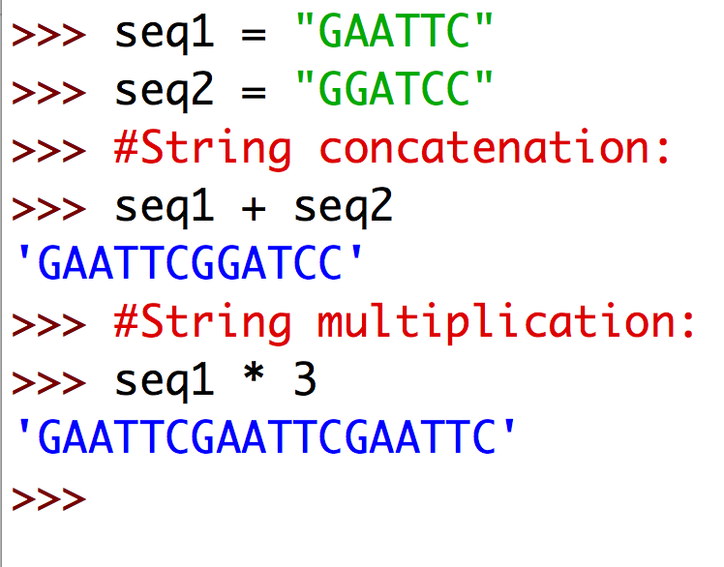
String manipulation

Slide 18
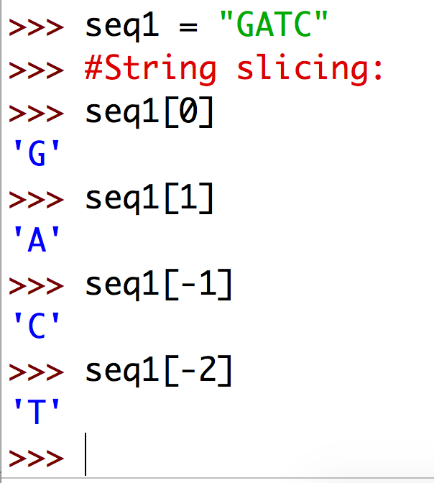
String slicing

Slide 19
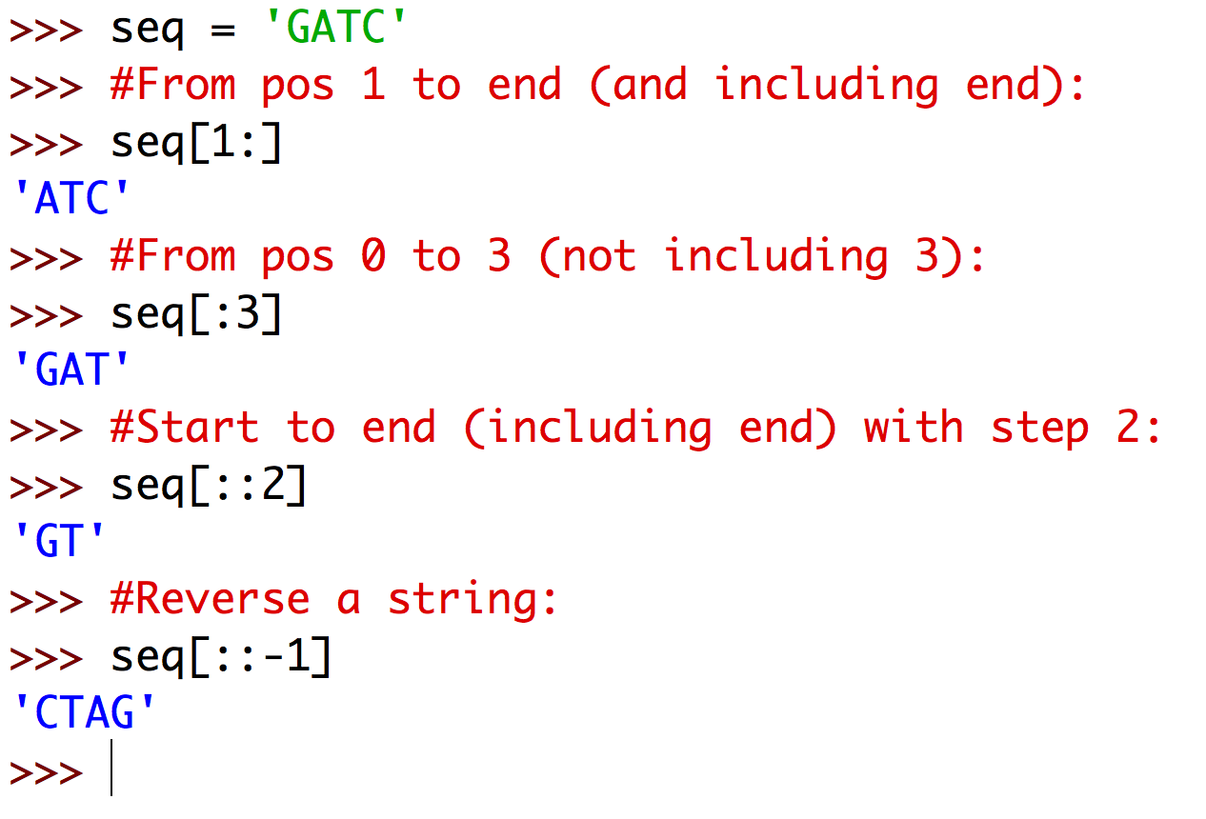
String slicing
Slicing rules:
seq[x:y:z] will return a slice starting at, and including, index x (or 0 if omitted) to, but excluding, index y (or the end if omitted), and only taking the character at each step z
A slice will always return the same data type

Slide 20
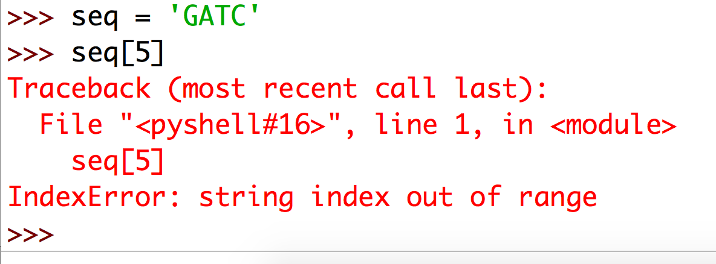
Wrong string indexing
What happens when you try to get a position that does not exist?
If you try to access an index that does not exist, you get an IndexError!

Slide 21
A first glance at objects & methods
Since Python is a real object-oriented programming language, all data in Python are represented as objects
In terms of programming, an object is a structure with data (properties or attributes) and methods (functionality)
We will explore these concepts a little with string objects

Slide 22
What is a method?
A method is a piece of code that is accessible through its name.
You can call a method and cause its code to be executed
Method calling comes in two flavors:
method( arguments )
object.method( arguments )

Slide 23
Method call, flavor 1
This flavor is used for methods calls within the same script and many build-in methods, such as str()
method( arguments )
method is the name of the piece of code you want to be executed (e.g. find)
arguments are one or more pieces of data you can pass to a method e.g. find('ATC'). Some methods do not take any arguments.

Slide 24
Method call, flavor 2
This flavor is used for methods calls on objects
object.method( arguments )
object is the piece of data you are working on (e.g. a string object)
You use the dot operator ('.') to call a method of an object

Slide 25
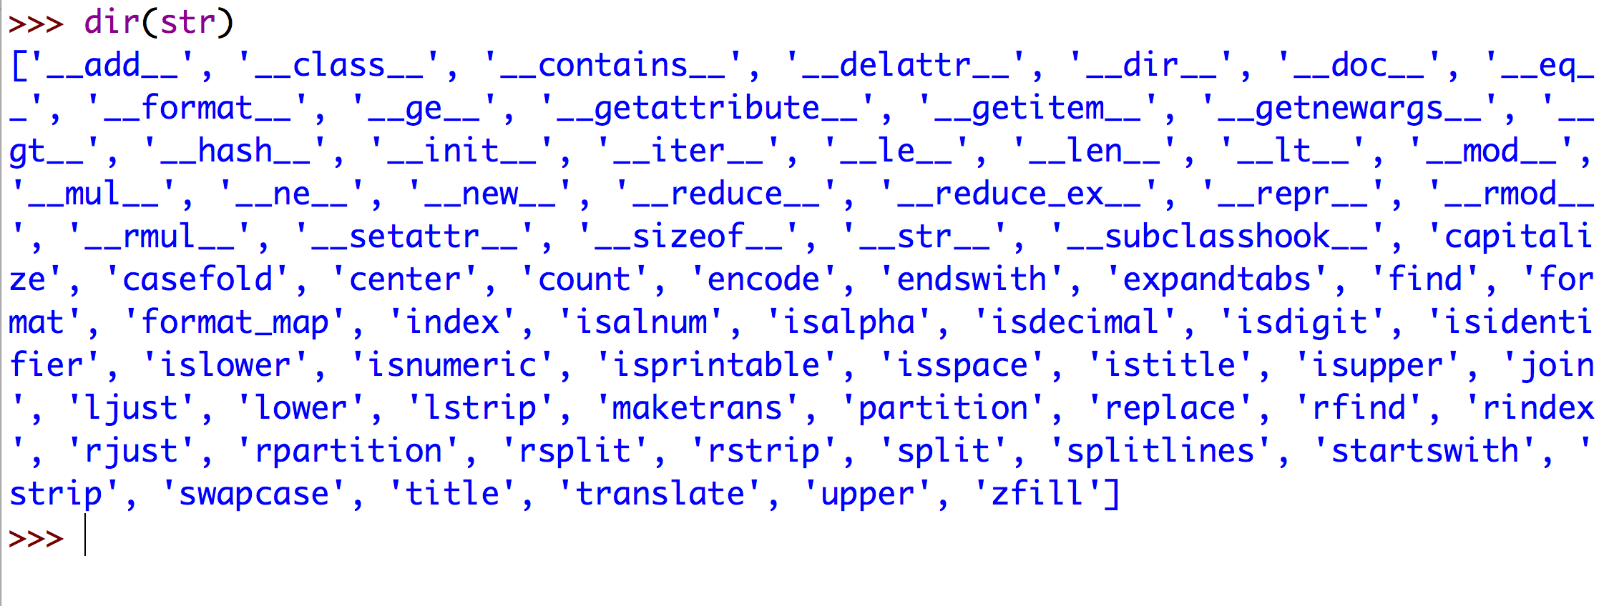
A first glance at objects & methods
Use dir(str) to explore the properties and methods of a string object.

Slide 26
String methods
String methods that you need to know off:
method | what to use it for
str.startswith('substring') str.endswith('substring') | tests whether a given string starts/ends with substring
str.strip() | strip off any leading and trailing characters
str.rstrip() str.lstrip() | strip off right or left trailing characters
str.split( 'pattern' ) | split the string in a list of strings on all occurrences of pattern
str.upper() str.lower() | convert string to upper/lower case
str.find() | returns the start position of substring
str.index() | returns the start position of substring

Slide 27
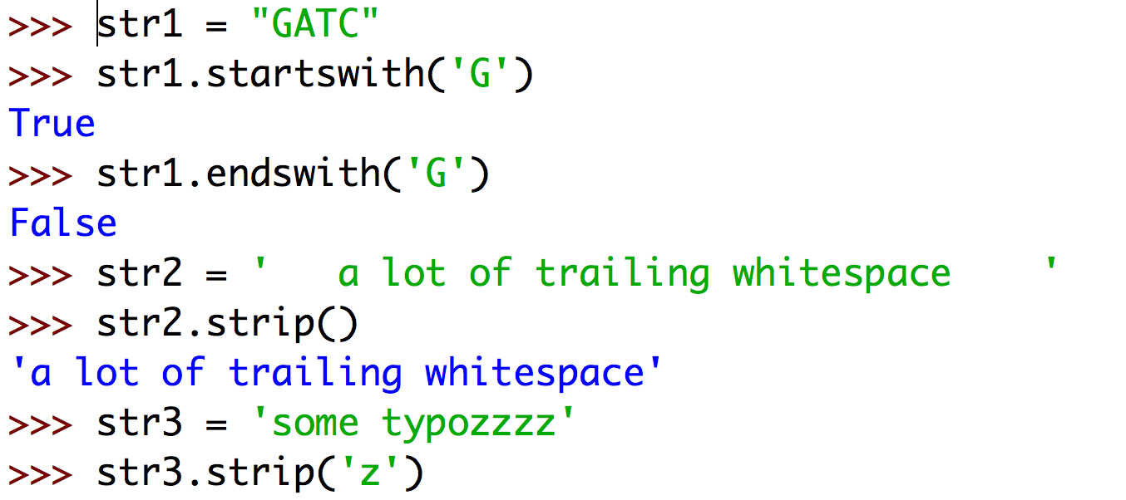
Use of string methods: strip()
Without argument strip will strip whitespace.
Note that strip will remove all repeats of the trailing character

Slide 28
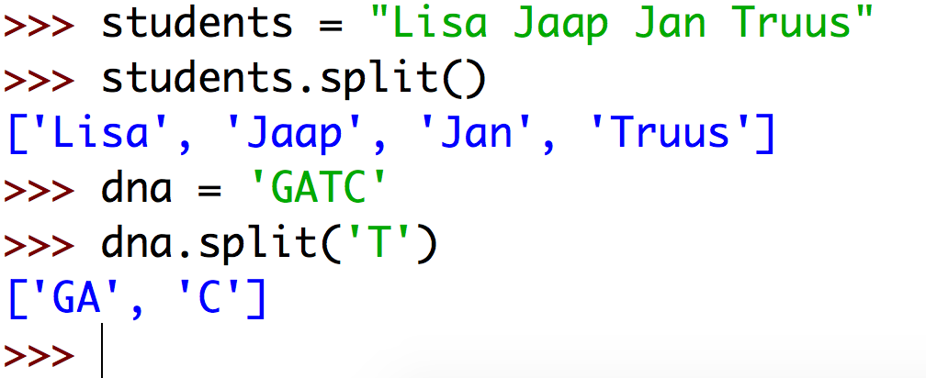
Use of string methods: split()
Without argument split will split on whitespace.
Note that split will not include the argument in a list

Slide 29
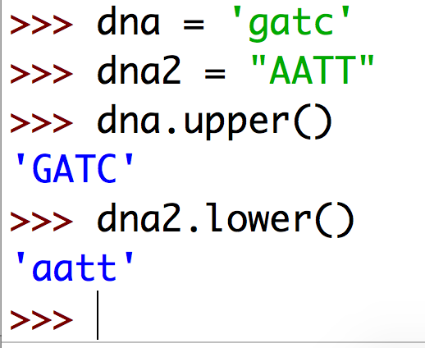
Use of string methods: upper() and lower()
Upper and lower will convert the whole string. It does not accept an argument.

Slide 30
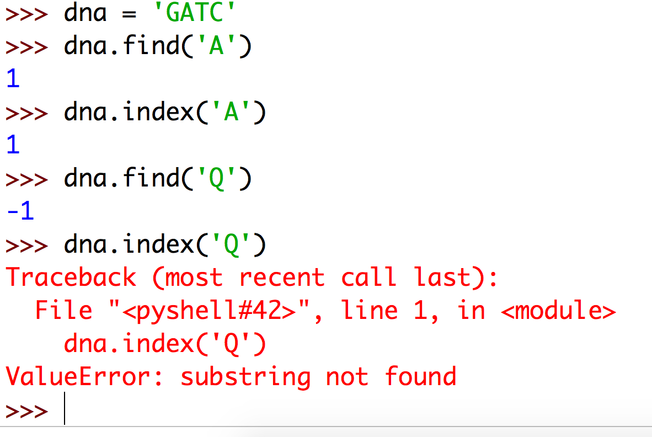
Use of string methods: find() and index()
When a substring is not found, find will return -1 while index will raise an error!

Slide 31
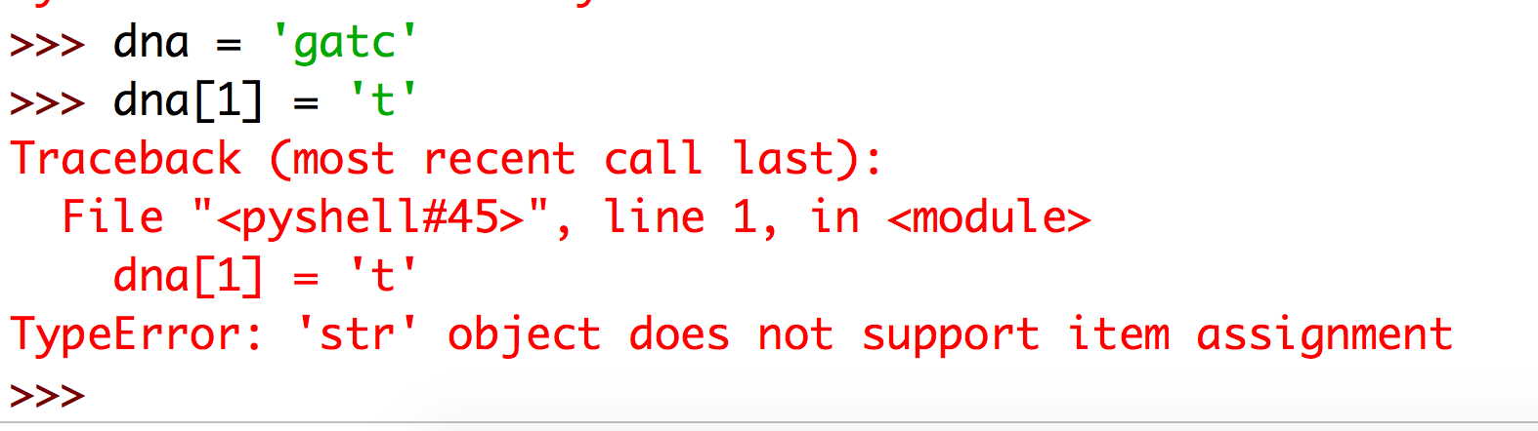
Warning! Strings are immutable
If you try to change a character within a string, you will get an error
The solution: use a List

Slide 32
Lists
Lists are … lists (of objects)
They are in other languages also called sequences, vectors or arrays
They contain ordered series of objects: characters, strings, numbers, or any other Python object
They are quite similar to strings in many ways but with one important exception: they are mutable

Slide 33
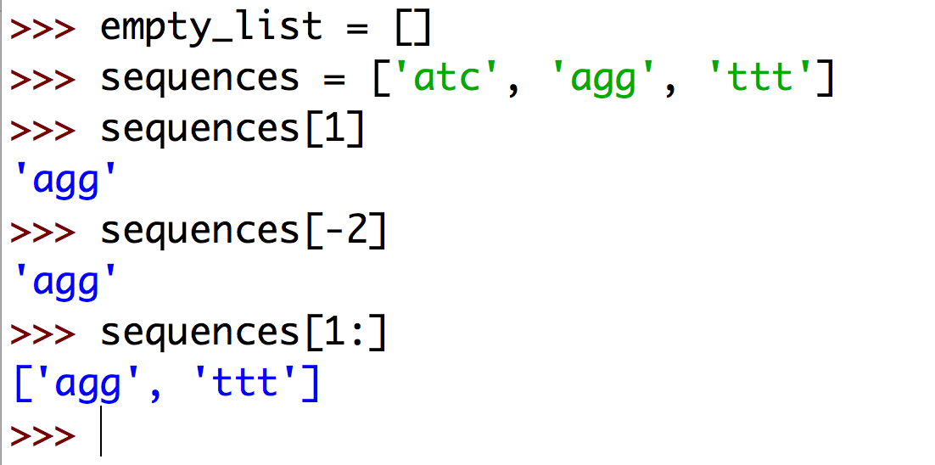
List basics
Lists are created using square brackets, with elements separated by commas
[] creates an empty list
List indexing works the same as with strings. If you access a single element you get its value; if you access more, you get a new list

Slide 34
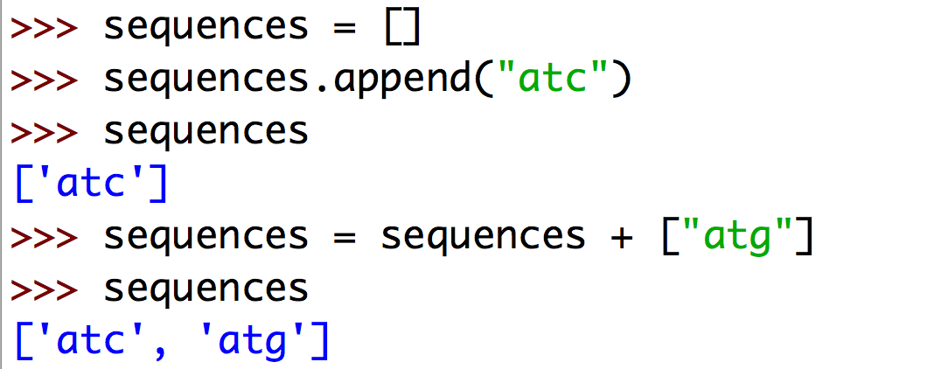
List basics: extend
Append and concatenating lists can both be used to extend

Slide 35
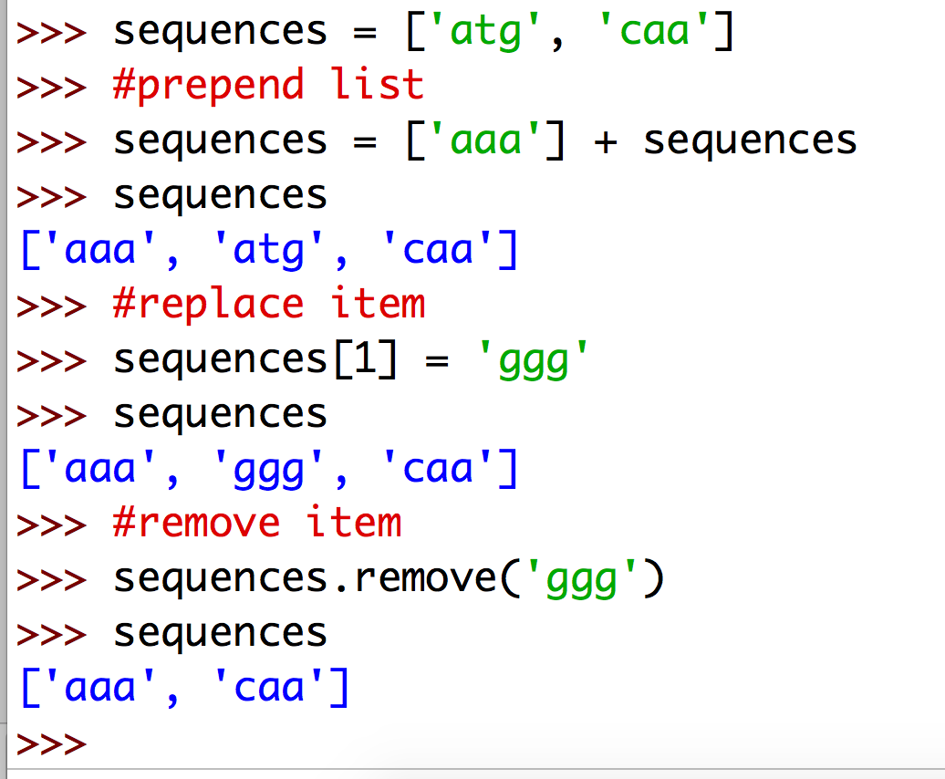
List: change a list

Slide 36
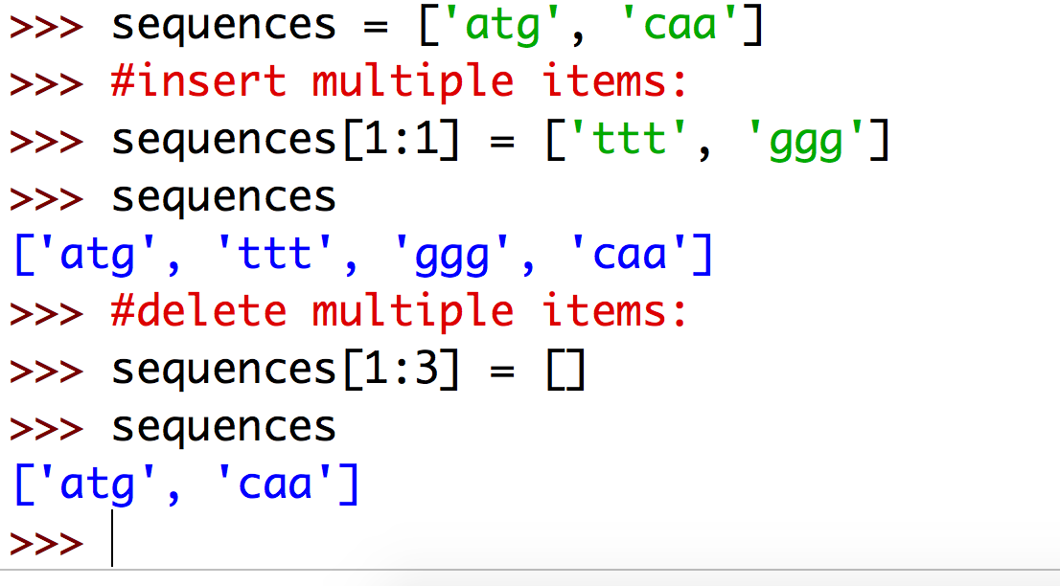
List: delete and insert multiple items

Slide 37
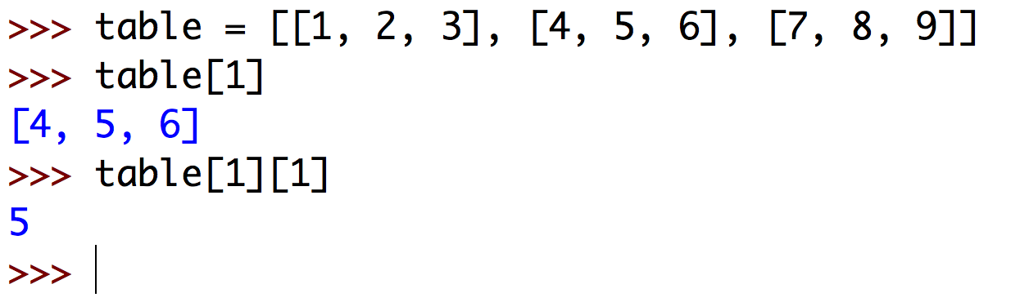
Nested Lists
You can also create lists within lists: nested lists or matrices (also called multi-dimensional lists)
this is a list of three lists of two elements each
here you get the second row of the matrix
and this returns the second element of the second row
1 | 2 | 3
4 | 5 | 6
7 | 8 | 9

Slide 38
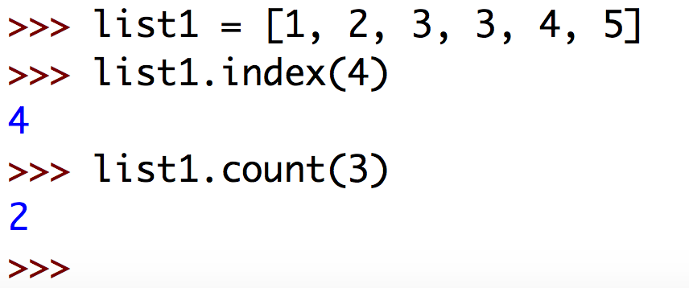
Some useful list methods
list.index(x) returns the index of the first occurrence of x in list
list.count(x) returns the number of occurrences of x in list

Slide 39
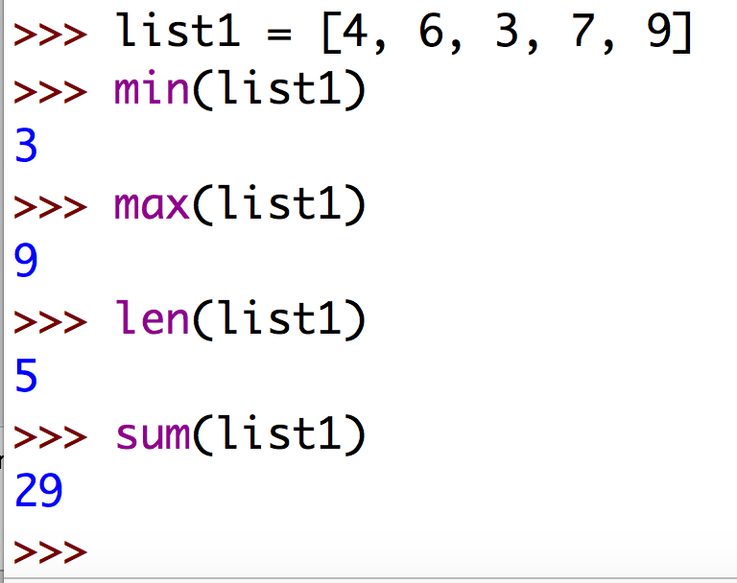
Some useful functions
These functions are useful on lists but work on any iterable
These functions are self-explanatory

Slide 40
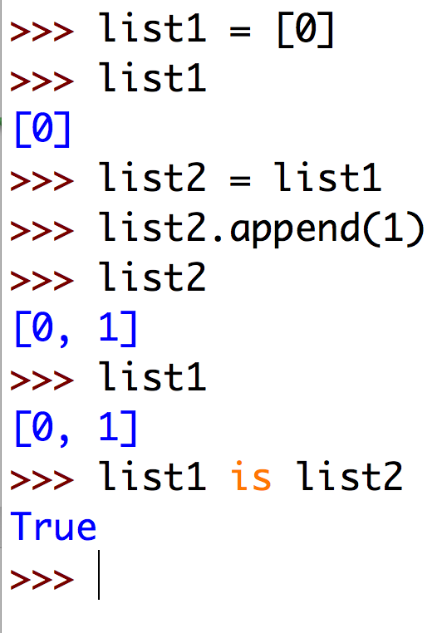
Warning! copy of list
Frequent cause of code errors
No need to understand this thoroughly but be aware that lists (as any object) references are passed by value. The following code snippet will explain:
list1 and list2 both refer to the same object.
list2 is NOT a copy of list1! They are the same thing!

Slide 41
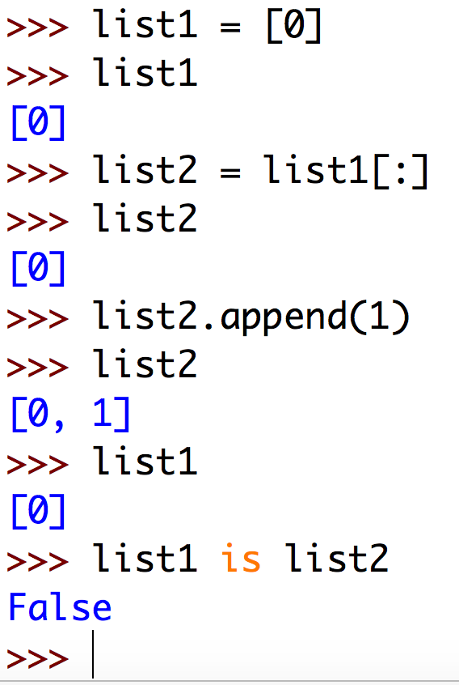
Solution! copy list
If you want a copy of a list do NOT assign it to a new variable but use [:] instead:
The slice [:] copies the objects of the list from beginning to end including the end.
list1 and list2 do not point to the same object in memory

Slide 42
Tuples
Tuples are like lists, but are as immutable as strings
They contain ordered series of data elements: characters, strings, numbers or any other Python object
They share a lot of methods and operations with strings and lists

Slide 43
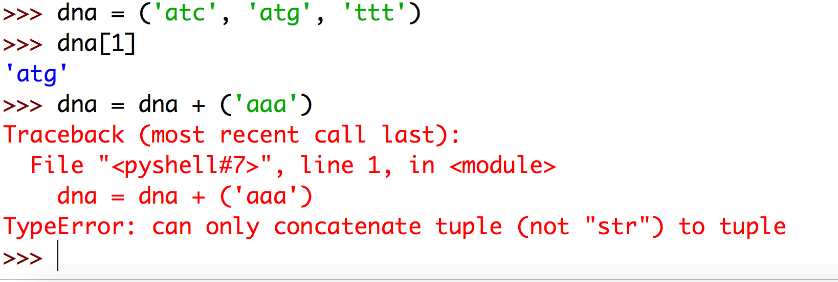
Tuples
Tuples are created using parentheses, with elements separated by commas
tuples are indexed just like lists and strings
tuples, like strings, cannot be changed

Slide 44
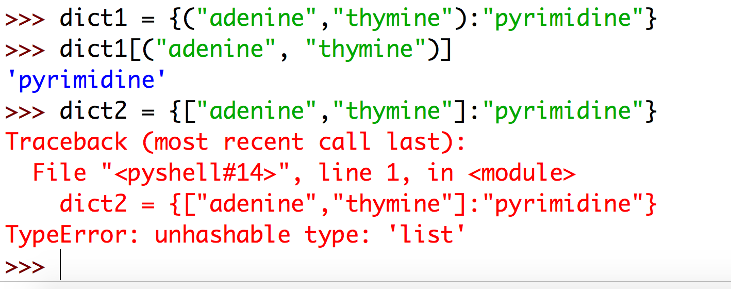
Why use tuples?
Tuples make code more safe. Because they are immutable you will be sure they are not changed
Tuples can be used as a key in a dictionary (see below). This is not possible with lists.

Slide 45
Shared sequence operations: list, string, tuple
Operation | Meaning
x in s | True if an item of s is equal to x, else False
x not in s | False if an item of s is equal to x, else True
s + t | the concatenation of s and t
s * n, n * s | n shallow copies of s concatenated
s[i] | i‘th item of s, origin 0
s[i:j] | slice of s from i to j
s[i:j:k] | slice of s from i to j with step k
len(s) | length of s
min(s) | smallest item of s
max(s) | largest item of s
s.index(i) | index of the first occurence of i in s
s.count(i) | total number of occurences of i in s

Slide 46
Dictionaries
Sometimes, you want fast access of values by some key; a simple list of data will not do
Suppose you want to store the amino acid translations for all 64 codons, where an amino acid is returned for a given codon (e.g. "GGG" will return "Gly"
The dictionary is the ideal structure to store this kind of data

Slide 47
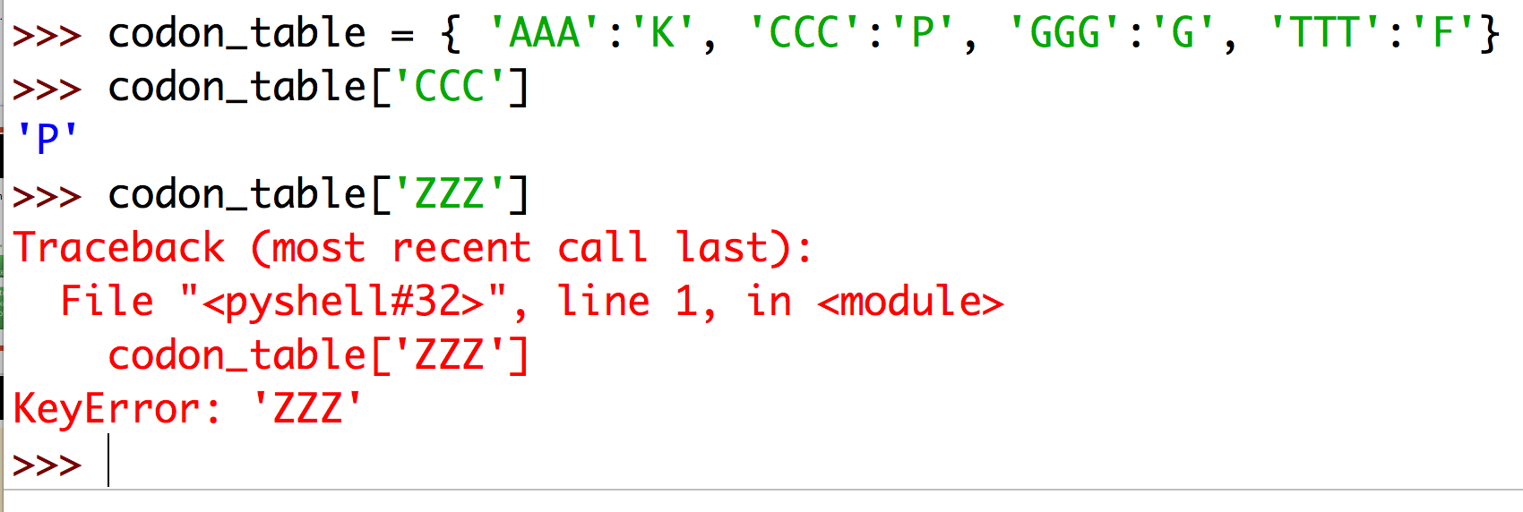
Dictionaries: keys and values
Here is how you could store the universal codon table in Python
create a dictionary with four entries
get a value based on a key
error if you try to access a key that does not exists

Slide 48
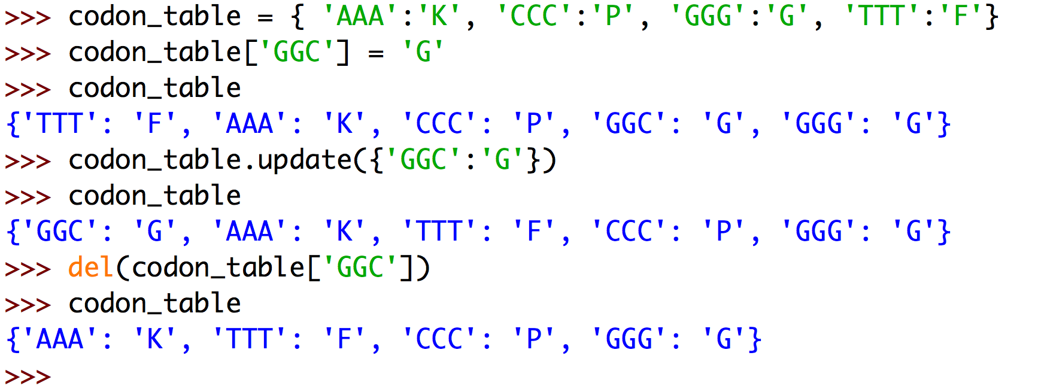
Dictionaries: keys and values
create a new entry
alternative to create a new entry
delete an entry

Slide 49
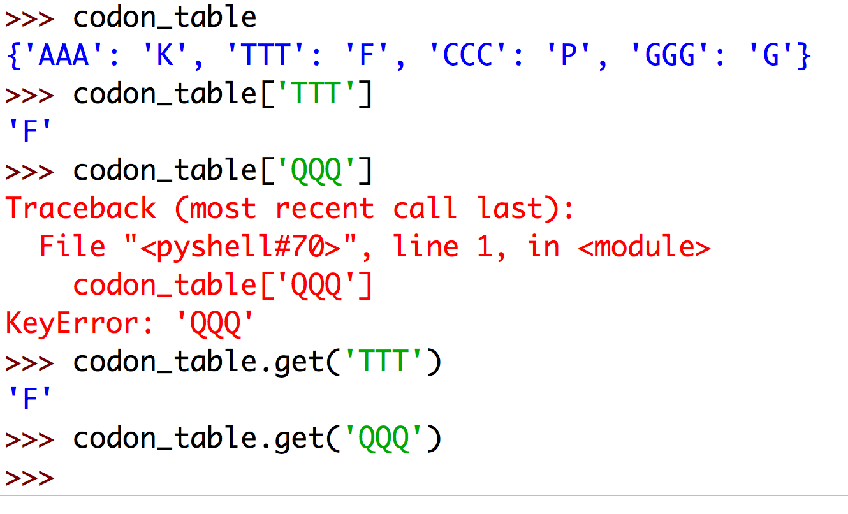
Dictionaries: prevent error if key does not exist
The dict.get() method returns None if a key does not exist.

Slide 50
Dictionaries are unordered
Dictionaries are, in contrast to lists and tuples, unordered.
That means the elements don't necessarily come out the way they are put into it

Slide 51
Python Arithmetic Operators
Expression | Description
x + y | addition
x - y | subtraction
x * y | multiplication
x / y | division
x % y | modulus
x ** y | exponent
x // y | floor division
https://www.tutorialspoint.com/python/python_basic_operators.htm

Slide 52
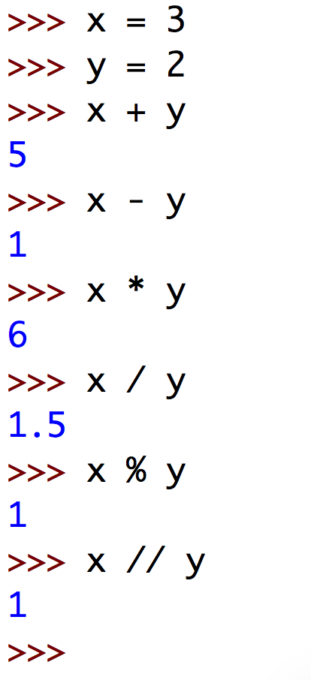
Python Arithmetic Operators: examples
3 / 2 = 1, remainder = 1
=> thus 3 % 2 = 1
3 / 2 = 1.5 , chop of decimal.
=> thus 3 // 2 = 1

Slide 53
Python Comparison Operators
Expression | Description
x == y | x equals y
x < y | x is less than y
x > y | x is greater than y
x >= y | x is greater than or equal to y
x <= y | x is less than or equal to y
x != y | x is not equal to y
https://www.tutorialspoint.com/python/python_basic_operators.htm

Slide 54
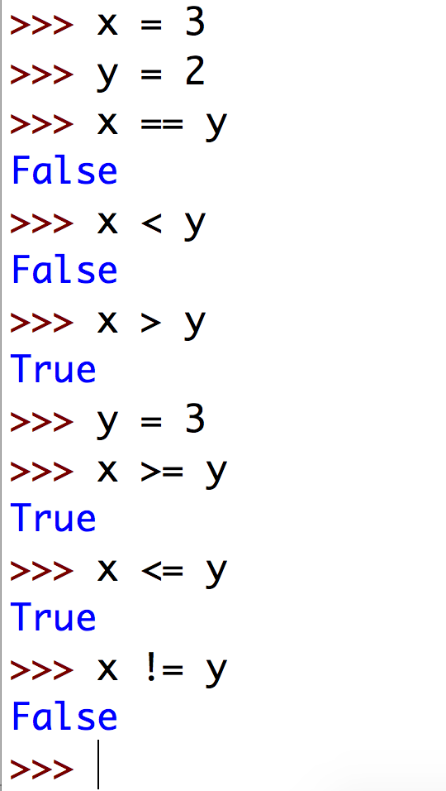
Python Comparison Operators: examples
y is now similar to x!

Slide 55
Python assignment operators
Operator | Description | Example
= | Assigns values from right side operands to left side operand | c = a + b assigns value of a + b into c
+= | adds right operand to the left operand and assign the result to left operand | c += a is equivalent to c = c + a
-= | subtracts right operand from the left operand and assign the result to left operand | c -= a is equivalent to c = c - a
*= | multiplies right operand with the left operand and assign the result to left operand | c *= a is equivalent to c = c * a
/= | divides left operand with the right operand and assign the result to left operand | c /= a is equivalent to c = c / ac /= a is equivalent to c = c / a
%= | takes modulus using two operands and assign the result to left operand | c %= a is equivalent to c = c % a
**= | Performs exponential (power) calculation on operators and assign value to the left operand | c **= a is equivalent to c = c ** a
//= | performs floor division on operators and assign value to the left operand | c //= a is equivalent to c = c // a
https://www.tutorialspoint.com/python/python_basic_operators.htm

Slide 56
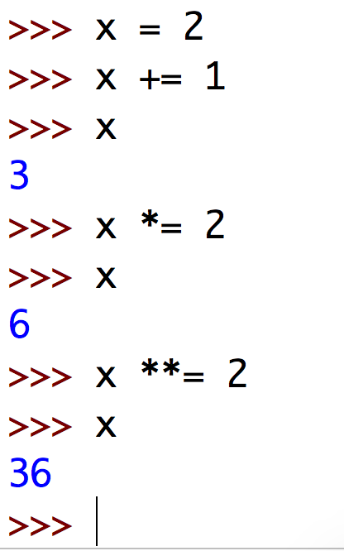
Python assignment operators: examples

Slide 57
Python membership and identity operators
Operator | Description
in | Evaluates to true if it finds a variable in the specified sequence and false otherwise.
not in | Evaluates to true if it does not finds a variable in the specified sequence and false otherwise.
is | Evaluates to true if the variables on either side of the operator point to the same object and false otherwise.
is not | Evaluates to false if the variables on either side of the operator point to the same object and true otherwise.
https://www.tutorialspoint.com/python/python_basic_operators.htm

Slide 58
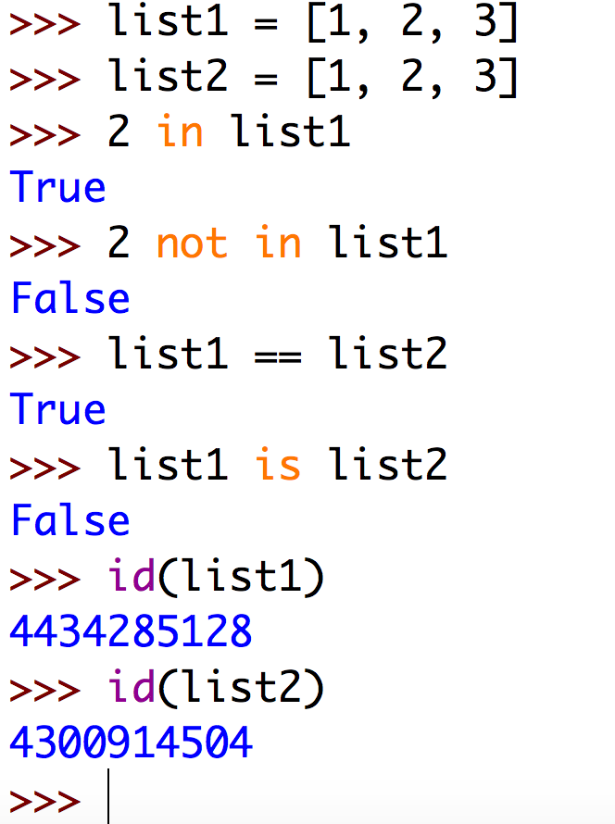
Python membership and identity operators: examples
list1 has identical content as list 2
But they are not the same object!
This shows that the list objects have different identities

Slide 59
The Math module
The math module has some neat math-related properties and methods
Simply import it with ‘import math’
Use dir(math) to explore all the properties and methods

Slide 60
The Math module
Math property/method | Description
math.pi | he mathematical constant π = 3.141592…, to available precision.
math.e | The mathematical constant e = 2.718281…, to available precision.
math.log10(x) | Return the base-10 logarithm of x
math.log(x[, base]) | With one argument, return the natural logarithm of x (to base e). With two arguments, return the logarithm of x to the given base.
math.pow(x, y) | Return x raised to the power y.
math.exp(x) | Return e**x.

Slide 61
The Math module
Math property/method | Description
math.sin(x) math.cos(x) math.tan(x) | Return the sine, cosine or tangent of x radians. Note it expects radians, not degrees!
math.sqrt(x) | Return the square root of x.
math.ceil(x) math.floor(x) | Return the ceiling or floor of x, the smallest integer greater than or equal to x

Slide 62
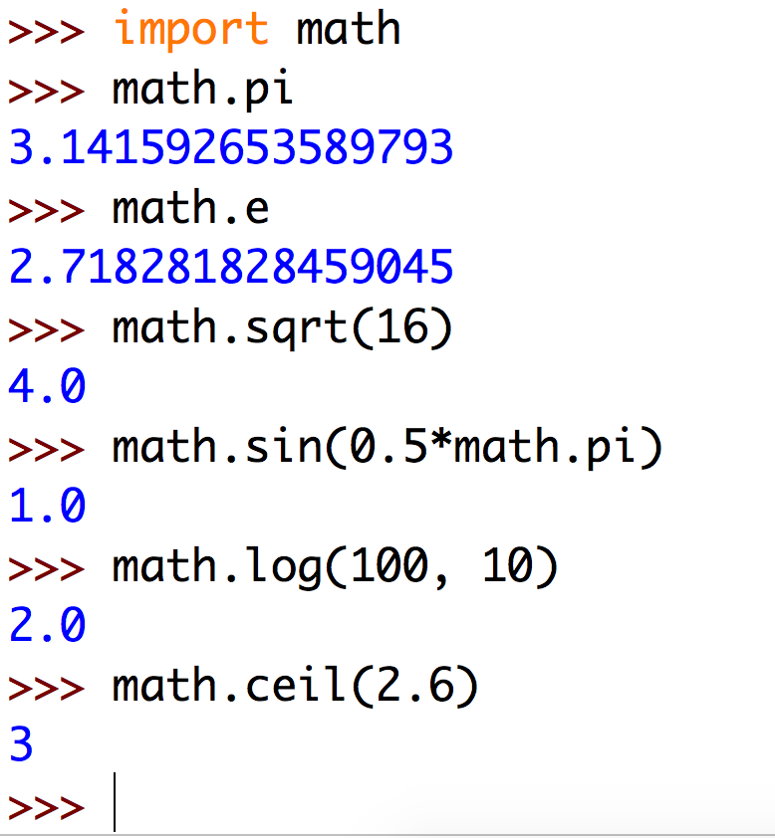
The Math module: examples

Slide 63
The random module
To use (pseudo) random numbers, use the random module
Simply type: import random
Note that true random numbers are difficult to achieve for computers
dir(random) will give you all methods and properties.
random.randint() and random.choice() are the most interesting for now

Slide 64
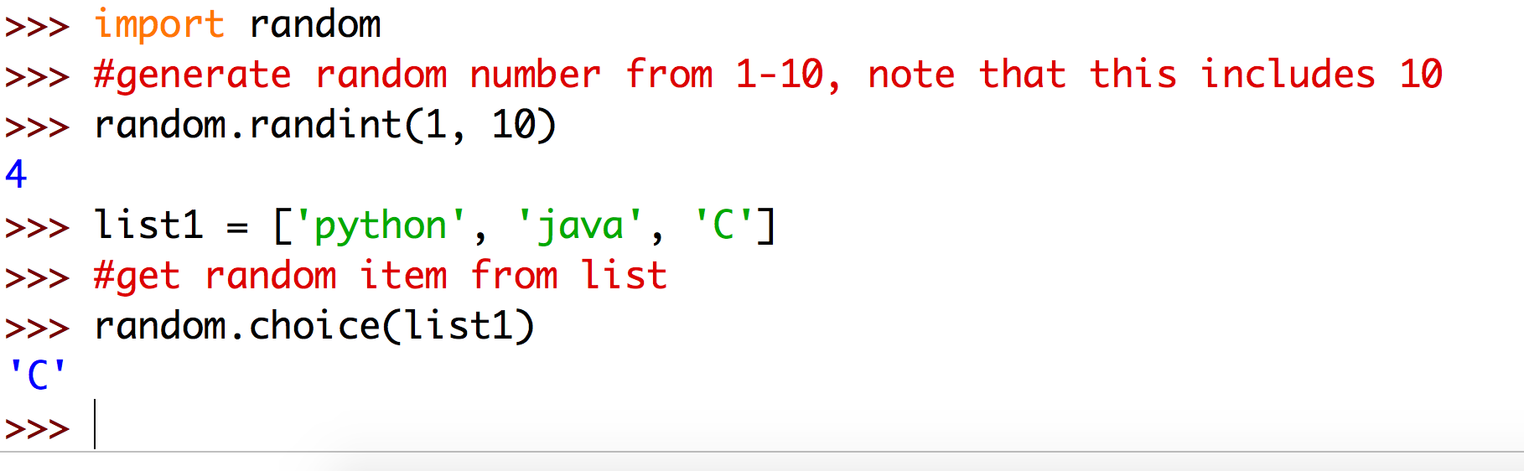
The random module: examples

