Slide 1
Introduction to programming with Python Booleans
J. Hageman
Hanze University of Applied Sciences
Groningen
Bioinformatics data processing and –analysis using the scripting language Python

Slide 2
Booleans
There are only two possible Booleans:
True
False
In Python you can convert many datatypes to Boolean with the bool() function
For every if/elif/else statement, expressions will be converted to Booleans

Slide 3
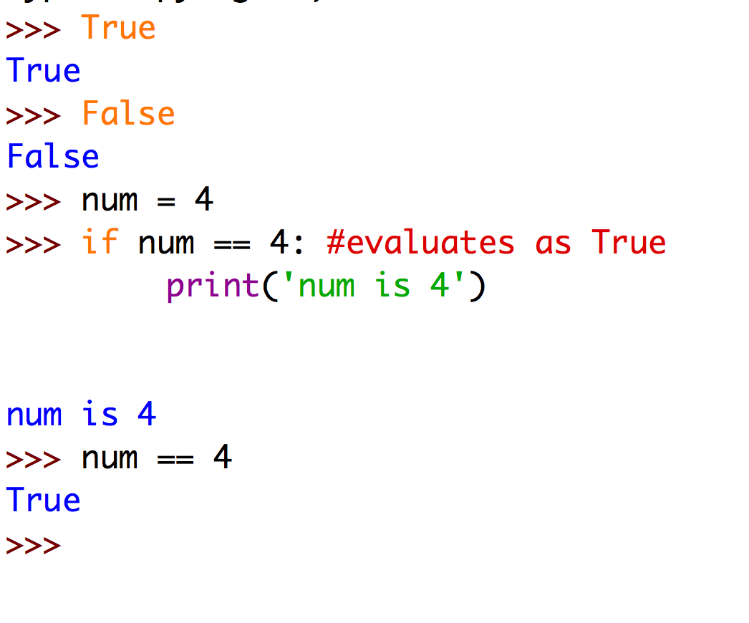
Booleans
This should be easy to follow by now

Slide 4
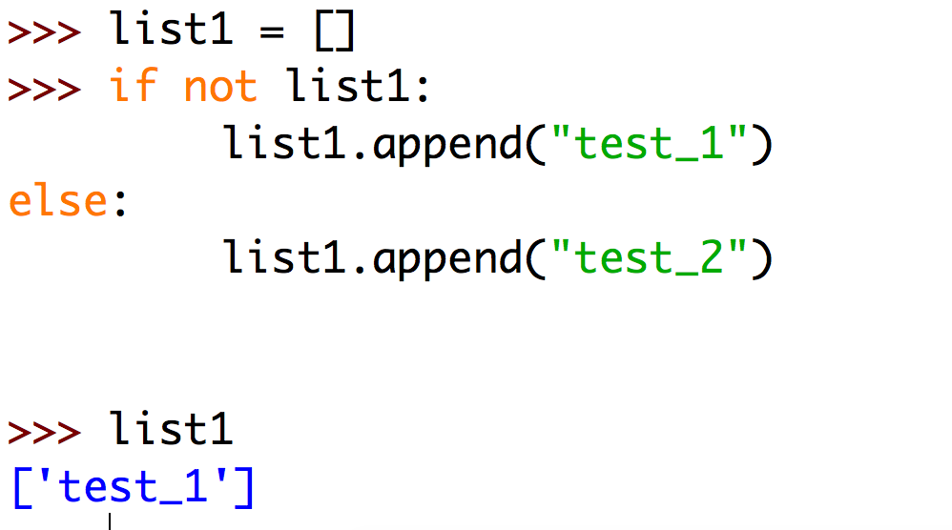
Booleans
But many cases will be more complex.
Example:
This expression will test if the list is empty. Empty lists are evaluated as False!

Slide 5
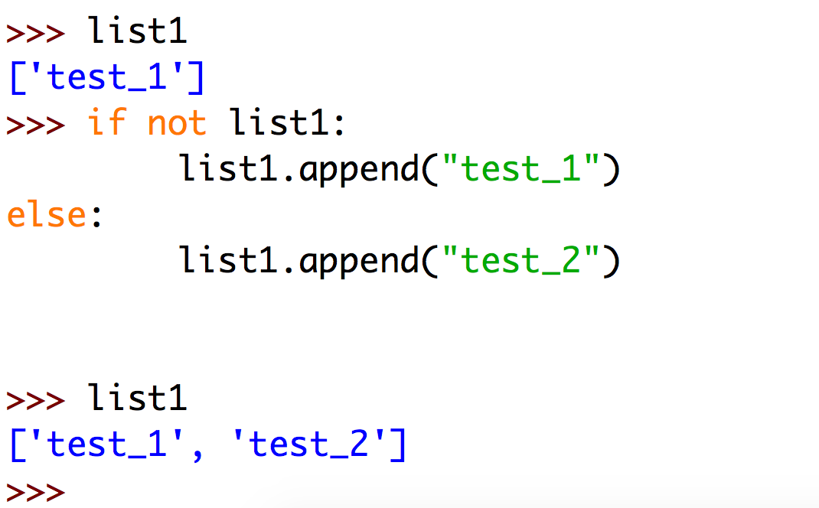
Booleans
But many cases will be more complex.
Example:
Now the list was not empty so the else clause will be executed.

Slide 6
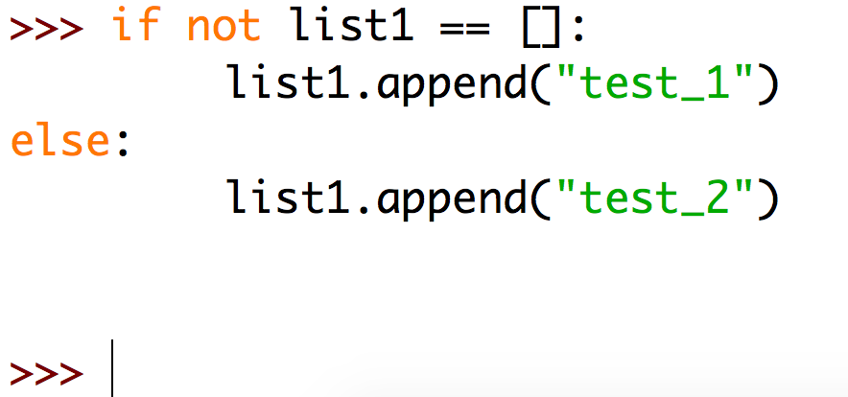
Booleans
To understand this code, it is important that you understand how Booleans work.
Probably this is more easy for you to understand but Python programmers do often directly evaluate variables for Bool types!

Slide 7
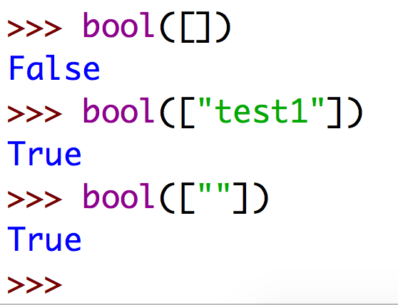
Booleans
For every if, elif, else statement, an expression is converted to a bool:
Empty lists are False. As soon as a list contains an element (even an empty string) it is True

Slide 8
True/False in Python
So what is True and what is False?
This might seem complicated but it is not:
False is:
None
False
0 (zero as integer or float)
empty sequence such as ”” [] ()
empty dictionary or set {}
Consider the rest True! (some details left out for simplicity)

Slide 9
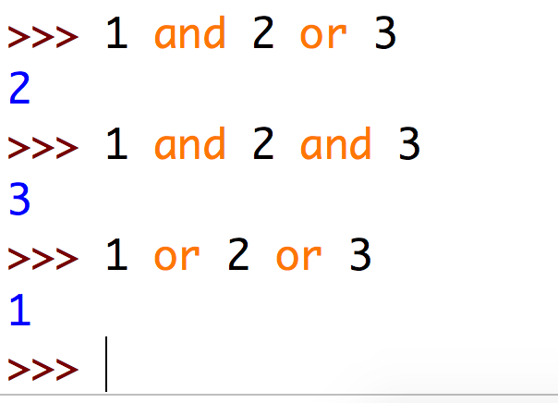
Boolean Operators
There are three Boolean operations:
or
and
not
They have a priority order:
or goes first, than and and then not
To understand this:
See the next slides

Slide 10
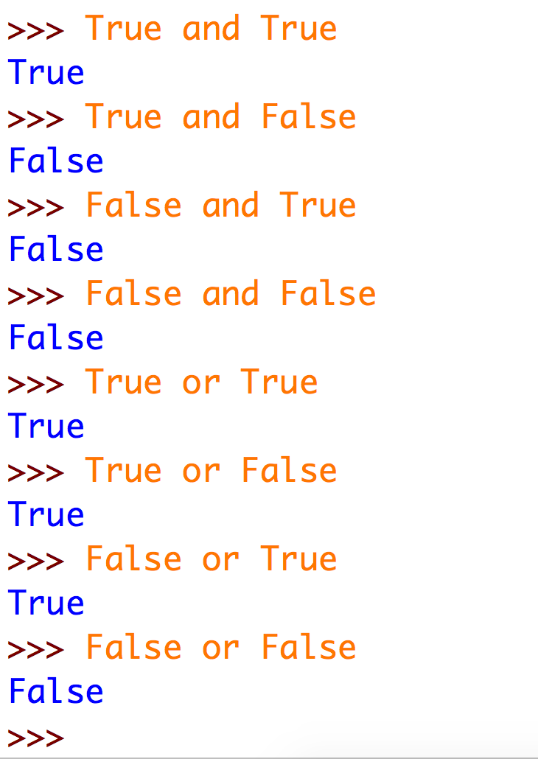
Operators
As soon as an and expression finds False: it’s False.
As soon as an or expression finds True: it’s True.

Slide 11
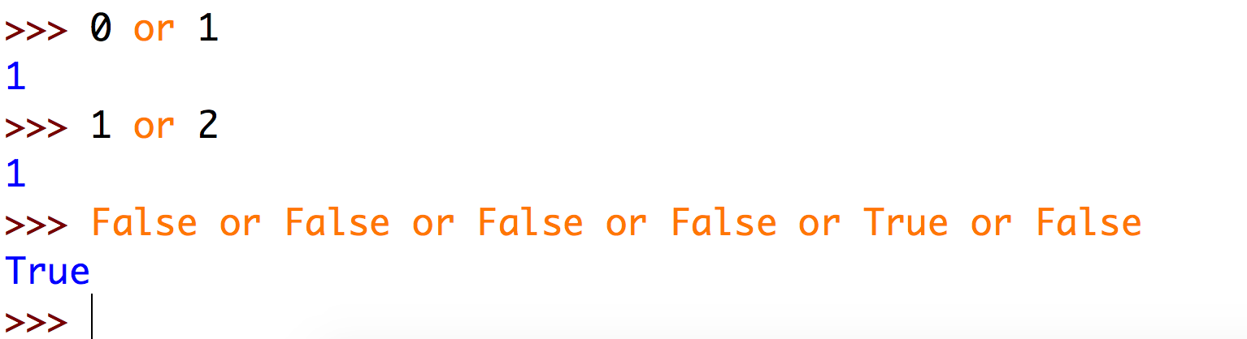
Boolean Operator Priority
or is a short-circuit operator, so it only evaluates the second argument if the first one is false.
bool(0) is False so Python will continue with bool(1)
bool(1) is True so Python will stop. No need to continue.
Python will stop here. No need to continue.

Slide 12
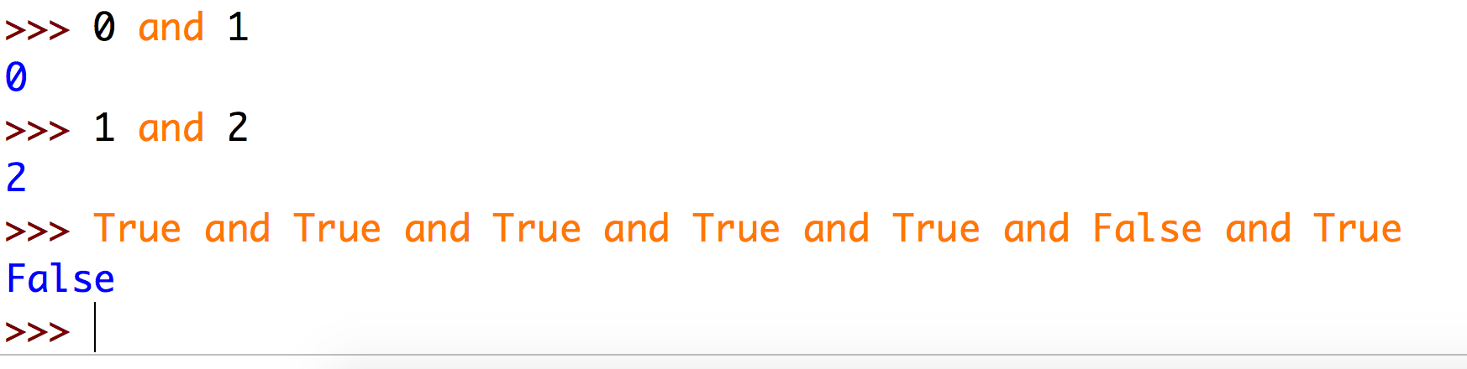
Boolean Operator Priority
and is also short-circuit operator, so it only evaluates the second argument if the first one is true.
bool(0) is False so Python will stop here.
bool(1) is True so Python will continue.
Python will stop here. No need to continue.

Slide 13
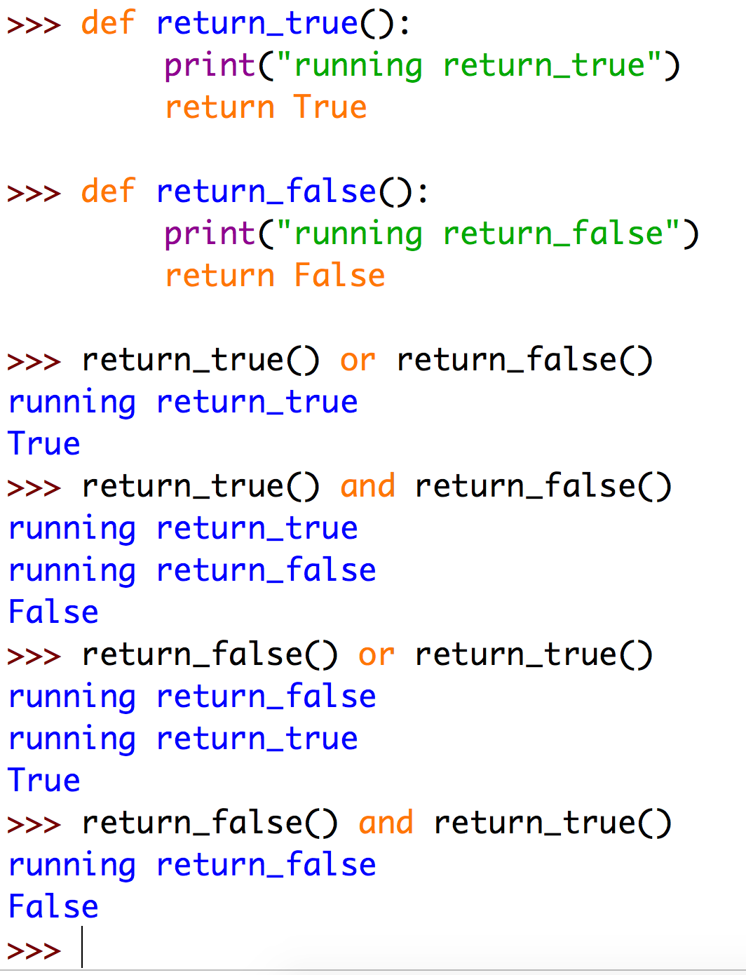
Short circuit operator
Two functions are defined: One returns True, the other False
return_false() does not run because the or statement has received True already
return_true() does not run because the and statement has received False already

Slide 14
Brain heater
1 and not (”Yes” == “Yes” or False) and not [] or 5 != 6
True or False?

Slide 15
Brain heater
1 and not (”Yes” == “Yes” or False) and not [] or 5 != 6
Not so hard as it seems.
First solve any equality checks:
1 and not (True or False) and not [] or True
Find each and/or in parenthesis ():
1 and not (True) and not [] or True
Find each not and invert it:
1 and False and True or True
Find any remaining and/or and solve them:
True and False and True or True
True

Slide 16
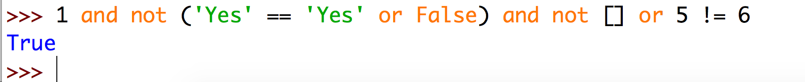
Brain heater

