Slide 1
Interplay between repressive chromatin marks
Lab meeting 17/07/2026
Bea

Slide 2
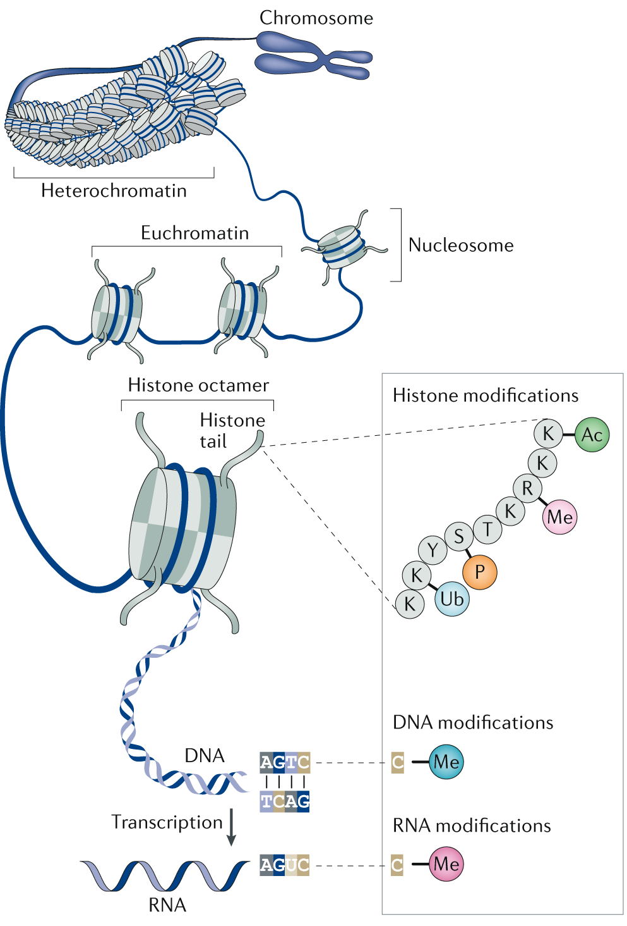
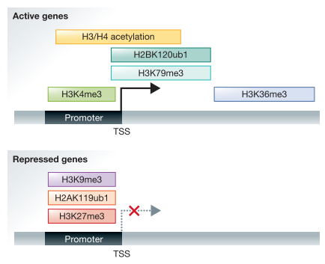


Epigenetic regulation of gene expression
147 bp DNA +
2x:
H3 (H3K27ac, open chromatin) (H3Ser10P, mitosis)
H4
H2A
H2B
Adapted from Hogg, S.J., Beavis, P.A., Dawson, M.A. et al. Targeting the epigenetic regulation of antitumour immunity. Nat Rev Drug Discov (2020)
Adapted from Zhang T, Cooper S, Brockdorff N, The interplay of histone modifications – writers that read, EMBO reports, (2015)

Slide 3
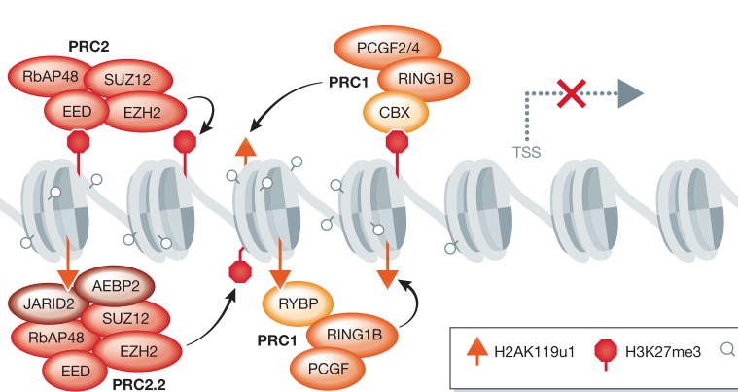
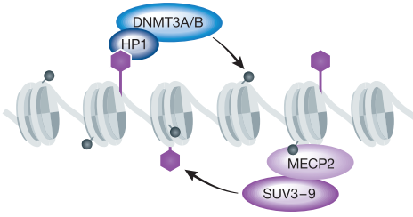
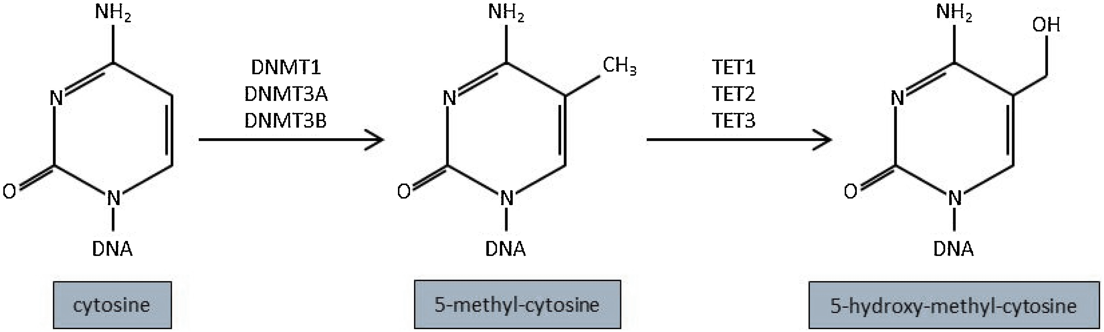



Repressive chromatin marks
DNA methylation
Polycomb group Proteins
PRC1 & PRC2
H3K9me2/3
CpG dinucleotides
Stable transcriptional silencing
Transposable elements, genome stability
Low 5mC in CGI of regulatory regions
Maintenance of transcriptional silencing
Promoters of developmentally regulated genes
Repressive Polycomb domains
Recruited to unmethylated CGI
Constitutive heterochromatin
Pericentric satellites
Tissue-specific genes
Crosstalk with 5mC & H3K27me3
PRC2
PRC1
DNA methylation
DNA demethylation
What is the functional redundancy, antagonism and cooperativity of repressive chromatin mechanisms?
Ehrlich M, DNA hypomethylation in Cancer, Epigenomics (2009)
Nishiyama A, Nakanishi M, Navigating the DNA methylation landscape in cancer, Trends in Genetics (2021)
Zhang T, Cooper S, Brockdorff N, The interplay of histone modifications – writers that read, EMBO reports, (2015),

Slide 4
Crosstalk between DNA methylation and H3K27me3
DNA methylation
Polycomb group Proteins
PRC1 & PRC2
H3K9me2/3
PRC2
PRC1
DNA methylation
DNA demethylation
RING1B
EZH2
Mutually exclusive at CGI promoters
The lack of 5mC in mESCs leads to H3K27me3 spread from CGI to surrounding regions
CGIs rich in PRC2 are more prone to acquire 5mC during differentiation and diease

Slide 5
H3K9 methyltransferases contribute to the establishment and maintenance of DNA methylation
DNA methylation
Polycomb group Proteins
PRC1 & PRC2
H3K9me2/3
PRC2
PRC1
DNA methylation
DNA demethylation
RING1B
EZH2
H3K9me2/3 may precede 5mC (Karimi, 2011)
G9a binds DNMT1 during DNA replication (Esteve, 2006)
H3K9me2/3 binds to UHRF1
Lack of SETDB1 activity leads to loss of the novo 5mC at LTRs and telomeres
In G9a KO mouse embryos, 5mC is not properly established at germline-specific genes

Slide 6
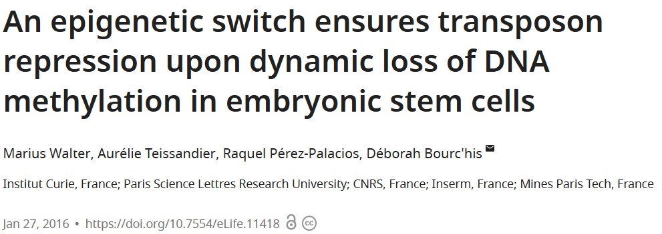
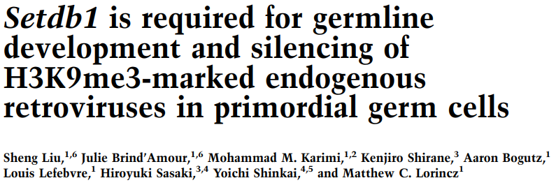
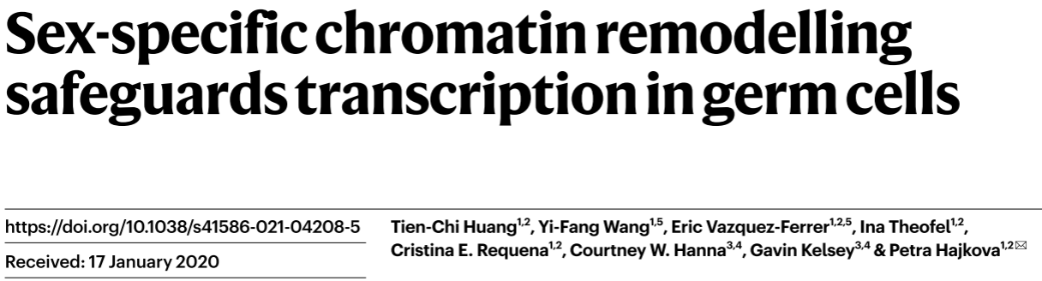
Functional compensation of repressive systems to safeguard transcriptional silencing
In mES cells that undergo DNA hypomethylation, TE remain silenced thanks to H3K9me3 stable retention and H3K27me3 redistribution to transposons, ensuring genome stability. H3K9me3 and H3K27me3 can co-occupy the same elements but in separate territories.
SETDB1 is essential to repress LTRs in E13.5 PGCs prior to the onset of DNA methylation in the germline
The erasure of DNA methylation in PGCs (E11.5-E12.5) leads to hypomehtylated TEs which remain silenced due to a compensation by H3K27me9 or H3K27me3 (E13.5) in different or same TE (LINE1).
The maintenance of silenced TEs in the absence of DNA methylation is supported by H3K27me3 and H3K9me3, indicating functional compensation

Slide 7
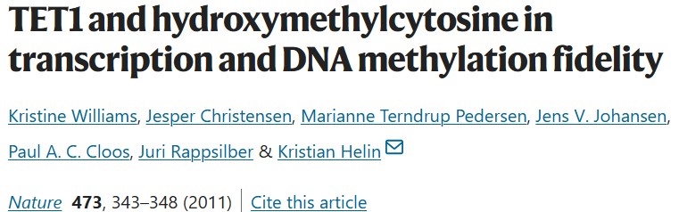
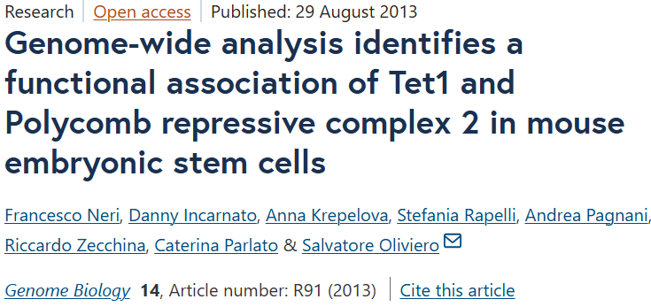
Functional co-operation between epigenetic players
TET1 binds at TSS of CpG-rich promoters of transcriptionally active genes
5hmC is enriched at CpG-rich promoters, including many non-expressed genes
TET1 KO mESCs show up and downregulated genes
TET1 binds Polycomb group target genes.
Upregulated genes in TET1 KO overlap with upregulated genes in EED KO.
Bivalent genes commonly bound by TET1 are found hydroxymethylated and co-occupied by PRC2 in mES cells, which is absent in differentiated cells.
Reduced 5hmC at bivalent promoters in Suz12 KO mESCs led to suggest that TET1 is recruited by PRC2
What is the role of TET enzymes and 5hmC in Polycomb-mediated repression?
What is the role of TET enzymes and 5hmC on repressive chromatin systems?

Slide 8
Role of TET enzymes and DNA hydroxymethylation in chromatin regulation
TET activity prevents DNA methylation maintenance
TET activity and 5hmC has been associated to active transcription, but also to colocalization with PRC2
Does the absence of TET activity leads to global DNA hypermethylation and disruption of transcriptional regulation?
The KO of TET enzymes in mESCs (TTKO) is well tolerated in vitro
TTKO exhibit a similar morphology to WT cells
TTKOs do not show major transcriptional changes compared to WT cells
DNA methylation
DNA demethylation
Could TTKO be differentiated into other cell types? Could they reshape the epigenome to adapt to differentiated cells?
Do TET proteins have major roles in regulating chromatin and gene expression?

Slide 9
?
What is the functional redundancy between repressive epigenetic systems?
Mutually exclusive marks are functionally redundant
What is the interplay of TET enzymes and 5hmC with other repressive epigenetic systems?
In the absence of TET enzymes, is DNA hypermethylation prevented by other epigenetic players?
What is the genome-wide distribution of hmC and what is the correlation with transcriptional activity?
Does the absence of 5hmC leads to remodelling of other repressive chromatin marks?
Is there an active co-operation between Polycomb and TET activities to coordinate transcriptional silencing?

Slide 10
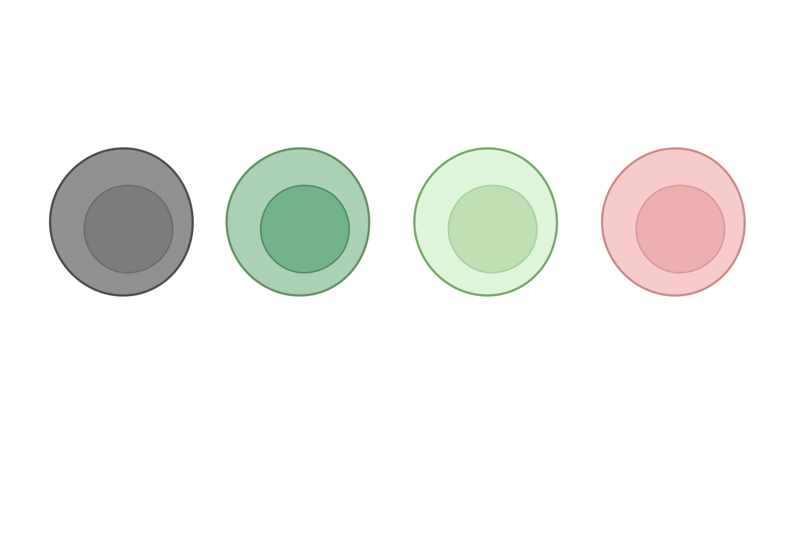
Mouse embryonic stem cell lines lacking different epigenetic players
WT
DNA Methyltrasnferase
Triple KO (DTKO)
Lack of 5mC and 5hmC
Cytosine
5mC
5hmC
TET Triple KO (TTKO)
Lack of 5hmC
Cytosine
5mC
5hmC
PRC2
PRC1
EZH2 KO (EKO)
Lack of H3K27me3
mESCs (J1) can tolerate the loss of the different epigenetic players (and were cultured under FBS-based conditions)

Slide 11
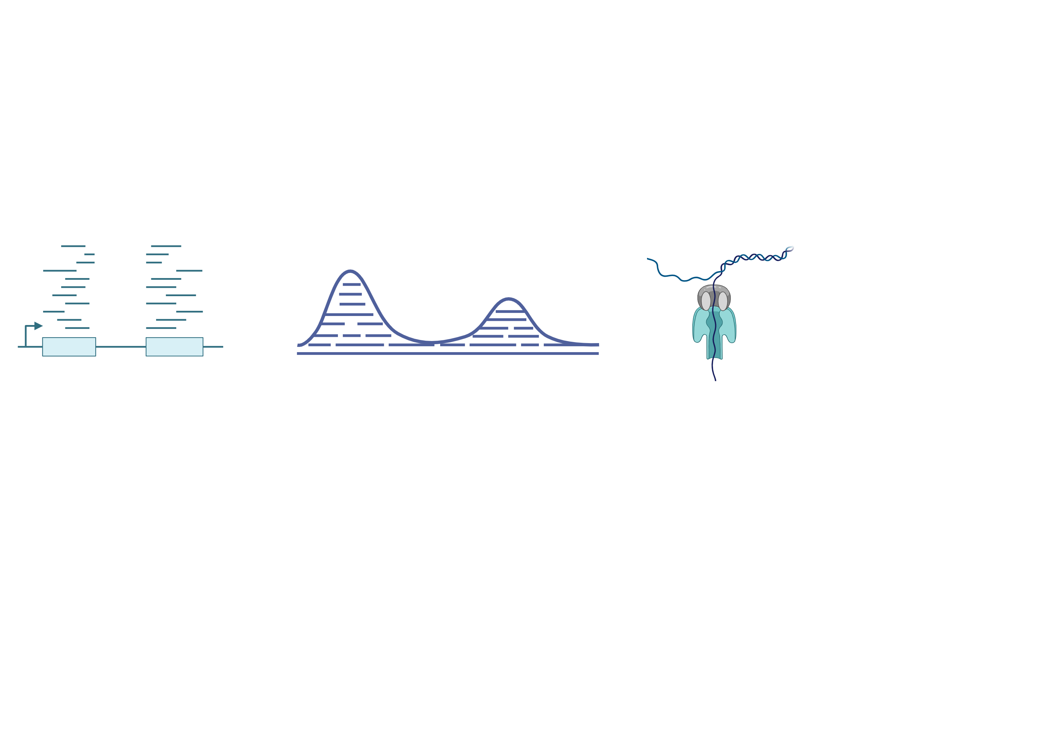
Experimental design (mESCs)
WT
DNA Methyltransferase
Triple KO (DTKO)
TET Triple KO (TTKO)
EZHO KO (EKO)
RNA-seq
Cut&Run
Oxford Nanopore
5mC
5hmC
Notes:
CUT & RUN → (x4 Reps) H3K27me3, H2AK119ub1, H3K9me3
RNA seq (x4 Reps)
ONT → (1 Rep ~28X) in WT, TTKO and EKO

Slide 12
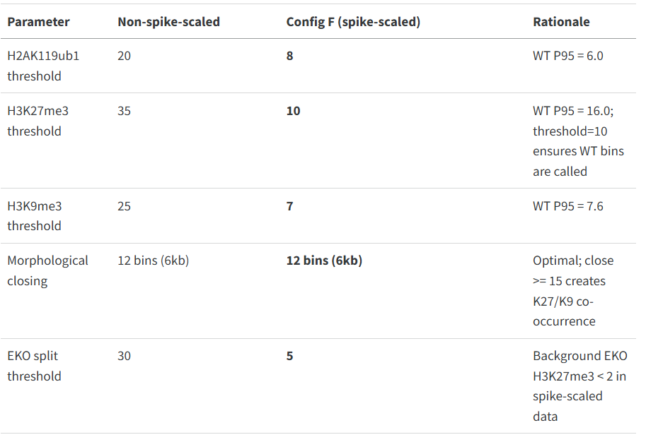
Spike-Scaling Impact on Thresholds
The CUT&RUN data was normalized using spike-in calibration, which produces signal values substantially lower than raw data
Binarization thresholds had to be recalibrated

Slide 13
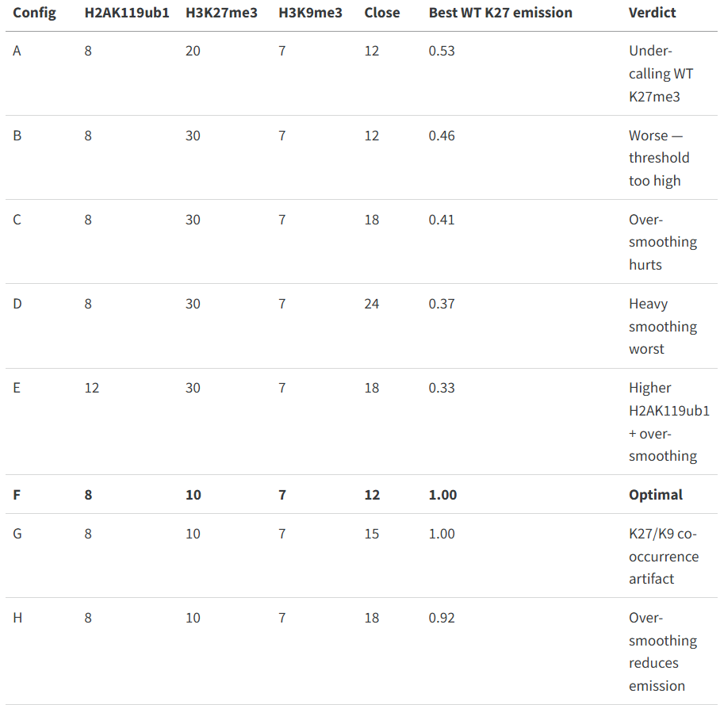
Parameter Sweep Results (chr2)
Boris
Eight configurations were tested on chr2.
The key metric was the maximum WT H3K27me3 emission probability across states — indicating whether ChromHMM learned a proper WT Polycomb state
Config F is the clear winner: H3K27me3=10 captures enough WT bins for ChromHMM to learn a proper WT Polycomb state with emission=1.0, and morphological closing radius=12 maintains clean H3K27me3/H3K9me3 separation.

Slide 14
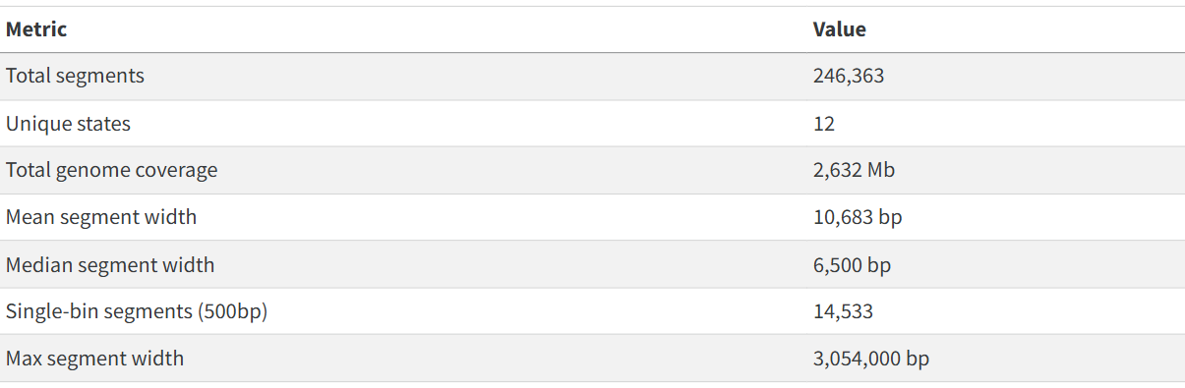
Segmentation Statistics
The CUT&RUN data was normalized using spike-in calibration, which produces signal values substantially lower than raw data
Binarization thresholds had to be recalibrated

Slide 15
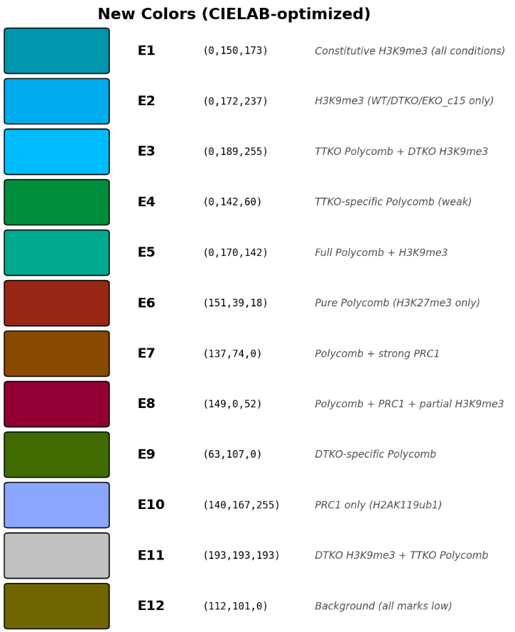
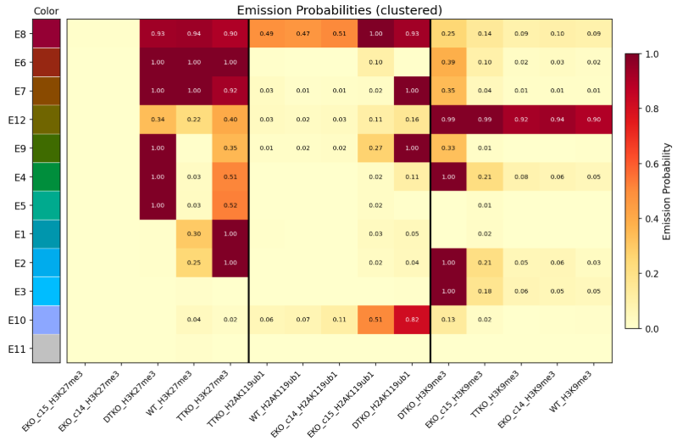
Worrying states…?
E9 – overlap of H3K9me3 with H3K27me in WT…
E4 – overlap of H3K9me3 with H3K27me3 in DTKO…
Emission Heatmap
H3K27me3 (TTKO strong, WT weak)
H3K27me3 (TTKO strong, WTweak) H3K9me3 (DTKO, strong)
H3K9me3 (DTKO strong)
H3K27me3 (DTKO strong, TTKO weak) H3K9me3 (DTKO, strong)
H3K27me3 (DTKO strong, TTKO weak)
H3K27me3 (constitutive)
H3K9me3 (DTKO, weak)
H3K27me3 (constitutive)
H2AK119ub1 (DTKO, strong)
H3K9me3 (DTKO, weak)
H3K27me3 (constitutive)
H2AK119ub1 (medium in WT, TTKO & EZKOc14) (strong in DTKO & EKOc15)
H3K27me3 (DTKO strong, TTKO weak)
H2AK119ub1 (DTKO strong)
H2AK119ub1 (DTKO, EKOc15 middle)
Background (all marks low)
H3K9me3 (constitutive)
H3K27me3 (weak)
Notes:
representation of the probability that a specific epigenetic mark (columns) is present in a specific chromatin state (rows).

Slide 16
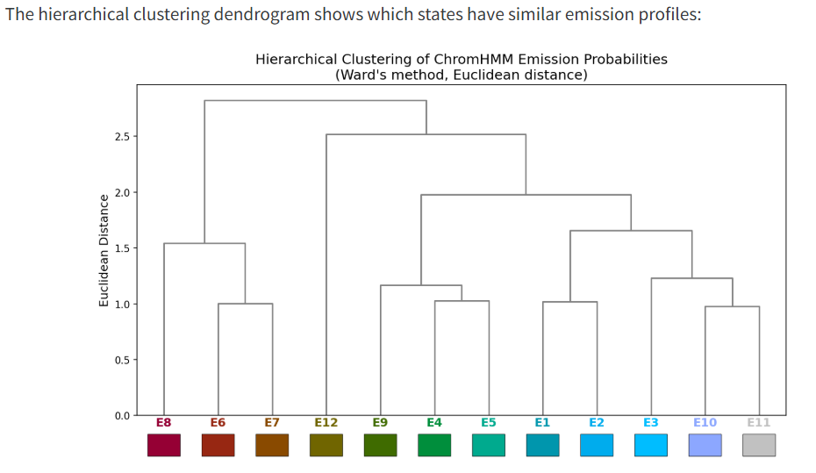
H3K27me3 (TTKO strong, WT weak)
H3K27me3 (TTKO strong, WTweak) H3K9me3 (DTKO, strong)
H3K9me3 (DTKO strong)
H3K27me3 (DTKO strong, TTKO weak) H3K9me3 (DTKO, strong)
H3K27me3 (DTKO strong, TTKO weak)
H3K27me3 (constitutive)
H3K9me3 (DTKO, weak)
H3K27me3 (constitutive)
H2AK119ub1 (DTKO, strong)
H3K9me3 (DTKO, weak)
H3K27me3 (constitutive)
H2AK119ub1 (medium in WT, TTKO & EZKOc14) (strong in DTKO & EKOc15)
H3K27me3 (DTKO strong, TTKO weak)
H2AK119ub1 (DTKO strong)
H2AK119ub1 (DTKO, EKOc15 middle)
H3K27me3
(constitutive)
H2AK119ub1
(medium in WT, TTKO & EZKOc14) (strong in DTKO & EKOc15)
H3K27me3
(constitutive)
H3K9me3
(DTKO, weak)
H3K27me3
(constitutive)
H3K9me3
(DTKO, weak)
H2AK119ub1
(DTKO, strong)
H3K9me3
(constitutive)
H3K27me3
(weak)
H3K27me3
(DTKO, strong
TTKO, weak)
H2AK119ub1
(DTKO, strong)
H3K27me3
(DTKO, strong
TTKO, weak)
H3K9me3
(DTKO, strong)
H3K27me3
(DTKO, strong
TTKO, weak)
H3K27me3
(TTKO, strong
WT, weak)
H3K27me3
(TTKO, strong
WT, weak)
H3K9me3
(DTKO, strong)
H3K9me3
(DTKO, strong)
H2AK119ub1
(DTKO, EKOc15
middle)
Background (all marks low)
Background
(all marks low)
H3K9me3 (constitutive)
H3K27me3 (weak)

Slide 17
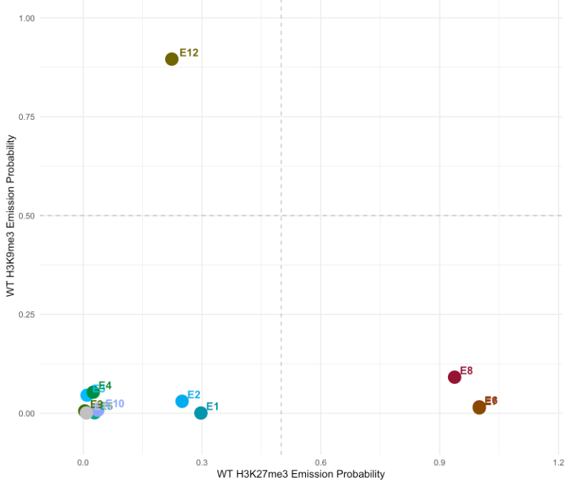
H3K27me3 and H3K9me3 emission probabilities in WT cells
H3K9me3 constitutive
H3K27me3 (TTKO strong, WT weak)
H3K27me3 (TTKO strong, WTweak) H3K9me3 (DTKO, strong)
H3K9me3 (DTKO strong)
H3K27me3 (DTKO strong, TTKO weak) H3K9me3 (DTKO, strong)
H3K27me3 (DTKO strong, TTKO weak)
H3K27me3 (constitutive)
H3K9me3 (DTKO, weak)
H3K27me3 (+H3K9me3/
H2AK119ub1) in DTKO strong, TTKO weak
H3K27me3 (constitutive)
H2AK119ub1 (DTKO, strong)
H3K9me3 (DTKO, weak)
H3K27me3
(& H2AK119ub1)
constitutive
H3K27me3 (constitutive)
H2AK119ub1 (medium in WT, TTKO & EZKOc14) (strong in DTKO & EKOc15)
H3K27me3 in TTKO
H3K27me3 (DTKO strong, TTKO weak)
H2AK119ub1 (DTKO strong)
H2AK119ub1 (DTKO, EKOc15 middle)
Background (all marks low)
With the optimized thresholds, these marks show the expected mutual exclusivity in WT cells
H3K9me3 (constitutive)
H3K27me3 (weak)

Slide 18
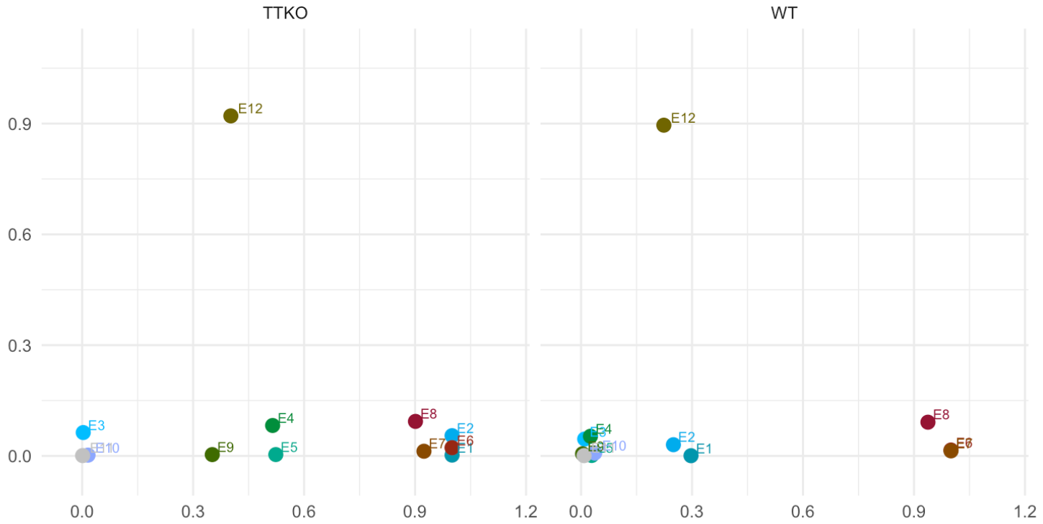
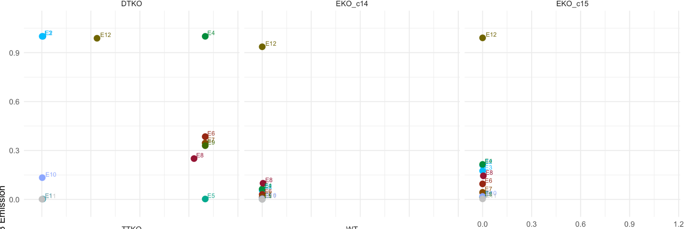
H3K27me3 and H3K9me3 emission probabilities in WT vs DTKO
WT
K27me3 in TTKO, K9me3 DTKO
H3K27me3 +H3K9me3 in DTKO strong
H3K9me3 constitutive
H3K27me3 (TTKO strong, WT weak)
H3K9me3 constitutive
H3K27me3 (TTKO strong, WTweak) H3K9me3 (DTKO, strong)
H3K9me3 (DTKO strong)
H3K27me3 (DTKO strong, TTKO weak) H3K9me3 (DTKO, strong)
H3K27me3
(& H2AK119ub1)
Constitutive
H3K27me3 + H2AK119ub1 DTKO strong
H3K27me3 (DTKO strong, TTKO weak)
H3K27me3 (constitutive)
H3K9me3 (DTKO, weak)
H3K27me3 (+H3K9me3/
H2AK119ub1) in DTKO strong, TTKO weak
H3K27me3 (constitutive)
H2AK119ub1 (DTKO, strong)
H3K9me3 (DTKO, weak)
H3K27me3
(& H2AK119ub1)
constitutive
H2AK119ub1 in DTKO
H3K27me3 (constitutive)
H2AK119ub1 (medium in WT, TTKO & EZKOc14) (strong in DTKO & EKOc15)
H3K27me3 in TTKO
H3K27me3 (DTKO strong, TTKO weak)
H2AK119ub1 (DTKO strong)
H3K27me3
DTKO strong
H2AK119ub1 (DTKO, EKOc15 middle)
Background (all marks low)
In the absence of 5mC, there is a shift of the chromatin states towards increased H3K9me3 and H3K27me3
H3K9me3 (constitutive)
H3K27me3 (weak)

Slide 19
H3K27me3 and H3K9me3 emission probabilities in WT vs EKO
H3K27me3 (TTKO strong, WT weak)
H3K9me3 constitutive
H3K9me3 constitutive
H3K27me3 (TTKO strong, WTweak) H3K9me3 (DTKO, strong)
H3K9me3 (DTKO strong)
H3K27me3 (DTKO strong, TTKO weak) H3K9me3 (DTKO, strong)
H3K27me3 (DTKO strong, TTKO weak)
H3K27me3 (constitutive)
H3K9me3 (DTKO, weak)
H3K27me3 (+H3K9me3/
H2AK119ub1) in DTKO strong, TTKO weak
H3K27me3 (constitutive)
H2AK119ub1 (DTKO, strong)
H3K9me3 (DTKO, weak)
H3K27me3
(& H2AK119ub1)
constitutive
H3K27me3 (constitutive)
H2AK119ub1 (medium in WT, TTKO & EZKOc14) (strong in DTKO & EKOc15)
H3K27me3 in TTKO
H3K27me3 (DTKO strong, TTKO weak)
H2AK119ub1 (DTKO strong)
H2AK119ub1 (DTKO, EKOc15 middle)
Background (all marks low)
In the absence of H3K27me3, canonical PRC2 regions behave like non-PRC2 targets
H3K9me3 (constitutive)
H3K27me3 (weak)

Slide 20
H3K27me3 and H3K9me3 emission probabilities in WT vs TTKO
H3K27me3 (TTKO strong, WT weak)
H3K9me3 constitutive
H3K9me3 constitutive
H3K27me3 (TTKO strong, WTweak) H3K9me3 (DTKO, strong)
H3K9me3 (DTKO strong)
H3K27me3 (DTKO strong, TTKO weak) H3K9me3 (DTKO, strong)
H3K27me3 (DTKO strong, TTKO weak)
H3K27me3 (constitutive)
H3K9me3 (DTKO, weak)
H3K27me3 (+H3K9me3/
H2AK119ub1) in DTKO strong, TTKO weak
H3K27me3
(& H2AK119ub1)
constitutive
H3K27me3 (constitutive)
H2AK119ub1 (DTKO, strong)
H3K9me3 (DTKO, weak)
H3K27me3
(& H2AK119ub1)
constitutive
H3K27me3 +H3K9me3 in DTKO strong
H3K27me3 (constitutive)
H2AK119ub1 (medium in WT, TTKO & EZKOc14) (strong in DTKO & EKOc15)
H3K9me3 in TTKO
H2AK119ub1 in DTKO
H3K27me3 in TTKO
H3K27me3 in TTKO
H3K27me3 (DTKO strong, TTKO weak)
H2AK119ub1 (DTKO strong)
H2AK119ub1 (DTKO, EKOc15 middle)
Background (all marks low)
In the absence of 5hmC, there are regions that gain H3K27me3, and other regions gain H3K27me3 in DTKO-specific areas
H3K9me3 (constitutive)
H3K27me3 (weak)

Slide 21
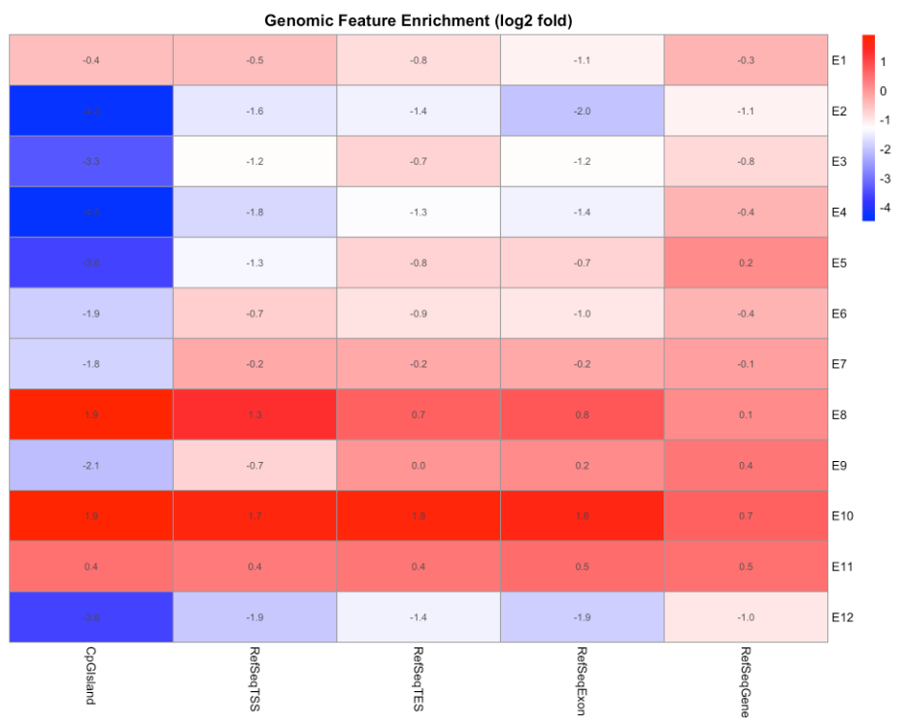
Genomic overlap enrichment
H3K27me3 (TTKO strong, WT weak)
H3K27me3 (TTKO strong, WT weak) H3K9me3 (DTKO, strong)
H3K9me3 (DTKO strong)
H3K27me3 (DTKO strong, TTKO weak) H3K9me3 (DTKO, strong)
H3K27me3 (DTKO strong, TTKO weak)
H3K27me3 (constitutive)
H3K9me3 (DTKO, weak)
H3K27me3 (constitutive)
H2AK119ub1 (DTKO, strong)
H3K9me3 (DTKO, weak)
H3K27me3 (constitutive)
H2AK119ub1 (medium in WT, TTKO & EZKOc14) (strong in DTKO & EKOc15)
H3K27me3 (DTKO strong, TTKO weak)
H2AK119ub1 (DTKO strong)
H2AK119ub1 (DTKO, EKOc15 middle)
(E1) H3K27me3 gain in TTKO is slightly depleted in genes
(E2-E5) H3K27me3/H3K9me3-enriched regions in DTKO are depleted in CpG islads (and genes)
(E6, E7) In the absence of H2AK119ub1, constitutive H3K27me3 regions are depleted in CpG islands
(E8) Constitutive H3K27me3 is enriched in CpG islands (and gene regions) only under the presence of H2AK119ub1
(E9) New H3K27me3/H3K9me3-rich regions in DTKOs are depleted in CpG islands
(E10) New H2AK119ub1-rich regions in DTKOs are enriched in CpG islands, behaving like PRC1-PRC2 canonical sites
Background (all marks low)
H3K9me3 (constitutive)
H3K27me3 (weak)

Slide 22
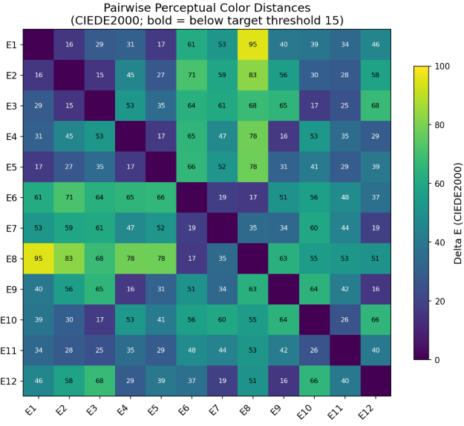
Distance matrix between states
H3K27me3 (TTKO strong, WT weak)
H3K27me3 (TTKO strong, WT weak) H3K9me3 (DTKO, strong)
H3K9me3 (DTKO strong)
H3K27me3 (DTKO strong, TTKO weak) H3K9me3 (DTKO, strong)
E8 (& E6 & E7) which represents constitutive PRC1/2 regions have a high dissimilarity from E1, which represents regions rich in H3K27me3 in TTKO.
E8 (& E6 & E7) also shows dissimilarity from E2, E3, E4, E5, which represents mainly H3K27me3 and H3K9me3- rich regions in DTKO (&TTKO)
H3K27me3 (DTKO strong, TTKO weak)
H3K27me3 (constitutive)
H3K9me3 (DTKO, weak)
H3K27me3 (constitutive)
H2AK119ub1 (DTKO, strong)
H3K9me3 (DTKO, weak)
H3K27me3 (constitutive)
H2AK119ub1 (medium in WT, TTKO & EZKOc14) (strong in DTKO & EKOc15)
H3K27me3 (DTKO strong, TTKO weak)
H2AK119ub1 (DTKO strong)
H2AK119ub1 (DTKO, EKOc15 middle)
Background (all marks low)
H3K9me3 (constitutive)
H3K27me3 (weak)

Slide 23
Expected states
A. Canonical Polycomb Domains (developmentally regulated genes)
H3K27me3 and H2AK119ub1 have high emission probabilities, while H3K9me3 is 0.
B. Non-canonical PRC1
H2AK119ub1 is high, but H3K27me3 is low
Missing!
C. Only PRC2 for absolute boundaries of Polycomb domains
H3K27me3 is high but H2AK119ub1 is low
D. Constitutive Heterochromatin: repetitive elements
H3K9me3 is highly saturated while H3K27me3 and H2AK119ub1 are 0.
Not really… Some Polycomb signal
C. Background: no marks
Refine the thersholds for binarization

Slide 24
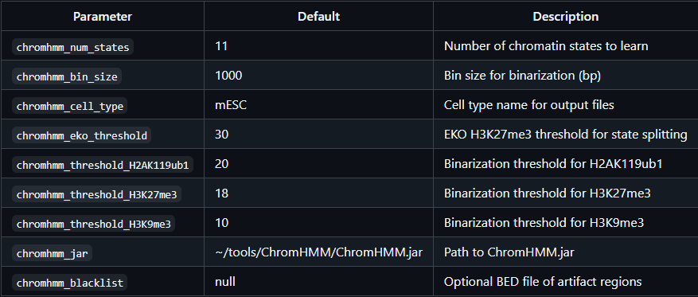
New chromhmm model
Model redefined in order to integrate the EKO split threshold in the initial ChromHMM analysis and improve state identification
Original parameters
500
5
8
10
7

Slide 25
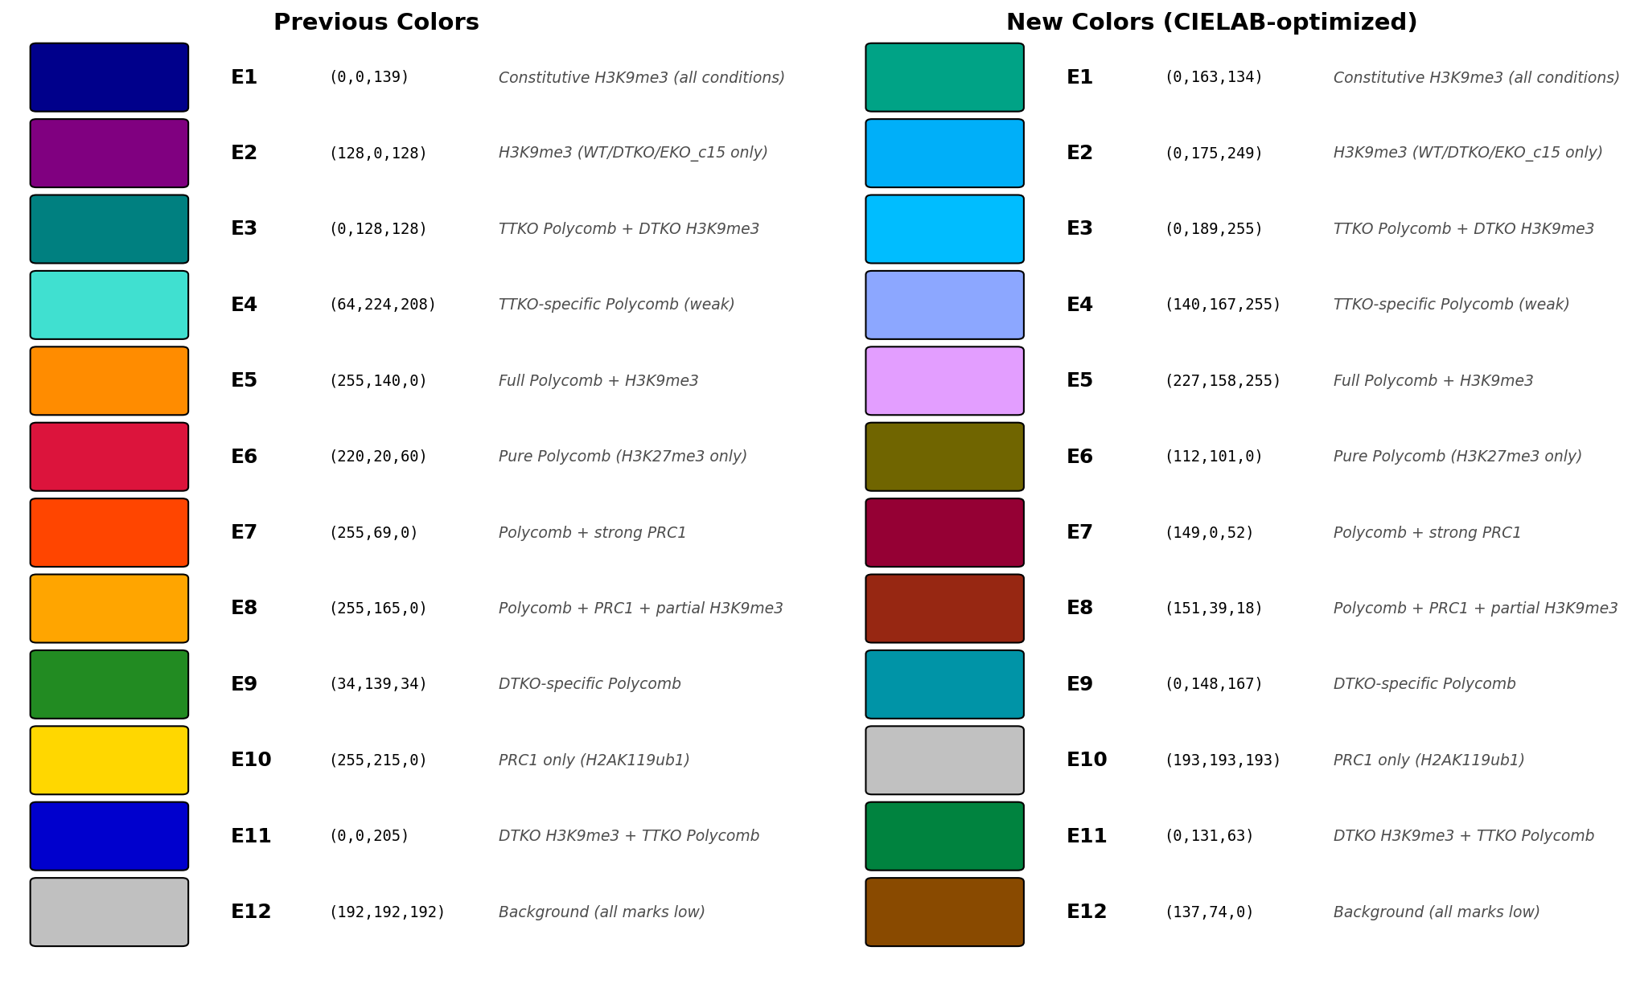
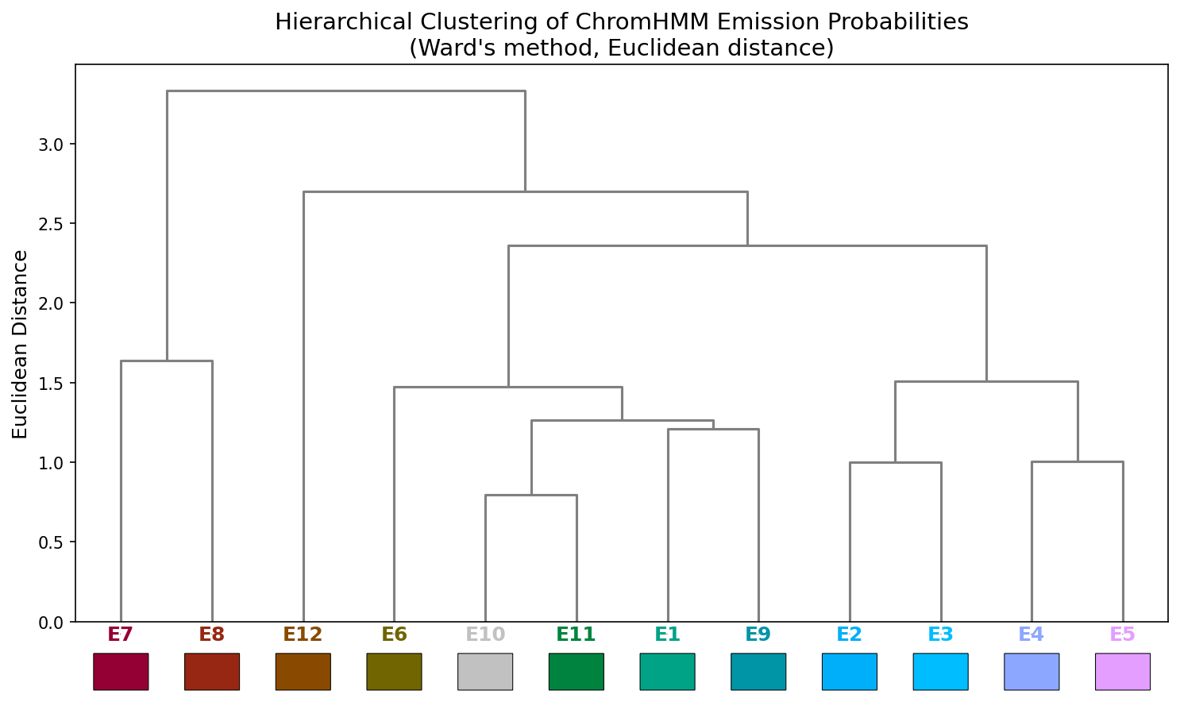
H2AK119ub1 in DTKO (& EKO c15)
H3K27me3 in DTKO (& TTKO, & WT)
H2AK119ub1 in DTKO & EKO c15
H3K27me3 in DTKO (& TTKO, & WT) H2AK119ub1 in DTKO & EKO c15
Polycomb in DTKO
H3K27me3 in DTKO (& TTKO)
H2AK119ub1 in DTKO
H3K27me3 in DTKO (& TTKO)
H3K27me3 in TTKO (& WT)
H3K27me3 & H2AK119ub1 canonical
H2AK119ub1 &
H3K27me3
H2AK119ub1 non-canonical
H2AK119ub1 in EKO c15
Background
H3K9me3 in DTKO
H3K9me3
H3K9me3 canonical

Slide 26
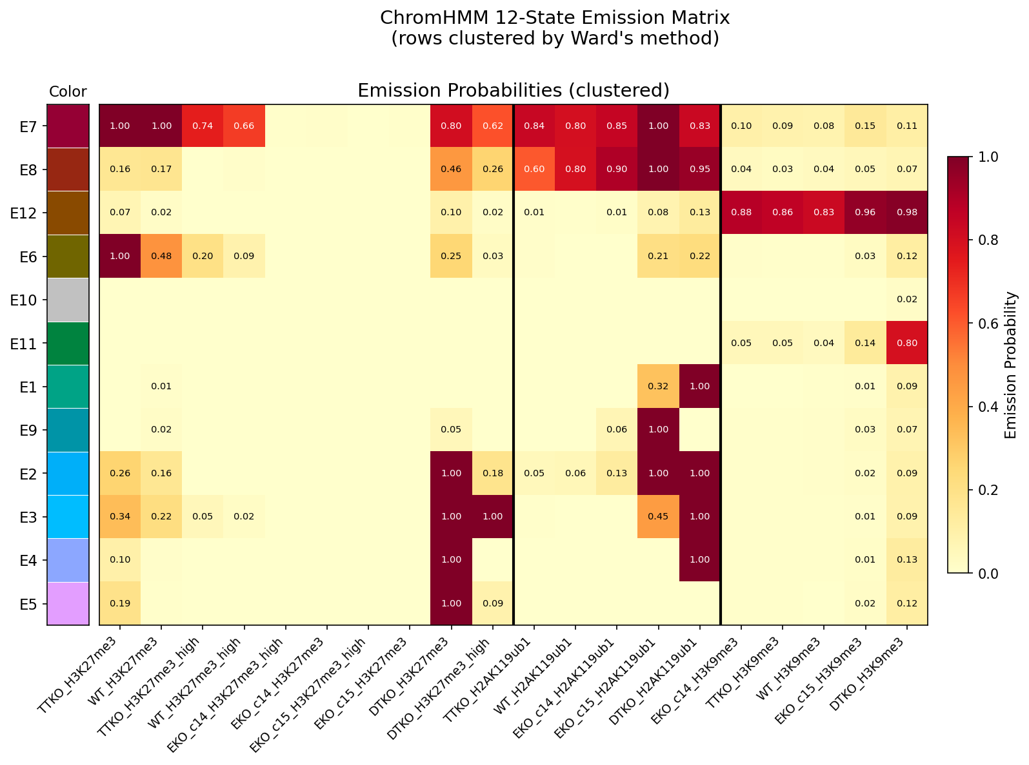
H2AK119ub1 in DTKO (& EKO c15)
H3K27me3 in DTKO (& TTKO, & WT)
H2AK119ub1 in DTKO & EKO c15
H3K27me3 in DTKO (& TTKO, & WT) H2AK119ub1 in DTKO & EKO c15
Polycomb in DTKO
H3K27me3 in DTKO (& TTKO)
H2AK119ub1 in DTKO
H3K27me3 in DTKO (& TTKO)
H3K27me3 in TTKO (& WT)
H3K27me3 & H2AK119ub1 canonical
H2AK119ub1 &
H3K27me3
H2AK119ub1 non-canonical
H2AK119ub1 in EKO c15
Background
H3K9me3 in DTKO
H3K9me3
H3K9me3 canonical
Notes:
E1, E2, E3 - EKO c15 behaves similarly to DTKO
E9 (E1, E2, E3) – EKO c15 is very different from c14, and more similar to DTKO
E1, E2, E3, E4, E5 – states belong almost exclusively to regions of Polycomb increase in DTKO
E6 - H3K27me3 acts as 5hmC in its absence to prevent 5mC widespread
E7 – Caonical Polycomb (H3K27me3 and H2ak119ub1)
E8 – non-canonical PRC1
E12 – Canonical H3K9me3

Slide 27
Conclusions from new model
E1, E2, E3 - EKO c15 behaves similarly to DTKO
E9 (E1, E2, E3) – EKO c15 is very different from c14, and more similar to DTKO
E1, E2, E3, E4, E5 – states belong almost exclusively to regions of Polycomb increase in DTKO
E6 - H3K27me3 acts as 5hmC in its absence to prevent 5mC widespread
E7 – Caonical Polycomb (H3K27me3 and H2ak119ub1)
E8 – non-canonical PRC1
E12 – Canonical H3K9me3

Slide 28
Differences between two models
States maintained:
E8 – Canonical Polycomb (E7)
E12 – Canonical H3K9me3 (E12), cleaner now, no H3K27me3
E1 – H3K27me3 in TTKO & WT, but diff clustering (E6)
E3 – H3K9me3 in DTKO (E11)
E9 – H3K27me3/H2AK119ub1 in DTKO (E2, E3, E4)
E5 – H3K27me3 in DTKO (& TTKO) (E5)
E10 – H2AK119ub1 in DTKO and c15 (E1)
States changed:
Lost - only PRC2 state (E6, E7)
Lost - (E2) H3K27me3 in TTKO together with H3K9me3 in DTKO
Gained – (E8) non-canonical H2AK119ub1
Gained –(E9) H2AK119ub1 in EKO c15
We have lost worrying states…
E4 – overlap of H3K9me3 with H3K27me3 in DTKO…
E9 – overlap of H3K9me3 with H3K27me in WT…

Slide 29
However…
It is highly discouraged to apply a hard fold-enrichment cutoff, which we are currently doing
The fold enrichment parameter defaults to 0 and should be kept that way
A hard threshold will filter out all the genomic bins that pass the statistical Poisson significance but do not reach the set threshold, potentially stripping away certain bins
Standard protocol relies on ChomHMM’s Poisson model to naturally evaluate the marks based on their calibrated sequencing depth
Iterations through the data allow the model to learn the states comparing the bins within each mark throughout the genome
Currently re-evaluating the model….

Slide 30
Summary – overall trends
Most of the chromatin changes occur in the DTKO with strong H3K27me3 and H3K9me3 remodeling
DTKO-specific H3K27me3 + H3K9me3 enrichment (E1,2)
DTKO-specific H3K9me3 enrichment (only) (E3)
H2AK119ub1 follows H3K27me3 increase in DTKO in just some states (E7, E8, E9) but also shows a gain in the absence of increased H3K27me3 (E10).
EZKO KO does not lead to major remodeling of H3K9me3 and H2AK119ub1 marks:
EZHO KO clones shows some differences regarding H2AK119ub1 redistribution in c15, which behaves similar to DTKO in E8 & E10
H2AK119ub1 remodeling in the absence of H3K27me3 is unclear: c14 does not change (surprisingly), but c15 shows a gain in H2AK119ub1 in E8
TTKO cells only show some remodeling of H3K27me3 and H3K9me3:
E4, E5 (& E9) shows some TTKO-specific H3K27me3 (absent in WT), together with strong H3K27me3 in DTKO
Weak H3K9me3-positive regions in WT cells show a strong increase of H3K27me3 in TTKO cells only (E1) and in TTKO & DTKO cells (E2).

Slide 31
Chromatin states’ correlation to DNA methylation and transcriptional expression
WT
DNA Methyltransferase
Triple KO (DTKO)
TET Triple KO (TTKO)
EZHO KO (EKO)
RNA-seq
Cut&Run
Oxford Nanopore
5mC
5hmC

Slide 32
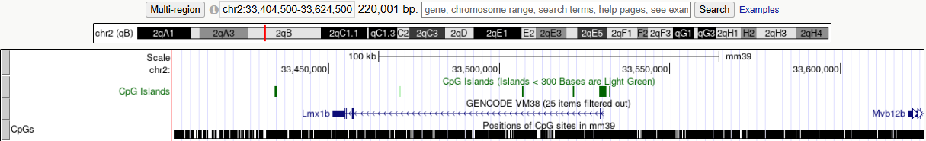
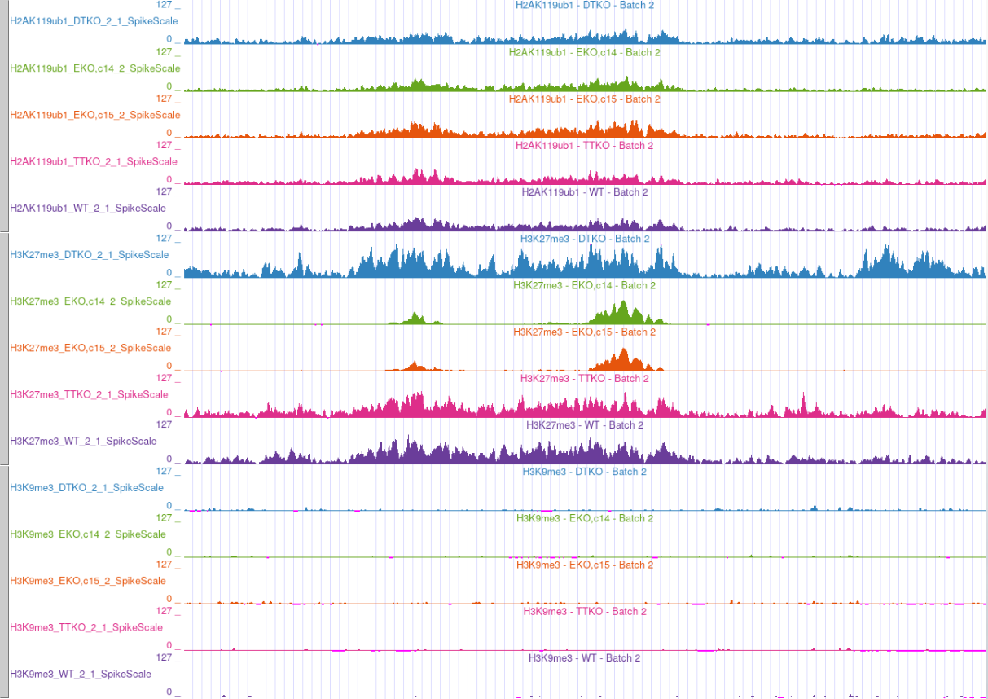
H2AK119ub1
H3K27me3
H3K9me3

Slide 33
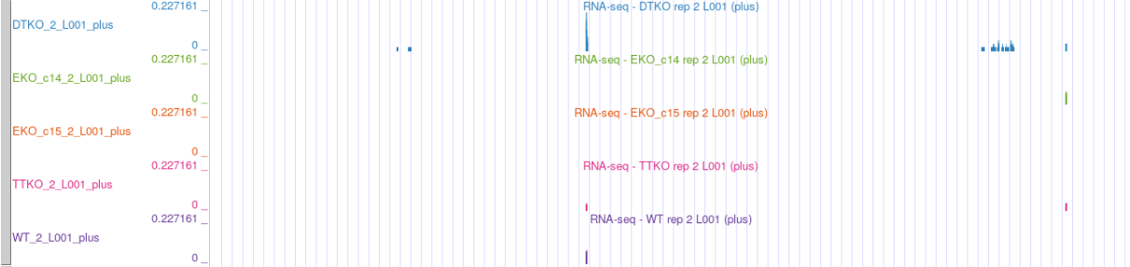
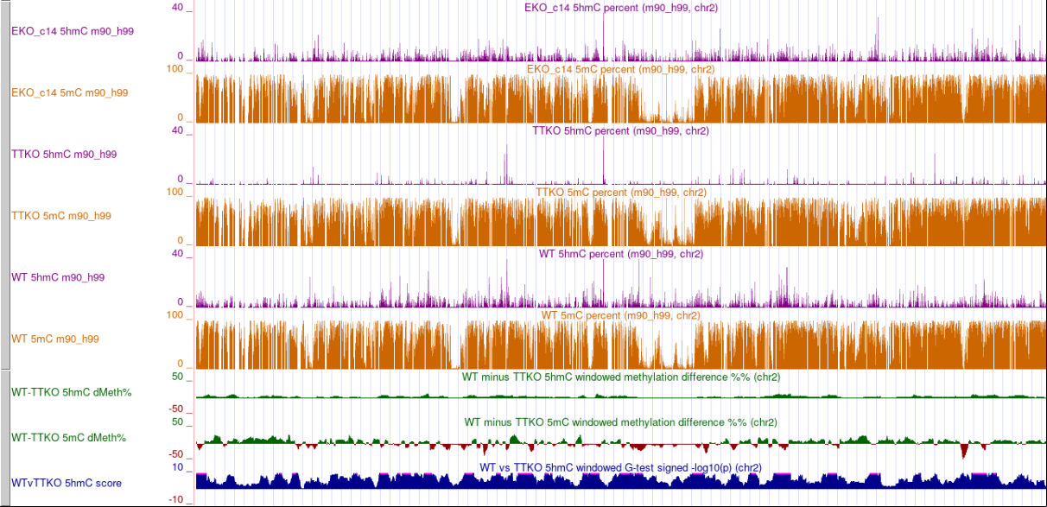

Slide 34
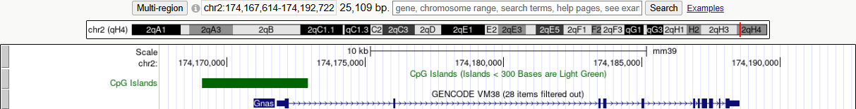
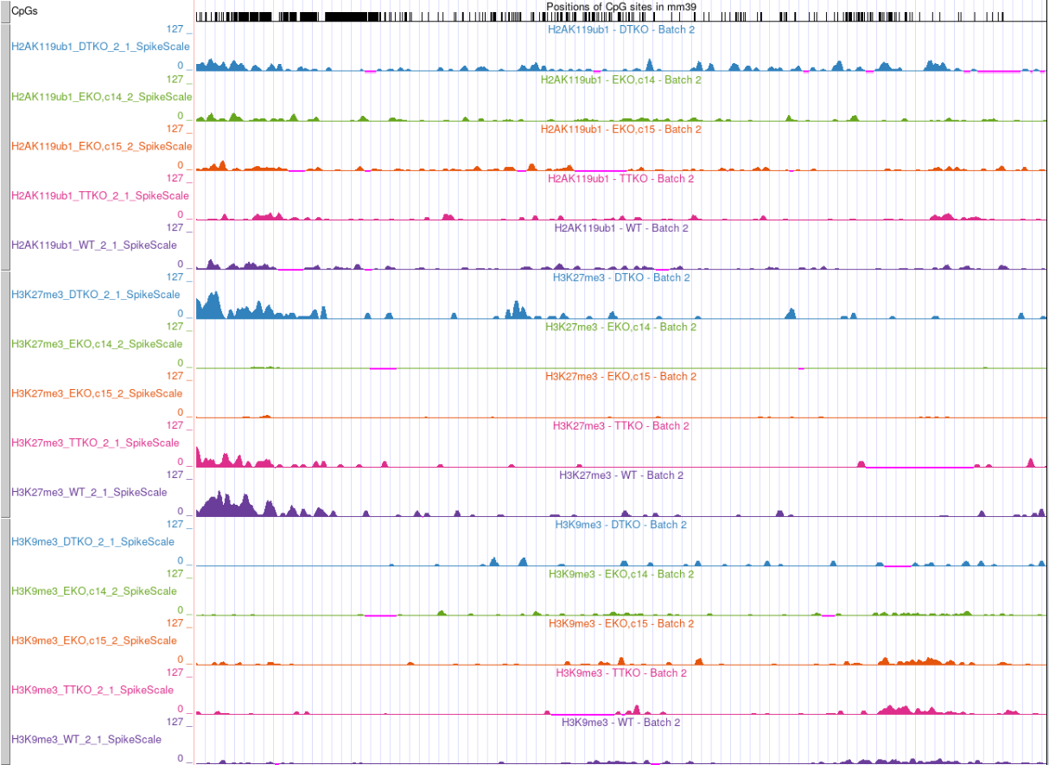
H2AK119ub1
H3K27me3
H3K9me3

Slide 35
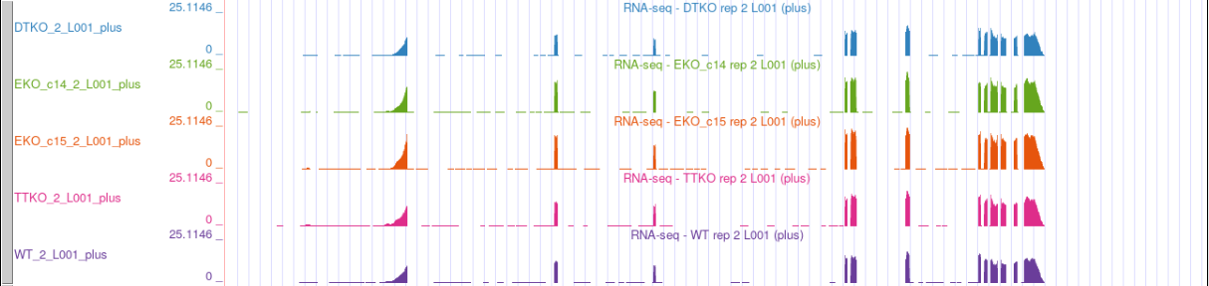
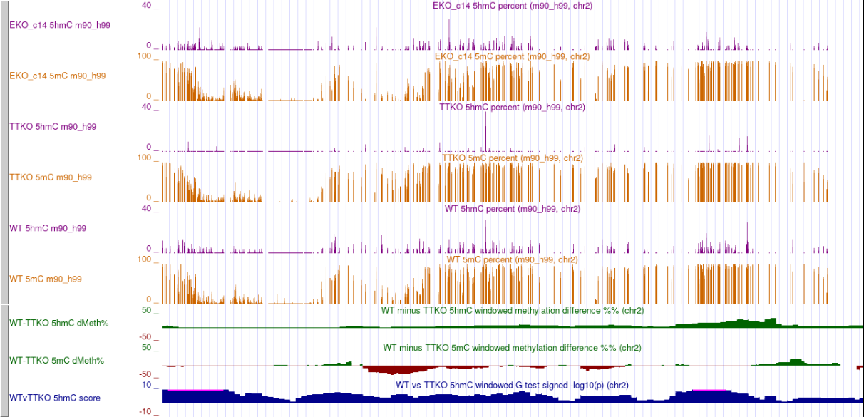

Slide 36
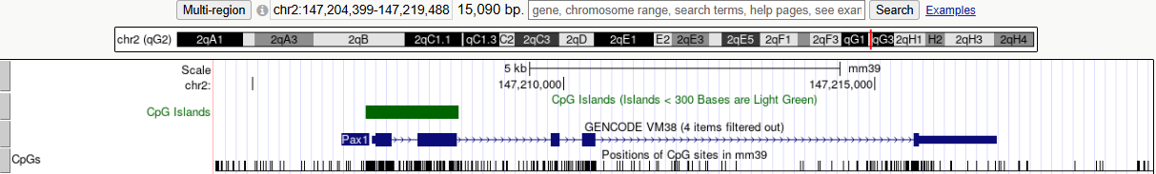
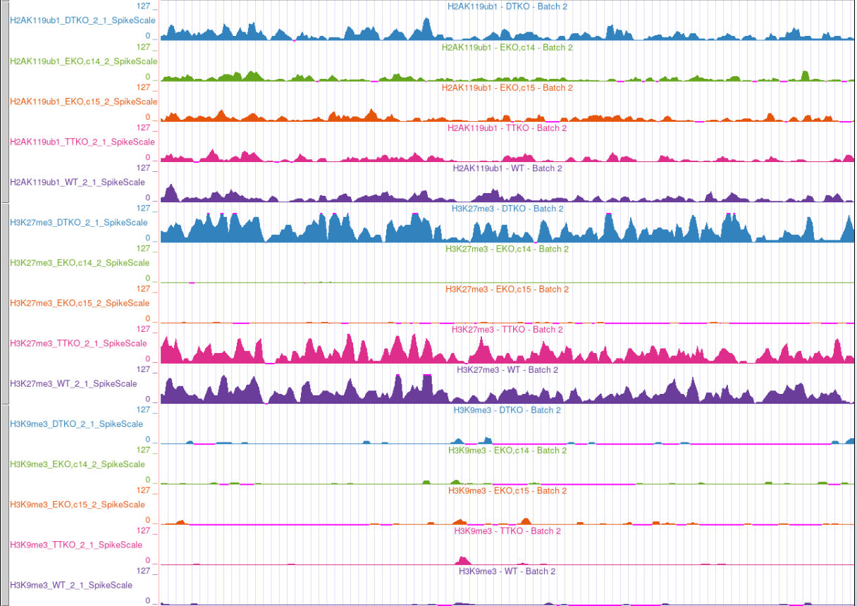
H2AK119ub1
H3K27me3
H3K9me3

Slide 37
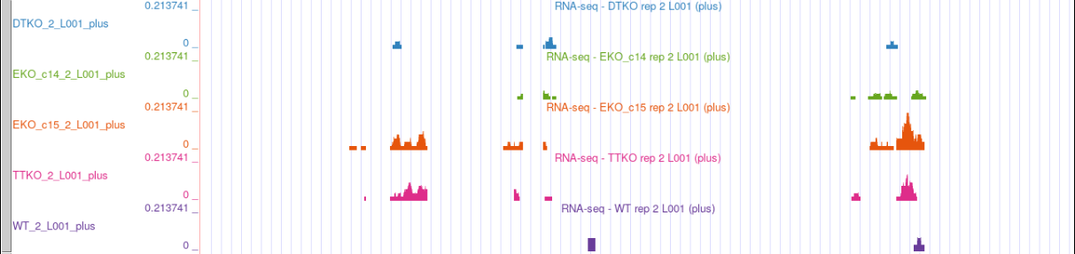
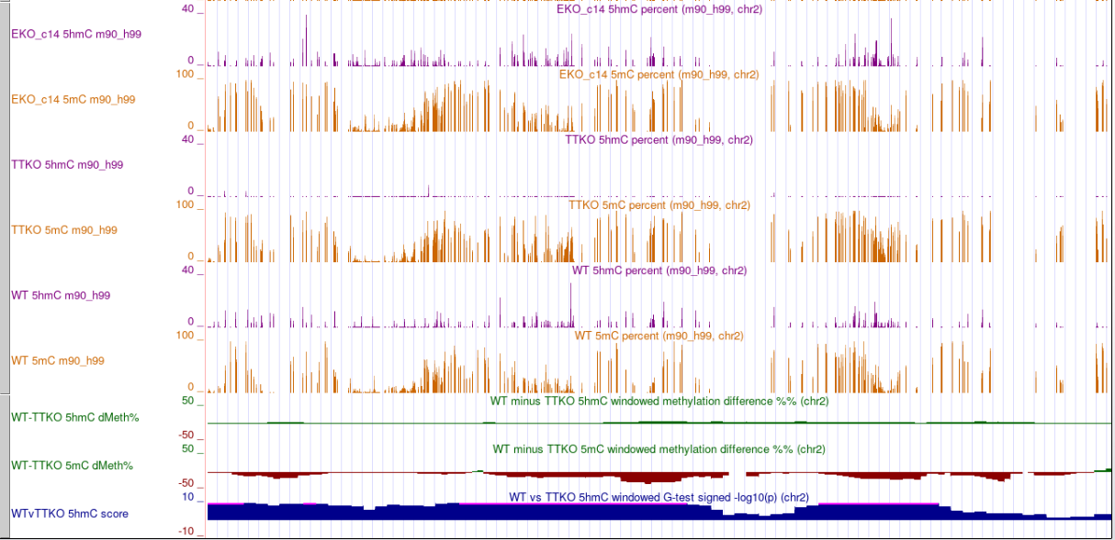

Slide 38
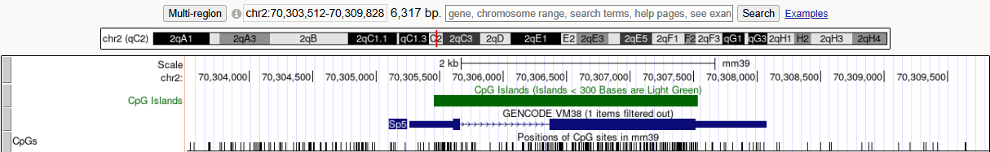
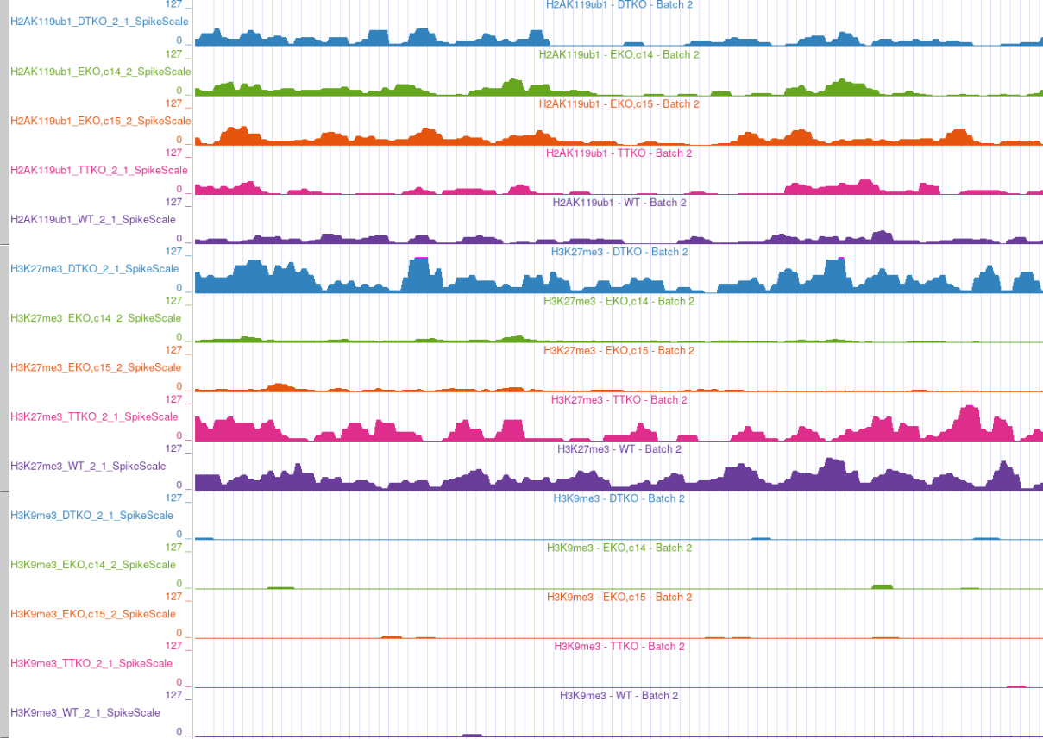
H2AK119ub1
H3K27me3
H3K9me3

Slide 39
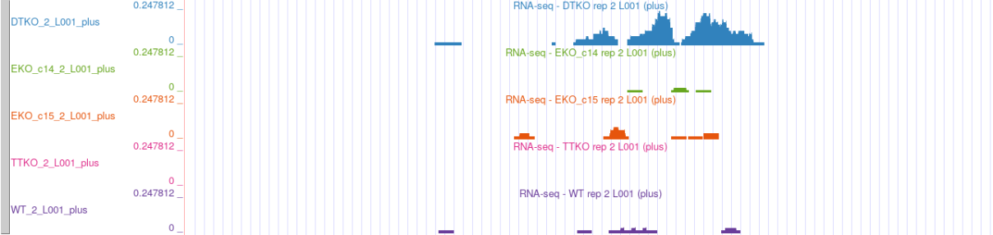
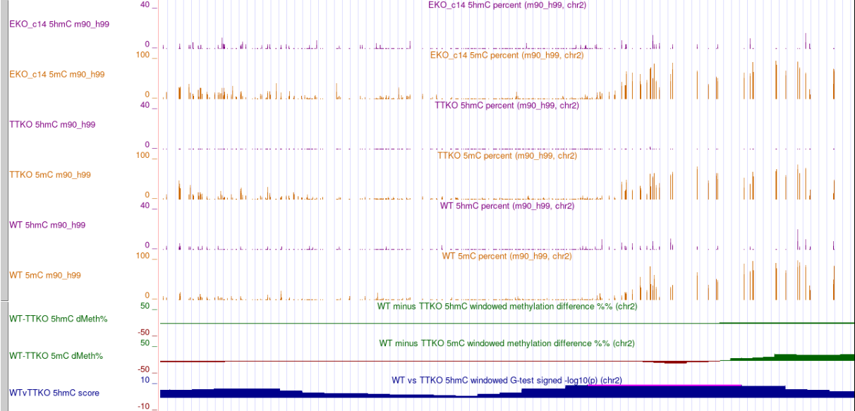

Slide 40
Work in progress
Define the best approach to define states within ChromHMM
Analyse differentially methylated and hydroxymethylated nucleotides across WT vs TTKO, WT vs EKO
Integrate DNA methylation and hydroxymethylation data for each genomic region per chromatin state
Analyse up- and downregulated genes, as well as unchanged genes for each chromatin state
Can we extrapolate these regulatory networks to other biological systems?

Slide 41
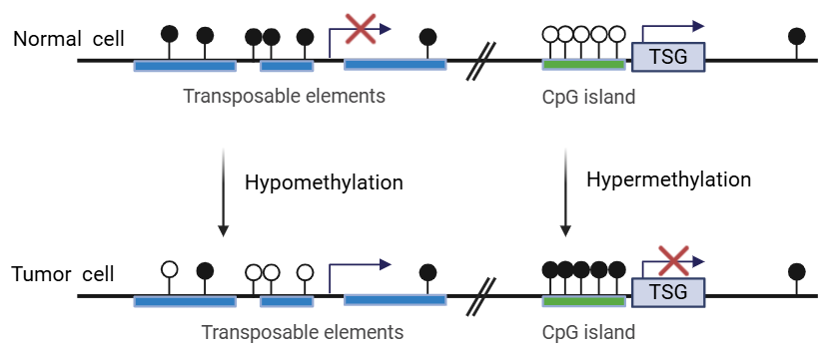
Aberrant DNA methylation patterns in cancer
DNA hypomethylation
DNA hypermethylation
hallmark of cancer
mostly found in large DNA blocks (repetitive sequences, retro elements…)
causes chromosomal instability
associated with tumor progression
in CpG islands within promoters
silencing of tumor suppressor genes (TSG)
DNA demethylating agents as cancer therapeutics
Ehrlich M, DNA hypomethylation in Cancer, Epigenomics (2009)
Nishiyama A, Nakanishi M, Navigating the DNA methylation landscape in cancer, Trends in Genetics (2021)
Fig adapted from Lehang Lin, Xu Cheng and Dong Yin Front. Oncol., 23 October 2020
Most cancers display both changes in their genome
These changes are dynamic
Overall reduction of m5C content in almost every type of cancer (ovarian, prostate, leukemia, colon, cervical…)
DNA demethylating agents used for certain cancers including leukemias and myelodysplastic syndromes

Slide 42
Chromatin regulation during oncogenic initiation and development
Are aberrant global DNA methylation patterns cause or consequence of cancer initiation?
How is chromatin regulated under aberrant genome-wide DNA methylation and hydroxymethylation patterns?
Do tumours survive due to functional epigenetic compensation?
Could we target the compensatory mechanisms that make cancer cells survive?
If TET activity interacts with PRC2 to prevent stable DNA methylation, then TET activity mantains the plasticity of genes during the development.
In the absence of TET activity, PRC2 fails to locate to their target genes, leading to CGI hypermethylation in cancer

Slide 43
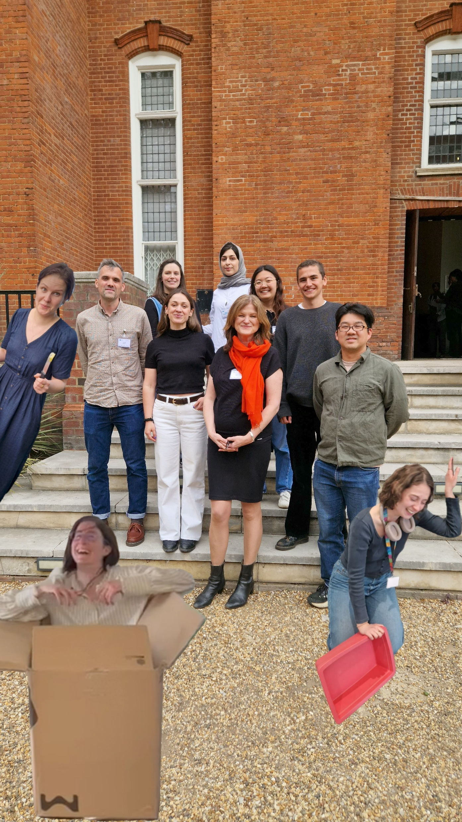
Thank you!

Slide 44
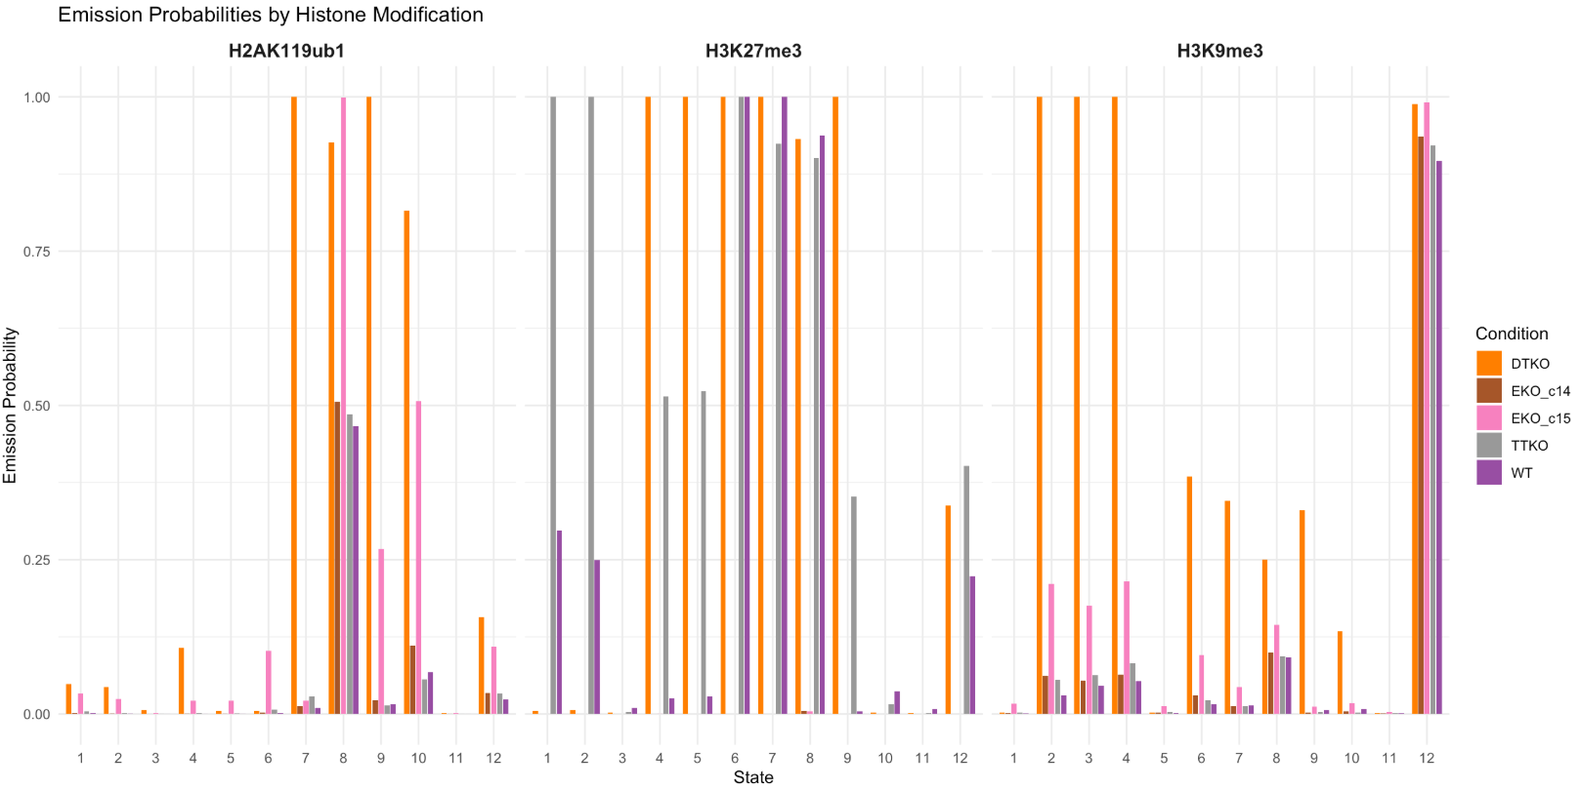

Slide 45
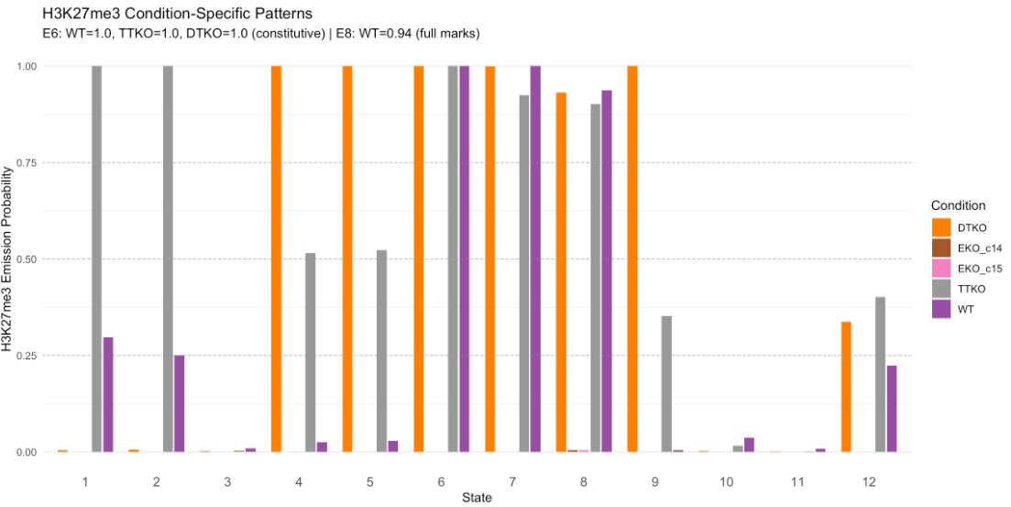
H3K27me3 patterns
H3K27me3 (TTKO strong, WT weak)
H3K27me3 (TTKO strong, WT weak) H3K9me3 (DTKO, strong)
H3K9me3 (DTKO strong)
H3K27me3 (DTKO strong, TTKO weak) H3K9me3 (DTKO, strong)
H3K27me3 (DTKO strong, TTKO weak)
H3K27me3 (constitutive)
H3K9me3 (DTKO, weak)
H3K27me3 (constitutive)
H2AK119ub1 (DTKO, strong)
H3K9me3 (DTKO, weak)
H3K27me3 (constitutive)
H2AK119ub1 (medium in WT, TTKO & EZKOc14) (strong in DTKO & EKOc15)
H3K27me3 (DTKO strong, TTKO weak)
H2AK119ub1 (DTKO strong)
H2AK119ub1 (DTKO, EKOc15 middle)
E6, E7, E8 = constitutive PRC2
E1 & E2 have regions that gain H3K27me3 in TTKO
E4, E5, E9 have regions that gain H3K27me3 in Dtko
Background (all marks low)
H3K9me3 (constitutive)
H3K27me3 (weak)

Slide 46
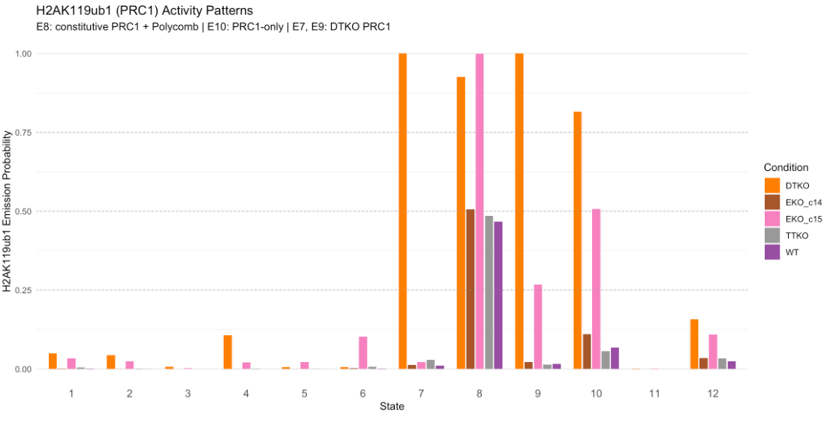
H2AK119ub1 patterns
H3K27me3 (TTKO strong, WT weak)
H3K27me3 (TTKO strong, WT weak) H3K9me3 (DTKO, strong)
H3K9me3 (DTKO strong)
H3K27me3 (DTKO strong, TTKO weak) H3K9me3 (DTKO, strong)
H3K27me3 (DTKO strong, TTKO weak)
H3K27me3 (constitutive)
H3K9me3 (DTKO, weak)
H3K27me3 (constitutive)
H2AK119ub1 (DTKO, strong)
H3K9me3 (DTKO, weak)
H3K27me3 (constitutive)
H2AK119ub1 (medium in WT, TTKO & EZKOc14) (strong in DTKO & EKOc15)
H3K27me3 (DTKO strong, TTKO weak)
H2AK119ub1 (DTKO strong)
H2AK119ub1 (DTKO, EKOc15 middle)
E8 = constitutive PRC1
E7, E9, E10 = gain of H2AK119ub1 in DTKOs
E9, E10 = gain of H2AK119ub1 in EKO c15
Background (all marks low)
H3K9me3 (constitutive)
H3K27me3 (weak)

Slide 47
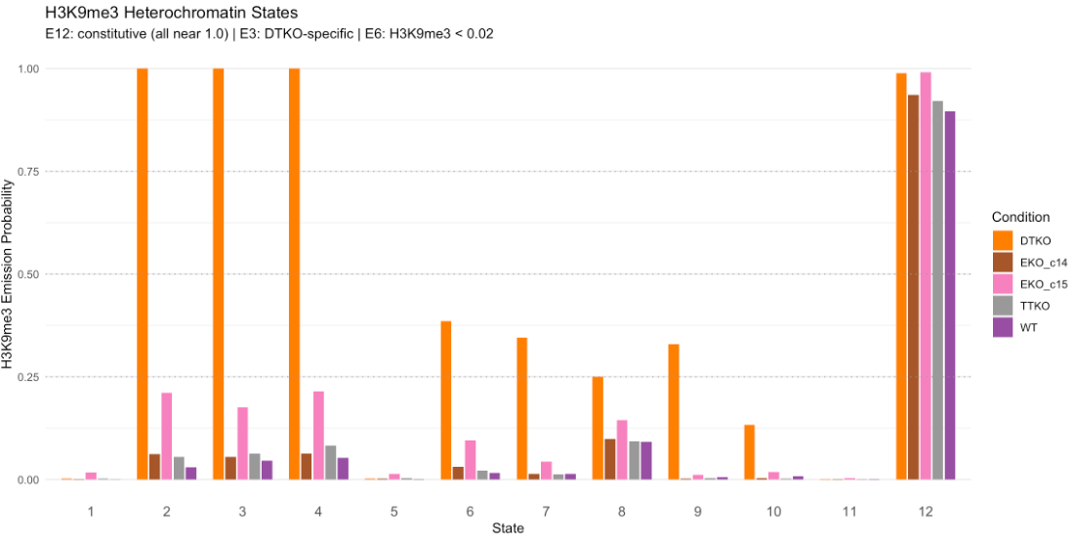
H3K9me3 patterns
H3K27me3 (TTKO strong, WT weak)
H3K27me3 (TTKO strong, WT weak) H3K9me3 (DTKO, strong)
H3K9me3 (DTKO strong)
H3K27me3 (DTKO strong, TTKO weak) H3K9me3 (DTKO, strong)
H3K27me3 (DTKO strong, TTKO weak)
H3K27me3 (constitutive)
H3K9me3 (DTKO, weak)
H3K27me3 (constitutive)
H2AK119ub1 (DTKO, strong)
H3K9me3 (DTKO, weak)
H3K27me3 (constitutive)
H2AK119ub1 (medium in WT, TTKO & EZKOc14) (strong in DTKO & EKOc15)
H3K27me3 (DTKO strong, TTKO weak)
H2AK119ub1 (DTKO strong)
H2AK119ub1 (DTKO, EKOc15 middle)
E12 = constitutive heterochromatin
E2, E3, E4 = strong H3K9me3 in DTKO
E6, E7, E8, E9, E10 = mild H3K9me3 in DTKO
Background (all marks low)
H3K9me3 (constitutive)
H3K27me3 (weak)

Slide 48
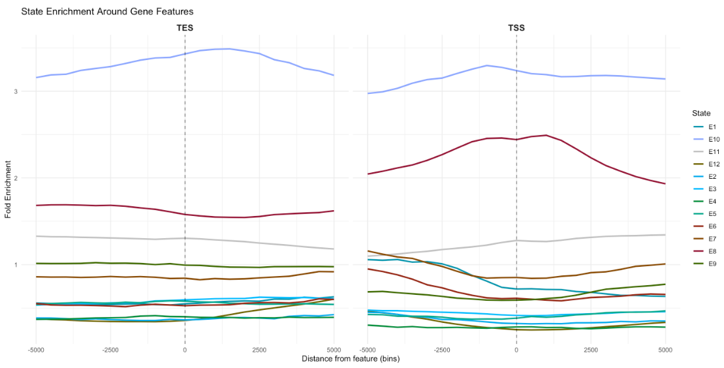
State enrichment around TES &TSS
H3K27me3 (TTKO strong, WT weak)
H3K27me3 (TTKO strong, WT weak) H3K9me3 (DTKO, strong)
H3K9me3 (DTKO strong)
H3K27me3 (DTKO strong, TTKO weak) H3K9me3 (DTKO, strong)
H3K27me3 (DTKO strong, TTKO weak)
H3K27me3 (constitutive)
H3K9me3 (DTKO, weak)
H3K27me3 (constitutive)
H2AK119ub1 (DTKO, strong)
H3K9me3 (DTKO, weak)
H3K27me3 (constitutive)
H2AK119ub1 (medium in WT, TTKO & EZKOc14) (strong in DTKO & EKOc15)
H3K27me3 (DTKO strong, TTKO weak)
H2AK119ub1 (DTKO strong)
H2AK119ub1 (DTKO, EKOc15 middle)
Background (all marks low)
H3K9me3 (constitutive)
H3K27me3 (weak)

Slide 49

Genome coverage by chromatin state
H3K27me3 (TTKO strong, WT weak)
H3K27me3 (TTKO strong, WT weak) H3K9me3 (DTKO, strong)
H3K9me3 (DTKO strong)
H3K27me3 (DTKO strong, TTKO weak) H3K9me3 (DTKO, strong)
H3K27me3 (DTKO strong, TTKO weak)
H3K27me3 (constitutive)
H3K9me3 (DTKO, weak)
H3K27me3 (constitutive)
H2AK119ub1 (DTKO, strong)
H3K9me3 (DTKO, weak)
H3K27me3 (constitutive)
H2AK119ub1 (medium in WT, TTKO & EZKOc14) (strong in DTKO & EKOc15)
H3K27me3 (DTKO strong, TTKO weak)
H2AK119ub1 (DTKO strong)
Background dominates
H3K9me3 gain in DTKO shows high coverage (E3), similar to constitutive H3K9me3 (E9)
Next dominates constitutive PRC1/2 (E8), followed by increased PRC1/2 in DTKO (E9, E5, E4)
H3K27me3 gain in TTKO shows a 5% coverage in the genome (E1)
Constitutive ONLY PRC2 regions (E7, E8, total ~10%) shows similar coverage than PRC1/2 regions (E8, ~10%)
H2AK119ub1 in DTKO represents ~5% of the genome (E10)
H3K9me3 in DTKO and H3K27me3 in TTKO represent 4% of the genome coverage (E2)
H2AK119ub1 (DTKO, EKOc15 middle)
Background (all marks low)
H3K9me3 (constitutive)
H3K27me3 (weak)

Slide 50

Segment width by chromatin state
H3K27me3 (TTKO strong, WT weak)
H3K27me3 (TTKO strong, WT weak) H3K9me3 (DTKO, strong)
H3K9me3 (DTKO strong)
H3K27me3 (DTKO strong, TTKO weak) H3K9me3 (DTKO, strong)
H3K27me3 (DTKO strong, TTKO weak)
H3K27me3 (constitutive)
H3K9me3 (DTKO, weak)
H3K27me3 (constitutive)
H2AK119ub1 (DTKO, strong)
H3K9me3 (DTKO, weak)
H3K27me3 (constitutive)
H2AK119ub1 (medium in WT, TTKO & EZKOc14) (strong in DTKO & EKOc15)
H3K27me3 (DTKO strong, TTKO weak)
H2AK119ub1 (DTKO strong)
H2AK119ub1 (DTKO, EKOc15 middle)
Constitutive PRC1/2 (E8) shows the highest segment width, while, followed by increased PRC1/2 in DTKO (E9, E5, E4)
H3K27me3/H3K9me3 in DTKO and H3K27me3 in TTKO shows the smaller segment width
Background (all marks low)
H3K9me3 (constitutive)
H3K27me3 (weak)

Slide 51


EZHO KO state splitting
H3K27me3 (TTKO strong, WT weak)
H3K27me3 (TTKO strong, WT weak) H3K9me3 (DTKO, strong)
H3K9me3 (DTKO strong)
H3K27me3 (DTKO strong, TTKO weak) H3K9me3 (DTKO, strong)
H3K27me3 (DTKO strong, TTKO weak)
H3K27me3 (constitutive)
H3K9me3 (DTKO, weak)
H3K27me3 (constitutive)
H2AK119ub1 (DTKO, strong)
H3K9me3 (DTKO, weak)
H3K27me3 (constitutive)
H2AK119ub1 (medium in WT, TTKO & EZKOc14) (strong in DTKO & EKOc15)
H3K27me3 (DTKO strong, TTKO weak)
H2AK119ub1 (DTKO strong)
Some loci retain H3K27me3 through compensation by EZH1 in EZHO KO cells
Regions in state E8 (constitutive PRC1/2)
Regions in E12: constitutive hrterochromatin
H2AK119ub1 (DTKO, EKOc15 middle)
Background (all marks low)
H3K9me3 (constitutive)
H3K27me3 (weak)
Notes:
ChromHMM cannot learn rare events. To identify Ezh1-compensated loci (which retain H3K27me3 in EKO knockout cells), states are split post-hoc based on max EKO H3K27me3 signal across EKO_c14 and EKO_c15.
Background EKO H3K27me3 is < 2 in spike-scaled data
Ezh1-compensated loci (e.g., Lmx1b) show EKO signal ~5-7
Ezh2-dependent loci (e.g., Pax6) stay below 3

Slide 52
Work in progress
Integrate ONT data:
Integrate 5mC & 5hmC data into the ChromHMM results
Integrate RNA-seq data:
Map gene upregulation, downregulation or absence of changes within each state

Slide 53
DNA methylation
DNA hydroxymethylation:
WT vs TTKO: higher 5hmC, as expected
EKO vs WT: maybe lower hmC in EKO
DNA methylation:
EKO vs WT: not diff
TTKO vs WT: TTKO vs WT comparison shows ~8 million significantly different positions (23% of all CpGs), reflecting the widespread methylation changes when TET-mediated hydroxymethylation is abolished. Depending on the region, higher 5mC in TTKO or lower 5mC in TTKO.
Changes in RNA? H3K27me3? H2AK119ub1?
EKO vs TTKO: higher 5mC in EKO

Slide 54
How to represent 5mC/5hmC?
Where does hmC lies?
What consequences does loss of 5hmC have at the gene expression level?
Is there widespread distribution of 5mC in the absence of 5hmC?
Is 5mC re-distribution prevented by remodelling of other repressive marks?
Threshold for blacklisting TTKO 5hmC+ positions
Need data for unmodified cytosines in CpGs→ Silvia
Line plots showing differential enrichment of 5mC and 5hmC across estates 1-12
Components of coding genes (CGI, Promoter, gene bodies) and classes of repeats (LTR, SINE, LTR) differentially enriched in DMRs

Slide 55
New chromhmm model
Model redefined in order to integrate the EKO split threshold in the initial ChromHMM analysis. However additional additional parameters were changed
Original parameters
500
5
8
10
7

