Slide 1
Text Classification Pipeline Forensics
Reproducibility, Shortcut Sensitivity, and Data Quality in Disaster Tweets
AIAA 3102 · Topic A · Kaggle Disaster Tweets Classification
text classification · reproducibility · error analysis · dataset shortcuts · decision thresholds · data quality

Slide 2
A Higher Score Is Not the Same as a Trustworthy Improvement
Background
Research Objectives
Task: binary classification of Kaggle disaster tweets, where target=1 marks a tweet describing a real disaster and target=0 marks it as unrelated.
The task is deliberately forensic: a score increase can arise from several unrelated sources, including
noise in the fixed data split
a decision threshold that happens to fit the metric
metadata that exposes a baseline shortcut
label inconsistencies that change what the metric rewards
Every proposed improvement is tied to four categories of evidence:
a controlled, predeclared intended lever
dev-set metrics and prediction transitions
row-level case evidence keyed by stable ID
a held-out report produced only after freezing
Five tickets cover baseline reproduction, text normalization, feature shortcuts, decision-rule tuning, and data-quality auditing.
"The unifying question was not which row of a score table was largest, but which conclusions remained defensible when prediction movements, perturbation behavior, data provenance, and unresolved uncertainty were considered together."
2

Slide 3
Fixed-ID Splits and a Freeze-Before-Reveal Protocol Prevent Held-Out Leakage
Split | Rows | Target = 0 | Target = 1
Train | 4,567 | 2,614 | 1,953
Dev | 1,523 | 868 | 655
Held-out | 1,523 | 868 | 655
Total 7,613 unique Kaggle IDs. Membership is resolved by stable ID, never by row position.
Every ticket follows the same freeze protocol
Predeclare hypotheses and bounded candidates
Select using dev set only (1,523 rows)
Freeze decision and configuration to disk
Report held-out once
All error transitions in every ticket are compared against the same frozen Ticket 1 raw-text baseline. Five independent clean-process replays reproduced every label exactly, with maximum score drift of 1.11 × 10-16, well inside the declared 10-12 tolerance.
Source: report_outline.md · experiments/*/frozen_decision.json
3

Slide 4
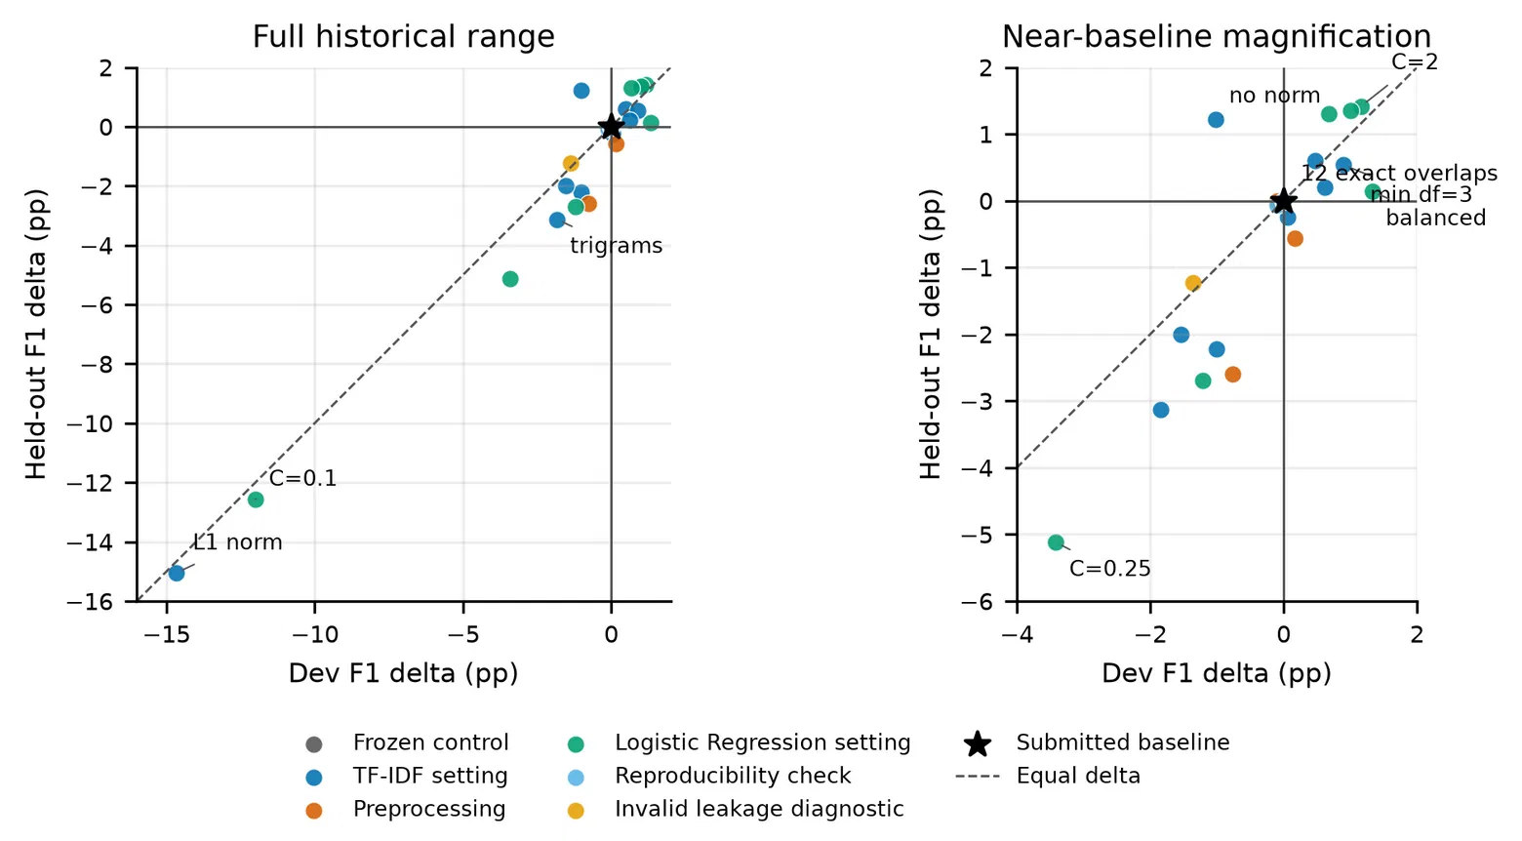
Ticket 1: The Local Baseline Reproduces Deterministically but Leaves an Unresolved Gap to the Reference
Config: raw text · word-unigram TF-IDF · Logistic Regression (C=1, no class weight, threshold 0.50, seed 3102)
Metric | Dev | Held-out | Reference
Precision-1 | 0.7909 | 0.8014 | —
Recall-1 | 0.6931 | 0.7034 | —
F1-1 | 0.7388 | 0.7492 | 0.7574
Held-out gap to reference = −0.0082, exceeding the declared ±0.001 tolerance.
32 single-lever diagnostic probes were run to attribute the gap:
Disabling lowercasing: −0.0077 F1
Word bigrams: −0.0101 F1
liblinear solver: −0.0001 F1, flips dev ID 5282 to a false negative
Balanced class weights: +0.0133 F1 (the only lever later admitted, in Ticket 4)
No published reference configuration or prediction file exists, so the gap is documented and left unresolved rather than silently closed.
Dev-vs-held-out F1 deltas across all 32 probes (Pearson r=0.978). Source: figure_06_ticket1_dev_probe_deltas.png
4

Slide 5
Ticket 2: URL Placeholdering Is the One Normalization Lever with Exact Invariance Evidence
Variant | Dev F1 | Decision
Raw text (control) | 0.7388 | baseline
URL placeholder | 0.7403 | adopted
Mention placeholder | 0.7388 | no change
Punctuation to space | 0.7388 | no change
Hashtag stripping | 0.7388 | no change
Lowercasing | 0.7388 | no change
Emoji placeholder | 0.7388 | no change (0 rows affected)
Robustness evidence
Representative held-out cases
767 dev rows contain a URL. Under paired substitution, the raw model changed 275 predictions while the URL-normalized model changed 0: exact invariance to link content.
Held-out F1 rose from 0.7492 to 0.7531, fixing 22 false positives and 8 false negatives, at the cost of 4 new false positives and 15 new false negatives.
ID 773 (target 0, an ad tweet with two links): score 0.533 → 0.461, fixing a false positive.
ID 902 (target 1, a bioterrorism report with a link): score 0.509 → 0.499, becoming a new false negative — the mechanism's explicit cost.
5

Slide 6
Ticket 3: The Highest Dev Score Was Rejected Because It Collapsed Under a Robustness Probe
Variant | Dev F1
Text-only (control) | 0.7388
Keyword-only | 0.7074
Text + keyword + shallow features | 0.7494
Text + location | 0.7388
Text + length | 0.7388
Why the top score was rejected
Masking the keyword field on the richest candidate changed 702 predictions and collapsed its F1 from 0.7494 to 0.6423 — a drop of 0.1071.
591 dev-set location values never appeared in training, exposing a generalization risk in the metadata features.
Decision: retain the text-only Ticket 1 baseline; the score gain was not causally tied to language understanding.
Highest visible dev score, highlighted in red, was ultimately rejected.
Dev ID 7 (target 1): "Just got sent this photo from Ruby #Alaska as smoke from #wildfires pours into a school" — keyword feature fixes a false negative.
Dev ID 25 (target 0): "Summer is lovely" — the identical keyword score creates a false positive on the same lexical cue.
6

Slide 7
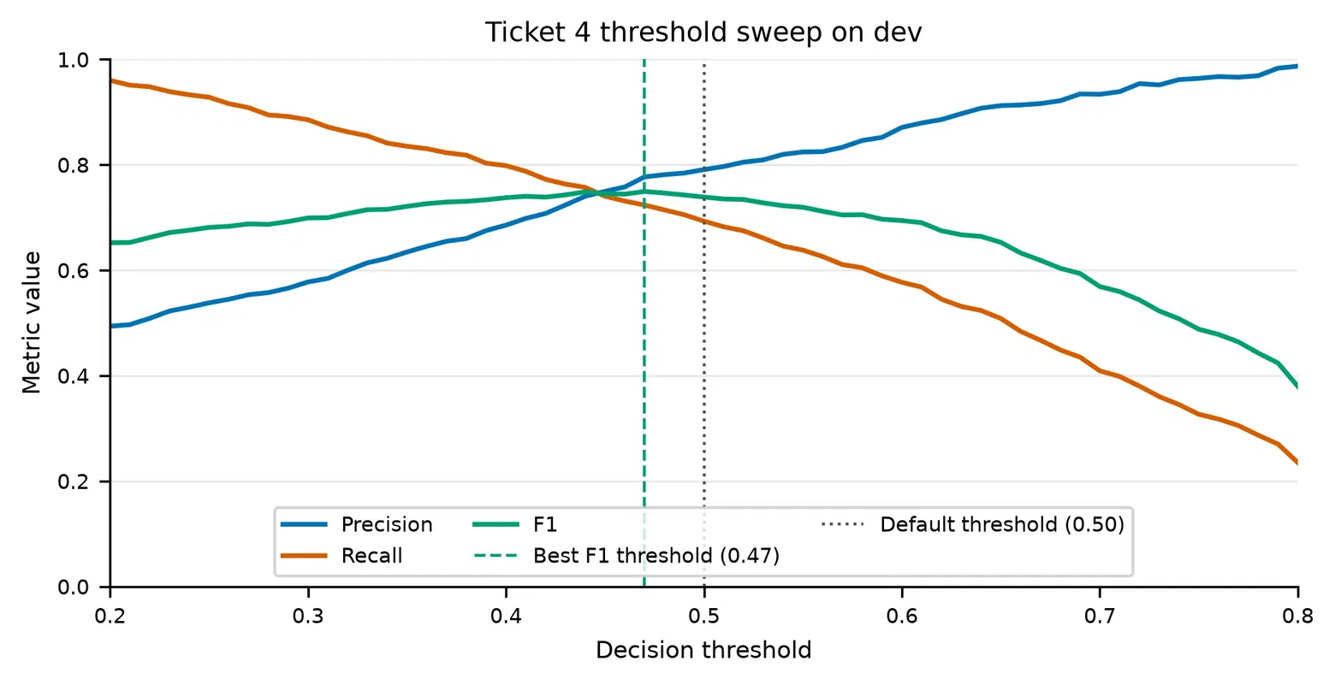
Ticket 4: Balanced Logistic Regression Wins on F1, at an Explicit Precision and Accuracy Cost
Metric | Baseline | Balanced LR | Δ
Precision-1 | 0.8014 | 0.7444 | −0.0570
Recall-1 | 0.7034 | 0.7569 | +0.0535
F1-1 | 0.7492 | 0.7506 | +0.0014
Accuracy | 0.7978 | 0.7840 | −0.0138
Fixed FN / New FP | 35 fixed · 56 new
The selection rule was declared before dev evaluation: maximize target-1 dev F1 across a bounded grid of 12 candidates (thresholds, class weights, regularization strengths, and one LinearSVC). Balanced LR at C=1, threshold 0.50, won that grid.
Threshold sweep on dev: best-F1 threshold is 0.47 (F1=0.7494), close to but distinct from the default 0.50. Source: figure_01_threshold_sweep.png
Held-out: F1 gain is only +0.0014; recall rises 0.0535 while precision falls 0.0570 — a directional move, not a general quality improvement.
7

Slide 8
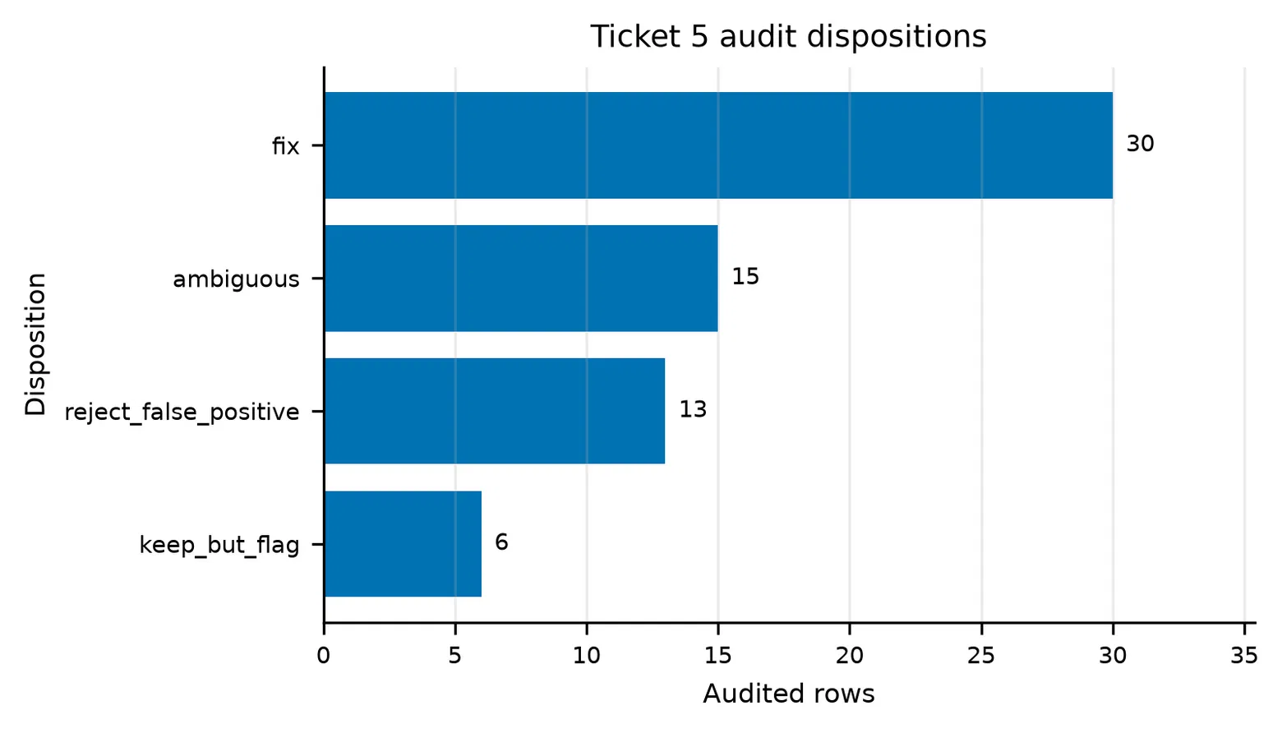
Ticket 5: Label Conflicts Are Widespread, but the Correction Probe Failed Its Own Gates
Duplicate type | Groups | Conflicting | Cross-split
Raw exact | 69 | 18 | 41
Canonicalized | 292 | 64 | 194
Near-duplicate pairs | 960 | 186 | 546
8-row correction probe
Dev F1: 0.7521 → 0.7489 (−0.0032). Fixed 3 errors but created 8 new ones — both adoption gates failed.
64-row audit dispositions. Source: figure_04_data_quality_dispositions.png
Decision: retain the Ticket 4 balanced Logistic Regression with no source label changes. Representative cases — held-out ID 5760 ("no forest fires") is a valid hard negative, not a mislabel; IDs 6220/6223 share identical D.B. Cooper image text with opposite held-out labels and remain flagged ambiguous rather than silently resolved.
8

Slide 9
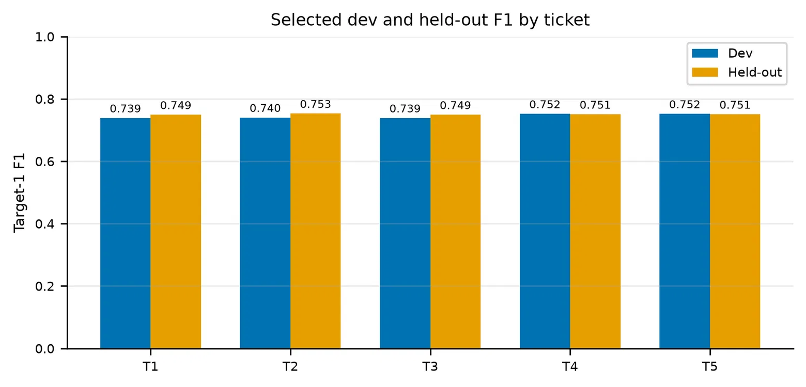
Across Five Tickets, Protocol Discipline Outranks the Highest Post-Hoc Score
Ticket | Decision | Dev F1 | Held-out F1 | FN Fixed / FP New
T1 | Baseline retained | 0.7388 | 0.7492 | — / —
T2 | URL norm. adopted | 0.7403 | 0.7531 | 8 / 4
T3 | Shortcut rejected | 0.7388 | 0.7492 | 0 / 0
T4 | Balanced LR adopted | 0.7521 | 0.7506 | 35 / 56
T5 | Correction rejected | 0.7521 | 0.7506 | 35 / 56
Source: figure_02_dev_heldout_f1.png
Why Ticket 2's held-out F1 (0.7531) is not the final model
Each ticket answers a different predeclared question under its own dev-only freeze. Selecting Ticket 2 only after observing every held-out score would violate the freeze protocol. The valid final model is the last dev-based frozen decision: the Ticket 4/5 balanced Logistic Regression.
9

Slide 10
Case Evidence Reveals the Mechanism Behind Every Metric Shift, Not Just Its Size
ID | Ticket | Label | Transition | Tweet summary | Note
773 | T2 | 0 | FP → correct | Auto-parts ad with two links | URL norm. fixes a false positive
902 | T2 | 1 | correct → FN | Bioterrorism report with a link | Explicit cost of URL normalization
556 | T4 | 1 | FN → correct | Arson-related disaster report | Balanced LR fixes a false negative
59 | T4 | 0 | correct → FP | Link-heavy tweet tagged #nsfw | Precision cost of balanced weighting
5760 | T5 | 0 | model error | "no #forest fires" (negation) | Valid hard negative, not a mislabel
2619 | T5 | 1 | model error | "My iPod crashed" + fan hashtags | Flagged as a potential annotation issue
A metric improvement must be paired with a transition analysis: the same F1 gain can bundle a defensible fix with an indefensible new error.
10

Slide 11
Six Recurring Challenges Expose Systemic Risks in the Evaluation Pipeline
Challenge | Evidence | Solution / Residual Risk
Baseline-reference mismatch | F1 gap 0.0082 > 0.001 tolerance | 32 probes run; gap left unresolved
Replay numerical drift | Max drift 1.11×10-16 | Explicit 10-12 tolerance declared
Shortcut-feature dependence | Keyword masking: F1 −0.1071 | Robustness probes; rich candidate rejected
Recall/precision tradeoff | 35 FN fixed, 56 new FP | Full threshold sweep + confusion matrices
Duplicate / label conflicts | 64-row audit, 292 canonical dup groups | 4-way disposition; correction gated on dev, and failed
Emoji normalization, zero coverage | 0 rows affected | Zero-coverage result retained as unresolved
Methodological limitation
The impact of different hyperparameters was not exhaustively explored: candidate grids were bounded and predeclared on a single fixed dev split, with no confidence intervals, resampling, or external test set.
11

Slide 12
Trustworthiness Comes From a Chain of Evidence, Not the Top Row of a Score Table
Final frozen model: raw word-unigram TF-IDF + balanced Logistic Regression (C=1.0, threshold 0.50, no label corrections) — recall 0.703 → 0.757, precision 0.801 → 0.744, F1 +0.0014
Ticket 2 — URL placeholdering is a credible improvement: a small F1 gain paired with exact substitution invariance.
Ticket 3 — The highest dev score was rejected: keyword dependence made the gain untrustworthy under masking.
Ticket 4 — Balanced weighting is defensible under the predeclared F1 criterion, but its held-out advantage is small.
Ticket 5 — Data-quality issues are real, yet the correction probe failed its own gates; the conservative decision held.
"Trustworthiness means convergence among controlled dev selection, expected directional movements, targeted robustness, stable-ID examples, and freeze provenance — not the highest score in a table."
12

