Slide 1
COMP 4332 / RMBI 4310
Big Data Mining (Spring 2026)
Project 2: TabPFN
TA: Yisen Gao (ygaodi@connect.ust.hk)
1

Slide 2
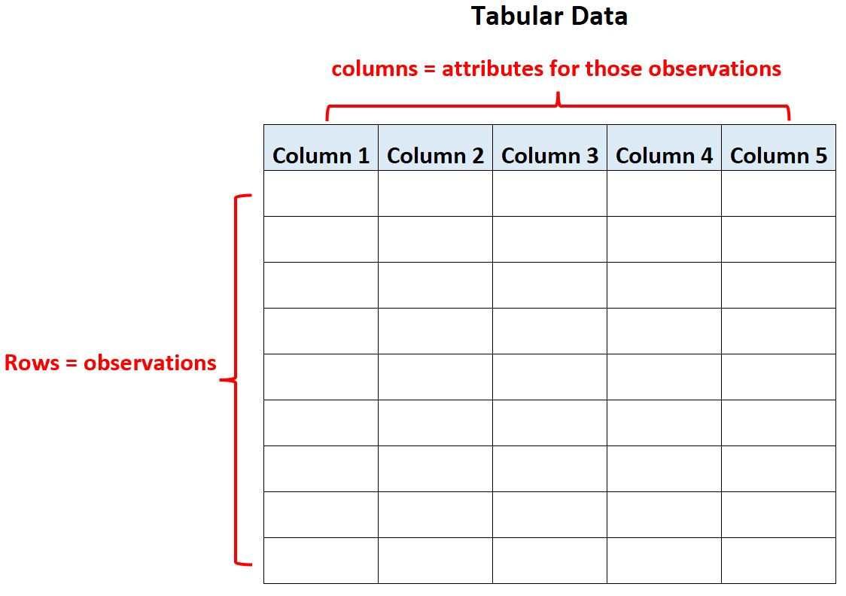
Tabular Data
Very common in real-world applications
Industry
Business
Medical
…
https://www.statology.org/tabular-data/

Slide 3
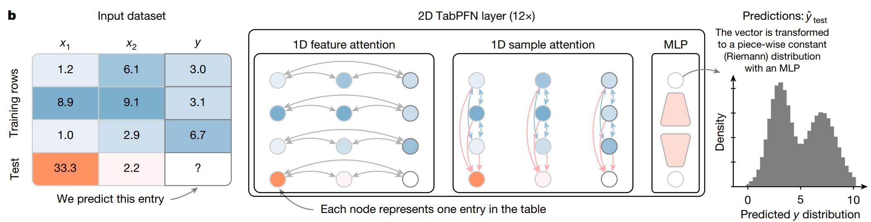
TabPFN
In TabPFN v2, tokens are individual cells (a single feature value or label), not entire rows.
During Sample Attention, the sequence consists of all cells within the same feature column.
Tokens attend only to other cells within the same column. The Train Samples: Features and labels are encoded as separate, independent cell tokens.
This allows a test cell to find training cells with similar values, essentially performing a sophisticated, learned 1D k-Nearest Neighbors or Kernel Regression per feature.

Slide 4
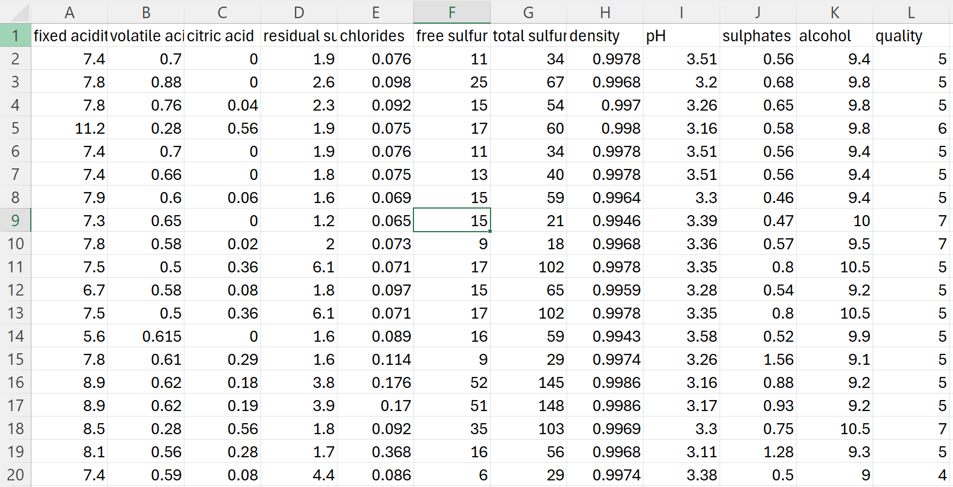
Tabular Regression/Classfication
Regression: Predict the value; evaluate with RMSE.
Classfication: Predict the class; evaluate with Accuracy.

Slide 5
Dataset
Ten tabular data with 5 for regression task and 5 for classfication task.
Each one have train.csv, test.csv and result.csv
The last column is your target prediction
You can see the detailed data in the ‘data/reg’ and ‘data/cls’ file
2

Slide 6
Method
You can use tabpfn or its variants like Tarte, Limix.
Note that you do not need to train the model
Note that there may be a limit on the maximum number of lines allowed in the context.
2

Slide 7
Evaluation
RMSE for regression dataset on test data
Accuracy for classfication dataset on test data
You should generate the ‘predict.csv’ for the target column
Use the ‘evaluate.py’ to get your performance.
8

Slide 8
Submission
Report (1~2 pages), including the motivation of your model choise, the choise of the context (if there are too many lines), and the comparison of model performances.
Code
predict.csv
DDL: April 26, 2026
Submission: Each team leader is required to submit the groupNo.zip file that contains the report, results and your team’s code on canvas.
We will check your report with your code and the Accuracy/RMSE scores. You will be graded based on your testing set performance and your report.

Slide 9
Grading Rule
The baseline for each dataset is listed below. For each dataset you outperform, you will earn 10% of the total score.
We will also adjust your final grade based on your report.
Table 1. Baseline Performance on Classification Dataset
Table 2. Baseline Performance on Regression Dataset
dataset | accuracy
1 | 0.86
2 | 0.70
3 | 0.64
4 | 0.68
5 | 0.70
dataset | rmse
1 | 2.60
2 | 3.60
3 | 0.70
4 | 0.03
5 | 0.21

Slide 10
Thank You

