Slide 1
ASP.Net Overview

Slide 2
Topic
ASP.NET - Background and Future
asdf
Homework

Slide 3
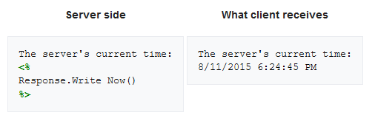
ASP.NET – Background and Future
Active Server Pages (ASP) 1.0 released in Dec 1996
Server-side script engine for dynamically generated web pages
Initially an add-on to Internet Information Services (IIS), MS’s web server
ASP 3.0 released Nov 2000 as part of IIS
Supported scripting languages include VBScript, JScript and PerlScript
https://en.wikipedia.org/wiki/Active_Server_Pages

Slide 4
ASP.NET – Background and Future
ASP.NET is an open source server-side web-application framework
Released Jan 2002 with version 1.0 of .Net Framework
Successor to ASP
Built on CLR – write ASP.Net code using any supported .NET language
https://en.wikipedia.org/wiki/ASP.NET

Slide 5
ASP.NET – Background and Future
Multiple programming models for buiding web apps
ASP.NET Web Forms – modular framework, UI events processed server side
ASP.NET MVC – build web pages using model-view-controller deisgn pattern
ASP.NET Web Pages – lightweight syntax for dynamic code and data access directly in HTML markup
ASP.NET Web API – building Web APIs on top of .Net Framework
ASP.NET Webhooks – implements Webhook pattern
SignalR – Real-time communications for bi-directional comms between client and server
https://en.wikipedia.org/wiki/ASP.NET

Slide 6
ASP.NET – Background and Future
ASP.NET Core re-implements ASP.NET.
Uses open-source .NET compilre Platform (codename ‘Roslyn’)
ASP.NET MVC, ASP.NET Web API and ASP.NET Web Pages (Razor Pages) merged into unified MVC 6.
Modular framework runs on both .Net Framework on Windows and cross-platform .NET Core
However, ASP.NET Core 3 works only on .NET Core
Dropping support for .NET Framework
https://en.wikipedia.org/wiki/ASP.NET

Slide 7
Exercise
WingtipToys Example Web Application
.NET Framework 4.5.2, ASP.NET Web Forms
Read the ‘Green Section’ on different ASP.NET options.
Download the ebook and follow the rest of the exercise
https://docs.microsoft.com/en-us/aspnet/web-forms/overview/getting-started/getting-started-with-aspnet-45-web-forms/create-the-project
https://en.wikipedia.org/wiki/ASP.NET

Slide 8
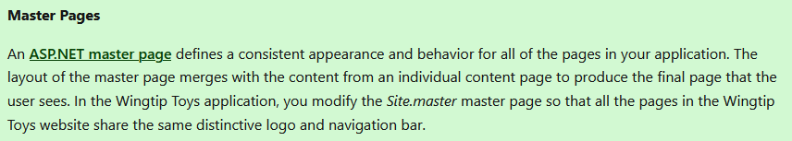

Exercise
Master Pages
Look at Site.Master code
Defines the common structure of the web page
Eg. Main header, navigation
Content Placeholder dynamically created for individual web page

Slide 9
Exercise
Open ‘Contact.aspx’ - Note the Content Placeholder Code
Open ‘Site.Mobile.Master’ - Note the content
Start the web app
View Page Source – observer master pages, contact pages content
Contrast between code on VS2019 and page source
Use Developer Tools to inspect elements.
Adjust to mobile settings to see ‘Site.Mobile.Master’

Slide 10
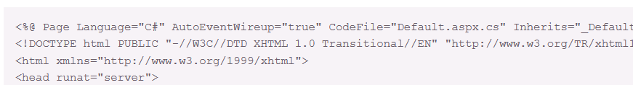
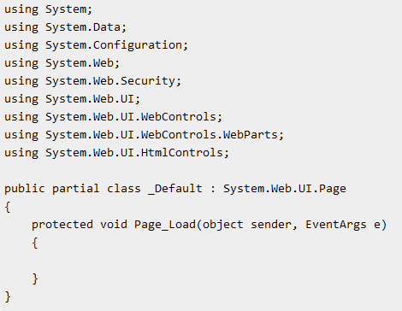
Exercise
CodeBehind
Shift code between <% %> tags to another file
Allows you to use C#, VB.NET to code
For example, Default.aspx would have Default.aspx.cs file.
https://asp.net-tutorials.com/basics/code-behind/

Slide 11
Exercise
CodeBehind
https://asp.net-tutorials.com/basics/code-behind/

Slide 12
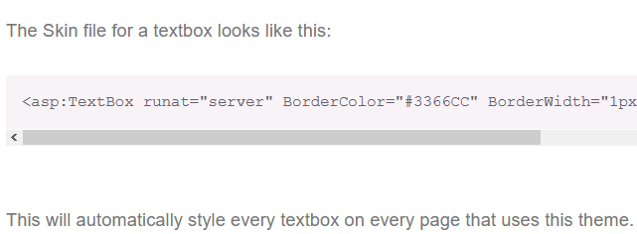
Themes and Skins
Themes and skins are a way to style your web site
Themes are made up of skins, Cascading Style Sheets (CSS), images and other resources.
Themes are like CSS styles – define a set of common attributes to apply to controls and elements of any page
Themes do not cascade (unlike CSS). Located in App_Theme folder
Skin is a set of properties and templaes that can be used to standardise fonts and characteristics of controls on a page.
https://www.codeguru.com/csharp/csharp/cs_network/internetweb/article.php/c7937/Themes-and-Skins-in-ASPNET-20.htm#page-2
https://lonewolfonline.net/themes-skins-aspnet/

Slide 13
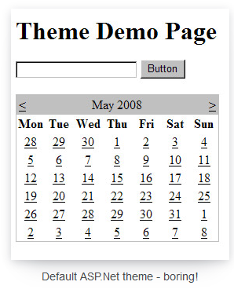
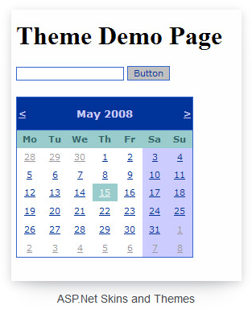
Themes and Skins
https://www.codeguru.com/csharp/csharp/cs_network/internetweb/article.php/c7937/Themes-and-Skins-in-ASPNET-20.htm#page-2
https://lonewolfonline.net/themes-skins-aspnet/

Slide 14
Themes and Skins
Skin is a set of properties and templaes that can be used to standardise fonts and characteristics of controls on a page.
https://www.codeguru.com/csharp/csharp/cs_network/internetweb/article.php/c7937/Themes-and-Skins-in-ASPNET-20.htm#page-2
https://lonewolfonline.net/themes-skins-aspnet/

Slide 15
Homework
Read through history of ASP.NET: https://www.dotnetcurry.com/aspnet/1492/aspnet-history-part-1
WingtipToys has Paypal and other features
Other areas to familiarise with
HTML
CSS
Javascript
Bootstrap

