Slide 1
.Net Overview

Slide 2
Topic
.Net - Background and Future
CLR, CTS, BCL, CIL, CLI
Dynamic Language Runtime (DLR)
Discuss: Language Interoperability, Cross Platform
Homework

Slide 3
.Net – Background and Future
.Net
Free, cross-platform, open source developer platform for building different types of applications
Consists of language (C#, F#, VB.Net) and libraries
.Net version 1.0, 2002
https://www.geeksforgeeks.org/introduction-to-net-framework/

Slide 4
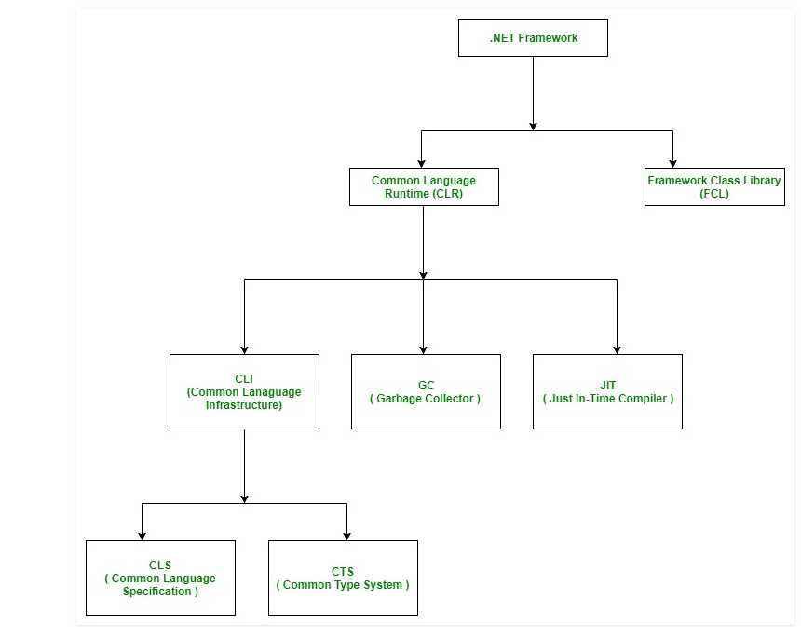
.Net – Background and Future
Framework Class Library (FCL): collection of reusable, object-oriented class libraries and methods.
Integrated with CLR.
Also called assemblies.
https://www.geeksforgeeks.org/introduction-to-net-framework/

Slide 5
.Net – Background and Future
.Net Core
Cross-platform .Net implementation on Windows, Linux and macOS
.Net Framework
Supports apps on Windows
Xamarin/Mono
Supports apps on major mobile OS
.Net Standard
Formal specificaton of .Net APIs intended to be available on all .Net implementations
https://www.geeksforgeeks.org/introduction-to-net-framework/

Slide 6
.Net – Background and Future
Future of .Net
.Net Framework 4.8 will be last major version
.Net Core 3.1 (released Nov 2019) is last version before .Net 5
.Net 5 is rebranding of what would be .Net Core 4
To be released Nov 2020
New release of .Net every November
Long-Term Support (LTS) version every other year starting with .Net 6 in 2021
AT least 3 years of security updates and bug fixes
https://medium.com/capgemini-dynamics-365-team/future-of-net-net-5-microsoft-build-2019-from-a-net-developer-point-of-view-7a1158fb0691

Slide 7
Homework
.Net Framework vs .Net Core
https://docs.microsoft.com/en-us/dotnet/standard/choosing-core-framework-server
UWP (Universal Windows Platform) vs WPF (Windows Presentation Platform)
https://github.com/jbe2277/waf/wiki/UWP-vs.-WPF
.Net Platform Support Policy
https://dotnet.microsoft.com/platform/support/policy
.Net Framework Architecture, Component Stack
https://www.geeksforgeeks.org/c-sharp-net-framework-basic-architecture-component-stack/
https://dotnet.microsoft.com/learn/dotnet/what-is-dotnet

Slide 8
CLR, CTS
As a programmer, view .Net as a runtime environment and a comprehensive base class library
Common Language Runtime (CLR)
Loads, locate and manage .Net objects
Memory management, application hosting, security checks, coordinate threads
Common Type System (CTS)
Describes all data types and all related constructs
Each language can have its own data type definition and cannot be understood by another language
CLR understands all the data types
https://medium.com/@v.cheshmi/clr-bcl-cil-and-assemblies-in-net-framework-3de8bf09e781

Slide 9
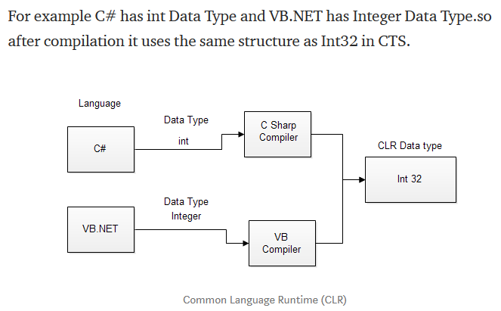
CLR, CTS
https://medium.com/@v.cheshmi/clr-bcl-cil-and-assemblies-in-net-framework-3de8bf09e781

Slide 10
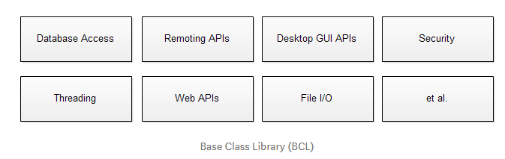
BCL
Base Class Library (BCL)
Also known as Class Library (CL); subset of Framework Class Library (FCL)
Collection of resuable types. Integrated with CLR.
Define types that build any type of software application.
Eg. dealing with strings and primitive types, databases, I/O
https://medium.com/@v.cheshmi/clr-bcl-cil-and-assemblies-in-net-framework-3de8bf09e781

Slide 11
CLS
Common Language Specification (CLS)
Subset of the CTS
Defines rules and restrictions every language must follow to run under .Net framework
Different languages have different syntax rules
Each language converted to MSIL (Microsoft Intermediate Language).
MSIL is the language specification of CLR
https://medium.com/@v.cheshmi/clr-bcl-cil-and-assemblies-in-net-framework-3de8bf09e781

Slide 12
CIL
Common Intermediate Language (CIL)
Formerly known as Microsoft Intermediate Language (MSIL) or Intermediate Language (IL)
Intermediate Language binary instruction set defined within the Common Language Infrastructure (CLI) specification
CIL instructions are executed by a CLI-compatible runtime environment (eg. CLR)
Languages which target the CLI compile to CIL.
Runtimes typically just-in-time compile CIL instructions to native code.
https://en.wikipedia.org/wiki/Common_Intermediate_Language

Slide 13
CLI
Common Language Infrastructure
Open specification developed by MS and standardised by ISO and Ecma
Describes executable code and a runtime environment allowing multiple high-level languages to be used on different computer platforms without being rewritten for specific architectures.
.Net Framework, .Net Core, Mono, DotGNU and Portable.Net are implementations of the CLI
4 aspects: CTS, Metadata (info about program structure that is language agnostic), CLS, Virtual Execution System (VES)
https://en.wikipedia.org/wiki/Common_Intermediate_Language

Slide 14
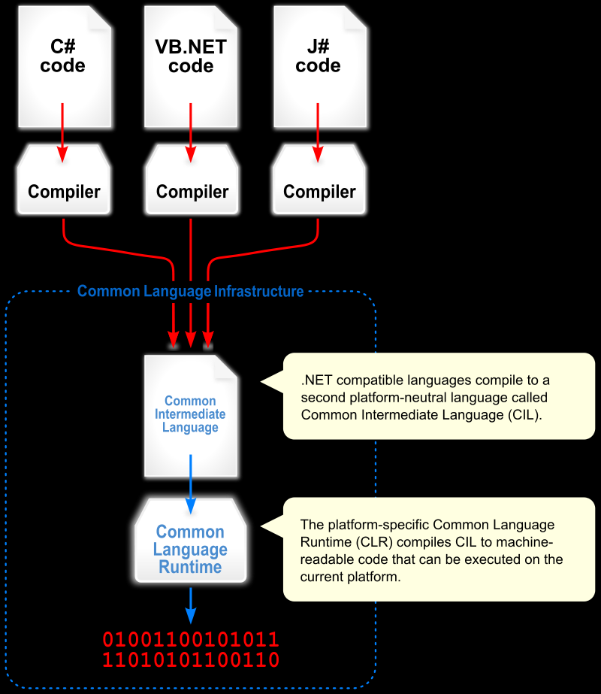
CLI
.
https://en.wikipedia.org/wiki/Common_Language_Infrastructure

Slide 15
Dynamic Language Runtime (DLR)
Runtime environment that adds a set of services for dynamic languages to the common runtime
Makes it easier to develop dynamic languages to run on the .Net Framework
Add dynamic features to statically-typed languages
Makes it easier to develop dynamic languages to run on the .Net Framework
Dynamic languages – Python, Ruby, Javascript, Groovy
The versions that run on .Net Framework include IronPython, IronRuby

Slide 16
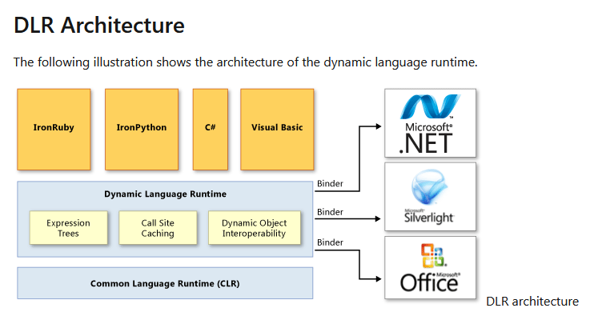
Dynamic Language Runtime (DLR)
https://docs.microsoft.com/en-us/dotnet/framework/reflection-and-codedom/dynamic-language-runtime-overview

Slide 17
Language Interoperability, Cross Platform
Discuss
Which features allow for Language Interoperability?
Which features allow for Cross Platform?
https://en.wikipedia.org/wiki/Common_Intermediate_Language

Slide 18
Homework
Read and go through “An Overview of .Net Assemblies” section from link: https://medium.com/@v.cheshmi/clr-bcl-cil-and-assemblies-in-net-framework-3de8bf09e781
Qn: Is compiled .Net program typically converted to executable binary code or intermediate code?
Qn: Can the compiled intermediate code run without a CLR?
Qn: Is there a technology to compile a .Net program to executable binary code?

Slide 19
Homework
Professional Development Tips
Spend time daily to update .Net knowledge
Set browser homepage to suitable site: https://www.devtrends.co.uk/blog/creating-your-first-shared-library-in-.net-core
https://blog.elmah.io/net-blogs-to-follow-the-ultimate-list/
Consider teaching C#
Free ebooks: https://www.packtpub.com/free-learning

