Slide 1
Aspects of Software Engineering

Slide 2
Topics
Software Architecture
UML – Use Case Diagrams, Object/Class Diagrams, Sequence Diagrams
Refactoring – unit testing
Design Patterns – Adapter, Factory, Template, Singleton, Fascade
SOLID

Slide 3
Software Engineering
Software Engineering
Creating and maintaining software applications by applying technologies and practices from computer science, project management and other fields
People working in teams under constraints, creating value for customers
Software engineering as discipline
Statistics
85% of software projects fail (ie. Failure to meet deadlines, quality ...)
Death March projects (10-hour days, 6 days a week)
Bugs!

Slide 4
Software Engineering
Aspects of Software Engineering
Processes necessary to turn a concept into a robust deliverable that can evolve over time
Work with limited time and resources
Satisfy a customer
Manage risk
Teamwork and Communication

Slide 5
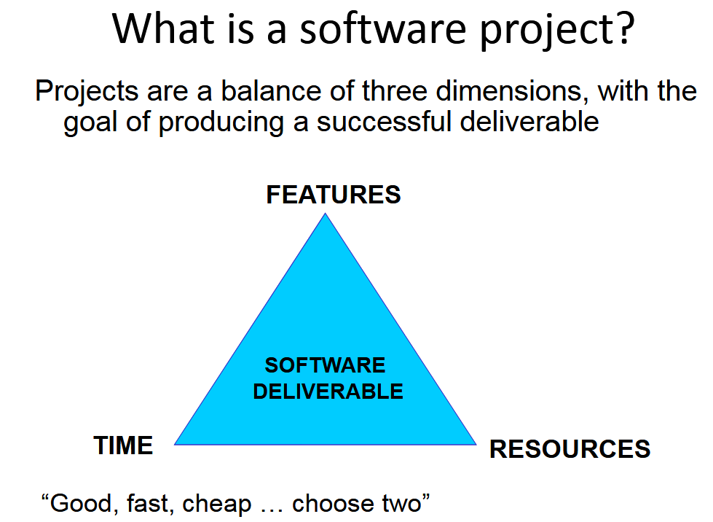
Software Engineering

Slide 6
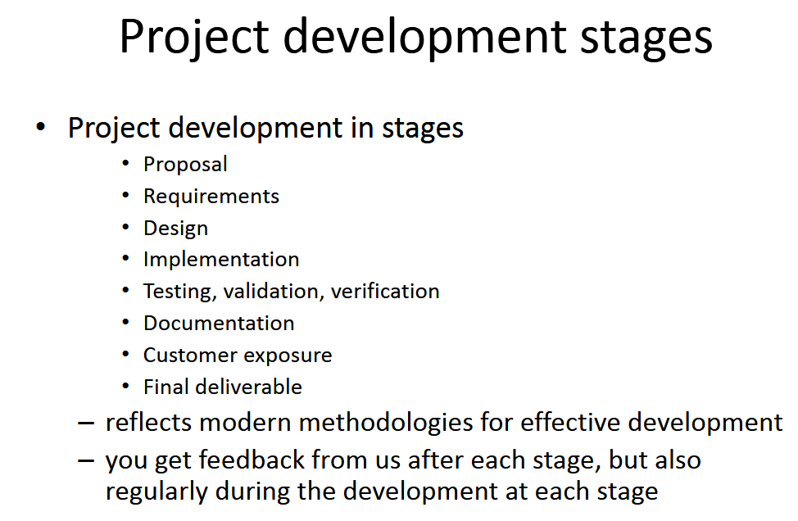
Software Engineering

Slide 7
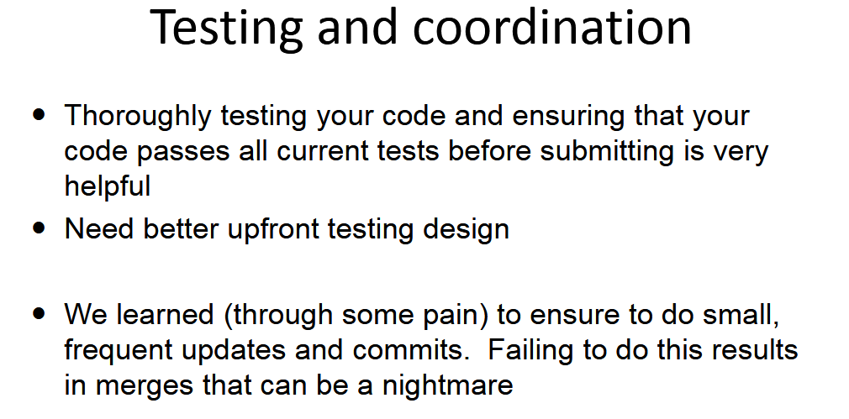
Software Engineering

Slide 8
Software Architecture
[ Imagine your role as a software architecture, leading a team of competent software engineers who can build whatever you design]

Slide 9
Unified Modelling Language (UML)

Slide 10
UML – Use Case Diagram
Use case diagram sumarizes the details of your systme’s users (ie. Actors) and their interactions with the system.
Helps to understand the scenarios in which your system interacts with users
Clarify goals of your system
Understand scope of your system
https://www.lucidchart.com/pages/uml-use-case-diagram#discovery__top

Slide 11
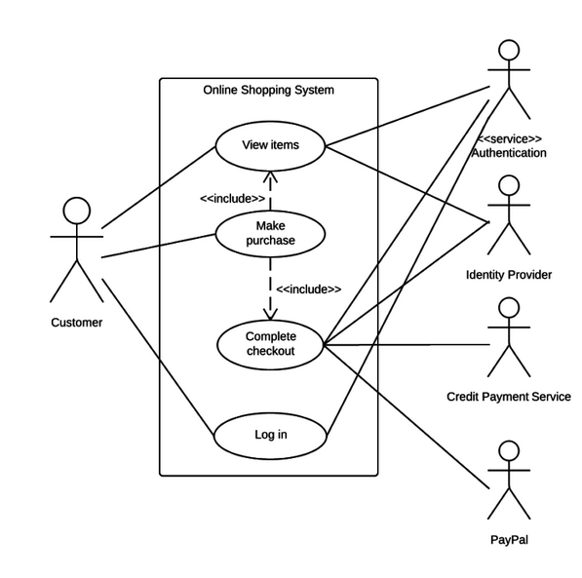
UML – Use Case Diagram
1. What is the name of the system?
2. What are the ‘use cases’ that
make up the system?
3. Identify the actors.
https://www.lucidchart.com/pages/uml-use-case-diagram#discovery__top

Slide 12
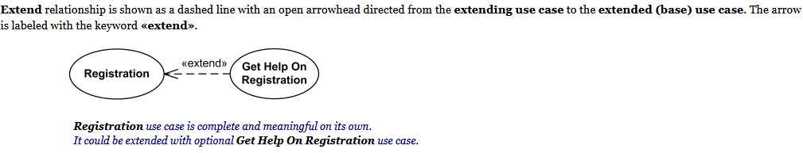
UML – Use Case Diagram
https://www.lucidchart.com/pages/uml-use-case-diagram#discovery__top

Slide 13
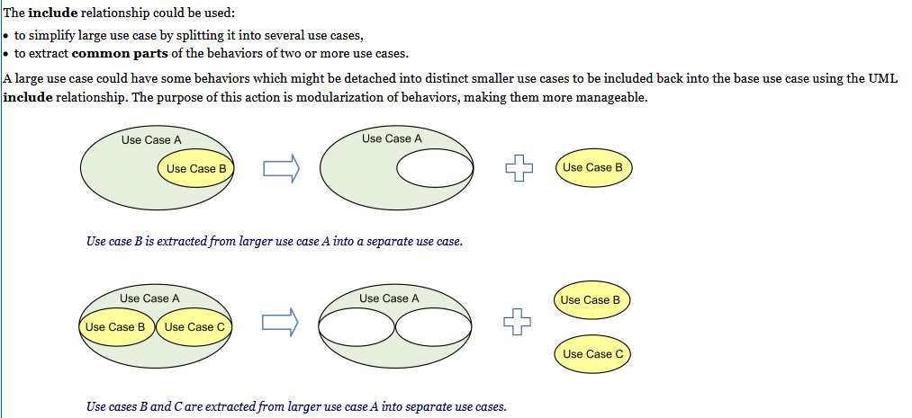
UML – Use Case Diagram
https://www.lucidchart.com/pages/uml-use-case-diagram#discovery__top

Slide 14
UML – Use Case Diagram
https://www.lucidchart.com/pages/uml-use-case-diagram#discovery__top

Slide 15
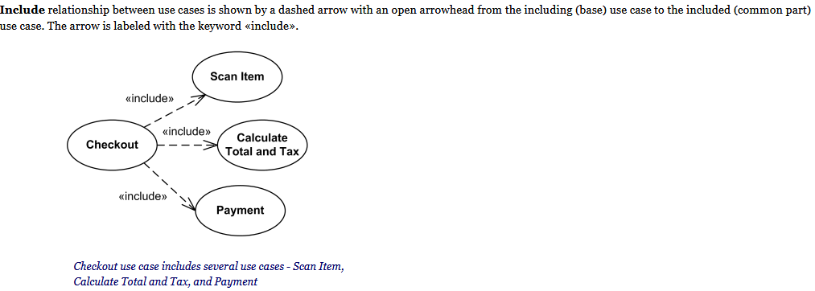
UML – Use Case Diagram
https://www.lucidchart.com/pages/uml-use-case-diagram#discovery__top

Slide 16
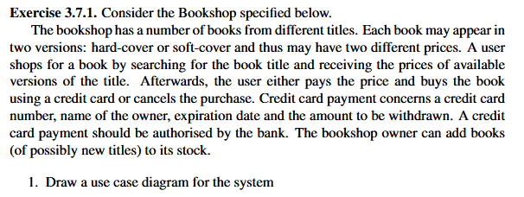
UML – Use Case Diagram

Slide 17
Refactoring and Unit Testing

Slide 18
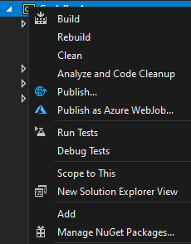
Unit Testing
Unit Testing allows us to test a unit of code
Several options for C# - MSTest, Xunit
Install MSTest.Framework and MSTest.Adaptor from NuGet
https://www.geeksforgeeks.org/introduction-to-net-framework/

Slide 19
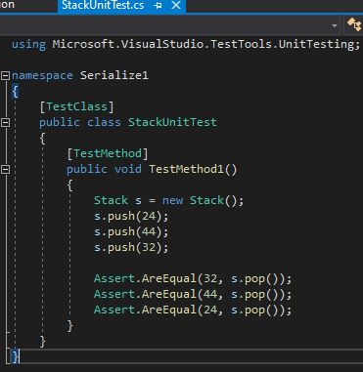
Unit Testing
Create a new file xxxUnitTest.cs. Below is an example testing Stack class.

Slide 20

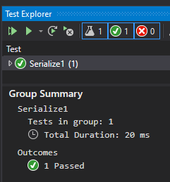
Unit Testing
Right click to run test

Slide 21
Unit Testing
Now write the code for the Stack class.
Hints: Use of namespace
Add additional tests:
pop() when stack is empty
push() when stack is full

Slide 22
Design Patterns
A software design pattern is a general, reusable solution to a commonly occurring problem within a given context in software engineering.
Patterns began as an architectural concept by Christopher Alexander.
Made popular by the book, Design Patterns: Elements of Reusable Object-Oriented Software (1994) by the “Gang of Four”. Often called GoF.
3 main categories – creational, structural and behavioural.
https://en.wikipedia.org/wiki/Software_design_pattern

Slide 23
Design Patterns
Singleton – Creational
https://www.dofactory.com/net/singleton-design-pattern
Observe the Singleton class. It has a private static _instance variable, protected constructor (ie. you cannot create ‘new’ instances from outside). Only way to access it is using the static method, Instance()
Factory – Creational
https://www.dofactory.com/net/factory-method-design-pattern
Observe “Document” class. Its constructor calls CreatePages(), which is the Factory Method implemented as an abstract method, that needs to be overriden by those inheriting from Document.

Slide 24
Design Patterns
Fascade – Structural (centralised vs distributed)
https://www.dofactory.com/net/facade-design-pattern
Draw the sequence diagram for IsEligible()
Template – Behavioural
https://www.dofactory.com/net/template-method-design-pattern
Note the ‘Template Method’ Run(). It defines the 4 methods that need to run in this sequence. Note that these are abstract methods within the abstract class. Implementing classes need to override these.

Slide 25
Design Patterns
Adaptor – Structural
https://www.dofactory.com/net/adapter-design-pattern
Note that ‘RichCompound’ class (the Adapter) inherits from ‘Compound’ (the Target). It overrides Display() to allow it to display more information based on the ChemicalDatabank (the Adaptee)

Slide 26
SOLID
A set of principles by Robert Martin (Uncle Bob)
Single Responsibility Principle (SRP)
Open-Close Principle
Liskov Substitution Principle
Interface
Dependency Injection

Slide 27
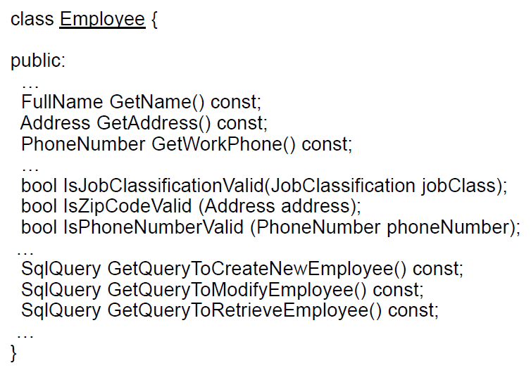
SOLID
Single Responsibility Principle (SRP)
“A class should have only one reason to change.”

Slide 28
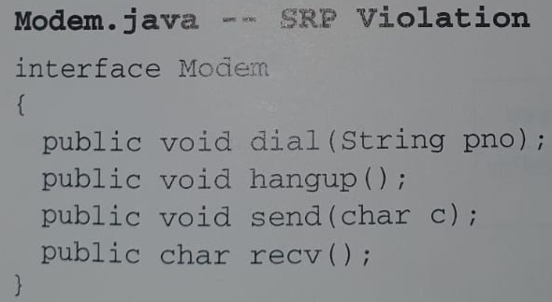
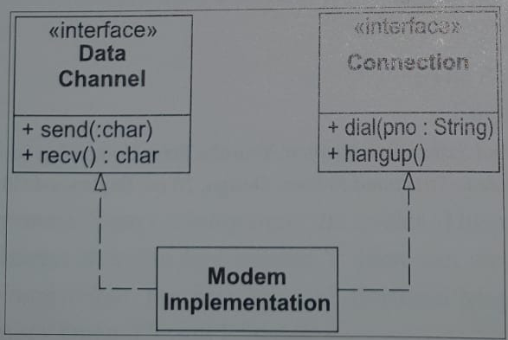
SOLID
Single Responsibility Principle (SRP)

Slide 29
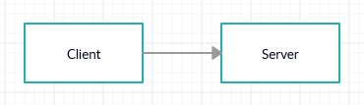
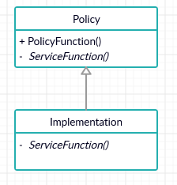
SOLID
Open-Close Principle
“Software entities (classes, modules, functions etc) should be open for extension, but closed for modification.”
Client is not open and closed
Template Method Pattern:
Base class is open and closed

Slide 30
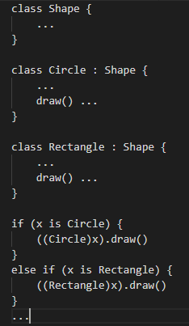
SOLID
Liskov Substitution Principle (LSP)
Subtypes must be substitutable for their base types.
Violating LSP often results in Run-Time Type Information (RTTI)
Frequent use of if or if/else to determine type of an object so behaviour is appropriate.

Slide 31
SOLID
Interface Segregation Principle
Clients should not be forced to depend on methods that they do not use.
Disadvantages of ‘fat’ interfaces – classes whose interfaces are not cohesive.
Should be broken up into group of methods.

Slide 32
SOLID
Dependency Inversion Principle (DIP)
High-level modules should not depend on low-level modules. Both should depend on abstractions.
Abstractions should not depend on details. Details should depend on abstractions.
Naively:
No variable should hold a reference to a concrete class;
No class should derive from a concrete class;
No method should override an implemented method of any of its base classes.

Slide 33
References
University of Wisconsin, CSE 403 materials
https://courses.cs.washington.edu/courses/cse403/11sp/lectures/
Blackboard system/Architecture
https://en.wikipedia.org/wiki/Blackboard_system
https://www.geeksforgeeks.org/introduction-to-net-framework/

