Slide 1
Language Integrated Query (LINQ)

Slide 2
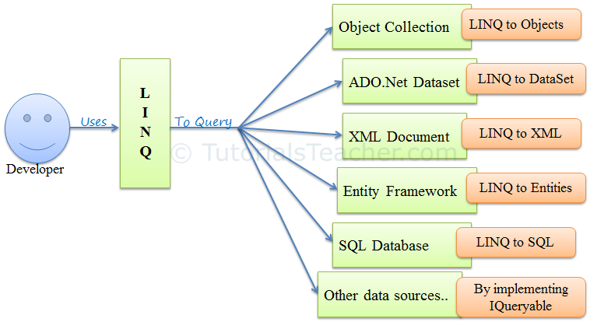
LINQ
Powerful query language introduced with .Net 3.5 & VS2008
Integrated with C# or VB to query different data sources
Eliminate mismatch between programming languages and databases
Single query interface for different types of data sources.
https://www.tutorialsteacher.com/linq/what-is-linq

Slide 3

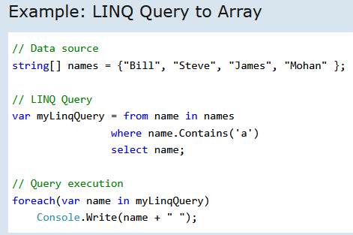
LINQ
LINQ queries returns as objects – use object-orineted approach on result set

Slide 4
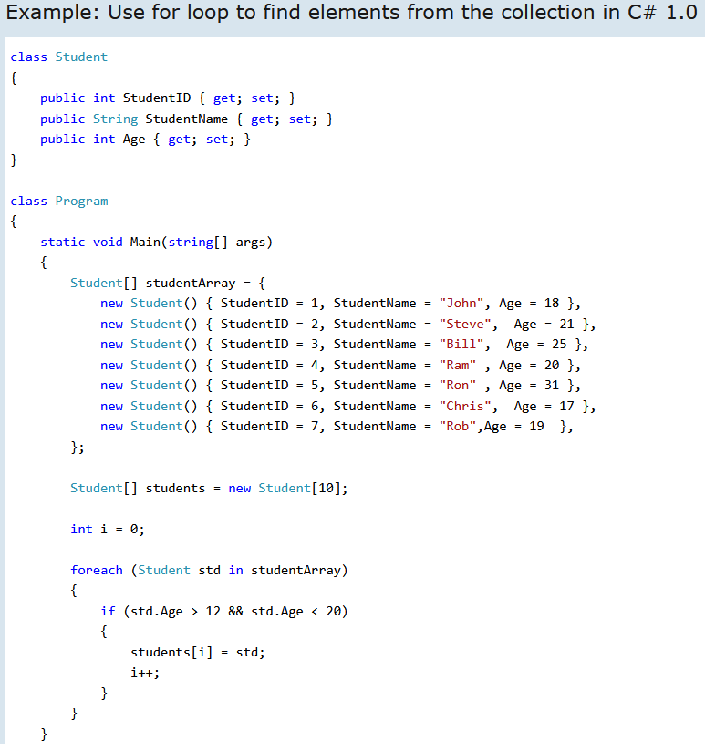
Why LINQ?
Use of ‘foreach’
to loop
through students

Slide 5
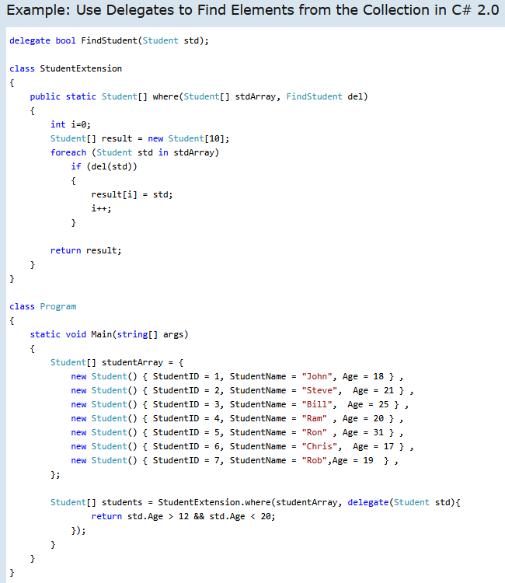
Why LINQ?
Use of delegate

Slide 6
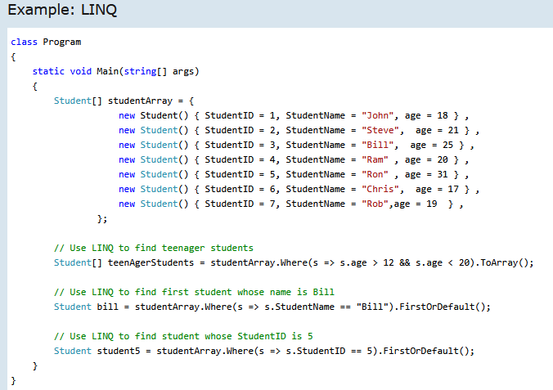
Why LINQ?
Use of lambda
expression

Slide 7
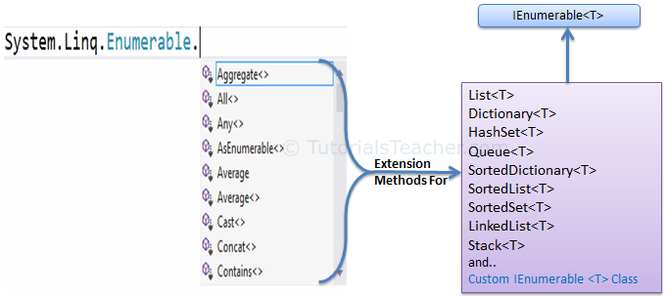
LINQ – How it works
Write LINQ queries for classes that implement either interfaces:
IEnumerable<T>
IQuerable<T>
LINQ queries use extension methods for classes that implement these interfaces. Enumerable and Querable are two static classes that contain extension methods.

Slide 8
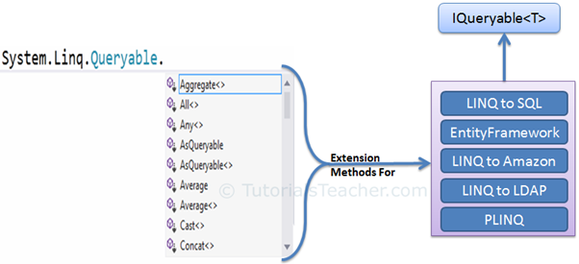
LINQ – How it works
IQueryable<T> interface used to provide querying capabilities against a specific data source where the type of the data is known
Eg. Entity Framework
Also Apis available to access third-party data (eg. LINQ to Amazon)

Slide 9
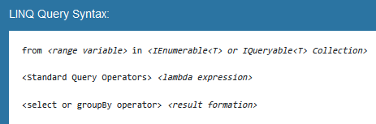
LINQ – 2 basic ways
Two ways to write LINQ query
Query Syntax
Method Syntax
Query Syntax is similar to SQL

Slide 10
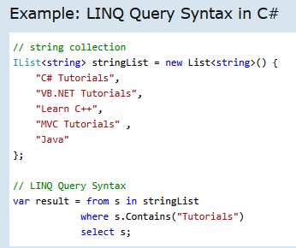
LINQ – 2 basic ways

Slide 11
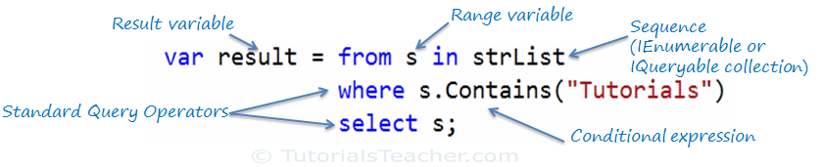
LINQ – 2 basic ways

Slide 12
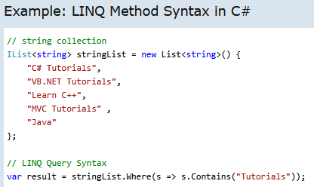

LINQ – 2 basic ways
Method Syntax is similar to lambda expression

Slide 13
LINQ – 2 basic ways
Method Syntax is similar to lambda expression

Slide 14
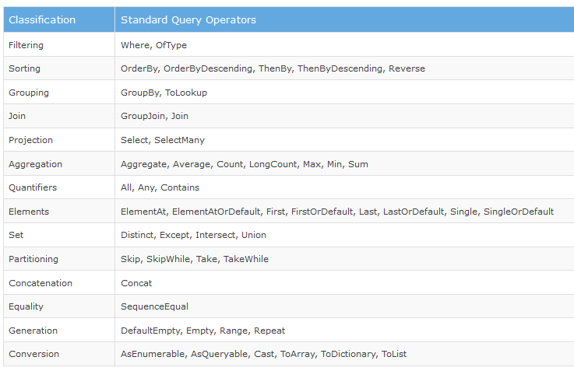
LINQ
Classificaton of Standard Query Operators

Slide 15
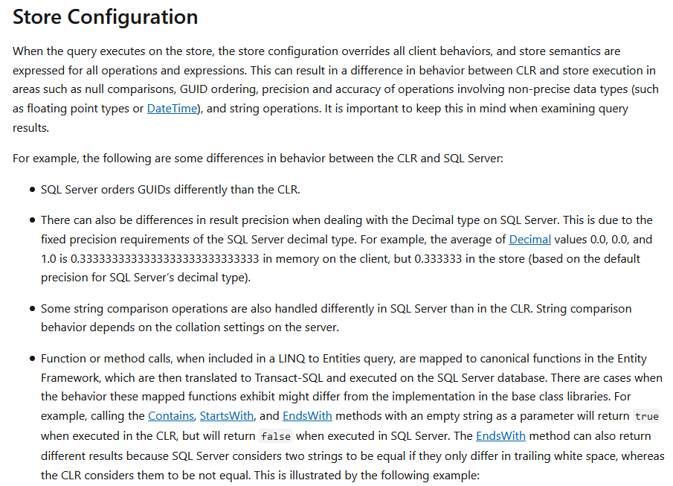
LINQ to SQL
https://www.tutorialspoint.com/linq/linq_sql.htm
https://docs.microsoft.com/en-us/dotnet/framework/data/adonet/ef/language-reference/query-execution

