Slide 1


R Shiny
by Justin Chan

Slide 2
Module 4
Publish on shinyapps.io and rpubs.com

Slide 3

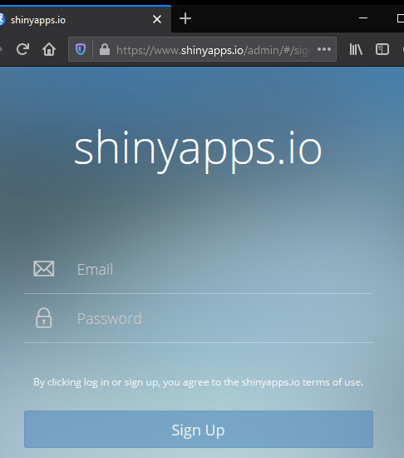
Sign up at shinyapps.io

Slide 4
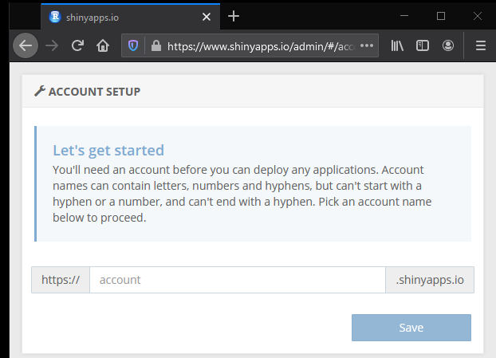
Select an Account Name

Slide 5
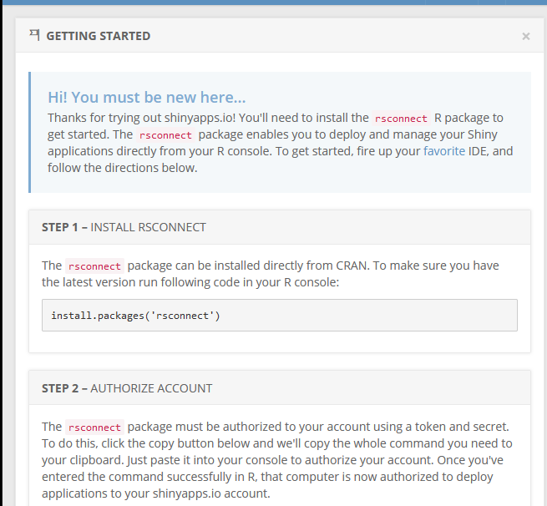
Install rsconnect in R console. Then Authorise Account (Step 2)

Slide 6
Paste Code
rsconnect::setAccountInfo
Sometimes, there is a “bad signature” error.
Remember to ‘Show Secret’!!
Correct by running this before rsconnect
Sys.setlocale(locale="en_US.UTF-8")

Slide 7
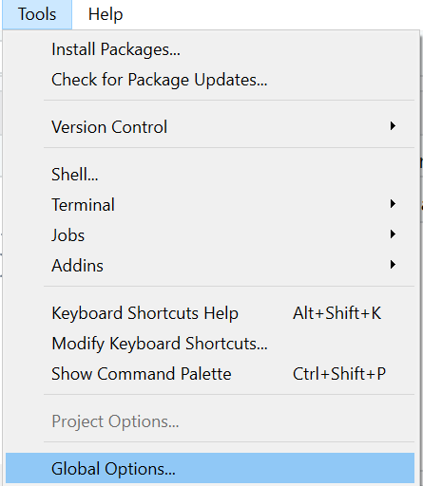
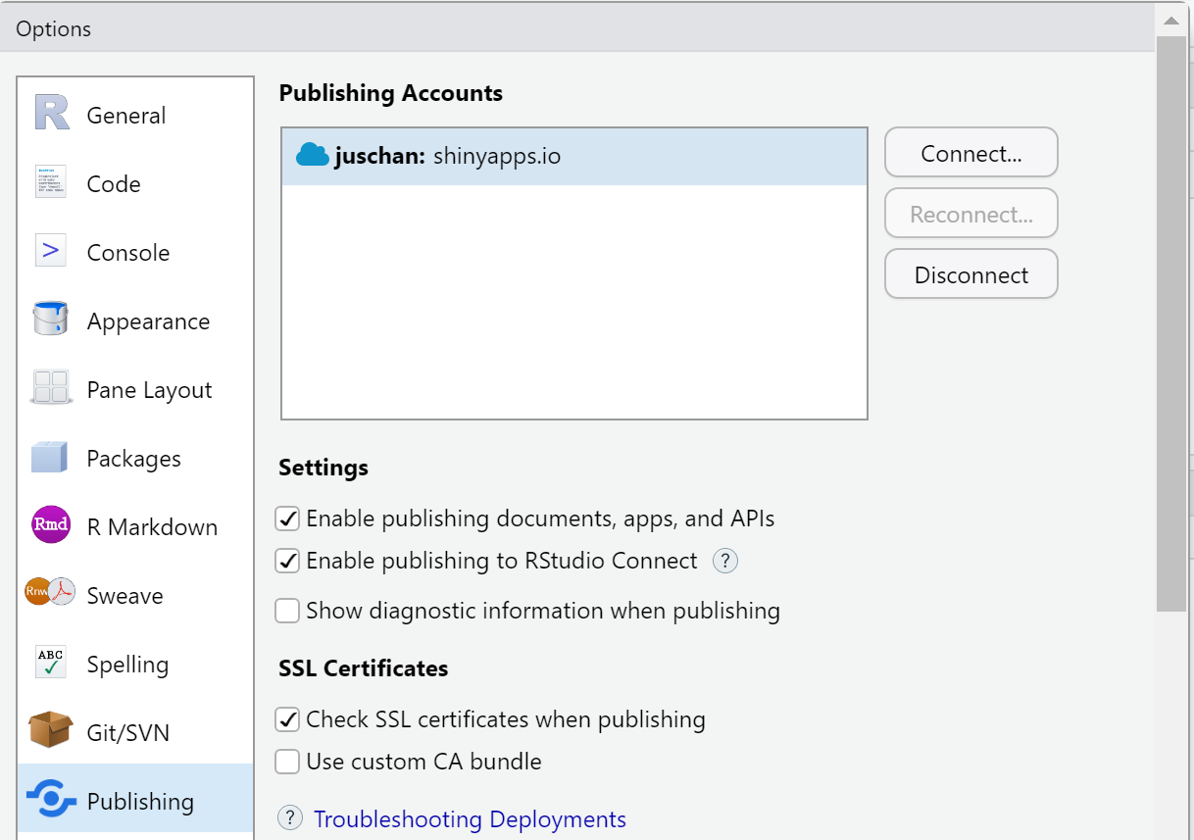
[Alternative to enable Token] Within Rstudio > Tools > Global Options > Publishing > Connect > shinyapps.io > Paste Token

Slide 8
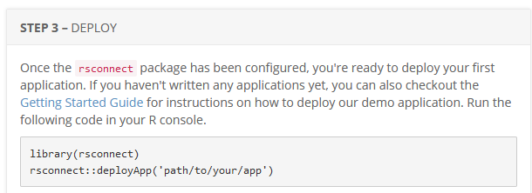
Deploy!

Slide 9
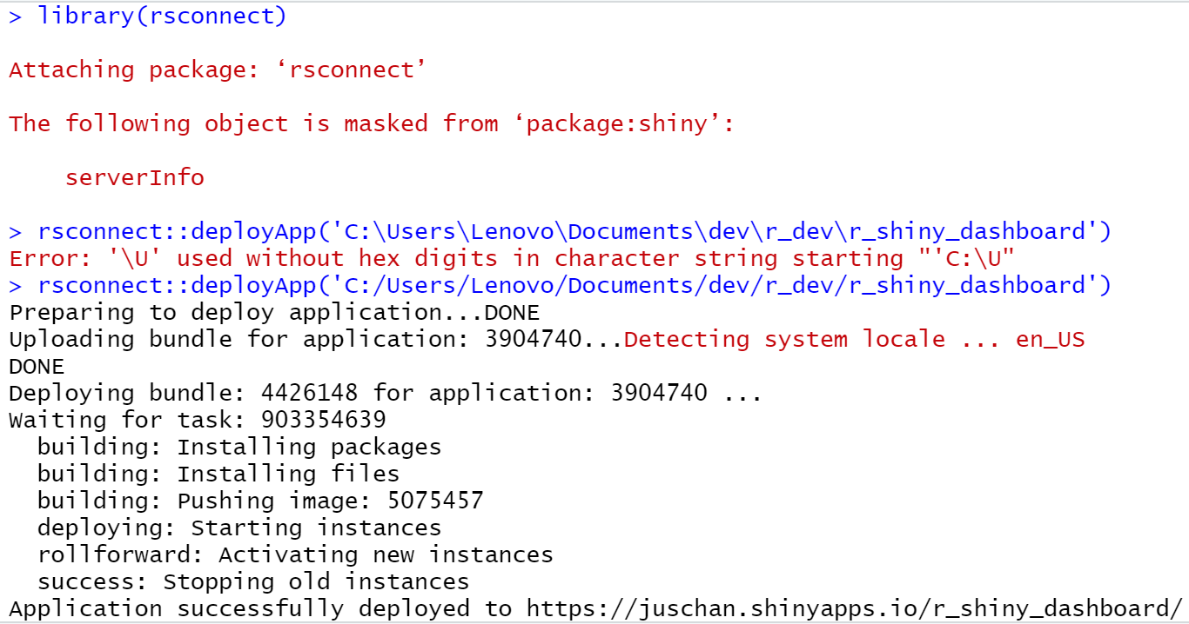
RStudio output Note the path forward slash

Slide 10
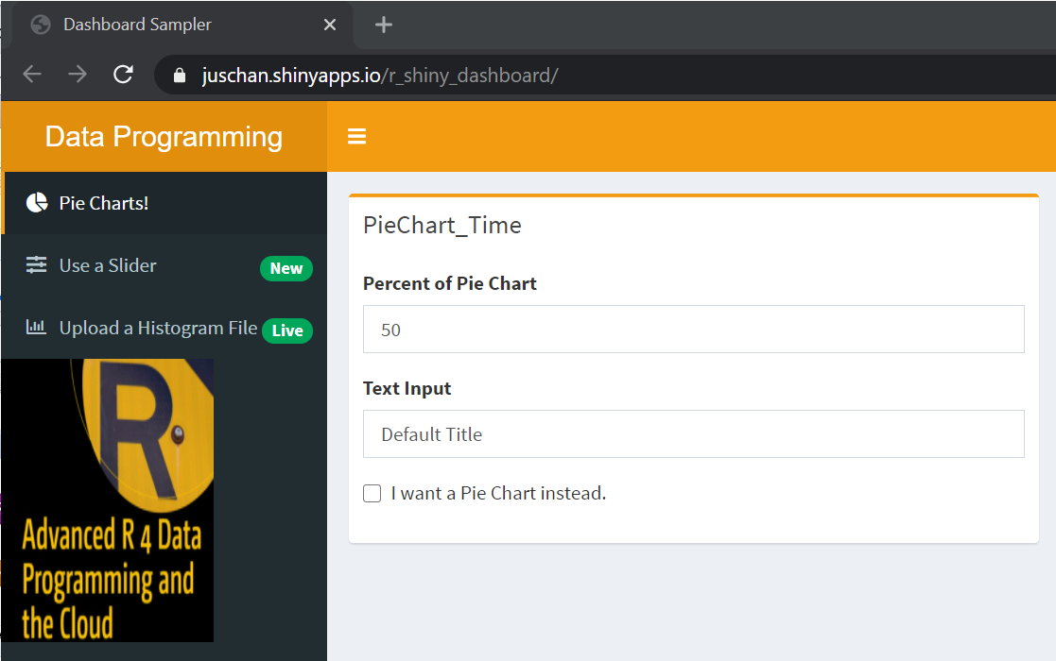
Published on Shinyapps.io website

Slide 11
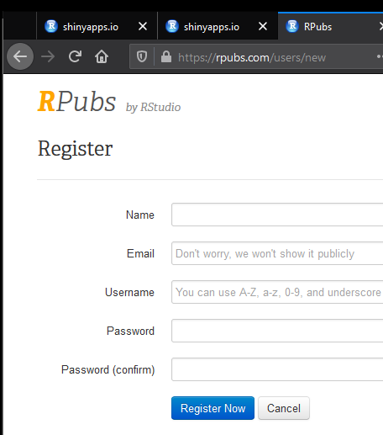
Register at rpubs.com

Slide 12
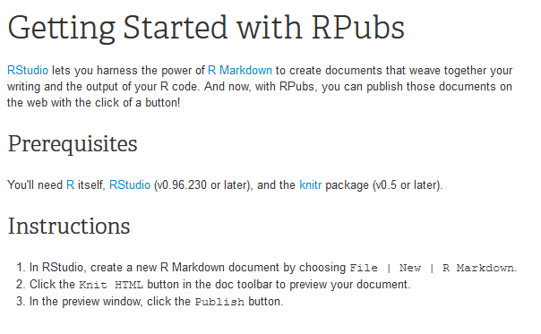
Create the R Markdown page

Slide 13
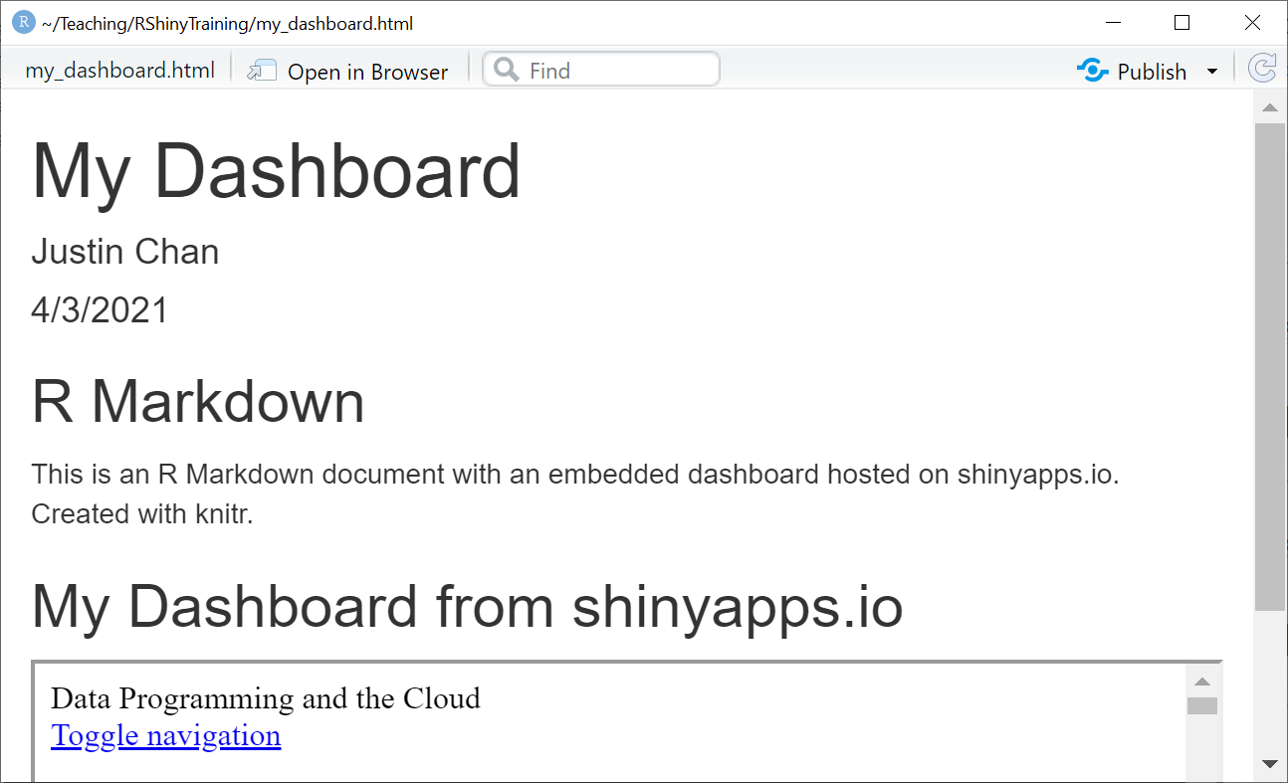
Click on ‘Knitr HTML’ > Publish

Slide 14
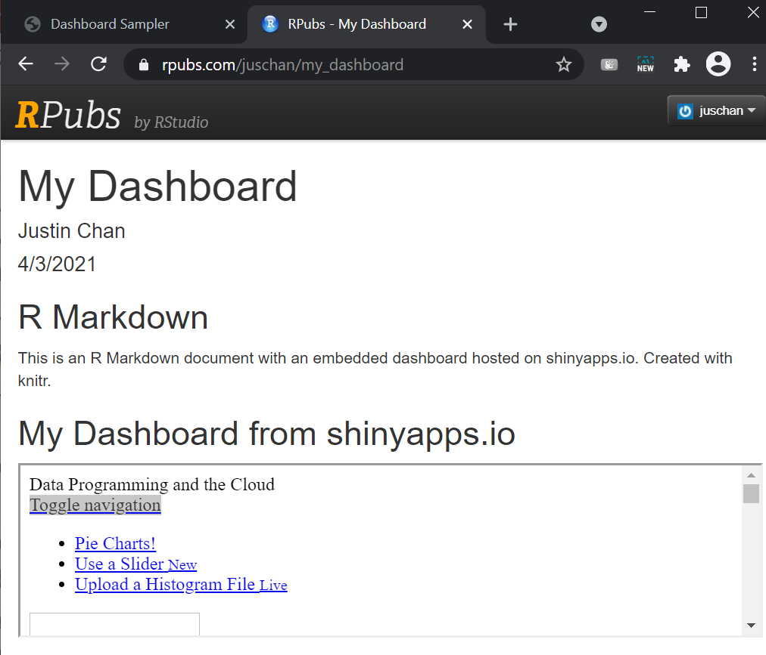
Display errors

